Slide 1
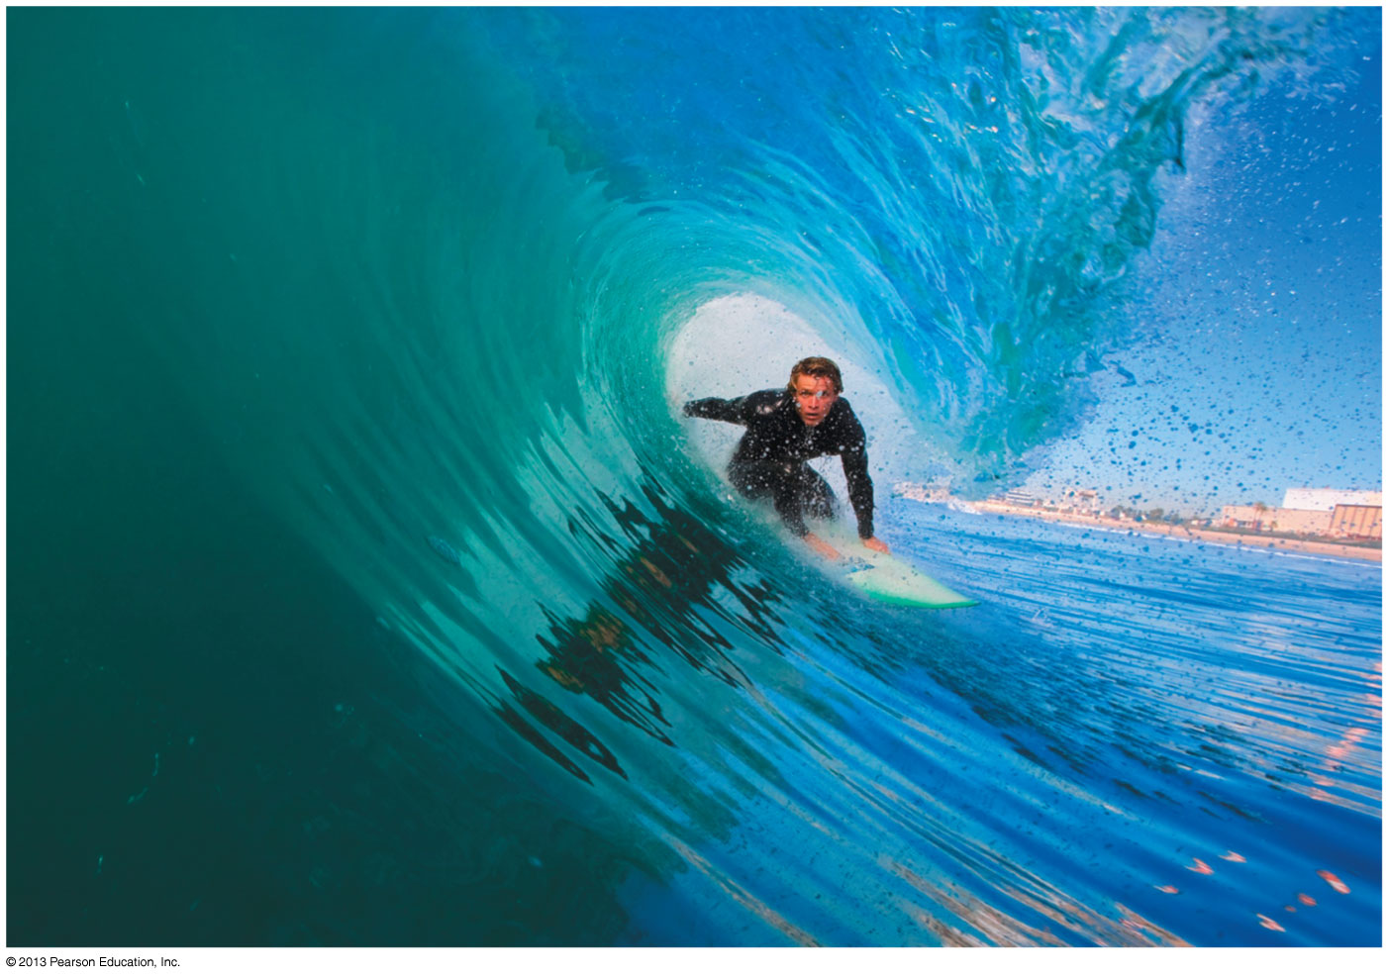
PHY132 Introduction to Physics II Class 2 – Outline:
Waves in 2-D and 3-D
Spherical waves and plane waves
Index of Refraction
Power, Intensity and
Decibels
The Doppler Effect

Slide 2
Last Time
Mechanical Waves: waves that require a medium
The wave travels through the medium. The wave speed is relative to that medium
Many waves: “transverse” or “longitudinal”
Sinusoidal waves
Source: Simple Harmonic Motion
Periodic in time (period T ) and space (wavelength λ)

Slide 3
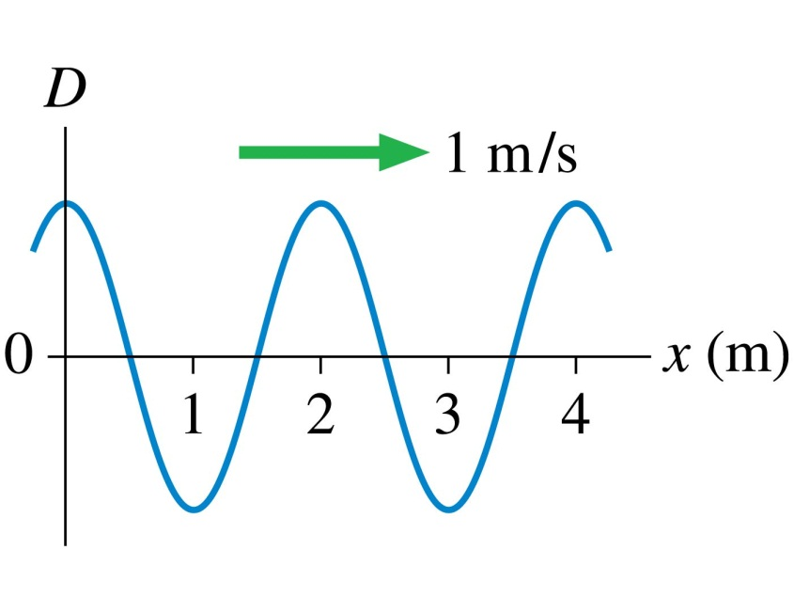
QuickCheck 20.6
Clicker Question 1
Sinusoidal Wave Review
The period of this wave is
1 s.
2 s.
4 s.
Not enough information to tell.
The postal code of University of Toronto is M5S1A1.
Notes:
3

Slide 4
Class 2 Preclass Quiz on MasteringPhysics
This was due this morning at 8:00am
651 students submitted the quiz on time
56% of students answered correctly: The “phase” of a sinusoidal wave is the argument of the sine function (what is in the brackets)
91% answered correctly: The speed of light in a material is determined by the index of refraction.
93% answered correctly: When a source is moving away from an observer, the observed frequency is changed due to the motion (also the wavelength, but that was not a choice listed)
94% answered correctly: The sound intensity level in decibels is related to the logarithm of the intensity.
95% answered correctly: Human ears can detect frequencies in the range 20 Hz up to 20,000 Hz

Slide 5
Class 2 Preclass Quiz on MasteringPhysics
Some common or interesting student comments/feedback:
“Phi is the argument of the sin function correct? But why is there also a phi in the brackets?”

Slide 6
Class 2 Preclass Quiz on MasteringPhysics
“Doppler effect. don't quite understand this. will it just have a higher or lower pitch as it's moving away/towards you?”
Harlow answer: Right! But it’s higher if it’s moving toward you, lower if it’s moving away.
“Are we being marked on whether we get the right answer on these preclass quizzes? I'm slightly confused.”
Harlow answer: Yes. You can always click on “Grading Policy” to see exactly how the marks are determined for any MasteringPhysics assignment.

Slide 7
Class 2 Preclass Quiz on MasteringPhysics
“The equations related to "Wave Motion on a String." Should we have to know the proof for v = sqrt (T/u) ? Or any part of that proof? I started seeing Ts and got confused.”
Harlow answer: We do not generally ask “proof” questions on tests and exams. However, I do think it is good to work through these so you can see where equations are coming from them, and understand and apply them better.
“That preclass quiz was "intense".”
“Didn't actually read, since there's no way ur reading this unless u have no life, which i hope u do have one.”
“How does intensity relates with numbers of sound sources? Is it directly proportional?”
Harlow answer: Yes. If you have N identical sources. The intensity at a certain distance will be N times the intensity from one of them.

Slide 8
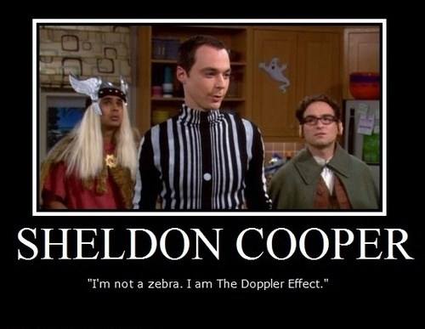
Class 2 Preclass Quiz on MasteringPhysics
The Doppler Effect. EEEEEEEEEEEeeeeeeeeeeeeeeee
The explanation on the doppler effect was really interesting, especially having pre-exposed to it in the Big Bang Theory!

Slide 9
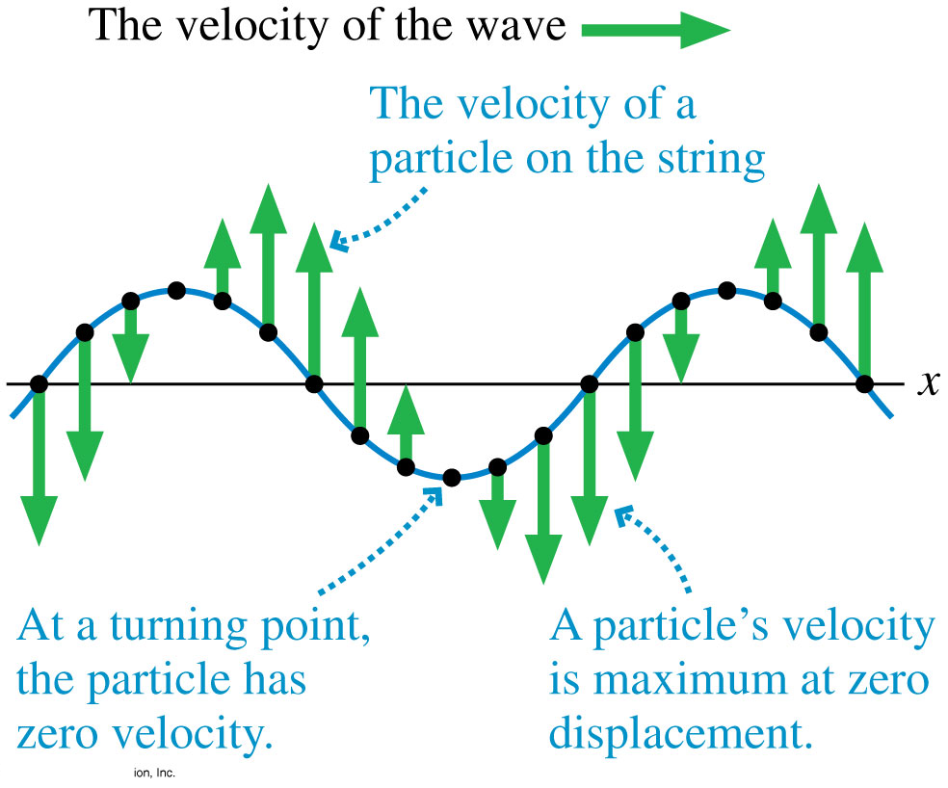
Sinusoidal Waves
As the wave moves along x, the velocity of a particle on the string is in the y-direction.

Slide 10
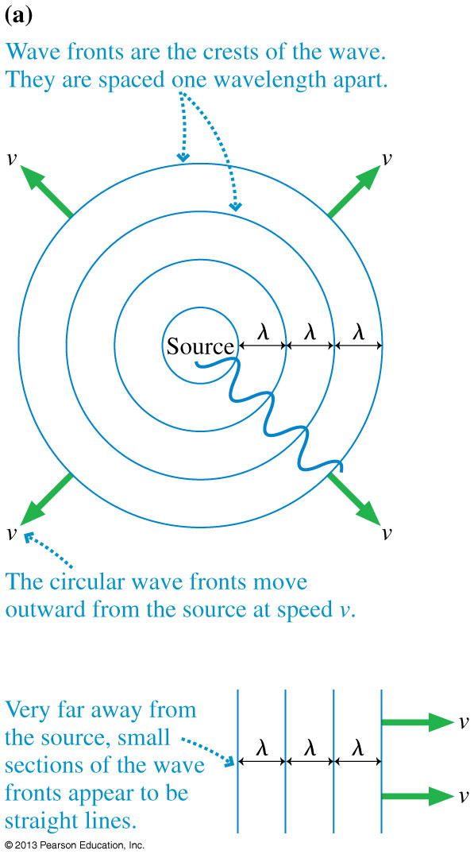
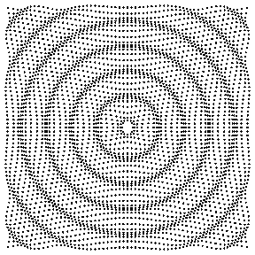
Waves in Two and Three Dimensions
[Animation courtesy of Dan Russell, Penn State]

Slide 11
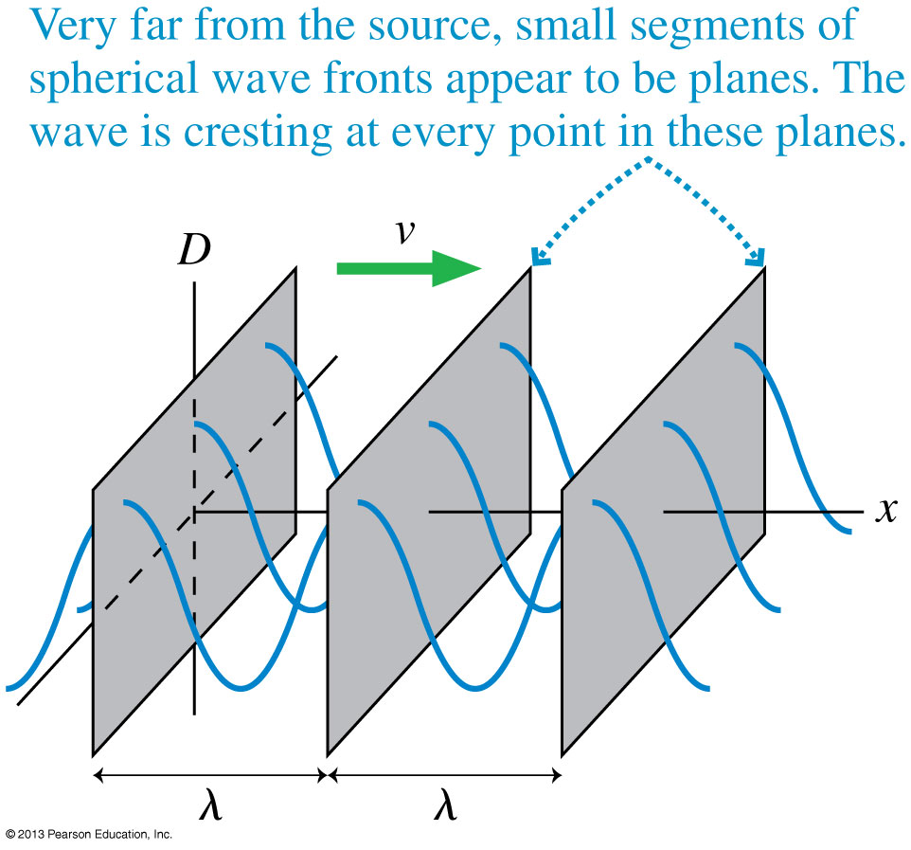
Waves in Two and Three Dimensions

Slide 12
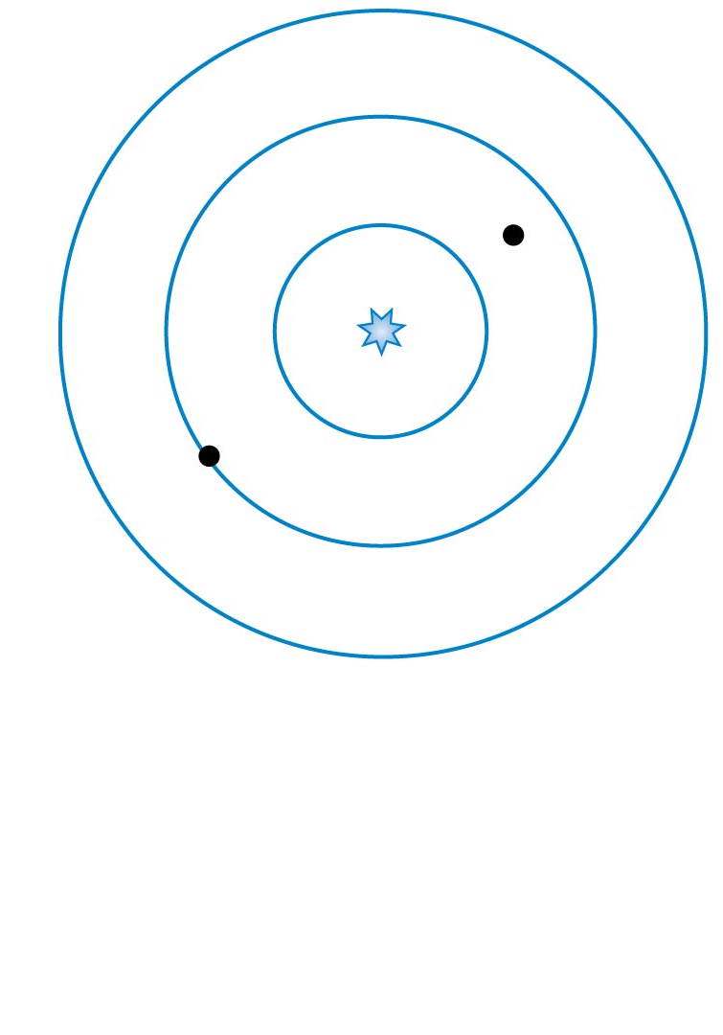
Clicker Question 2
QuickCheck 20.8
A spherical wave travels outward from a point source. What is the phase difference between the two points on the wave marked with dots?
π/4 radians.
π /2 radians.
π radians.
7π /2 radians.
7π radians.
Notes:
12

Slide 13
The Index of Refraction
Light waves travel with speed c in a vacuum, but they slow down as they pass through transparent materials such as water or glass or even, to a very slight extent, air.
The speed of light in a material is characterized by the material’s index of refraction n, defined as

Slide 14
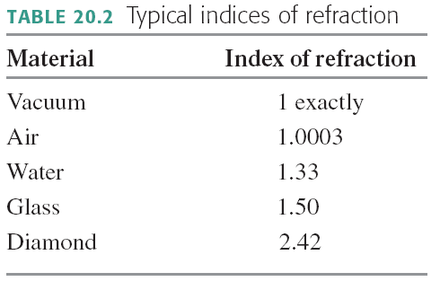
The Index of Refraction

Slide 15
Clicker Question 3
QuickCheck 20.9
A light wave travels, as a plane wave, from air (n = 1.0) into glass (n = 1.5). Which diagram shows the correct wave fronts?
Notes:
15

Slide 16
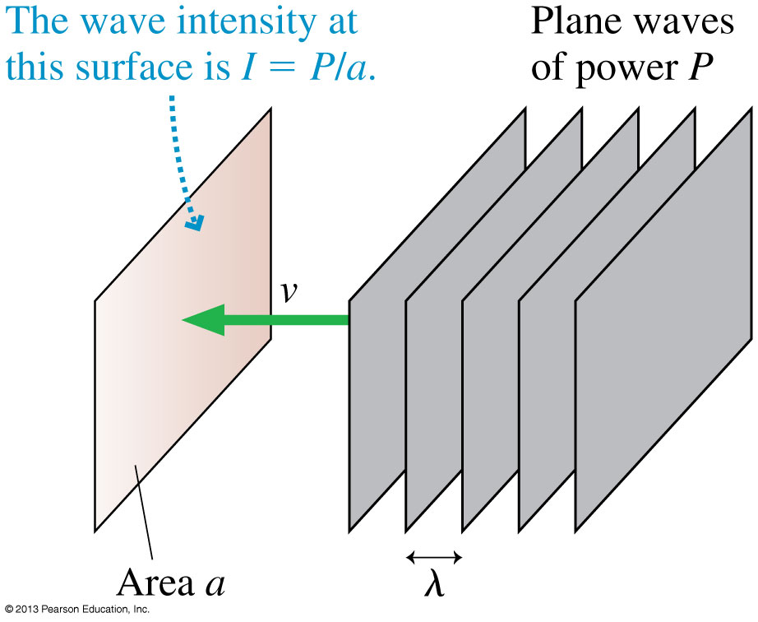
Power and Intensity
The power of a wave is the rate, in joules per second, at which the wave transfers energy.
When plane waves of power P impinge on area a, we define the intensity I to be:

Slide 17
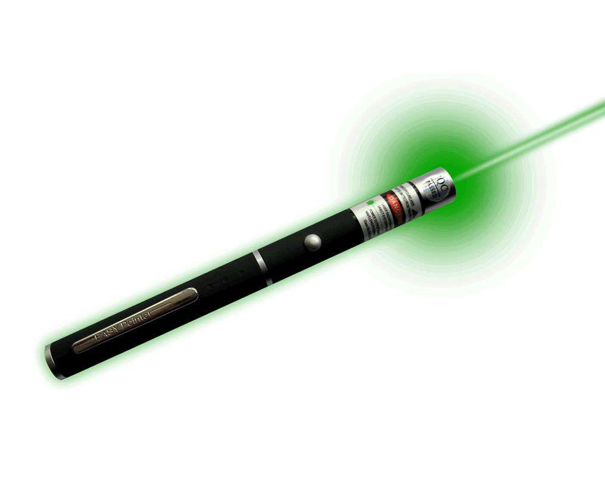
Example 20.9.
A laser pointer emits 1.0 mW of light power into a 1.0 mm diameter laser beam. What is the intensity of the laser beam?

Slide 18
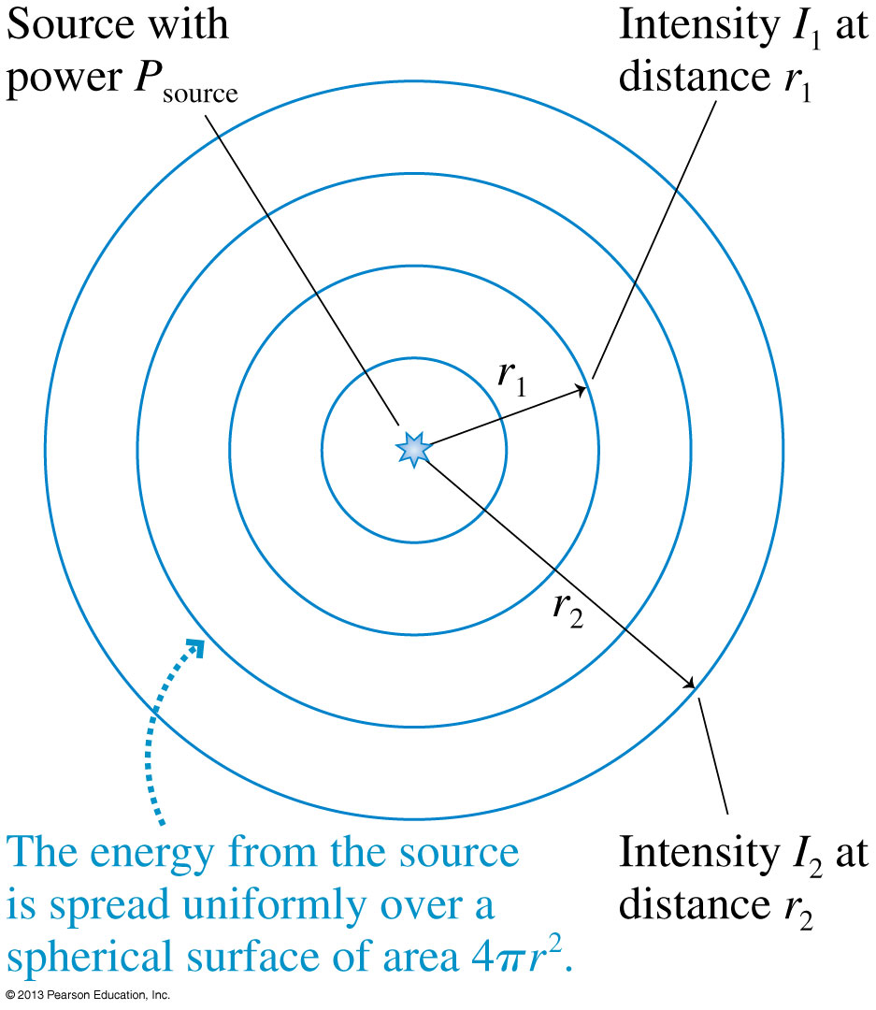
Intensity of Spherical Waves
If a source of spherical waves radiates uniformly in all directions, then the power at distance r is spread uniformly over the surface of a sphere of radius r.
The intensity of a uniform spherical wave is:

Slide 19
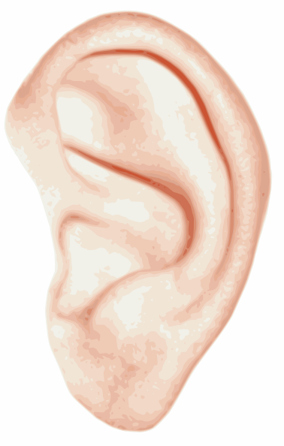
Intensity and Decibels
Human hearing spans an extremely wide range of intensities, from the threshold of hearing at ≈ 1 × 10⁻¹² W/m² (at midrange frequencies) to the threshold of pain at ≈ 10 W/m².
If we want to make a scale of loudness, it’s convenient and logical to place the zero of our scale at the threshold of hearing.
To do so, we define the sound intensity level, expressed in decibels (dB), as:
where I₀ = 1 × 10⁻¹² W/m².

Slide 20
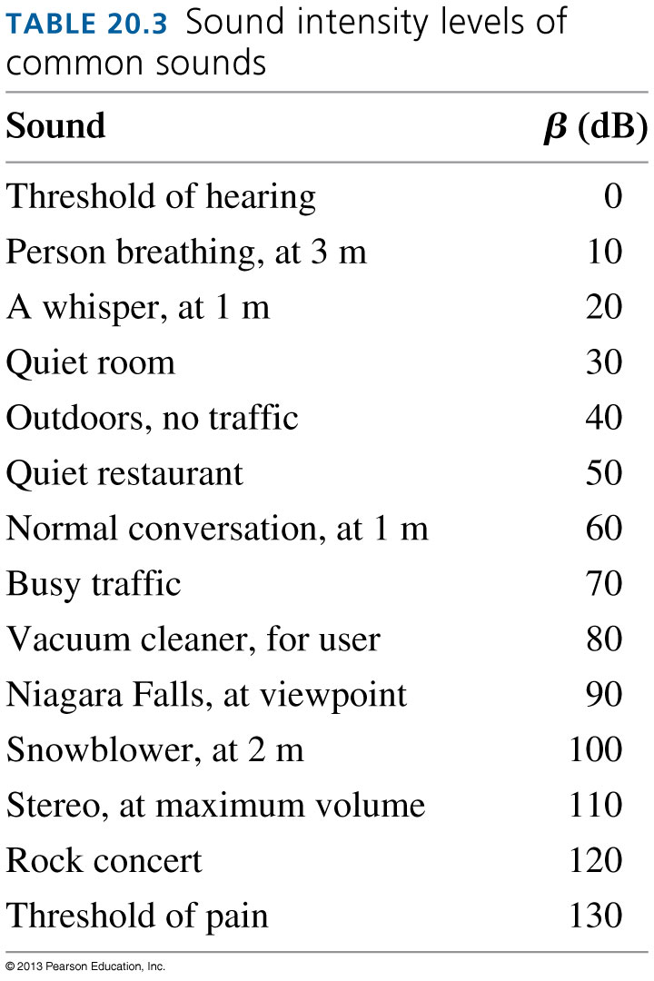
Intensity and Decibels

Slide 21
Clicker Question 4
A sound level of 10 decibels has 10 times more intensity than a sound level of zero decibels.
A sound level of 20 decibels has ___ times more intensity than a sound level of zero decibels.
10
20
50
100
200

Slide 22
Clicker Question 5
When you turn up the volume on your ipod, the sound originally entering your ears at 50 decibels is boosted to 80 decibels. By what factor is the intensity of the sound has increased?
1 (no increase)
30
100
300
1000

Slide 23
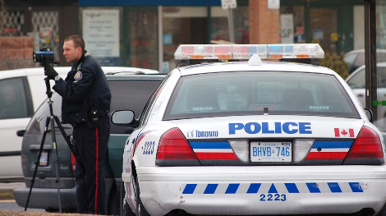
Doppler Effect
If a sound source is not moving relative to you, you hear the “rest frequency” of the emitted sound.
If the source is moving toward you, you will hear a frequency that is higher than the rest frequency.
If the source is moving away from you, you will hear a frequency that is lower than the rest frequency.
By measuring the difference between the observed and known rest frequencies, you can determine the speed of the source.

Slide 24
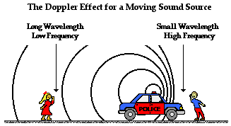
Doppler Effect
[image from http://www.physicsclassroom.com/class/waves/u10l3d.cfm ]

Slide 25
Clicker Question 6
Which statement is true?
Valerie is standing in the middle of the road, as a police car approaches her at a constant speed, v. The siren on the police car emits a “rest frequency” of f₀.
The frequency she hears rises steadily as the police car gets closer and closer.
The frequency she hears steadily decreases as the police car gets closer and closer.
The frequency she hears does not change as the police car gets closer.
Notes:
STT20.6

Slide 26
Clicker Question 7
Which statement is true?
Valerie is standing in the middle of the road, listening to the siren of a police car approaching her at a constant speed, v. Daniel is listening to a similar siren on a police car that is not moving.
The frequency Daniel hears is lower than the frequency Valerie hears.
The frequency Daniel hears is higher than the frequency Valerie hears.
The frequencies that Daniel and Valerie hear are exactly the same.
Notes:
STT20.6

Slide 27
The Doppler Effect
The frequencies heard by a stationary observer when the sound source is moving at speed v₀ are
The frequencies heard by an observer moving at speed v₀ relative to a stationary sound source emitting frequency f₀ are

Slide 28
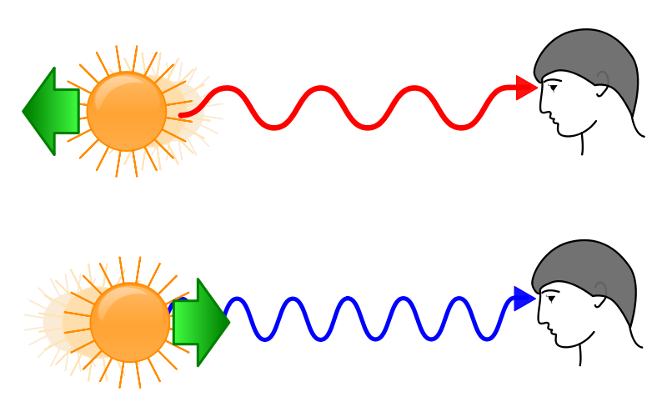
Doppler Shift for Light
When a light source is moving away from you, the spectrum is shifted toward the red.
When a light source is moving toward you, the spectrum is shifted toward the blue.

Slide 29
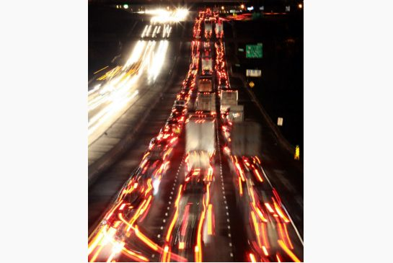
Doppler Shift for Light
The Doppler shift can be observed in the headlights of cars on the highway.
The cars moving away from you appear more red, while the cars moving toward you appear more blue-ish or white.

Slide 30
Doppler Shift for Light
wthhhhhhhhhhhh??
wrong
The Doppler shift can be observed in the headlights of cars on the highway.
The cars moving away from you appear more red, while the cars moving toward you appear more blue-ish or white.

Slide 31
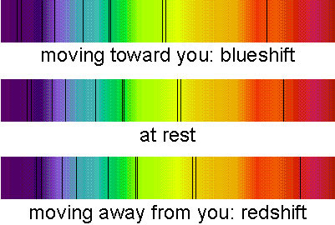
Doppler Shift for Light (yes, really!)
The Doppler shift can be observed with carefully obtained spectra of very fast moving objects like stars
There is a slight shift in “absorption lines”

Slide 32
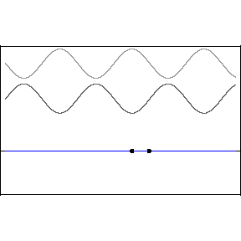
Before Class 3 on Monday
Please read Knight pages 591-603: Ch. 21, sections 21.1-21.4
Please do the short pre-class quiz on MasteringPhysics by Sunday evening.
Something to think about: What is the difference between a traveling wave and a standing wave. Does a standing wave really stand still?

