Slide 1
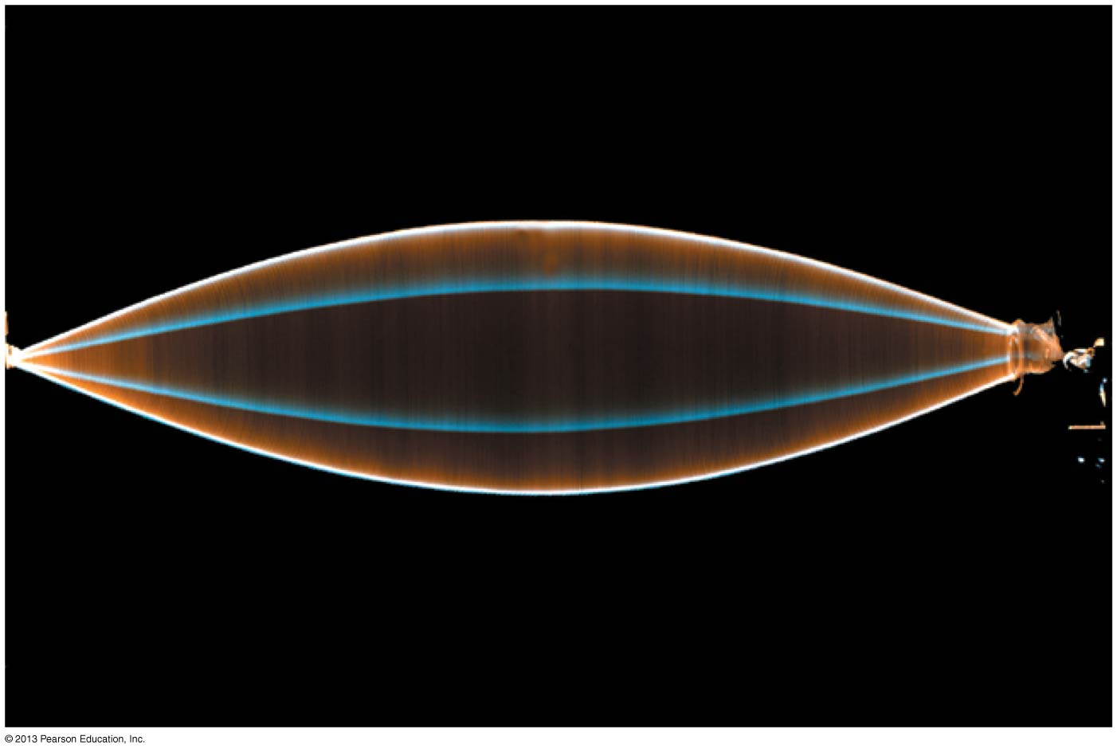
PHY132 Introduction to Physics II Class 3 – Outline:
Class 3 – Outline:
Ch. 21, sections 21.1-21.4
The Principle of Superposition
Standing Waves
Nodes and Antinodes
Musical Instruments

Slide 2
Getting into Medical School and the MCAT
Back by popular demand, U of T's Pre-Medical Society presents two seminars - Getting into Medical School and the MCAT.
The first seminar is hosted by our popular speaker, Alfred Basilious (BSc, MD) and will encompass everything you need to know for the admission process including the role of GPA, MCAT, volunteering, extracurriculars and much more! There will be a raffle for a $500 gift card for PREP 101 course as well!
Event details: Wednesday, January 15, 6-8 PM.
Medical Sciences Building McLeod Auditorium (MS 2158)
Free for members, $7 for new memberships
Pizza will be provided free of cost
The second seminar focuses specifically on the MCAT, covering its various categories, scoring and the new 2015 format: Wednesday, January 22nd, 6-8 PM.

Slide 3
Class 3 Preclass Quiz on MasteringPhysics
This was due this morning at 8:00am
651 students submitted the quiz on time
The figure shows the displacement of a standing sound wave in a 32-cm-long horizontal tube of air open at both ends.
The mode is m = 2 (count pressure antinodes)
The air molecules are moving horizontally. That’s because sound is a longitudinal wave.
The displacement antinodes are at 0, 16, 32 cm
The pressure antinodes are at 8, 24 cm

Slide 4
Class 3 Preclass Quiz on MasteringPhysics
A guitar string is fixed at both ends. If you tighten it to increase its tension the frequencies of its vibrational modes will increase but its wavelengths will not be affected.

Slide 5
Class 3 Preclass Quiz – Student Comments…
“The frequency at which I am reading the textbook has increased dramatically... Maybe because I just have too much tension in me. ”
“I was wondering: if you are listening to sound from two different speakers, is there a spot you could find somewhere at the nodes of the superimposed waves where you would hear no sound?”
Harlow answer: Yes, but only if both speakers were playing a single frequency (pure note). Also, you have to be at the same distance from both of them in order for the amplitudes to cancel exactly, and there needs to be no echoes interfering. In practice, it’s difficult to demonstrate this.
“It is hard to absorb all this reading while watching TV.”
“Don't listen to that mean student. You are an intelligent human being living a great life. Have an awesome day!”

Slide 6
Waves in Two and Three Dimensions
Particles and Waves
Particles cannot occupy the same space. They collide.
Waves pass right through each other. They interfere.
[Animations from http://www.physicsclassroom.com/mmedia/newtlaws/mb.cfm and http://www.acs.psu.edu/drussell/demos/superposition/superposition.html ]

Slide 7
Waves in Two and Three Dimensions
The Principle of Superposition
If two or more waves combine at a given point, the resulting disturbance is the sum of the disturbances of the individual waves.
$$D=D_{1}+D_{2}$$

Slide 8
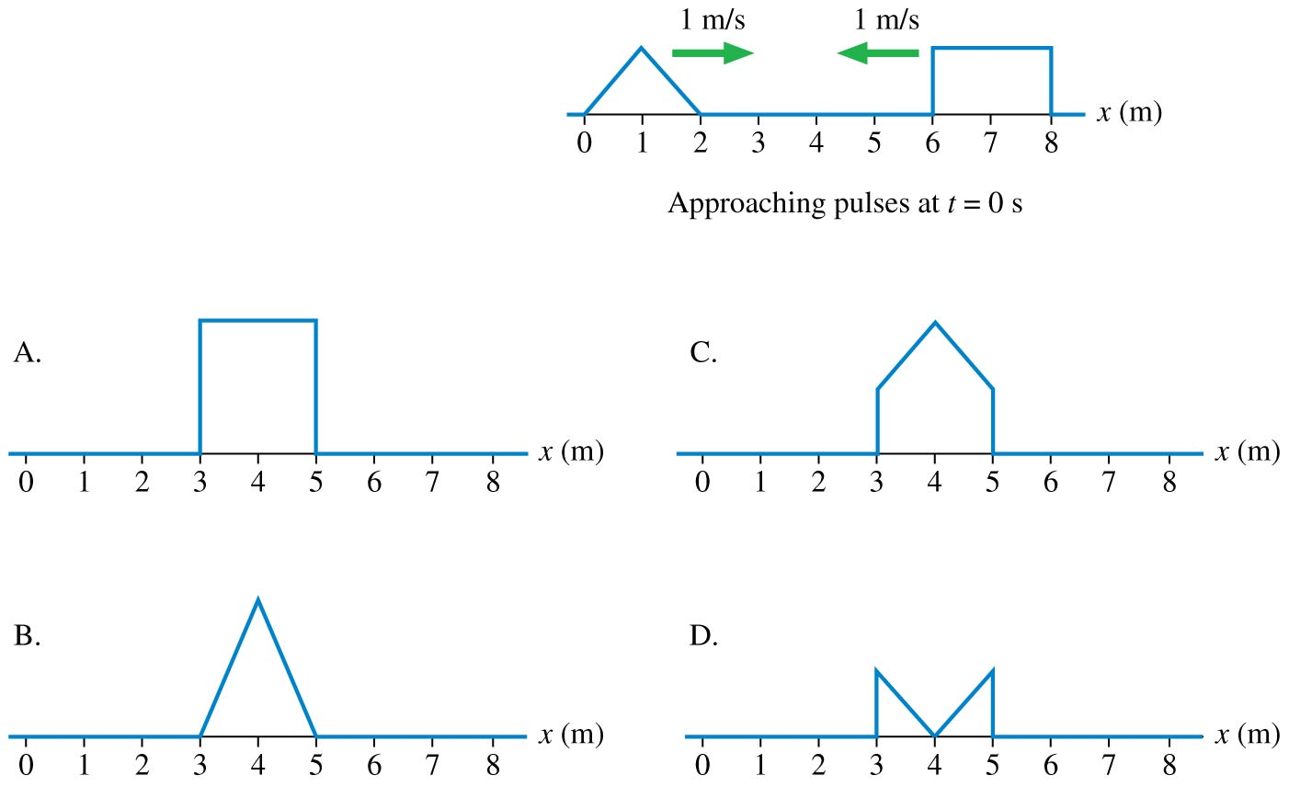
QuickCheck 21.1
Clicker Question 1
Two wave pulses on a string approach each other at speeds of 1 m/s. How does the string look at t = 3 s?
Notes:
8

Slide 9
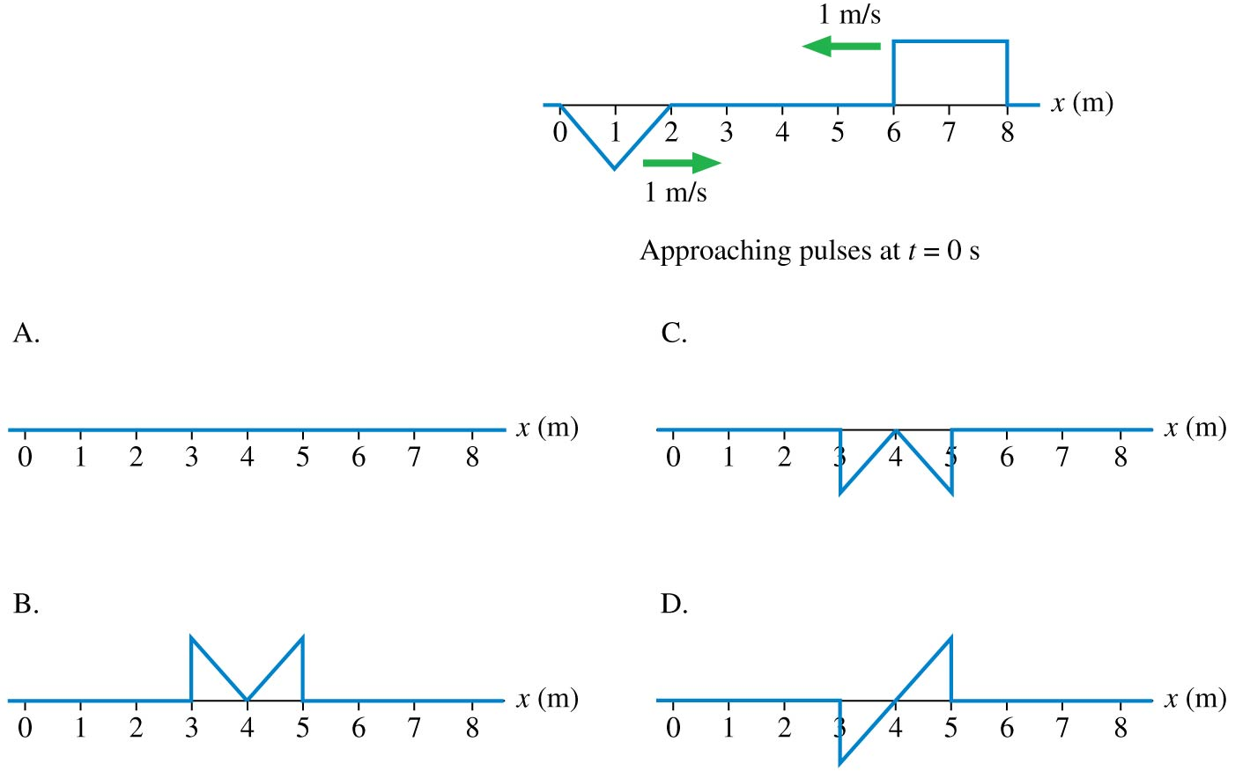
QuickCheck 21.2
Clicker Question 2
Two wave pulses on a string approach each other at speeds of 1 m/s. How does the string look at t = 3 s?
Notes:
9

Slide 10
Reflection of Transverse Wave Pulse
A pulse traveling to the right on a heavy string attached to a lighter string
Speed suddenly increases
[Animation courtesy of Dan Russell, Penn State]

Slide 11
Reflection of Transverse Wave Pulse
A pulse traveling to the right on a light string attached to a heavier string
Speed suddenly decreases
[Animation courtesy of Dan Russell, Penn State]

Slide 12
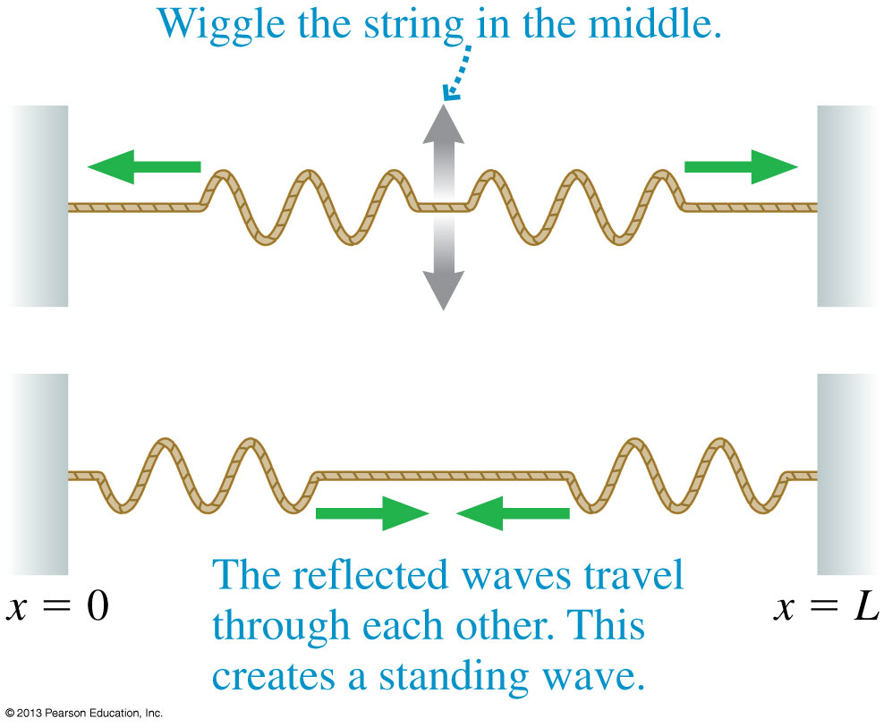
Standing Waves on a String
Reflections at the ends of the string cause waves of equal amplitude and wavelength to travel in opposite directions along the string, which results in a standing wave.

Slide 13
The Mathematics of Standing Waves
According to the principle of superposition, the net displacement of a medium when waves with displacements D_{R} and D_{L} are present is
We can simplify this by using a trigonometric identity, and arrive at:
where
For a standing wave, the pattern is not propagating!

Slide 14
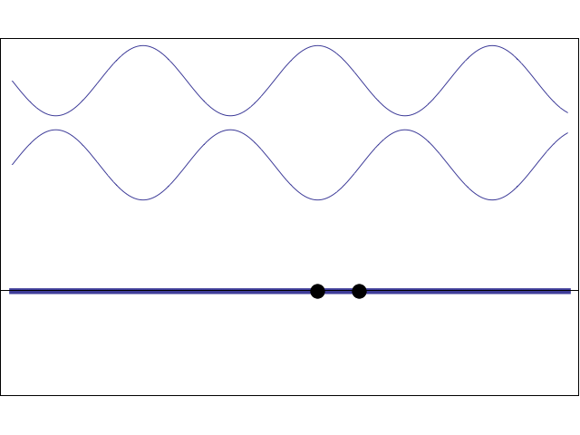
Standing Wave:
The superposition of two 1-D sinusoidal waves traveling in opposite directions.
[Animation courtesy of Dan Russell, Penn State]

Slide 15
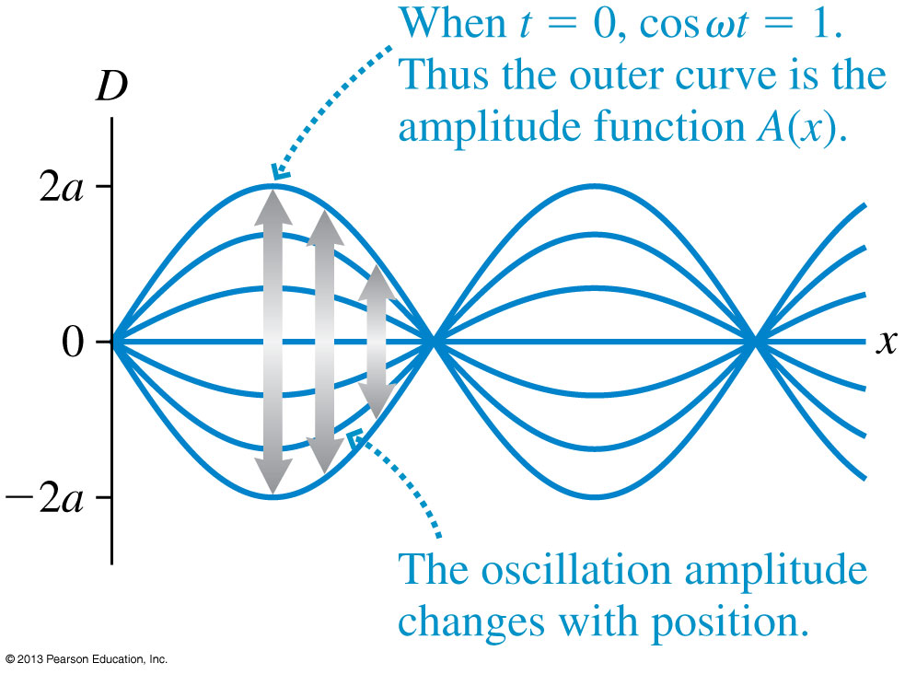
The Mathematics of Standing Waves
The amplitude reaches a maximum value of A_{max} = 2a at points where sin (kx) = 1.

Slide 16
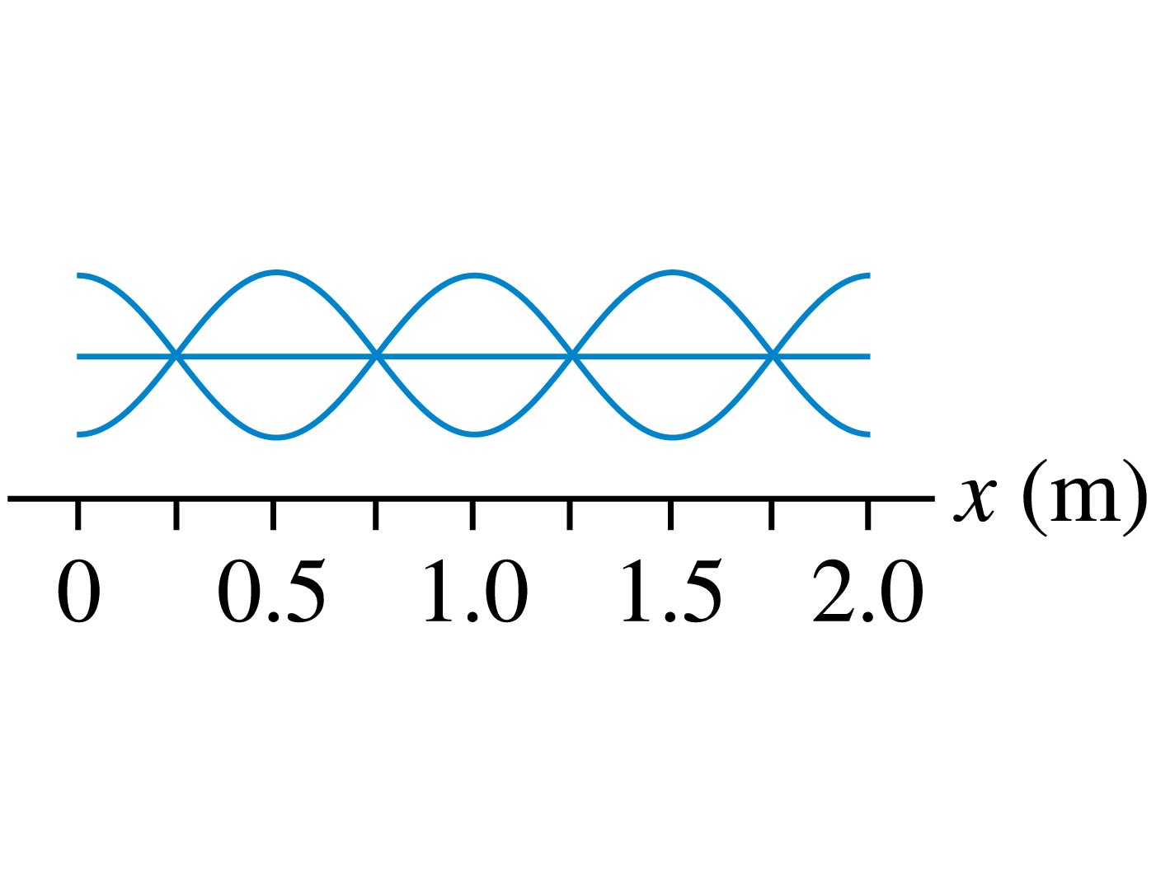
QuickCheck 21.3
Clicker Question 3
What is the wavelength of this standing wave?
0.25 m.
0.5 m.
1.0 m.
2.0 m.
Standing waves don’t have a wavelength.
Notes:
16

Slide 17
Node Spacing on a String

Slide 18
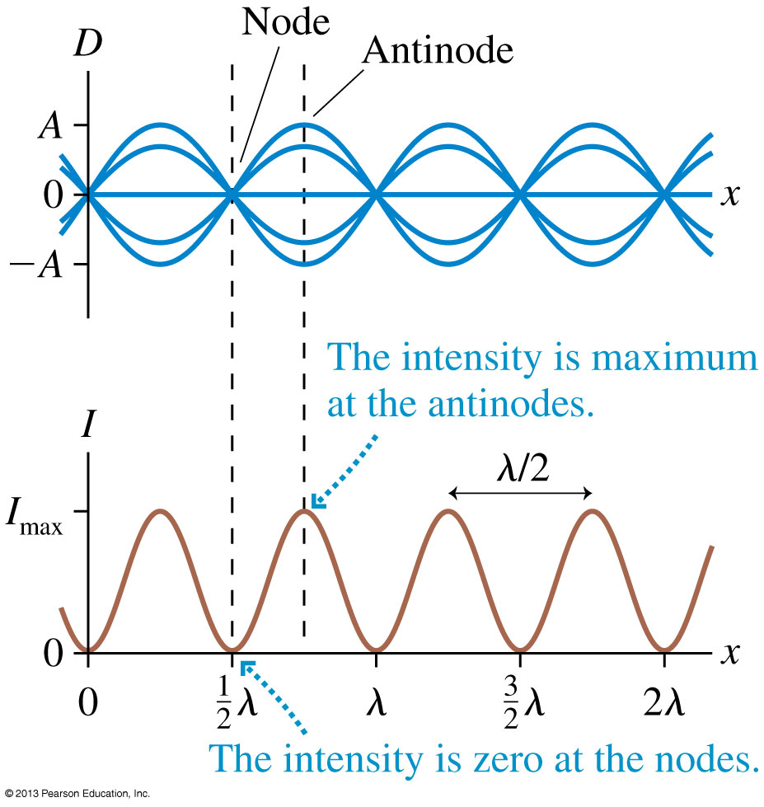
Standing Waves
In Chapter 20 you learned that the intensity of a wave is proportional to the square of the amplitude: I ∝ A².
Intensity is maximum at points of constructive interference and zero at points of destructive interference.

Slide 19
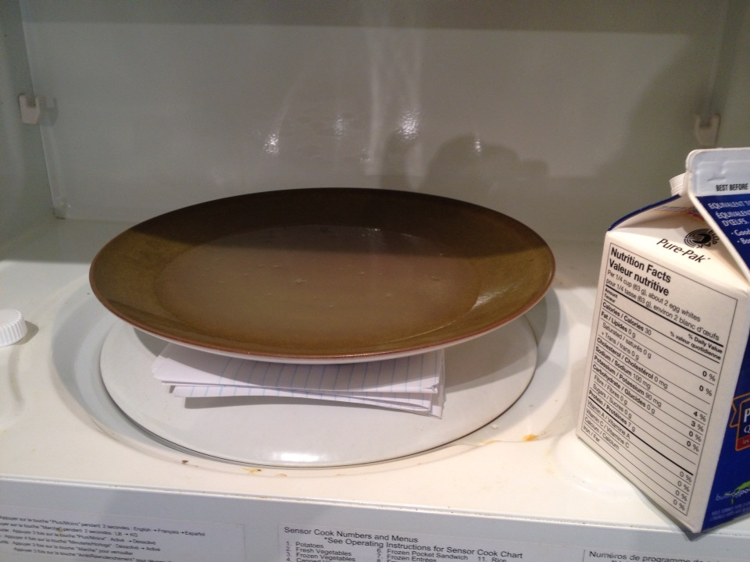
Standing Waves in a Microwave Oven
Microwaves are electromagnetic waves, which travel at the speed of light.
I removed the turntable from my microwave oven, and poured egg whites into a flat plate

Slide 20
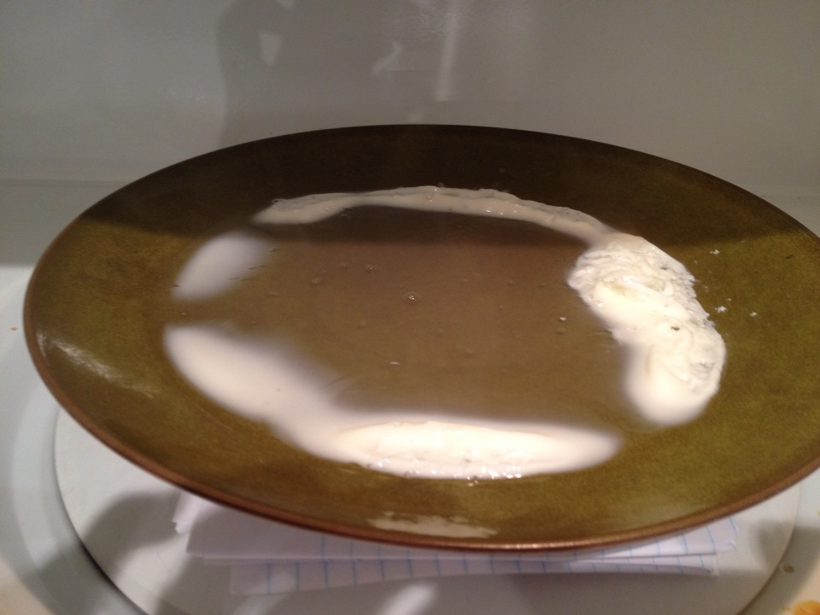
Standing Waves in a Microwave Oven
The egg whites heat faster around the edges. This is because the microwaves attenuate as they travel through the egg.
There also is a pattern of “hot spots”. These are antinodes in 3-dimensional standing wave pattern

Slide 21
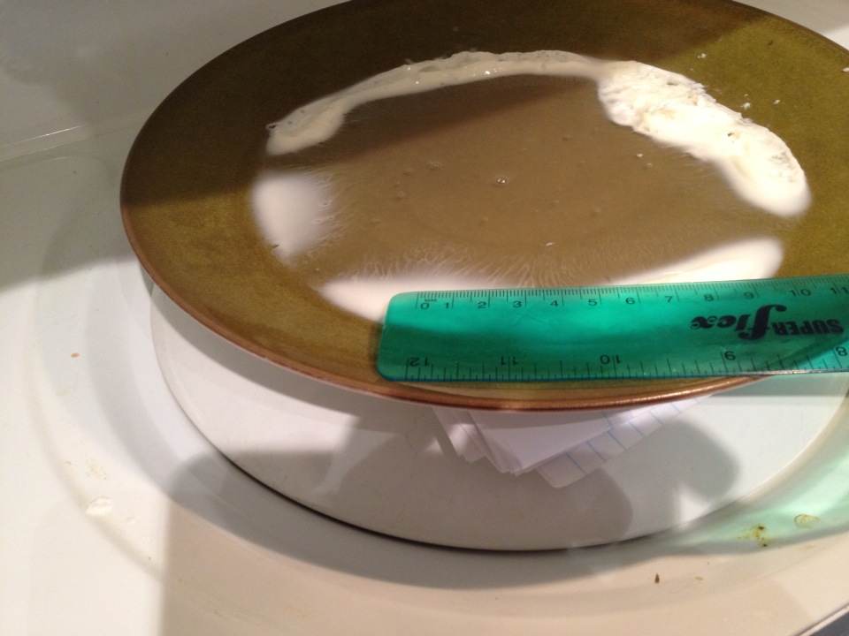
Standing Waves in a Microwave Oven
I measured the distance between antinodes to be about 6 cm ± 1 cm
This should be about $λ/2$, so λ = 12 cm ± 2 cm
My microwave manual says in specifications that its cooking frequency is 2450 MHz

Slide 22
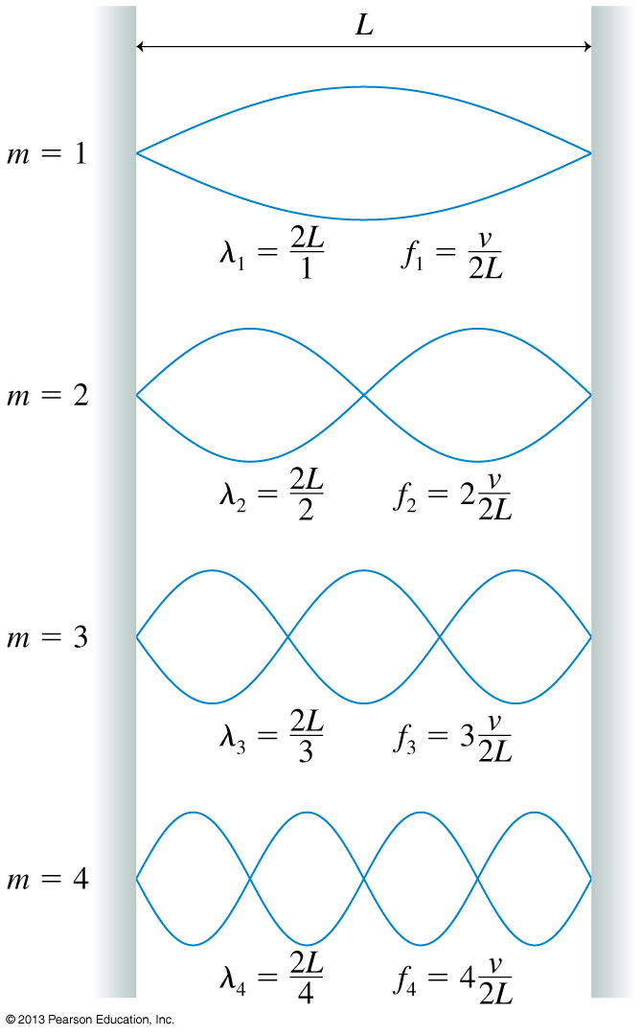
On a string of length L with fixed end points,
Only oscillations with specific wavelengths are allowed.

Slide 23
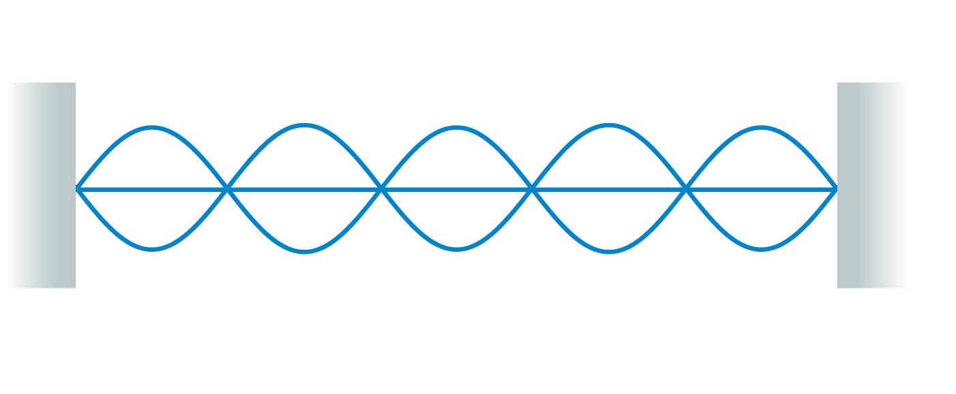
QuickCheck 21.4
Clicker Question 4
What is the mode number of this standing wave?
4.
5.
6.
Can’t say without knowing what kind of wave it is.
Notes:
23

Slide 24
Standing Waves on a String
There are three things to note about the normal modes of a string.
m is the number of antinodes on the standing wave.
The fundamental mode, with m = 1, has λ₁ = 2L.
The frequencies of the normal modes form a series: f₁, 2f₁, 3f₁, …These are also called harmonics. 2f₁ is the “second harmonic”, 3f₁ is the “third harmonic”, etc.

Slide 25
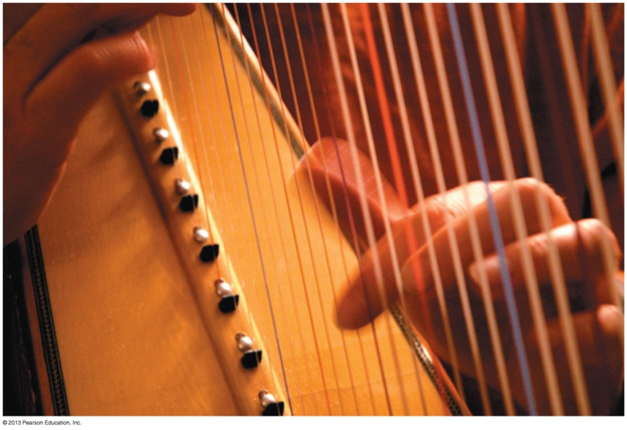
Musical Instruments
Instruments such as the harp, the piano, and the violin have strings fixed at the ends and tightened to create tension.
A disturbance generated on the string by plucking, striking, or bowing it creates a standing wave on the string.
The fundamental frequency is the musical note you hear when the string is sounded:
where T_{s} is the tension in the string and μ is its linear density.

Slide 26
Reading Question 21.5
Clicker Question 5
The frequency of the third harmonic of a string is
One-third the frequency of the fundamental.
Equal to the frequency of the fundamental.
Three times the frequency of the fundamental.
Nine times the frequency of the fundamental.
Notes:
26
Answer: C

Slide 27
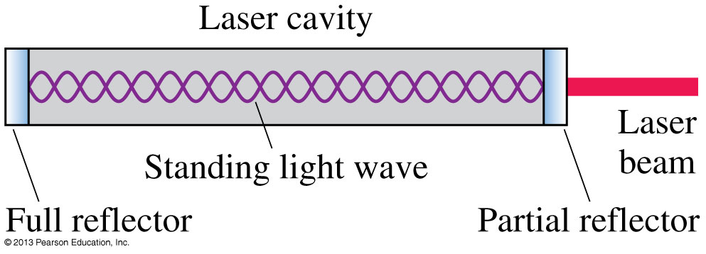
Standing Electromagnetic Waves
Standing electromagnetic waves can be established between two parallel mirrors that reflect light back and forth.
A typical laser cavity has a length L ≈ 30 cm, and visible light has a wavelength λ ≈ 600 nm.
The standing light wave in a typical laser cavity has a mode number m that is 2L/λ ≈ 1,000,000!

Slide 28
Standing Sound Waves
A long, narrow column of air, such as the air in a tube or pipe, can support a longitudinal standing sound wave.
A closed end of a column of air must be a displacement node. Thus the boundary conditions — nodes at the ends — are the same as for a standing wave on a string.
It is often useful to think of sound as a pressure wave rather than a displacement wave. The pressure oscillates around its equilibrium value.
The nodes and antinodes of the pressure wave are interchanged with those of the displacement wave.

Slide 29
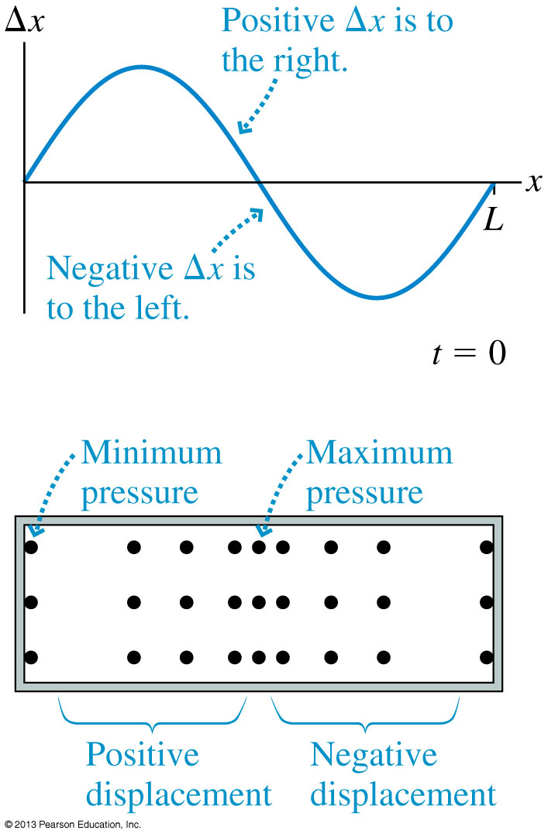
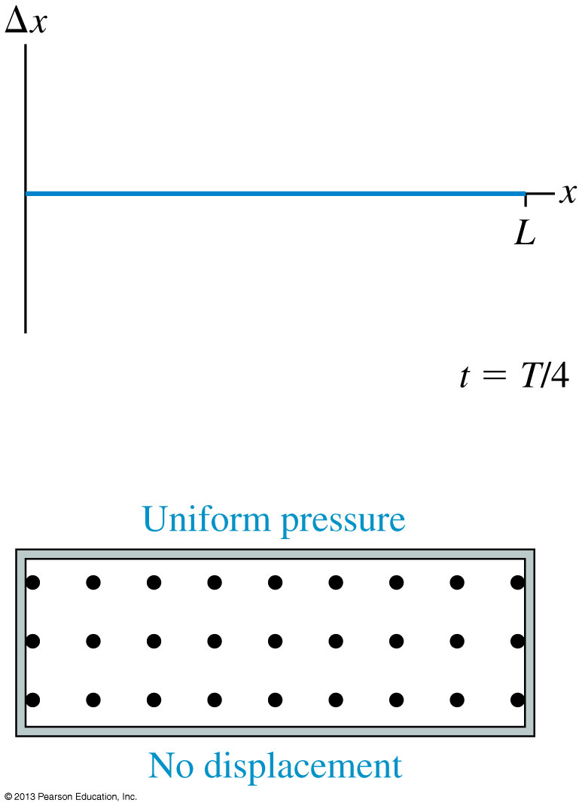
Standing Sound Waves

Slide 30
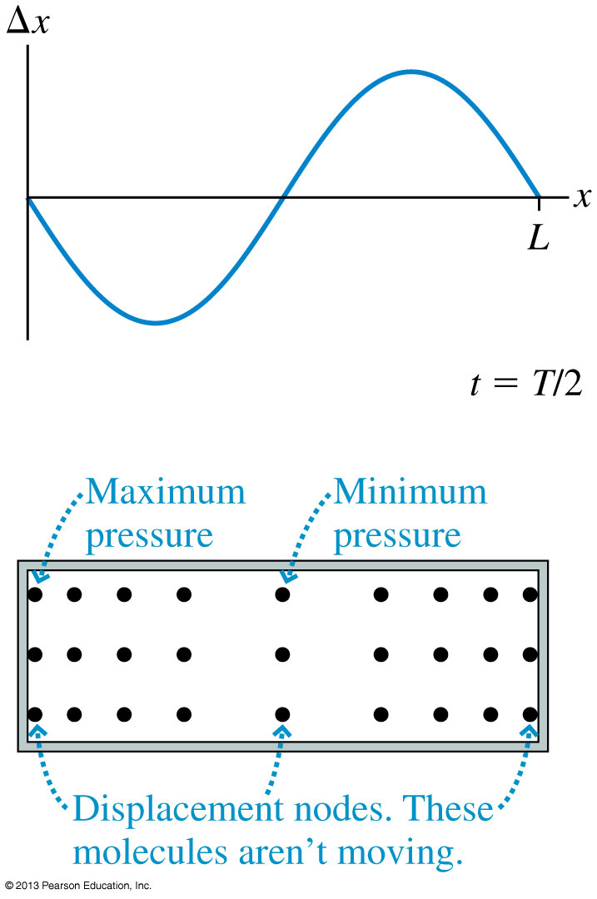
Standing Sound Waves

Slide 31
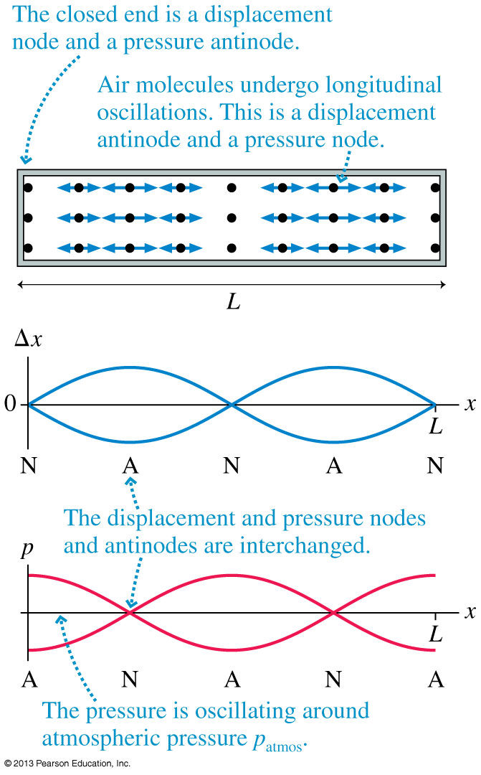
Displacement Δx and pressure graphs for the m = 2 mode of standing sound waves in a closed-closed tube.
The nodes and antinodes of the pressure wave are interchanged with those of the displacement wave.

Slide 32
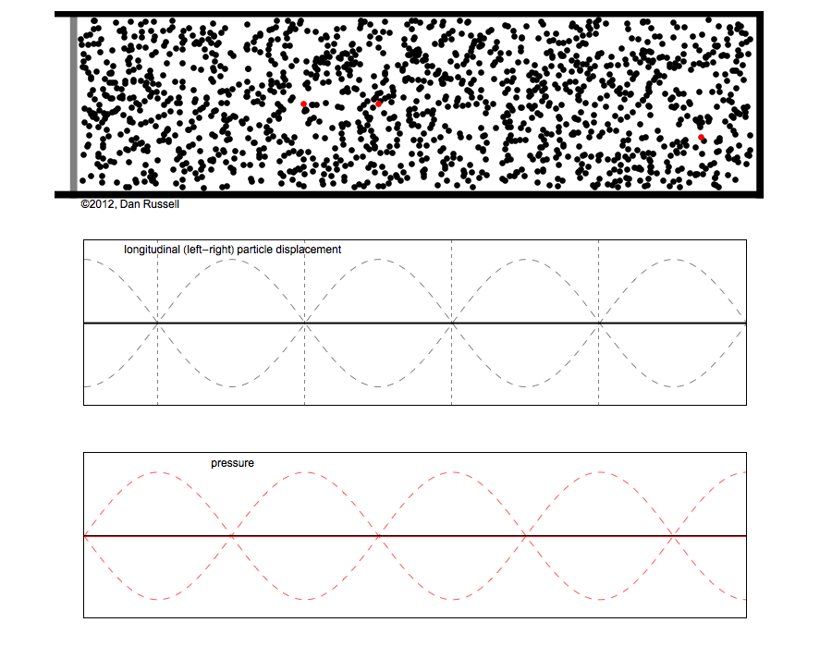

Slide 33
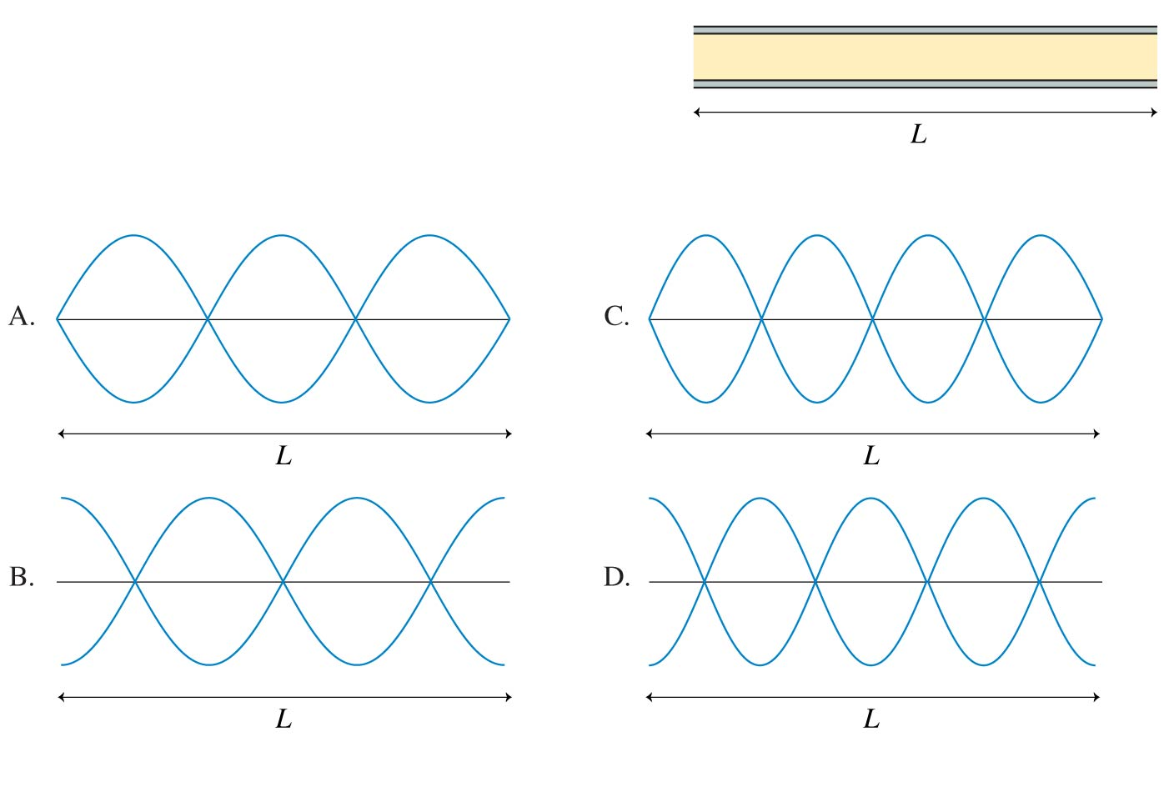
QuickCheck 21.6
Clicker Question 6
An open-open tube of air has length L. Which is the displacement graph of the m = 3 standing wave in this tube?
Notes:
33

Slide 34
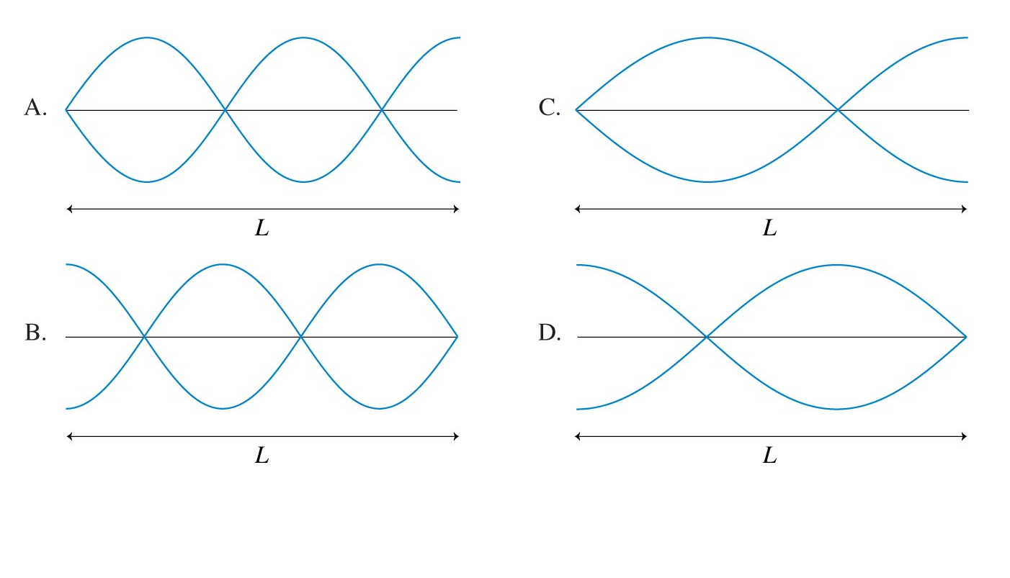
QuickCheck 21.7
Clicker Question 7
An open-closed tube of air of length L has the closed end on the right. Which is the displacement graph of the m = 3 standing wave in this tube?
Notes:
34

Slide 35
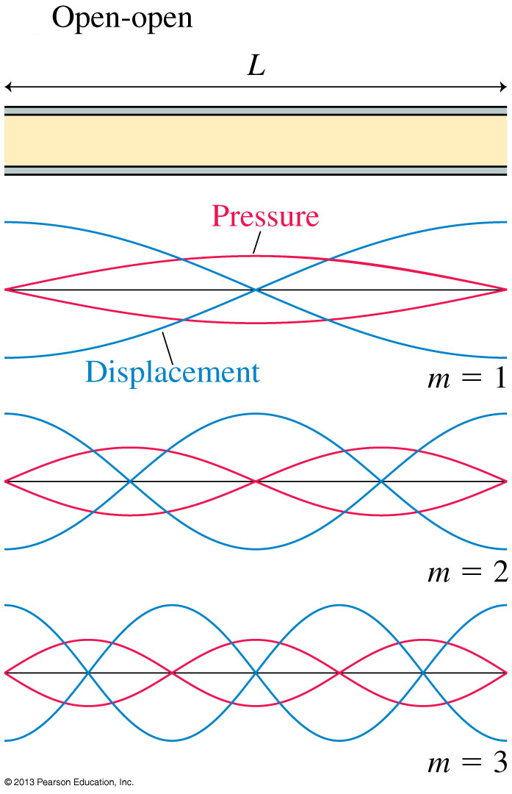

Slide 36
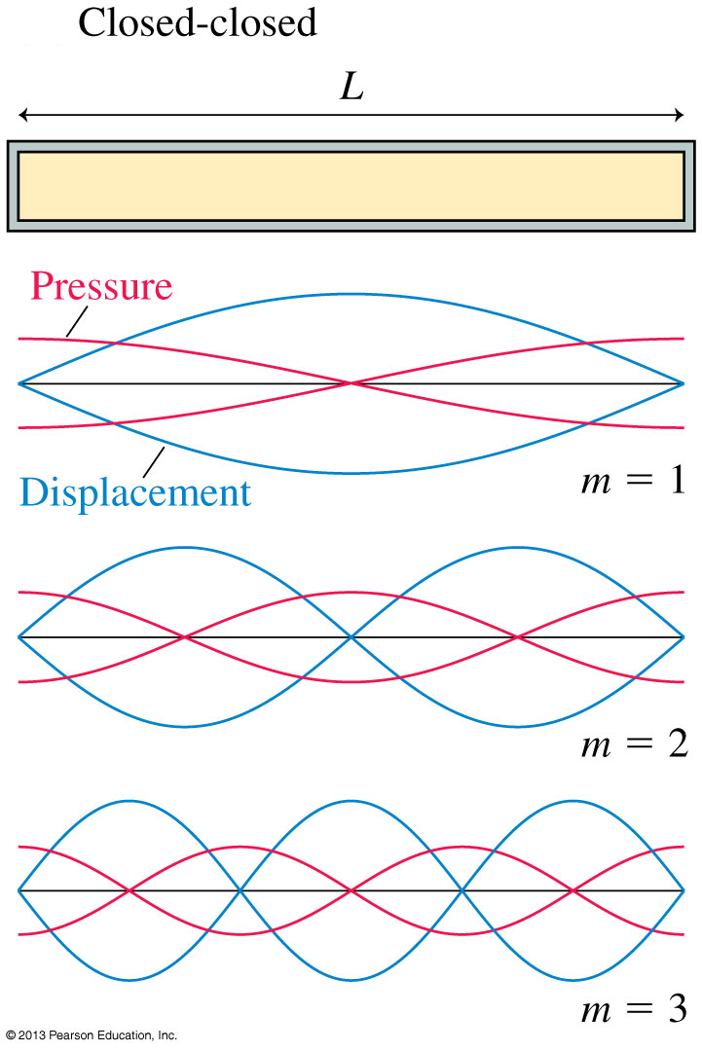

Slide 37
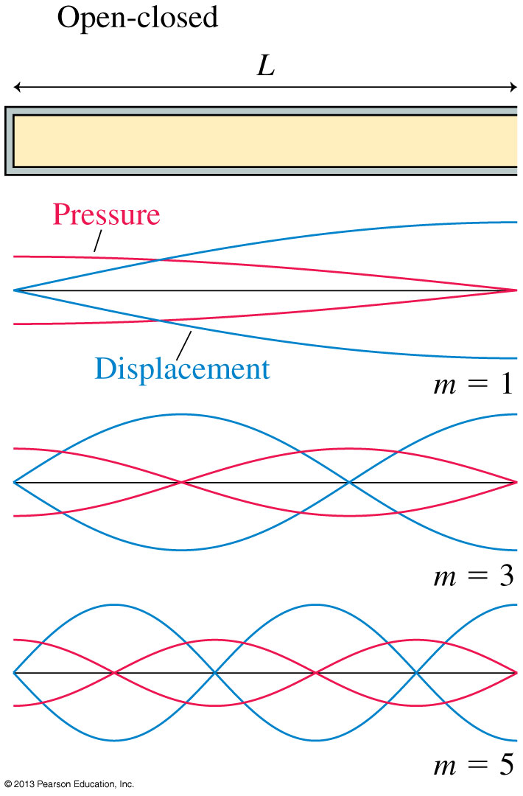
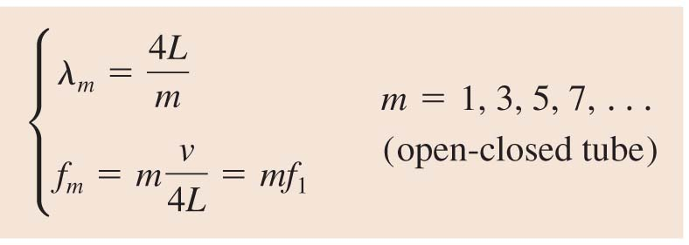

Slide 38
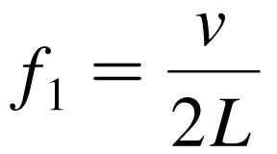
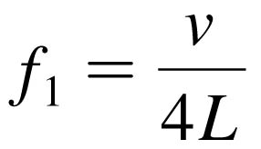
Musical Instruments
With a wind instrument, blowing into the mouthpiece creates a standing sound wave inside a tube of air.
The player changes the notes by using her fingers to cover holes or open valves, changing the length of the tube and thus its fundamental frequency:
for an open-open tube instrument, such as a flute
for an open-closed tube instrument, such as a clarinet
In both of these equations, v is the speed of sound in the air inside the tube.
Overblowing wind instruments can sometimes produce higher harmonics such as f₂ = 2f₁ and f₃ = 3f₁.

Slide 39
QuickCheck 21.8
Clicker Question 8
At room temperature, the fundamental frequency of an open-open tube is 500 Hz. If taken outside on a cold winter day, the fundamental frequency will be
Less than 500 Hz.
500 Hz.
More than 500 Hz.
Notes:
39

Slide 40
Practicals Begin This Week!!
(they actually began today!)
Check “My PRA Group” on the portal page for this course to see what room you go to.
Don’t miss it!

Slide 41
Before Class 4 on Wednesday
Please read Knight Ch. 21, sections 21.5-21.8 (finish the chapter)
Please do the short pre-class quiz on MasteringPhysics by Tuesday evening.
Something to think about: What is “constructive interference”? How can you interfere with something and increase its strength?

