Slide 1
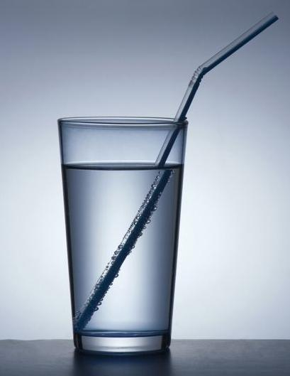
PHY132 Introduction to Physics II
Class 5 – Outline:
Ch. 23, sections 23.1-23.5
Reflection
Refraction
Total Internal Reflection
Image Formation
Colour and Dispersion
http://physics.tutorvista.com/light/index-of-refraction.html

Slide 2
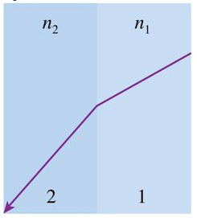
Class 5 Preclass Quiz on MasteringPhysics
This was due this morning at 8:00am
674 students submitted the quiz on time
96% got:“Specular Reflection” is reflection by a flat, smooth object. The “law of reflection” is obeyed.
79% got: “Dispersion” is when the index of refraction varies slightly with wavelength.
57% of students got: Whenever the ray bends away from the normal, it means the waves are speeding up. That means n2 < n1.
70% got: there is only a critical angle (for possible total internal reflection) when n2 < n1.

Slide 3
Class 5 Preclass Quiz – Student Comments…
“I don't know whether this is relevant but: how come when you shine your pointer in Con Hall, we see the green dot on screen, but we don't see a ray of green light travelling from the pointer to the screen?”
“So all objects emit light?”
Harlow answer: No. Most of them are diffuse reflectors.
I have a few questions: 1) You mentioned that when 2 light waves cross, they do not interfere with each other. If so, then how is thin film interference possible?
Harlow answer: They certainly do interfere with each other!! But they do not bounce off one another and go in different directions..
2) Do we have to memorize the wavelengths of light given in the book?
Harlow answer: No.

Slide 4
Class 5 Preclass Quiz – Student Comments…
when are your office hours??
Mondays 1:00-2:00, Thursdays and Fridays 11:00-noon.
How do one-way mirrors work? Is it something like thin-film optical coatings?
Harlow answer: Nope. It’s just a thin coating of aluminum on glass, so it is partially reflective and partially transmitting. And there is nothing one-way about it all mirrors are two-way. But if you keep one room in relative darkness and keep the other room quite bright, the people in the darker room will be able to see the brighter room, but not vice-versa.
After a full semester of completely new material, there is finally a topic that I have learned before from grade 10 science. :)

Slide 5
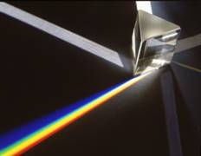
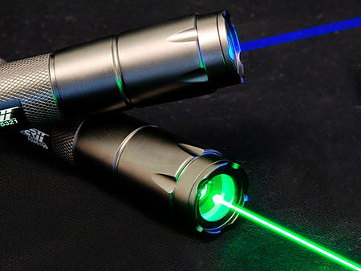
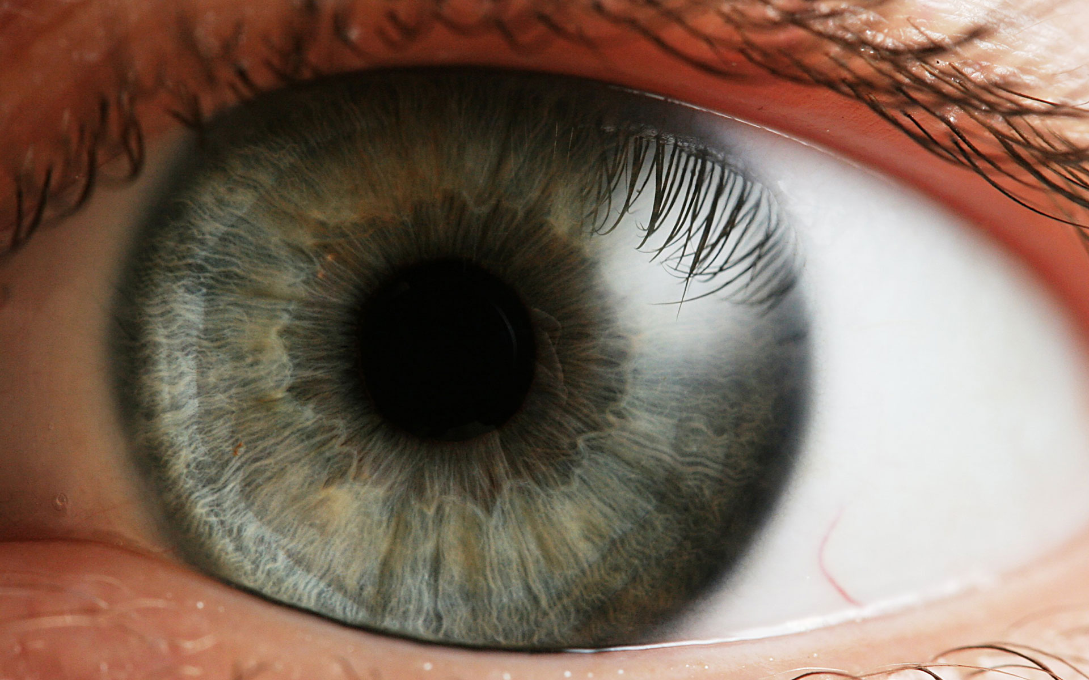
What is light?
Light is an electromagnetic wave – and is highly useful in our everyday life!

Slide 6
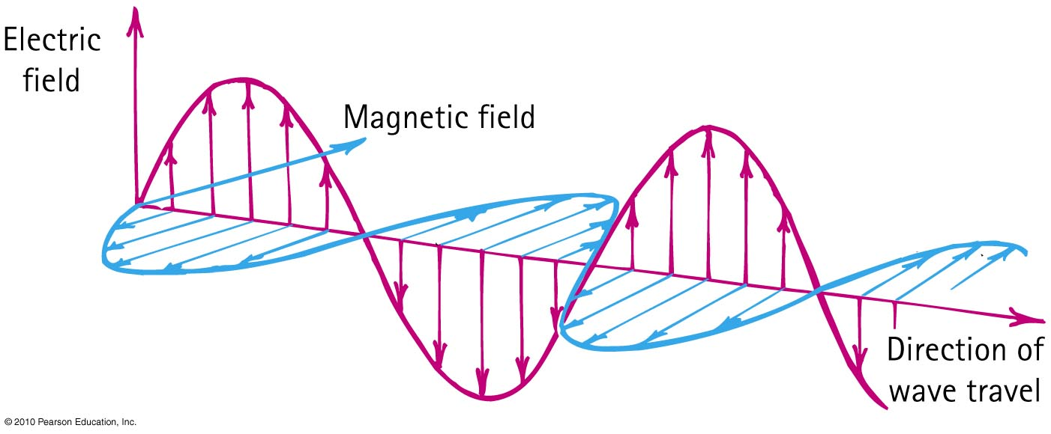
Electromagnetic Waves
The electric and magnetic fields of an electromagnetic wave are perpendicular to each other and to the direction of motion of the wave.

Slide 7
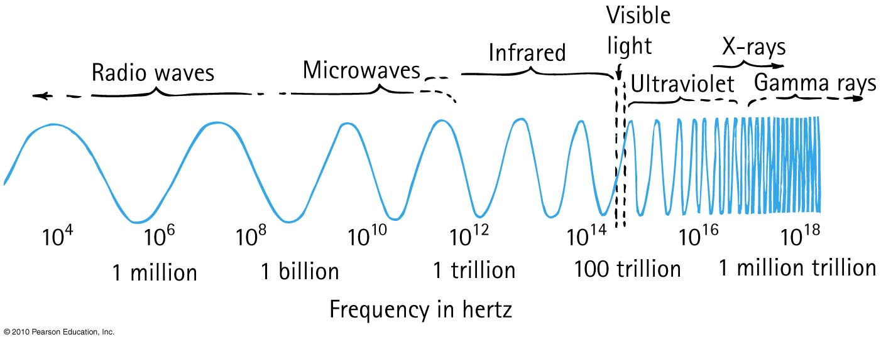
Electromagnetic Spectrum
In a vacuum, all electromagnetic waves move at the same speed
We classify electromagnetic waves according to their frequency (or wavelength)
Light is one kind of electromagnetic wave

Slide 8
If a certain material is “transparent” (ie, not opaque), what does this mean?
Electromagnetic Waves
CHECK YOUR NEIGHBOUR
Electromagnetic waves of all frequencies can pass straight through it
Electromagnetic waves of all frequencies are reflected from its surface
Electromagnetic waves of all frequencies are absorbed throughout its volume
Electromagnetic waves of a certain frequency can pass straight through it

Slide 9
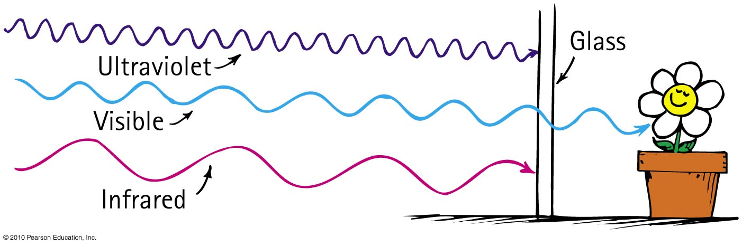
Transparent Materials
Glass blocks both infrared and ultraviolet, but it is transparent to visible light.

Slide 10
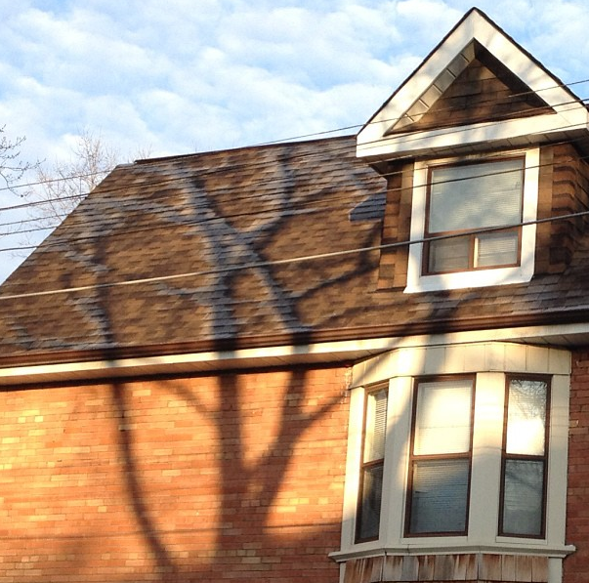
Opaque Materials
Most things around us are opaque—they absorb light without re-emitting it.
Vibrations given by light to their atoms and molecules are turned into random kinetic energy—into internal energy.
These materials become slightly warmer.

Slide 11
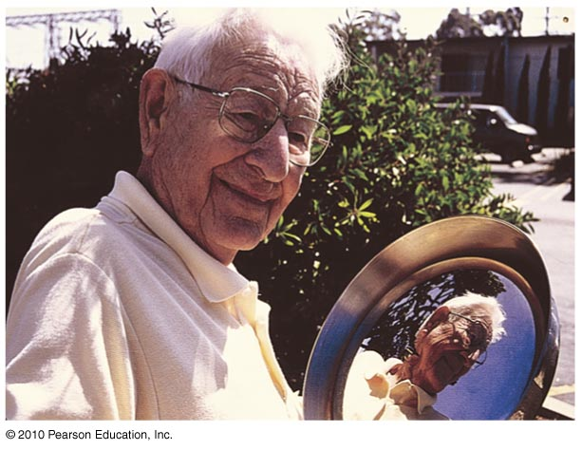
Opaque Materials
Metals
Light shining on metal forces free electrons in the metal into vibrations that emit their own light as reflection.

Slide 12
Which reflects more light, a white piece of paper or a black piece of paper?
Reflection
CHECK YOUR NEIGHBOUR
Black
White
About the same

Slide 13
Which reflects more light, a white piece of paper or a mirror?
Reflection
CHECK YOUR NEIGHBOUR
White Paper
Mirror
About the same

Slide 14
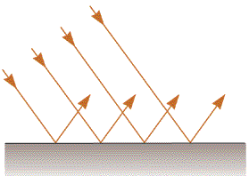
Specular Reflection
Mirrors
The surface is flat at distance scales near or above the wavelength of light
It looks “shiny”, and you can see images in it.

Slide 15
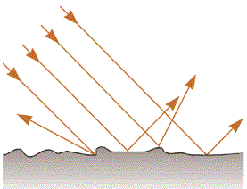
Diffuse Reflection
White Paper
The surface is rough at distance scales near or above the wavelength of light
Almost all surfaces reflect in this way!

Slide 16
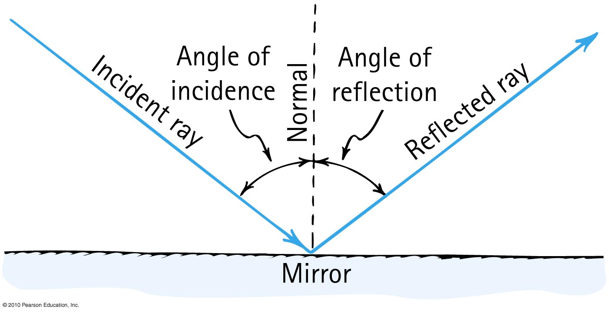
Law of Specular Reflection
The angle of reflection equals the angle of incidence.

Slide 17
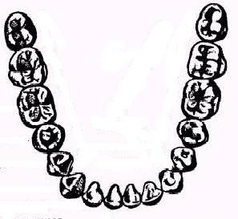
A dentist uses a mirror to look at the back of a second molar (A).
Next, she wishes to look at the back of a lateral incisor (B), which is 90° away.
By what angle should she rotate her mirror?
Mirror
A
B
A. 90°
B. 45°
C. 180°

Slide 18
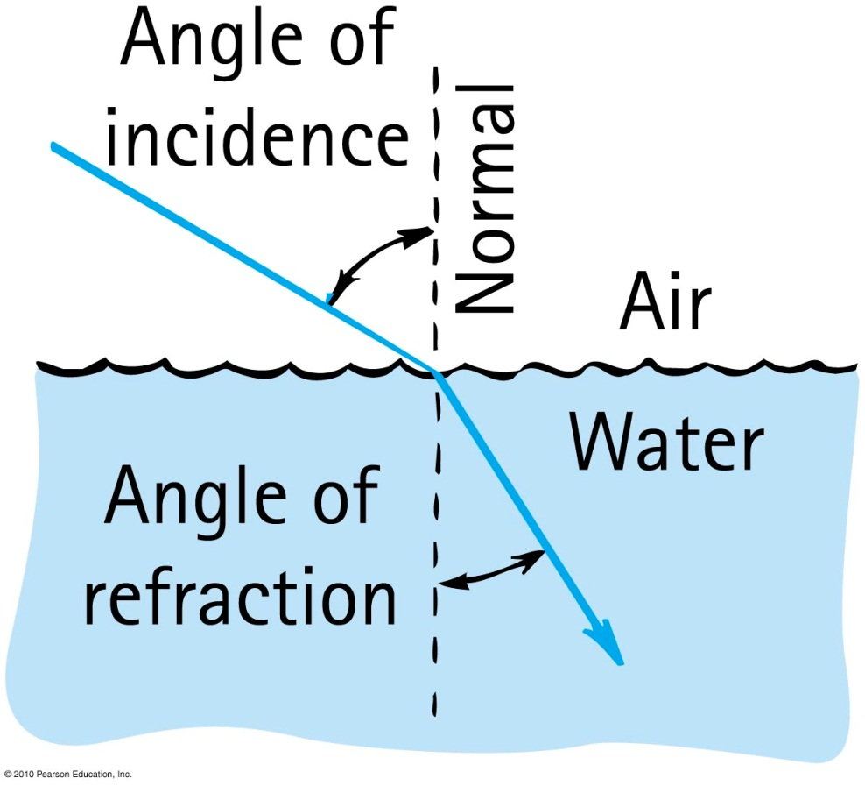
Refraction
When light bends in going obliquely from one medium to another, we call this process refraction.

Slide 19
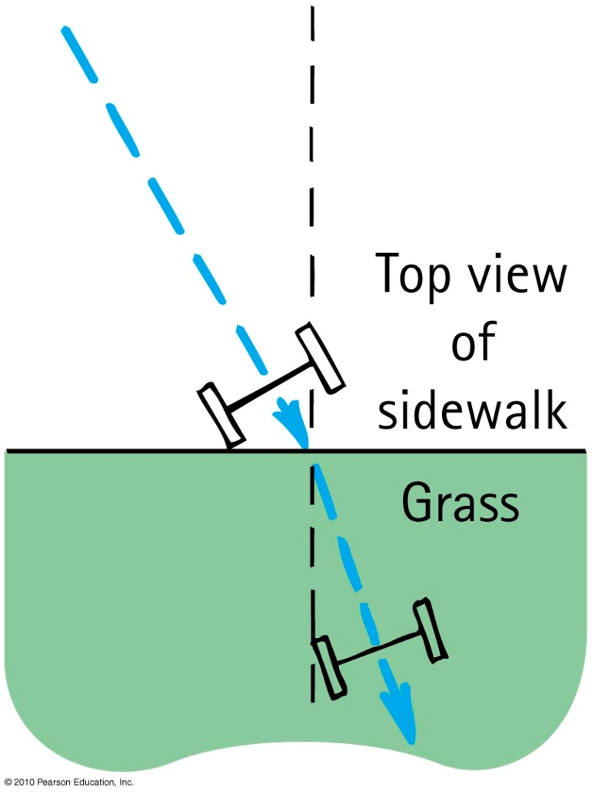
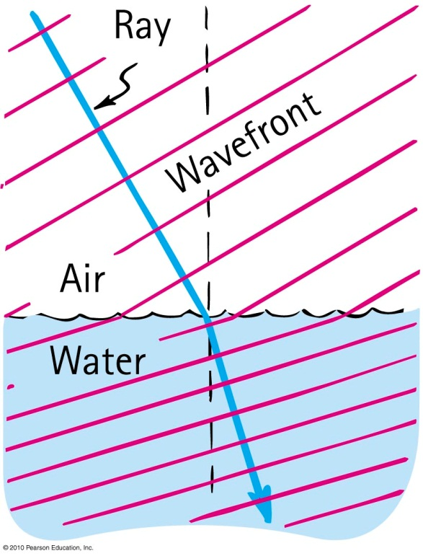
Cause of Refraction
Bending of light when it passes from one medium to another
Caused by change in speed of light

Slide 20

1
A soldier wants to get from point 1 to Point 2 in the shortest amount of time. Marching through mud is much slower than marching on dry land. Which might be the best path?
Dry Land
C
A
B
Mud
Dry Land
2

Slide 21
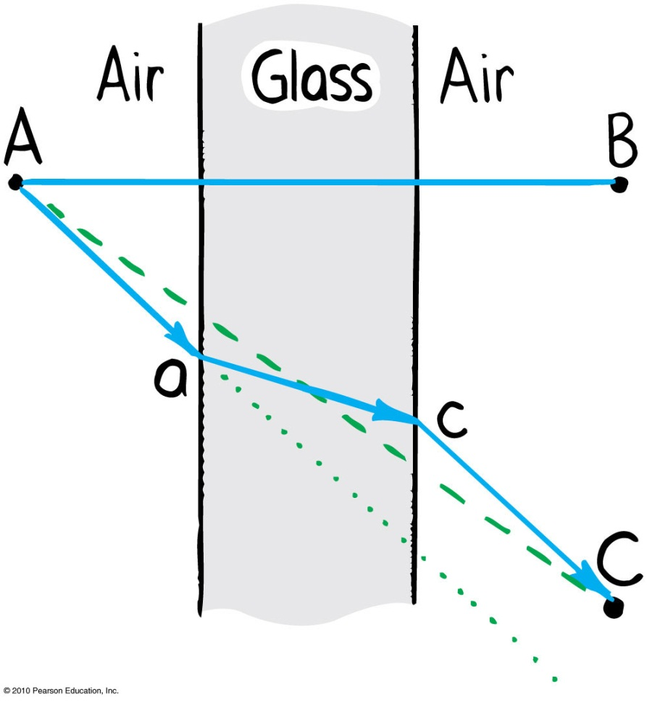
Refraction
  Light travels slower in glass than in air, so it minimizes the time it spends in the glass.

Slide 22
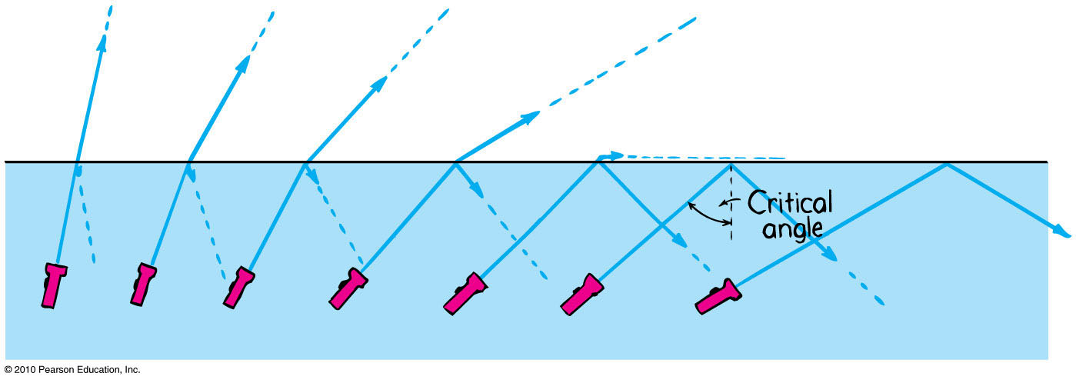
Total Internal Reflection
Total reflection of light traveling within a medium that strikes the boundary of another medium at an angle at, or greater than, the critical angle

Slide 23
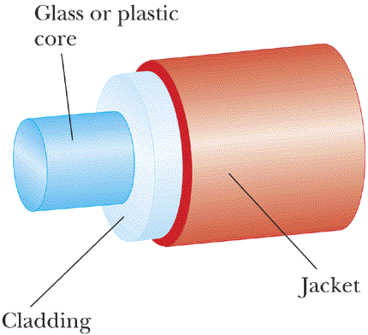
An Optical Fibre
Speed of light in cladding is higher than speed of light in core.

Slide 24
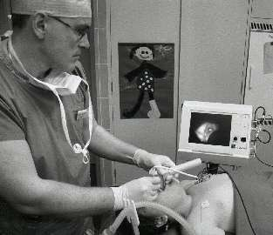
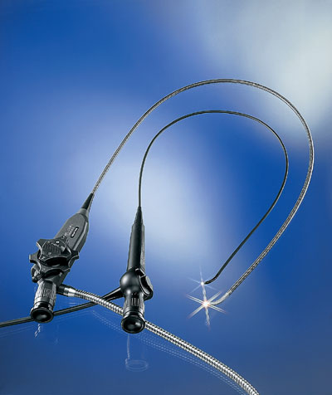
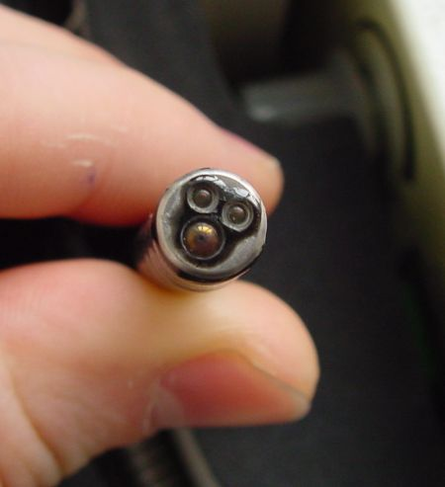
Medical Fibrescopes
Video-laryngoscopy with a flexible fiberscope

Slide 25
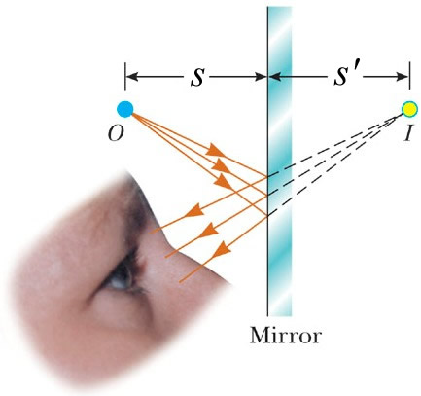
Virtual Image Formation
No light rays actually pass through or even near the image, so it is “virtual”.

Slide 26
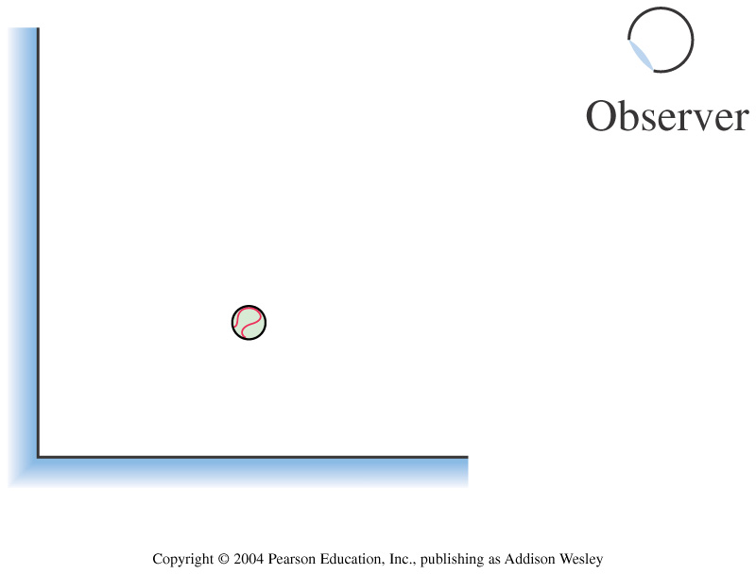
Two plane mirrors form a right angle. How many images of the ball can the observer see in the mirrors?
1
2
3
4

Slide 27
air
water
A fish swims below the surface of the water. An observer sees the fish at:
A. a greater depth than it really is.
B. its true depth.
C. a smaller depth than it really is.

Slide 28
air
water
A fish swims directly below the surface of the water. An observer sees the fish at:
A. a greater depth than it really is.
B. its true depth.
C. a smaller depth than it really is.

Slide 29
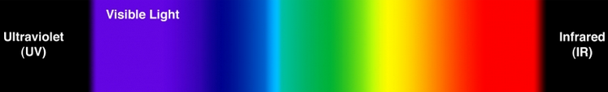




Color
Color we see depends on frequency of light.
$$0.4 μm$$
$$0.7 μm$$
$$f$$
High Frequency,
Short wavelength
Low Frequency,
Long wavelength
$$λ$$

Slide 30
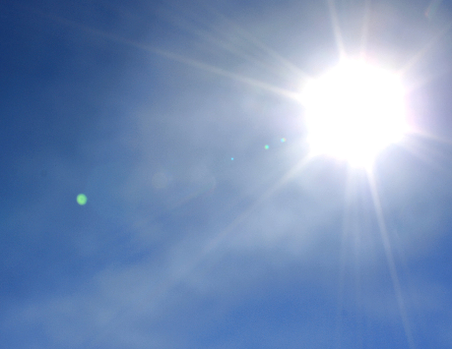
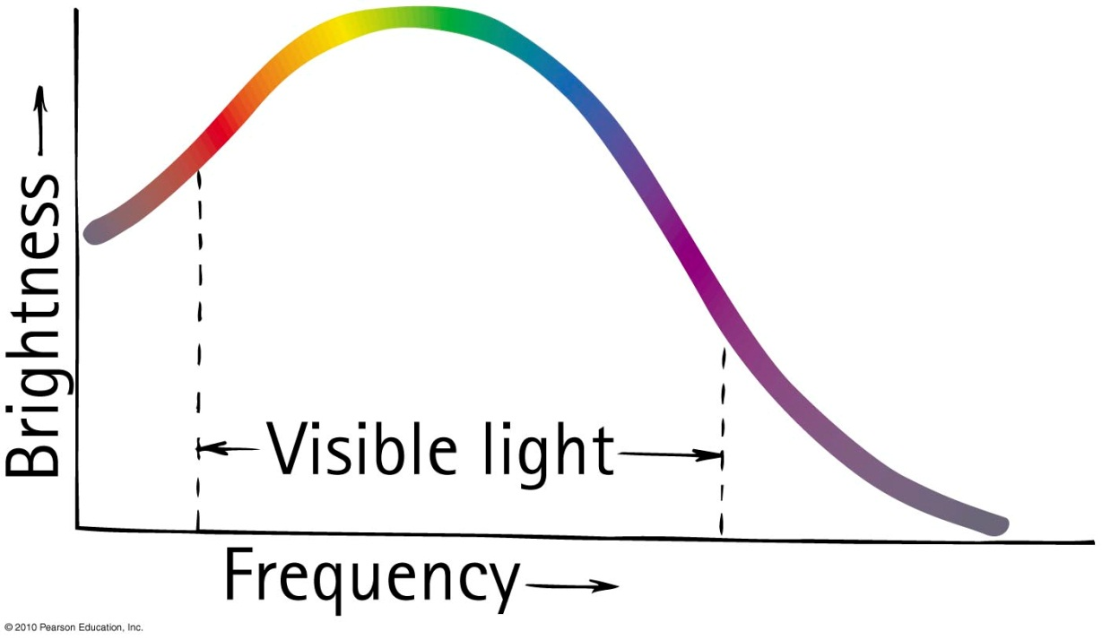
Mixing Colored Light
The spectrum of sunlight is a graph of brightness versus frequency.
Somehow, this mix looks “white” to us.

Slide 31
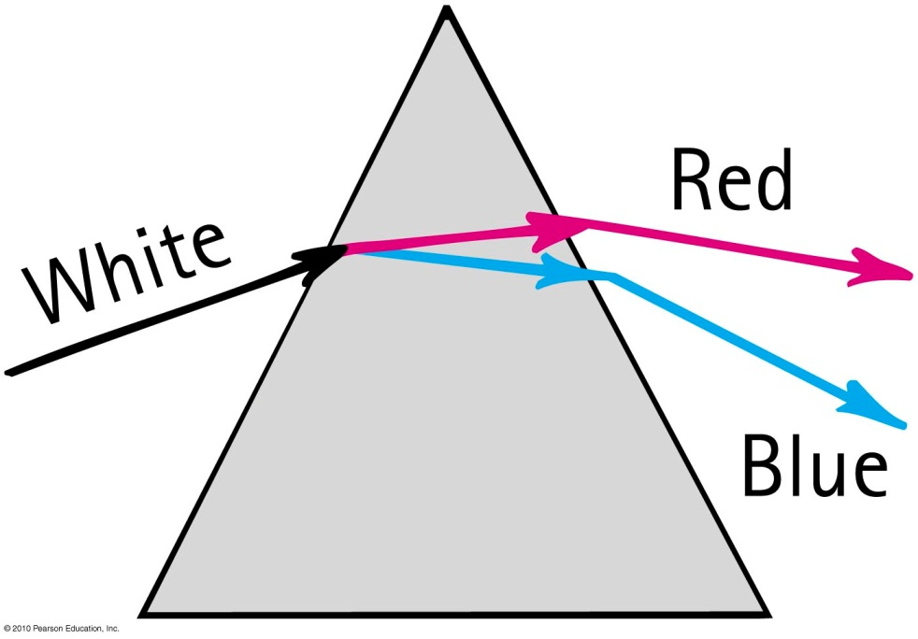
Dispersion
Process of separation of light into colors arranged by frequency
Components of white light are dispersed in a prism (and in a diffraction grating).

Slide 32
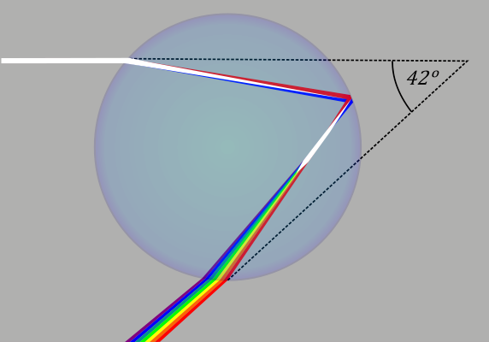
Rainbows
Rainbows are a result of dispersion by many drops.
Dispersion of light by a single drop

Slide 33
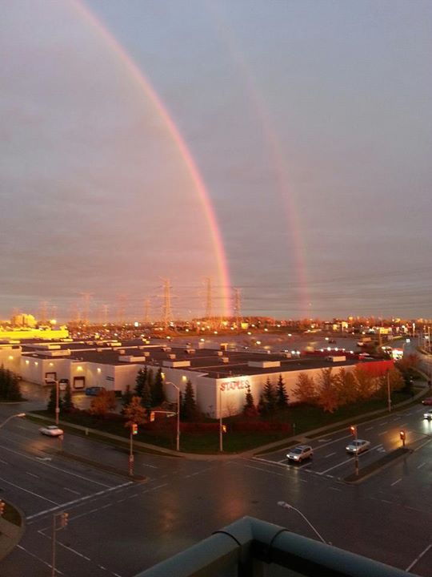
Rainbows
Radius of circle is about 41°
Antisun
(180° away from actual sun)
Image by Bita Janzadah. ©2014. https://fbcdn-sphotos-g-a.akamaihd.net/hphotos-ak-ash2/s720x720/560575_10151053440411899_1380323186_n.jpg

Slide 34
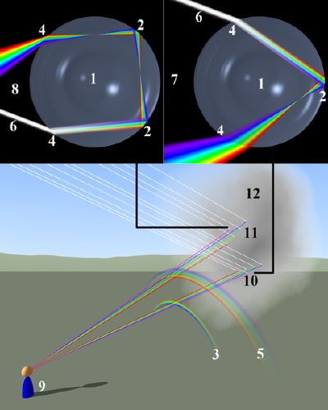
Double-rainbow
The second rainbow has blue on the top, and a radius of about 53°

Slide 35
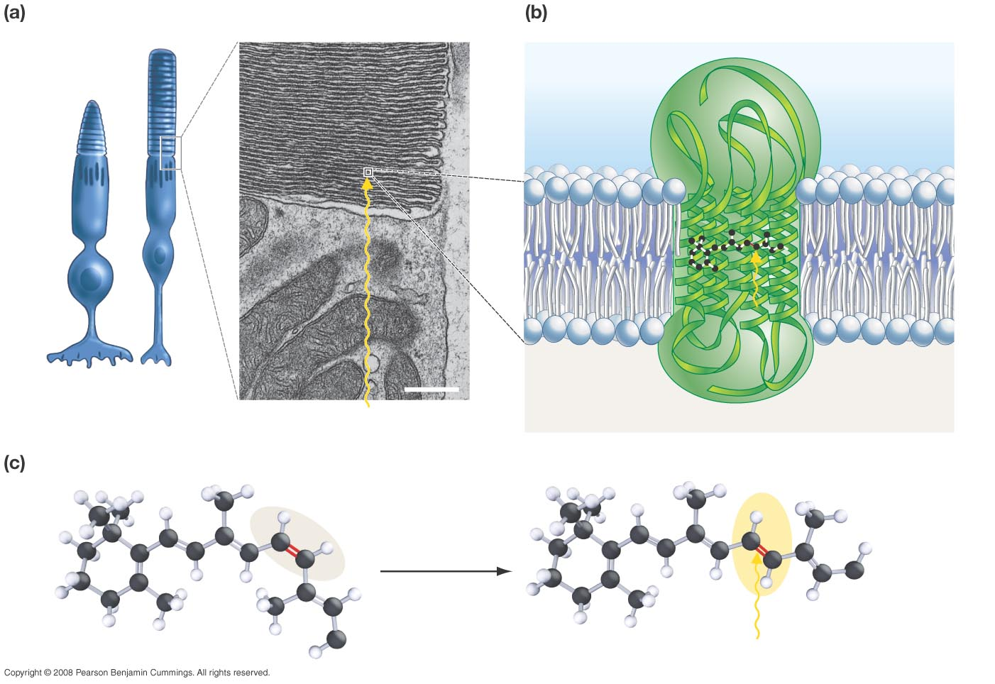
Rods and cones contain stacks of membranes.
Rhodopsin is a transmembrane protein complex.
Opsin (protein component)
Retinal (pigment)
Cone
Rod
0.5 µm
Rhodopsin
Light
Light
The retinal molecule inside rhodopsin changes shape when retinal absorbs light.
cis conformation (inactive)
trans conformation (activated)
Opsin
Opsin
Light
Slide courtesy of Ross Koning, Biology Department, Eastern Connecticut State University
http://plantphys.info/sciencematters/vision.ppt
Notes:
35

Slide 36
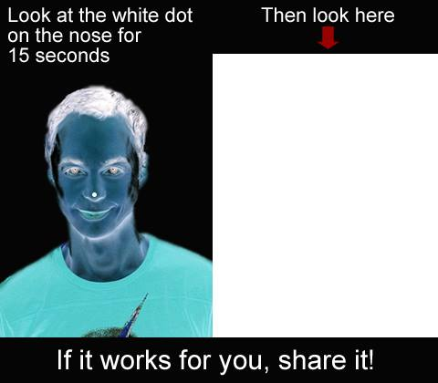
Use both eyes, stare at area shown in blue for 15 seconds or so
Stare at the dot on the nose for 15 seconds.

Slide 37
What do you see on this blank white slide? Blink if needed!
This is called an “after image”
Does it move around as you move your gaze?

Slide 38
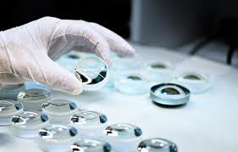
Before Class 6 on Wednesday
Please read Knight Pgs. 670-686: Ch. 23, sections 23.6-23.8
Please do the short pre-class quiz on MasteringPhysics by tomorrow night.
Something to think about: What is the difference between a converging and diverging lens? Which type can be used to focus sunlight onto a piece of paper and burn a hole?

