Slide 1
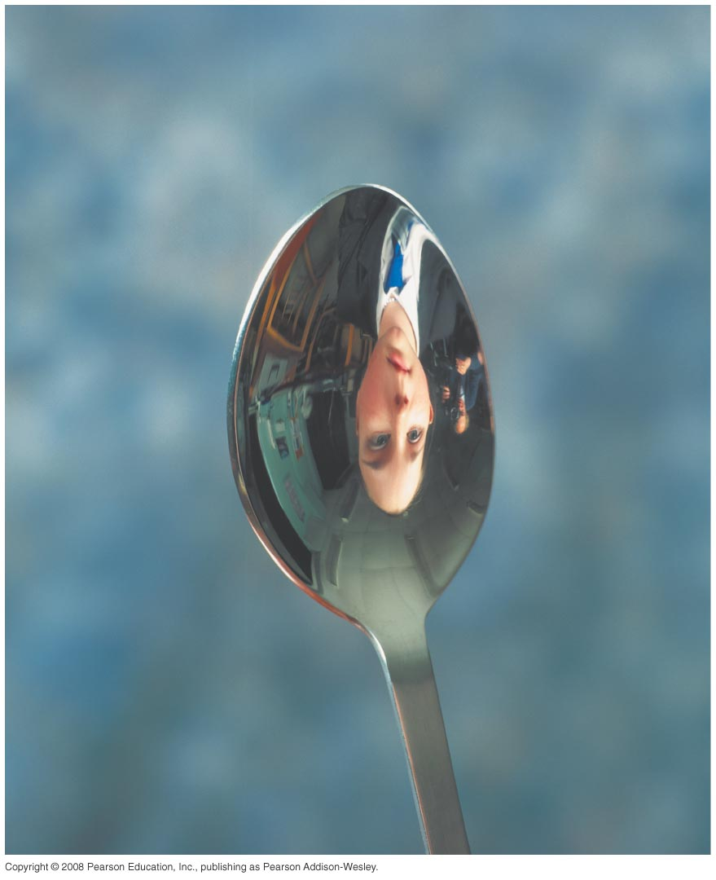
PHY132 Introduction to Physics II Class 6 – Outline:
Ch. 23, sections 23.6-23.8
The Thin Lens Equation
The Lens-Maker's Equation
Image Formation with Spherical Mirrors

Slide 2
Class 6 Preclass Quiz on MasteringPhysics
This was due this morning at 8:00am
642 students submitted the quiz on time
94% got: A lens which is thicker at the centre than at the edges is converging. (And a lens which is thinner at the centre than at the edges is diverging.)
90% got: The focal length of a converging lens is the distance at which parallel light rays are focused.
73% got: A virtual image is a point from which rays appear to diverge.

Slide 3
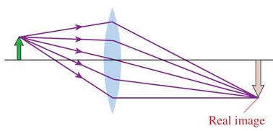
Class 6 Preclass Quiz on MasteringPhysics
71% got: If a real image is formed by a converging lens, that means the object distance was smaller than the focal length f.

Slide 4
Class 6 Preclass Quiz – Student Comments…
“Determining whether an image will be virtual or real was probably the most difficult aspect.”
Harlow thought: If the rays actually converge at the image, then it is real. You could, in principle, place a screen at a real image, and see the image. If the rays only appear to be coming from the image, but they didn’t actually touch it, then it is virtual.
“So I guess we should bring rulers to the exam?”
Answer: Yes. A ruler is an allowed aid on tests and the exam, and I would suggest you bring one just in case.
“is there an easy way to remember concave/convex?”
Harlow thought: A cave is concave.
Concave toward the left.
Convex toward the right.

Slide 5
Class 6 Preclass Quiz – Student Comments…
“real image is still blurry in my mind”
“Do we need to write down these equations onto our aid sheet or will they be provided ?”
Answer: No equations will be provided on the tests and exam. You must write every useful equation you don’t feel like memorizing on your aid sheet.
“Where does bad light go? In a prism.”
“I think optical fiber imaging is really cool - Total Internal Reflection sounds like the name of an action movie. "Total Internal Reflection" Director: J. J. Abrams Cast: Matt Damon, Sandra Bullock, Jennifer Lawrence (for comic relief) Plot: The characters are trapped inside a giant endoscope...”

Slide 6
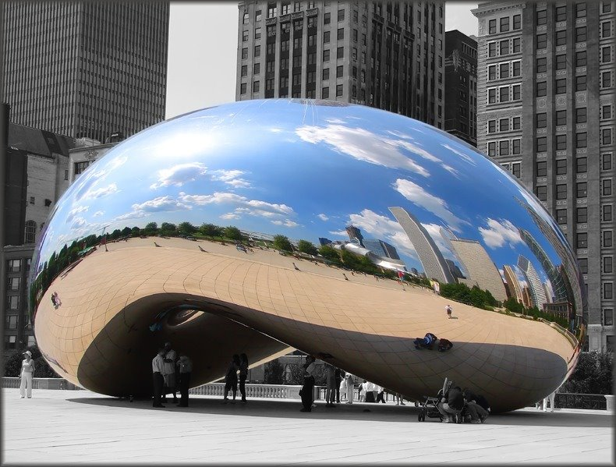
Class 6 Preclass Quiz – Student Comments…
“Now I know how "the Bean" in Chicago works, and why we see miniature versions of ourselves!”

Slide 7
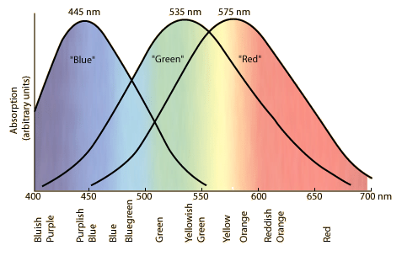
Response Curves for the three types of cones in the retina of the human eye.
Slide from http://hyperphysics.phy-astr.gsu.edu/hbase/vision/colcon.html

Slide 8
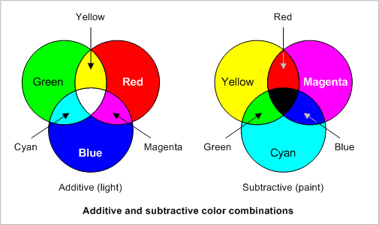
Additive Primary Colours (light bulbs) and Subtractive Primary Colours (ink)

Slide 9
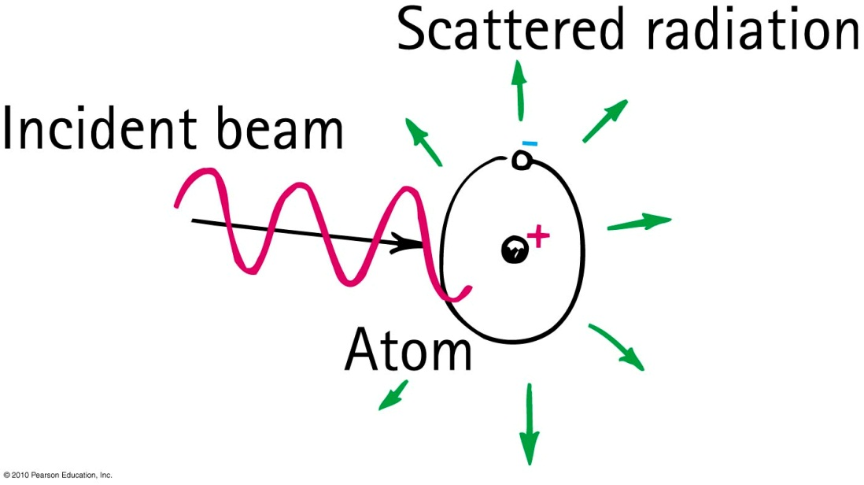
Why the Sky Is Blue
For small scattering particles, like nitrogen or oxygen molecules, higher frequency blue light is scattered much more readily than lower frequency red light.

Slide 10
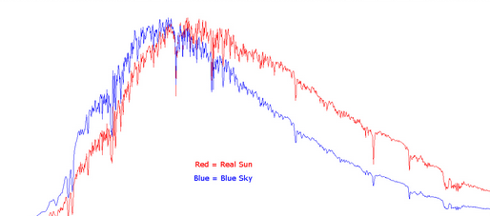
Why the Sky Is Blue
$$frequency$$

Slide 11
If molecules in the sky scattered orange light instead of blue light, the sky would be
Why Sunsets Are Red
CHECK YOUR NEIGHBOUR
A. orange.
yellow.
green.
blue.

Slide 12
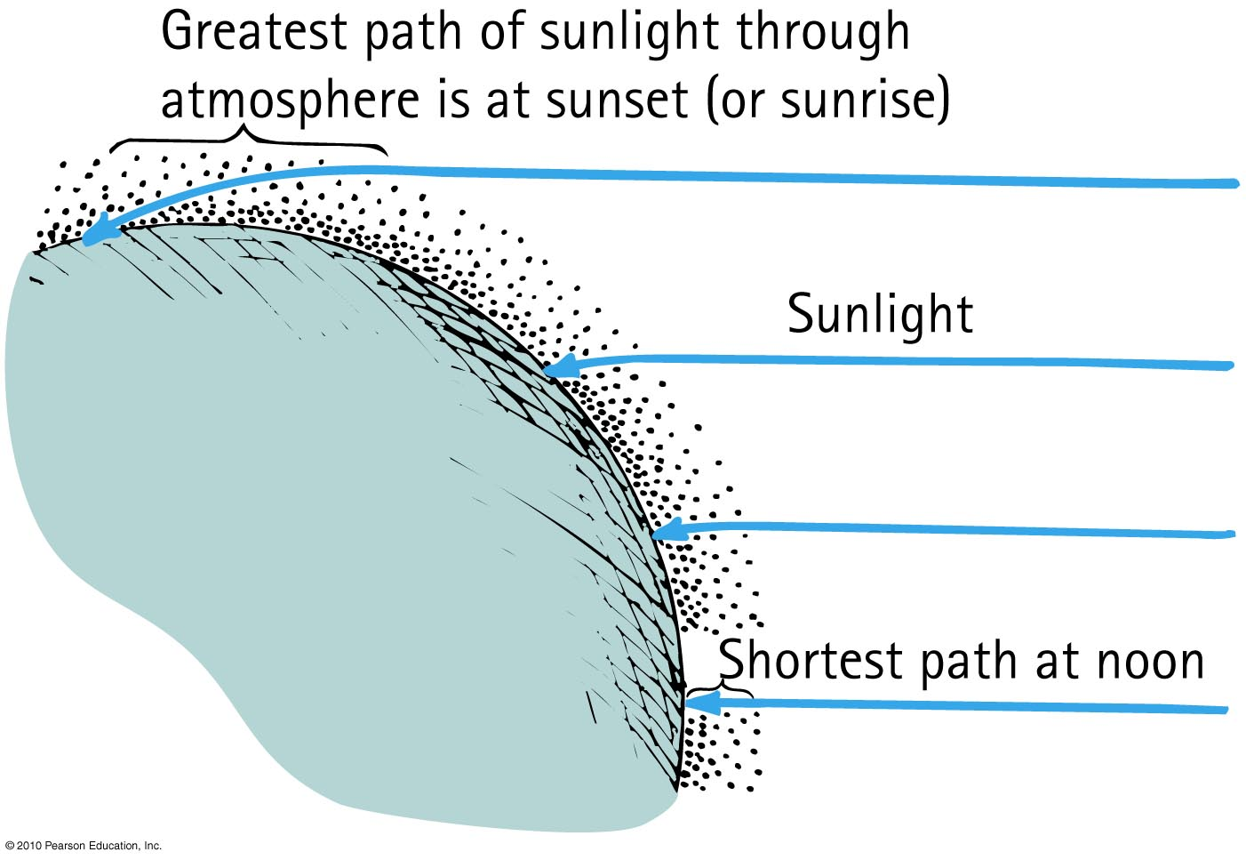
Why Sunsets Are Red
Light that is least scattered is light of low frequencies, which best travel straight through air.

Slide 13
If molecules in the sky scattered orange light instead of blue light, sunsets would be
Why Sunsets Are Red
CHECK YOUR NEIGHBOUR
A. orange.
yellow.
green.
blue.

Slide 14
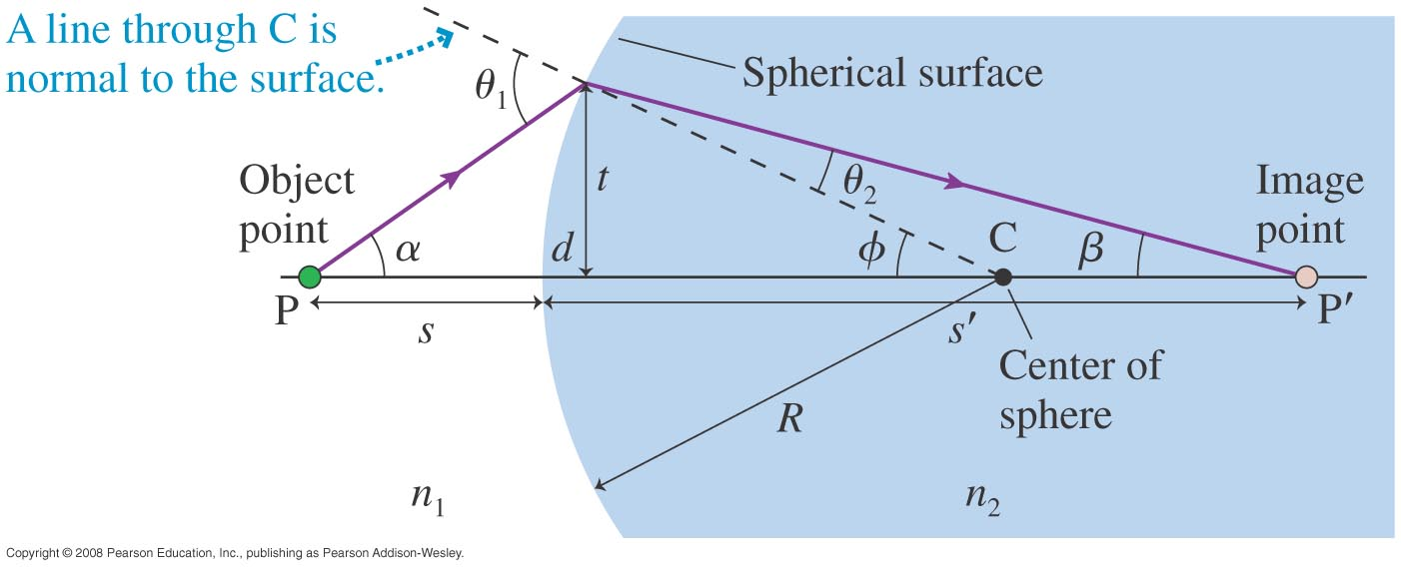
Image formation at a spherical interface
s_{o}
s_{i}
R is positive means surface is convex toward the object
R is negative means surface is concave toward object
s_{o} is positive means object is to the left of interface
s_{i} is positive means image is real, to the right of interface

Slide 15
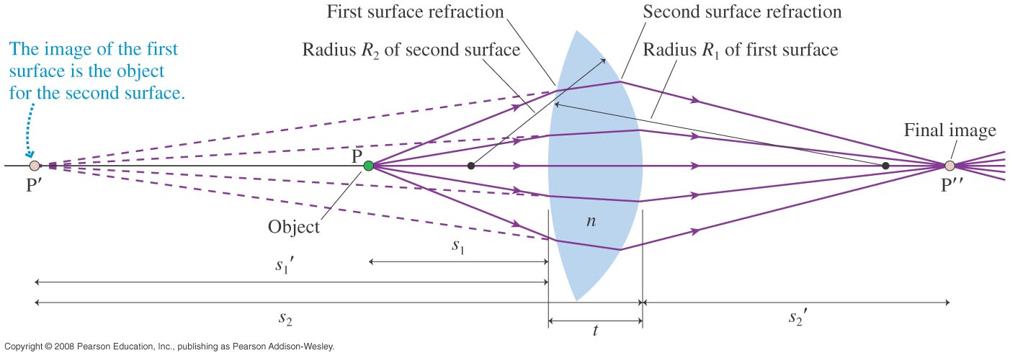
Lensmaker’s Formula
s_{o1}
s_{i1}
s_{o2}
s_{i2}

Slide 16
Converging Lens
Focal length, f
Focal Point
NOTE: Focal length is defined for initially parallel rays.

Slide 17
Diverging Lens
Negative Focal length, −f
Virtual Focal Point
Rays appear to emerge from Virtual Focal Point

Slide 18
QuickCheck 23.8
You can use the sun’s rays and a lens to start a fire. To do so, you should use
A converging lens.
A diverging lens.
Either a converging or a diverging lens will work if you use it correctly.
Notes:
18

Slide 19
Focusing Power
Traditionally, lenses are specified not by their focal length, but by the inverse of their focal length.
This is called “focusing power”
$$P=\frac{1}{f}$$
The S.I. unit of focusing power is m^{–1}
Traditionally, this unit is called the “diopter,” abbreviated D.
$$1 D=1 m^{−1}$$

Slide 20
Announcement
Test 1 is Tuesday Feb. 4th from 6:00-7:30pm.
Room To Be Announced
If you have a conflict with the above time, the alternate sitting will be from 4:30-6:00pm on Tuesday Feb. 4th
To register, students should submit the Alternate Sitting Registration Form, available now in the PHY132S Portal course menu.
The location will be emailed on Jan. 31 to the people who have registered.
You have until Jan. 30 at 4:00pm to do it (the form will not be available after).

Slide 21
Diverging rays through a Converging Lens
Focal length, f
If an object emits rays at the focal point, they end up being parallel on the other side of the converging lens.

Slide 22
f
What will happen to the rays emerging to the right of the lens if the face is moved a little closer to the lens?
They will remain parallel.
They will diverge (spread out).
They will converge (toward a focus).

Slide 23
f
What will happen to the rays emerging to the right of the lens if the face is moved a little further away from the lens?
They will remain parallel.
They will diverge (spread out).
They will converge (toward a focus).

Slide 24
Diverging rays through a Converging Lens
Focal length, f
s
s’
Thin Lens Equation:

Slide 25
Thin Lens Equation: sign conventions
object
image
f
s
s’
s is positive for objects to the left of lens, negative for objects to the right of lens (virtual objects).
s’ is positive for images to the right of lens, negative for images to the left of lens (virtual images).
f is positive for converging lenses, negative for diverging lenses.

Slide 26
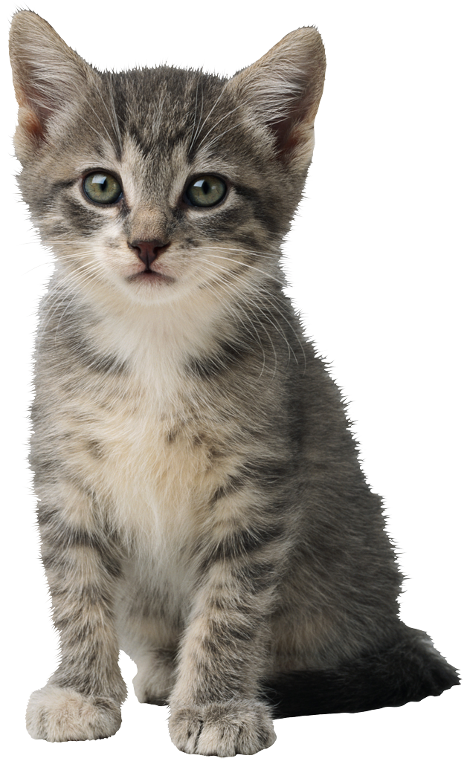
Example
+10D
A lens has a focal power of +10 D.
A 1 cm high object is placed 15 cm in front of the lens.
Where does the image form?
s = 15 cm
1 cm

Slide 27
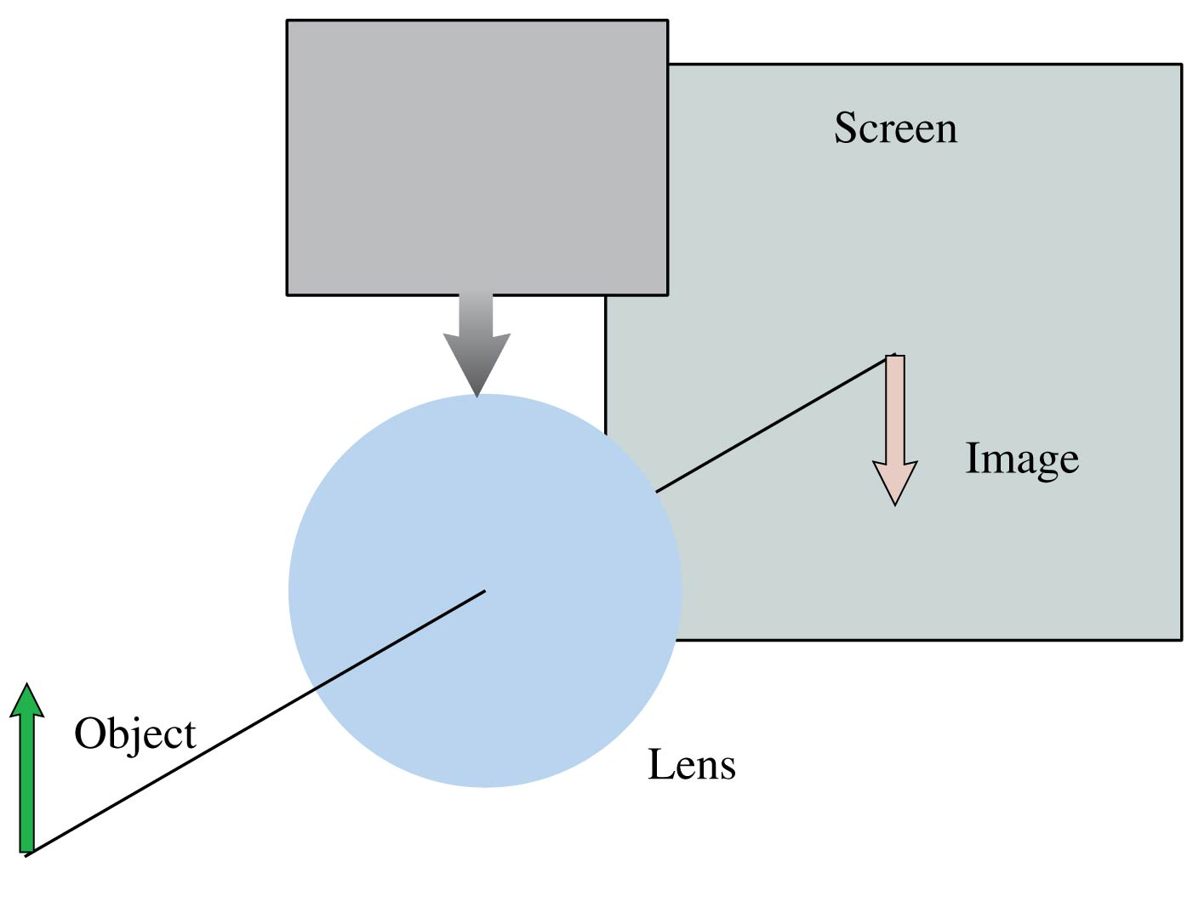
QuickCheck 23.10
A lens produces a sharply focused, inverted image on a screen. What will you see on the screen if a piece of dark paper is lowered to cover the top half of the lens?
An inverted but blurry image.
An image that is dimmer but otherwise unchanged.
Only the top half of the image.
Only the bottom half of the image.
No image at all.
Notes:
27

Slide 28
Lateral Magnification
The absolute magnitude of the magnification |M | is defined to be the ratio of image height to object height.
A positive value of M indicates that the image is upright relative to the object. A negative value of M indicates the image is inverted relative to the object.
Note that when s and s’ are both positive, M is negative.

Slide 29
Example
+10D
A lens has a focal power of +10 D.
A 1 cm high object is placed 15 cm in front of the lens.
How large is the image, and is it upright or inverted?
s = 15 cm
1 cm

Slide 30
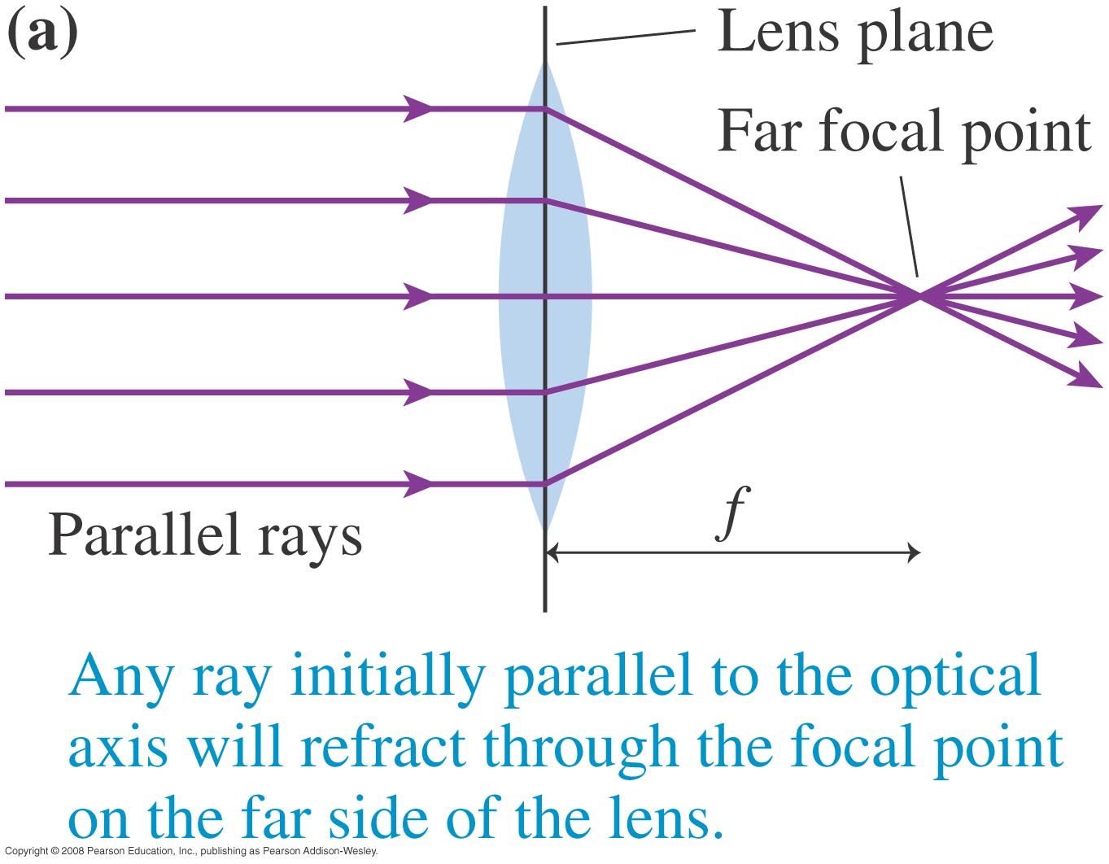
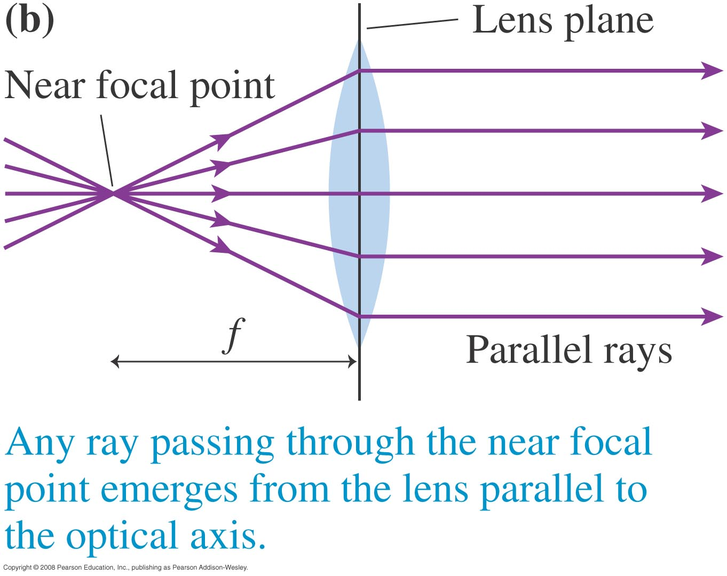
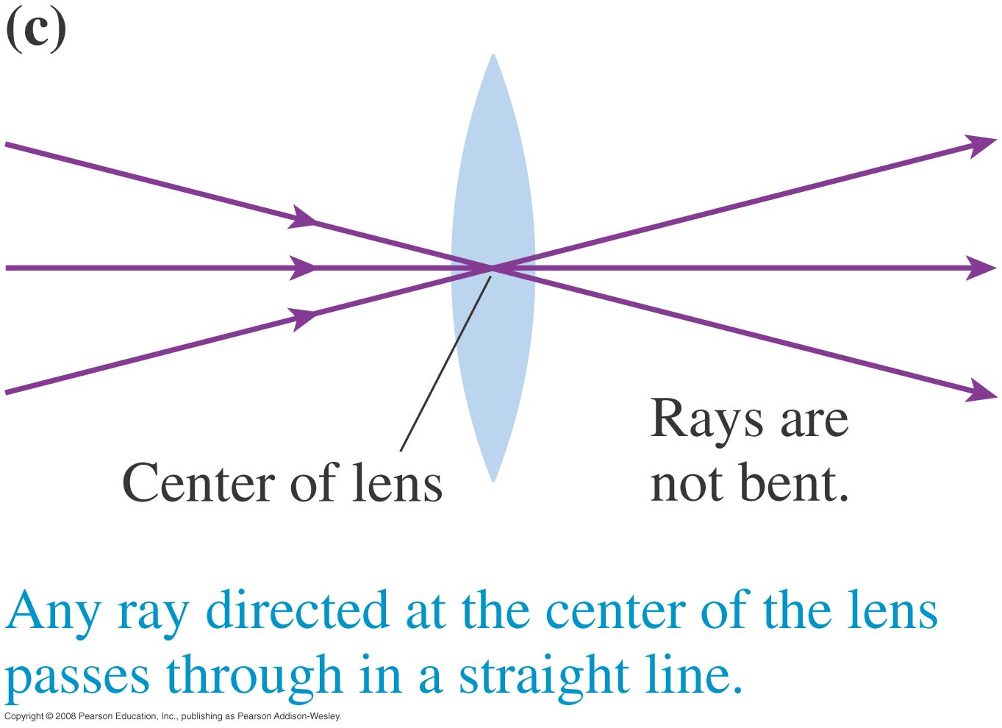
Ray Tracing
With a converging thin lens

Slide 31
Ray Tracing
With a diverging thin lens

Slide 32
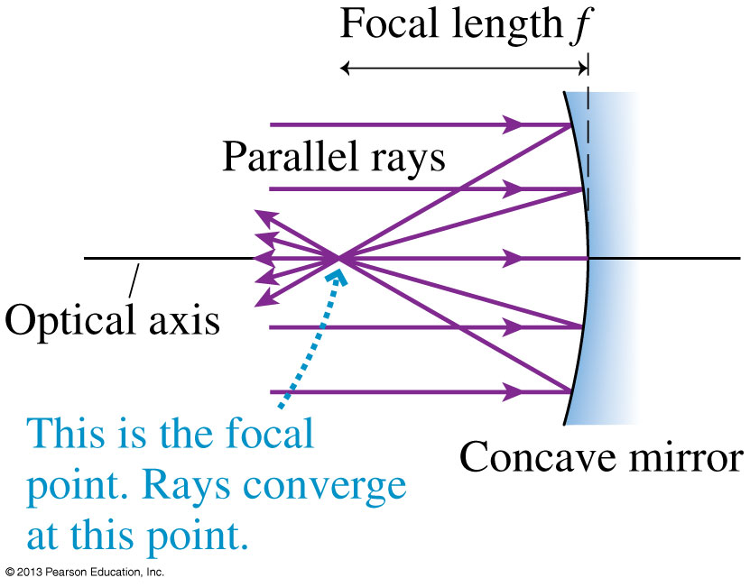
Image Formation with Concave Spherical Mirrors
The figure shows a concave mirror, a mirror in which the edges curve toward the light source.
Rays parallel to the optical axis reflect and pass through the focal point of the mirror.

Slide 33
$$f=\frac{R}{2}$$

Slide 34
No good focus
This is called “spherical abberation”
This focus only exists for rays that are close to the axis.

Slide 35
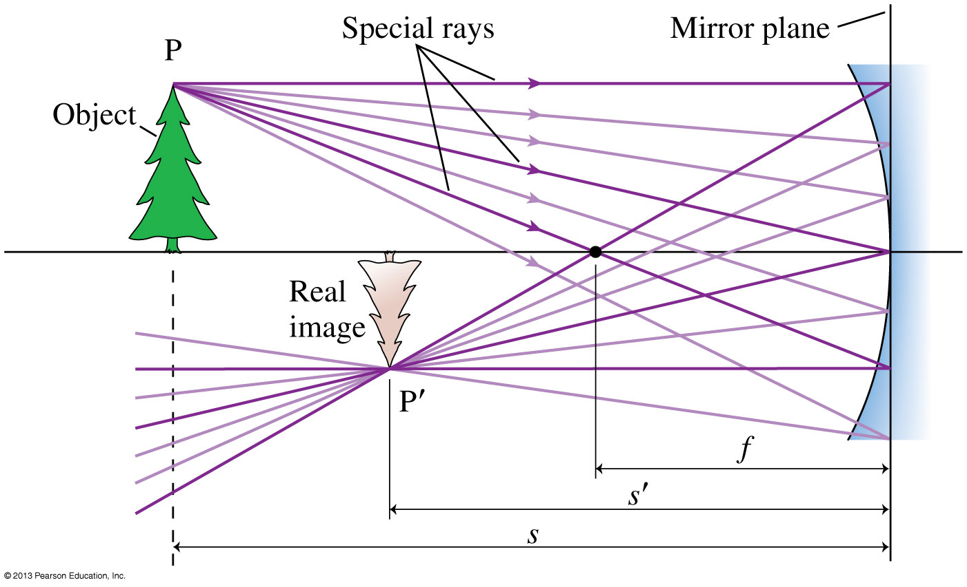
A Real Image Formed by a Concave Mirror

Slide 36
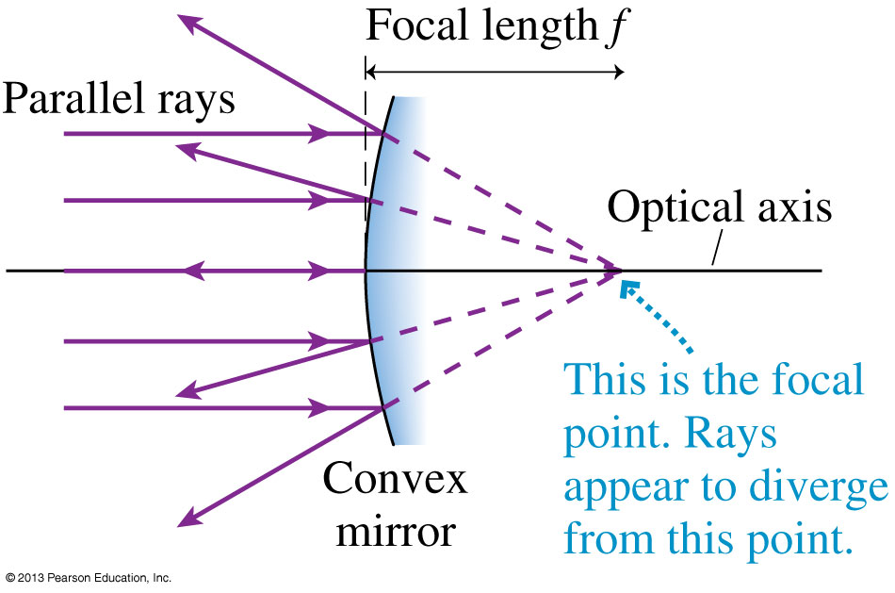
Image Formation with Convex Spherical Mirrors
The figure shows parallel light rays approaching a mirror in which the edges curve away from the light source.
This is called a convex mirror.
The reflected rays appear to come from a point behind the mirror.

Slide 37
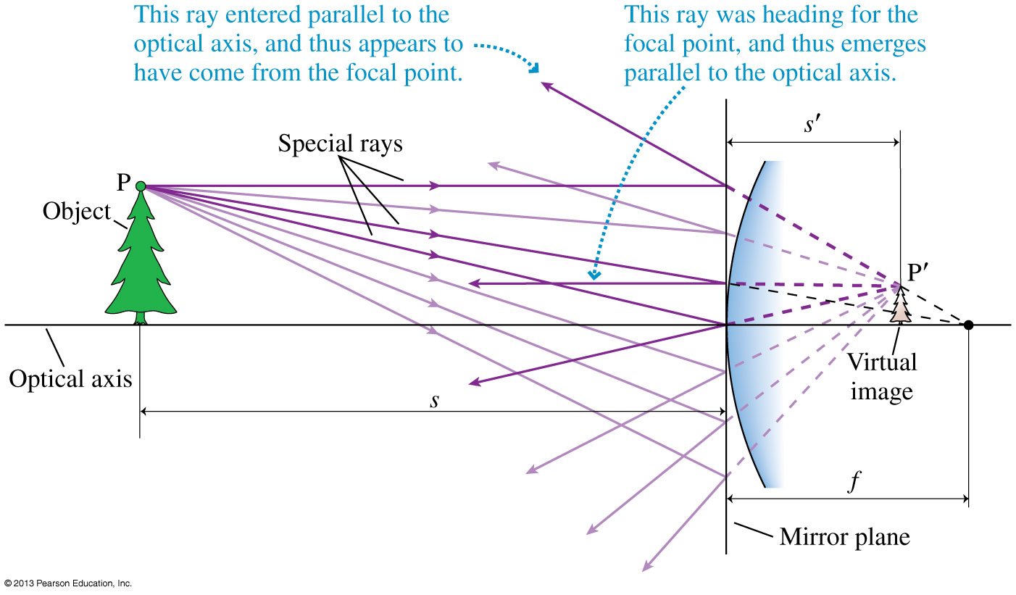
A Real Image Formed by a Convex Mirror

Slide 38
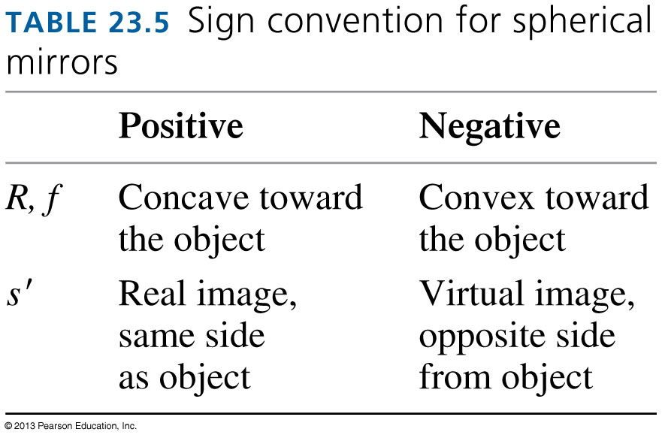
The Mirror Equation
For a spherical mirror with negligible thickness, the object and image distances are related by:
where the focal length f is related to the mirror’s radius of curvature by:

Slide 39
Clicker Question
You see an upright, magnified image of your face when you look into magnifying “cosmetic mirror.” The image is located
In front of the mirror’s surface.
On the mirror’s surface.
Behind the mirror’s surface.
Only in your mind because it’s a virtual image.
Notes:
39

Slide 40
Before Class 7 on Monday
Complete Problem Set 2 on MasteringPhysics due Sunday at 11:59pm on Ch. 23.
Please read Knight Pgs. 694-711: Ch.24
Please do the short pre-class quiz on MasteringPhysics by Sunday night.
Something to think about: When you look at an object with a telescope, it looks bigger. What, exactly, about the object is bigger? What are the units of image size?

