Slide 1
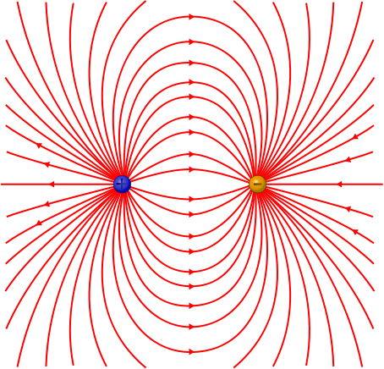
PHY132 Introduction to Physics II Class 9 – Outline:
Finishing off chapter 25, Starting chapter 26..
The Field Model
The Electric Field of a Point Charge, and many point charges

Slide 2
Class 9 Preclass Quiz on MasteringPhysics
Vocabulary:
60% got:The electric field of a charge is defined by the force on a positive probe charge.
98 % of students got: A charge alters the space around it. This alteration of space is called the Electric field.

Slide 3
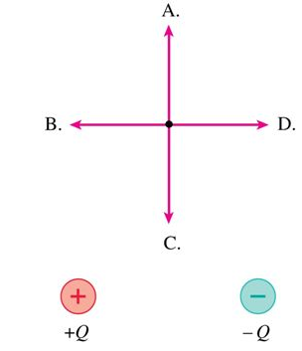
Class 9 Preclass Quiz on MasteringPhysics
77% of students got the electric field of a dipole question.

Slide 4
Class 9 Preclass Quiz – Student Comments…
“The difference between a test charge and a probe charge. What are their purposes and how do they differ? Can the electric field of a charge be canceled out by another charge?”
“Are positive and negative charges analogous to North and South poles on a magnet?”
“Can we go over why in electric fields the charge moves from positive to negative, I find this very confusing.”
Harlow answer: The electric field is in the direction that a positive probe charge would accelerate if placed there. Since like-charges repel, the electric field points away from positive source charges.

Slide 5
Class 9 Preclass Quiz – Student Comments…
Jokes:
“I once sat in an electric chair; it was a shocking experience.”
“I am so charged for the test!---->not really”
“What is the definition of a shock absorber? A careless electrician.”
“A neutron walks into a bar and asks how much drinks are. The bartender says ‘NO CHARGE!’”
“An electrician claimed that his truck was a volts wagon.”

Slide 6
Fun with Charge Conservation!!!
Identical metal spheres are initially charged as shown.
Spheres P and Q are touched together and then separated.
Then spheres Q and R are touched together and separated.
Afterward the charge on sphere R is
–1 nC or less.
–0.5 nC.
0 nC.
+0.5 nC.
+1.0 nC or more.
Notes:
6

Slide 7
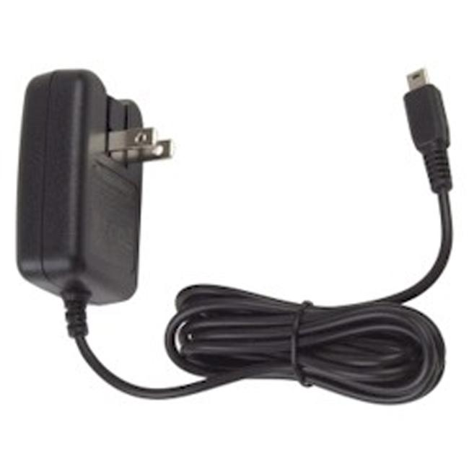
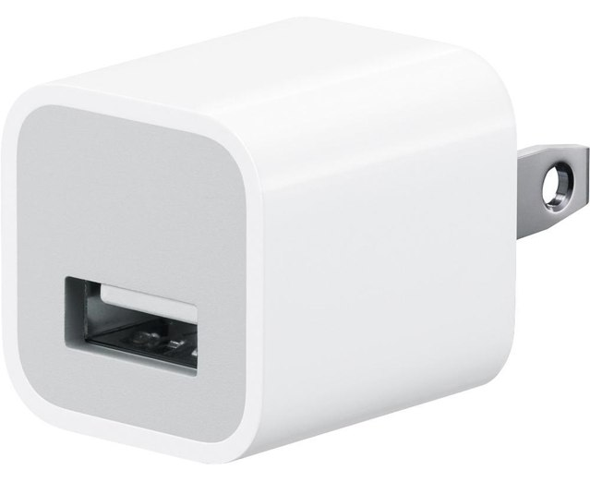
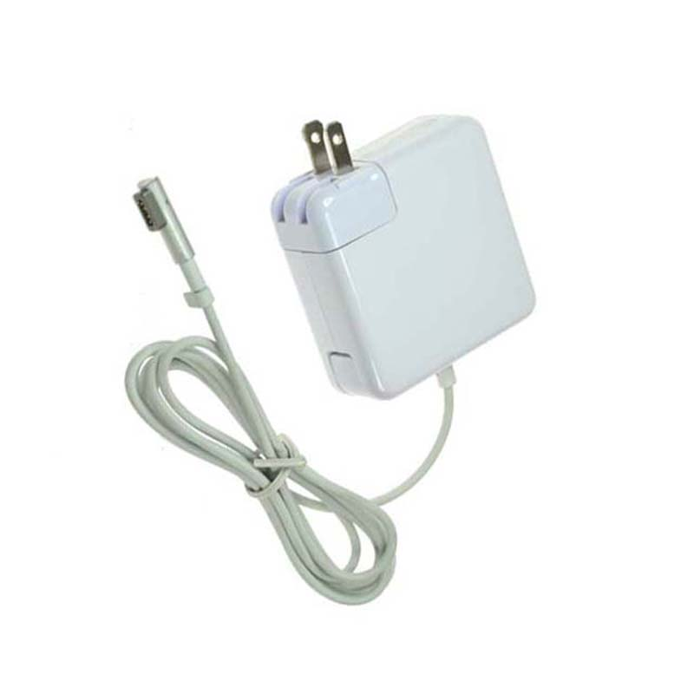
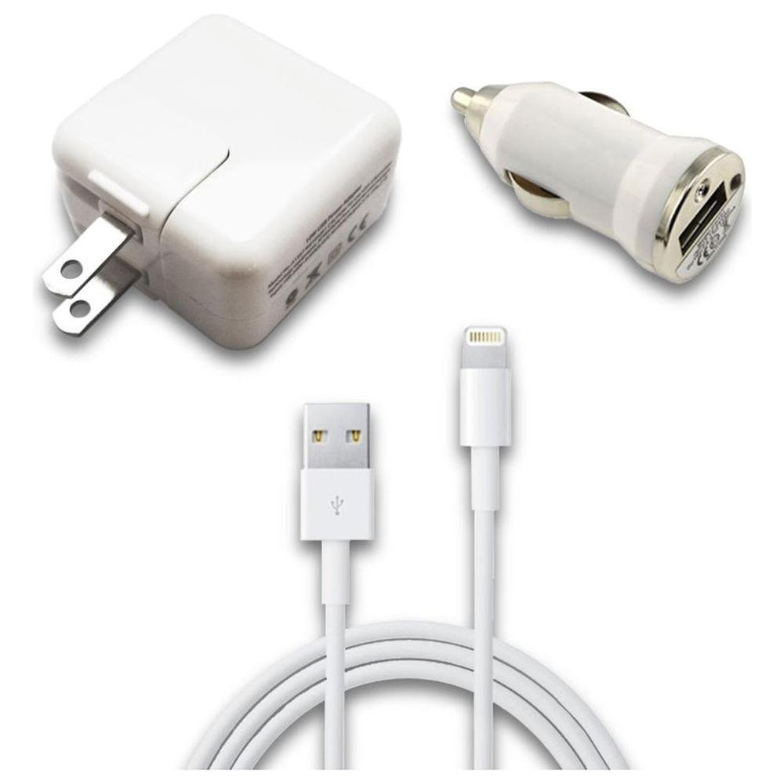
What is electric current?
It’s something to do with the electrons moving through the metal wires.
What is voltage?
Umm….

Slide 8
Our goal:
Circuits and
Ohm’s Law.
How do we get there?
Electric Charge, q
Electric Force, F
Electric Field, E
Electric Potential, V
Current and Ohm’s Law: ΔV = IR
You are here

Slide 9
Coulomb’s Law, and The Permittivity Constant
We can make many future equations easier to use if we rewrite Coulomb’s law in a somewhat more complicated way.
Let’s define a new constant, called the permittivity constant ₀:
∋
Rewriting Coulomb’s law in terms of ₀ gives us:
∋

Slide 10
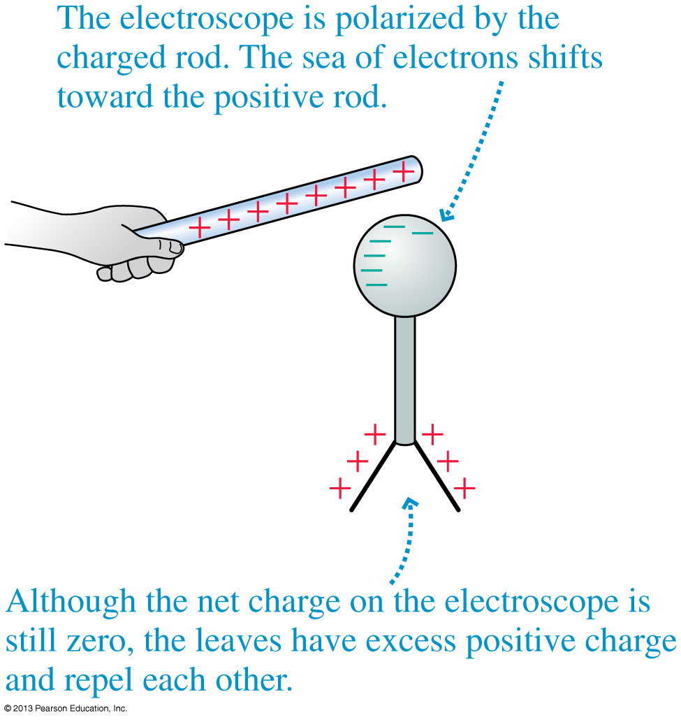
Charge Polarization
Charge polarization produces an excess positive charge on the leaves of the electroscope, so they repel each other.
Because the electroscope has no net charge, the electron sea quickly readjusts once the rod is removed.

Slide 11
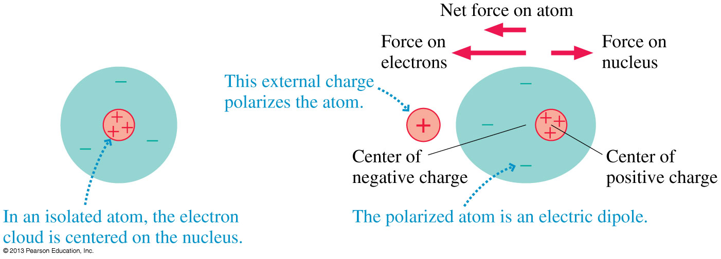
The Electric Dipole
Even a single atom can become polarized.
The figure below shows how a neutral atom is polarized by an external charge, forming an electric dipole.
Atom all alone:

Slide 12
The Electric Dipole
Even a single atom can become polarized.
The figure below shows how a neutral atom is polarized by an external charge, forming an electric dipole.
Atom near + charge:

Slide 13
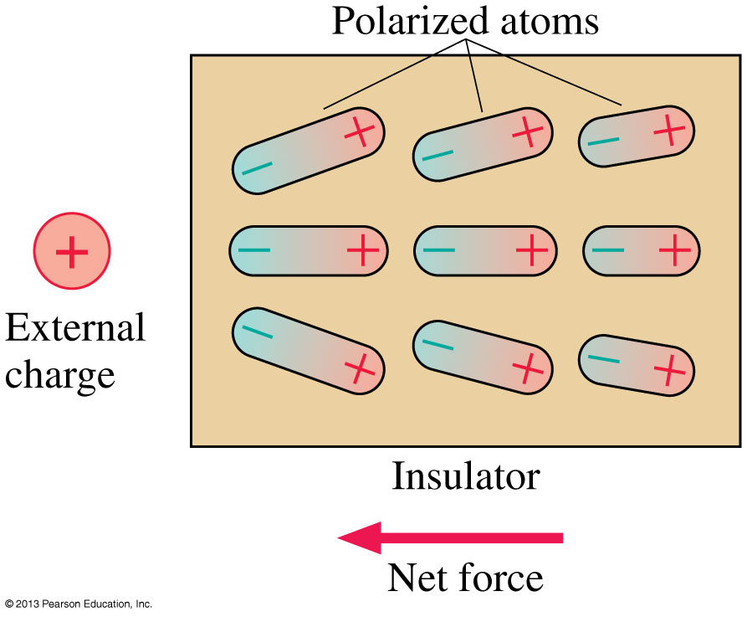
The Electric Dipole
When an insulator is brought near an external charge, all the individual atoms inside the insulator become polarized.
The polarization force acting on each atom produces a net polarization force toward the external charge.

Slide 14
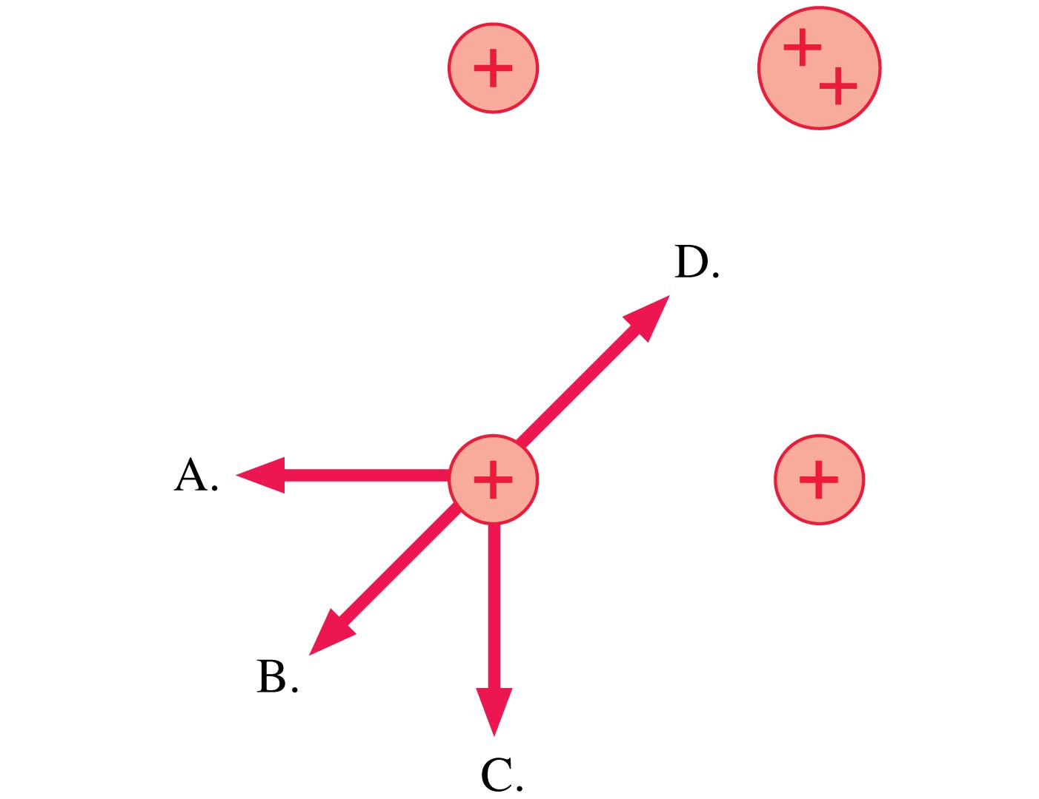
Thinking about Electric Force
Which is the direction of the net force on the charge at the lower left?
E. None of these.
Notes:
14

Slide 15
QuickCheck 25.11
Thinking about Electric Force
The direction of the force on charge –q is
Up.
Down.
Left.
Right.
The force on –q is zero.
Notes:
15

Slide 16
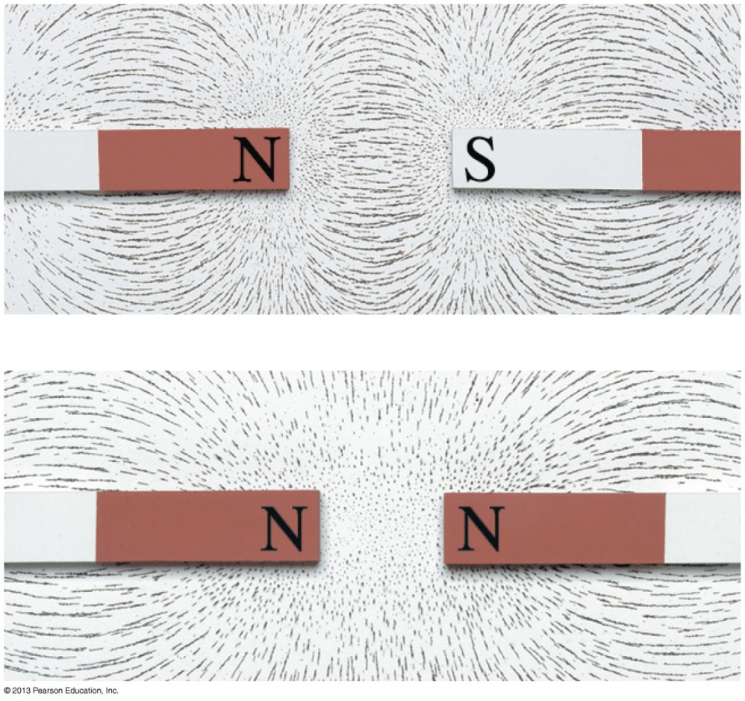
The Field Model
The photos show the patterns that iron filings make when sprinkled around a magnet.
These patterns suggest that space itself around the magnet is filled with magnetic influence.
This is called the magnetic field.
The concept of such a “field” was first introduced by Michael Faraday in 1821.

Slide 17
The Field Model
A field is a function that assigns a vector to every point in space.
The alteration of space around a mass is called the gravitational field.
Similarly, the space around a charge is altered to create the electric field.

Slide 18
The Electric Field
A charged particle with charge q at a point in space where the electric field is experiences an electric force:
If q is positive, the force on the particle is in the direction of .
The force on a negative charge is opposite the direction of .
The units of the electric field are N/C. The magnitude E of the electric field is called the electric field strength.

Slide 19
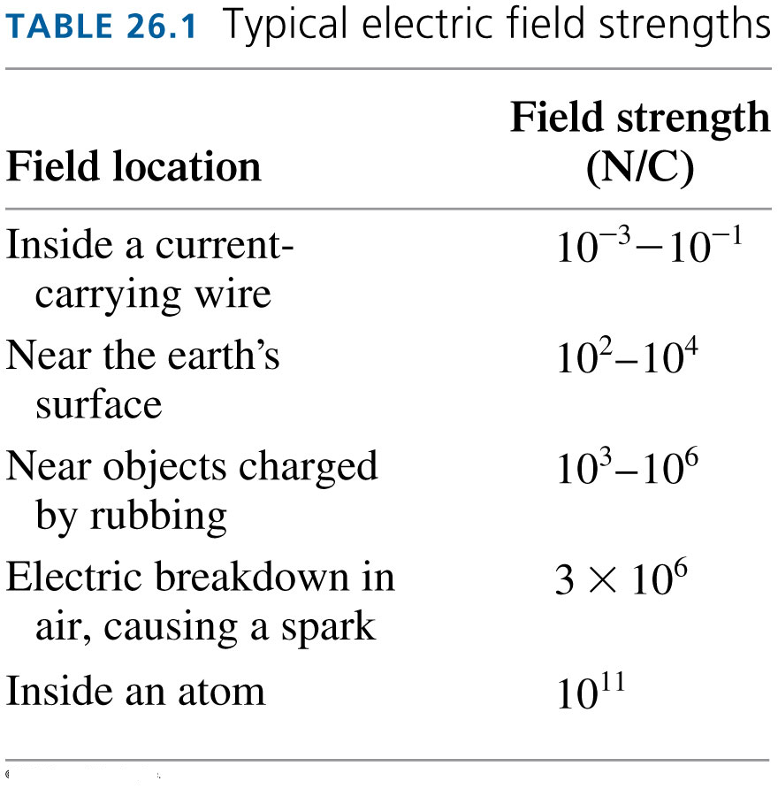

Slide 20
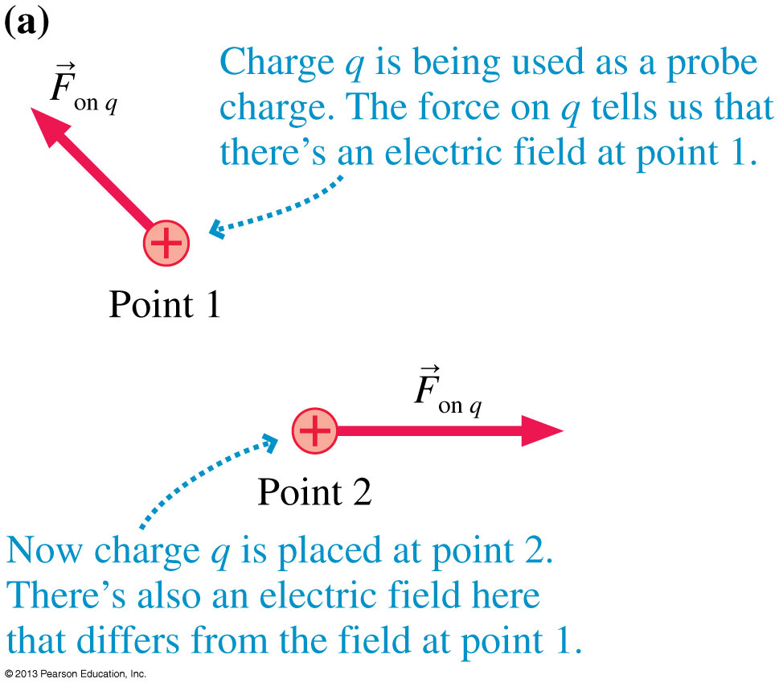
The Electric Force

Slide 21
The Electric Field

Slide 22
Example.
A 0.10 g honeybee has an electric charge.
There is a natural electric field near the earth’s surface of 100 N/C, downward.
What electric charge would the bee have to have to hang suspended in the air, without even flapping her wings?

Slide 23
The Electric Field of a Point Charge
The electric field at a distance r away from a point charge, q, is given by:

Slide 24
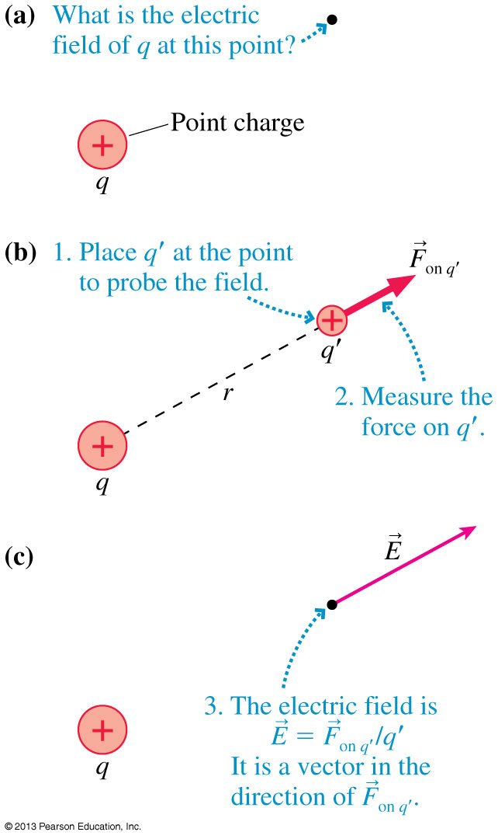
The Electric Field of a Point Charge

Slide 25
The Electric Field of a Point Charge

Slide 26
The Electric Field of a Point Charge

Slide 27
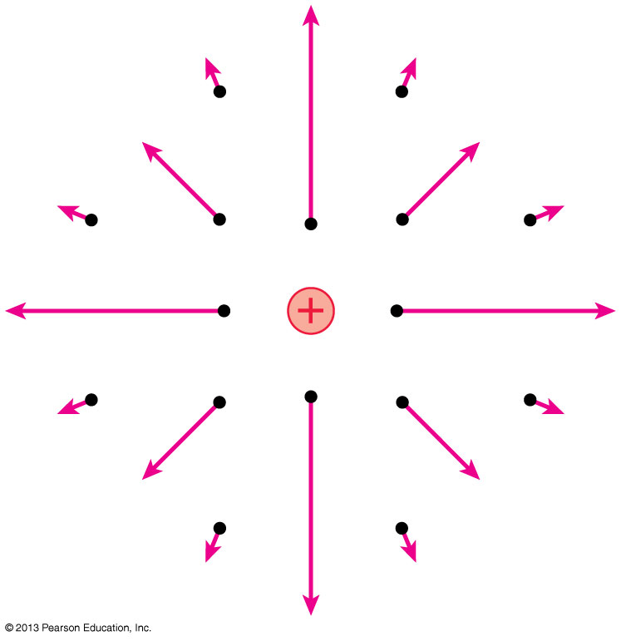
The Electric Field of a Point Charge
If we calculate the field at a sufficient number of points in space, we can draw a field diagram.
Notice that the field vectors all point straight away from charge q.
Also notice how quickly the arrows decrease in length due to the inverse-square dependence on r.

Slide 28
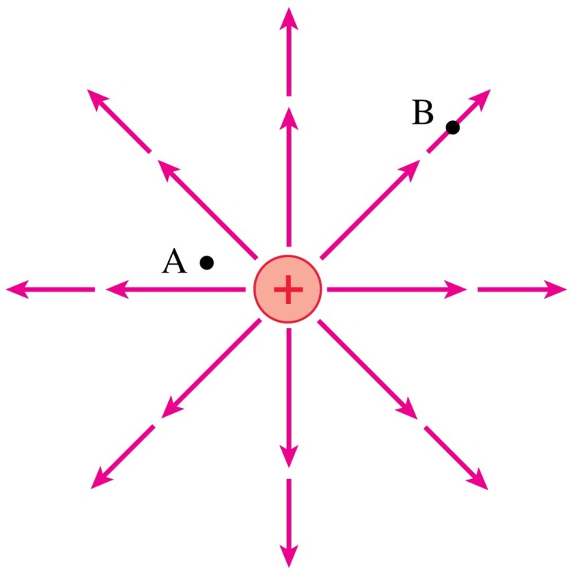
QuickCheck 25.12
At which point is the electric field stronger?
Point A.
Point B.
Not enough information to tell.
Notes:
28

Slide 29
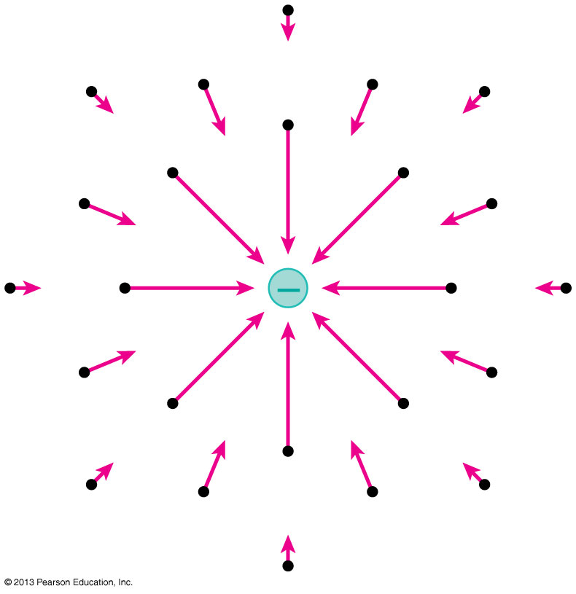
The Electric Field of a Point Charge
Using unit vector notation, the electric field at a distance r from a point charge q is:
A negative sign in front of a vector simply reverses its direction.
The figure shows the electric field of a negative point charge.

Slide 30
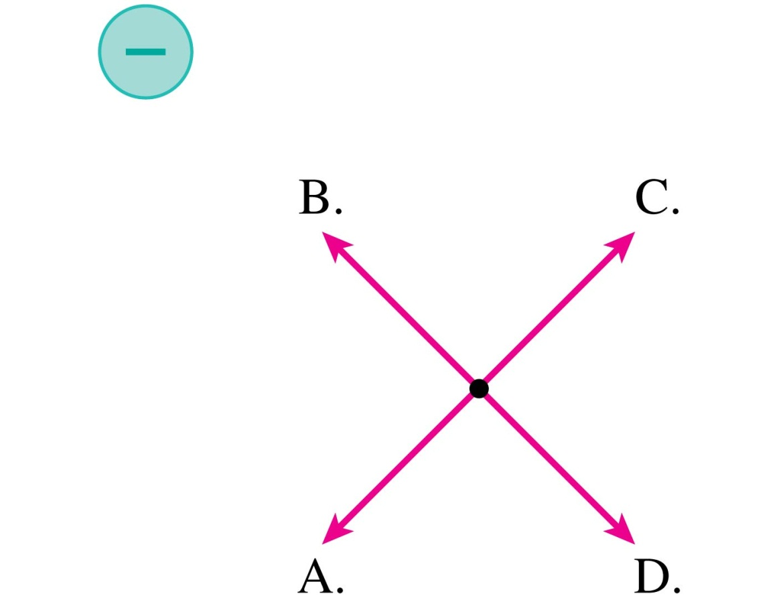
QuickCheck 25.14
Which is the electric field at the dot?
E. None of these.
Notes:
30

Slide 31
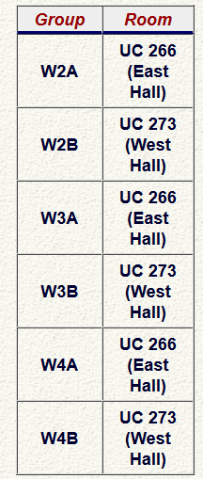
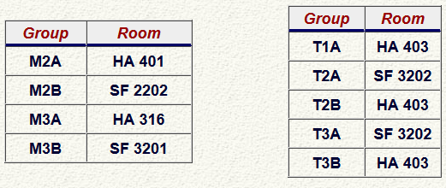
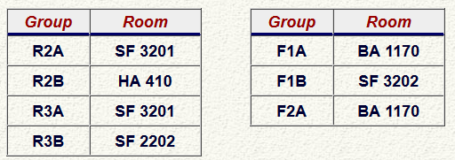
Test 1 is Tomorrow from 6:00-7:30pm.
Room is based on your Practical Group.

Slide 32
What will tomorrow evening’s test cover?
Test 1 is on:
Knight Chs. 20, 21, 23, 24 and 25 .
The midterm test will have:
8 multiple-choice questions
2 unrelated long-answer problems counting for a total of 16 marks, which will be graded in detail; part marks may be awarded, but only if you show your work.

Slide 33
Test 1 on Tuesday Evening
Please bring:
Your student card.
A calculator without any communication capability.
A single, original, handwritten 8 1/2 × 11 inch sheet of paper on which you may have written anything you wish, on both sides. You may also type it if you wish, but it must be prepared by you. No photocopies.
A ruler

Slide 34
The Electric Field of Multiple Point Charges
Suppose the source of an electric field is a group of point charges q₁, q₂, …
The net electric field E_{net} at each point in space is a superposition of the electric fields due to each individual charge:

Slide 35
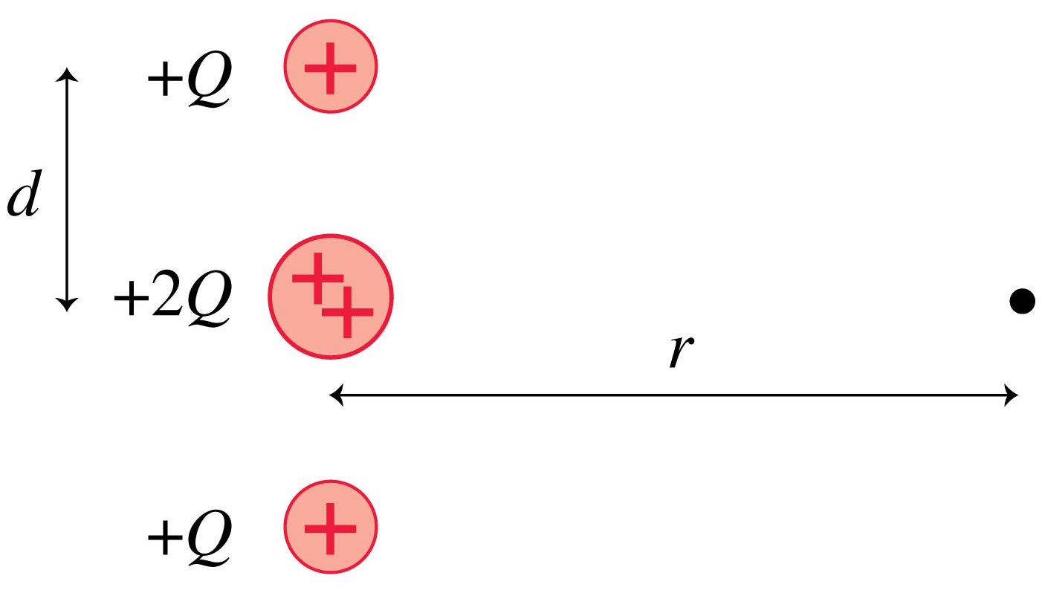
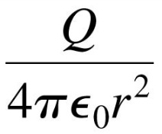
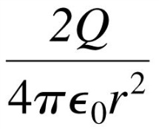
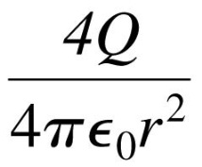
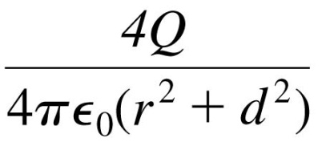
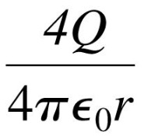
QuickCheck 26.3
When r >> d, the electric field strength at the dot is
A.
B.
C.
D.
E.
Notes:
35

Slide 36
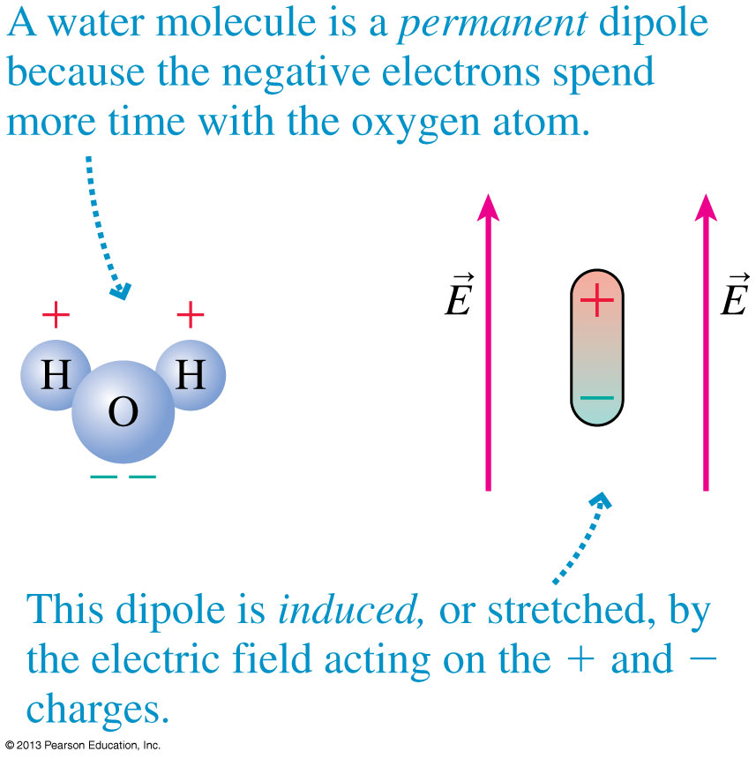
Electric Dipoles
Two equal but opposite charges separated by a small distance form an electric dipole.
The figure shows two examples.

Slide 37
The Dipole Moment
It is useful to define the dipole moment p, shown in the figure, as the vector:
The SI units of the dipole moment are C m.

Slide 38
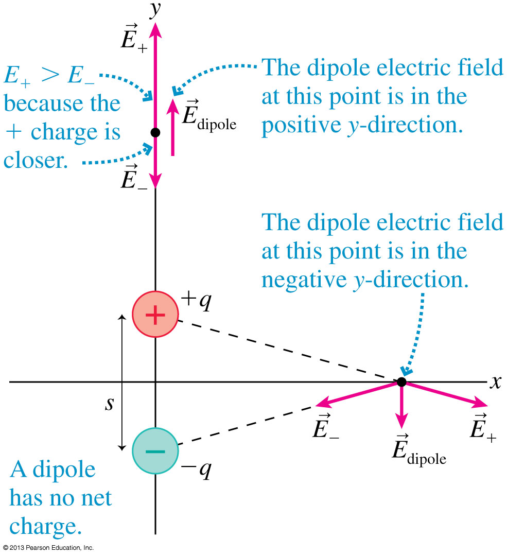
The Dipole Electric Field at Two Points

Slide 39
The Electric Field of a Dipole
The electric field at a point on the axis of a dipole is:
where r is the distance measured from the center of the dipole.
The electric field in the plane that bisects and is perpendicular to the dipole is
This field is opposite to the dipole direction, and it is only half the strength of the on-axis field at the same distance.

Slide 40
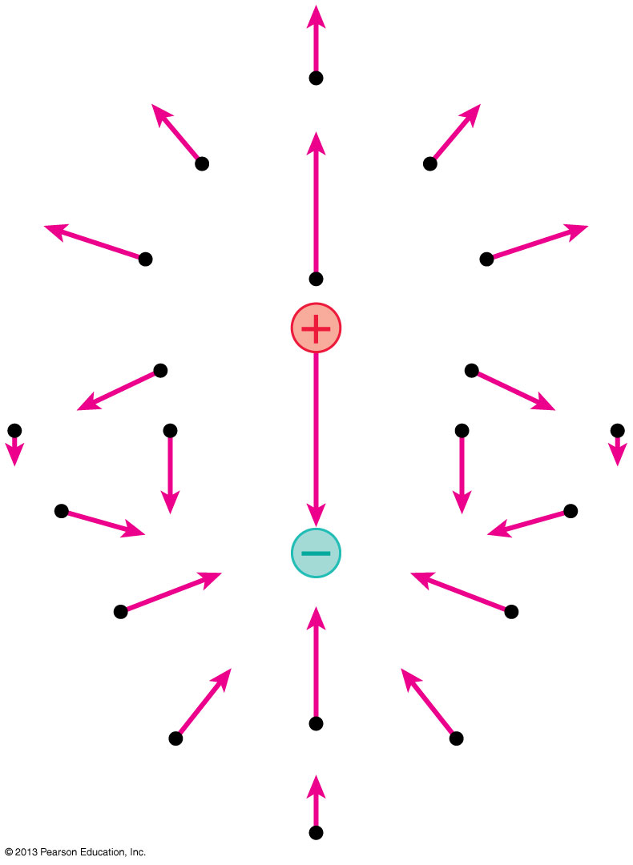
The Electric Field of a Dipole
This figure represents the electric field of a dipole as a field-vector diagram.

Slide 41
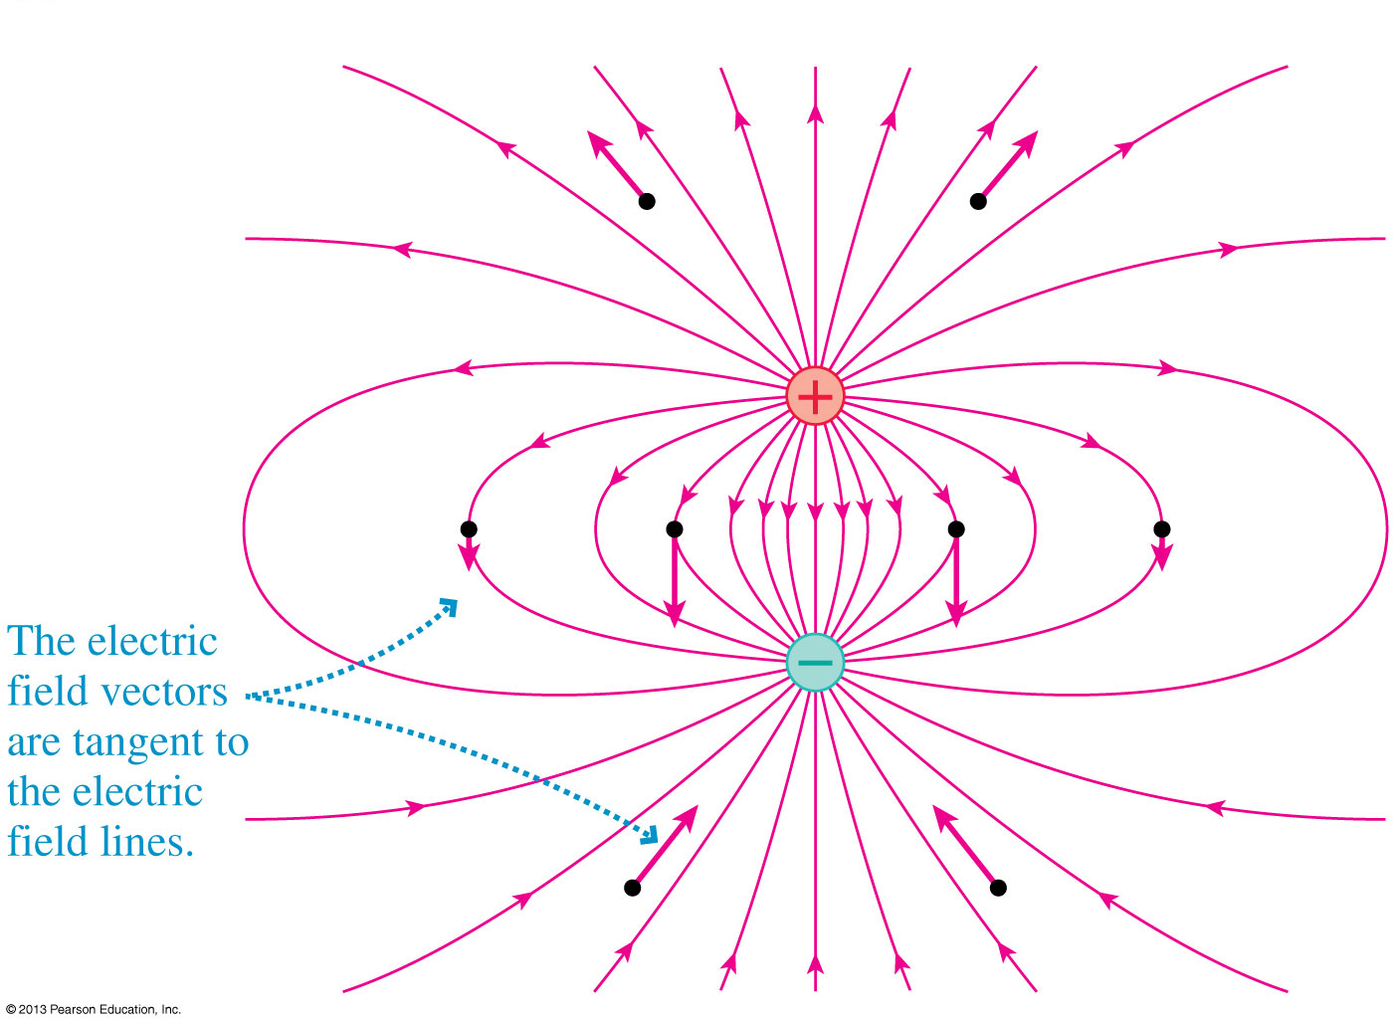
The Electric Field of a Dipole
This figure represents the electric field of a dipole using electric field lines.

Slide 42
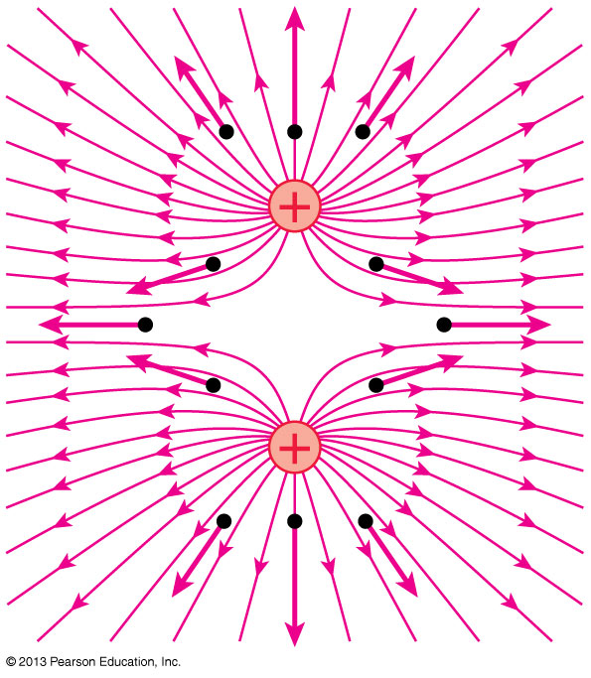
The Electric Field of Two Equal Positive Charges
This figure represents the electric field of two same-sign charges using electric field lines.

Slide 43
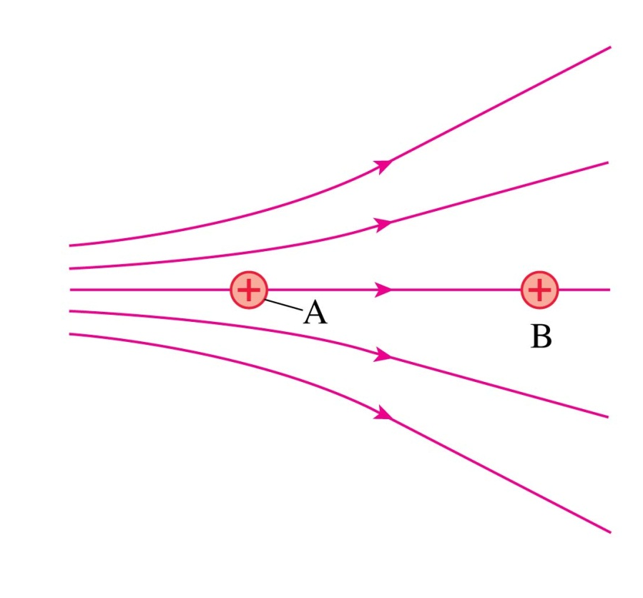
QuickCheck 26.4
Two protons, A and B, are in an electric field. Which proton has the larger acceleration?
Proton A.
Proton B.
Both have the same acceleration.
Notes:
43

Slide 44
Before Class 10 on Wednesday
There is NO pre-class quiz due on Wednesday morning.
However, if you could read over the rest of Chapter 26 before coming to class on Wednesday, I would appreciate it.
Something to think about: What causes lightning? If the ground is neutral and the cloud-cover is positive, is lightning the electrons jumping up to the clouds?
Good luck on the test tomorrow night!

