Slide 1
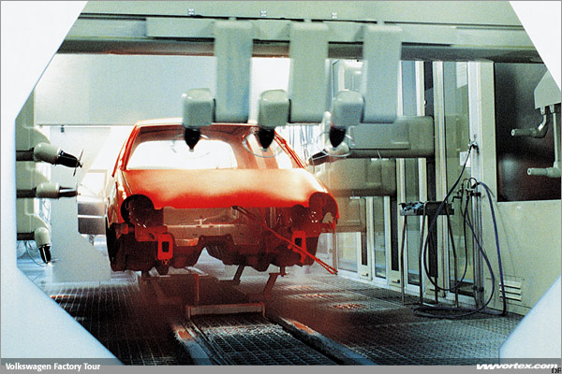
PHY132 Introduction to Physics II
Class 10 – Outline:
Finishing off chapter 26
Electric Field of:
  Continuous Charge Distribution
  Rings, Planes and Spheres
  Parallel Plate Capacitor
Volkswagon Factory Tour: Ionized paint droplets are transferred in an electrostatic field to the body, and adheres to the metal in an even coat.
Motion of a Charged Particle in an Electric Field
Motion of a Dipole in an Electric Field
Image from http://www.vwvortex.com/artman/publish/vortex_news/article_329.shtml?page=4

Slide 2
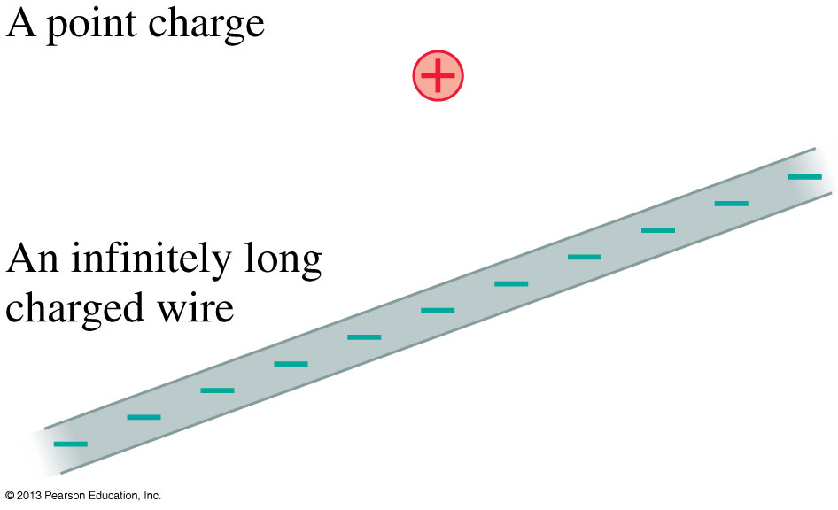
Electric Field Models
Most of this chapter will be concerned with the sources of the electric field.
We can understand the essential physics on the basis of simplified models of the sources of electric field.
The drawings show models of a positive point charge and an infinitely long negative wire.
We also will consider an infinitely wide charged plane and a charged sphere.

Slide 3
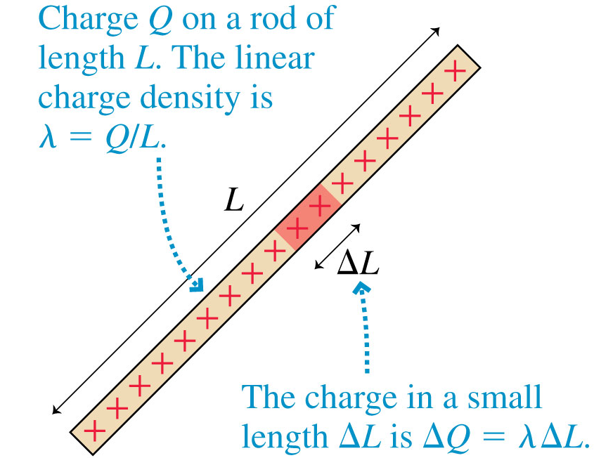
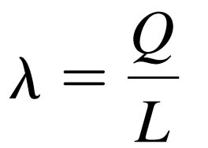
Continuous Charge Distributions
The linear charge density of an object of length L and charge Q is defined as
Linear charge density, which has units of C/m, is the amount of charge per meter of length.

Slide 4
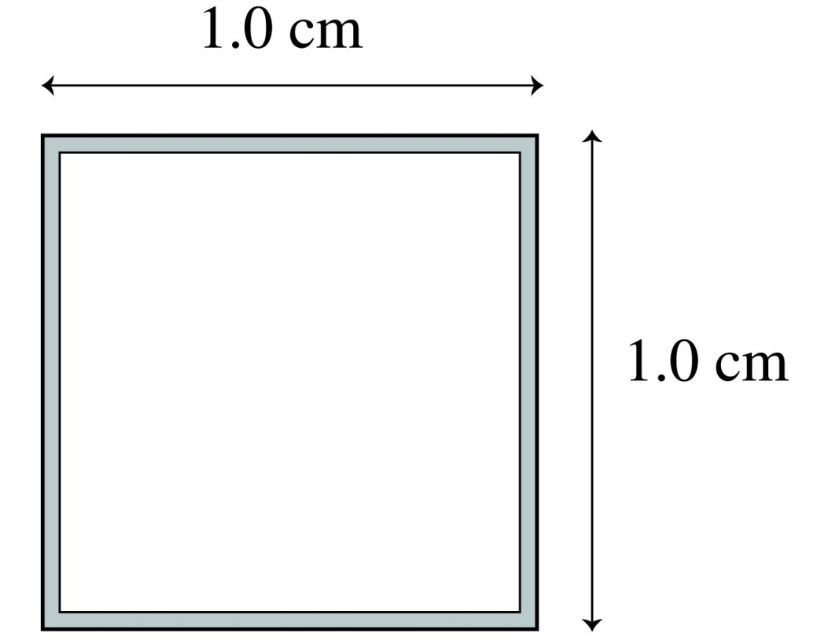
QuickCheck 26.6
If 8 nC of charge are placed on the square loop of wire, the linear charge density will be
800 nC/m.
400 nC/m.
200 nC/m.
8 nC/m.
2 nC/m.
Notes:
4

Slide 5
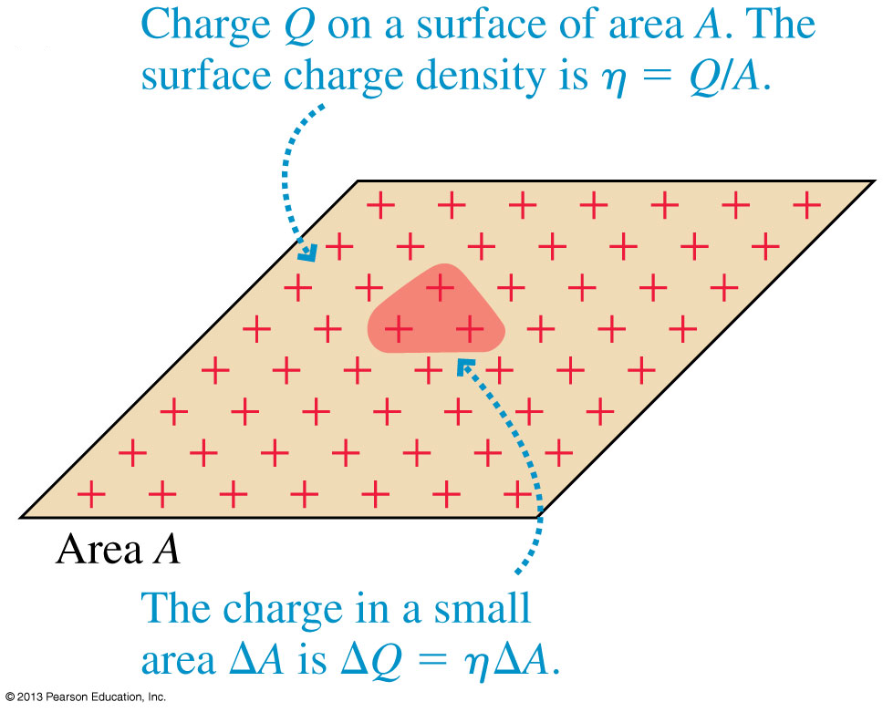
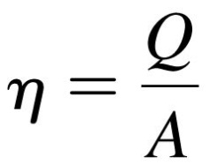
Continuous Charge Distributions
The surface charge density of a two-dimensional distribution of charge across a surface of area A is defined as:
Surface charge density, with units C/m², is the amount of charge per square meter.

Slide 6
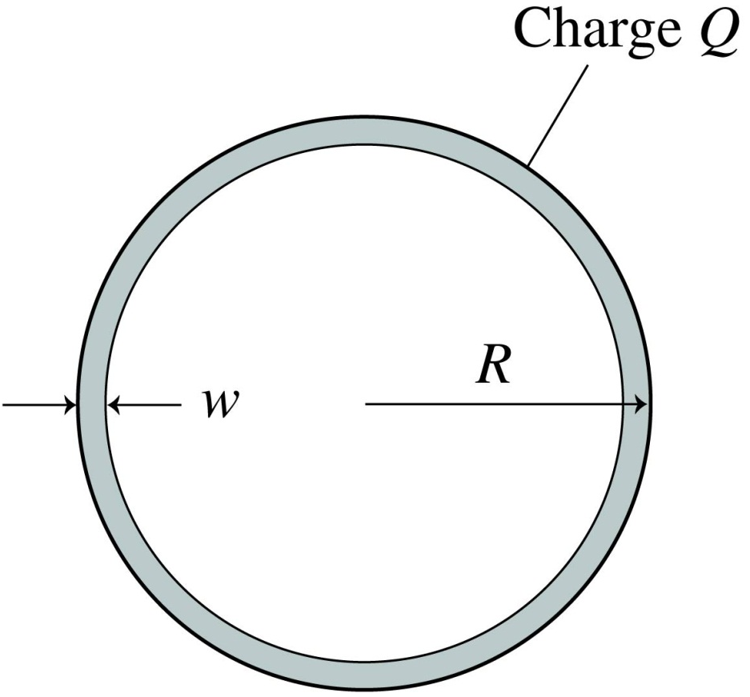
QuickCheck 26.7
A flat circular ring is made from a very thin sheet of metal. Charge Q is uniformly distributed over the ring. Assuming w << R, the surface charge density η on the top side, facing out of the page, is
Q/2πRw.
Q/4πRw.
Q/πR².
Q/2πR².
Q/πRw.
Notes:
6

Slide 7
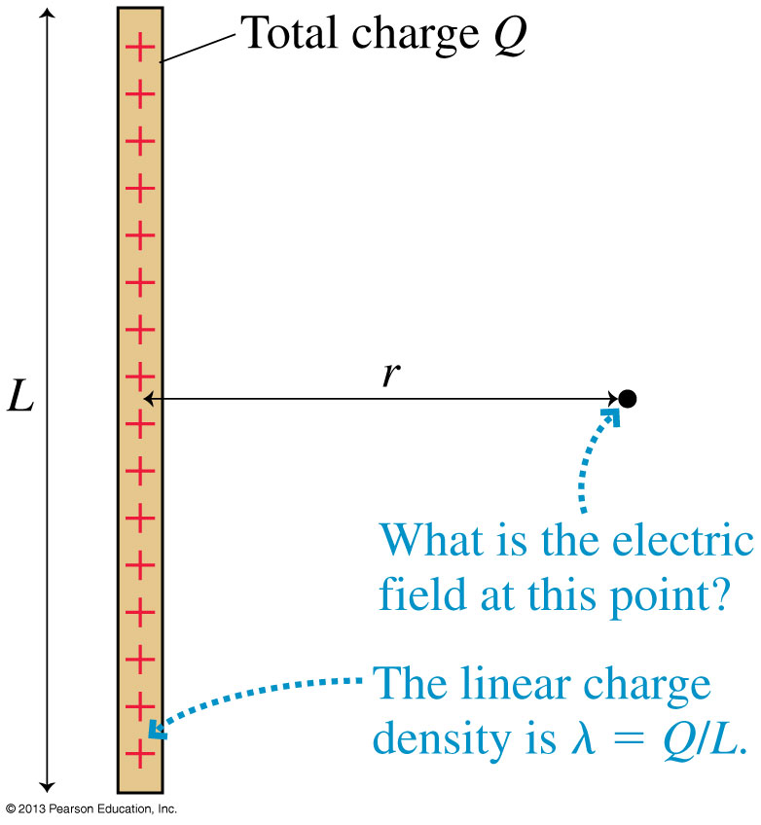
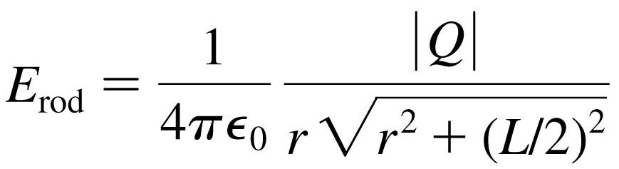
The Electric Field of a Finite Line of Charge
The Electric Field of a Finite Line of Charge
The electric field strength at a radial distance r in the plane that bisects a rod of length L with total charge Q:

Slide 8
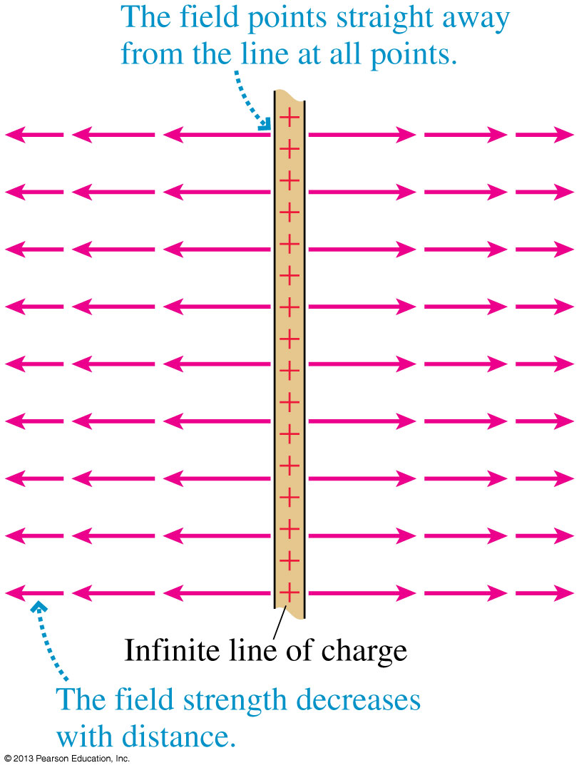
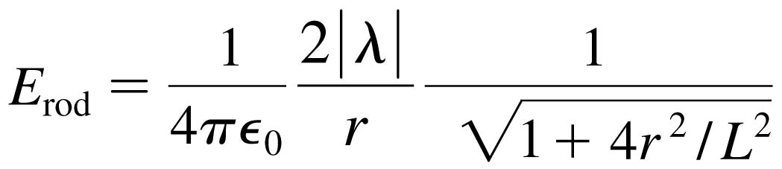

An Infinite Line of Charge
The electric field of a thin, uniformly charged rod may be written:
If we now let L → ∞, the last term becomes simply 1 and we’re left with:

Slide 9
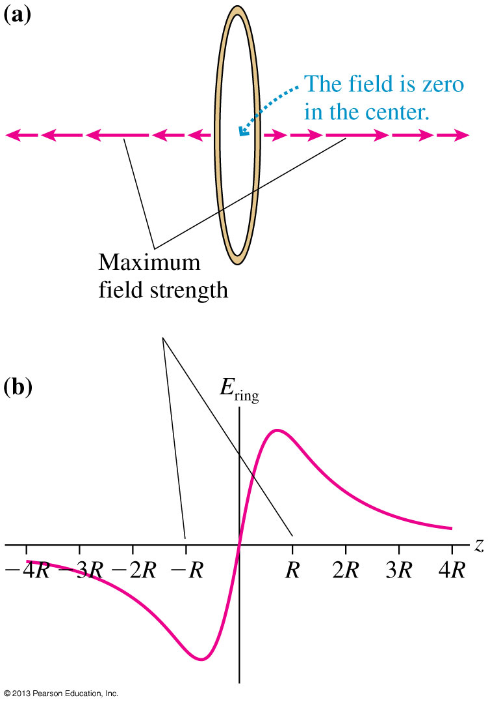
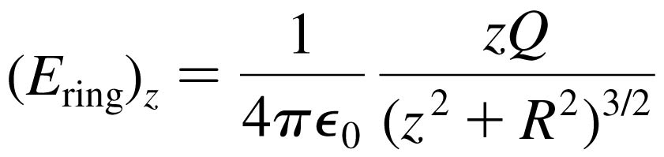
A Ring of Charge
Consider the on-axis electric field of a positively charged ring of radius R.
Define the z-axis to be the axis of the ring.
The electric field on the
z-axis points away from the center of the ring, increasing in strength until reaching a maximum when |z| ≈ R, then decreasing:

Slide 10
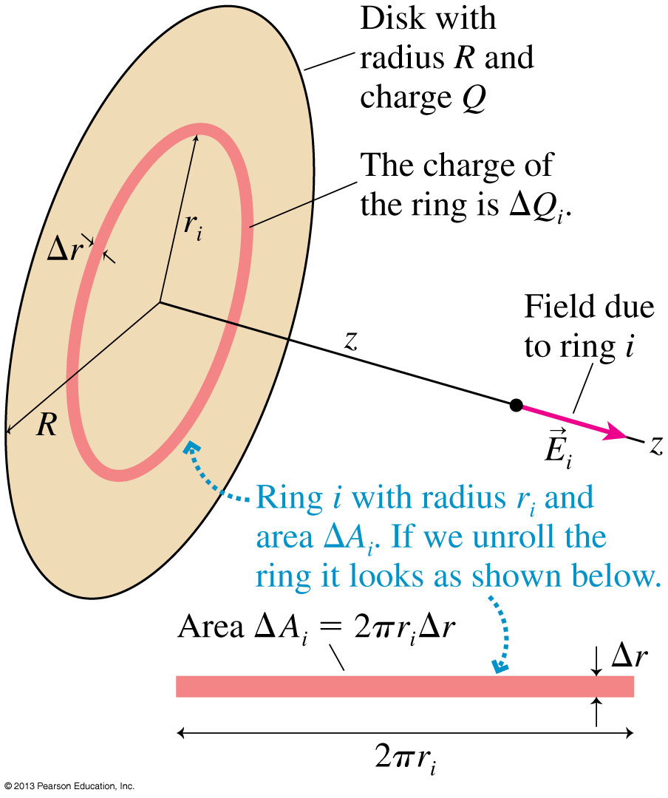

A Disk of Charge
Consider the on-axis electric field of a positively charged disk of radius R.
Define the z-axis to be the axis of the disk.
The electric field on the
z-axis points away from the center of the disk, with magnitude:

Slide 11
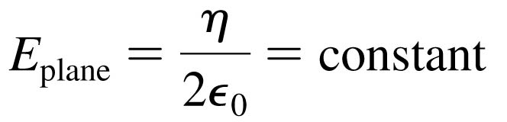
A Plane of Charge
The electric field of a plane of charge is found from the on-axis field of a charged disk by letting the radius R → ∞.
The electric field of an infinite plane of charge with surface charge density η is:
For a positively charged plane, with η > 0, the electric field points away from the plane on both sides of the plane.
For a negatively charged plane, with η < 0, the electric field points towards the plane on both sides of the plane.

Slide 12
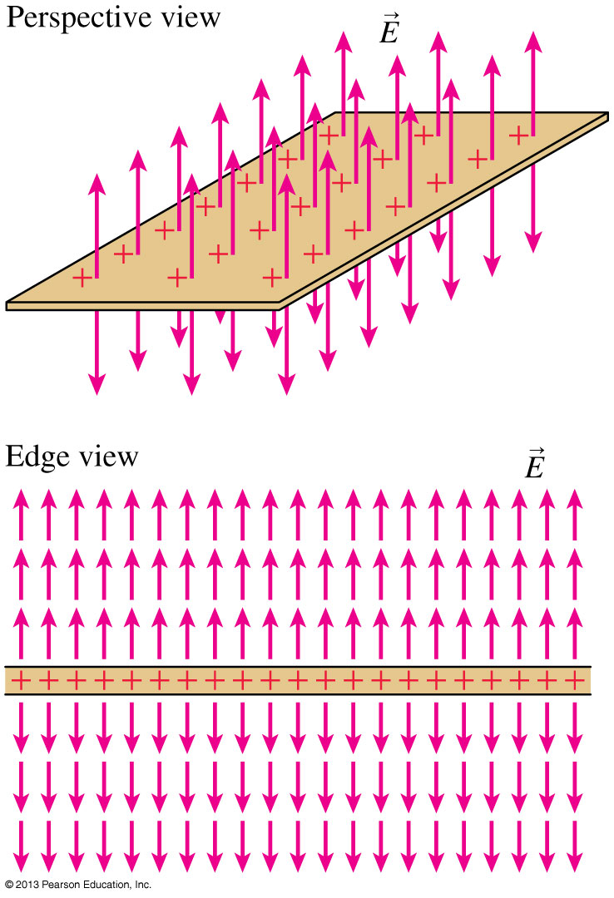
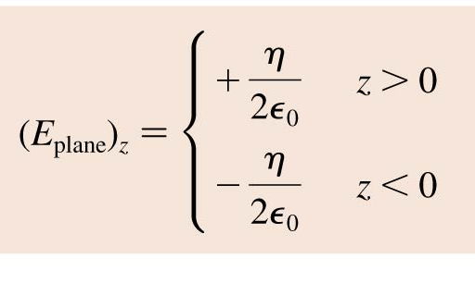
A Plane of Charge

Slide 13
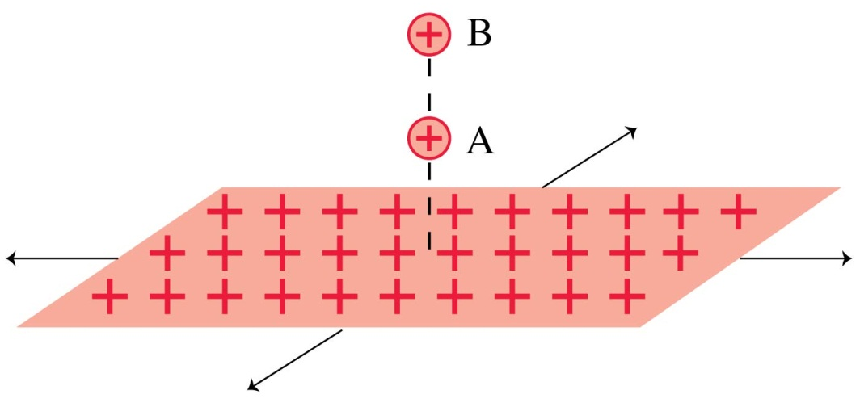
QuickCheck 26.9
Two protons, A and B, are next to an infinite plane of positive charge. Proton B is twice as far from the plane as proton A. Which proton has the larger acceleration?
Proton A.
Proton B.
Both have the same acceleration.
Notes:
13

Slide 14
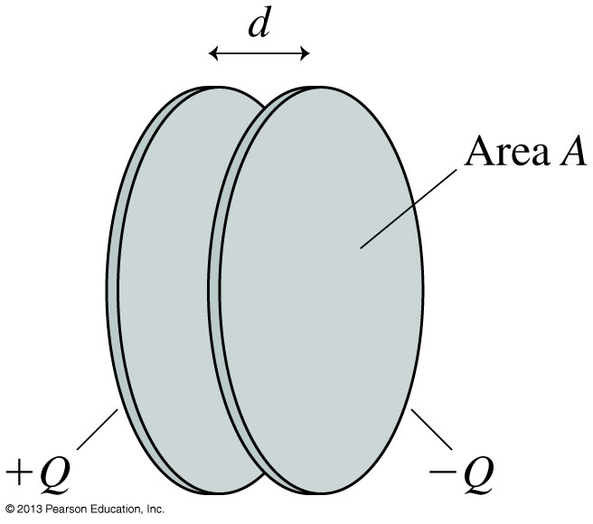
The Parallel-Plate Capacitor
The figure shows two electrodes, one with charge +Q and the other with −Q placed face-to-face a distance d apart.
This arrangement of two electrodes, charged equally but oppositely, is called a parallel-plate capacitor.
Capacitors play important roles in many electric circuits.

Slide 15
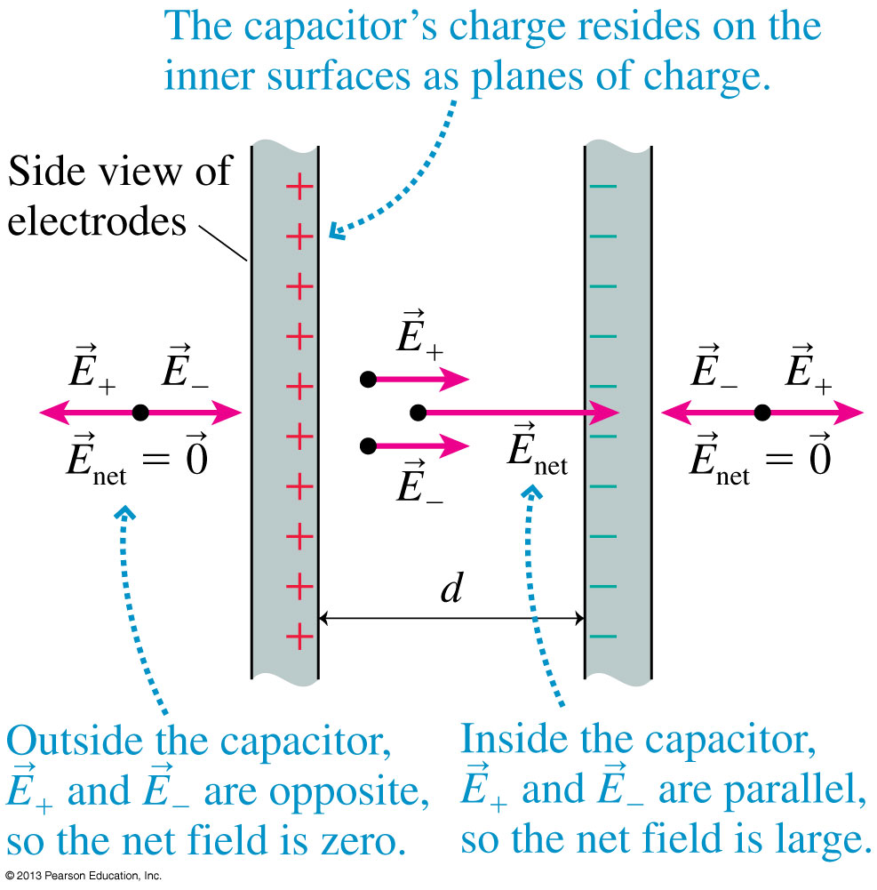
The Parallel-Plate Capacitor
The figure shows two capacitor plates, seen from the side.
Because opposite charges attract, all of the charge is on the inner surfaces of the two plates.
Inside the capacitor, the net field points toward the negative plate.
Outside the capacitor, the net field is zero.

Slide 16
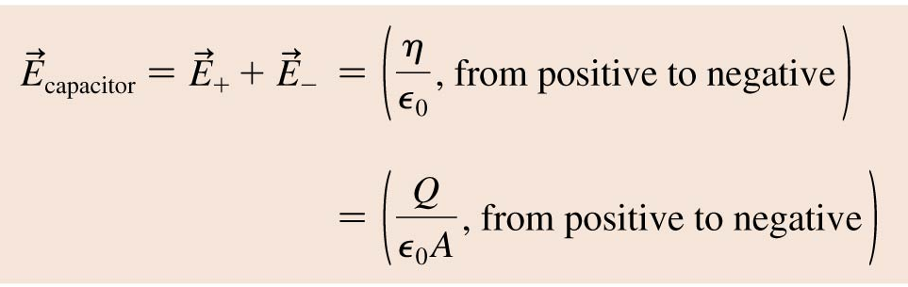
The Parallel-Plate Capacitor
The electric field inside a capacitor is
where A is the surface area of each electrode. Outside the capacitor plates, where E₊ and E₋ have equal magnitudes but opposite directions, the electric field is zero.

Slide 17
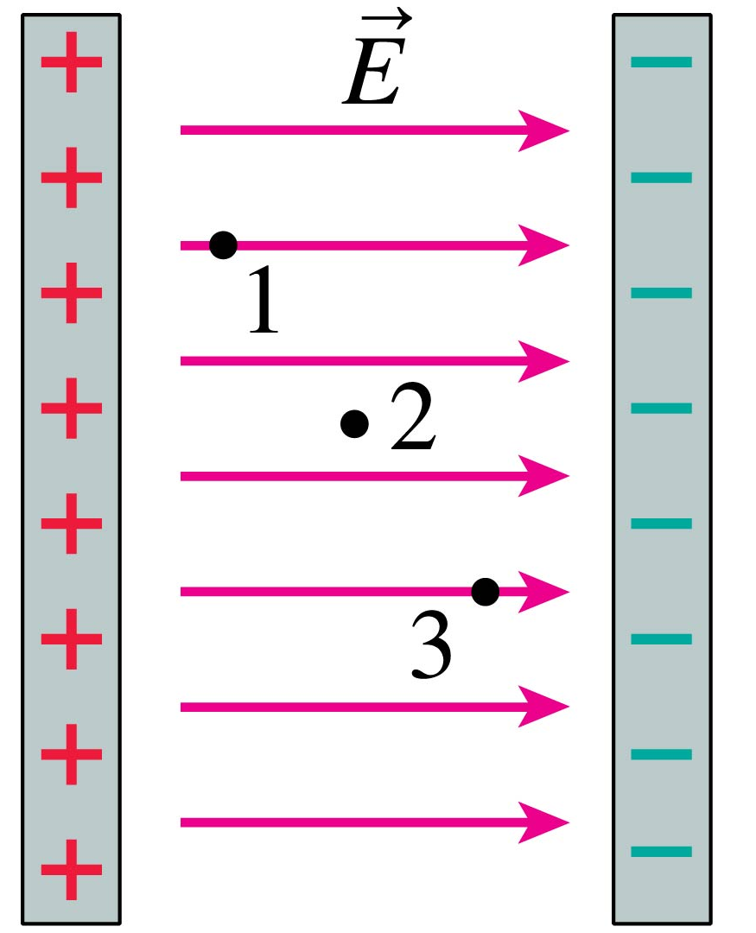
QuickCheck 26.10
Three points inside a
parallel-plate capacitor are marked. Which is true?
E₁ > E₂ > E₃
E₁ < E₂ < E₃
E₁ = E₂ = E₃
E₁ = E₃ > E₂
Notes:
17

Slide 18
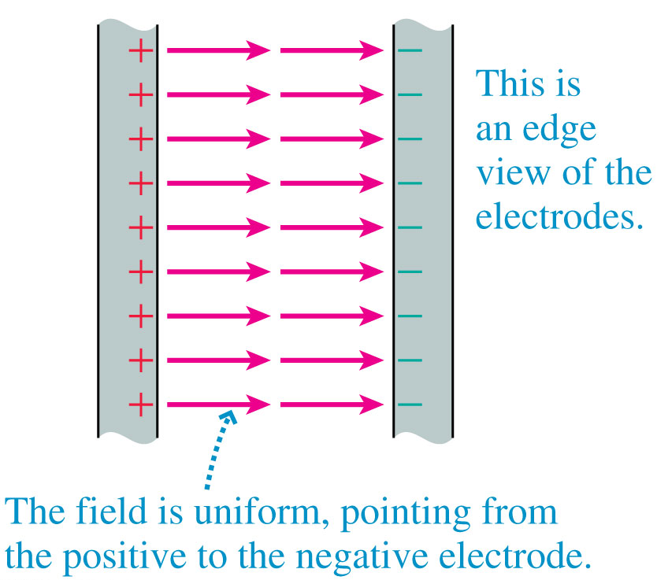
The Ideal Capacitor
The figure shows the electric field of an ideal parallel-plate capacitor constructed from two infinite charged planes
The ideal capacitor is a good approximation as long as the electrode separation d is much smaller than the electrodes’ size.

Slide 19
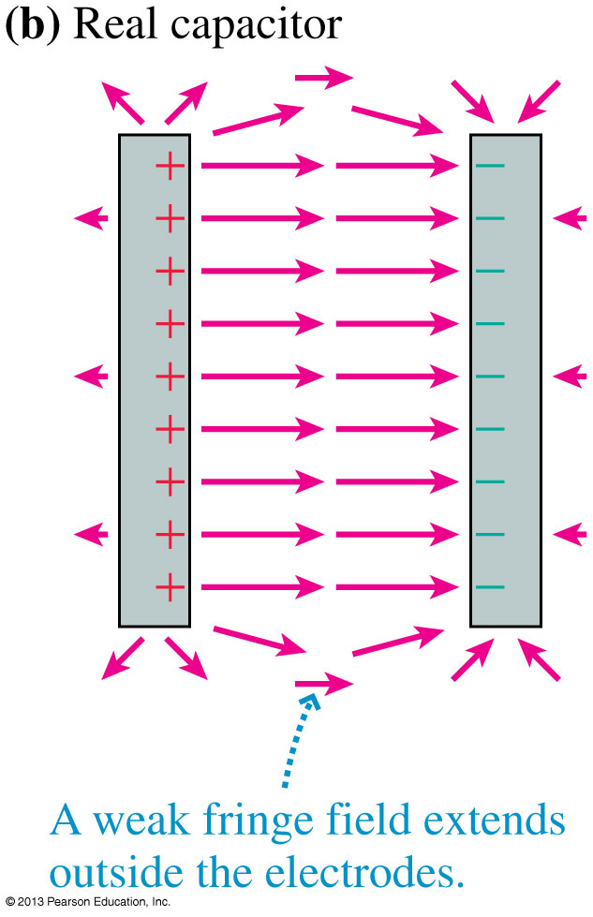
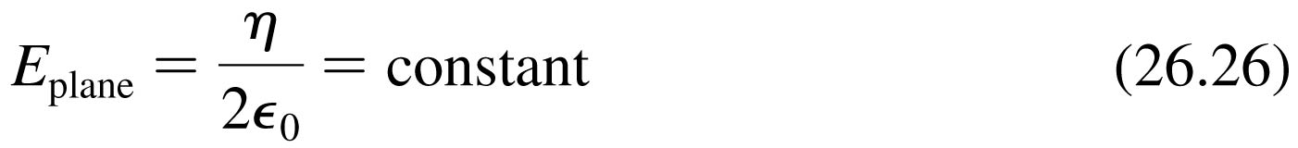
A Real Capacitor
Outside a real capacitor and near its edges, the electric field is affected by a complicated but weak fringe field.
We will keep things simple by always assuming the plates are very close together and using E = η/ ₀ for the magnitude of the field inside a parallel-plate capacitor.

Slide 20
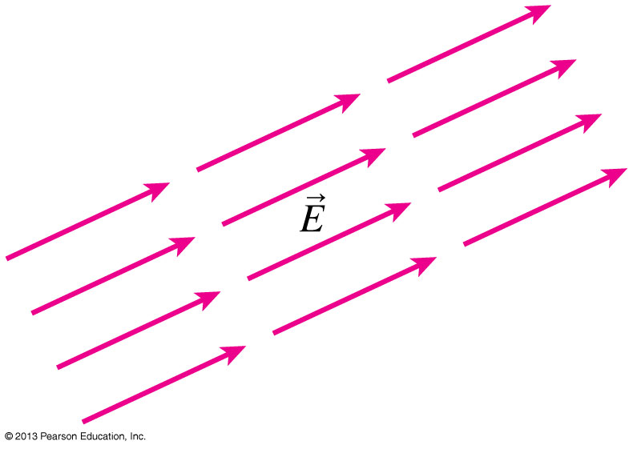
Uniform Electric Fields
The figure shows an electric field that is the same—in strength and direction—at every point in a region of space.
This is called a uniform electric field.
The easiest way to produce a uniform electric field is with a parallel-plate capacitor.

Slide 21

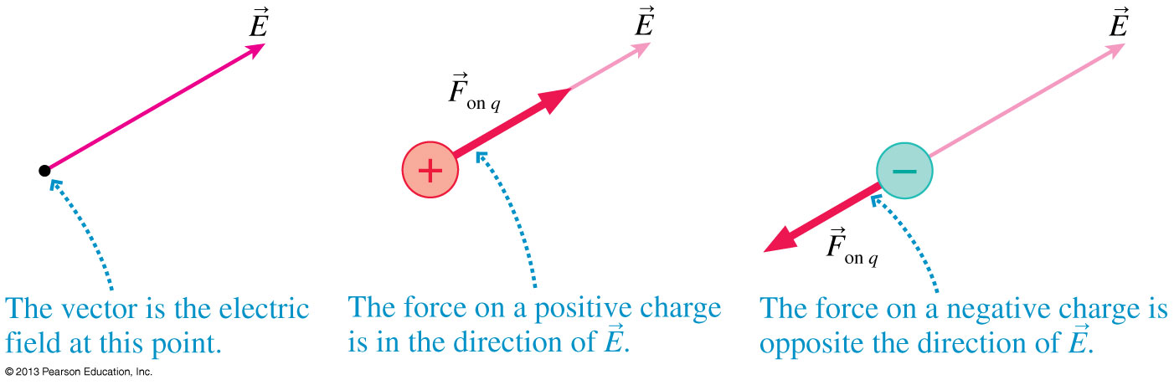
Motion of a Charged Particle in an Electric Field
Consider a particle of charge q and mass m at a point where an electric field E has been produced by other charges, the source charges.
The electric field exerts a force F_{on q} = qE.

Slide 22
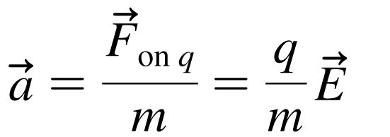
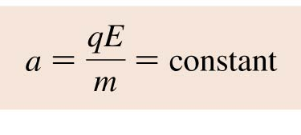
Motion of a Charged Particle in an Electric Field
The electric field exerts a force F_{on q} = qE on a charged particle.
If this is the only force acting on q, it causes the charged particle to accelerate with
In a uniform field, the acceleration is constant:

Slide 23
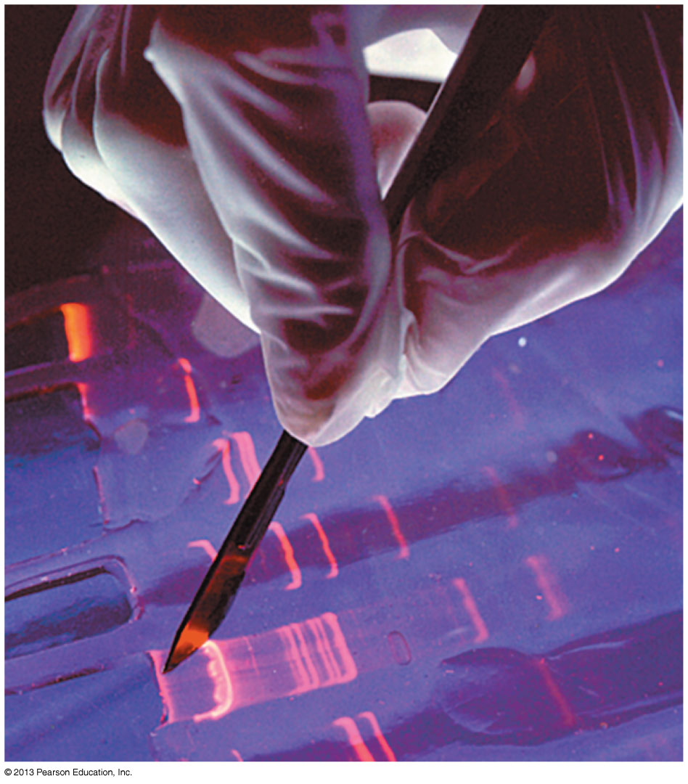
Motion of a Charged Particle in an Electric Field
“DNA fingerprints” are measured with the technique of gel electrophoresis.
A solution of negatively charged DNA fragments migrate through the gel when placed in a uniform electric field.
Because the gel exerts a drag force, the fragments move at a terminal speed inversely proportional to their size.

Slide 24
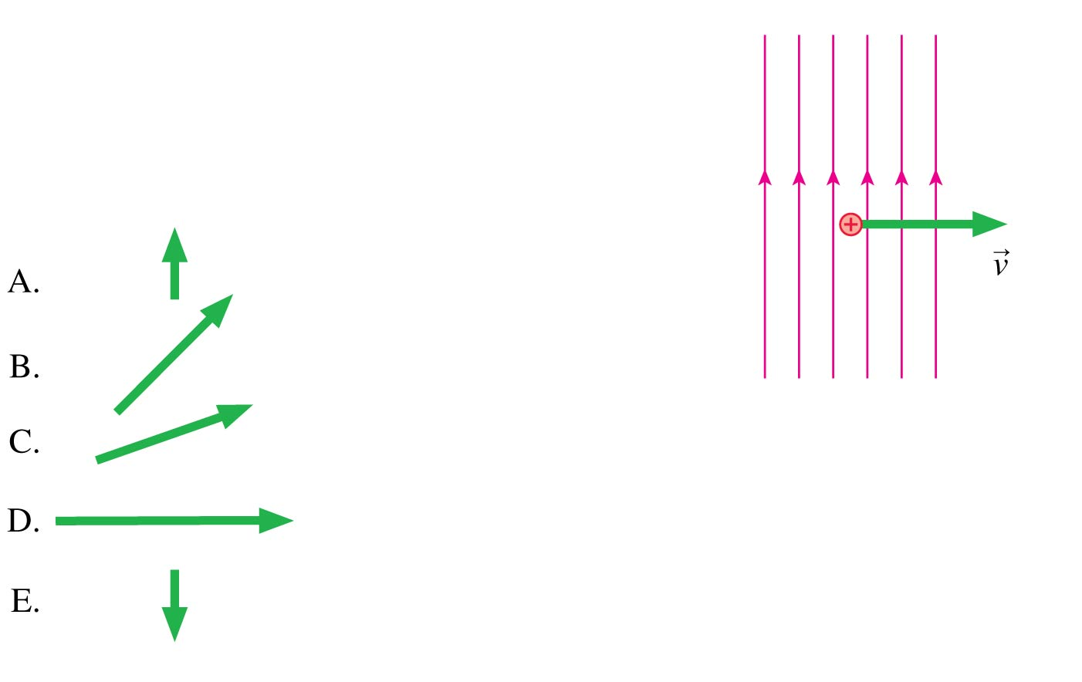
QuickCheck 26.11
A proton is moving to the right in a vertical electric field. A very short time later, the proton’s velocity is
Notes:
24

Slide 25
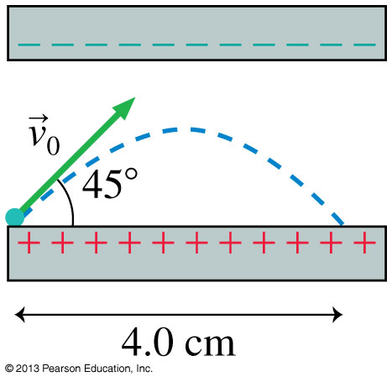
Problem 26.50
An electron is launched at a 45° angle at a speed of 5 × 10⁶ m/s from the positive plate of the parallel plate capacitor shown. The electron lands 4 cm away. What is the electric field strength inside the capacitor?

Slide 27
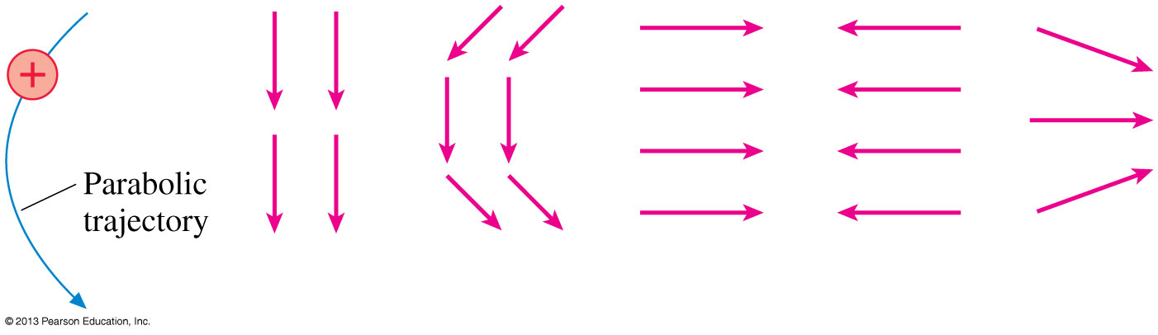
QuickCheck 26.12
Which electric field is responsible for the proton’s trajectory?
A.
B.
C.
D.
E.
Notes:
27

Slide 28
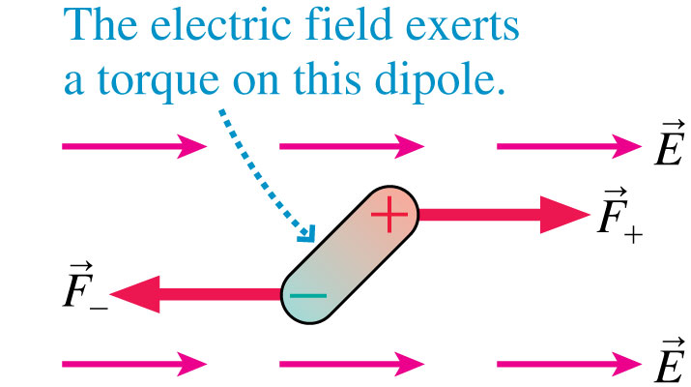
Dipoles in a Uniform Electric Field
The figure shows an electric dipole placed in a uniform external electric field.
The net force on the dipole is zero.
The electric field exerts a torque on the dipole which causes it to rotate.

Slide 29
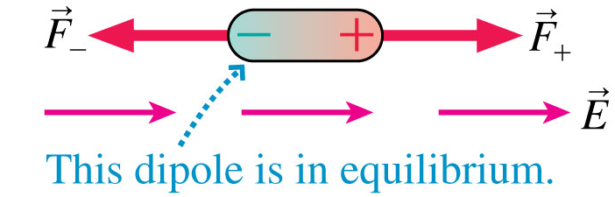
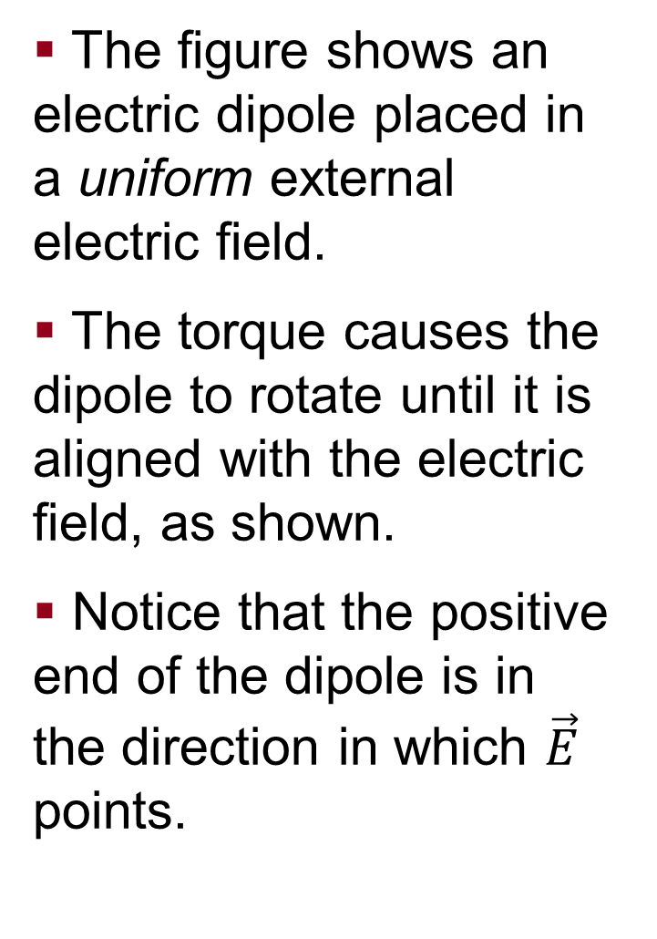
Dipoles in a Uniform Electric Field
The figure shows an electric dipole placed in a uniform external electric field.
The torque causes the dipole to rotate until it is aligned with the electric field, as shown.
Notice that the positive end of the dipole is in the direction in which $\vec{E}$ points.

Slide 30
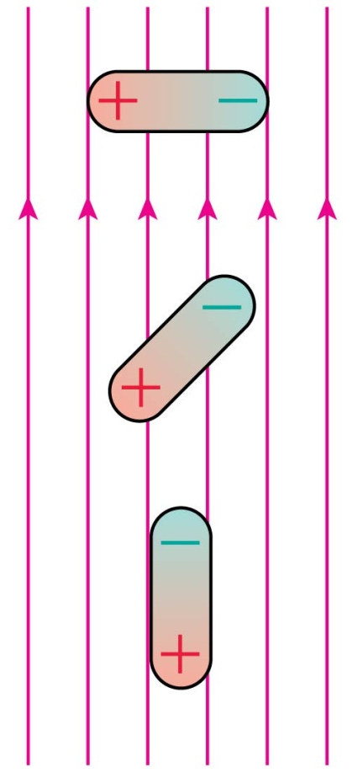
QuickCheck 26.13
Which dipole experiences no net force in the electric field?
A.
Dipole A.
Dipole B.
Dipole C.
Both dipoles A and C.
All three dipoles.
B.
C.
Notes:
30

Slide 31
QuickCheck 26.14
Which dipole experiences no net torque in the electric field?
A.
Dipole A.
Dipole B.
Dipole C.
Both dipoles A and C.
All three dipoles.
B.
C.
Notes:
31

Slide 32
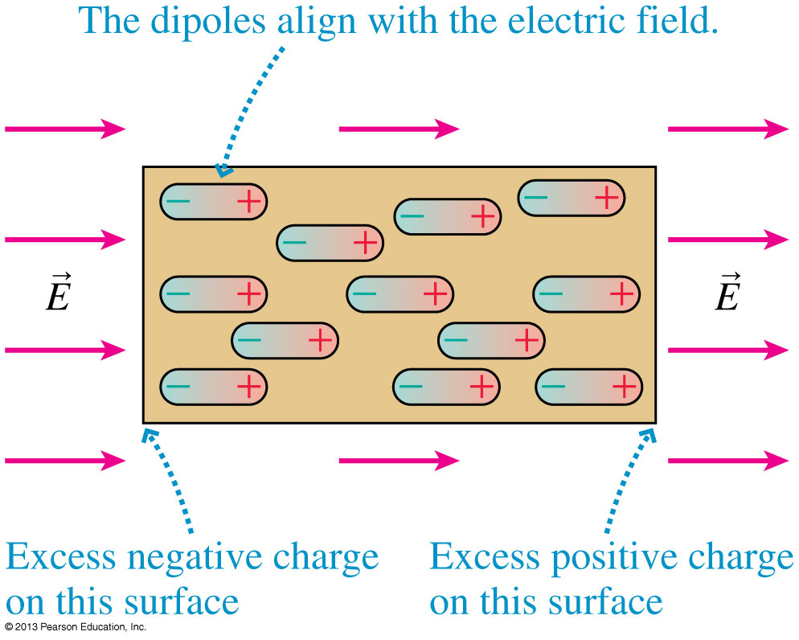
Dipoles in a Uniform Electric Field
The figure shows a sample of permanent dipoles, such as water molecules, in an external electric field.
All the dipoles rotate until they are aligned with the electric field.
This is the mechanism by which the sample becomes polarized.

Slide 33
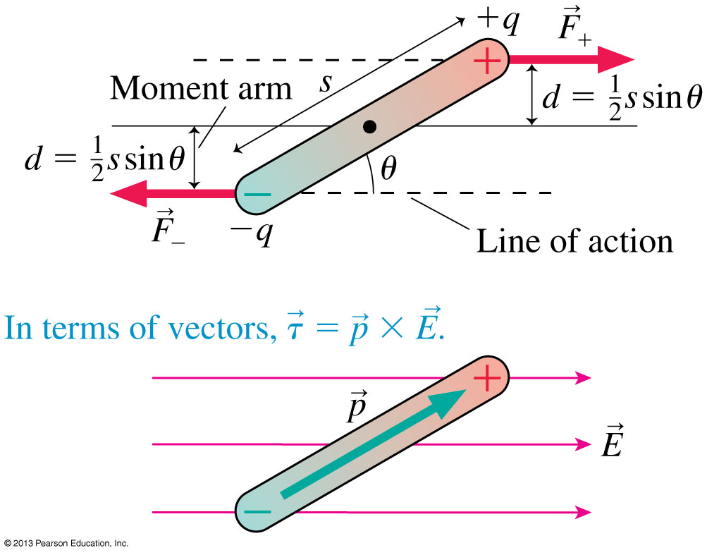
The Torque on a Dipole
The torque on a dipole placed in a uniform external electric field is

Slide 34
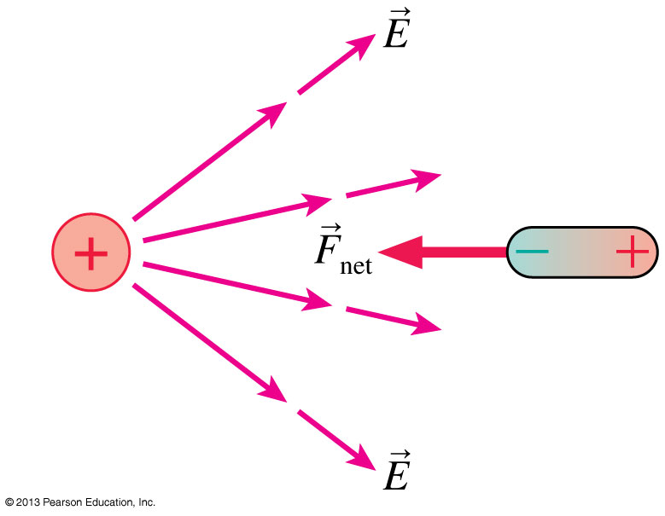
Dipoles in a Nonuniform Electric Field
Suppose that a dipole is placed in a nonuniform electric field, such as the field of a positive point charge.
The first response of the dipole is to rotate until it is aligned with the field.
Once the dipole is aligned, the leftward attractive force on its negative end is slightly stronger than the rightward repulsive force on its positive end.
This causes a net force to the left, toward the point charge.

Slide 35
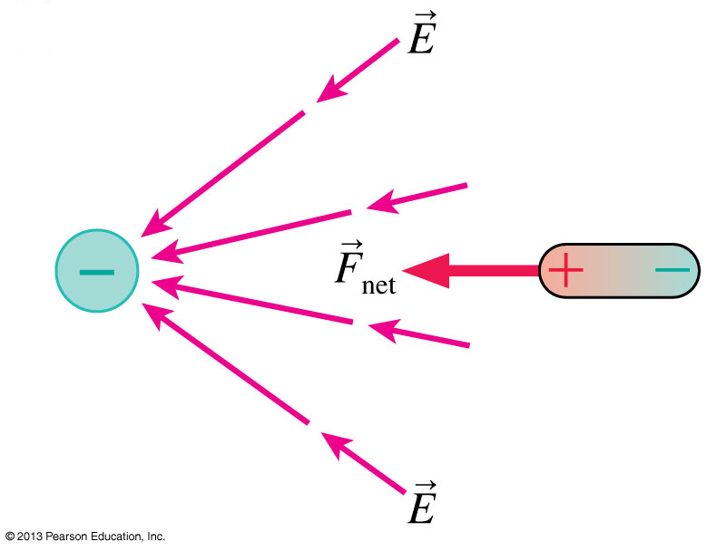
Dipoles in a Nonuniform Electric Field
A dipole near a negative point charge is also attracted toward the point charge.
The net force on a dipole is toward the direction of the strongest field.
Because field strength increases as you get closer to any finite-sized charged object, we can conclude that a dipole will experience a net force toward any charged object.

Slide 36
Before Class 11 on Monday
Complete Problem Set 4 on MasteringPhysics due Sunday at 11:59pm on Ch. 26.
Please read Knight Pgs. 810-818: Ch. 28, sections 28.1-28.3
Please do the short pre-class quiz on MasteringPhysics by Sunday night.
Something to think about: If a fixed charge repels a moving charge, does it do work on the charge? Does this increase the energy of the system?

