Slide 1

PHY132 Introduction to Physics II
Class 11 – Outline:
Electric Potential Energy of:
  Point Charges
  Dipoles
Electric Potential: V
Voltage: ΔV

Slide 2
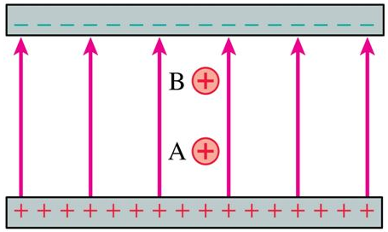
Class 11 Preclass Quiz on MasteringPhysics
74% got: Two positive charges are equal. Charge A has more electric potential energy.
Both of these charges have the potential to accelerate toward the negative plate, speeding up.

Slide 3
What is Potential Energy?
mgh
When an object has the potential to speed up.
Voltage
½ k(Δx)²

Slide 4
What is Potential Energy?
An object has potential energy when it is in a situation in which, if it moves, the potential energy can drop as it gains kinetic energy.
Gravitational potential energy is due to the gravity interaction between the earth and an object. It can be negative, and has an arbitrary zero point.
Elastic potential energy (ch.10) is energy stored in a spring. It is always positive or zero, and is zero when the spring is in equilibrium (Δx = 0)

Slide 5

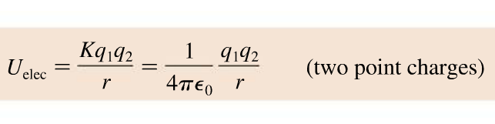
Class 11 Preclass Quiz on MasteringPhysics
47% of students got: A positive and a negative charge are released from rest in vacuum. They move toward each other. As they do a negative potential energy becomes more negative.

Slide 6
Class 11 Preclass Quiz on MasteringPhysics
72% of students got: The electric potential energy of a system of two point charges is proportional to the inverse of the distance between the two charges.

Slide 7
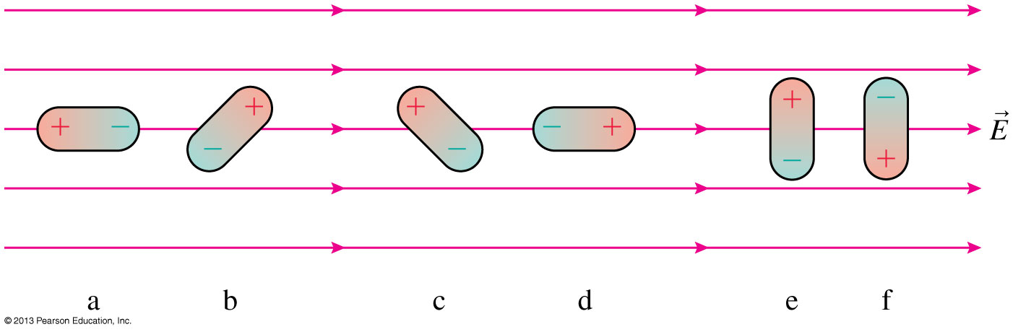
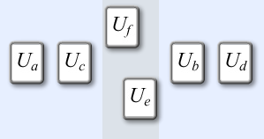
Class 11 Preclass Quiz on MasteringPhysics
76% of students got: Rank in order, from most positive to most negative, the potential energies U_{a} to U_{f} of the six electric dipoles in the uniform electric field of the figure.

Slide 8
Class 11 Preclass Quiz – Student Comments…
Jokes:
“If Miley Cyrus was a physicist, I guess she'd be torquing.”
“Why was the electron so sad? Because it had nothing to be positive about!”
“What is the name of the first electricity detective? Sherlock Ohms.”

Slide 9
Energy
The kinetic energy of a system, K, is the sum of the kinetic energies K_{i} = 1/2m_{i}v_{i}² of all the particles in the system.
The potential energy of a system, U, is the interaction energy of the system.
The change in potential energy, ΔU, is −1 times the work done by the interaction forces:
If all of the forces involved are conservative forces (such as gravity or the electric force) then the total energy K + U is conserved; it does not change with time.

Slide 10
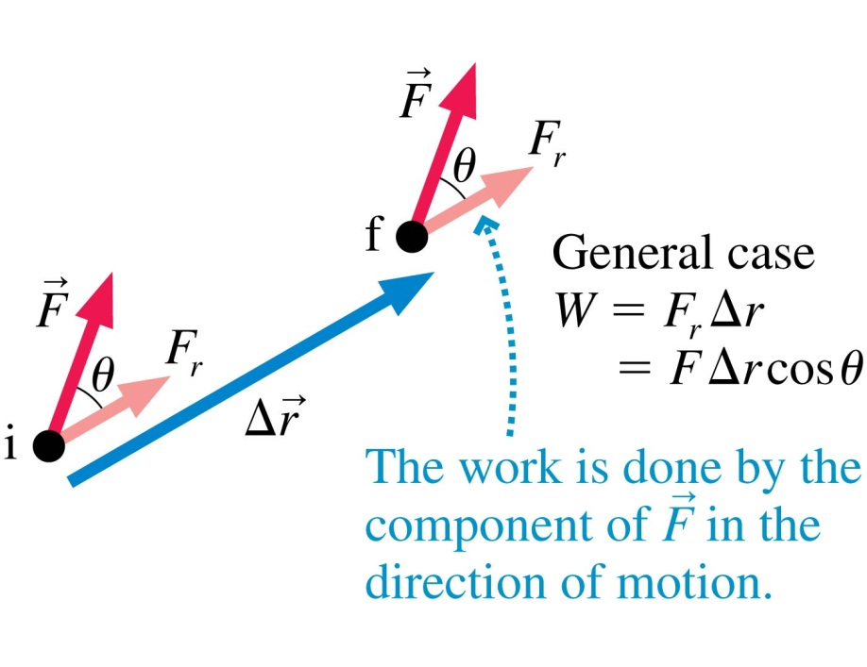
Work Done by a Constant Force
Recall that the work done by a constant force depends on the angle θ between the force F and the displacement Δr.
If θ = 0°, then W = FΔr.
If θ = 90°, then W = 0.
If θ = 180°, then W = −FΔr.

Slide 11
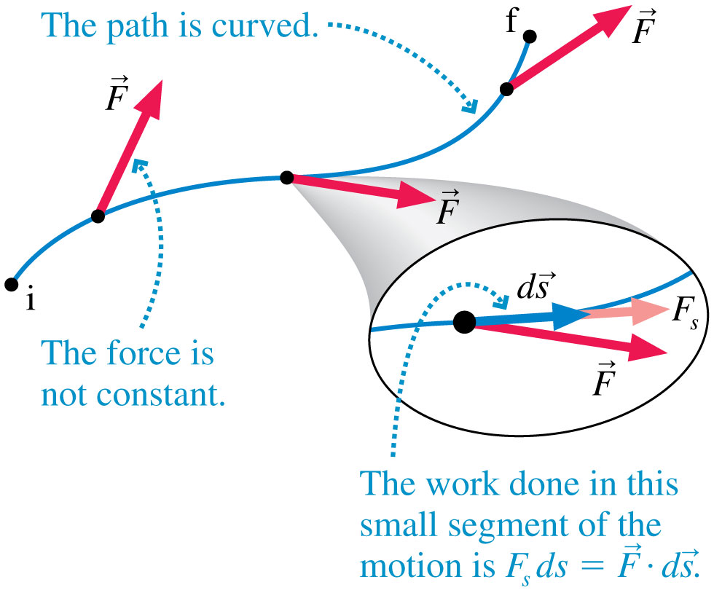
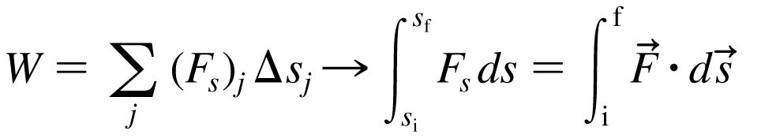
Work
If the force is not constant or the displacement is not along a linear path, we can calculate the work by dividing the path into many small segments.

Slide 12
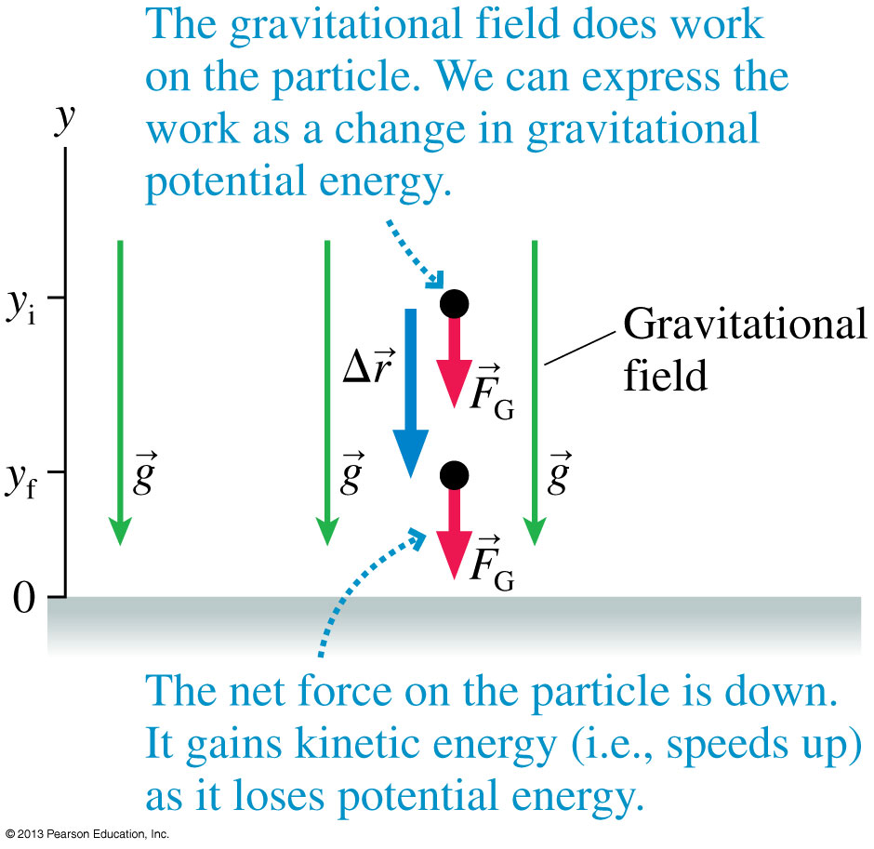
Gravitational Potential Energy
Every conservative force is associated with a potential energy.
In the case of gravity, the work done is:
W_{grav} = mgy_{i} − mgy_{f}
The change in gravitational potential energy is:
ΔU_{grav} = − W_{grav}
where
U_{grav} = U₀ + mgy

Slide 13
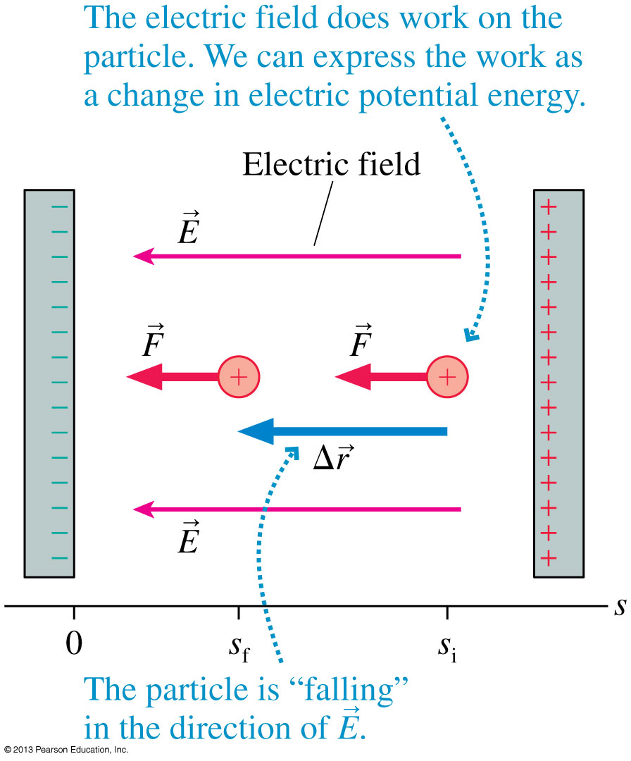
Electric Potential Energy in a Uniform Field
A positive charge q inside a capacitor speeds up as it “falls” toward the negative plate.
There is a constant force
F = qE in the direction of the displacement.
The work done is:
W_{elec} = qEs_{i} − qEs_{f}
The change in electric potential energy is:
ΔU_{elec} = −W_{elec}
where
U_{elec} = U₀ + qEs

Slide 14
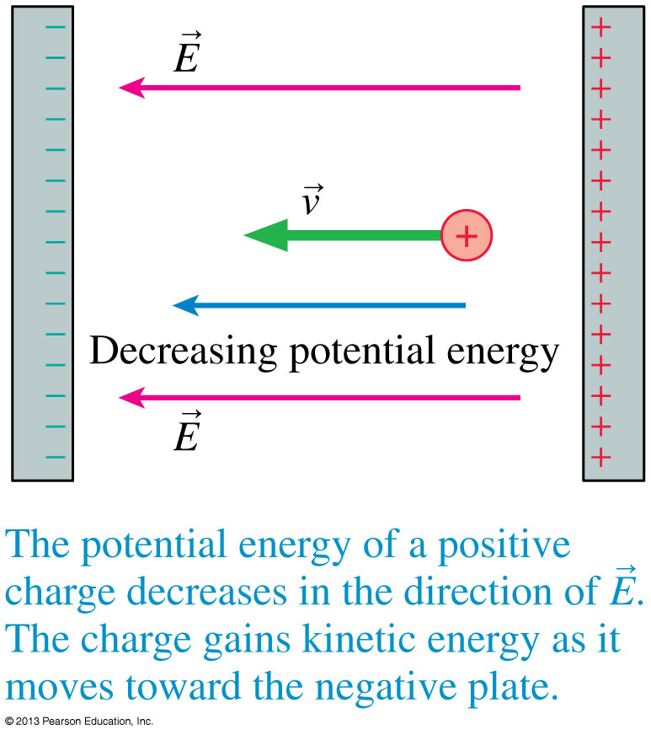
Electric Potential Energy in a Uniform Field
A positively charged particle gains kinetic energy as it moves in the direction of decreasing potential energy.

Slide 15
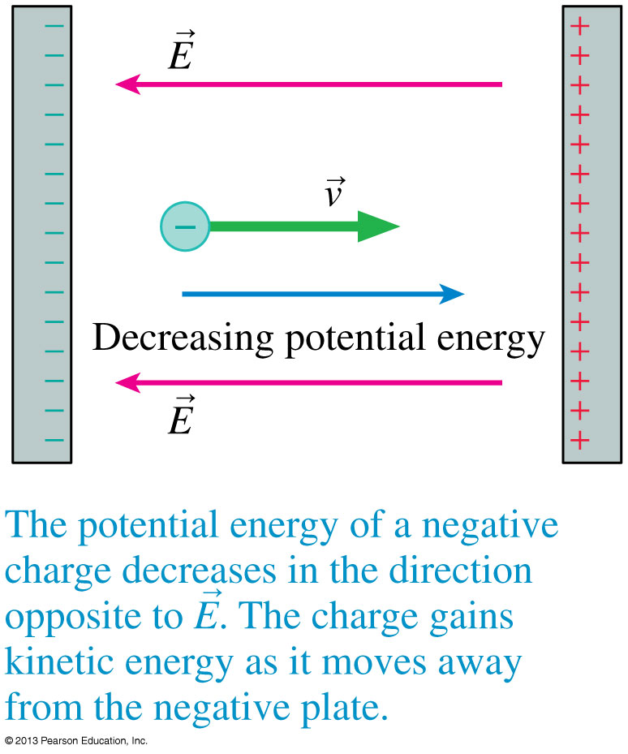
Electric Potential Energy in a Uniform Field
A negatively charged particle gains kinetic energy as it moves in the direction of decreasing potential energy.

Slide 16
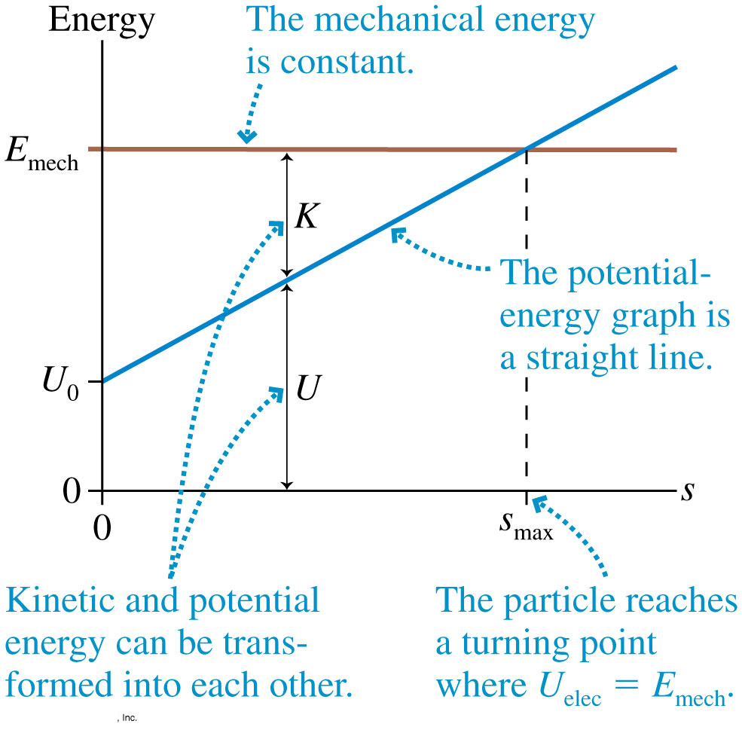
Electric Potential Energy in a Uniform Field
The figure shows the energy diagram for a positively charged particle in a uniform electric field.
The potential energy increases linearly with distance, but the total mechanical energy E_{mech} is fixed.

Slide 17
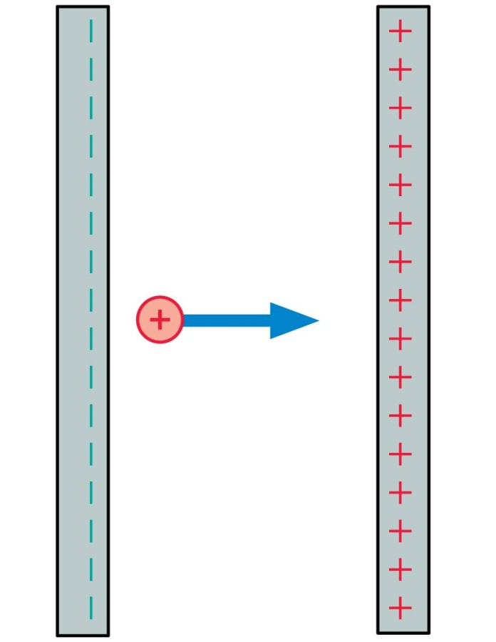
QuickCheck 28.4
A positive charge moves as shown. Its kinetic energy
Increases.
Remains constant.
Decreases.
Notes:
17

Slide 18
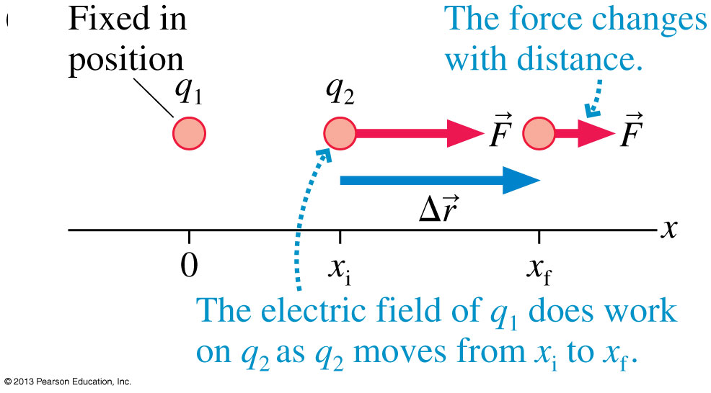
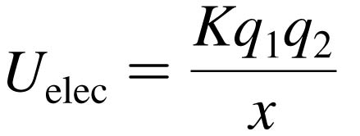
The Potential Energy of Two Point Charges
Consider two like charges q₁ and q₂.
The electric field of q₁ pushes q₂ as it moves from x_{i} to x_{f}.
The work done is:
The change in electric potential energy of the system is ΔU_{elec} = −W_{elec} if:

Slide 19

The Potential Energy of Point Charges
The Potential Energy of Two Point Charges
Consider two point charges, q₁ and q₂, separated by a distance r. The electric potential energy is
This is explicitly the energy of the system, not the energy of just q₁ or q₂.
Note that the potential energy of two charged particles approaches zero as r → ∞.

Slide 20
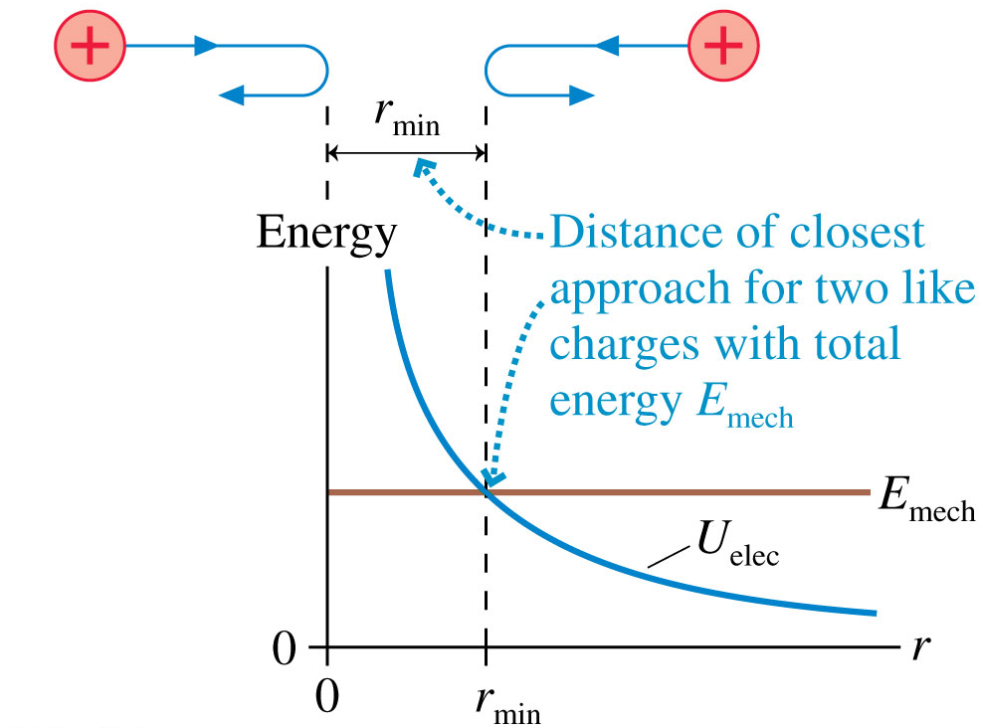
The Potential Energy of Two Point Charges
Two like charges approach each other.
Their total energy is E_{mech} > 0.
They gradually slow down until the distance separating them is r_{min}.
This is the distance of closest approach.

Slide 21
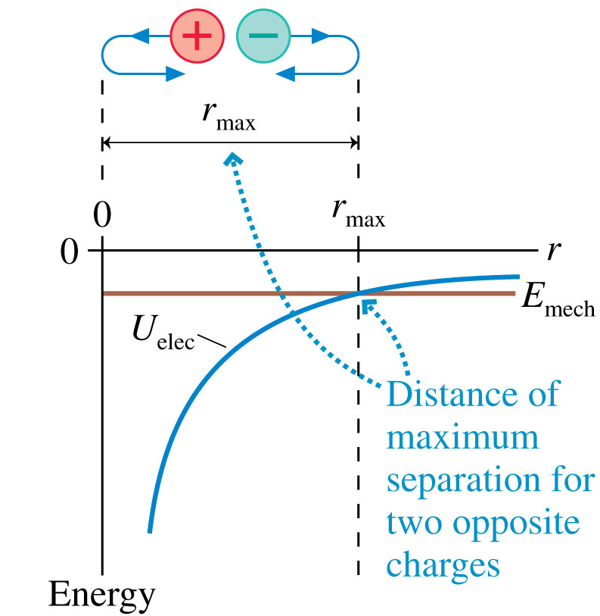
The Potential Energy of Two Point Charges
Two opposite charges are shot apart from one another with equal and opposite momenta.
Their total energy is
E_{mech} < 0.
They gradually slow down until the distance separating them is r_{max}.
This is their maximum separation.

Slide 22
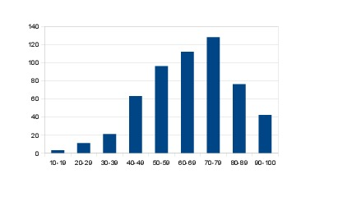
Test 1 Results
Average was 65.7%
Standard deviation was 19%
14 students got 100%
24.4% got A
25.4% got B
16.5% got C
13.8% got D
20% got F

Slide 23
Test 1 Results
Tests will be returned to you in Practicals this week.
Please check your mark and, no later than 4pm on Friday, February 14, report concerns.
Multiple-choice grades are calculated by Ms. Seeley in MP129. Please be aware that the answers you gave on the bubble sheet are the ones counted, not the ones you may have recorded on your question paper.
Please compare your answer to the posted solution before coming to us with questions or complaints about the marking.

Slide 24
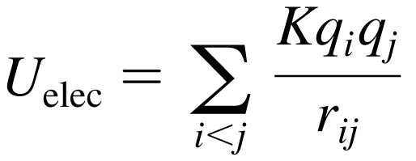
The Potential Energy of Multiple Point Charges
The Potential Energy of Multiple Point Charges
Consider more than two point charges, the potential energy is the sum of the potential energies due to all pairs of charges:
where r_{ij} is the distance between q_{i} and q_{j}.
The summation contains the i < j restriction to ensure that each pair of charges is counted only once.

Slide 25
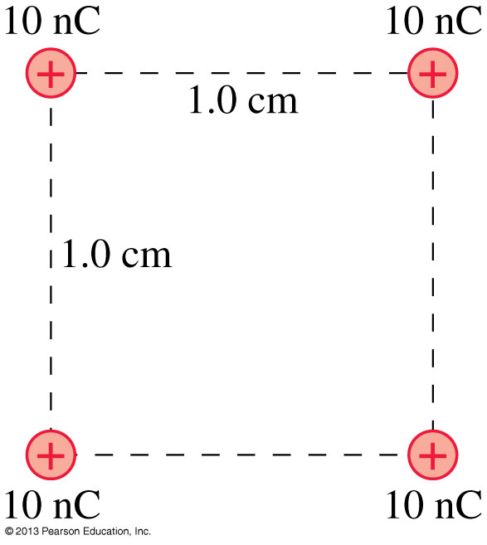
Problem 28.37
The four 1.0 g spheres shown in the figure are released simultaneously and allowed to move away from each other.
What is the speed of each sphere when they are very far apart?

Slide 27
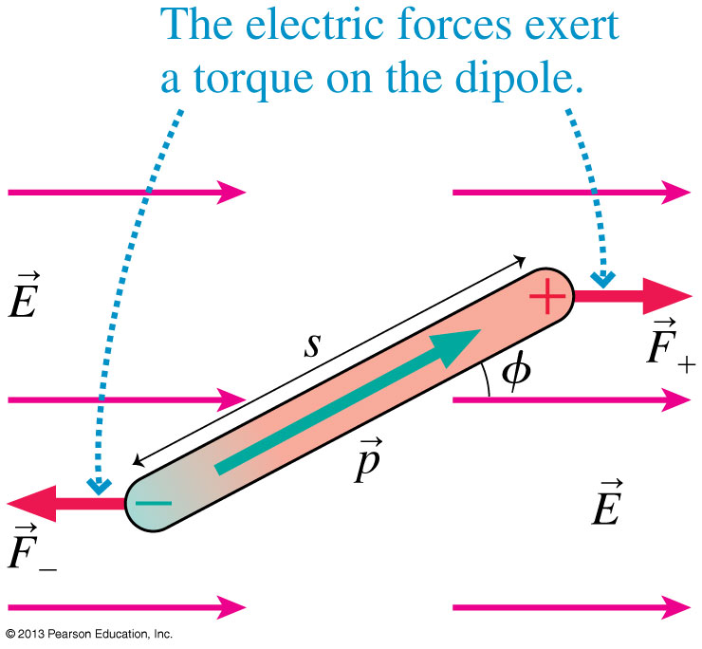
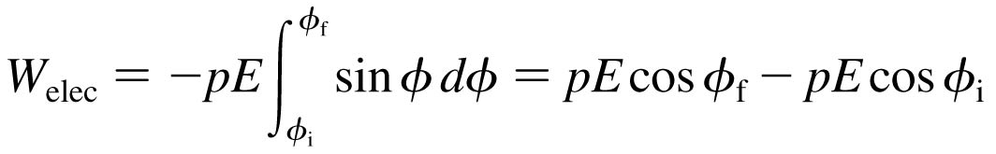
The Potential Energy of a Dipole
Consider a dipole in a uniform electric field.
The forces F₊ and F₋ exert a torque on the dipole.
The work done is:
The change in electric potential energy of the system is ΔU_{elec} = −W_{elec} if:

Slide 28
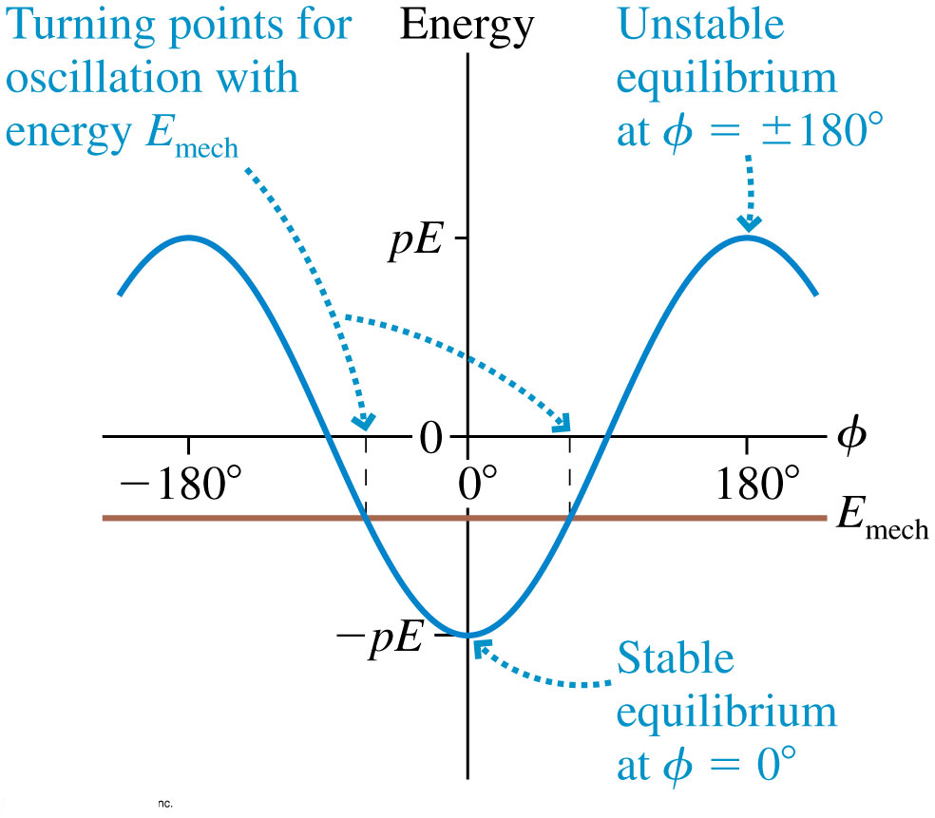
The Potential Energy of a Dipole
The potential energy of a dipole is φ = 0° minimum at where the dipole is aligned with the electric field.
A frictionless dipole with mechanical energy E_{mech} will oscillate back and forth between turning points on either side of φ = 0°.

Slide 29
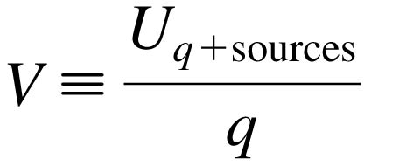

The Electric Potential
We define the electric potential V (or, for brevity, just the potential) as
This is NOT the same as electric potential energy. (different units, for one thing).
The unit of electric potential is the joule per coulomb, which is called the volt V:

Slide 30
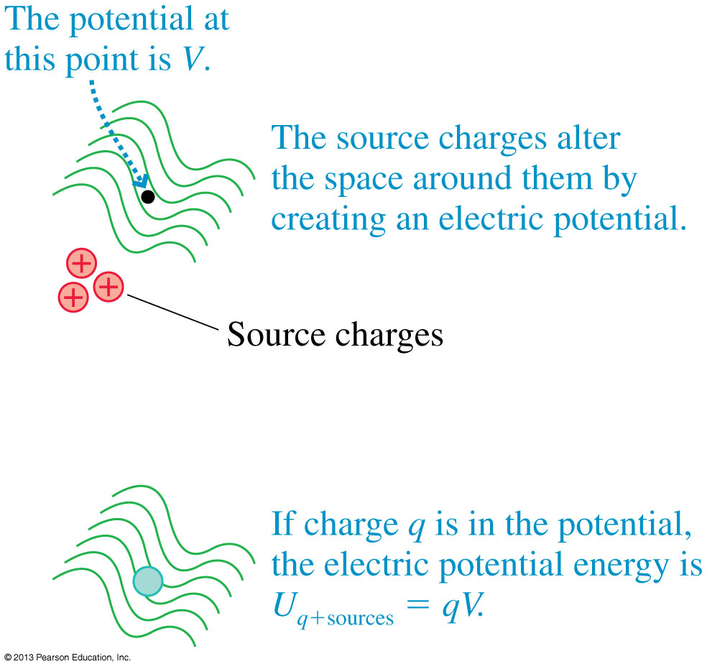
The Electric Potential
Test charge q is used as a probe to determine the electric potential, but the value of V is independent of q.
The electric potential, like the electric field, is a property of the source charges.

Slide 31
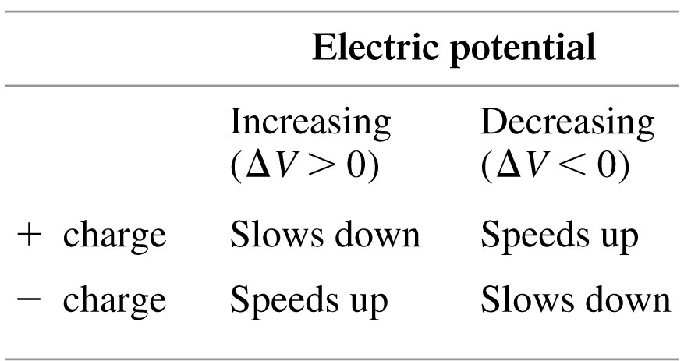
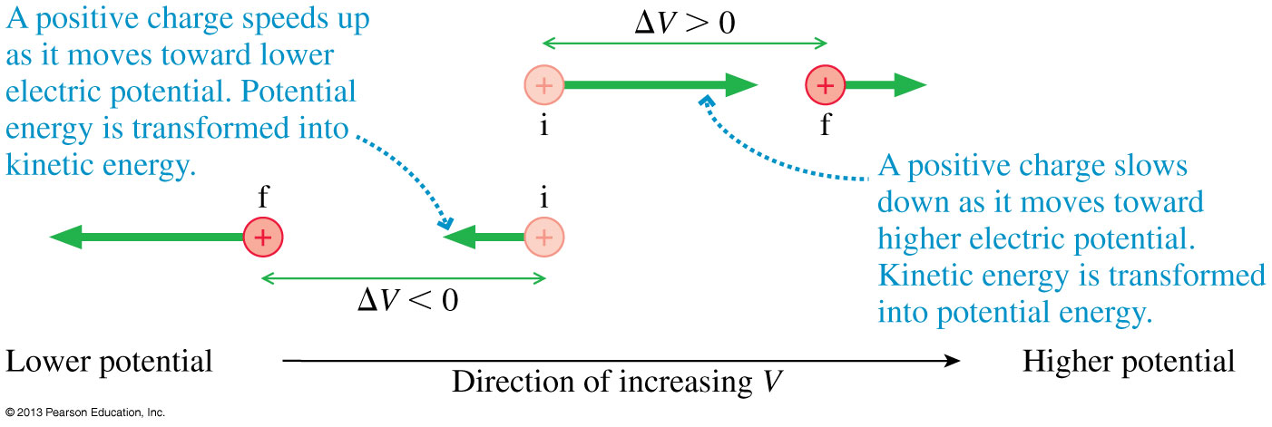
Using the Electric Potential
As a charged particle moves through a changing electric potential, energy is conserved:

Slide 32
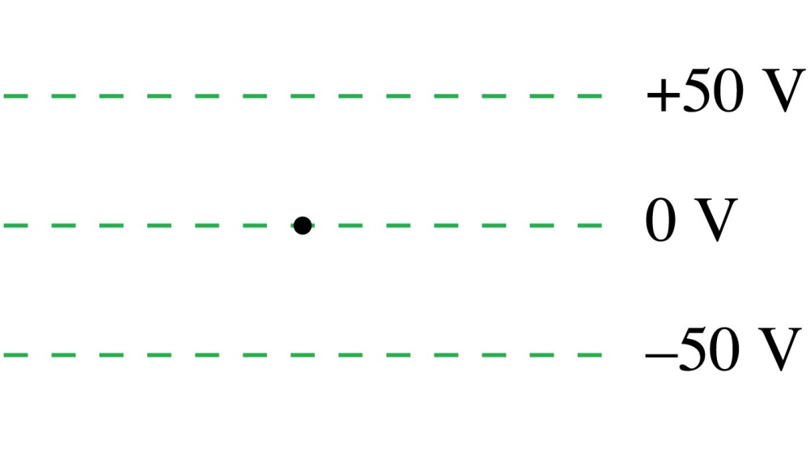
QuickCheck 28.6
A proton is released from rest at the dot. Afterward, the proton
Remains at the dot.
Moves upward with steady
speed.
Moves upward with an increasing speed.
Moves downward with a steady speed.
Moves downward with an increasing speed.
Notes:
32

Slide 33


Before Class 12 on Wednesday
(my last class…)
Please finish reading Knight Ch. 28
Please do the short pre-class quiz on MasteringPhysics by tomorrow night.
Something to think about. A battery is designed to supply a steady amount of which of the following quantities?
  Energy
  Power
  Electric potential difference
  Electric current
(Hint: only one of these is correct!)

