Slide 1
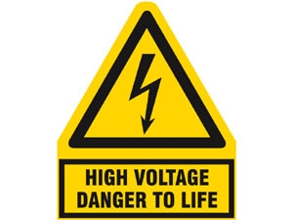
PHY132 Introduction to Physics II
Class 12 – Outline:
Electric Potential of:
  Parallel Plate Capacitor
  Point Charge
  Many Charges

Slide 2
Class 12 Preclass Quiz on MasteringPhysics
98% got:The units of potential difference are Volts.
82% got: New units for the electric field were introduced in this chapter. Old units were N/C. The new units are V/m.
You can show that these units are equivalent to each other:
1 N/C = 1 V/m

Slide 3
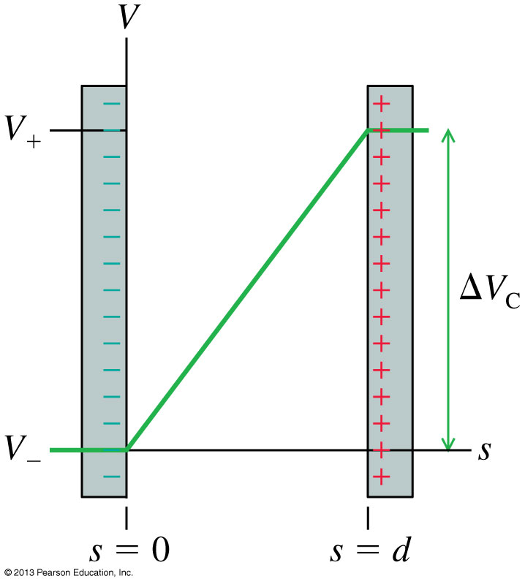
Class 12 Preclass Quiz on MasteringPhysics
86% got:The electric potential inside a capacitor increases linearly from the negative to the positive plate.

Slide 4
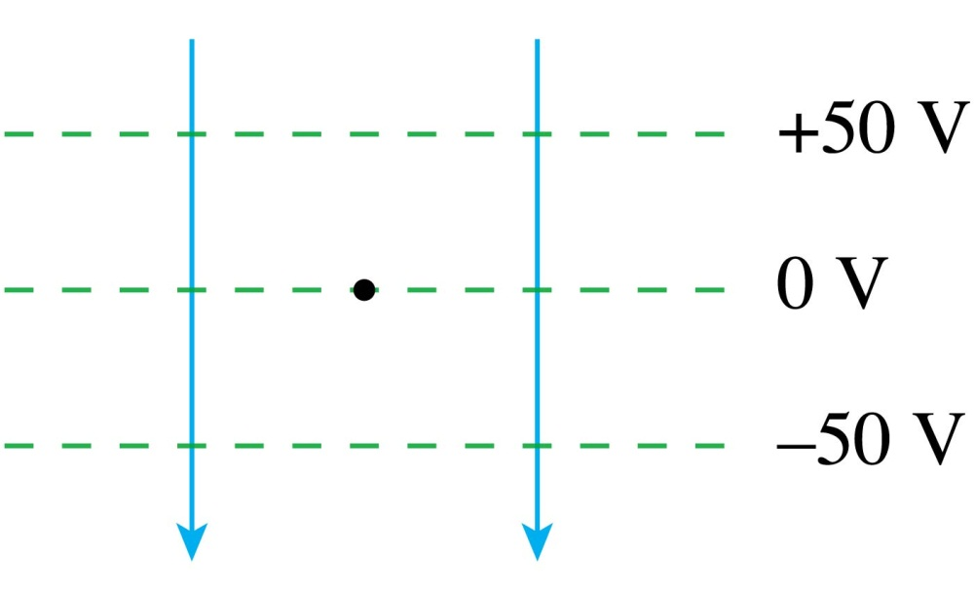
QuickCheck 28.6
Class 12 Preclass Quiz on MasteringPhysics
A proton is released from rest at the dot. Afterward, the proton
Decreasing PE
Increasing KE
85% got: Moves downward with an increasing speed.
Notes:
4

Slide 5
Class 12 Preclass Quiz – Student Comments…
“Could we go over what is meant by arbitrarily choosing the zero point of voltage? I'm not too sure on how to apply this concept.”
Harlow answer: In order to determine motion of charge, and actual measureable things, only the change in electric potential matters. So it really doesn’t matter where you define zero electric potential to be; we just choose a convenient location.
“what exactly is a capacitor, laymans terms”
Harlow answer: Two pieces of metal, separated by an insulator. There might be opposite electric charges on the capacitor.
“Do I want to put a fork in the outlet?”
Harlow answer: No! Trust me, don’t do this!

Slide 6
Class 12 Preclass Quiz – Student Comments…
Jokes:
“Two protons part ways after a date. As they are walking away from each other, one proton calls to the other "we had to such potential"”
“What did the proton say to the electron? - I'm attracted to you! Happy Valentine's Day.”

Slide 7
Last time I asked you to consider…
A battery is designed to supply a steady amount of which of the following quantities?
  Energy
  Power
  Electric potential difference
  Electric current

Slide 8
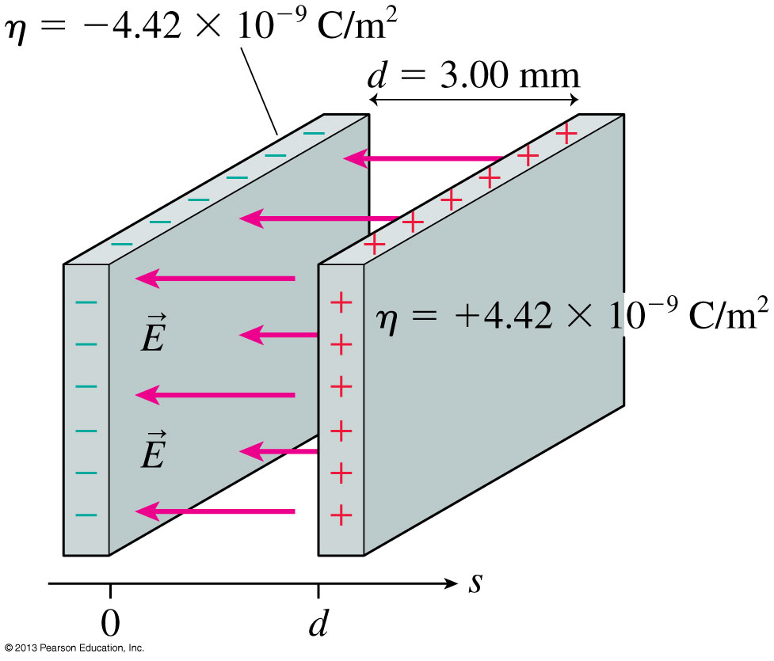
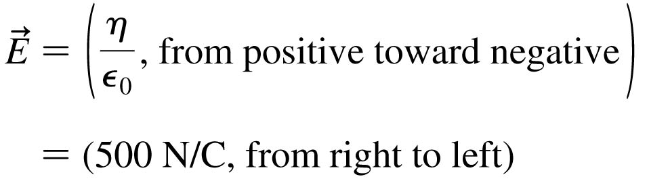
The Electric Field Inside a Parallel-Plate Capacitor
This is a review of Chapter 26.

Slide 9
The Electric Potential Inside a Parallel-Plate Capacitor
The electric potential inside a parallel-plate capacitor is
where s is the distance from the negative electrode.
The potential difference ΔV_{C}, or “voltage” between the two capacitor plates is

Slide 10
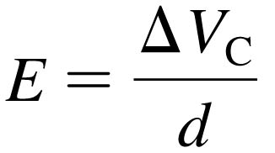
Units of Electric Field
If we know a capacitor’s voltage ΔV and the distance between the plates d, then the electric field strength within the capacitor is:
This implies that the units of electric field are volts per meter, or V/m.
Previously, we have been using electric field units of newtons per coulomb.
In fact, these units are equivalent to each other:
1 N/C = 1 V/m

Slide 11
Electric Potential = Electric Potential Energy per charge

Slide 12
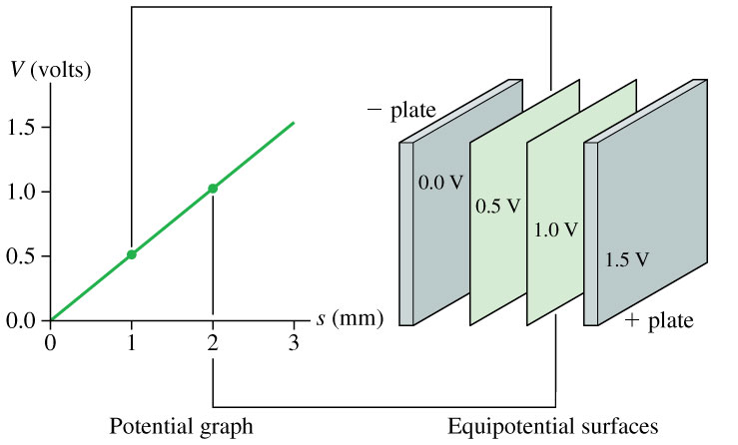
The Electric Potential Inside a Parallel-Plate Capacitor

Slide 13
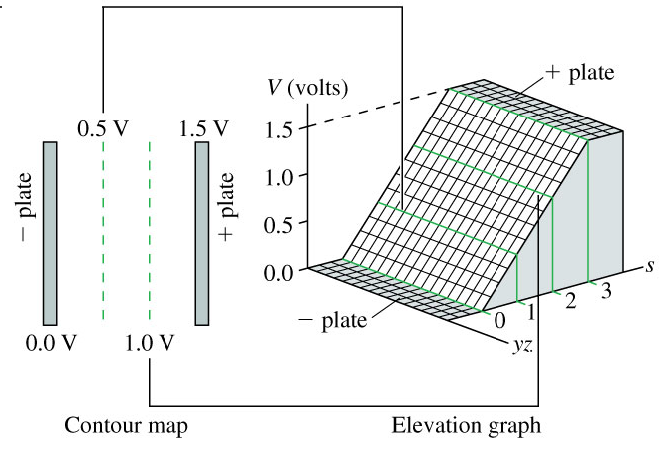
The Electric Potential Inside a Parallel-Plate Capacitor

Slide 14
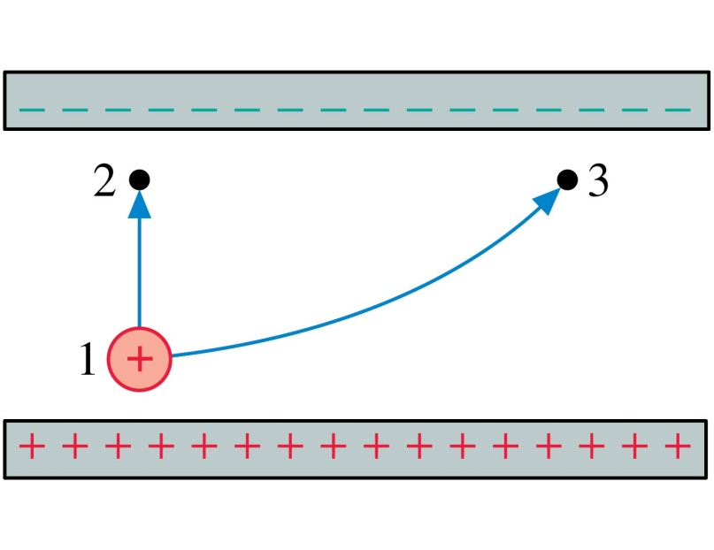
QuickCheck 28.9
Two protons, one after the other, are launched from point 1 with the same speed. They follow the two trajectories shown. The protons’ speeds at points 2 and 3 are related by
v₂ > v₃.
v₂ = v₃.
v₂ < v₃.
Not enough information to compare their speeds.
Notes:
14

Slide 15
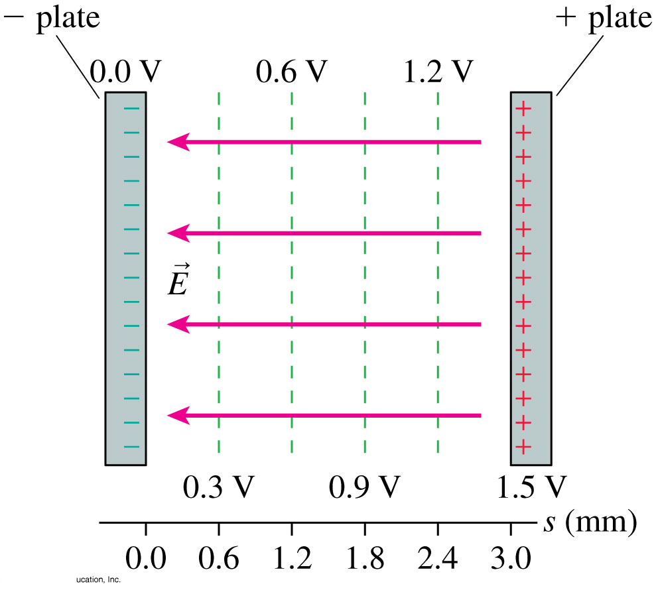
The Parallel-Plate Capacitor
The figure shows the contour lines of the electric potential and the electric field vectors inside a parallel-plate capacitor.
The electric field vectors are perpendicular to the equipotential surfaces.
The electric field points in the direction of decreasing potential.

Slide 16
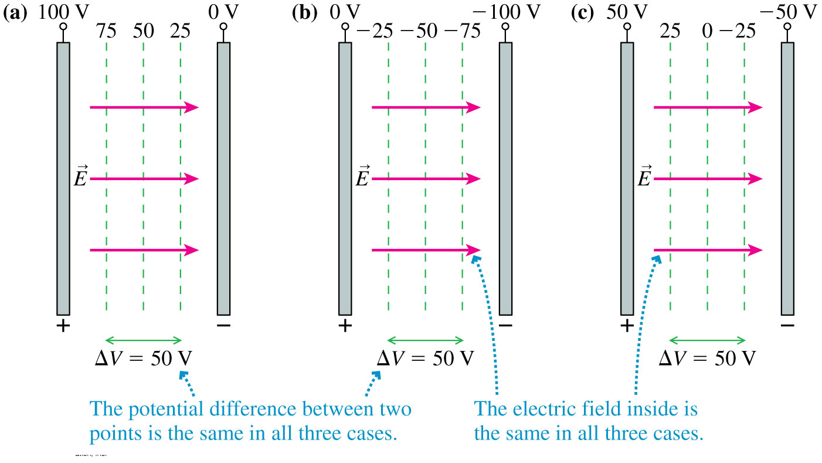
The Zero Point of Electric Potential
Where you choose V = 0 is arbitrary. The three contour maps below represent the same physical situation.

Slide 17
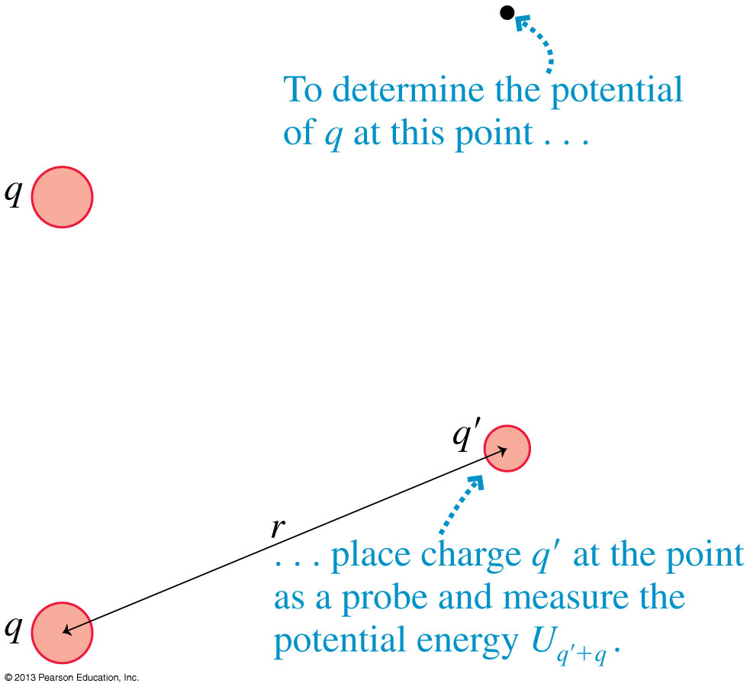
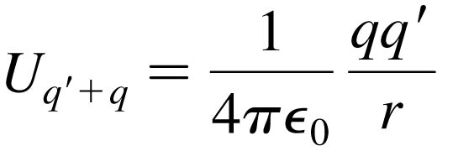
The Electric Potential of a Point Charge
Let q in the figure be the source charge, and let a second charge q', a distance r away, probe the electric potential of q.
The potential energy of the two point charges is

Slide 18
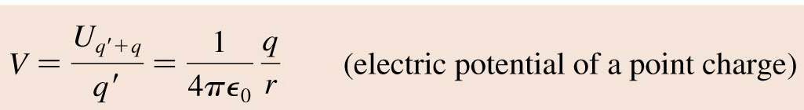
The Electric Potential of a Point Charge
The electric potential due to a point charge q is
The potential extends through all of space, showing the influence of charge q, but it weakens with distance as 1/r.
This expression for V assumes that we have chosen V = 0 to be at r = ∞.

Slide 19
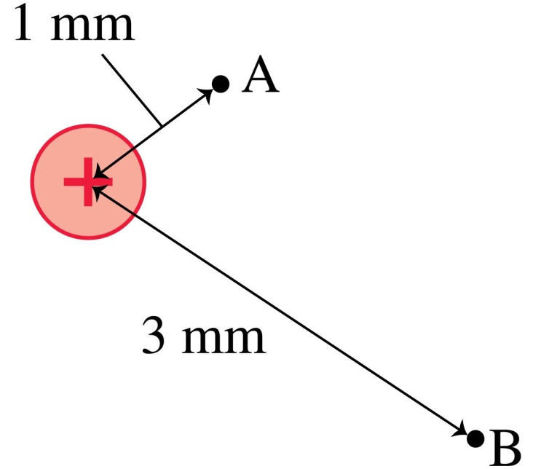
QuickCheck 28.10
What is the ratio V_{B}/V_{A} of the electric potentials at the two points?
9.
3.
1/3.
1/9.
Undefined without knowing the charge.
Notes:
19

Slide 20
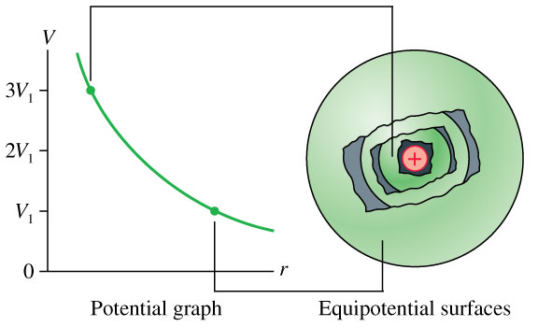
The Electric Potential of a Point Charge

Slide 21
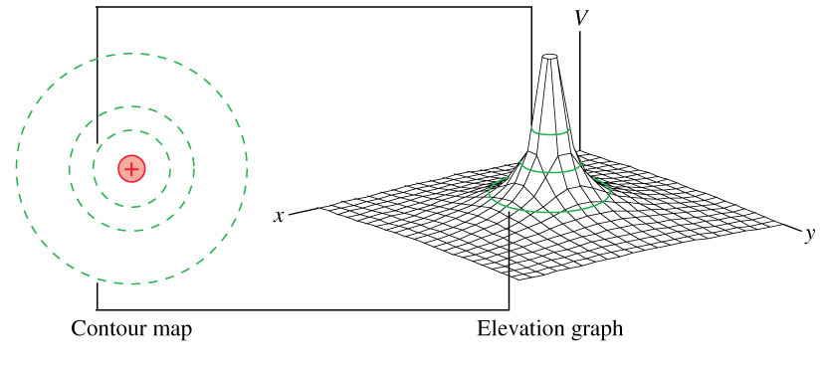
The Electric Potential of a Point Charge

Slide 22
Quick Equations Quiz.. [1/4]
Which is which?
The magnitude of the force, in Newtons, on a point charge that is near another point charge is:
A.
C.
B.
D.
Notes:
Answer: D

Slide 23
Quick Equations Quiz.. [2/4]
Which is which?
The magnitude of the Electric Field, in Newtons per Coulomb, near a point charge is:
A.
C.
B.
D.
Notes:
Answer: D

Slide 24
Quick Equations Quiz.. [3/4]
Which is which?
The electric potential energy, in Joules, of two point charges is:
A.
C.
B.
D.
Notes:
Answer: D

Slide 25
Quick Equations Quiz.. [4/4]
Which is which?
The electric potential, in Volts, near a point charge is:
A.
C.
B.
D.
Notes:
Answer: D

Slide 26
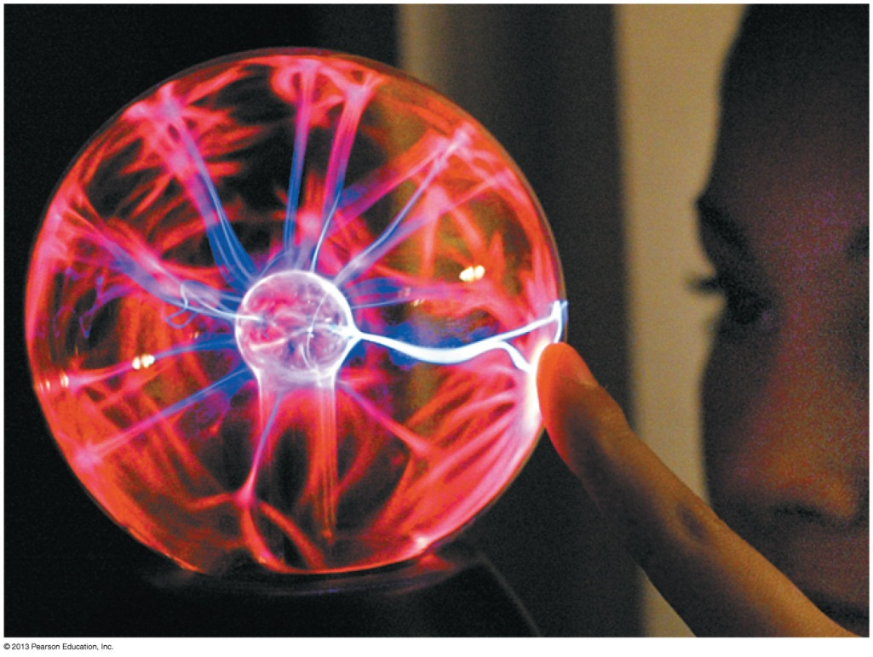
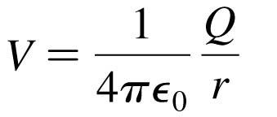
The Electric Potential of a Charged Sphere
Outside a uniformly charged sphere of radius R, the electric potential is identical to that of a point charge Q at the center.
where r > R.
If the potential at the surface V₀ is known, then the potential at
r > R is:

Slide 27
Class 12 Preclass Quiz – Student Comments…
“What is the difference between R and r in the equation for the electric potential of a charged sphere?”
Harlow answer: R is a constant: the radius of the sphere. r is the distance from the centre of the sphere (independent variable)

Slide 28
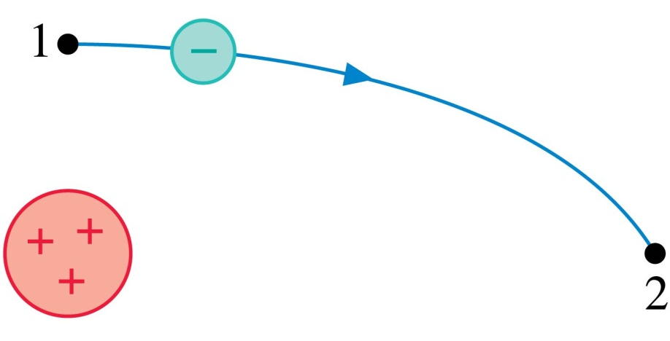
QuickCheck 28.11
An electron follows the trajectory shown from point 1 to point 2. At point 2,
v₂ > v₁.
v₂ = v₁.
v₂ < v₁.
Not enough information to compare the
speeds at these points.
Notes:
28

Slide 29
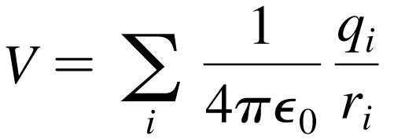
The Electric Potential of Many Charges
The Electric Potential of Many Charges
The electric potential V at a point in space is the sum of the potentials due to each charge:
where r_{i} is the distance from charge q_{i} to the point in space where the potential is being calculated.
The electric potential, like the electric field, obeys the principle of superposition.

Slide 30
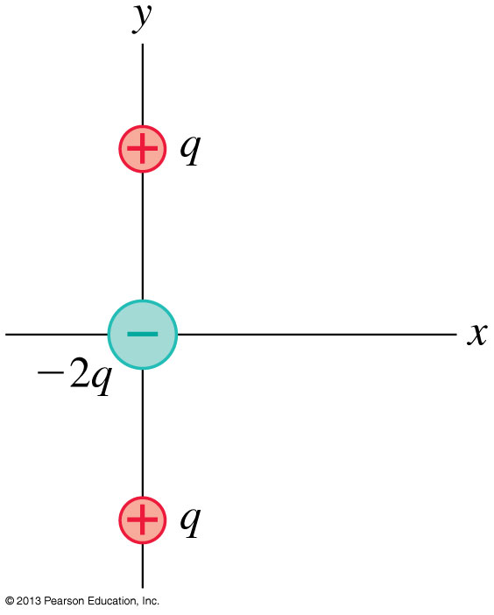
Problem 28.66
The arrangement of charges shown is called a linear electric quadrupole. The positive charges are located at y = ± s.
Find an expression for the electric potential on the y-axis at a distance y >> s.

Slide 32
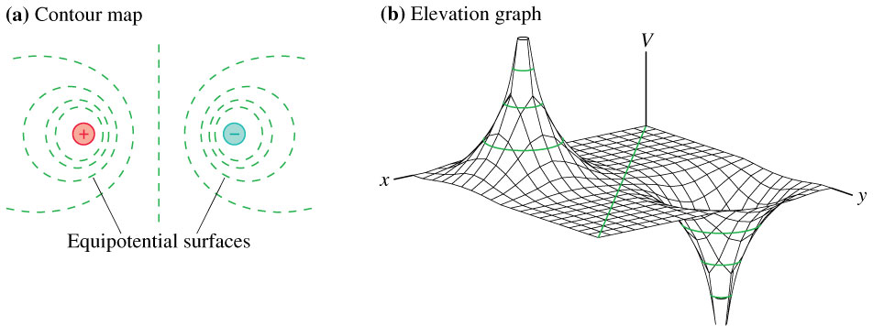
The Electric Potential of an Electric Dipole

Slide 33
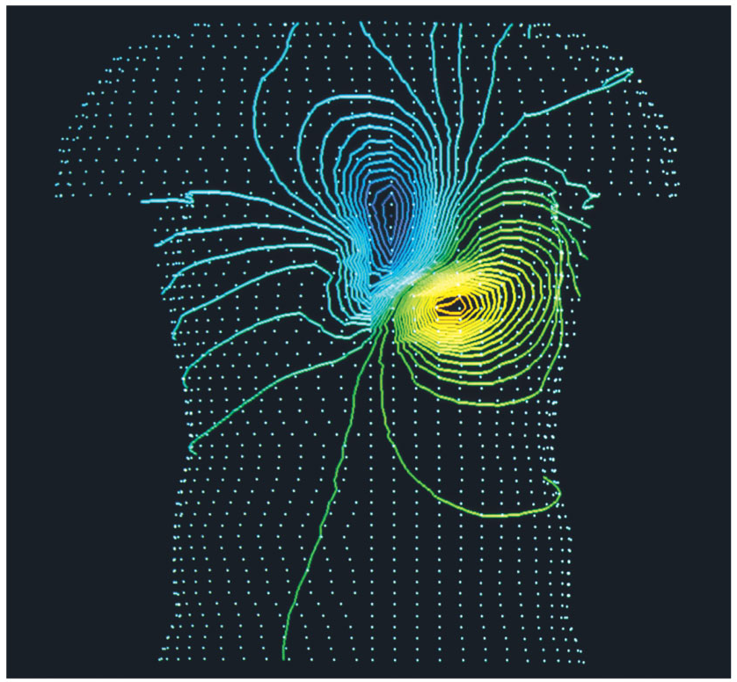
The Electric Potential of a Human Heart
The Electric Potential of a Human Heart
Electrical activity within the body can be monitored by measuring equipotential lines on the skin.
The equipotentials near the heart are a slightly distorted but recognizable electric dipole.

Slide 34
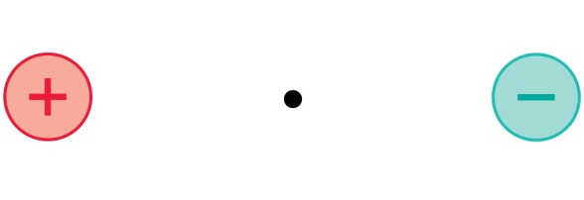

QuickCheck 28.12
At the midpoint between these two equal but opposite charges,
E = 0; V = 0.
E = 0; V > 0.
E = 0; V < 0.
E points right; V = 0.
E points left; V = 0.
Notes:
34

Slide 35
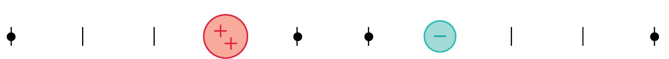
QuickCheck 28.13
At which point or points is the electric potential zero?
A.
B.
C.
D.
E. More than one of these.
Notes:
35

Slide 36
Have a great Reading Week!!
When you get back on Feb. 24, Professor Meyertholen will start where I am leaving off: Chapter 29, connecting Electric Potential with Electric Field.
You will learn all about electric circuits, magnetism, and Einstein’s theory of relativity.
I hope you enjoy it, and please keep coming to see me in office hours; you are my students until the final exam is done!
And even after you are no longer my students, please stay in touch and drop by whenever you like!
Best wishes and see you around!

