Slide 1
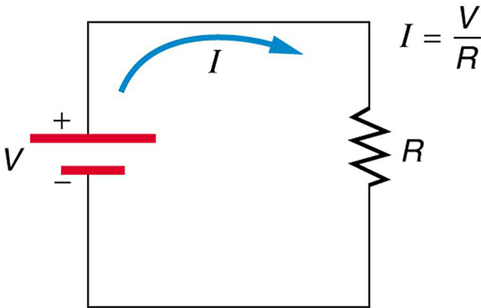
PHY132 Introduction to Physics II Class 15 – Outline:
Motion of charge carriers in a wire
Electron density, mean time between collisions for electrons in a solid
Helen Meyertholen was born Mar. 1, 2014
Electric current I = dQ/dt
Kirchhoff’s Junction Law
Conductivity and Resistivity
Resistance
Ohm’s Law

Slide 2
Class 15 Preclass Quiz on MasteringPhysics
The electron drift speed in a wire is exceedingly slow-typically only a fraction of a millimeter per second. Yet when you turn on a flashlight switch, the light comes on almost instantly. Resolve this apparent paradox.
Best student answer courtesy of Jaisie:
“Light can come on almost instantly because the components of the circuit in the flashlight already contain electrons. When the flashlight switch is turned on, the electric field created push on the electrons that are already in the circuit to progress through the circuit almost instantaneously. As a result, electrons will enter the lightbulb of the flashlight almost instantly, causing the light to come on almost instantly.”

Slide 3
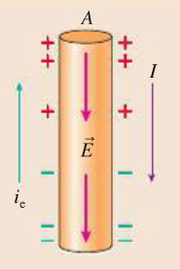
Class 15 Preclass Quiz on MasteringPhysics
72% got:The surface charge distribution for a current-carrying wire shown is not possible.
← No internal electric field!
← This is a correct surface charge distribution

Slide 4
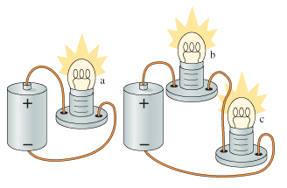
80% got: a is brightest. b and c have the same brightness; both are dimmer than a.
Best student answer courtesy of Xiaotang:
“for a, the total voltage of the battery is for bulb a alone. however, for b and c, they are sharing voltage, then they are not as bright as a. since all bulbs are the same, b and c have the same brightness”

Slide 5
Class 15 Preclass Quiz – Student Comments…
“Why a lightbulb does NOT use up current in a circuit?”
Harlow answer: Current is the motion of electric charge. If there was a different amount of current going into the bulb as going out of the bulb, it would quickly get a static charge build-up! It is the voltage that is used up in a lightbulb, not the current.
“What is the difference between resistivity and resistance?”
Harlow answer: Resistance is for a particular object (resistor). Resistivity is for a particular material. Also, the units are different.

Slide 6
Class 15 Preclass Quiz – Student Comments…
“What is the difference between an electron current and current?”
Harlow answer: Current is what we always use in calculations involving Ohm’s law, series and parallel circuits, etc. It is measured in amps = coulombs/second. “Electron current” is the number of electrons that pass a certain surface per second. It’s used more conceptually in this course.
“4. What does it mean that "the direction of current is DEFINED to be the direction in which positive charges seem to move"?”
Harlow answer: Even if the charge carriers happen to be negative (which they are in a metal) we still define “current” as being the flow of positive charge.

Slide 7
Class 15 Preclass Quiz – Student Comments…
“what affects the "brightness" of a bulb, is it V, I, R or a combination of said factors?”
Harlow answer: Actually it’s power: P = IV. More on this next class!

Slide 8
Class 15 Preclass Quiz – Student Comments…
Did you have any questions concerning the reading or pre-class video?
“Not currently but maybe when I'm a little more amped I will.”

Slide 9
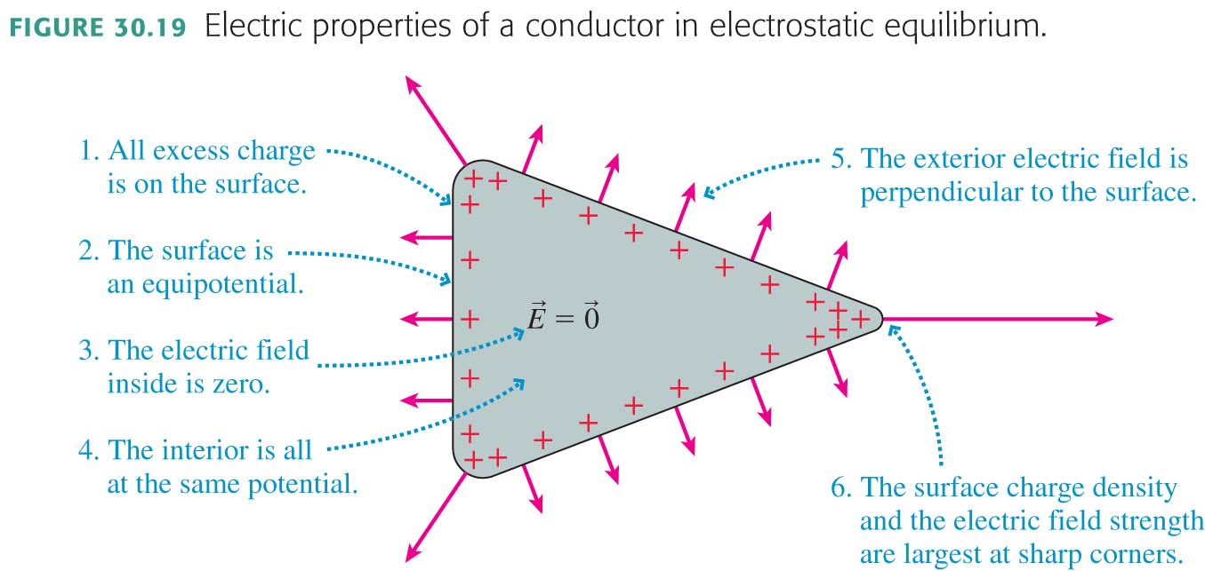
Charge in a conductor tends to flow very quickly until it comes into equilibrium…

Slide 10
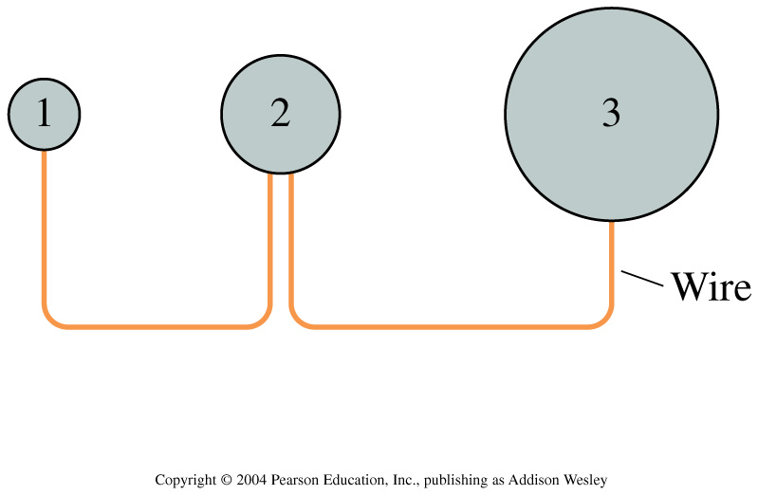
In class discussion question
Three charged, metal spheres of different radii are connected by a thin metal wire. The potential and electric field at the surface of each sphere are V and E. Which of the following is true?
V₁ = V₂ = V₃ and E₁ > E₂ > E₃
V₁ > V₂ > V₃ and E₁ = E₂ = E₃
V₁ = V₂ = V₃ and E₁ = E₂ = E₃
V₁ > V₂ > V₃ and E₁ > E₂ > E₃
V₃ > V₂ > V₁ and E₁ = E₂ = E₃

Slide 11
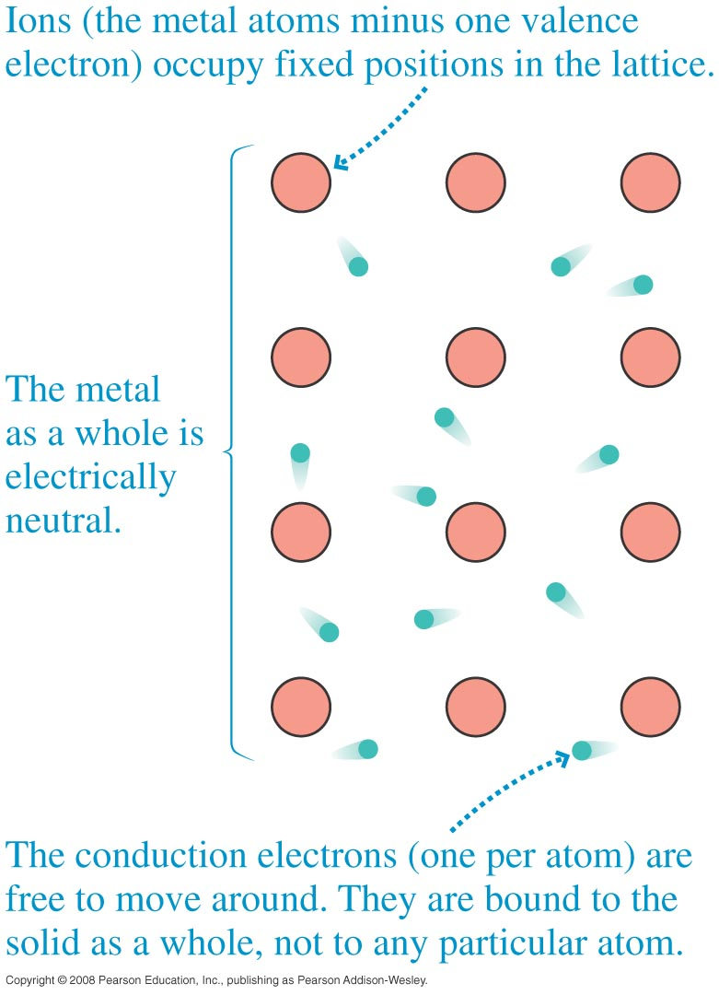
Inside an electrical conductor:

Slide 12
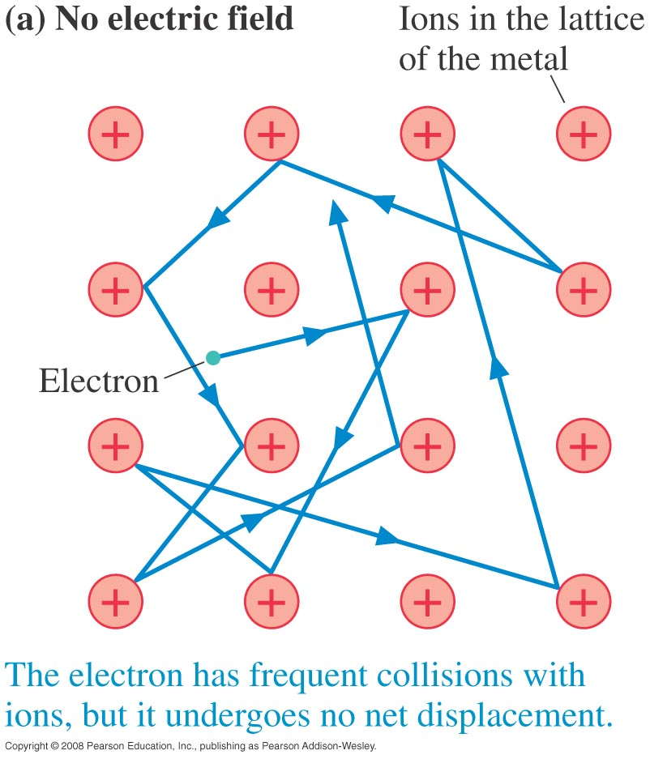
Inside an electrical conductor:
The overall average or “Drift” velocity is zero!

Slide 13
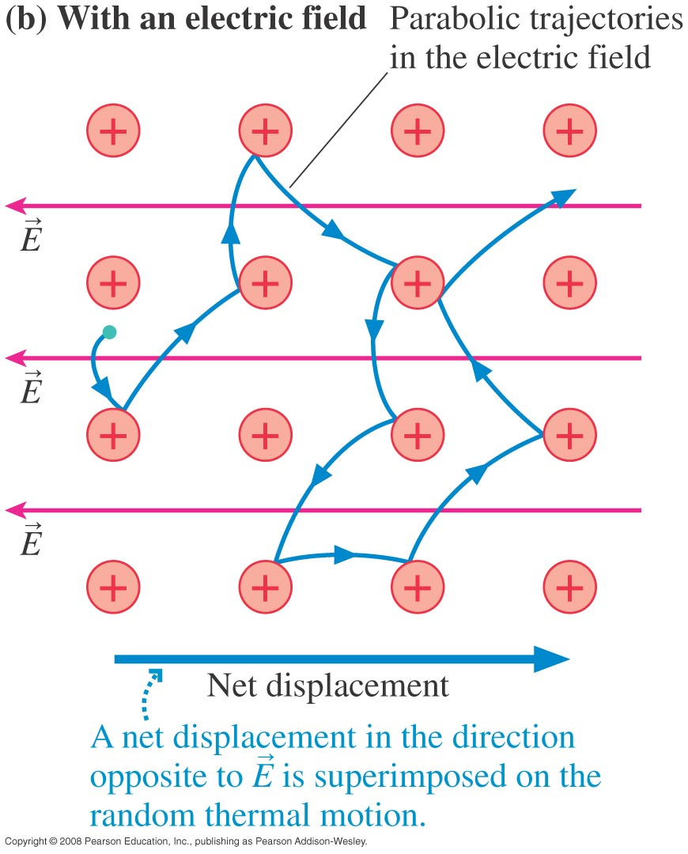
Inside an electrical conductor:
The overall average or “Drift” velocity is opposite to the electric field, about 10 to 100 cm/hour

Slide 14
In Class Discussion Question
Why does the light in a room come on almost instantly when you flip a switch several meters away?
Electrons travel at the speed of light through the wire.
The wire between the switch and the bulb is already full of electrons. Starting the flow of electrons from the switch into the wire almost immediately causes electrons to flow from the other end of the wire into the lightbulb.
The switch sends a radio signal which is received by a receiver in the light which tells it to turn on.
Optical fibers connect the switch with the light, so the light travels from switch to the light at the speed of light in an optical fiber.

Slide 16
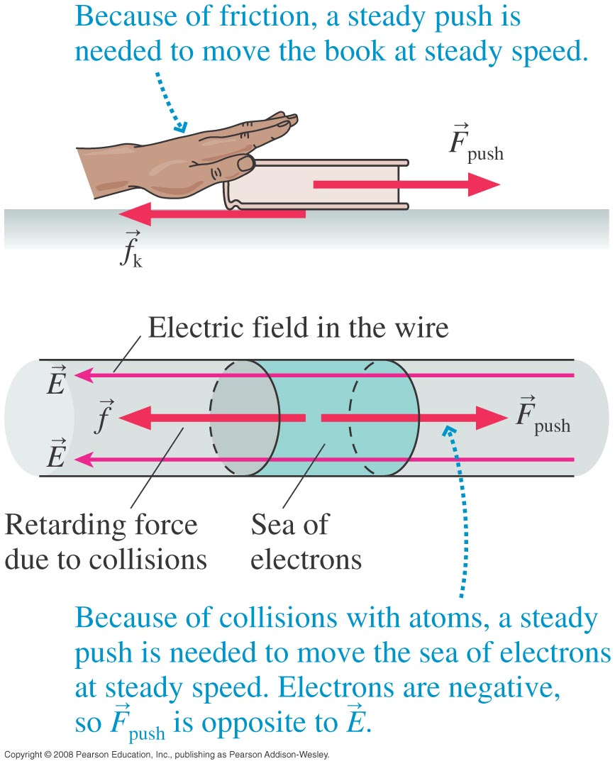

Slide 17
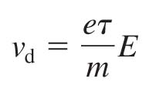
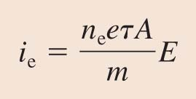
Creating a Current
The average speed at which the electrons are pushed along by an electric field is
Where τ is the mean time between collisions, and m is the mass of the electron.
The electron current is then

Slide 18
Definition of Current
If Q is the total amount of charge that has moved past a point in a wire, we define the current I in the wire to be the rate of charge flow:
The SI unit for current is the coulomb per second, which is called the ampere. 1 ampere = 1 A = 1 C/s.

Slide 19
The Current Density in a Wire
The current density J in a wire is the current per square meter of cross section:
The current density has units of A/m².

Slide 20
Recall: Kirchhoff’s Loop Law
For any path that starts and ends at the same point
Stated in words, the sum of all the potential differences encountered while moving around a loop or closed path is zero.
This statement is known as Kirchhoff’s loop law.
(The meaning is simply that electric potential is a property of space; it doesn’t matter how you got there.)

Slide 21
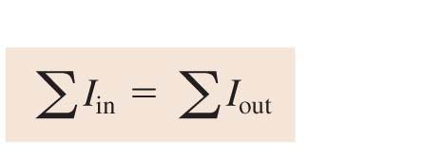
Kirchhoff’s Junction Law
For a junction, the law of conservation of current requires that
where the Σ symbol means summation.
This basic conservation statement – that the sum of the currents into a junction equals the sum of the currents leaving – is called Kirchhoff’s junction law.

Slide 23
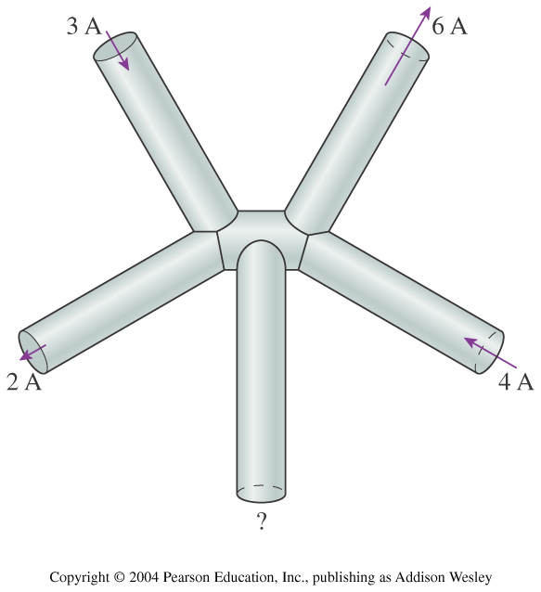
In Class Discussion Question
What are the magnitude and the direction of the current in the fifth wire?
15 A into the junction
15 A out of the junction
1 A into the junction
1 A out of the junction
Not enough data to determine

Slide 24
Conductivity and Resistivity
The conductivity of a material is
Conductivity, like density, characterizes a material as a whole.
The current density J is related to the electric field E by:
The resistivity tells us how reluctantly the electrons move in response to an electric field:

Slide 25
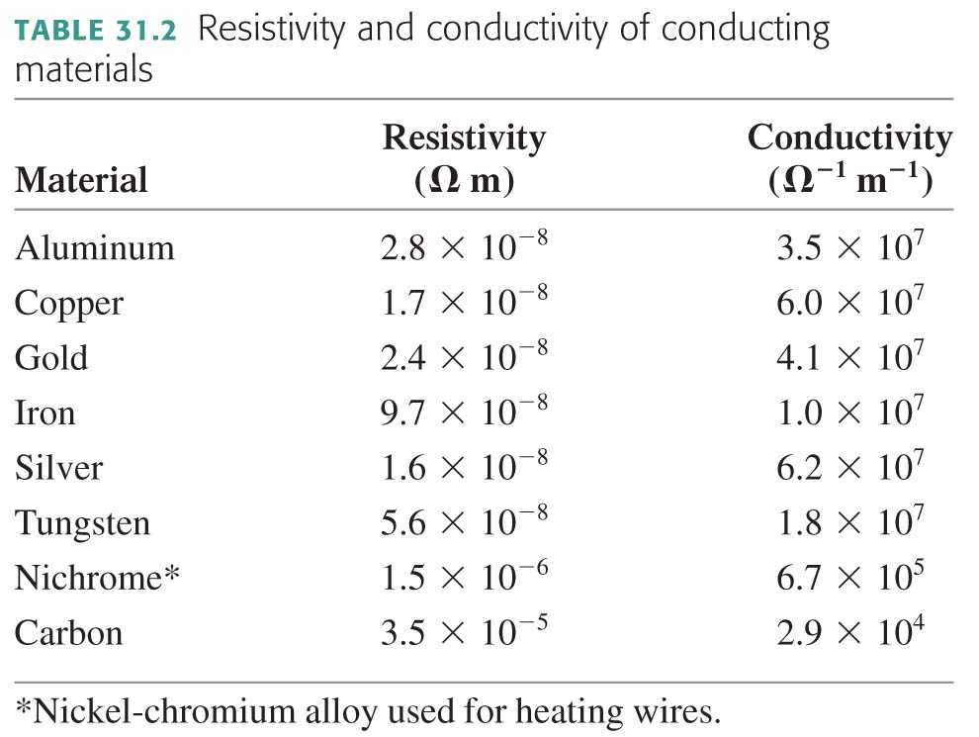

Slide 26
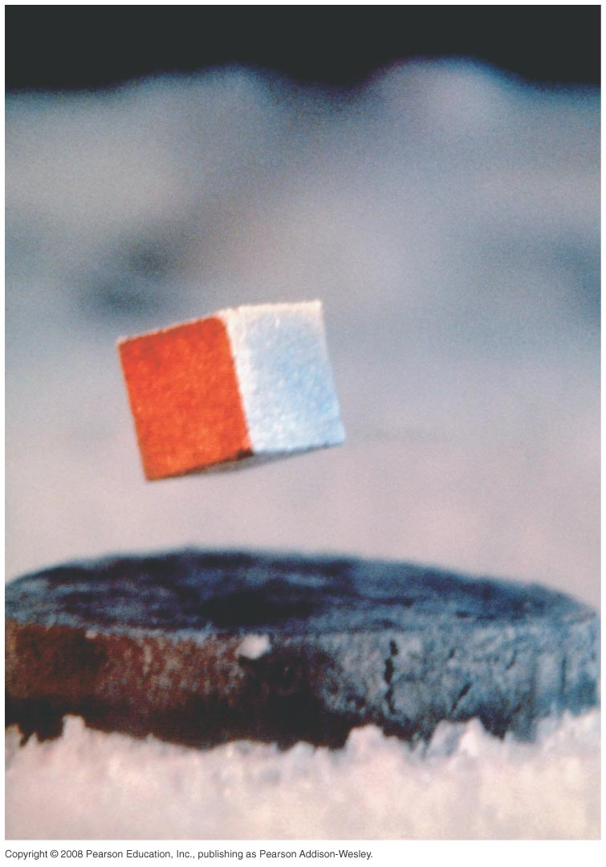
Superconductors
In 1911, it was discovered that certain materials (ie lead and niobium) suddenly and dramatically lose all resistance to current when cooled below about 5 to 10 degrees above absolute zero. Resistivity = 0!
In 1986, high-temperature superconductors were discovered (such as YBa₂Cu₃O₇), which can superconduct at temperatures below 125 Kelvin (−150 C).
Superconductors also have a property of expelling magnetic fields; this makes them repel nearby permanent magnets, allowing them to float.

Slide 28
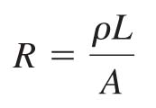
Resistance and Ohm’s Law
The resistance of a long, thin conductor of length L and cross=sectional area A is
The SI unit of resistance is the ohm. 1 ohm = 1 Ω = 1 V/A.
The current through a conductor is determined by the potential difference ΔV along its length:

Slide 29
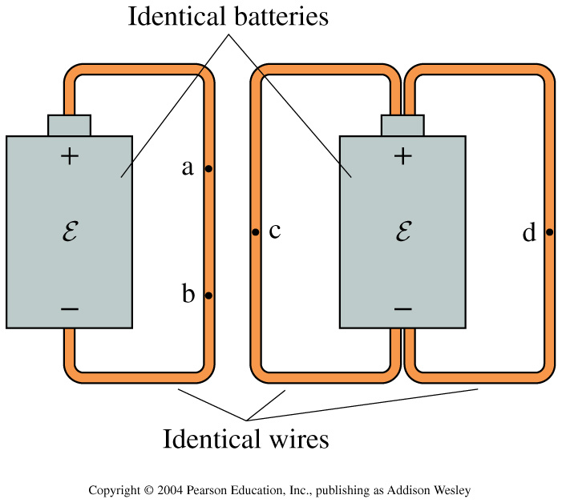
In Class Discussion Question
A wire connects the positive and negative terminals of a battery. Two identical wires connect the positive and negative terminals of an identical battery. Rank in order, from largest to smallest, the currents I_{a} to I_{d} at points a to d.
I_{c} = I_{d} > I_{a} > I_{b}
I_{a} = I_{b} > I_{c} = I_{d}
I_{c} = I_{d} > I_{a} = I_{b}
I_{a} = I_{b} = I_{c} = I_{d}
I_{a} > I_{b} > I_{c} = I_{d}

Slide 30
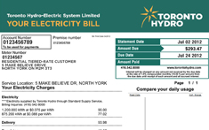
Andrew will be back Wednesday
Please read Chapter 31, first three sections.
Kirchoff’s Laws and the Basic Circuit
Energy and Electric Power (this is what you pay for from Toronto Hydro!)
Note: Problem Set 7 is not for marks; it is just practice for the test which is one week from tomorrow.

