Slide 1


Jason Harlow
Monday Apr. 6
2:00-4:00
SS2117
PHY132
Exam
Jam
PHY132 Exam:
Thursday Apr.9 at 2:00pm
Comprehensive (covers the entire course)

Slide 2
The Final ExaM
Course | Last Name | Date | Time | Location
PHY132H1S | A - LE | THU 09 APR | PM 2:00 - 4:00 | EX 100
PHY132H1S | LI - W | THU 09 APR | PM 2:00 - 4:00 | EX 200
PHY132H1S | X - Z | THU 09 APR | PM 2:00 - 4:00 | EX 320
EX is Central Exams Facility, 255 McCaul St. (just south of College St.)

Slide 3
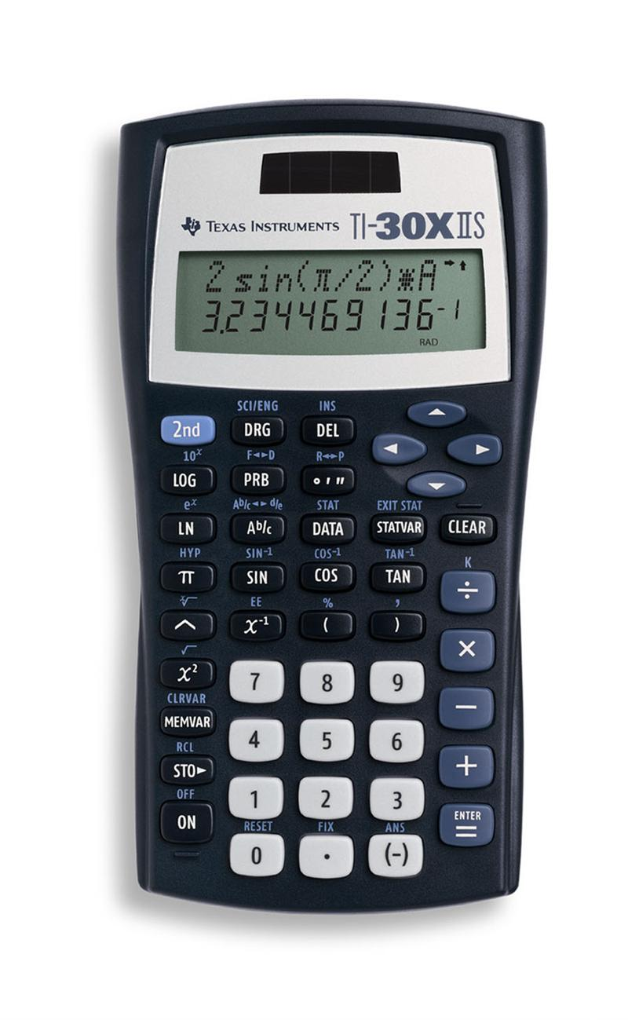
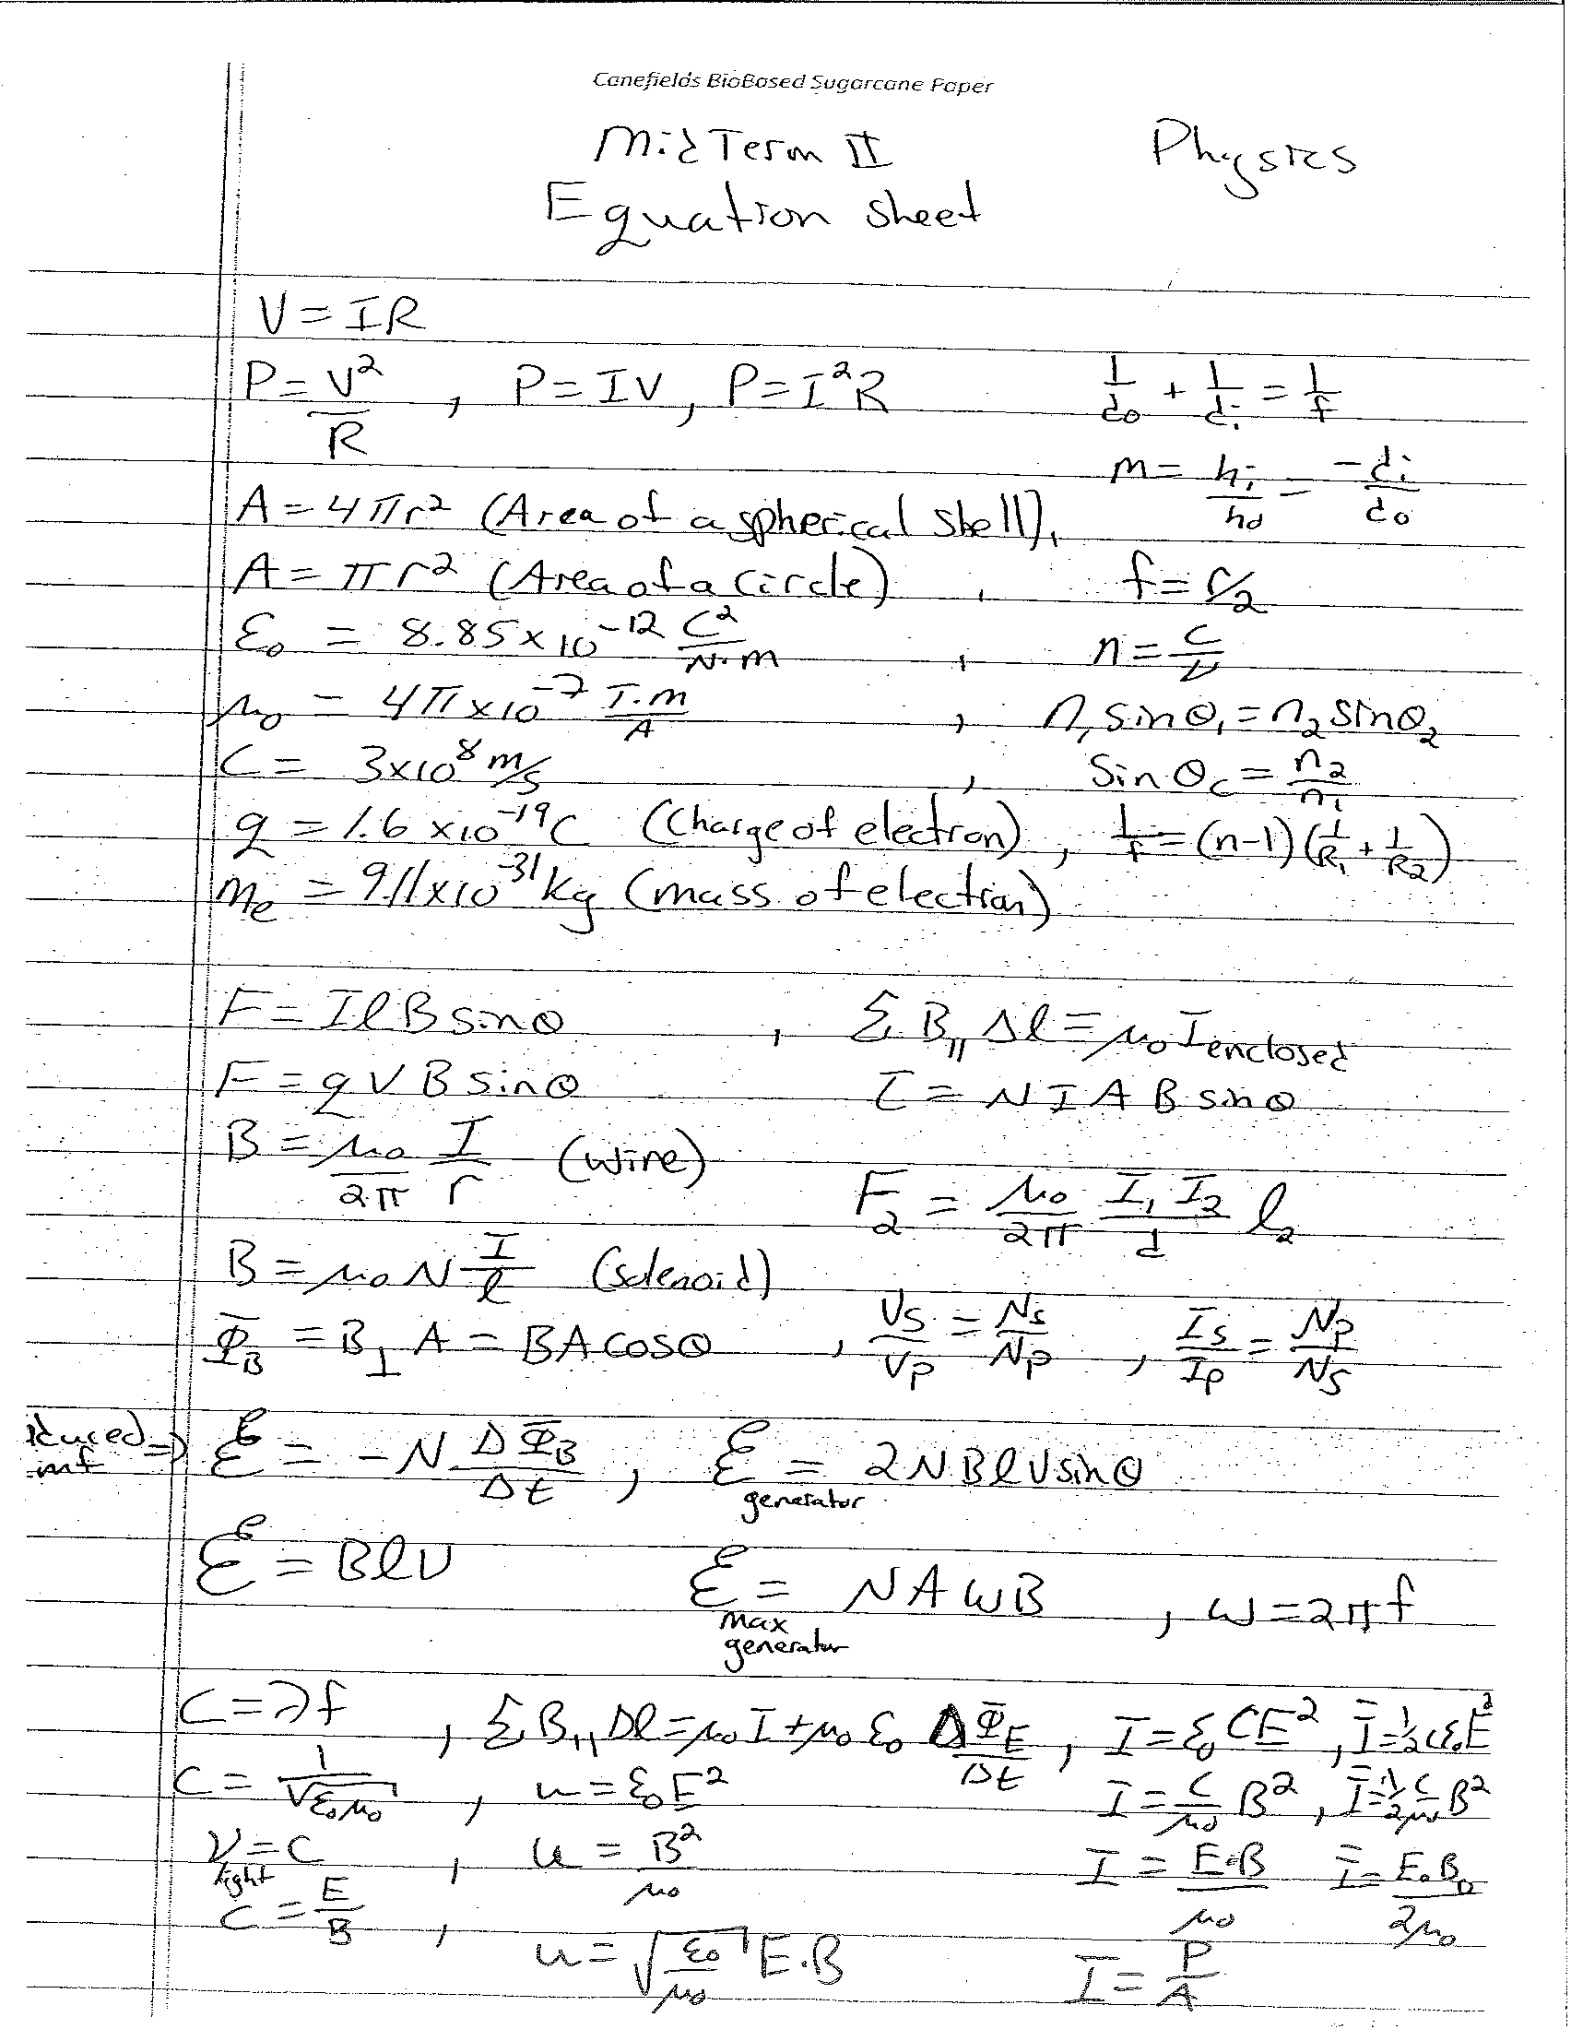
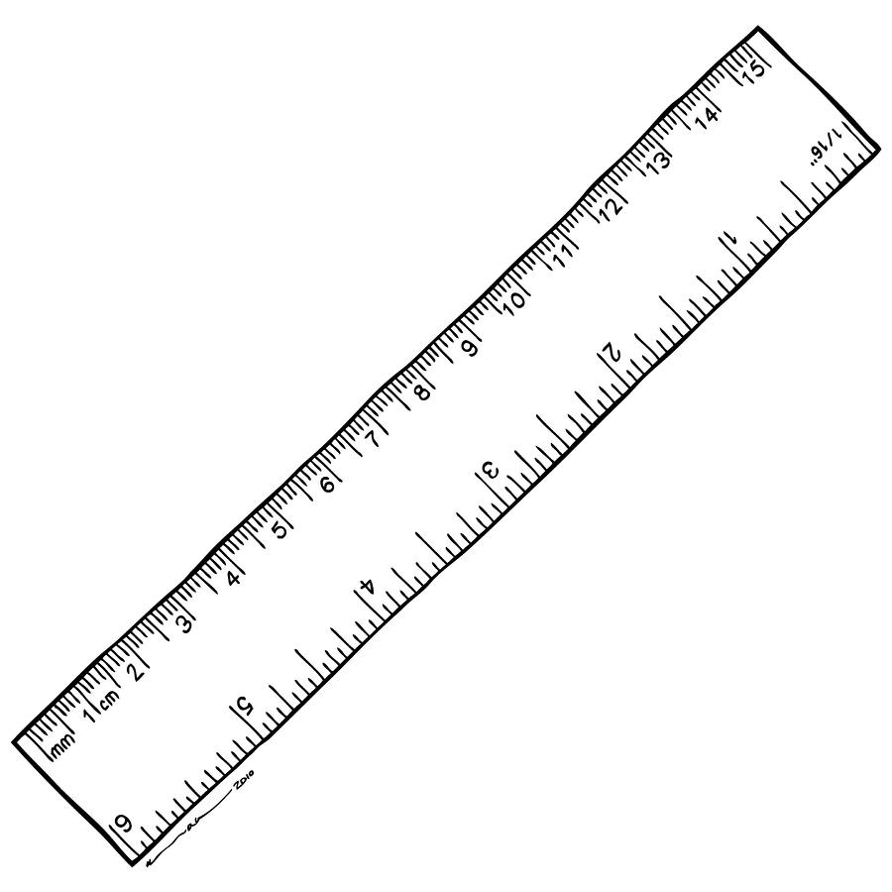



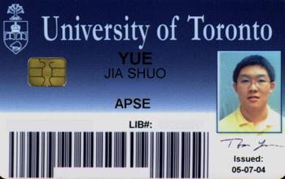

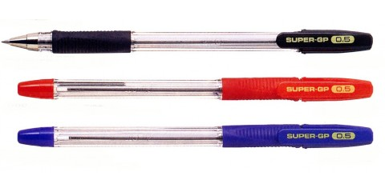
Aids Allowed on the Final Exam
Any calculator without communication capability.
Aid sheet: one single, original, handwritten 8 1/2 × 11 inch sheet of paper, which may be written on both sides.
A ruler.
A paper copy of an English translation dictionary.
Also:

Slide 4



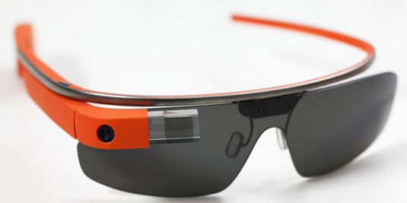
During the Exam
Exam begins at 2:00pm SHARP!!!
Skim over the entire exam from front to back before you begin. Look for problems that you have confidence to solve first.
If you start a problem but can’t finish it, leave it, make a mark on the edge of the paper beside it, and come back to it after you have solved all the easy problems.
When you are in a hurry and your hand is not steady, you can make little mistakes; if there is time, do the calculation twice and obtain agreement.
Bring a snack or drink.
Don’t leave an exam early!
No phones!
No Apple Watch!
No Google Glasses!

Slide 5
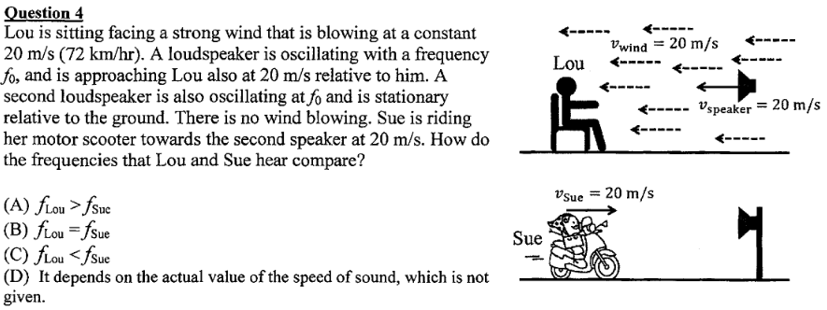
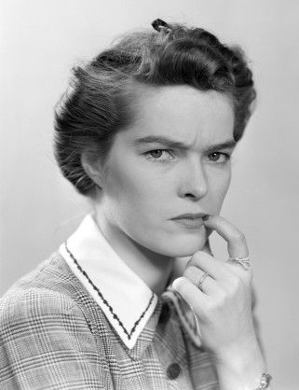
From April 2014 Final Exam
Let’s review.

Slide 6
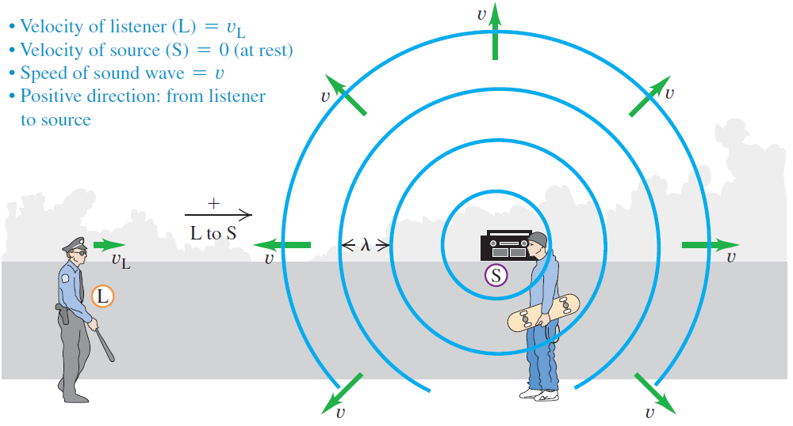

The Doppler effect: Moving listener
An observer moving toward a stationary source hears a frequency that is higher than the at-rest frequency f₀.
$$v_{o}$$

Slide 7
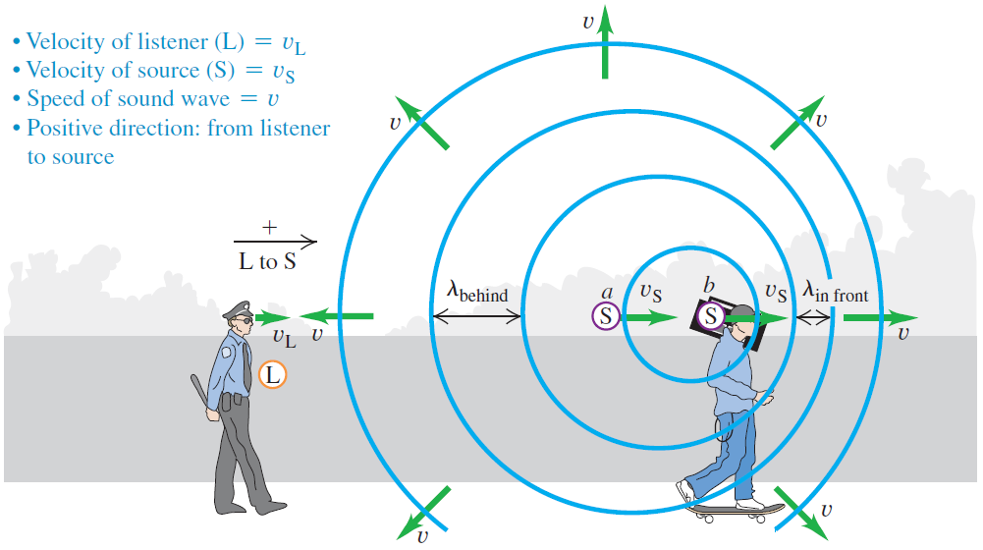

The Doppler effect: Moving source
When a source is moving away from an observer, the waves behind the source are stretched to a longer wavelength.
Since f = v/λ, a longer wavelength corresponds to a lower frequency.
$$v_{o}$$

Slide 8
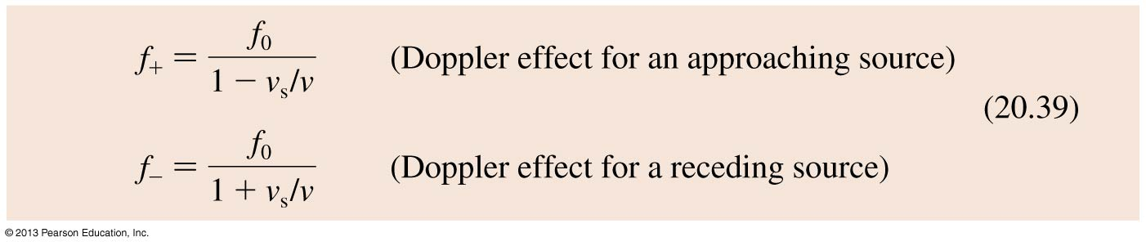
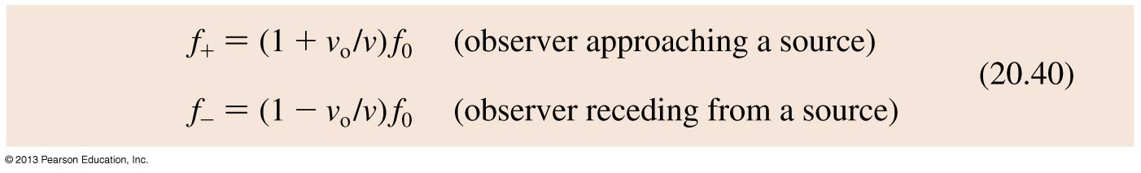
The Doppler Effect
The frequencies heard by a stationary observer when the sound source is moving at speed v₀ are
The frequencies heard by an observer moving at speed v₀ relative to a stationary sound source emitting frequency f₀ are

Slide 9
From April 2014 Final Exam

Slide 10
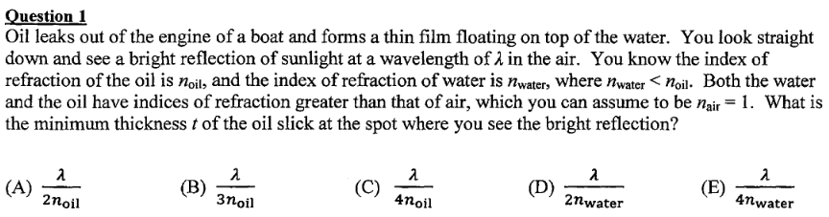

From April 2014 Final Exam
Let’s review.

Slide 11
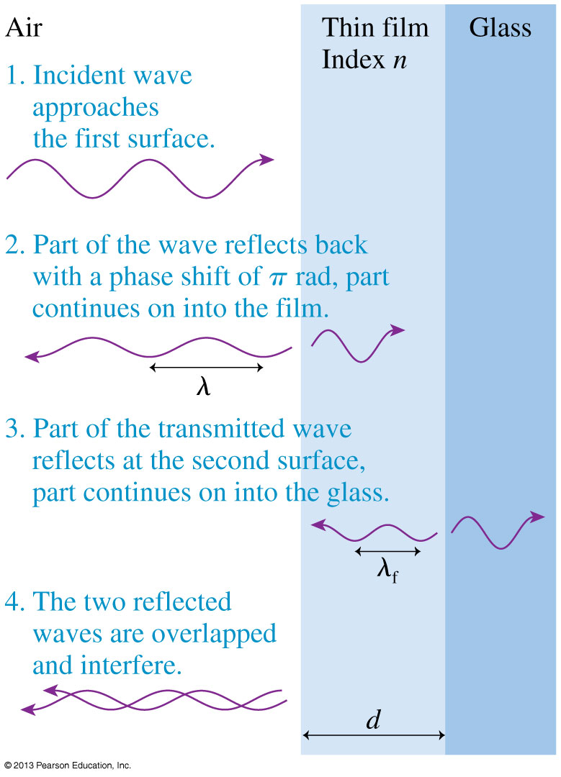
Thin-Film Optical Coatings
Thin transparent films, placed on glass surfaces, such as lenses, can control reflections from the glass.
Antireflection coatings on the lenses in cameras, microscopes, and other optical equipment are examples of thin-film coatings.

Slide 12
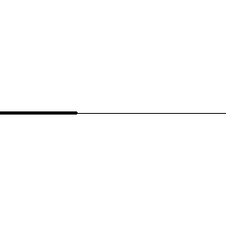
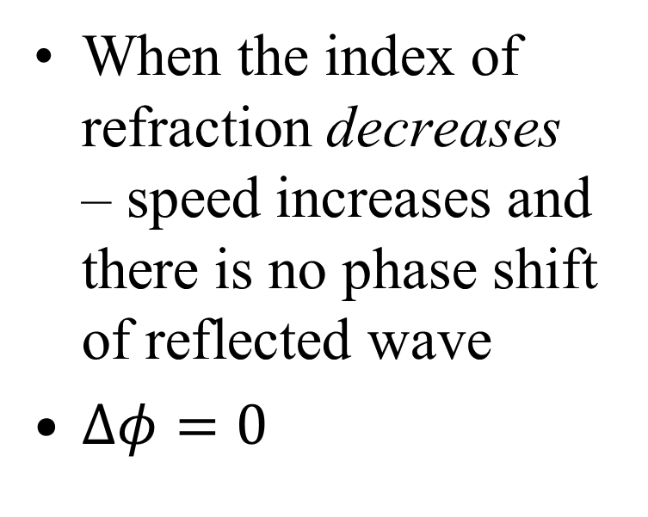
Reflection of Wave Pulse
When the index of refraction decreases – speed increases and there is no phase shift of reflected wave
$∆φ=0$
[Animation courtesy of Dan Russell, Penn State]

Slide 13
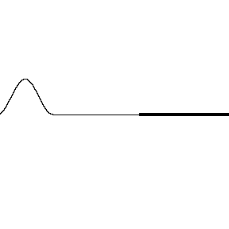
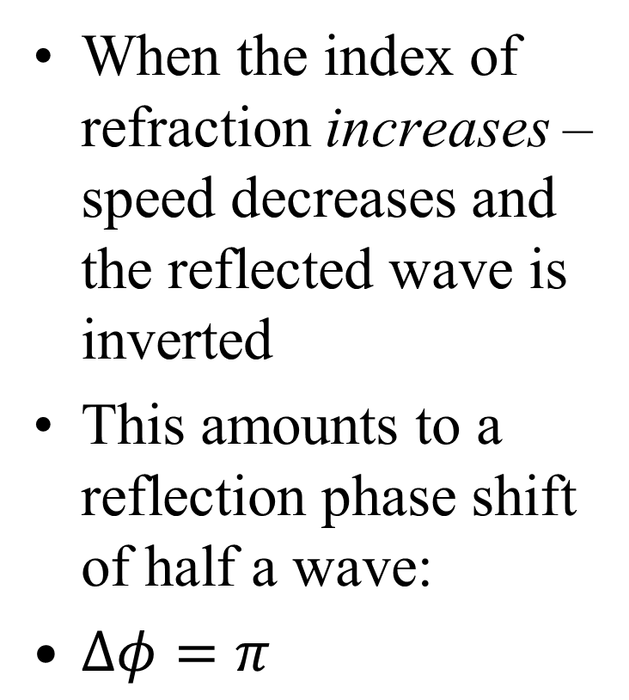
Reflection of Wave Pulse
When the index of refraction increases – speed decreases and the reflected wave is inverted
This amounts to a reflection phase shift of half a wave:
$∆φ=π$
[Animation courtesy of Dan Russell, Penn State]

Slide 14
From April 2014 Final Exam

Slide 15
air
water
A fish swims directly below the surface of the water. An observer sees the fish at:
A. a greater depth than it really is.
B. its true depth.
C. a smaller depth than it really is.

Slide 16
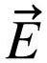
The Electric Field
A charged particle with charge q at a point in space where the electric field is experiences an electric force:
If q is positive, the force on the particle is in the direction of .
The force on a negative charge is opposite the direction of .
The units of the electric field are N/C. The magnitude E of the electric field is called the electric field strength.

Slide 17
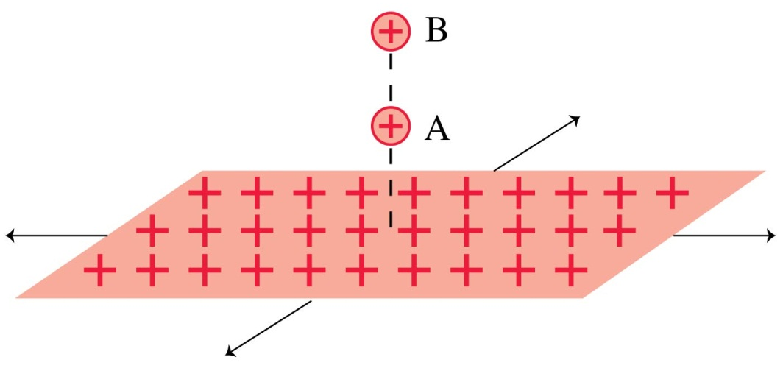
QuickCheck 26.9
Two protons, A and B, are next to an infinite plane of positive charge. Proton B is twice as far from the plane as proton A. Which proton has the larger acceleration?
Proton A.
Proton B.
Both have the same acceleration.
Notes:
17

Slide 18
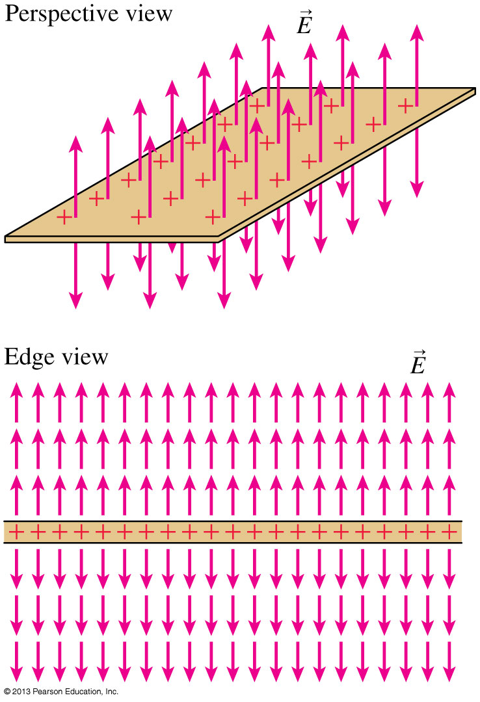
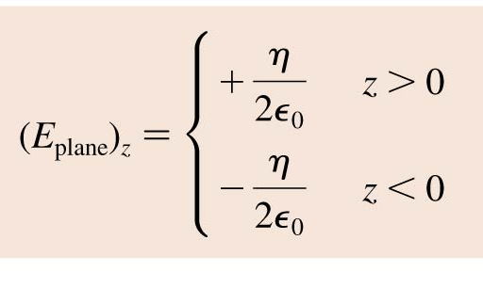
A Plane of Charge

Slide 19
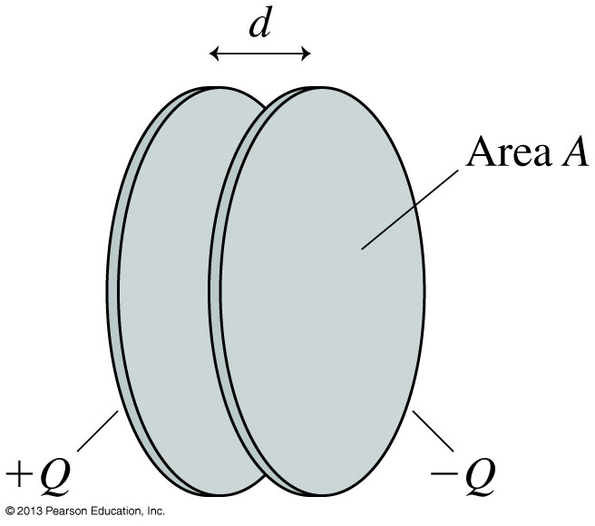
Capacitors
The figure shows two electrodes, one with charge +Q and the other with −Q placed face-to-face a distance d apart.
This arrangement of two electrodes, charged equally but oppositely, is called a capacitor.
Capacitors play important roles in many electric circuits.

Slide 20

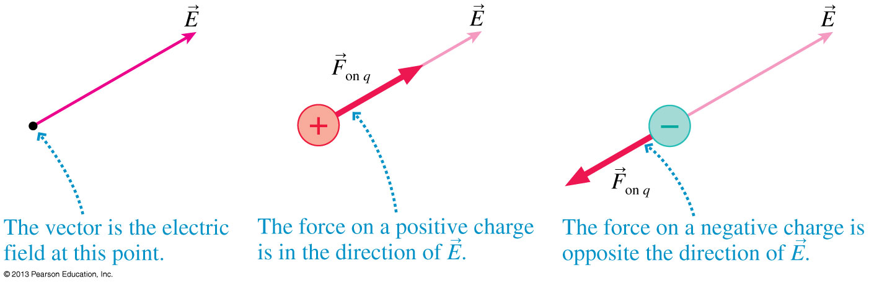
Motion of a Charged Particle in an Electric Field
Consider a particle of charge q and mass m at a point where an electric field E has been produced by other charges, the source charges.
The electric field exerts a force F_{on q} = qE.

Slide 21
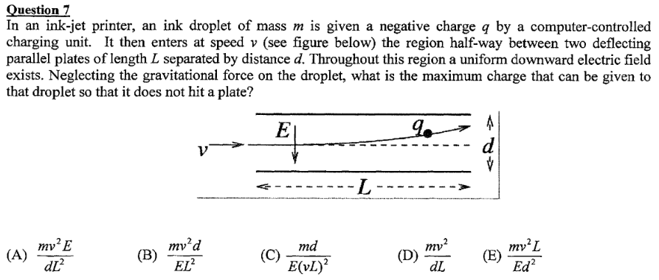
From April 2014 Final Exam

Slide 22
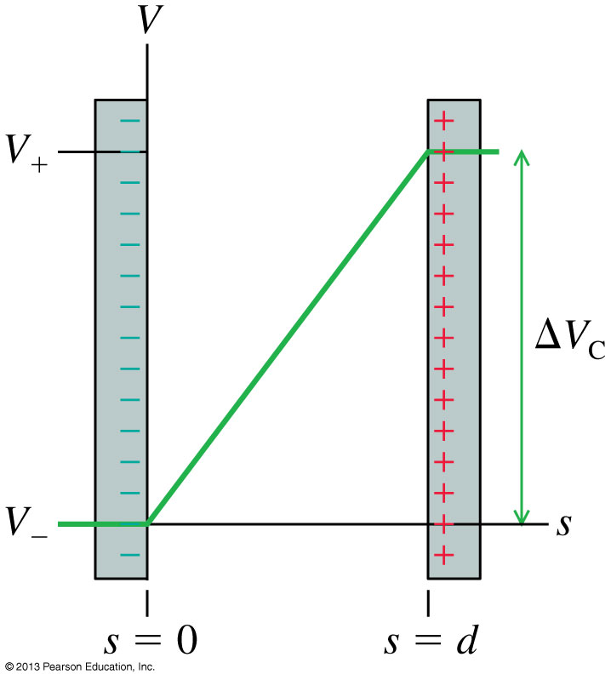
The Electric Potential Inside a Capacitor
The electric potential inside a capacitor is
where s is the distance from the negative electrode.
The potential difference ΔV_{C}, or “voltage” between the two capacitor plates is

Slide 23
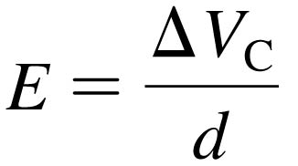
Units of Electric Field
If we know a capacitor’s voltage ΔV and the distance between the plates d, then the electric field strength within the capacitor is:
This implies that the units of electric field are volts per meter, or V/m.
Previously, we have been using electric field units of newtons per coulomb.
In fact, these units are equivalent to each other:
1 N/C = 1 V/m

Slide 24
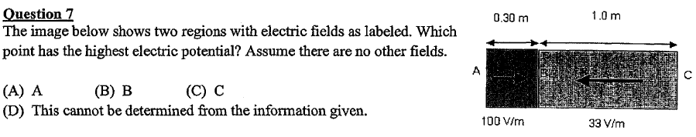
From April 2013 Final Exam

Slide 25
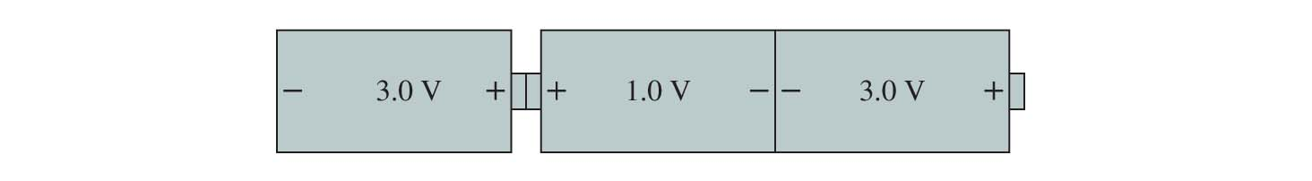
In class discussion question
What total potential difference (V_{B} – V_{A}) is created by these three batteries?
A
B
1.0 V
2.0 V
5.0 V
6.0 V
7.0 V
Notes:
STT30.3
Answer: C

Slide 26
The point:
Electric Potential is a property of space.
Every point has a certain value, and it must change from one side of a battery to another by its emf.
Also, V is higher on the + side of a battery.
V=+3V
V=+5V
V=+2V
B
A
Define this point to be V = 0
Notes:
STT30.3
Answer: C

Slide 27
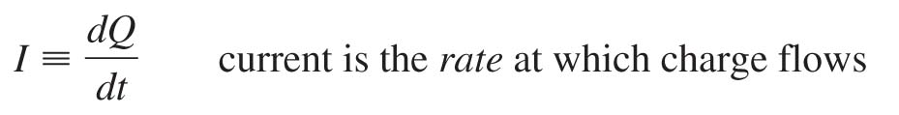
Definition of Current
If Q is the total amount of charge that has moved past a point in a wire, we define the current I in the wire to be the rate of charge flow:
The SI unit for current is the coulomb per second, which is called the ampere. 1 ampere = 1 A = 1 C/s.

Slide 28
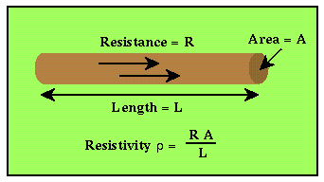
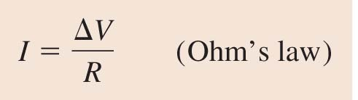
Resistance and Ohm’s Law
The SI unit of resistance is the ohm.
1 ohm = 1 Ω = 1 V/A.
The current through a conductor is determined by the potential difference ΔV along its length:

Slide 29
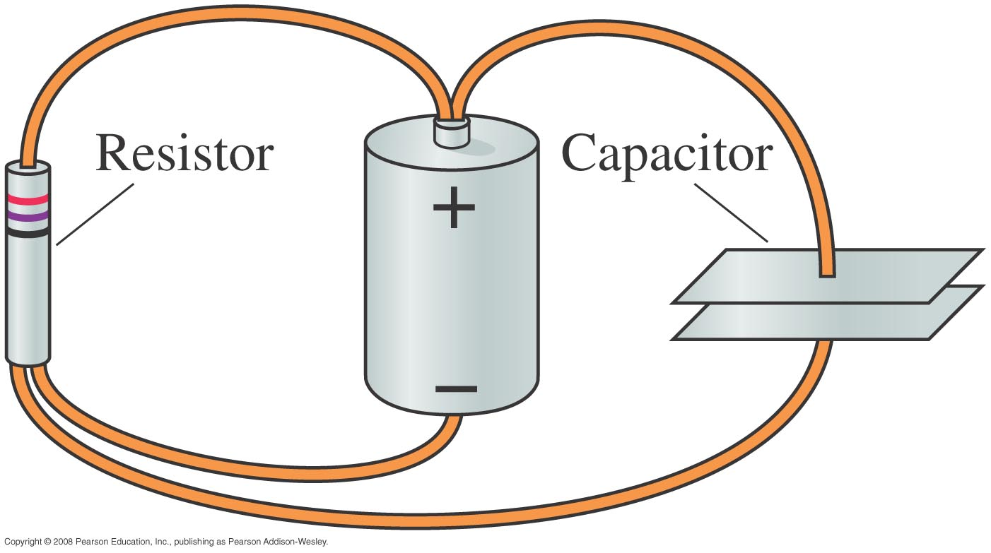
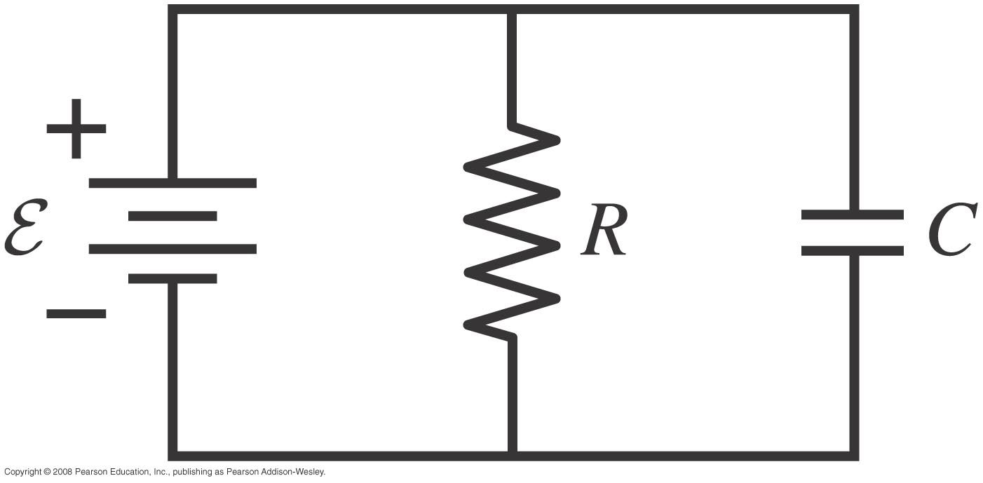
Circuit Diagrams
Real life:
A circuit diagram:

Slide 30

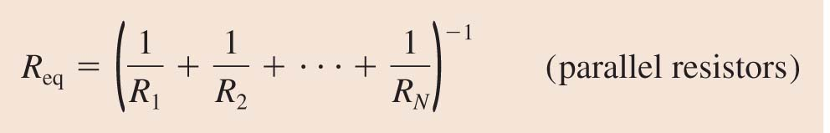
Series Resistors
Resistors that are aligned end to end, with no junctions between them, are called series resistors or, sometimes, resistors “in series.”
Parallel Resistors
Resistors connected at both ends are called parallel resistors or, sometimes, resistors “in parallel.”

Slide 31
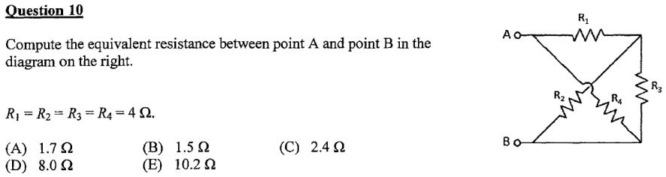
From April 2014 Final Exam

Slide 32
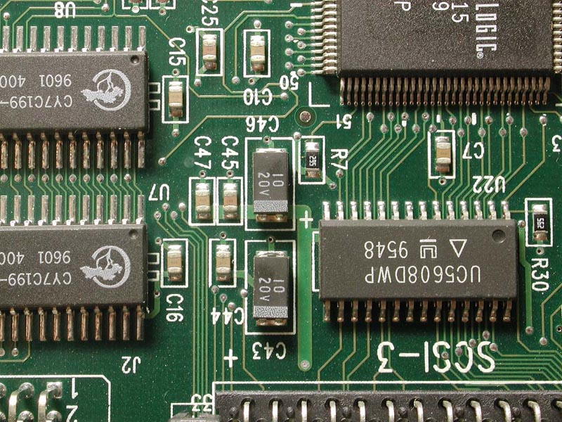
Some quick notes about circuits:
“Electric Potential Difference” and “Voltage” mean the same thing.
We speak of voltage “across” a resistor, and current “through” a resistor.
Two points connected by an ideal wire always have the same potential.

Slide 33
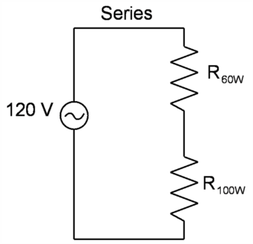
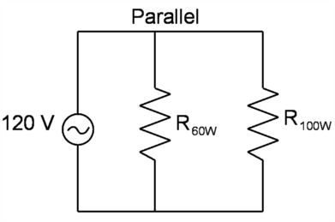
Demonstration. Two ways of wiring two different light bulbs.
Note: A circle with a wavy line in it represents an Alternating Current (AC) power supply. It is like a battery, except the voltage flips direction 60 times per second.

Slide 34
Demonstration. In Class Discussion Question.
If the bulbs are wired in series and the 100 W bulb is unscrewed, what will happen to the 60 W bulb?
A. It will light up.
B. It will not light up.

Slide 35
Demonstration. In Class Discussion Question
If the bulbs are wired in parallel and the 100 W bulb is unscrewed, what will happen to the 60 W bulb?
A. It will light up.
B. It will not light up.

Slide 36
Demonstration. In Class Discussion Question
If the bulbs are wired in parallel , which bulb will consume more power?
A. The 60 W bulb.
B. The 100 W bulb.
C. both will consume the same power.

Slide 37
Demonstration. In Class Discussion Question
If the bulbs are wired in series, which bulb will consume more power?
A. The 60 W bulb.
B. The 100 W bulb.
C. both will consume the same power.

Slide 38
Demonstration. The moral:
- The thing that is the same for resistors in parallel is voltage. Use P = V ² / R to compare power. Higher power corresponds lower resistance.
- The thing that is the same for resistors in series is current. Use P = I ² R to compare power. Higher resistance corresponds to higher power.
- In your house, Parallel is always used.

Slide 39
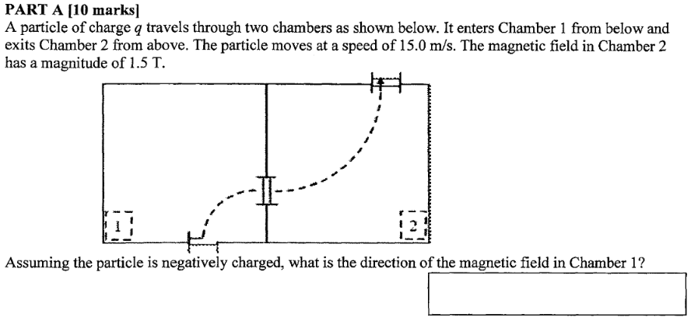

From April 2014 Final Exam
Let’s review.

Slide 40
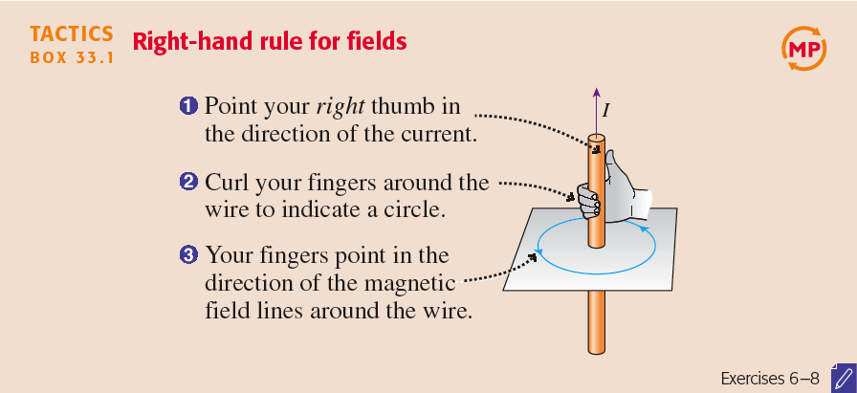
Right-hand rule for magnetic fields

Slide 41
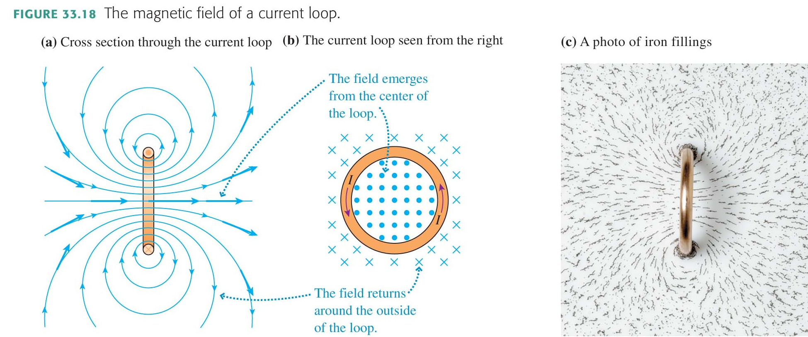

Slide 42
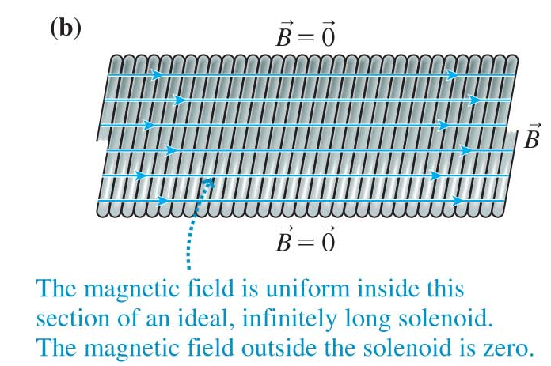
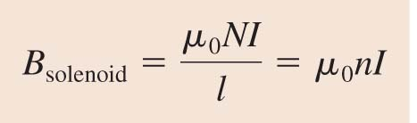
The strength of the uniform magnetic field inside a solenoid is
where n = N/l is the number of turns per unit length.

Slide 43
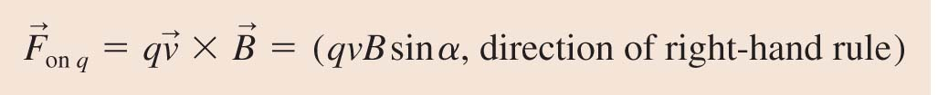
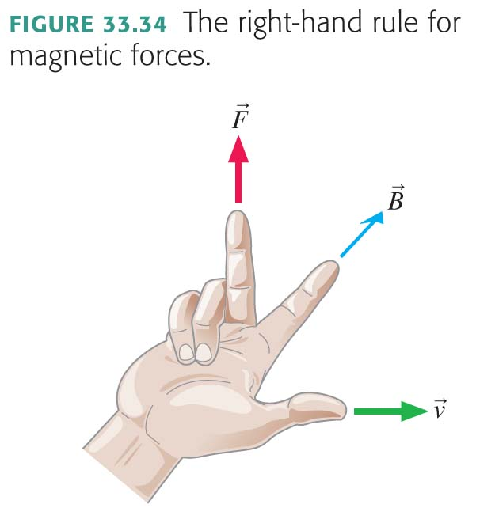
The Magnetic Force on a Moving Charge
The magnetic force on a charge q as it moves through a magnetic field B with velocity v is
where α is the angle between v and B.
Right Hand Rule for Forces:

Slide 44
From April 2014 Final Exam

Slide 45
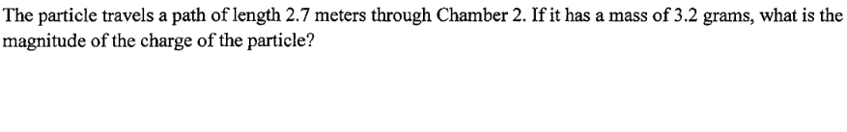
From April 2014 Final Exam

Slide 46
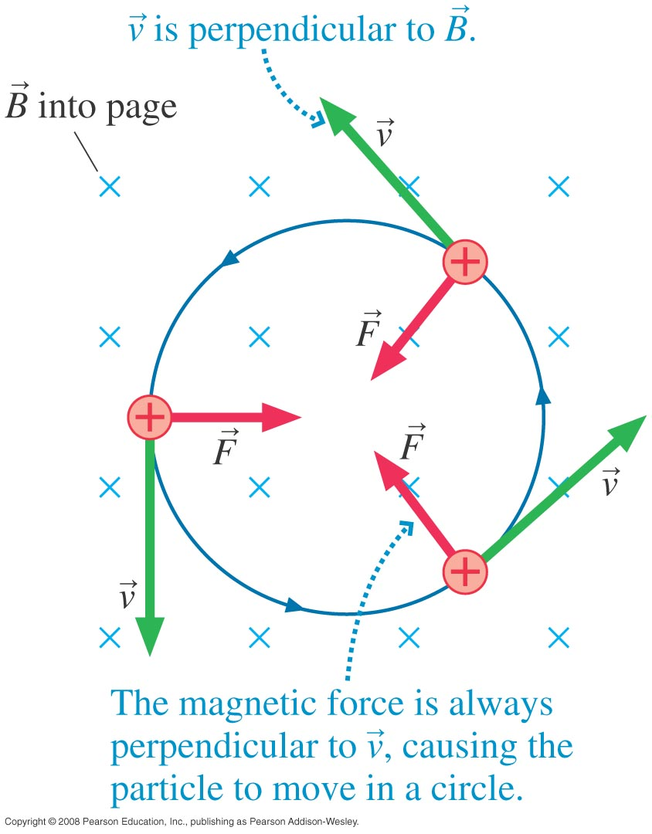
Magnetic Force is important for fast moving electrons or positive ions in a vacuum.
Since F tends to be perpendicular to v, it forms a good centripetal force.

Slide 47
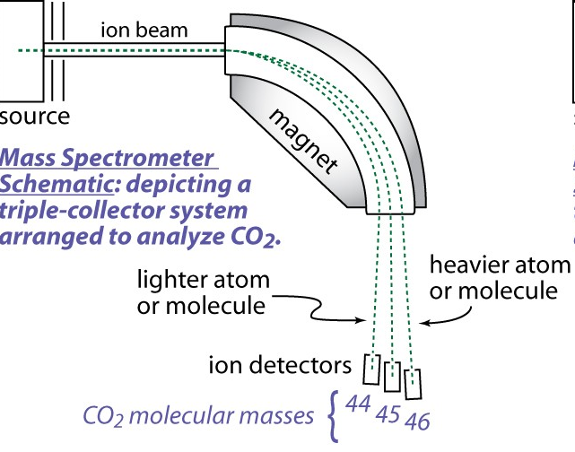
Mass Spectrometers use the fact that the radius of circular trajectory in a magnetic field depends on the mass of the particles.

Slide 48
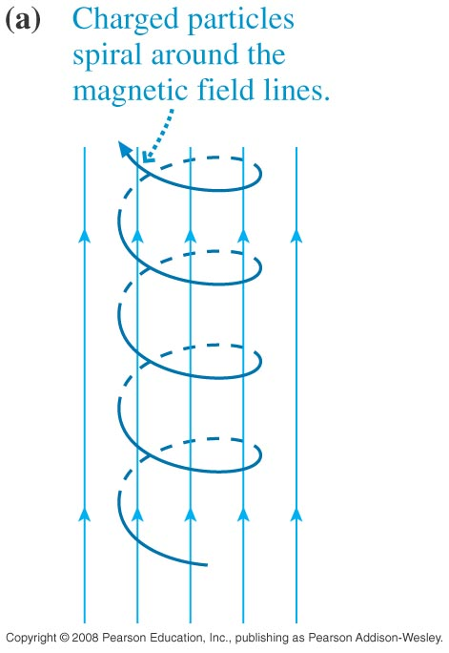

Cyclotron Motion: in 3D the motion of charged particles is not a circle but a spiral.
The Earth’s magnetic field protects us from high energy charged particles from the Sun (beta, alpha radiation).

Slide 49

Aurora Borealis is natural light caused by charged particles accelerating in the Earth’s magnetic field.

Slide 50


From April 2014 Final Exam
Let’s review.

Slide 51
Relativity quiz..
A flashlight is moving forward at speed 0.1 c (10% of the speed of light, or 30,000 km/s).
How fast do the light waves emerge from the front of the flashlight, as observed by a person who is at rest on the ground?
c
1.1 c
0.9 c
Notes:
Answer: D

Slide 52
Relativity quiz..
A flashlight is moving forward at speed 0.1 c (10% of the speed of light, or 30,000 km/s).
How fast do the light waves emerge from the front of the flashlight, as observed by the moving person who is holding on to the flashlight?
c
1.1 c
0.9 c
Notes:
Answer: D

Slide 53

Principle of Constancy of Lightspeed
The speed of light (and of other electromagnetic radiation) in empty space is the same for all observers, regardless of the motion of the light source or of the observer.
v = 0.25 c
The light moves at speed c relative to Mort and relative to Velma.
c
Notes:
This conclusion, the Principle of the Constancy of Lightspeed, is the second of the two principles behind Einstein's theory.
Logically, it is a consequence of the first principle and of Maxwell's theory. But it is such a surprising and far-reaching consequence that it is considered to be a separate principle.
Emphasize that it is an odd (counter-intuitive) idea—the first of many such ideas in modern physics. Make this principle concrete by discussing Figures 10.4–10.6, contrasting Einstein's predictions with Galileo's.
Figure above: Galilean relativity predicts that Mort sees the light move to the right at speed c and Velma sees the light move to the right at speed 0.75c. Einstein says c for both.

Slide 54

Do you really believe this??
v = 0.999,999 c
c
Even here, both Mort and Velma observe the speed of light to be c.
Notes:
Now imagine that Velma is moving away from Mort very quickly, at 0.999 999 c.
Mort sees the light from his flashlight move to the right at speed c.
For Mort, it looks like Velma should almost be keeping up with the light beam, as she moves only a little slower than c.
Galilean relativity predicts that Velma sees the light moving to the right at speed 0.000 001 c, or 300 m/s.
However, this is NOT what Velma sees!
Einstein’s relativity predicts that Velma sees the light moving to the right at speed c = 300,000 km/s.
This IS what would be observed.
Note that we never assign Velma a speed of exactly c. This is because no massive object can travel as fast as light.

Slide 55

Light Clocks
A “light clock” is made up of two parallel mirrors, separated by a vacuum and held at a fixed distance of d.
A short pulse of light bounces between the mirrors, “ticking” for each bounce.

Slide 56

Twin Paradox
Fred and George are identical, and so have identical life-spans. They each have a light clock. This light clock “ticks” once every millisecond, so they both expect to observe 2.5 × 10¹² ticks in their 80 year life-span.

Slide 57
Twin Paradox
Fred flies on his broomstick to the right at 20% of the speed of light. George stays on the ground.
Fred
Over his life, George sees 2.5 × 10¹² ticks of his stationary clock.
How many “ticks” of Fred’s clock does George observe?
More than 2.5 × 10¹²
Fewer than 2.5 × 10¹²
2.5 × 10¹²
George

Slide 58
Twin Paradox
Fred flies on his broomstick to the right at 20% of the speed of light. George stays on the ground.
Fred
After George sees 2.5 × 10¹² ticks of his stationary clock, he dies of old age. How do you expect his twin brother is doing?
Fred will also probably die at this time.
Fred has more life to live.
Fred has already been dead for some time.
George

Slide 59
Twin Paradox
Fred flies on his broomstick to the right at 20% of the speed of light. George stays on the ground.
According to Fred, in his reference frame, he is stationary, and his brother is moving to the left at 20% of the speed of light.
George
Over his life, Fred sees 2.5 × 10¹² ticks of his clock, which is stationary relative to him.
How many “ticks” of George’s clock does Fred observe?
More than 2.5 × 10¹²
Fewer than 2.5 × 10¹²
2.5 × 10¹²
Fred

Slide 60

Time Dilation
The time interval between two events that occur at the same position is called the proper time Δτ. In an inertial reference frame moving with velocity v = βc relative to the proper time frame, the time interval between the two events is
The “stretching out” of the time interval is called time dilation.

Slide 61
From April 2014 Final Exam

Slide 62


Good Luck!!
I’ll see you on Thursday at 2:00pm!!
Then I hope to see you again in the future – please say hi if you see me around campus, and feel free to stop by my office any time you see my open door.
It’s been a lot of fun teaching you physics this year – have a fantastic rest of your life!!!!
Course | Last Name | Date | Time | Location
PHY132H1S | A - LE | THU 09 APR | PM 2:00 - 4:00 | EX 100
PHY132H1S | LI - W | THU 09 APR | PM 2:00 - 4:00 | EX 200
PHY132H1S | X - Z | THU 09 APR | PM 2:00 - 4:00 | EX 320

