Slide 1
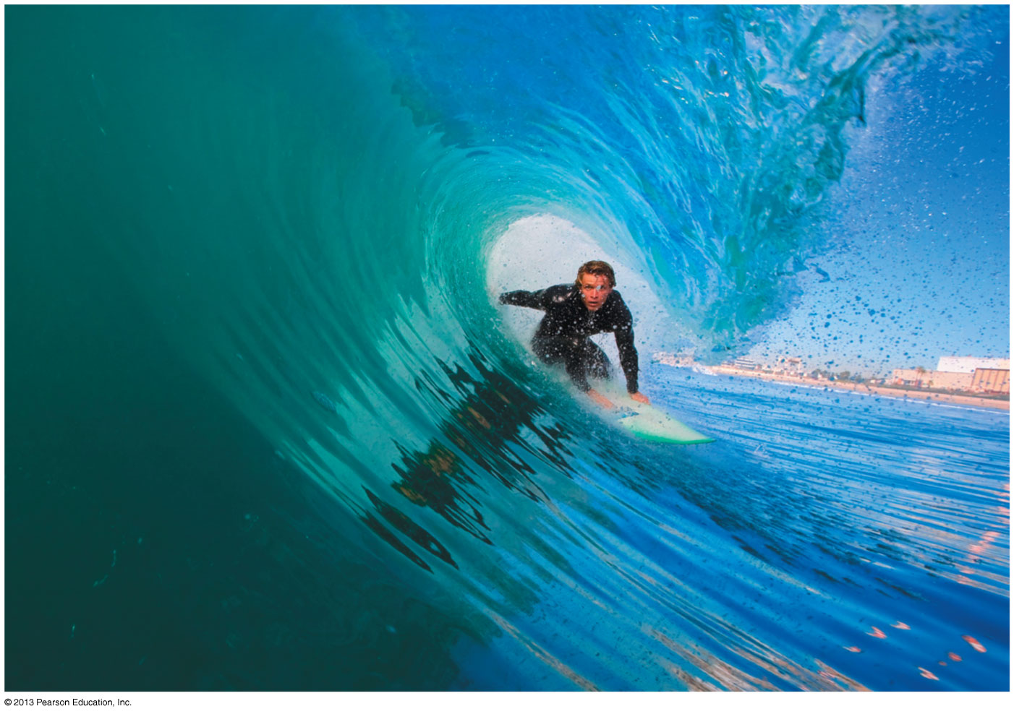
PHY132 Introduction to Physics II Class 2 – Outline:
Waves in 2-D and 3-D
Spherical waves and plane waves
Index of Refraction
Power, Intensity and
Decibels
The Doppler Effect

Slide 2
Pre-Class Slide Scavenger Hunt
These pre-class slides, posted Tuesday Jan. 6, 2015, contain one slide that purposefully has wrong information: Try to find it!
It is a joke, not meant to be taken seriously.
You may, or may not, find this joke to be funny.
Come to class, and I will let you know which slide it was!

Slide 3
i-Clicker Instructions
Status Light
When I start asking clicker questions:
Status light will flash green when your response is registered on my computer.
Status will flash red if your response is not registered.
Power Light
On/Off Switch
Please turn on your clicker now

Slide 4
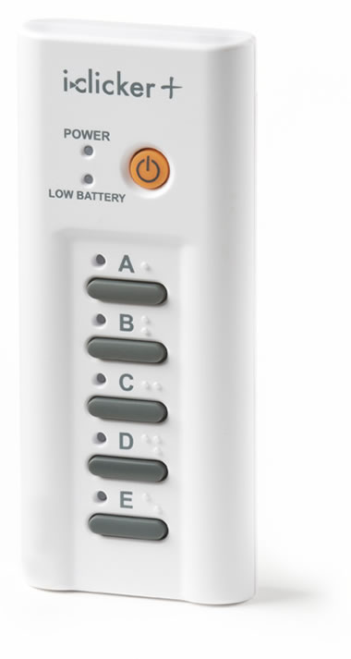
i-Clicker+ Instructions
Status Lights
When I start asking clicker questions:
Status light will flash green when your response is registered on my computer.
Status will flash red if your response is not registered.
Power Light
On/Off Switch
Please turn on your clicker now

Slide 5
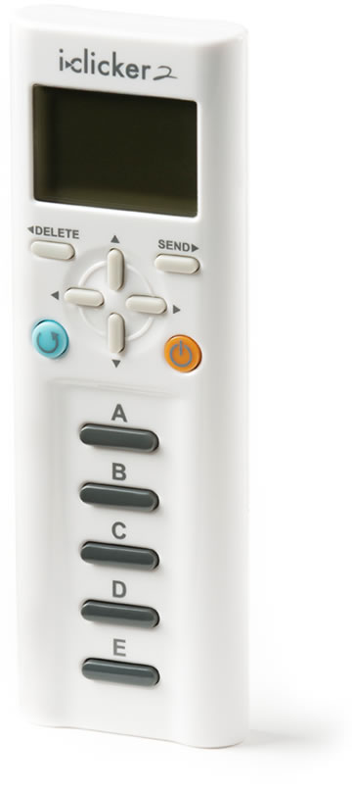
i-Clicker2 Instructions
Status Window
Tells you when your response has been registered on my computer.
Note that the frequency-code for this course is the default: “AA”
On/Off Switch
Please turn on your clicker now

Slide 6
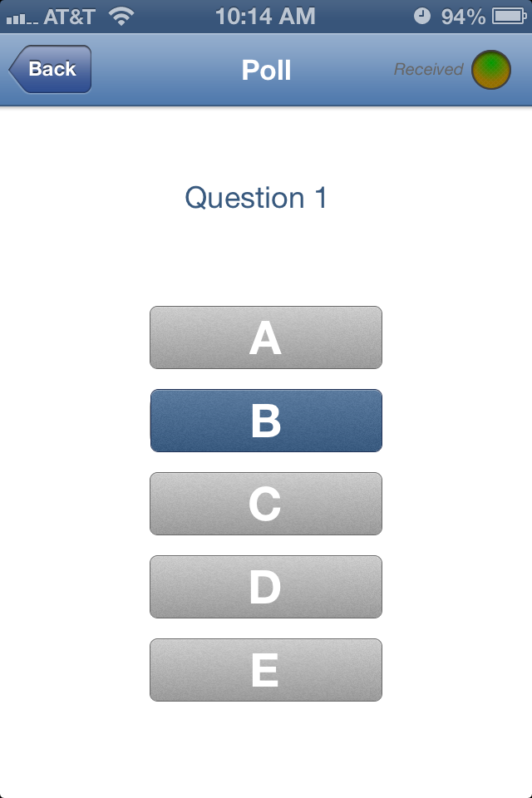
i-Clicker GO App instructions
You need to install the free app and you need to have a data plan or be able to use the wi-fi in this room (ie the “U of T” network – log on with your portal ID and password.)
After a 2-week trial, the cost is $10 per semester.
You have to type in the zip-code for U of T St.George campus, which is M5S1A1.
Find Jason Harlow, and find PHY132 Winter 2015.
When I start the vote, your phone will look like this.

Slide 7
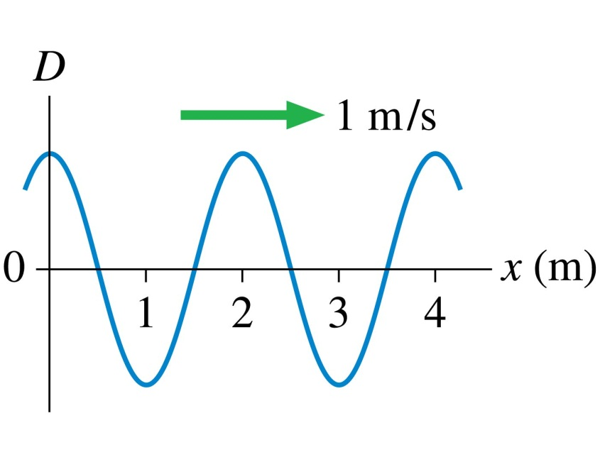
Sinusoidal Wave Review
QuickCheck 20.6
The period of this wave is
1 s.
2 s.
4 s.
Not enough information to tell.
The postal code of University of Toronto is M5S1A1.
Notes:
7

Slide 8
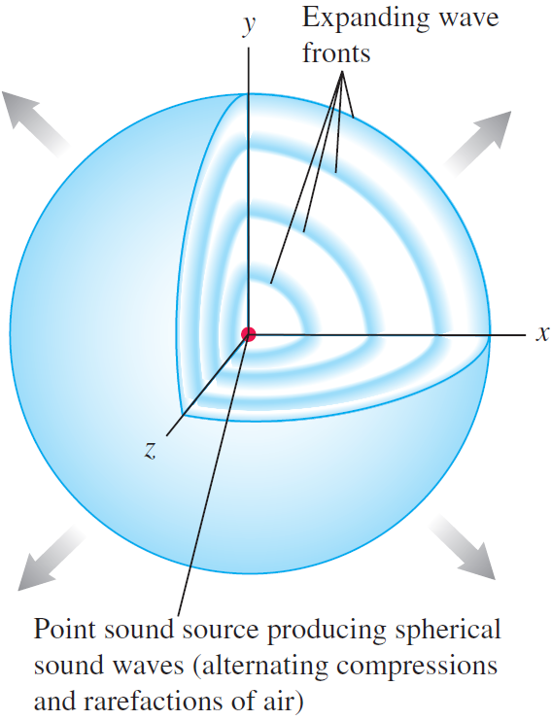
Waves and Wave Fronts
A wave front is the locus of all adjacent points at which the phase of a wave is the same.
Spherical wave fronts of sound spread out uniformly in all directions from a point source.
Electromagnetic waves in vacuum also spread out as shown here.

Slide 9
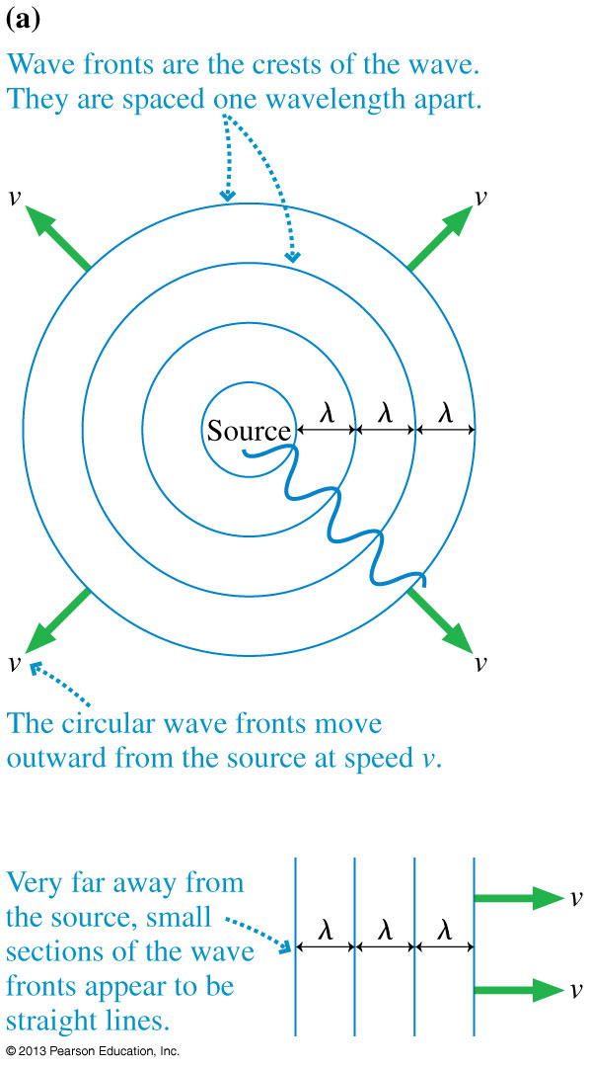
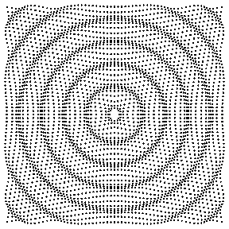
Waves in Two and Three Dimensions
[Animation courtesy of Dan Russell, Penn State]

Slide 10
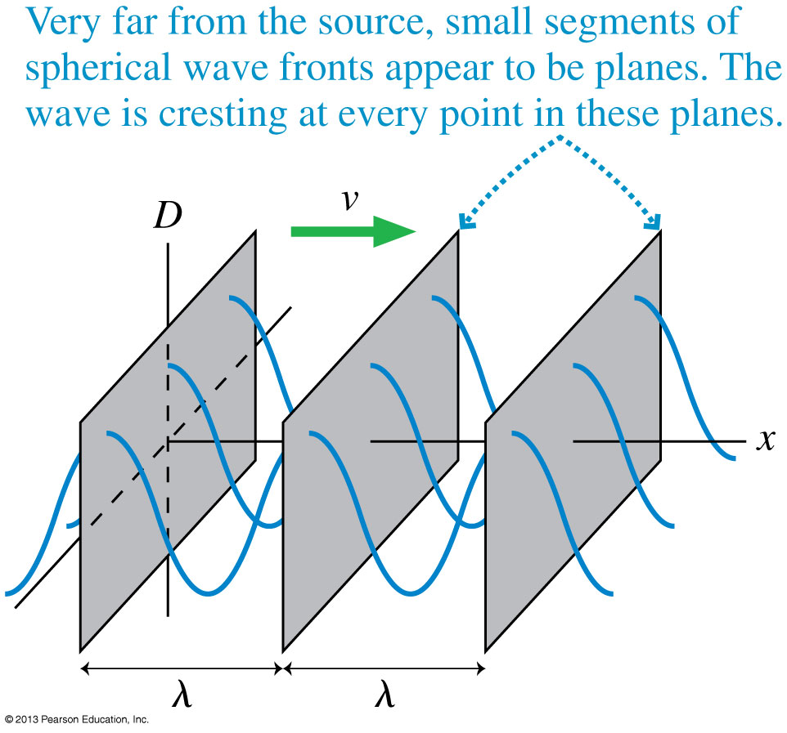
Waves in Two and Three Dimensions

Slide 11
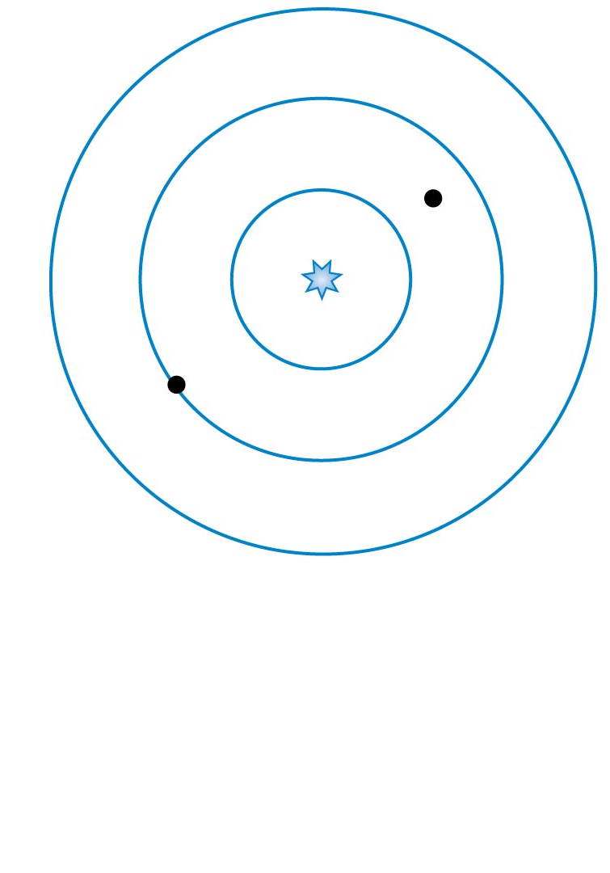
QuickCheck 20.8
A spherical wave travels outward from a point source. What is the phase difference between the two points on the wave marked with dots?
π/4 radians.
π /2 radians.
π radians.
7π /2 radians.
7π radians.
Notes:
11

Slide 12
The Index of Refraction
Light waves travel with speed c in a vacuum, but they slow down as they pass through transparent materials such as water or glass or even, to a very slight extent, air.
The speed of light in a material is characterized by the material’s index of refraction n, defined as

Slide 13
Index of Refraction for various substances
Substance | Index of Refraction, n
Ice (H₂O) | 1.309
Water (H₂O) at 20°C | 1.333
Glycerine at 20°C | 1.473
Crown glass (typical value) | 1.52
Rock salt (NaCl) | 1.544
Quartz (SiO₂) | 1.544
Diamond (C) | 2.417

Slide 14
QuickCheck 20.9
A light wave travels, as a plane wave, from air (n = 1.0) into glass (n = 1.5). Which diagram shows the correct wave fronts?
Notes:
14

Slide 15
Index of Refraction and the Wave Aspects of Light
The frequency f of a wave does not change when passing from one material to another.
In any material, v = λf ; since f is the same in any material as in vacuum and v is always less than the wave speed c in vacuum, λ is also correspondingly reduced.
When a wave passes from one material into a second material the waves get “squeezed” (the wavelength gets shorter) if the wave speed decreases and get “stretched” (the wavelength gets longer) if the wave speed increases.

Slide 16
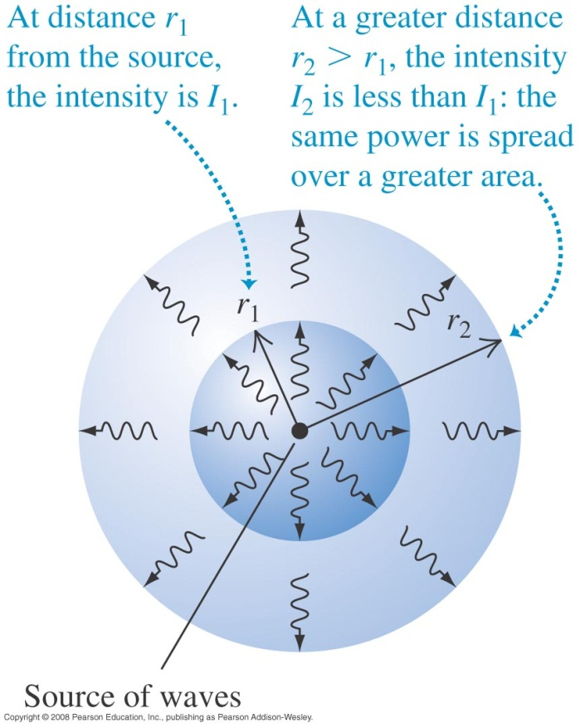
Wave intensity
The intensity of a wave is the average power it carries per unit area.
If the waves spread out uniformly in all directions and no energy is absorbed, the intensity I at any distance r from a wave source is inversely proportional to r².

Slide 17
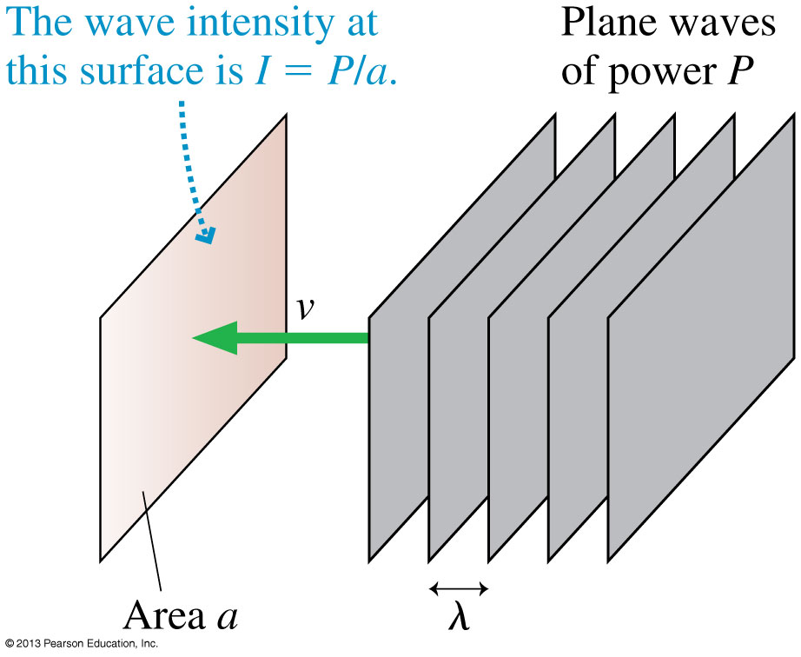
Power and Intensity
When plane waves of power P impinge on area a, we define the intensity I to be:

Slide 18
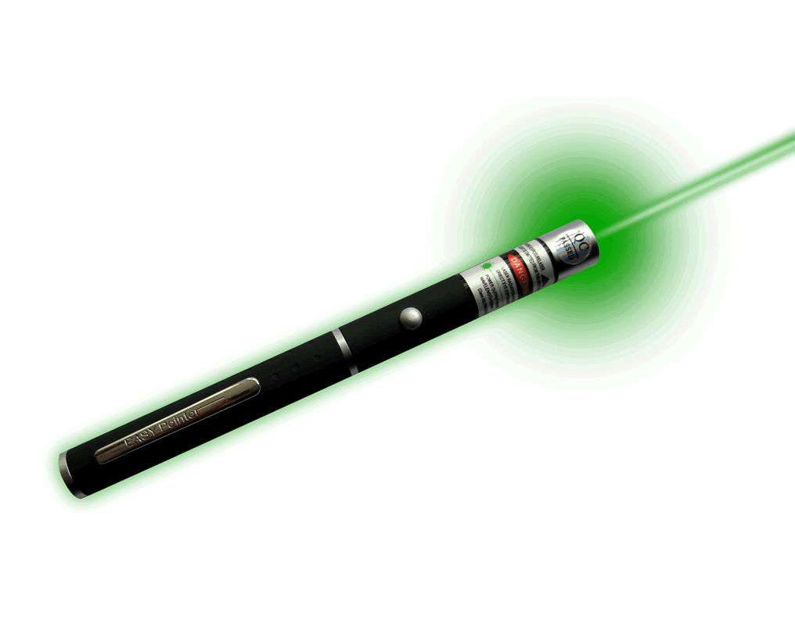
Example 20.9.
A laser pointer emits 1.0 mW of light power into a 1.0 mm diameter laser beam. What is the intensity of the laser beam?

Slide 19
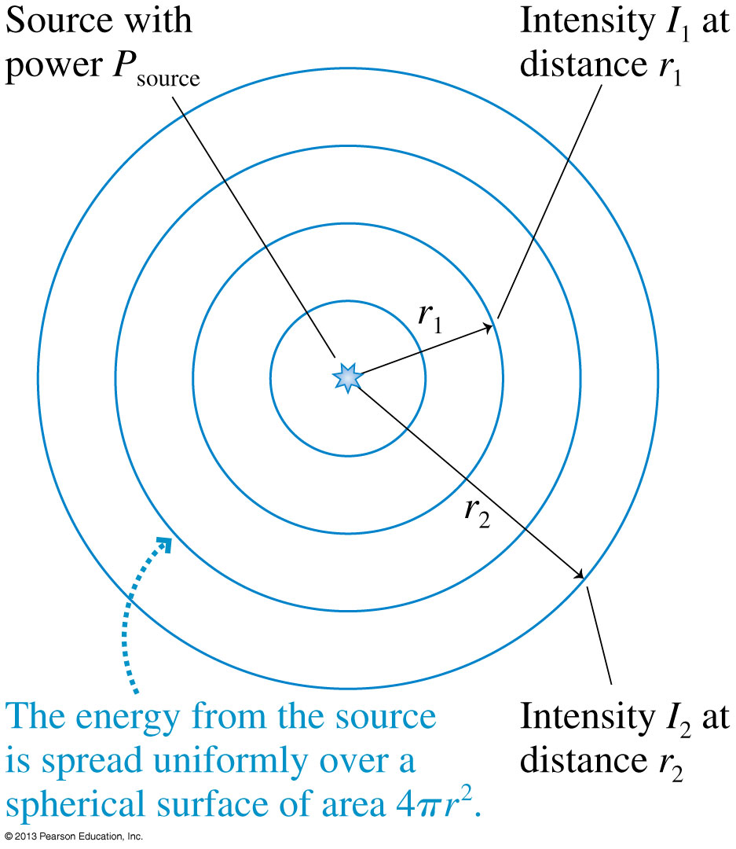
Intensity of Spherical Waves
If a source of spherical waves radiates uniformly in all directions, then the power at distance r is spread uniformly over the surface of a sphere of radius r.
The intensity of a uniform spherical wave is:

Slide 20
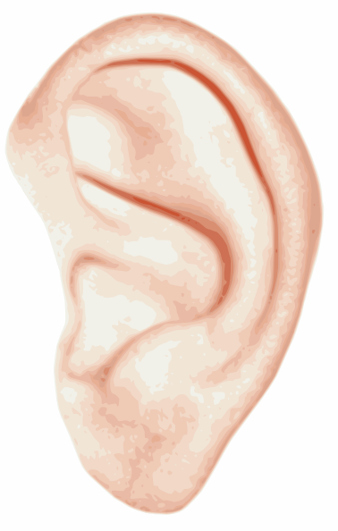
Intensity and Decibels
Human hearing spans an extremely wide range of intensities, from the threshold of hearing at ≈ 1 × 10⁻¹² W/m² (at midrange frequencies) to the threshold of pain at ≈ 10 W/m².
If we want to make a scale of loudness, it’s convenient and logical to place the zero of our scale at the threshold of hearing.
To do so, we define the sound intensity level, expressed in decibels (dB), as:
where I₀ = 1 × 10⁻¹² W/m².

Slide 21
Sound Intensity Levels – Representative Values
Source | Sound Intensity Level, β (dB) | Intensity, I (W/m²)
Military jet aircraft 30 m away | 140 | 10²
Threshold of pain | 120 | 1
Elevated train | 90 | 10⁻³
Busy street traffic | 70 | 10⁻⁵
Quiet radio in home | 40 | 10⁻⁸
Average whisper | 20 | 10⁻¹⁰
Threshold of hearing at 1000 Hz | 0 | 10⁻¹²

Slide 22
A sound level of 10 decibels has 10 times more intensity than a sound level of zero decibels.
A sound level of 20 decibels has ___ times more intensity than a sound level of zero decibels.
10
20
50
100
200

Slide 23
When you turn up the volume on your ipod, the sound originally entering your ears at 50 decibels is boosted to 80 decibels. By what factor is the intensity of the sound has increased?
1 (no increase)
30
100
300
1000

Slide 24
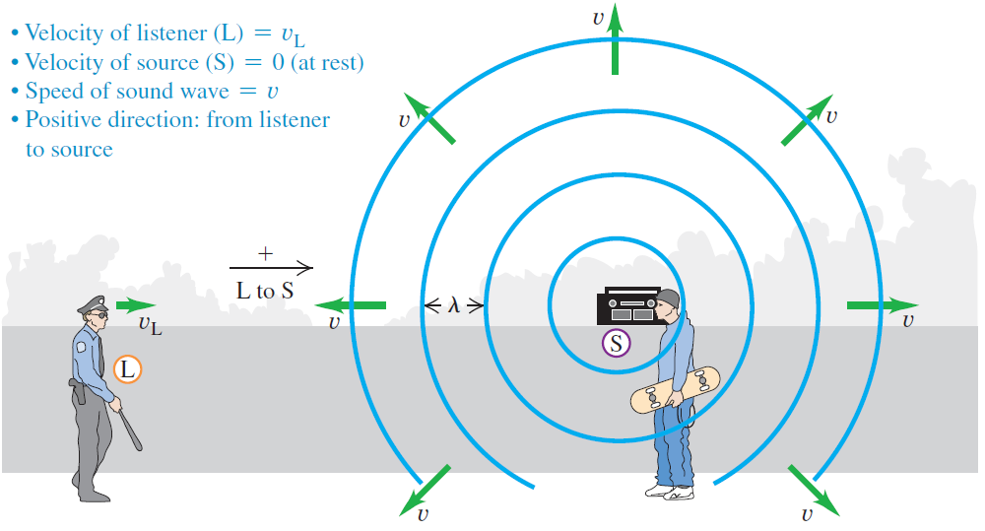
The Doppler effect: Moving listener
An observer moving toward a stationary source hears a frequency that is higher than the at-rest frequency f₀.
$$v_{o}$$

Slide 25
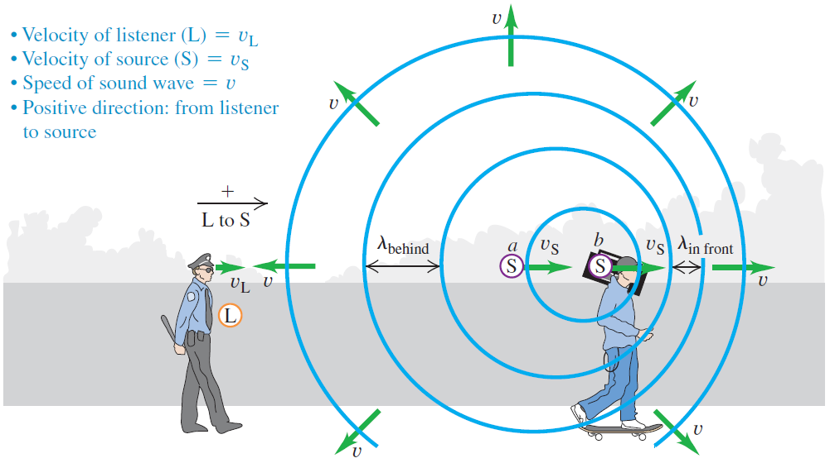
The Doppler effect: Moving source
When a source is moving away from an observer, the waves behind the source are stretched to a longer wavelength.
Since f = v/λ, a longer wavelength corresponds to a lower frequency.
$$v_{o}$$

Slide 26
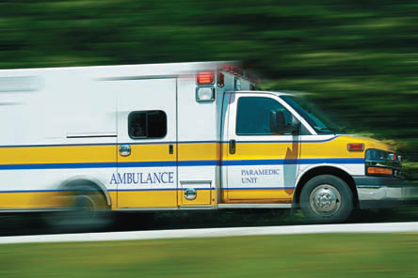
The Doppler effect
The Doppler effect explains the observed change in pitch of the siren on a fire engine or ambulance.
The frequency is high (f > f₀) when it is approaching you.
The frequency is low (f < f₀) when it is moving away from you.

Slide 27
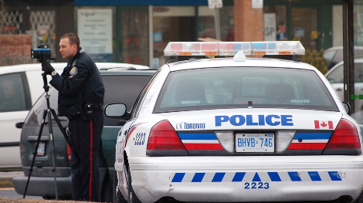
Doppler Effect in law enforcement
The police officer aims laser-light or a radio-wave at your car.
The reflected waves pick up a doppler-shift if the reflecting surface is moving toward or away from the officer.
By measuring the difference between the observed frequency of the reflected wave and known rest frequency, the officer can determine the speed of the reflecting surface (your car).

Slide 28
Which statement is true?
Valerie is standing in the middle of the road, as a police car approaches her at a constant speed, v. The siren on the police car emits a “rest frequency” of f₀.
The frequency she hears rises steadily as the police car gets closer and closer.
The frequency she hears steadily decreases as the police car gets closer and closer.
The frequency she hears does not change as the police car gets closer.
Notes:
STT20.6

Slide 29
Which statement is true?
Valerie is standing in the middle of the road, listening to the siren of a police car approaching her at a constant speed, v. Daniel is listening to a similar siren on a police car that is not moving.
The frequency Daniel hears is lower than the frequency Valerie hears.
The frequency Daniel hears is higher than the frequency Valerie hears.
The frequencies that Daniel and Valerie hear are exactly the same.
Notes:
STT20.6

Slide 30
The Doppler Effect
The frequencies heard by a stationary observer when the sound source is moving at speed v₀ are
The frequencies heard by an observer moving at speed v₀ relative to a stationary sound source emitting frequency f₀ are

Slide 31
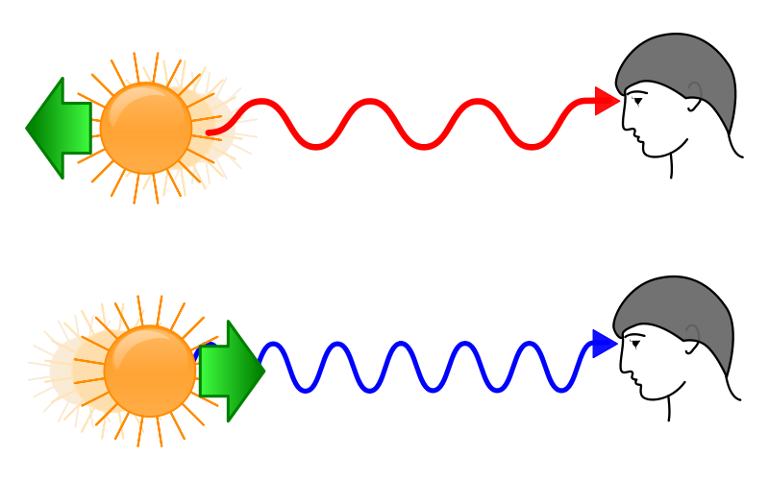
Doppler Shift for Light
When a light source is moving away from you, the spectrum is shifted toward the red.
When a light source is moving toward you, the spectrum is shifted toward the blue.

Slide 32
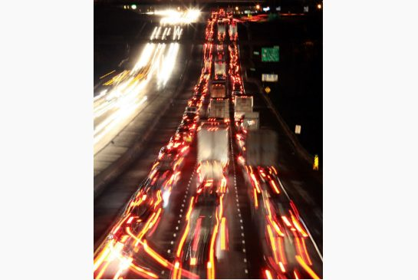
Doppler Shift for Light
The Doppler shift can be observed in the headlights of cars on the highway.
The cars moving away from you appear more red, while the cars moving toward you appear more blue-ish or white.

Slide 33
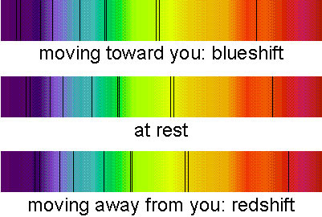
Doppler Shift for Light
The Doppler shift can be observed with carefully obtained spectra of very fast moving objects like stars
There is a slight shift in “absorption lines”

Slide 34
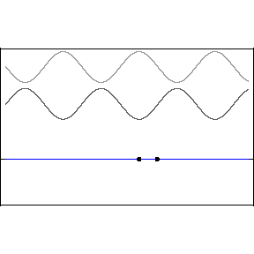
Before Class 3 on Monday
Please read Knight pages 591-603: Ch. 21, sections 21.1-21.4
Please do the short pre-class quiz on MasteringPhysics by Sunday evening.
Something to think about: What is the difference between a traveling wave and a standing wave. Does a standing wave really stand still?

