Slide 1
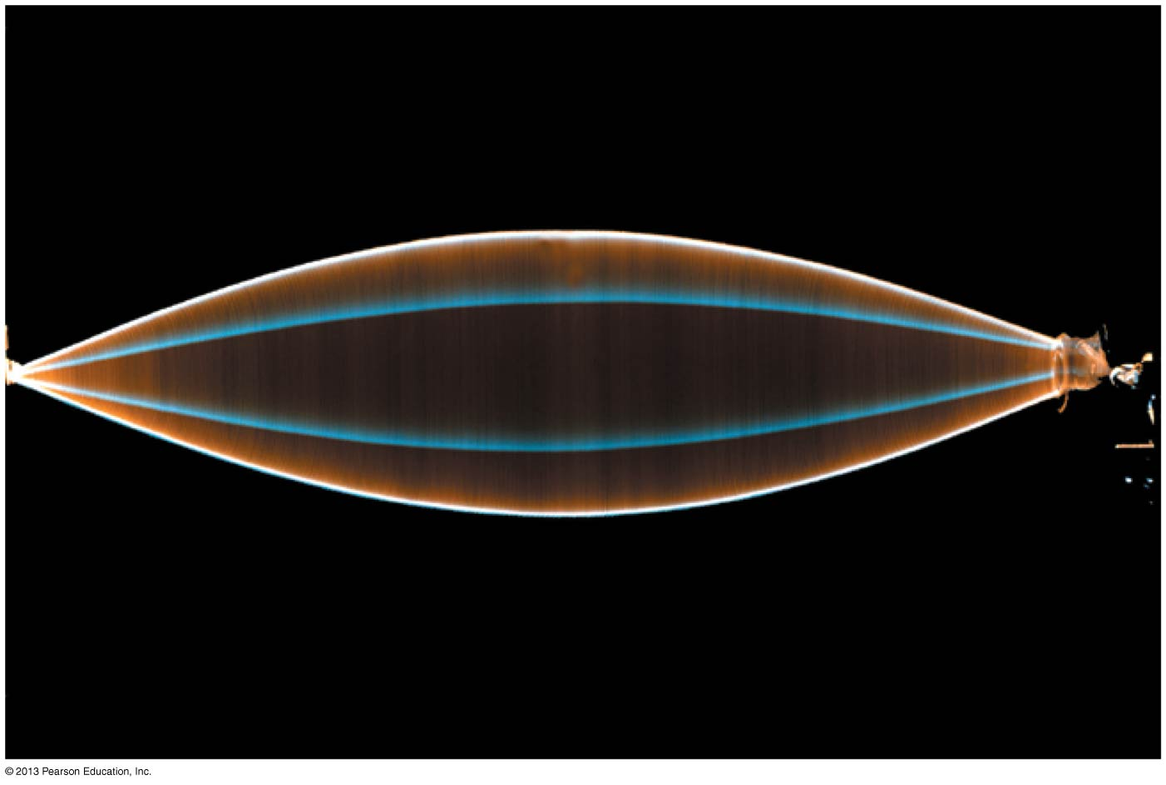
PHY132 Introduction to Physics II
Class 3 – Outline:
Class 3 – Outline:
Ch. 21, sections 21.1-21.4
The Principle of Superposition
Standing Waves
Nodes and Antinodes
Musical Instruments

Slide 2
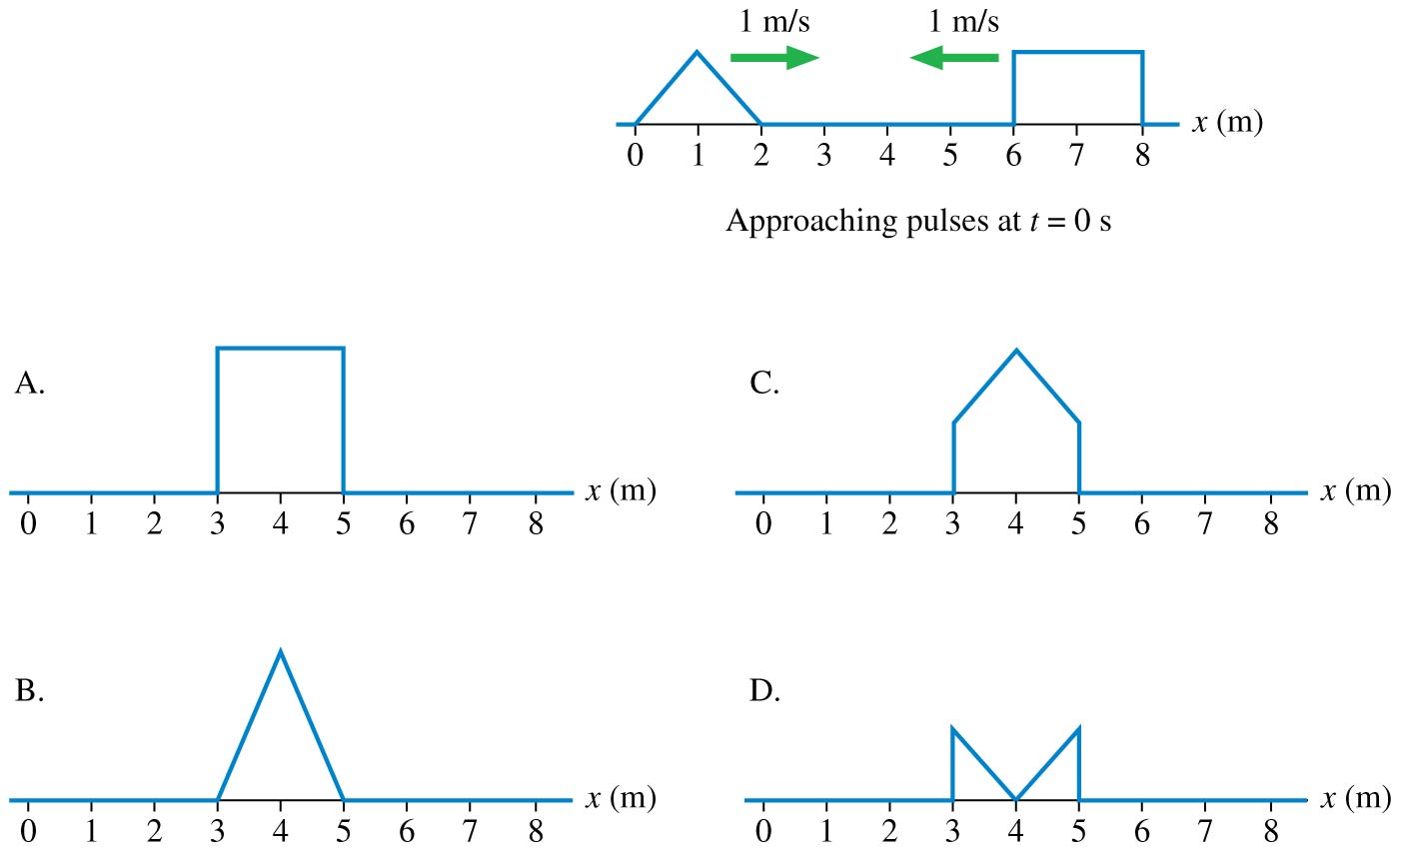
QuickCheck 1.1
i-Clicker Discussion Question
Two wave pulses on a string approach each other at speeds of
1 m/s. How does the string look at t = 3 s?
Notes:
2

Slide 3

Class 3 Preclass Quiz on MasteringPhysics
This was due this morning at 8:00am
679 students submitted the quiz on time
The figure shows the displacement of a standing sound wave in a 32-cm-long horizontal tube of air open at both ends.
67% of students answered correctly: The mode is m = 2 (count pressure antinodes)
The air molecules are moving horizontally. That’s because sound is a longitudinal wave.
The displacement antinodes are at 0, 16, 32 cm
The pressure antinodes are at 12, 24 cm

Slide 4
Class 3 Preclass Quiz on MasteringPhysics
81% of students answered correctly: A guitar string is fixed at both ends. If you tighten it to increase its tension the frequencies of its vibrational modes will increase but its wavelengths will not be affected.

Slide 5
Class 3 Preclass Quiz – Student Comments…
“Do you play the guitar??”
Harlow answer: Yes, I do, but very poorly. I have a stand in my living room and sometimes I pick it up and play little “3-chord busker” songs for my kids..
“whats the difference between regular waves and standing waves?”
Harlow answer: A regular wave is travels along in a particular direction, carrying energy from one place to another. A standing wave is a very specific kind of wave: a sinusoidal wave trapped in a cavity with reflecting walls and a certain ‘resonance’ frequency.
“The concept of superposition is super confusing!”

Slide 6
Class 3 Preclass Quiz – Student Comments…
“Does the length of string have anything to do with the wave's properties(wavelength, frequency...), like piano?”
Harlow answer: YES! The length of the string is λ/2!
“I was particularly confused about the changing the tension on a guitar string question. I understand the frequency changes (as that's what changes the sound to a higher pitch), so do the wavelengths get shorter as well? If that's the case, then can v = fλ work?”
Harlow answer: No: for a standing wave, the wavelength depends on the length of the string (or tube, in the case of sound waves), and the mode number. If these are fixed, then the wavelength is fixed, and changing v by tightening the string changes f.

Slide 7
Class 3 Preclass Quiz – Student Comments…
“the video moved too fast when talking about modes of waves and how to calculate frequency.”
Harlow suggestion: If the video goes too quickly or you miss something, press pause, rewind a bit, and go over it again. Try that 2 or 3 times. If it doesn’t work, try reading the section in the book. There’s also your friends, Tas, my office hours, etc. Don’t give up!

Slide 8
Class 3 Preclass Quiz – Student Comments…
“I cant differentiate between the velocity of the particles and the velocity of waves.I mean of course the formulas are given for it but I dont undertsand the concewpt.Isnt the particle moving same speed as the wave when a disturbance is caused>?”
Harlow thought: This is an important point to figure out. The particles are always oscillating so v is not constant. The wave is a pattern that moves with a fixed speed. These are completely different.
“Shouldn't air be able to move vertically and horizontally?”
Harlow answer: Well it can, but it doesn’t support a wave that way. There has to be a restoring force. For vibrations in the direction of the wave, the pressure in an ideal gas tries to push particles in a compression back into a rarefaction.

Slide 9
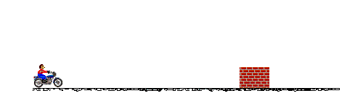

Waves in Two and Three Dimensions
Particles and Waves
Particles cannot occupy the same space. They collide.
Waves pass right through each other. They interfere.
[Animations from http://www.physicsclassroom.com/mmedia/newtlaws/mb.cfm and http://www.acs.psu.edu/drussell/demos/superposition/superposition.html ]

Slide 10
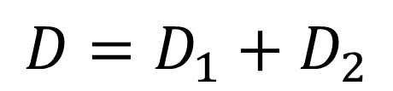
Waves in Two and Three Dimensions
The Principle of Superposition
If two or more waves combine at a given point, the resulting disturbance is the sum of the disturbances of the individual waves.
$$D=D_{1}+D_{2}$$

Slide 11
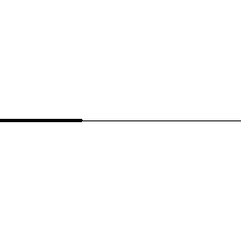
Reflection of Transverse Wave Pulse
A pulse traveling to the right on a heavy string attached to a lighter string
Speed suddenly increases
[Animation courtesy of Dan Russell, Penn State]

Slide 12
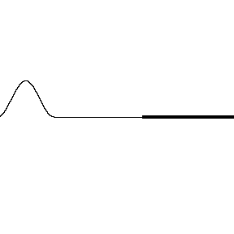
Reflection of Transverse Wave Pulse
A pulse traveling to the right on a light string attached to a heavier string
Speed suddenly decreases
[Animation courtesy of Dan Russell, Penn State]

Slide 13
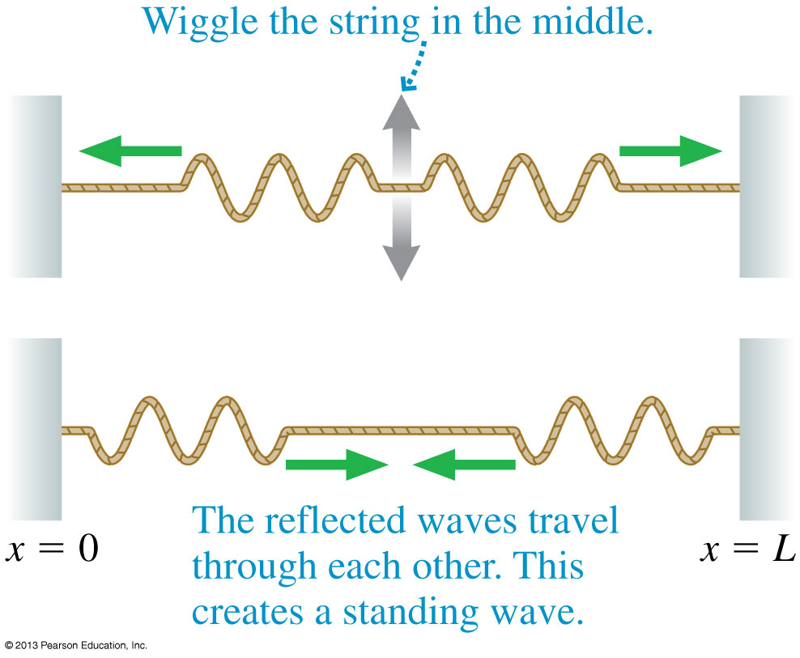
Standing Waves on a String
Reflections at the ends of the string cause waves of equal amplitude and wavelength to travel in opposite directions along the string, which results in a standing wave.

Slide 14
The Mathematics of Standing Waves
According to the principle of superposition, the net displacement of a medium when waves with displacements D_{R} and D_{L} are present is
We can simplify this by using a trigonometric identity, and arrive at:
where
For a standing wave, the pattern is not propagating!

Slide 15
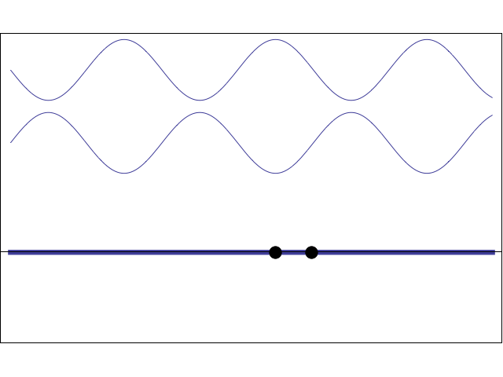
Standing Wave:
The superposition of two 1-D sinusoidal waves traveling in opposite directions.
[Animation courtesy of Dan Russell, Penn State]

Slide 16
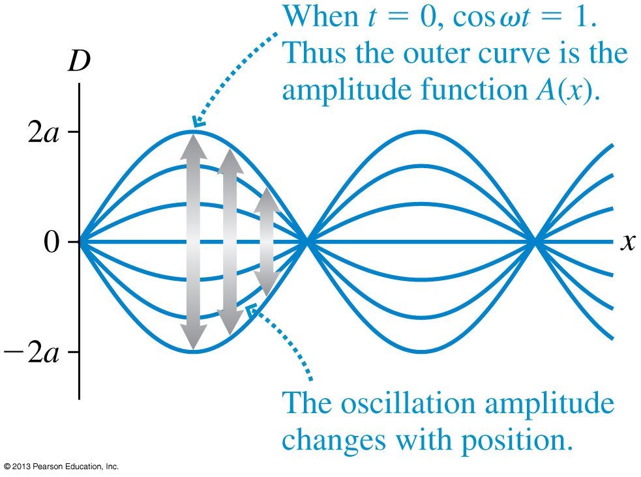
The Mathematics of Standing Waves
The amplitude reaches a maximum value of A_{max} = 2a at points where sin (kx) = 1.

Slide 17
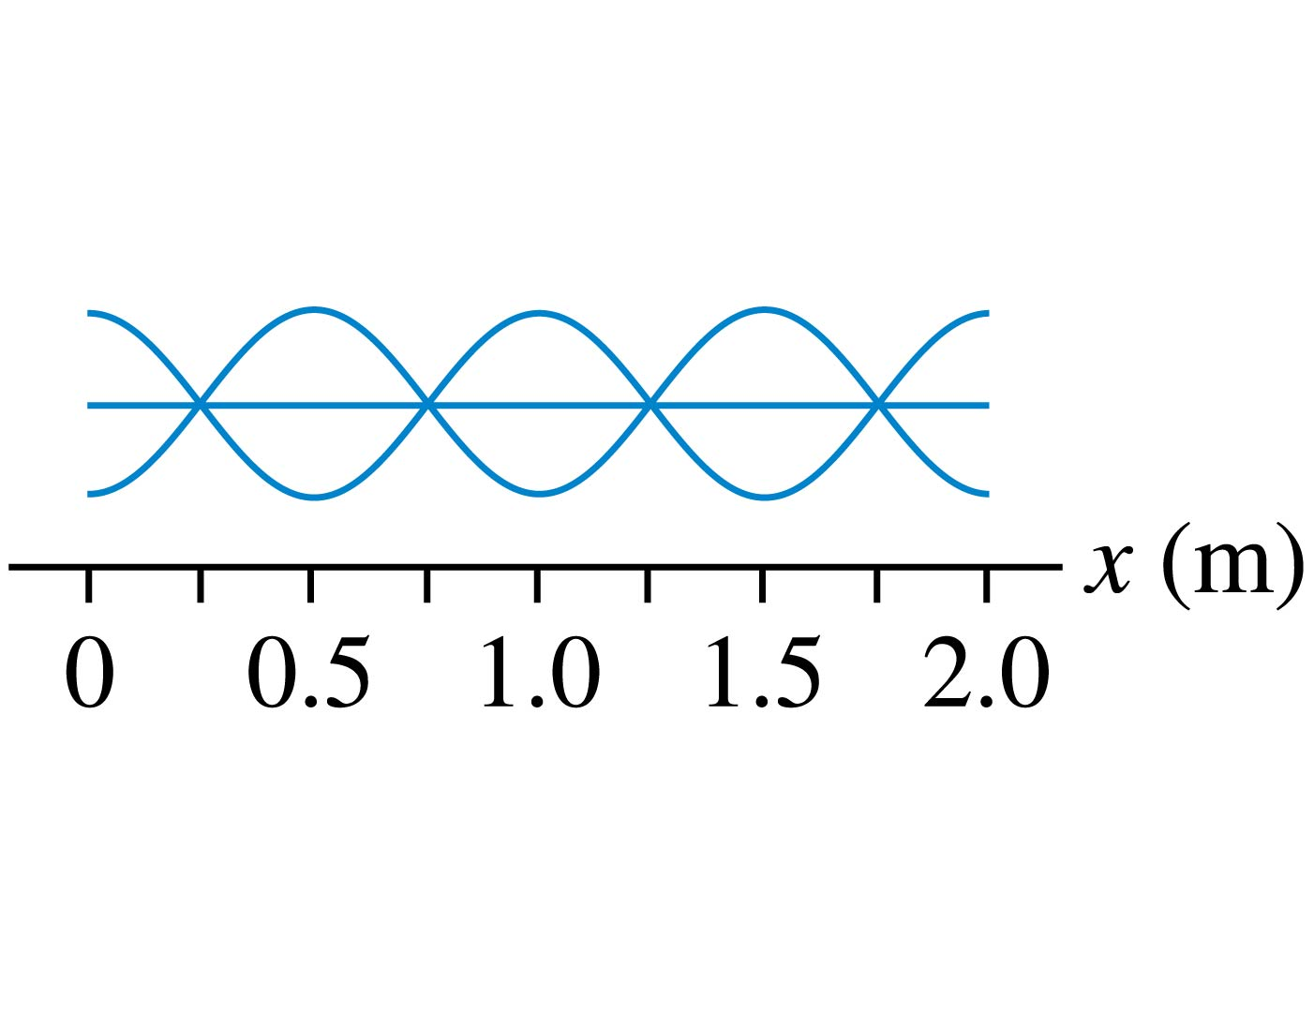
QuickCheck 21.3
i-Clicker Discussion Question
What is the wavelength of this standing wave?
0.25 m.
0.5 m.
1.0 m.
2.0 m.
Standing waves don’t
have a wavelength.
Notes:
17

Slide 18
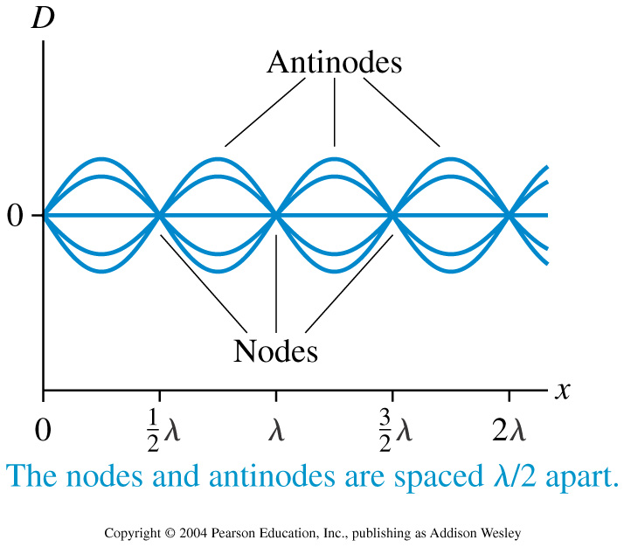
Node Spacing on a String

Slide 19
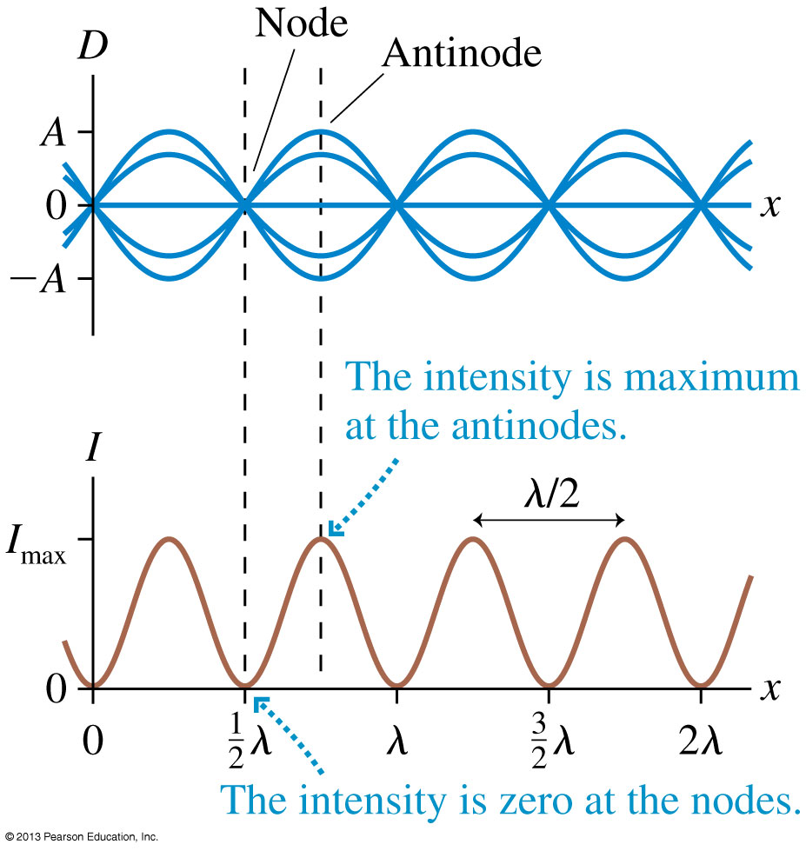
Standing Waves
In Chapter 20 you learned that the intensity of a wave is proportional to the square of the amplitude: I ∝ A².
Intensity is maximum
at points of constructive interference and zero
at points of destructive interference.

Slide 20
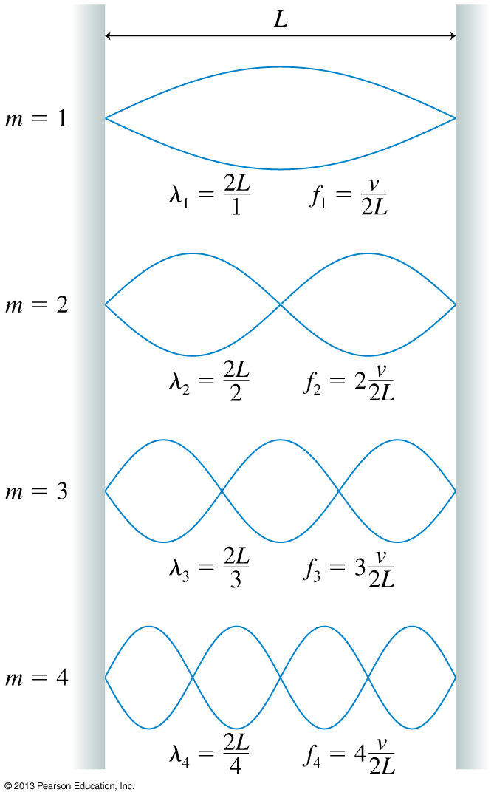
On a string of length L with fixed end points,
Only oscillations with specific wavelengths are allowed.

Slide 21
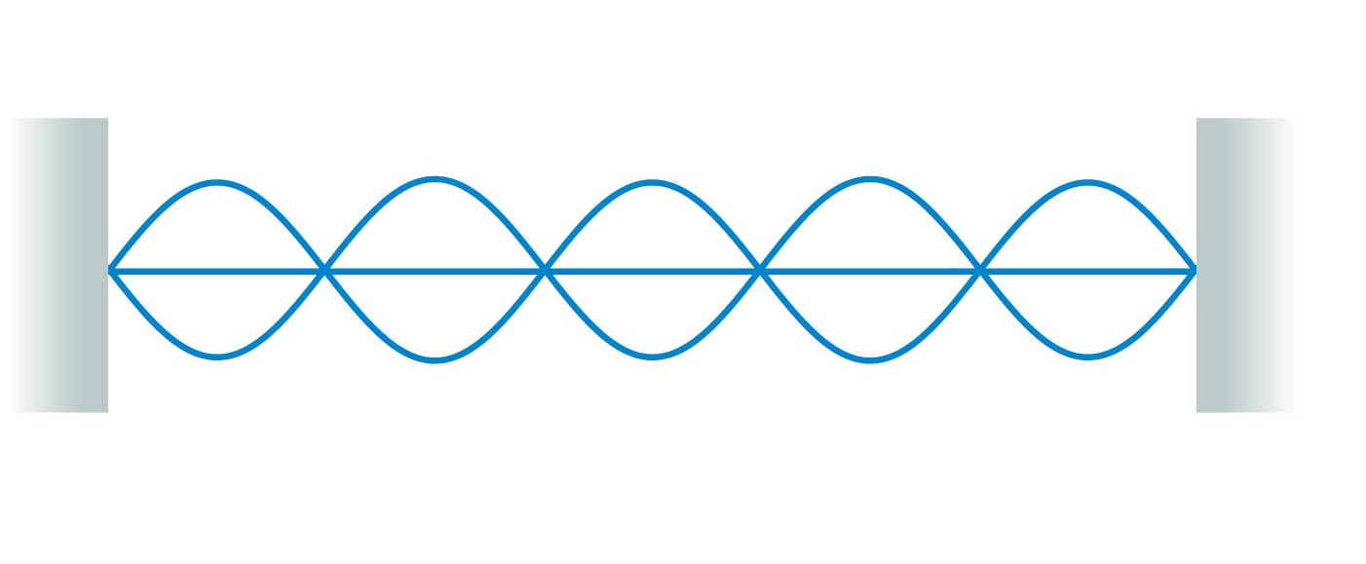
QuickCheck 21.4
i-Clicker Discussion Question
What is the mode number of this standing wave?
4.
5.
6.
Can’t say without knowing what kind of wave it is.
Notes:
21

Slide 22
Standing Waves on a String
There are three things to note about the normal modes of a string.
m is the number of antinodes on the standing wave.
The fundamental mode, with m = 1, has λ₁ = 2L.
The frequencies of the normal modes form a series: f₁, 2f₁, 3f₁, …These are also called harmonics. 2f₁ is the “second harmonic”, 3f₁ is the “third harmonic”, etc.

Slide 23
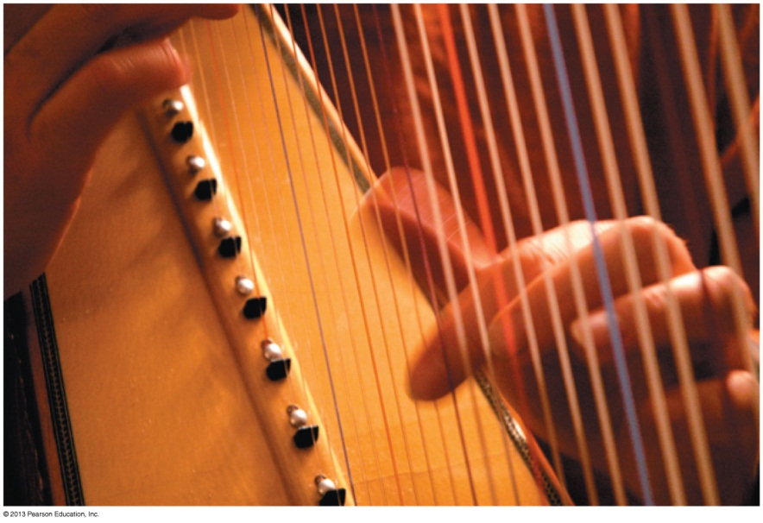
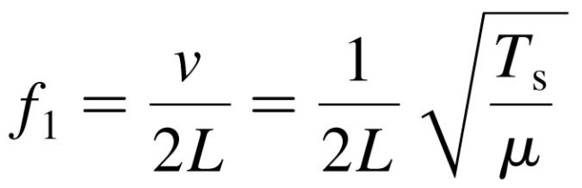
Musical Instruments
Instruments such as the harp, the piano, and the violin have strings fixed at the ends and tightened to create tension.
A disturbance generated on the string by plucking, striking, or bowing it creates a standing wave on the string.
The fundamental frequency is the musical note you hear when the string is sounded:
where T_{s} is the tension in the string and μ is its linear density.

Slide 24
Reading Question 21.5
i-Clicker Discussion Question
The frequency of the third harmonic of a string is
One-third the frequency of the fundamental.
Equal to the frequency of the fundamental.
Three times the frequency of the fundamental.
Nine times the frequency of the fundamental.
Notes:
24
Answer: C

Slide 25
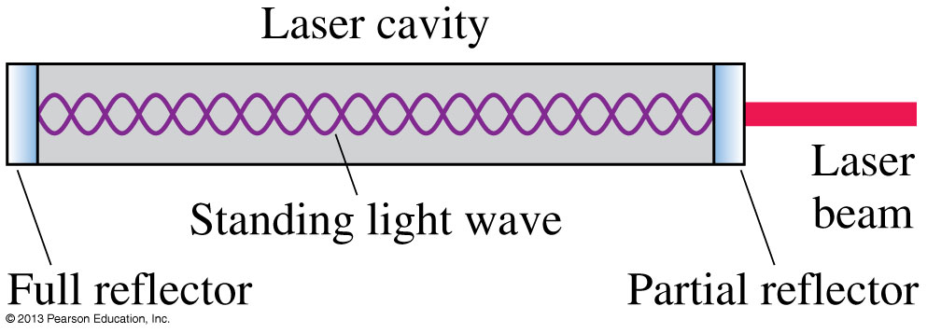
Standing Electromagnetic Waves
Standing electromagnetic waves can be established between two parallel mirrors that reflect light back and forth.
A typical laser cavity has a length L ≈ 30 cm, and visible light has a wavelength λ ≈ 600 nm.
The standing light wave in a typical laser cavity has a mode number m that is 2L/λ ≈ 1,000,000!

Slide 26
Standing Sound Waves
A long, narrow column of air, such as the air in a tube or pipe, can support a longitudinal standing sound wave.
A closed end of a column of air must be a displacement node. Thus the boundary conditions — nodes at the ends — are the same as for a standing wave on a string.
It is often useful to think of sound as a pressure wave rather than a displacement wave. The pressure oscillates around its equilibrium value.
The nodes and antinodes of the pressure wave are interchanged with those of the displacement wave.

Slide 27
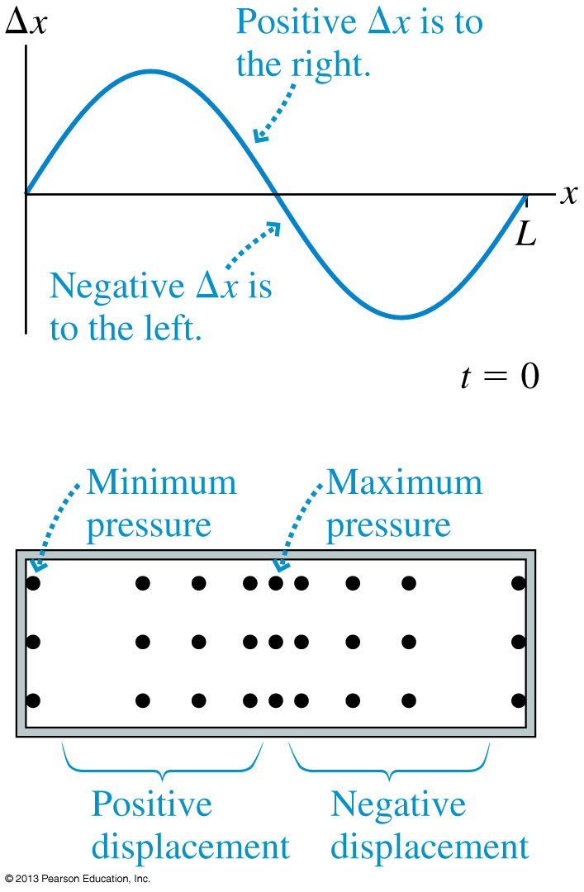
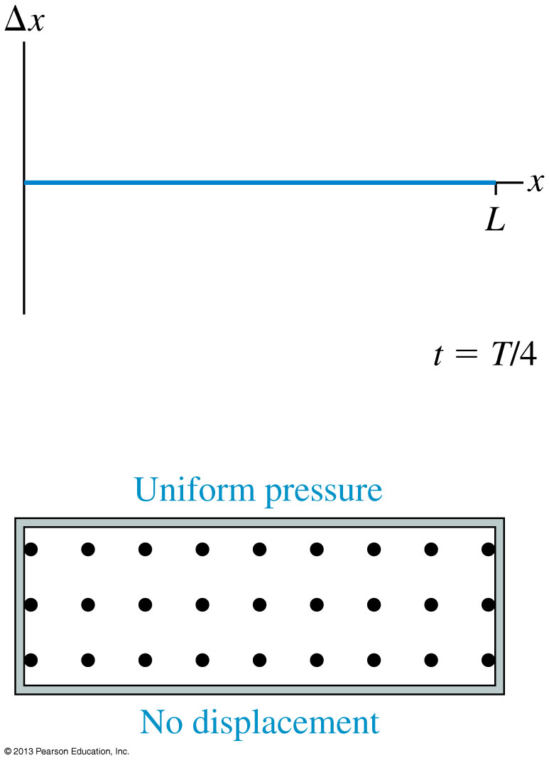
Standing Sound Waves

Slide 28
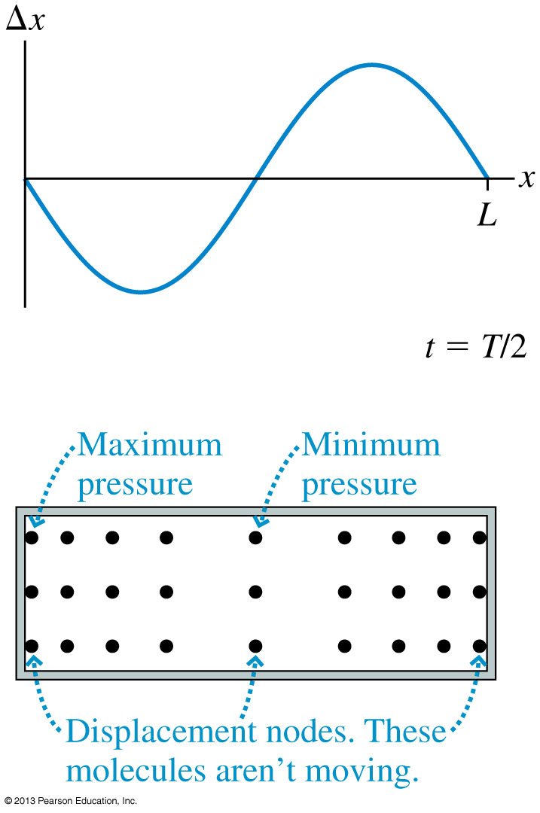
Standing Sound Waves

Slide 29
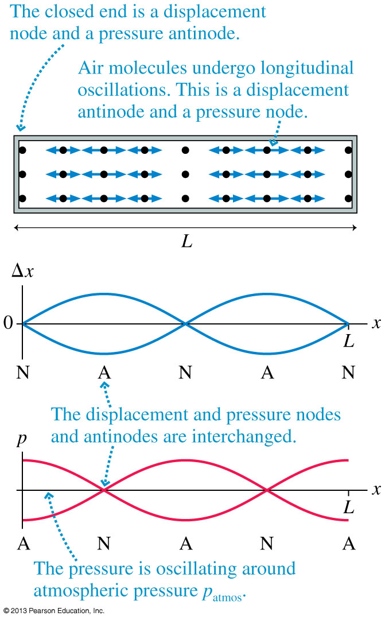
Displacement Δx and pressure graphs for the m = 2 mode of standing sound waves in a closed-closed tube.
The nodes and antinodes of the pressure wave are interchanged with those of the displacement wave.

Slide 30
Class 3 Preclass Quiz – Student Comments…
“In vibration of air molecules in a tube (regardless of open ends or closed ends), why does maximum pressure corresponds to minimum displacement (still do not quite get that idea).” [LOTS of questions like this]
Harlow answer: This is tricky. Let’s look carefully at the animation on the next page…

Slide 31
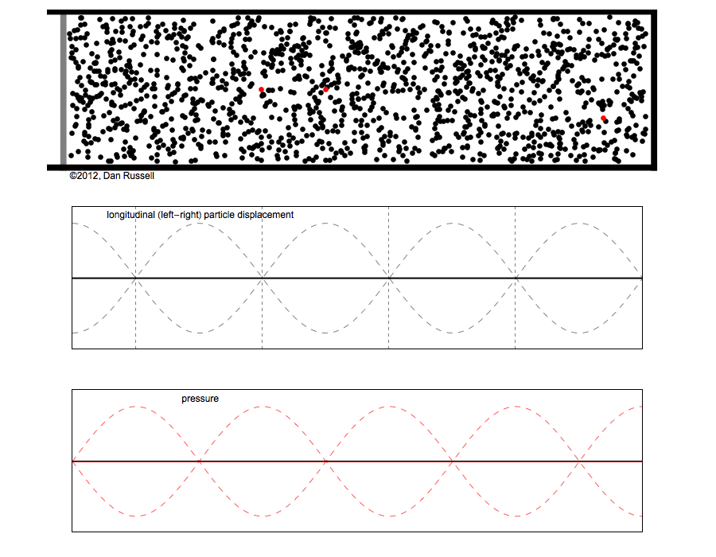

Slide 32
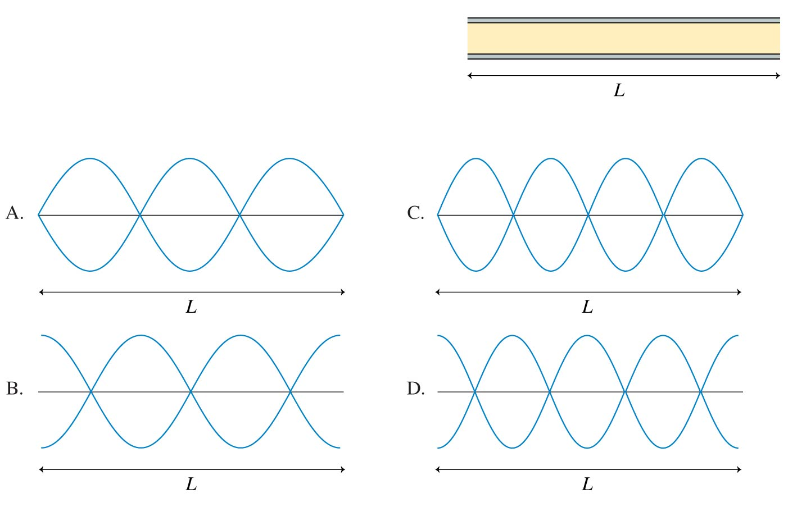
QuickCheck 21.6
i-Clicker Discussion Question
An open-open tube of air has length L. Which is the displacement graph of the m = 3 standing wave in this tube?
Notes:
32

Slide 33
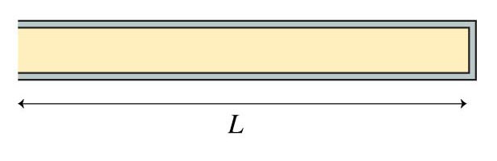
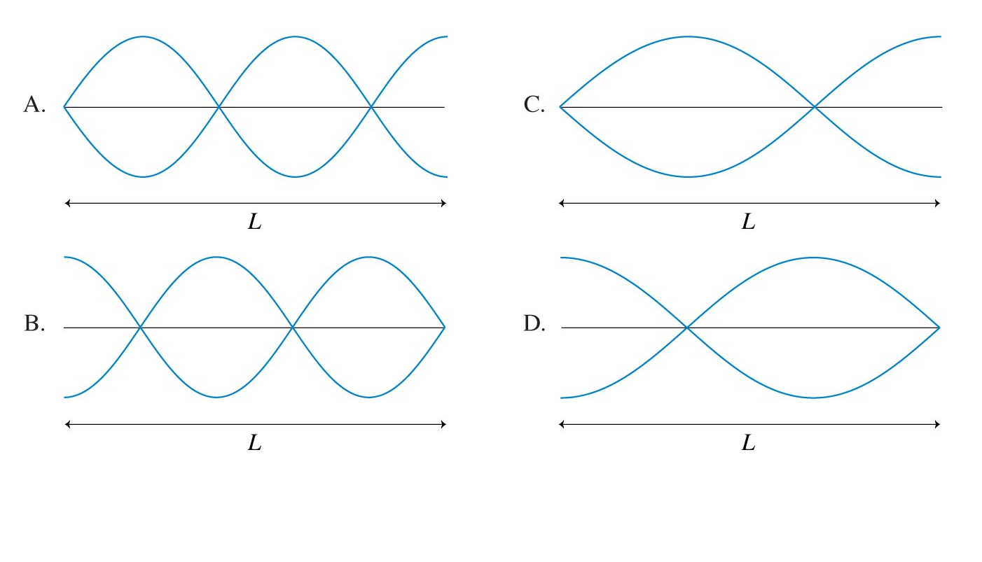
QuickCheck 21.7
i-Clicker Discussion Question
An open-closed tube of air of length L has the closed end on the right. Which is the displacement graph of the m = 3 standing wave in this tube?
Notes:
33

Slide 34
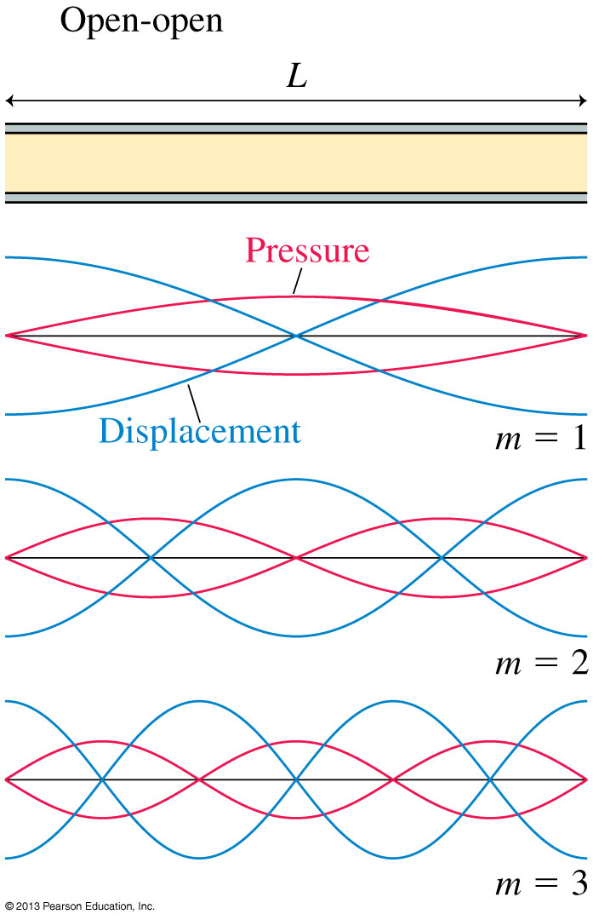
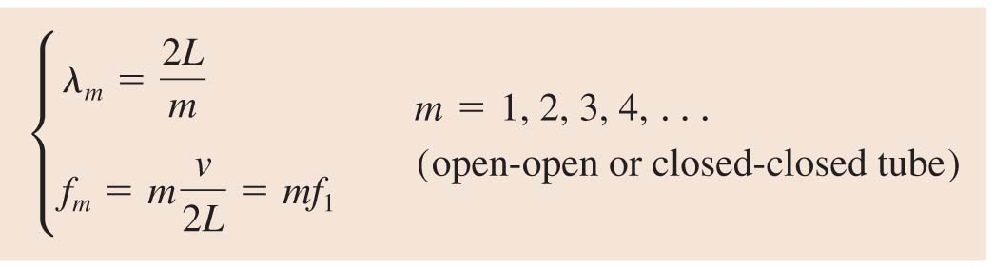

Slide 35
Example from a past test
A metal pipe, open at both ends, can create a standing wave in the second harmonic with a frequency of 483 Hz. What is the length of the pipe?

Slide 36
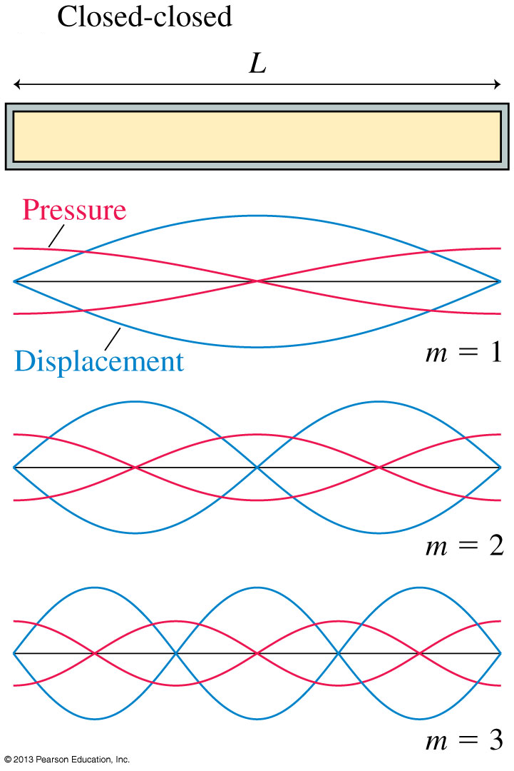

Slide 37
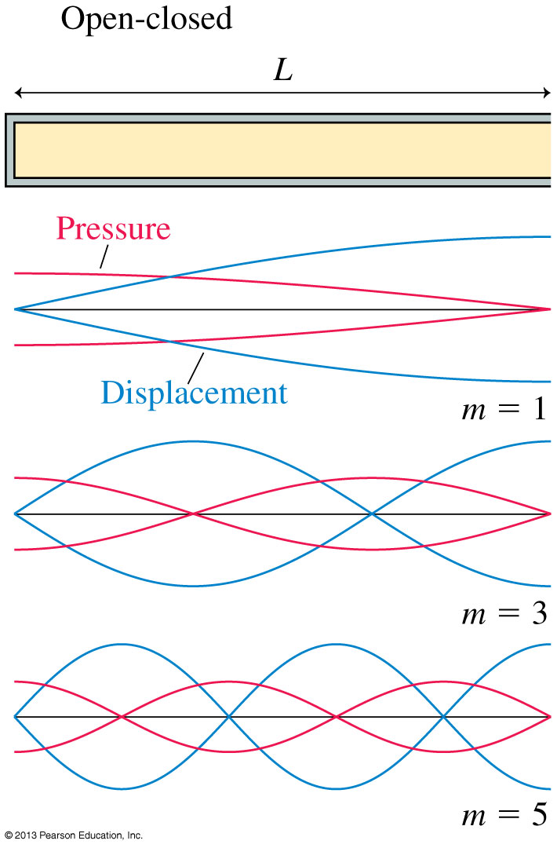
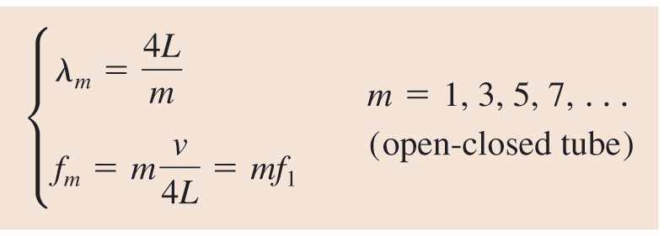

Slide 38
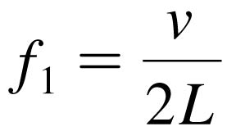
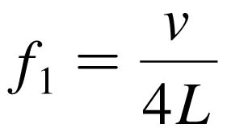
Musical Instruments
With a wind instrument, blowing into the mouthpiece creates a standing sound wave inside a tube of air.
The player changes the notes by using her fingers to cover holes or open valves, changing the length of the tube and thus its fundamental frequency:
for an open-open tube instrument, such as a flute
for an open-closed tube instrument, such as a clarinet
In both of these equations, v is the speed of sound in the air inside the tube.
Overblowing wind instruments can sometimes produce higher harmonics such as f₂ = 2f₁ and f₃ = 3f₁.

Slide 39
A longitudinal wave is sent along a long spring by moving the left end rapidly to the right and keeping it there.
The figure shows the wave pulse at QR—part RS of the long spring is as yet undisturbed. Which of the graphs A–E correctly shows the relation between displacement s and position x? (Displacements to the right are positive.)
A
B
C
D
E

Slide 40

Before Class 4 on Wednesday
Please read Knight Ch. 21, sections 21.5-21.8 (finish the chapter)
Please do the short pre-class quiz on MasteringPhysics by Tuesday evening.
Something to think about: What is “constructive interference”? How can you interfere with something and increase its strength?

