Slide 1
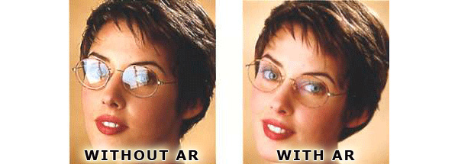
PHY132 Introduction to Physics II Class 4 – Outline:
Ch. 21, sections 21.5-21.8
Wave Interference
Constructive and Destructive Interference
Thin-Film Optical Coatings →
Interference in 2 and 3 Dimensions
Beats

Slide 2
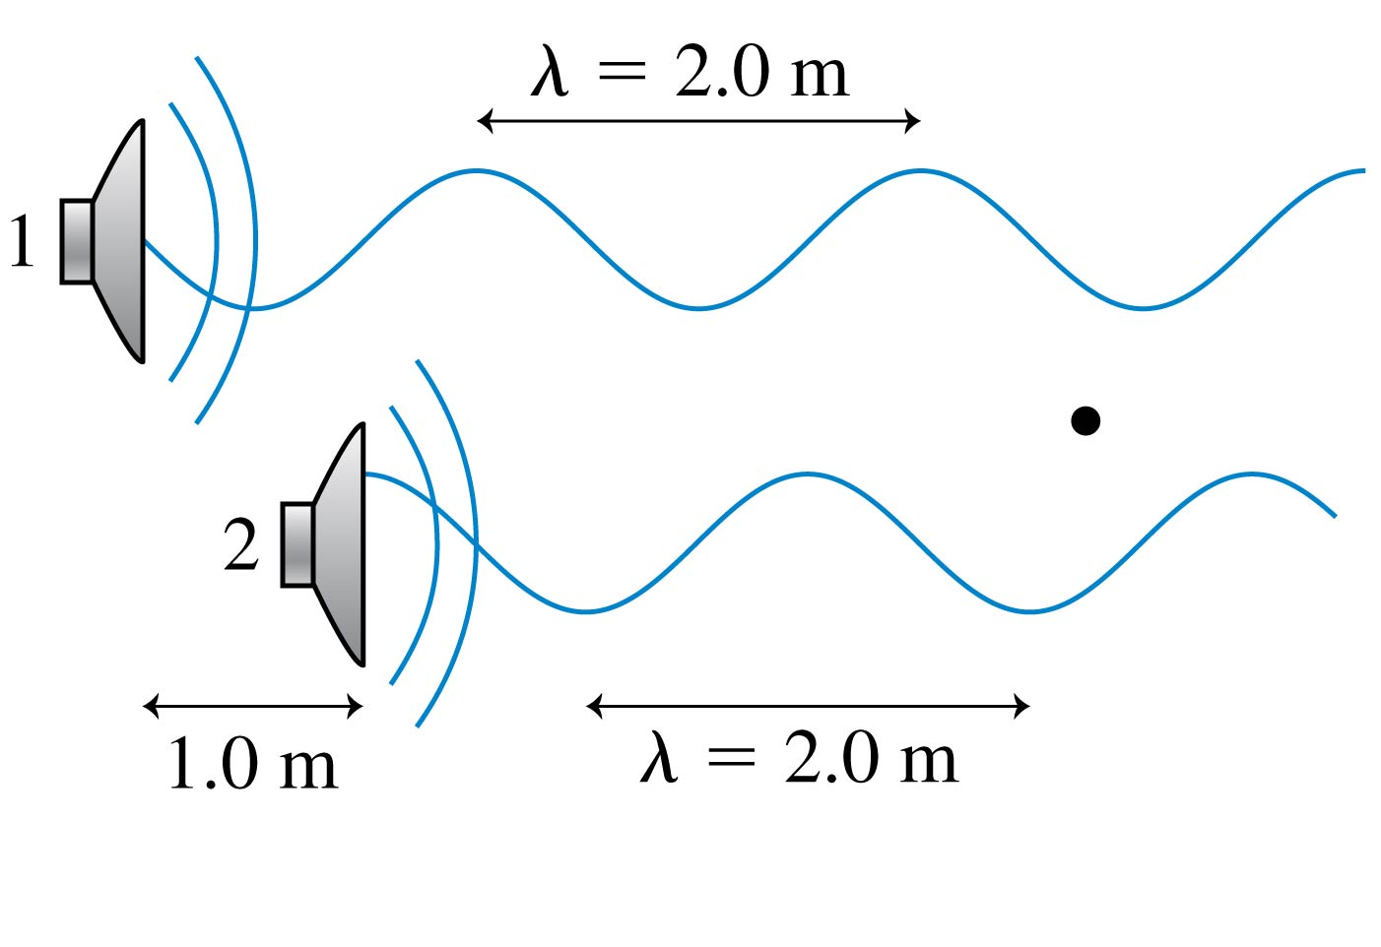
Clicker Question
Two loudspeakers emit sound waves with the same wavelength and the same amplitude. Which of the following would cause there to be completely destructive interference at the position of the dot? (zero resulting amplitude)
Move speaker 2 forward (right) 1.0 m.
Move speaker 2 forward (right) 0.5 m.
Move speaker 2 backward (left) 0.5 m.
Move speaker 2 backward (left) 1.0 m.
Nothing. Destructive interference is not possible in this situation.
Notes:
2

Slide 3
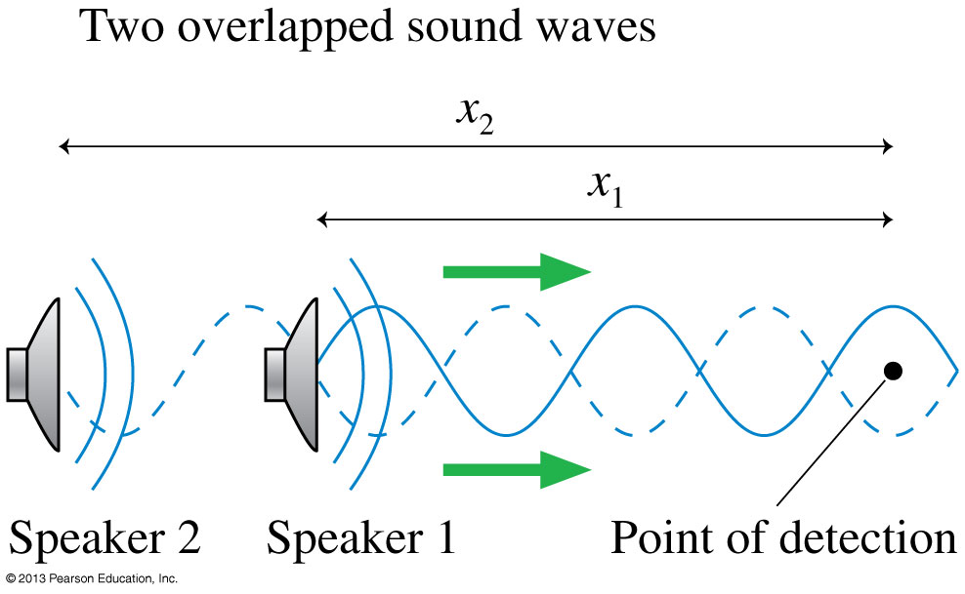
Wave Interference
The pattern resulting from the superposition of two waves is called interference. Interference can be
constructive, meaning the disturbances add to make a resultant wave of larger amplitude, or
destructive, meaning the disturbances cancel, making a resultant wave of smaller amplitude.

Slide 4
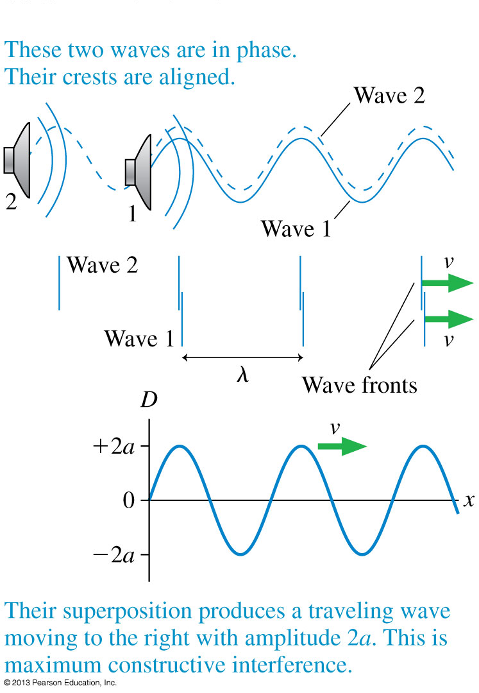
Wave Interference
D₁ = a sin(kx₁ − ωt + φ₁₀)
D₂ = a sin(kx₂ − ωt + φ₂₀)
D = D₁ + D₂
The two waves are in phase, meaning that
D₁(x) = D₂(x)
The resulting amplitude is A = 2a for maximum constructive interference.

Slide 5
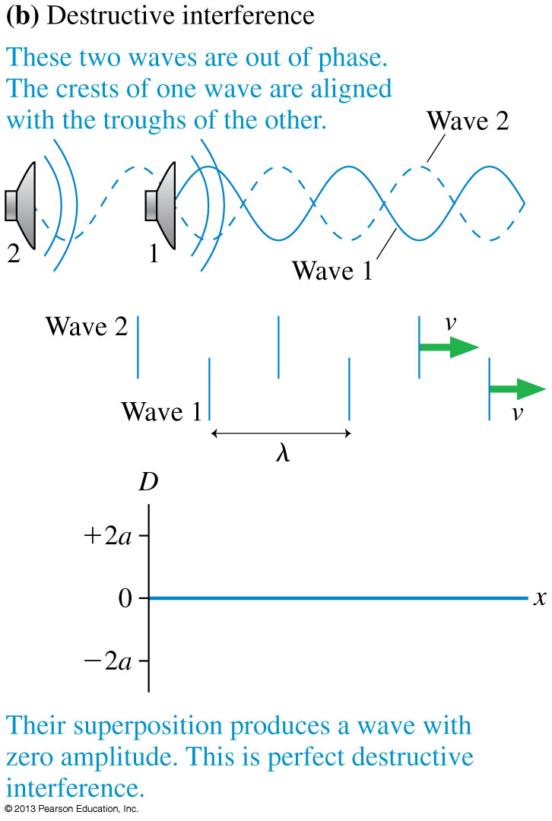
Wave Interference
The two waves are out of phase, meaning that
D₁(x) = −D₂(x).
The resulting amplitude is A = 0 for perfect destructive interference.

Slide 6
The Mathematics of Interference
The Mathematics of Interference
As two waves of equal amplitude and frequency travel together along the x-axis, the net displacement of the medium is:
The amplitude depends on the phase difference

Slide 7
The Mathematics of Interference
The Mathematics of Interference
The amplitude has a maximum value A = 2a if cos(Δφ/2) = ±1.
This is maximum constructive interference, when:
where m is an integer.
Similarly, perfect destructive interference is when:

Slide 8
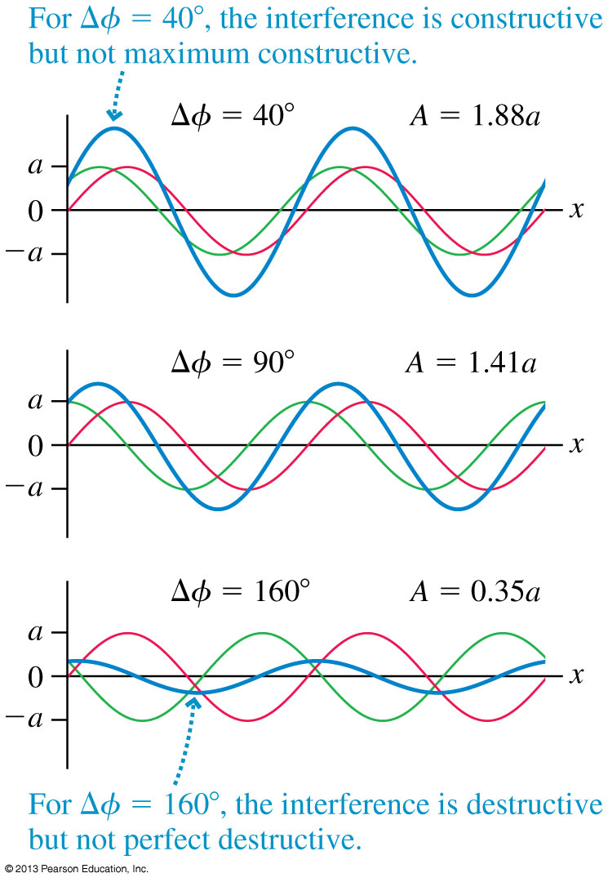
The Mathematics of Interference
It is entirely possible, of course, that the two waves are neither exactly in phase nor exactly out of phase.
(as we learned from today’s pre-class quiz!)

Slide 9
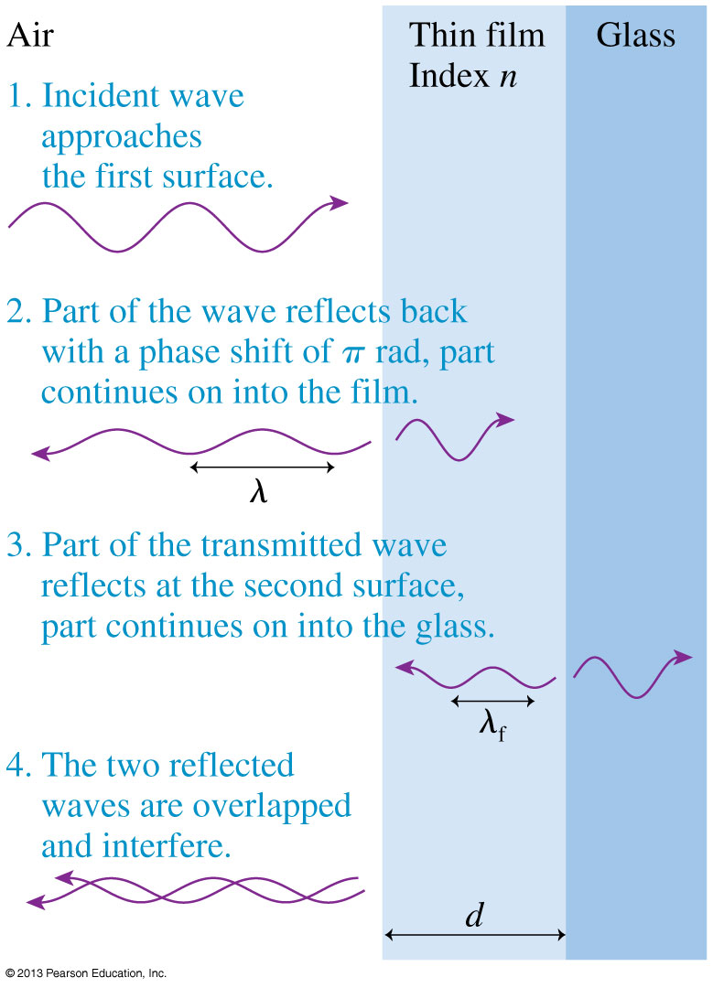
Thin-Film Optical Coatings
Thin transparent films, placed on glass surfaces, such as lenses, can control reflections from the glass.
Antireflection coatings on the lenses in cameras, microscopes, and other optical equipment are examples of thin-film coatings.

Slide 10
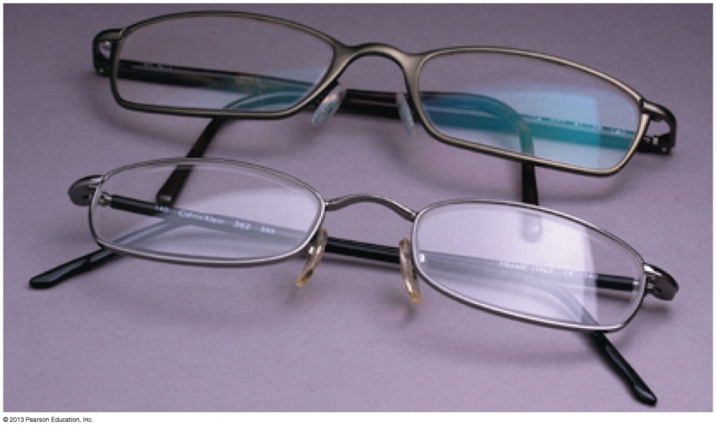
Application: Thin-Film Optical Coatings
The phase difference between the two reflected waves is:
where n is the index of refraction of the coating, d is the thickness, and λ is the wavelength of the light in vacuum or air.
For a particular thin-film, constructive or destructive interference depends on the wavelength of the light:

Slide 11
Example
A thin coating of Magnesium Flouride (MgF₂) is deposited on the surface of some eyeglasses which have an index of refraction of 1.6. The MgF₂ has an index of refraction of 1.38. What is the minimum thickness of the coating so that green light of wavelength 500 nm has minimal reflectance?

Slide 12
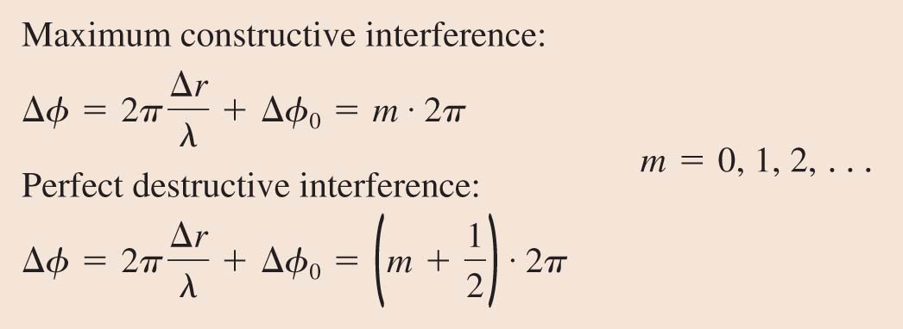
Interference in Two and Three Dimensions
The mathematical description of interference in two or three dimensions is very similar to that of one-dimensional interference. The conditions for constructive and destructive interference are
where Δr is the path-length difference.

Slide 13
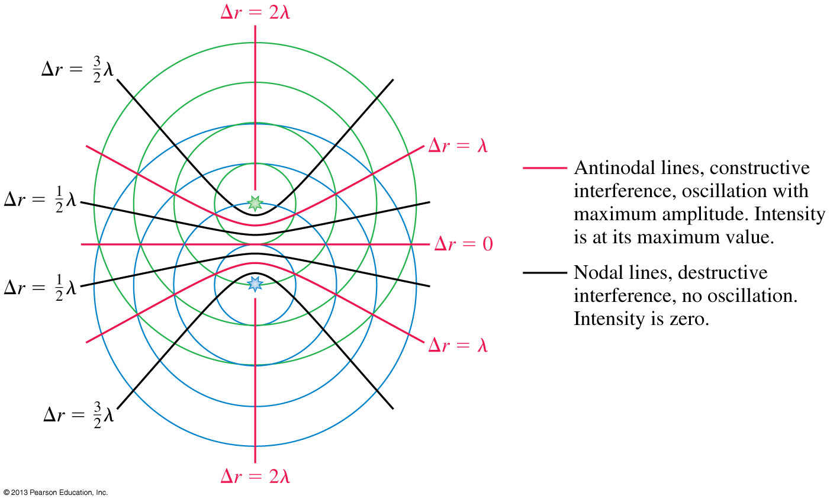
Interference in Two and Three Dimensions

Slide 14
Two speakers, A and B, are “in phase” and emit a pure note with a wavelength 2 m. The speakers are side-by-side, 3 m apart. Point C is 4 m directly in front of speaker A.
Example
Will a listener at point C hear constructive or destructive interference?

Slide 15
Two speakers, A and B, are “in phase” and emit a pure note with a wavelength 2 m. The speakers are side-by-side, 3 m apart. Point C is 4 m directly in front of speaker A.
Clicker Question 3
How many wavelengths are between Speaker A and Point C?
0.5
1.0
1.5
2.0
2.5

Slide 16
Two speakers, A and B, are “in phase” and emit a pure note with a wavelength 2 m. The speakers are side-by-side, 3 m apart. Point C is 4 m directly in front of speaker A.
Clicker Question 4
How many wavelengths are between Speaker B and Point C?
0.5
1.0
1.5
2.0
2.5

Slide 17
Two speakers, A and B, are “in phase” and emit a pure note with a wavelength 2 m. The speakers are side-by-side, 3 m apart. Point C is 4 m directly in front of speaker A.
Clicker Question 5
At point C, what is the path difference between the sounds received from speakers A and B, as measured in wavelengths?
0.5 B. 1.0 C. 1.5
D. 2.0 E. 2.5

Slide 18
Two speakers, A and B, are “in phase” and emit a pure note with a wavelength 2 m. The speakers are side-by-side, 3 m apart. Point C is 4 m directly in front of speaker A.
Clicker Question 6
At point C, there will be
Constructive interference
Destructive interference

Slide 19
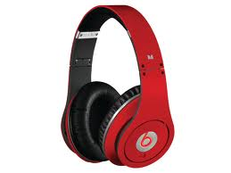
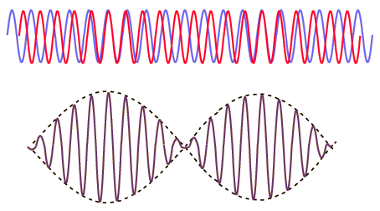
Beats
Periodic variations in the loudness of sound due to interference
Occur when two waves of similar, but not equal frequencies are superposed.
Provide a comparison of frequencies
Frequency of beats is equal to the difference between the frequencies of the two waves.
[image from http://hyperphysics.phy-astr.gsu.edu/hbase/sound/beat.html ]

Slide 20
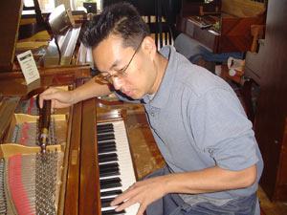
Beats
Applications
Piano tuning by listening to the disappearance of beats from a known frequency and a piano key
Tuning instruments in an orchestra by listening for beats between instruments and piano tone

Slide 21
Suppose you sound a 1056-hertz tuning fork at the same time you strike a note on the piano and hear 2 beats/second. What is the frequency of the piano string?
Clicker Question 7
1054 Hz
1056 Hz
1058 Hz
Either A or C
Either A, B or C
Notes:
B. downward.

Slide 22
Suppose you sound a 1056-hertz tuning fork at the same time you strike a note on the piano and hear 2 beats/second. You tighten the piano string very slightly and now hear 3 beats/second. What is the frequency of the piano string?
Clicker Question 8
1053 Hz
1056 Hz
1059 Hz
Either A or C
Either A, B or C
Notes:
B. downward.

Slide 23
Before Class 5 on Monday
Complete Problem Set 1 on MasteringPhysics due Sunday at 11:59pm on Chs. 20, 21. This is a rather long one so definitely get started early!
Please read Knight Ch. 22, sections 22.1-22.4
Please do the short pre-class quiz on MasteringPhysics by Monday morning at the latest.
Something to think about: Light is a wave. So is it possible for two beams of light to meet at the same place, destructively interfere, and produce darkness?

