Slide 1
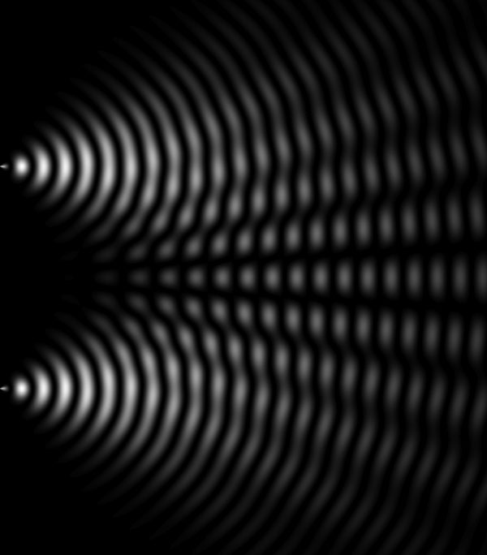
PHY132 Introduction to Physics II Class 5 – Outline:
Ch. 22, sections 22.1-22.4
(Note we are skipping sections 22.5 and 22.6 in this course)
Light and Optics
Double-Slit Interference
The Diffraction Grating
Single-Slit Diffraction

Slide 2
Clicker Discussion Question
A laboratory experiment produces a double-slit interference pattern on a screen. The point on the screen marked with a dot is how much farther from the left slit than from the right slit?
1.0 λ
1.5 λ
2.0 λ
2.5 λ
3.0 λ
Central maximum

Slide 3
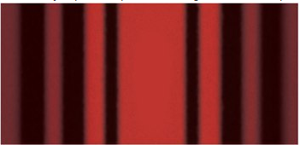
Class 5 Preclass Quiz on MasteringPhysics
This was due this morning at 8:00am
685 students submitted the quiz on time
94% of students got: A diffraction grating is an opaque object with many closely spaced slits. (Or a smooth surface with many closely spaced rectangular mirrors, separated by black strips.)
96% of students got: The first experiment to show that light is a wave was Thomas Young’s double-slit experiment (1803).
71% of students got: The spreading of waves behind an aperture is more for long wavelengths and less for short wavelengths.
73% of students got: The narrower the slit in a single-slit diffraction experiment, the wider the central maximum (all fringes get farther apart)

Slide 4
Class 5 Preclass Quiz student comments/questions
“Huygean wavelets are theoretical, right? Are we just imagining all of the light coming from a few tiny sources of waves?”
Harlow answer: There is a proper, mathematical wave of describing how waves travel (wave equation). Huygen’s wavelets are a trick for visualizing this mathematical result.
“In the diffraction grating section of your video, the equation (I max) = (N^2)(I 1) is given for the intensity of bright fringes. Does this give the intensity of all bright fringes or just that of the central maximum?”
Harlow answer: It’s all the maxima.

Slide 5
Class 5 Preclass Quiz student comments/questions
“Why does the intensity decrease when the angle from the slit (be it single or double) increases? I mean, what is the explanation for it because I would have thought that the intensity would osicillate about 2I?”
Harlow answer: For a double-slit of infinitesimally narrow slits, it does just oscillate. For a single slit, there is a bright central maximum, then it falls off very quickly. A real double slit is a combination of both of these.

Slide 6
Class 5 Preclass Quiz student comments/questions
“i would like to know how to prepare for this chapter for the exam/midterm like do we just remember the results and we'll do good or should we know how it got derived because the problem set 1 had stuff THAT YOU DIDNT GO THROUGH IN LECTURES .. like how the phase changes by pi when light goes from higher refractive to lower.”
Harlow answer: That’s a good point. I don’t have time to go over everything in the lectures, but you are responsible for all the reading in these four chapters for test 1.

Slide 7
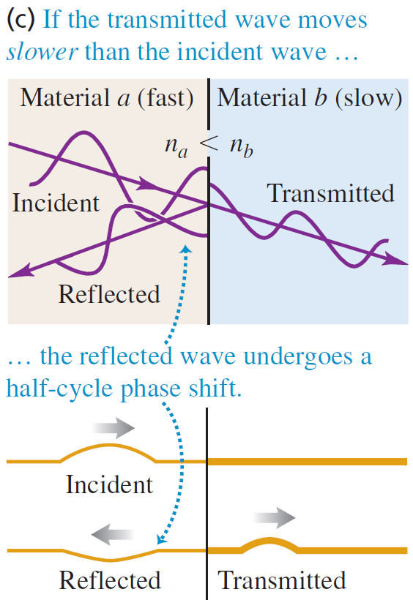
When the index of a film is less than the index of the material beyond it (ie glass), then the half-cycle phase shift occurs for both reflections, and the wavelengths of constructive and destructive interference were as mentioned in class:

Slide 8
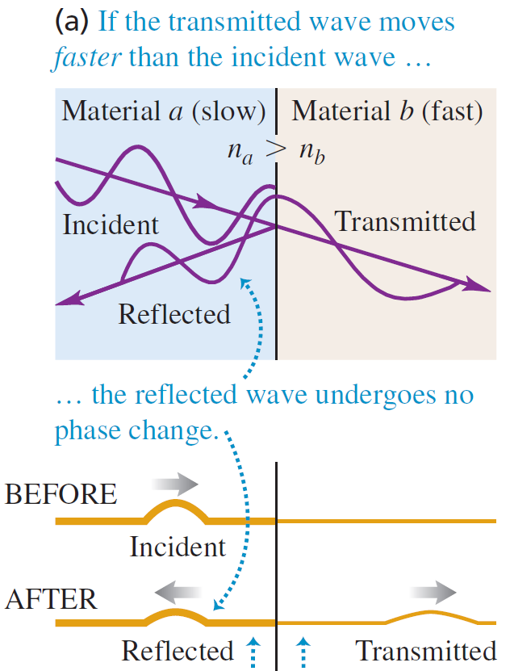
When the index of a film is greater than the index of the material beyond it (ie glass), then the half-cycle phase shift occurs for the front surface, but not the back-surface of the film.
This flips the constructive vs destructive equations:

Slide 9
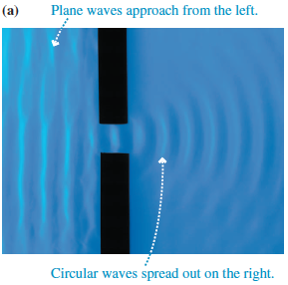
Diffraction of Water Waves
A water wave, after passing through an opening, spreads out to fill the space behind the opening
This well-known spreading of waves is called diffraction

Slide 10
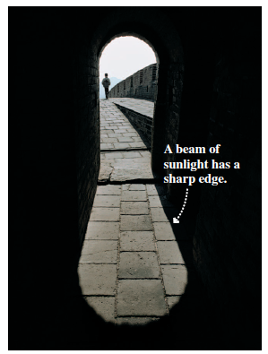
Models of Light
Unlike a water wave, when light passes through a a large opening, it makes a sharp-edged shadow
This lack of noticeable diffraction means that if light is a wave, the wavelength must be very small

Slide 11
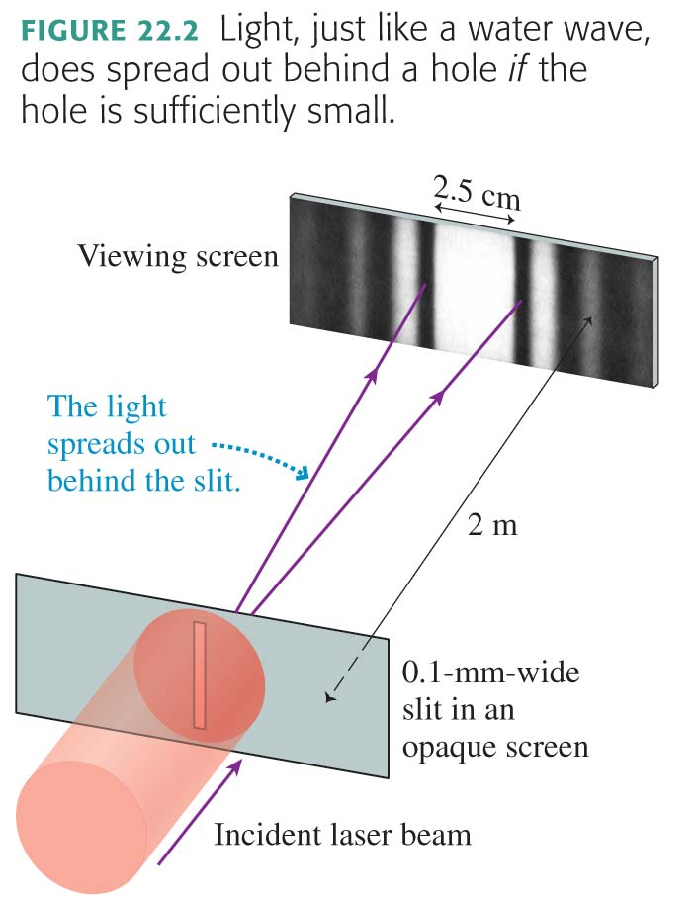
Diffraction of Light
When red light passes through an opening that is only 0.1 mm wide, it does spread out
Diffraction of light is observable if the hole is sufficiently small

Slide 12
Models of Light
The wave model: under many circumstances, light exhibits the same behavior as sound or water waves. The study of light as a wave is called wave optics.
The ray model: The properties of prisms, mirrors, and lenses are best understood in terms of light rays. The ray model is the basis of ray optics.
The photon model: In the quantum world, light behaves like neither a wave nor a particle. Instead, light consists of photons that have both wave-like and particle-like properties. This is the quantum theory of light.

Slide 13
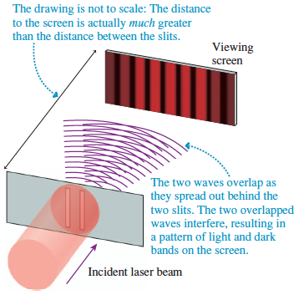
Young’s Double-Slit Experiment

Slide 14
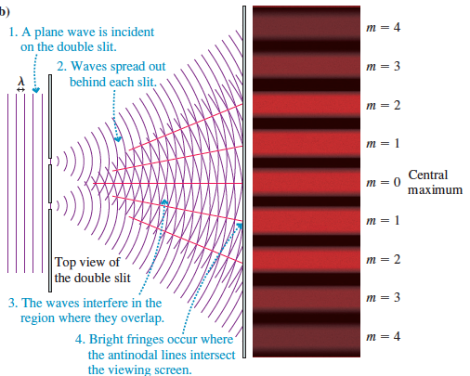

Slide 15
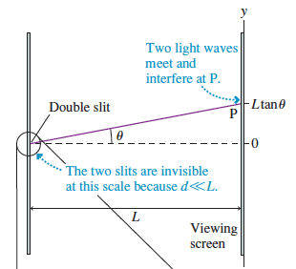
Analyzing Double-Slit Interference
The figure shows the “big picture” of the double-slit experiment
The next slide zooms in on the area inside the circle

Slide 16
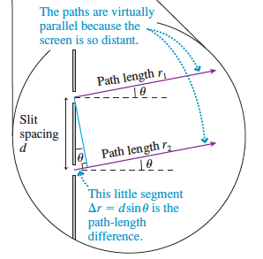
Analyzing Double-Slit Interference
The figure shows a magnified portion of the double-slit experiment
The wave from the lower slit travels an extra distance
Bright fringes (constructive interference) will occur at angles θ_{m} such that Δr = mλ, where m = 0, 1, 2, 3, …

Slide 17
Analyzing Double-Slit Interference
The mth bright fringe emerging from the double slit is at an angle
where θ_{m} is in radians, and we have used the small-angle approximation
The y-position on the screen of the mth bright fringe on a screen a distance L away is

Slide 18
Clicker Discussion Question
A laboratory experiment produces a double-slit interference pattern on a screen. If the screen is moved farther away from the slits, the fringes will be
closer together.
in the same positions.
farther apart.
fuzzy and out of focus.
Central maximum

Slide 19
Clicker Discussion Question
A laboratory experiment produces a double-slit interference pattern on a screen. If green light is used, with everything else the same, the bright fringes will be
closer together.
in the same positions.
farther apart.
There will be no fringes
because the conditions for
interference won’t be satisfied.
Central maximum

Slide 20
Clicker Discussion Question
A laboratory experiment produces a double-slit interference pattern on a screen. If the slits are moved closer together, the bright fringes will be
closer together.
in the same positions.
farther apart.
There will be no fringes
because the conditions for
interference won’t be satisfied.
Central maximum

Slide 21
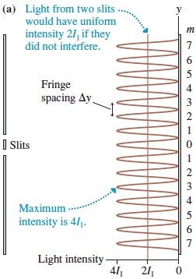
Intensity of the Double-Slit Interference Pattern
The intensity of the double-slit interference pattern at position y is:

Slide 22
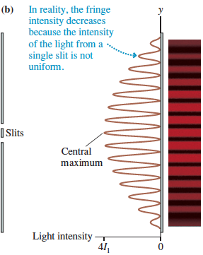
Intensity of the Double-Slit Interference Pattern
The actual intensity from a double-slit experiment slowly decreases as |y| increases.

Slide 23
The Diffraction Grating
Suppose we were to replace the double slit with an opaque screen that has N closely spaced slits
When illuminated from one side, each of these slits becomes the source of a light wave that diffracts, or spreads out, behind the slit
Such a multi-slit device is called a diffraction grating
Bright fringes will occur at angles θ_{m}, such that:
The y-positions of these fringes will occur at:

Slide 24
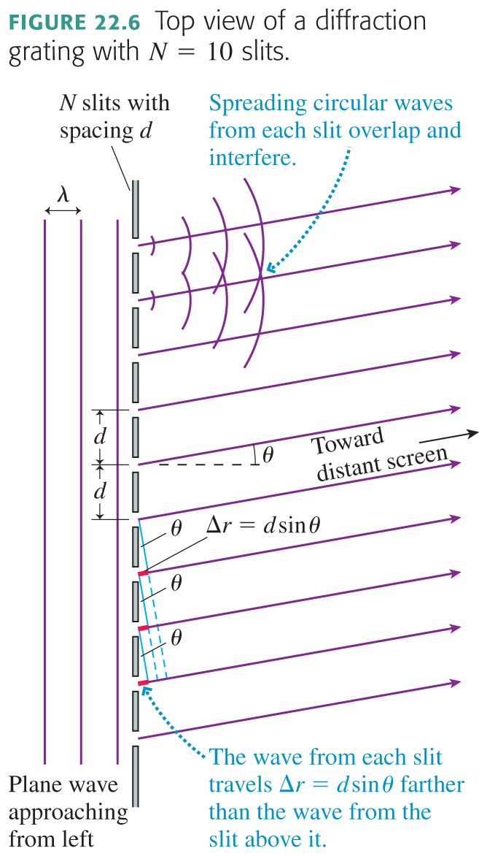
The Diffraction Grating
Suppose we were to replace the double slit with an opaque screen that has N closely spaced slits
When illuminated from one side, each of these slits becomes the source of a light wave that diffracts, or spreads out, behind the slit
Such a multi-slit device is called a diffraction grating

Slide 25
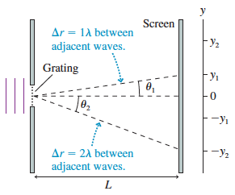
The Diffraction Grating
Bright fringes will occur at angles θ_{m}, such that
d sinθ_{m} = mλ
where m = 0, 1, 2, 3, …
The y-positions of these fringes are:

Slide 26
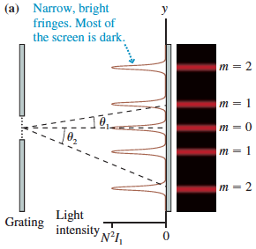
The Diffraction Grating
The integer m is called the order of the diffraction
The wave amplitude at the points of constructive interference is Na
Because intensity depends on the square of the amplitude, the intensities of the bright fringes are

Slide 27
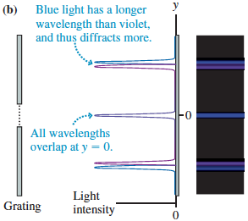
The Diffraction Grating
Diffraction gratings are used for measuring the wavelengths of light
If the incident light consists of two slightly different wavelengths, each wavelength will be diffracted at a slightly different angle

Slide 28
Clicker Discussion Question
In a laboratory experiment, a diffraction grating produces an interference pattern on a screen. If the number of slits in the grating is increased, with everything else (including the slit spacing) the same, then
The fringes stay the same brightness and get closer together.
The fringes stay the same brightness and get farther apart.
The fringes stay in the same positions but get brighter and narrower.
The fringes stay in the same positions but get dimmer and wider.
The fringes get brighter, narrower, and closer together.

Slide 29
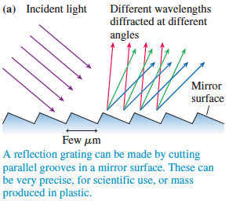
Reflection Gratings
In practice, most diffraction gratings are manufactured as reflection gratings
The interference pattern is exactly the same as the interference pattern of light transmitted through N parallel slits

Slide 30
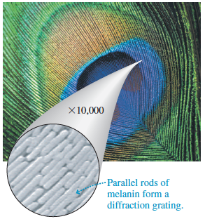
Reflection Gratings
Naturally occurring reflection gratings are responsible for some forms of color in nature
A peacock feather consists of nearly parallel rods of melanin, which act as a reflection grating

Slide 31
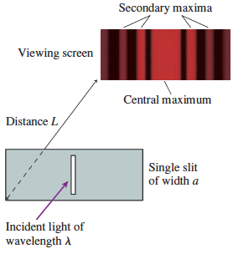
Single-Slit Diffraction
Diffraction through a tall, narrow slit is known as single-slit diffraction
A viewing screen is placed distance L behind the slit of width a, and we will assume that L >> a

Slide 32
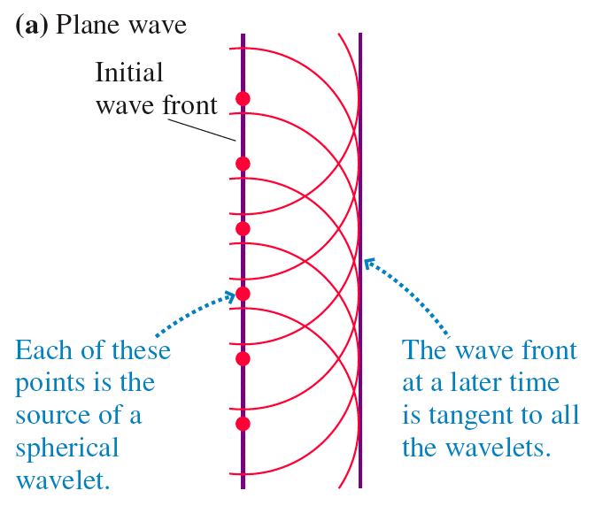
Huygens’ Principle: Plane Waves

Slide 33
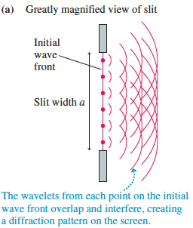
Analyzing Single-Slit Diffraction
The figure shows a wave front passing through a narrow slit of width a
According to Huygens’ principle, each point on the wave front can be thought of as the source of a spherical wavelet

Slide 34
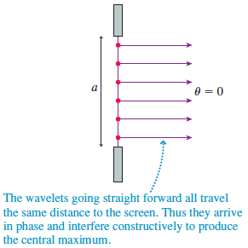
Analyzing Single-Slit Diffraction
The figure shows the paths of several wavelets that travel straight ahead to the central point on the screen
The screen is very far to the right in this magnified view of the slit
The paths are very nearly parallel to each other, thus all the wavelets travel the same distance and arrive at the screen in phase with each other

Slide 35
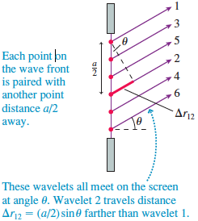
In this figure, wavelets 1 and 2 start from points that are a/2 apart
Every point on the wave front can be paired with another point distance a/2 away
If the path-length difference is Δr = λ/2, the wavelets arrive at the screen out of phase and interfere destructively

Slide 36
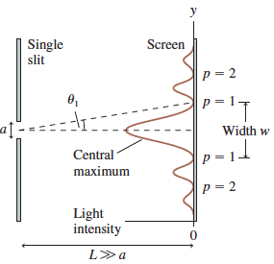
Single-Slit Diffraction
The light pattern from a single slit consists of a central maximum flanked by a series of weaker secondary maxima and dark fringes
The dark fringes occur at angles:

Slide 37
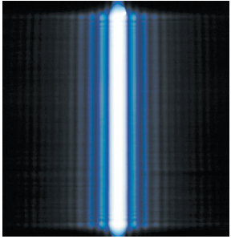
The Width of a Single-Slit Diffraction Pattern
The central maximum of this single-slit diffraction pattern is much brighter than the secondary maximum
The width of the central maximum on a screen a distance L away is twice the spacing between the dark fringes on either side:
The farther away from the screen (larger L), the wider the pattern of light becomes
The narrower the opening (smaller a), the wider the pattern of light becomes!

Slide 38
Clicker Discussion Question
A laboratory experiment produces a single-slit diffraction pattern on a screen. If the slit is made narrower, the bright fringes will be
closer together.
in the same positions.
farther apart.
There will be no fringes
because the conditions for
diffraction won’t be satisfied.

Slide 39
Clicker Discussion Question
A laboratory experiment produces a double-slit interference pattern on a screen. If the left slit is blocked, the screen will look like
A.
B.
Laser beam
C.
D.

Slide 40
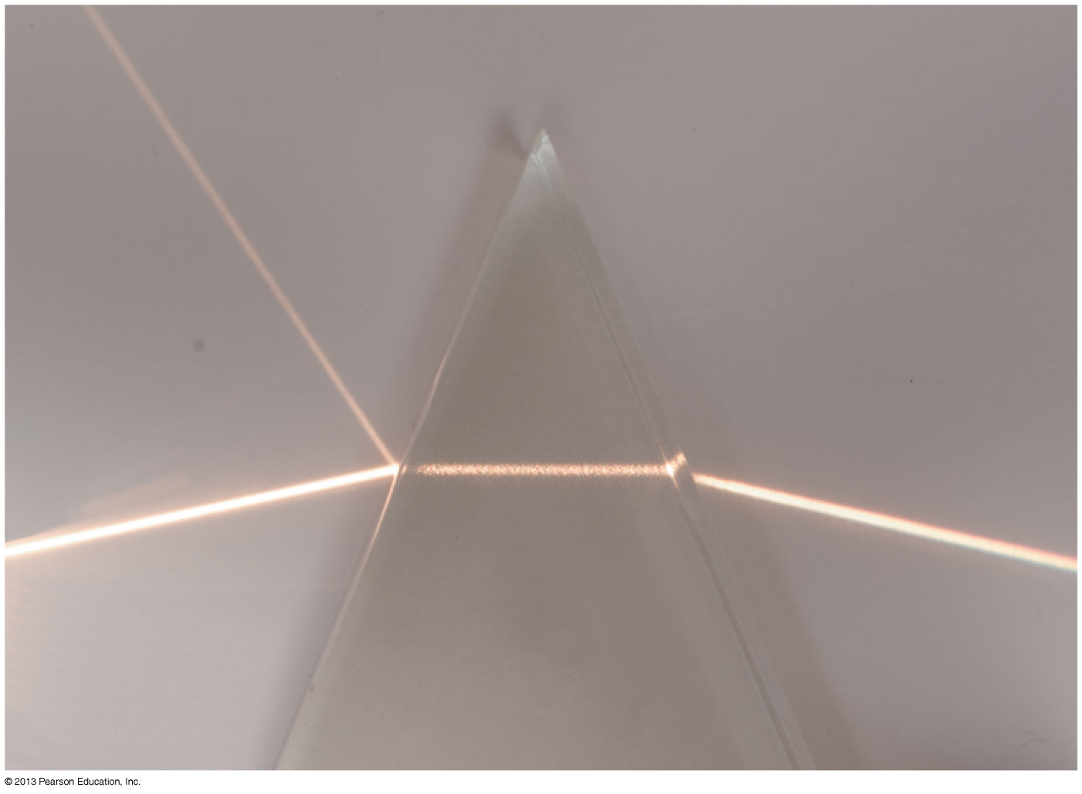
Before Class 6 on Wednesday
Please read Knight Ch. 23, sections 23.1-23.5
Please do the short pre-class quiz on MasteringPhysics by Wednesday morning at the latest.
Something to think about: Is it possible to see a ray of light if it does not actually enter your eye?

