Slide 1
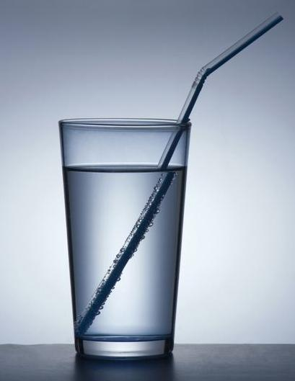
PHY132 Introduction to Physics II
Class 6 – Outline:
Ch. 23, sections 23.1-23.5
Reflection
Refraction
Total Internal Reflection
Image Formation
Colour and Dispersion
http://physics.tutorvista.com/light/index-of-refraction.html

Slide 2
Where to get help
Your classmates: go on Piazza.com, form a study group, hang out in MP125, etc
Your two graduate student TAs. Learn their email address, office hours, and office location.
Me. After class + MP121B office hours are T12, F10, email [Note I am away Friday Jan.23]
Professor Meyertholen, MP129A office hours are M2, F11-12
The Physics Drop-In Centre in MP125, back corner MTWR 12-3, F11-2
Academic Success Centre in Koffler 1st floor, inside the Career Centre

Slide 3
Announcement
Test 1 is Tuesday Jan. 27th from 6:00-7:30pm.
Room To Be Announced
If you have a conflict with the above time, the alternate sitting will be from 4:30-6:00pm on Tuesday Jan. 27th
  To register, students should submit the Alternate Sitting Registration Form, available now in the PHY132S Portal course menu.
  The location will be emailed no later than Jan. 26 to the people who have registered.
  You have until Jan. 22 at 4:00pm to do it (the form will not be available after).

Slide 4
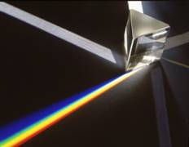
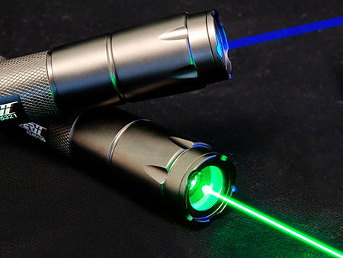
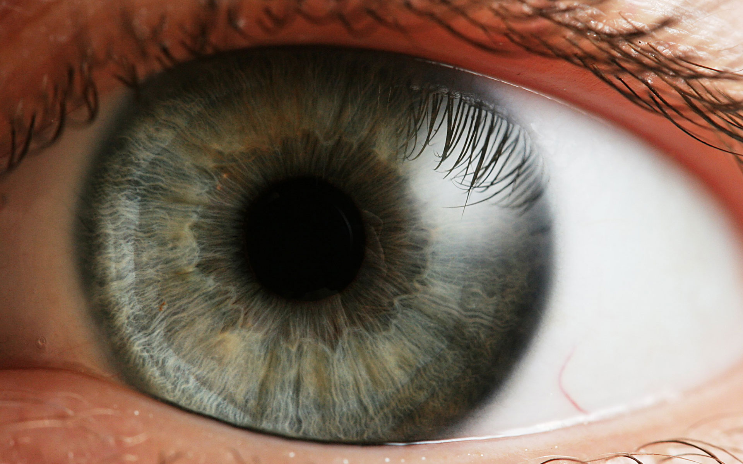
What is light?
Light is an electromagnetic wave – and is highly useful in our everyday life!

Slide 5
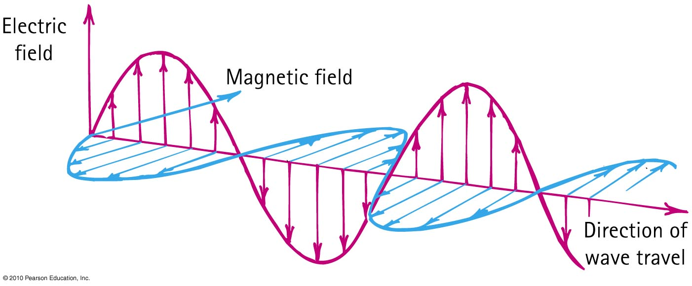
Electromagnetic Waves
The electric and magnetic fields of an electromagnetic wave are perpendicular to each other and to the direction of motion of the wave.

Slide 6
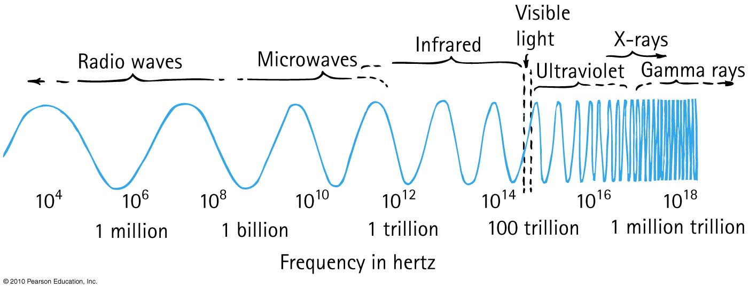
Electromagnetic Spectrum
In a vacuum, all electromagnetic waves move at the same speed
We classify electromagnetic waves according to their frequency (or wavelength)
Light is one kind of electromagnetic wave

Slide 7
If a certain material is “transparent” (ie, not opaque), what does this mean?
Electromagnetic Waves
CHECK YOUR NEIGHBOUR
Electromagnetic waves of all frequencies can pass straight through it
Electromagnetic waves of all frequencies are reflected from its surface
Electromagnetic waves of all frequencies are absorbed throughout its volume
Electromagnetic waves of a certain frequency can pass straight through it

Slide 8
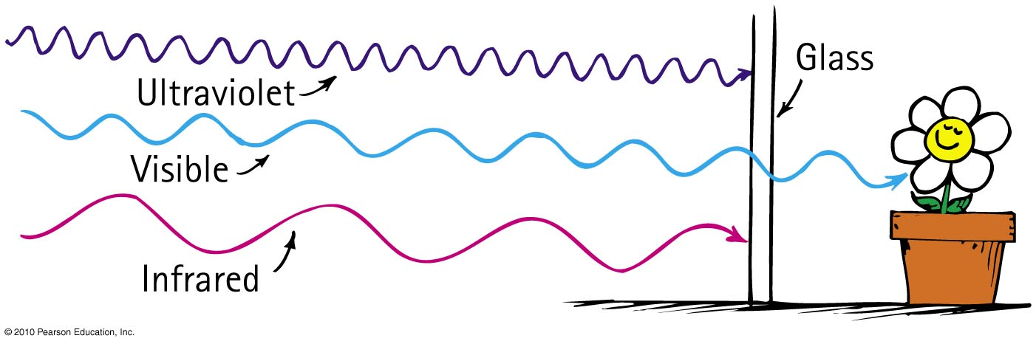
Transparent Materials
Glass blocks both infrared and ultraviolet, but it is transparent to visible light.

Slide 9
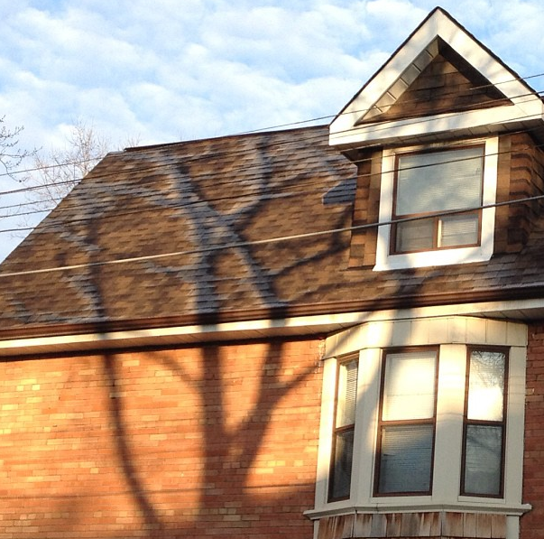
Opaque Materials
Most things around us are opaque—they absorb light without re-emitting it.
Vibrations given by light to their atoms and molecules are turned into random kinetic energy—into internal energy.
These materials become slightly warmer.

Slide 10
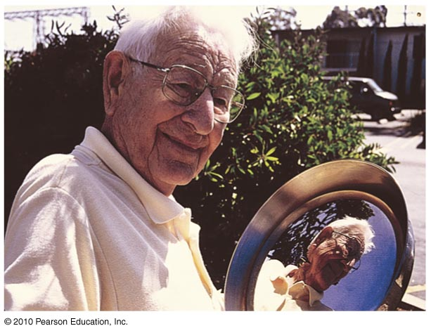
Opaque Materials
Metals
Light shining on metal forces free electrons in the metal into vibrations that emit their own light as reflection.

Slide 11
Which reflects more light, a white piece of paper or a black piece of paper?
Reflection
CHECK YOUR NEIGHBOUR
Black
White
About the same

Slide 12
Which reflects more light, a white piece of paper or a mirror?
Reflection
CHECK YOUR NEIGHBOUR
White Paper
Mirror
About the same

Slide 13
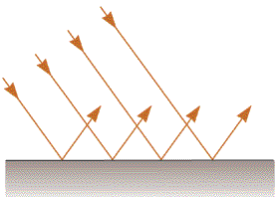
Specular Reflection
Mirrors
The surface is flat at distance scales near or above the wavelength of light
It looks “shiny”, and you can see images in it.

Slide 14
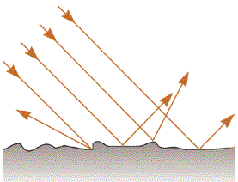
Diffuse Reflection
White Paper
The surface is rough at distance scales near or above the wavelength of light
Almost all surfaces reflect in this way!

Slide 15
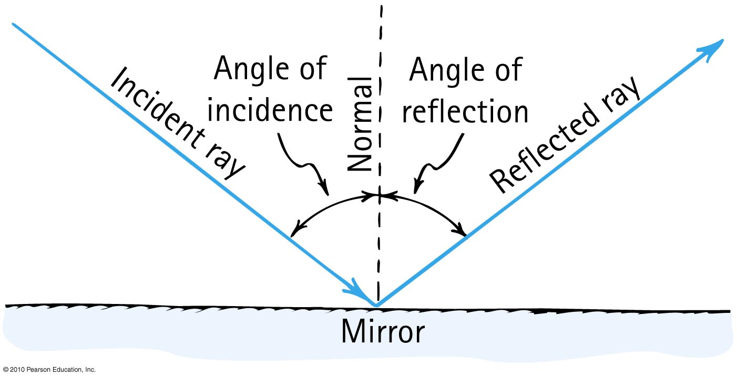
Law of Specular Reflection
The angle of reflection equals the angle of incidence.

Slide 16
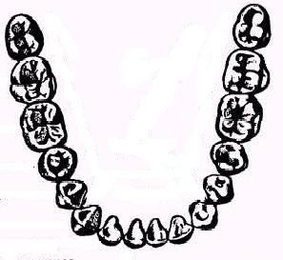
A dentist uses a mirror to look at the back of a second molar (A).
Next, she wishes to look at the back of a lateral incisor (B), which is 90° away.
By what angle should she rotate her mirror?
Mirror
A
B
A. 90°
B. 45°
C. 180°

Slide 17
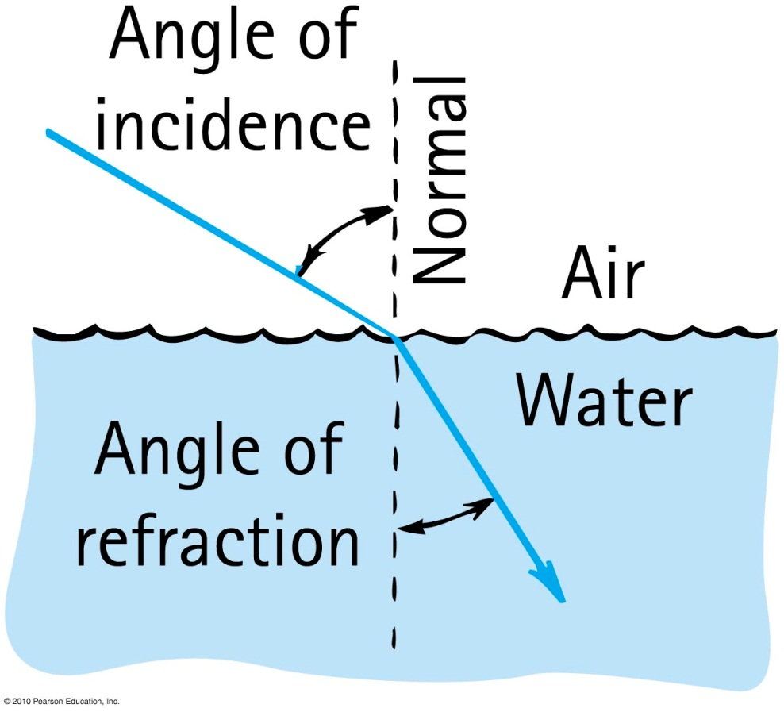
Refraction
When light bends in going obliquely from one medium to another, we call this process refraction.

Slide 18
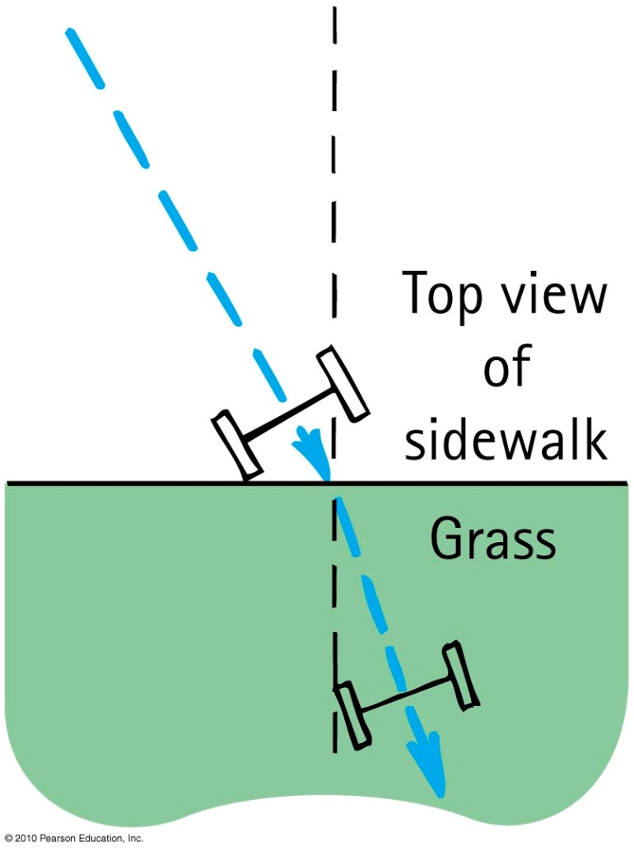
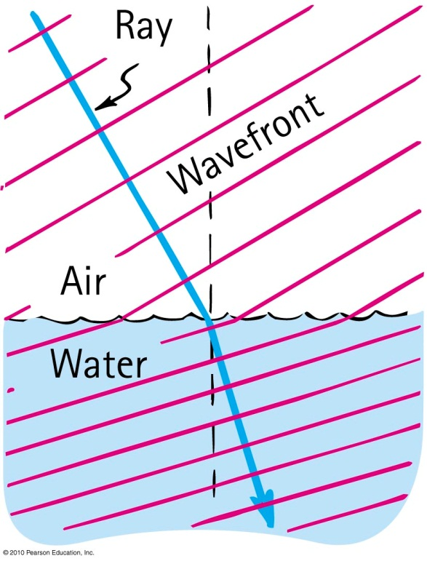
Cause of Refraction
Bending of light when it passes from one medium to another
Caused by change in speed of light

Slide 19

1
A soldier wants to get from point 1 to Point 2 in the shortest amount of time. Marching through mud is much slower than marching on dry land. Which might be the best path?
Dry Land
C
A
B
Mud
Dry Land
2

Slide 20
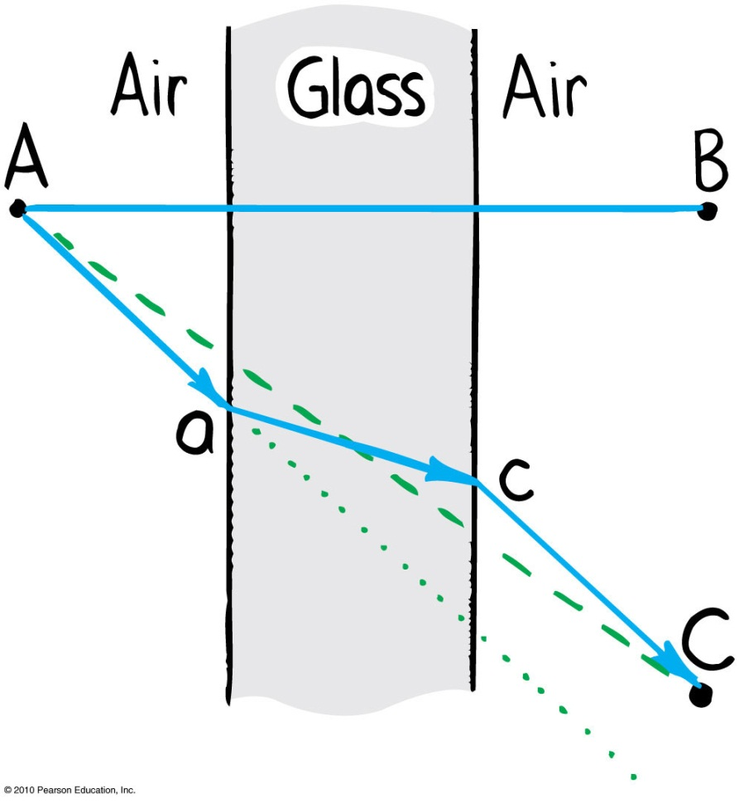
Refraction
  Light travels slower in glass than in air, so it minimizes the time it spends in the glass.

Slide 21
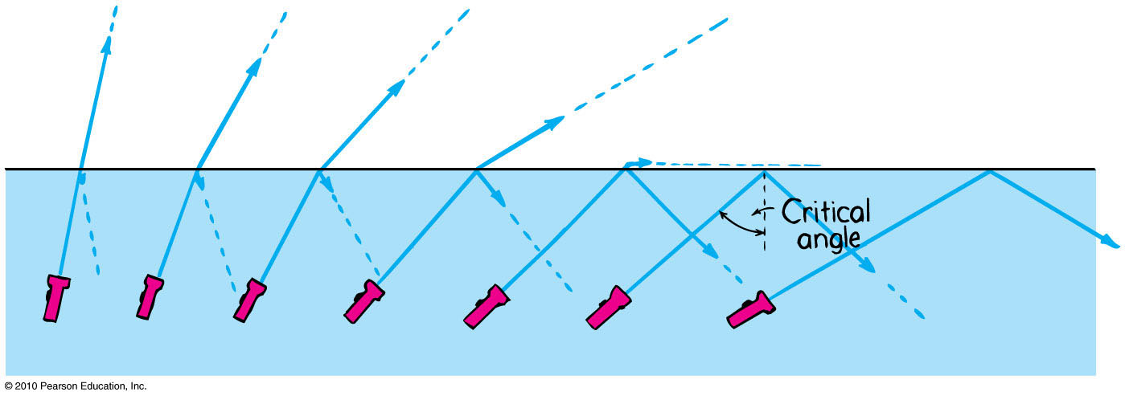
Total Internal Reflection
Total reflection of light traveling within a medium that strikes the boundary of another medium at an angle at, or greater than, the critical angle

Slide 22
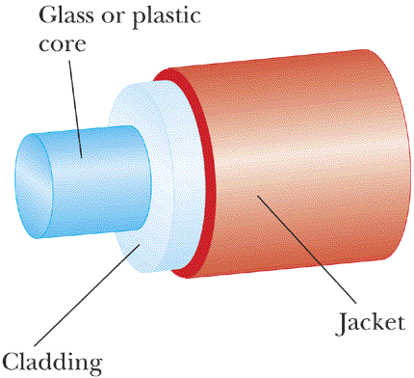
An Optical Fibre
Speed of light in cladding is higher than speed of light in core.

Slide 23
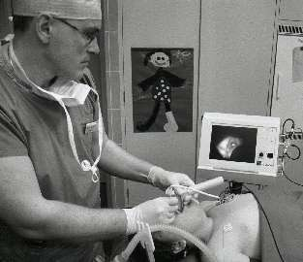
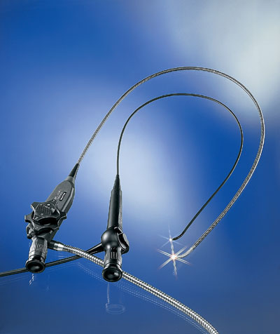
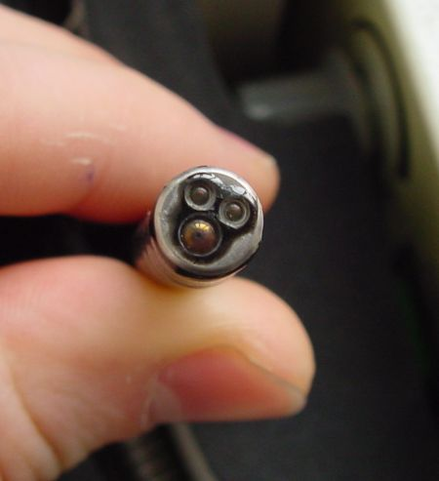
Medical Fibrescopes
Video-laryngoscopy with a flexible fiberscope

Slide 24
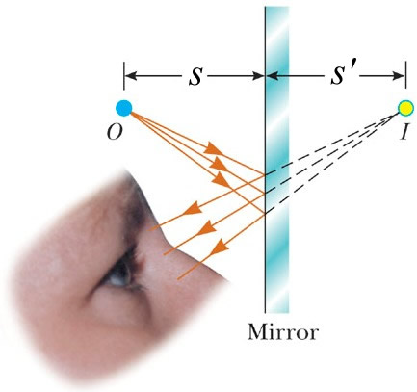
Virtual Image Formation
No light rays actually pass through or even near the image, so it is “virtual”.

Slide 25
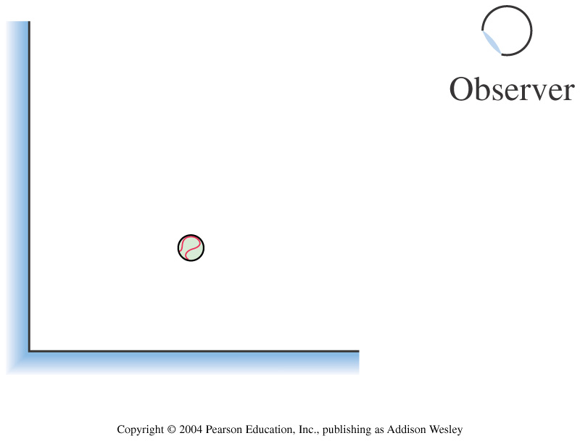
Two plane mirrors form a right angle. How many images of the ball can the observer see in the mirrors?
1
2
3
4

Slide 26
air
water
A fish swims below the surface of the water. An observer sees the fish at:
A. a greater depth than it really is.
B. its true depth.
C. a smaller depth than it really is.

Slide 27
air
water
A fish swims directly below the surface of the water. An observer sees the fish at:
A. a greater depth than it really is.
B. its true depth.
C. a smaller depth than it really is.

Slide 28
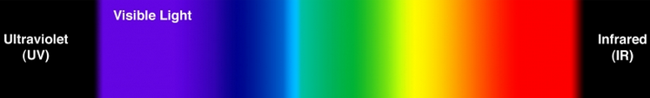




Color
Color we see depends on frequency of light.
$$0.4 μm$$
$$0.7 μm$$
$$f$$
High Frequency,
Short wavelength
Low Frequency,
Long wavelength
$$λ$$

Slide 29
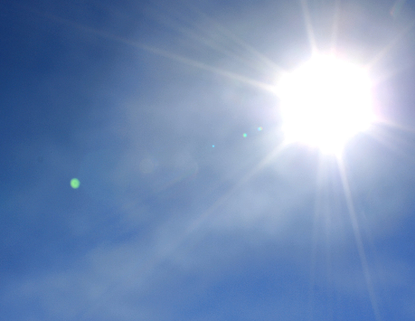
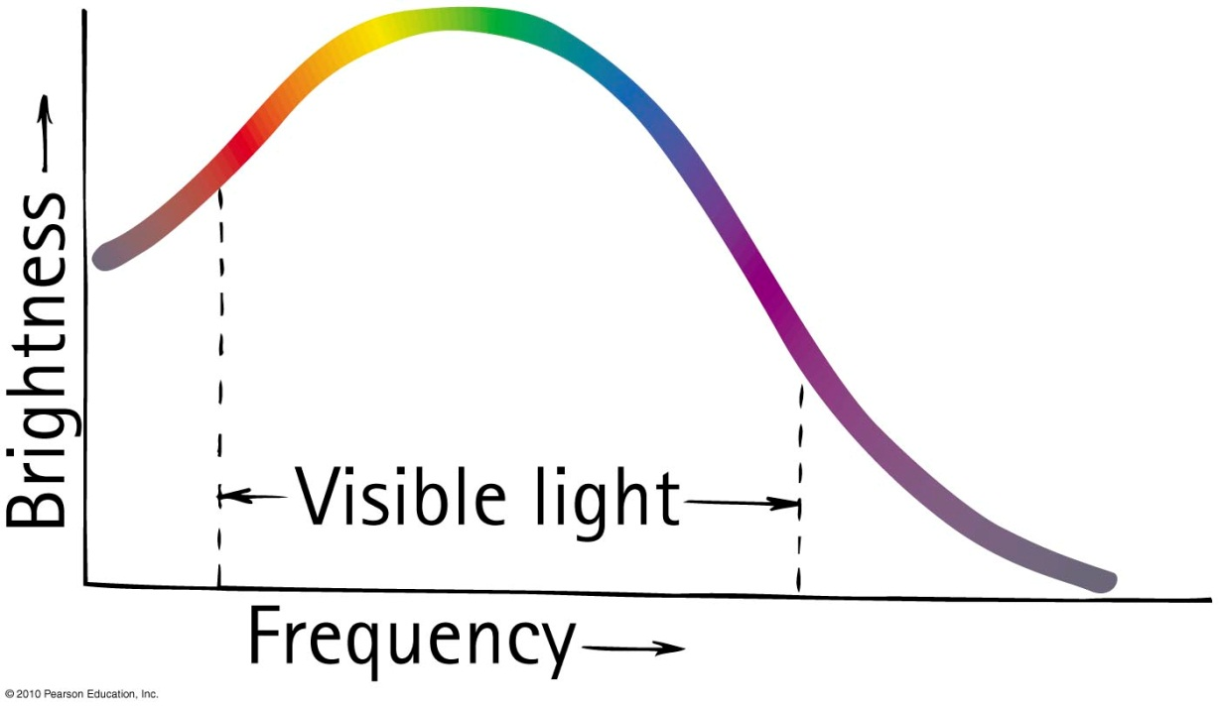
Mixing Colored Light
The spectrum of sunlight is a graph of brightness versus frequency.
Somehow, this mix looks “white” to us.

Slide 30
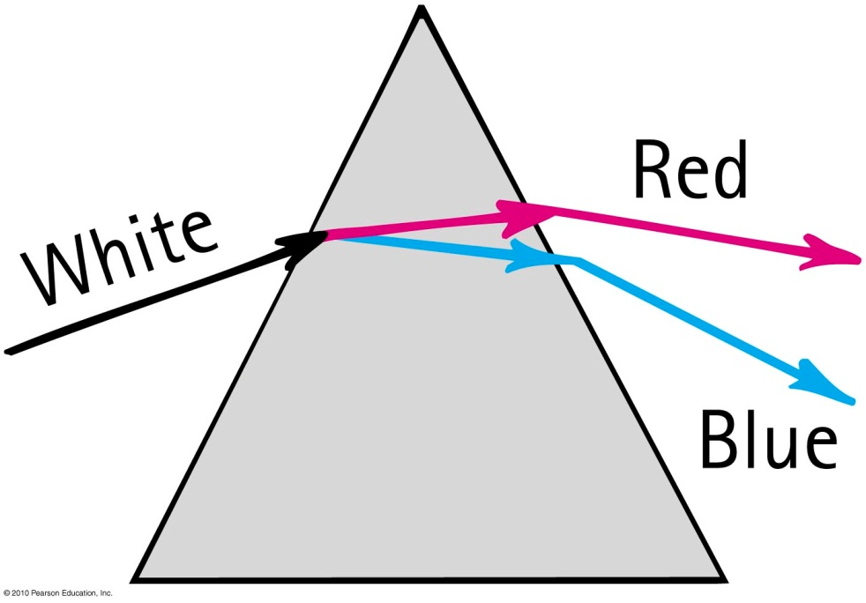
Dispersion
Process of separation of light into colors arranged by frequency
Components of white light are dispersed in a prism (and in a diffraction grating).

Slide 31
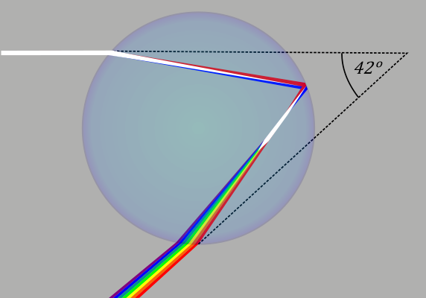
Rainbows
Rainbows are a result of dispersion by many drops.
Dispersion of light by a single drop

Slide 32
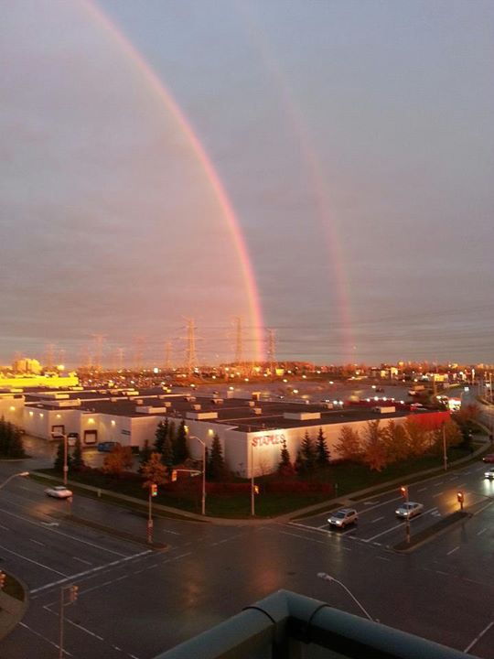
Rainbows
Radius of circle is about 41°
Antisun
(180° away from actual sun)
Image by Bita Janzadah. ©2014. https://fbcdn-sphotos-g-a.akamaihd.net/hphotos-ak-ash2/s720x720/560575_10151053440411899_1380323186_n.jpg

Slide 33
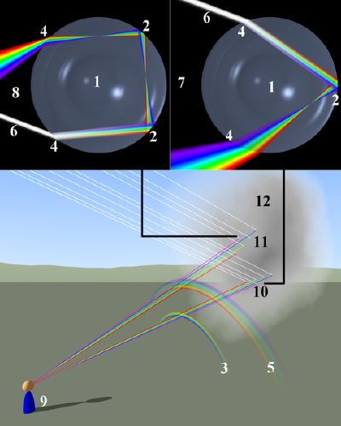
Double-rainbow
The second rainbow has blue on the top, and a radius of about 53°

Slide 34
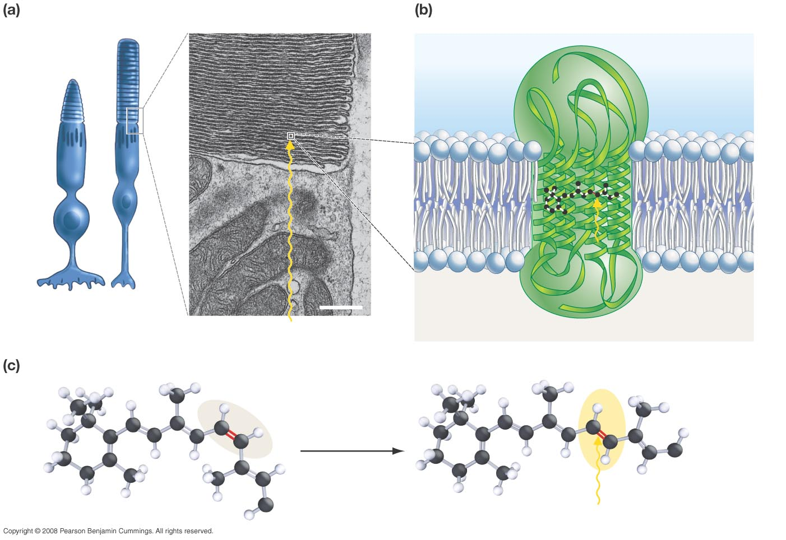
Rods and cones contain stacks of membranes.
Rhodopsin is a transmembrane protein complex.
Opsin (protein component)
Retinal (pigment)
Cone
Rod
0.5 µm
Rhodopsin
Light
Light
The retinal molecule inside rhodopsin changes shape when retinal absorbs light.
cis conformation (inactive)
trans conformation (activated)
Opsin
Opsin
Light
Slide courtesy of Ross Koning, Biology Department, Eastern Connecticut State University
http://plantphys.info/sciencematters/vision.ppt
Notes:
34

Slide 35
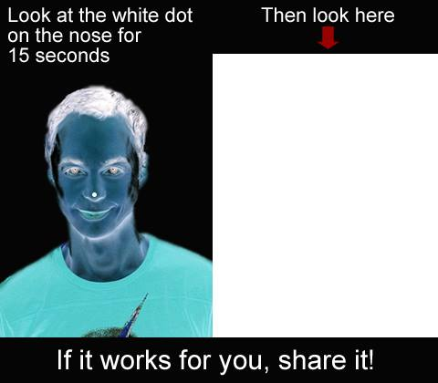
Use both eyes, stare at area shown in blue for 15 seconds or so
Stare at the dot on the nose for 15 seconds.

Slide 36
What do you see on this blank white slide? Blink if needed!
This is called an “after image”
Does it move around as you move your gaze?

Slide 37
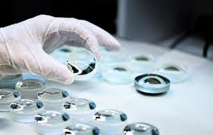
Before Class 7 on Monday
Please read Knight Pgs. 670-686: Ch. 23, sections 23.6-23.8
Don’t forget Problem Set 2 due on Sunday night!
Something to think about: What is the difference between a converging and diverging lens? Which type can be used to focus sunlight onto a piece of paper and burn a hole?

