Slide 1
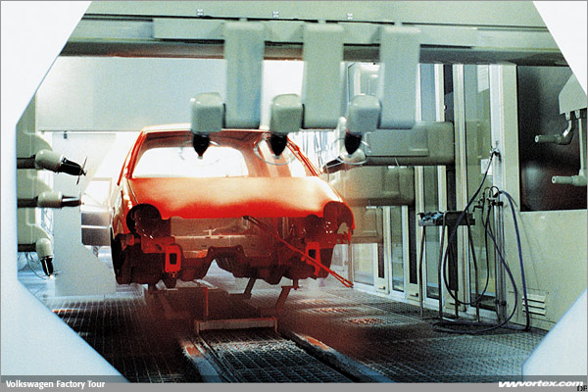
PHY132 Introduction to Physics II
Class 10 – Outline:
Chapter 26
Electric Field of:
  Continuous Charge Distribution
  Rings, Planes and Spheres
  Parallel Plate Capacitor
Volkswagon Factory Tour: Ionized paint droplets are transferred in an electrostatic field to the body, and adheres to the metal in an even coat.
Motion of a Charged Particle in an Electric Field
Image from http://www.vwvortex.com/artman/publish/vortex_news/article_329.shtml?page=4

Slide 2
QuickCheck 26.6
A positively charged paint droplet is placed at rest at the centre of a region of space in which there is a uniform, three-dimensional electric field. The force of gravity on the droplet is negligible.
When the droplet is released, what will its subsequent motion be?
It will move at constant speed.
It will move at constant velocity.
It will move at constant acceleration.
It will move with a linearly changing acceleration.
It will remain at rest in its initial position.
Notes:
2

Slide 3
Class 10 Preclass Quiz on MasteringPhysics
This was due this morning at 8:00am
592 students submitted the quiz on time
91% got: A practical device which produces a uniform electric field is a parallel-plate capacitor.
81% got: In chapter 26 Knight calculated the field for all of these:
  a line of charge
  a parallel-plate capacitor
  a ring of charge
  a plane of charge.

Slide 4
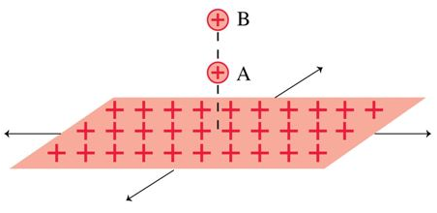
Class 10 Preclass Quiz on MasteringPhysics
40% got: Both A and B have the same acceleration (same force, and same electric field) when they are near an infinite plane of positive charge!

Slide 5
Class 10 Preclass Quiz student comments
“We are not responsible for the derivation of the equations illustrated in Ch 26, are we? Because that was fairly complicated calculus and was rather intimidating...”
Harlow answer: On test 2 and the final exam we will not be asking you to perform integrals like the ones done in these chapters. You should be familiar with the process though and concepts, and you should have the final results for these charge distributions (in the summary for Ch.26 on pg.773) on your aid sheet. [Note that in PHY152 the students do perform these kinds of integrals on tests and final exam.]
“Is a ring of charge the same as a disk of charge?”
Harlow answer: No. A ring has a giant hole in the middle. A disk is solid.
“I hope my score of test 1 is above the average, otherwise I will probably kill someone.”

Slide 6
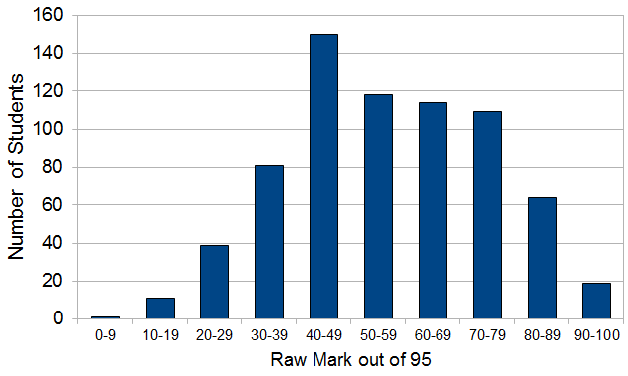
Test 1: Waves and Optics Results
Raw test average: 59%
Four students got 95/95 = 100%
40% of students got less than 50/95.

Slide 7
The Boost
Breakpoints for adjustment:
Raw | Maps to Adjusted
0 | 0
36.1 | 47.5
61.8 | 66.5
95 | 95
The average boost was +6.5%.
After the boost, your mark was converted to a percentage, and then rounded to the nearest percent.

Slide 8
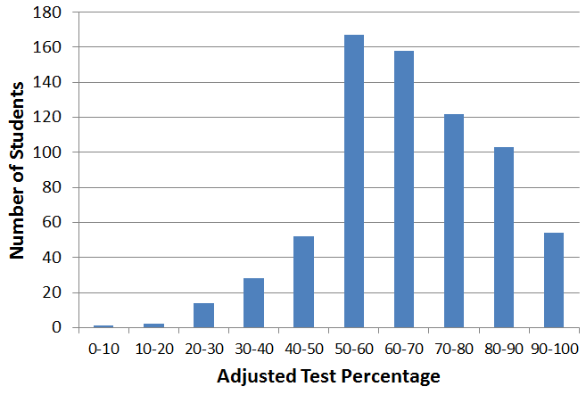
Test 1: Waves and Optics Results
Adjusted test average: 65.5%
Adjusted test median: 66%
22% of students got between 80 and 100.

Slide 9
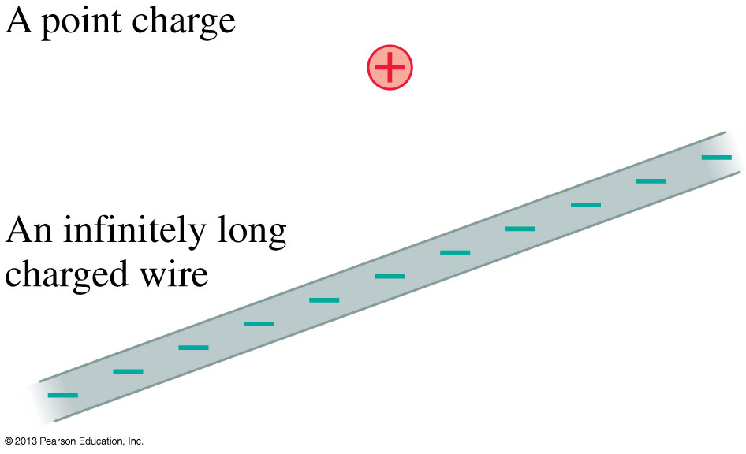
Electric Field Models
Most of this chapter will be concerned with the sources of the electric field.
We can understand the essential physics on the basis of simplified models of the sources of electric field.
The drawings show models of a positive point charge and an infinitely long negative wire.
We also will consider an infinitely wide charged plane and a charged sphere.

Slide 10
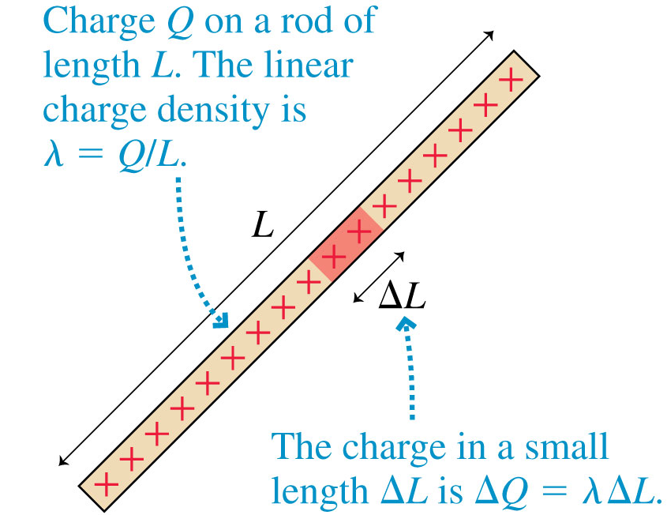
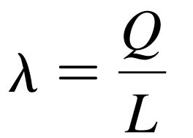
Continuous Charge Distributions
The linear charge density of an object of length L and charge Q is defined as
Linear charge density, which has units of C/m, is the amount of charge per meter of length.

Slide 11
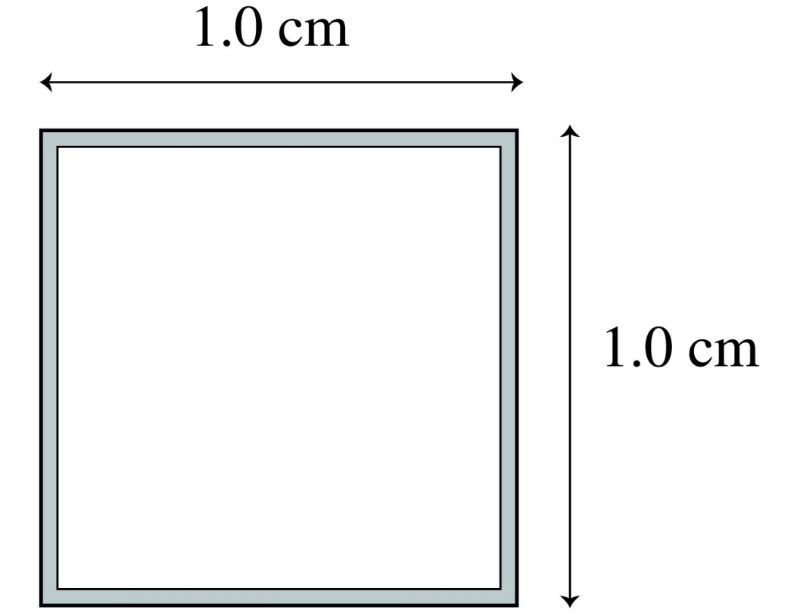
QuickCheck 26.6
If 8 nC of charge are placed on the square loop of wire, the linear charge density will be
800 nC/m.
400 nC/m.
200 nC/m.
8 nC/m.
2 nC/m.
Notes:
11

Slide 12
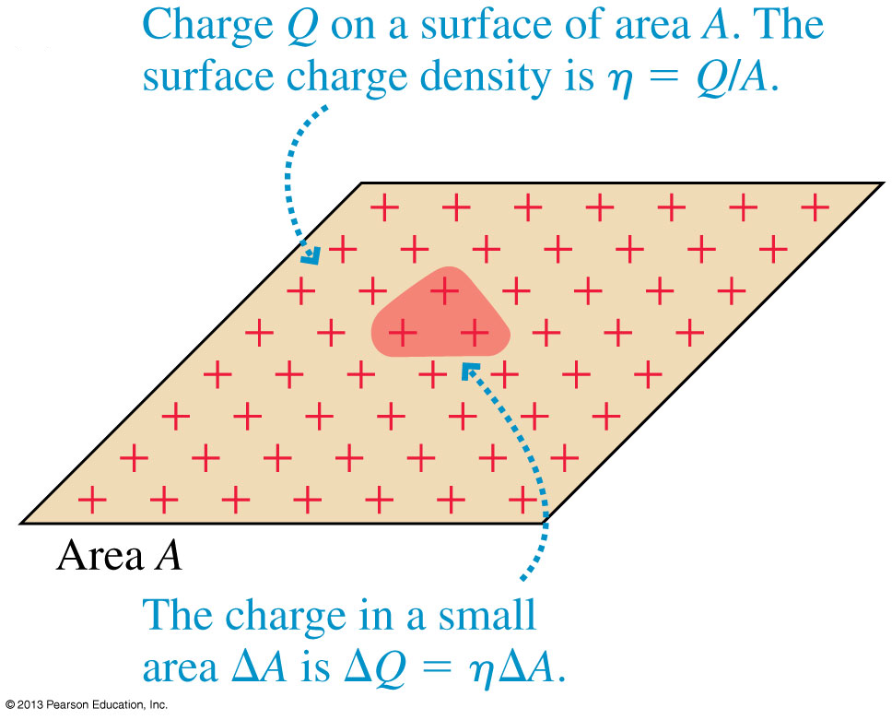
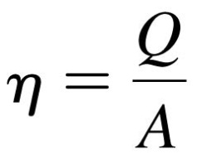
Continuous Charge Distributions
The surface charge density of a two-dimensional distribution of charge across a surface of area A is defined as:
Surface charge density, with units C/m², is the amount of charge per square meter.

Slide 13
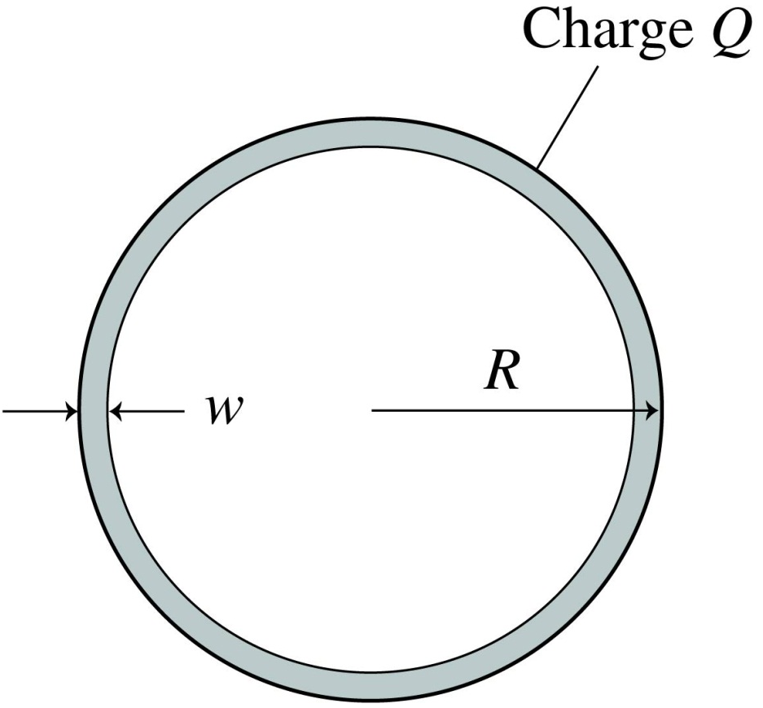
QuickCheck 26.7
A flat circular ring is made from a very thin sheet of metal. Charge Q is uniformly distributed over the ring. Assuming w << R, the surface charge density η on the top side, facing out of the page, is
Q/2πRw.
Q/4πRw.
Q/πR².
Q/2πR².
Q/πRw.
Notes:
13

Slide 14
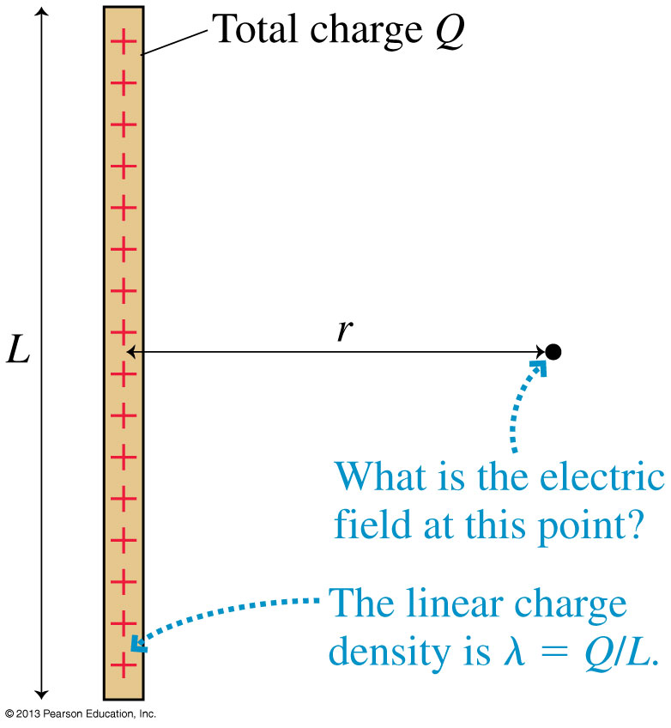
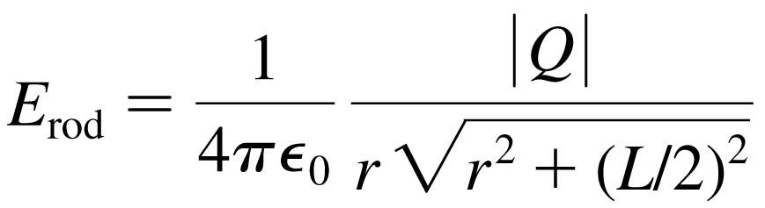
The Electric Field of a Finite Line of Charge
The Electric Field of a Finite Line of Charge
The electric field strength at a radial distance r in the plane that bisects a rod of length L with total charge Q:

Slide 15
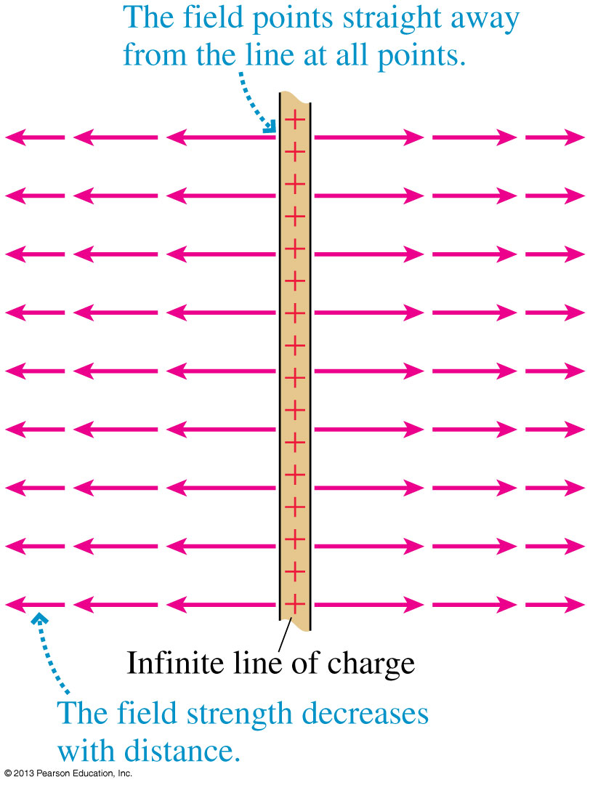
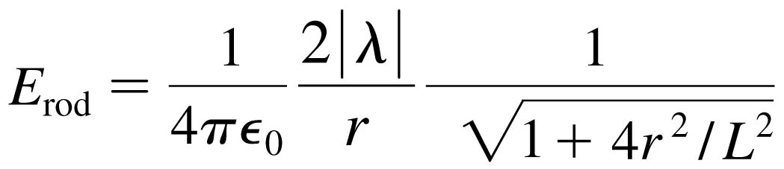
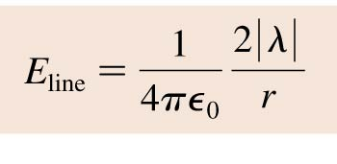
An Infinite Line of Charge
The electric field of a thin, uniformly charged rod may be written:
If we now let L → ∞, the last term becomes simply 1 and we’re left with:

Slide 16
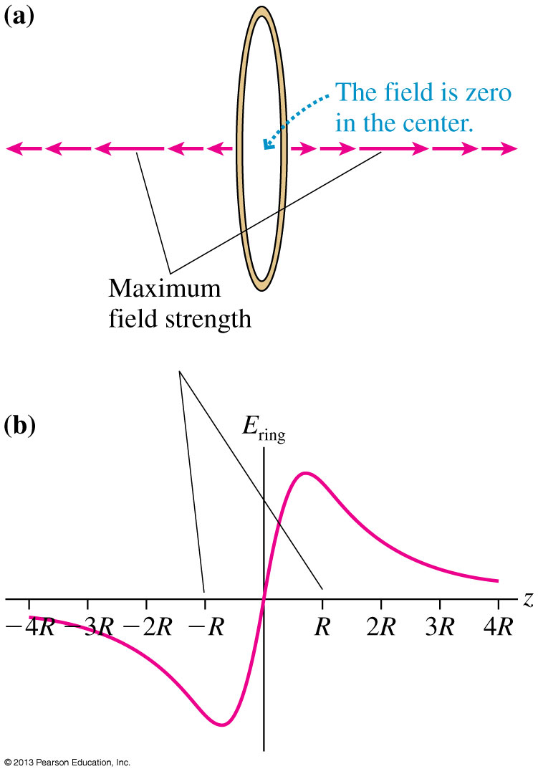
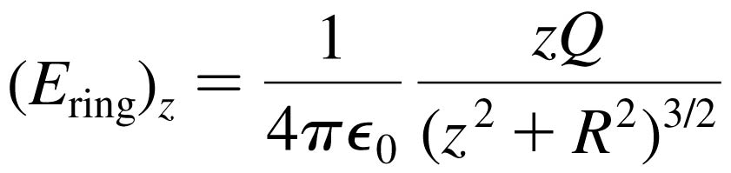
A Ring of Charge
Consider the on-axis electric field of a positively charged ring of radius R.
Define the z-axis to be the axis of the ring.
The electric field on the
z-axis points away from the center of the ring, increasing in strength until reaching a maximum when |z| ≈ R, then decreasing:

Slide 17
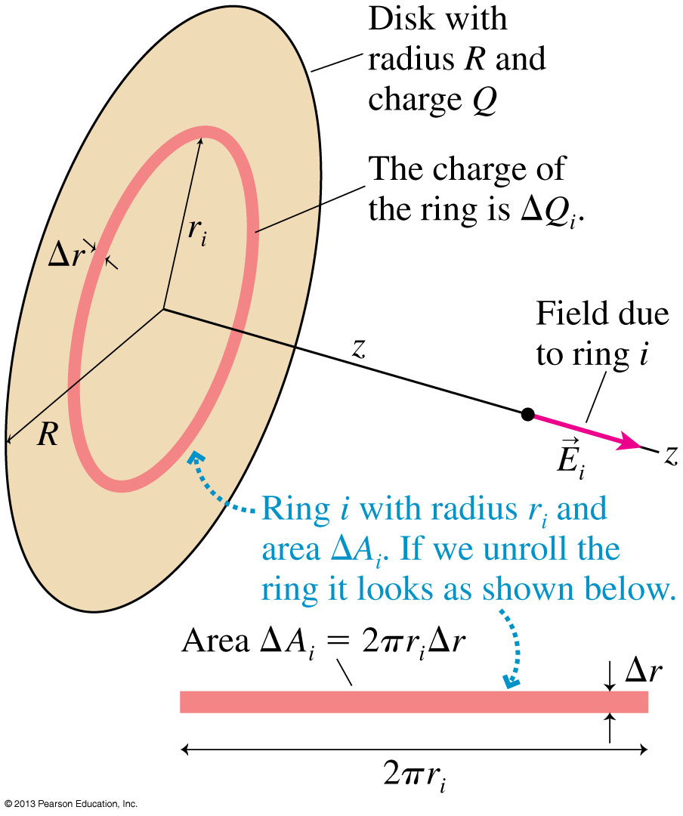

A Disk of Charge
Consider the on-axis electric field of a positively charged disk of radius R.
Define the z-axis to be the axis of the disk.
The electric field on the
z-axis points away from the center of the disk, with magnitude:

Slide 18
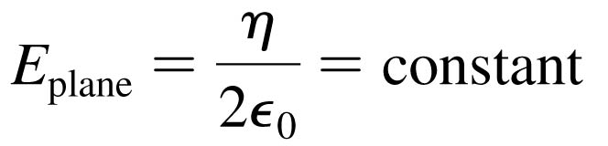
A Plane of Charge
The electric field of a plane of charge is found from the on-axis field of a charged disk by letting the radius R → ∞.
The electric field of an infinite plane of charge with surface charge density η is:
For a positively charged plane, with η > 0, the electric field points away from the plane on both sides of the plane.
For a negatively charged plane, with η < 0, the electric field points towards the plane on both sides of the plane.

Slide 19
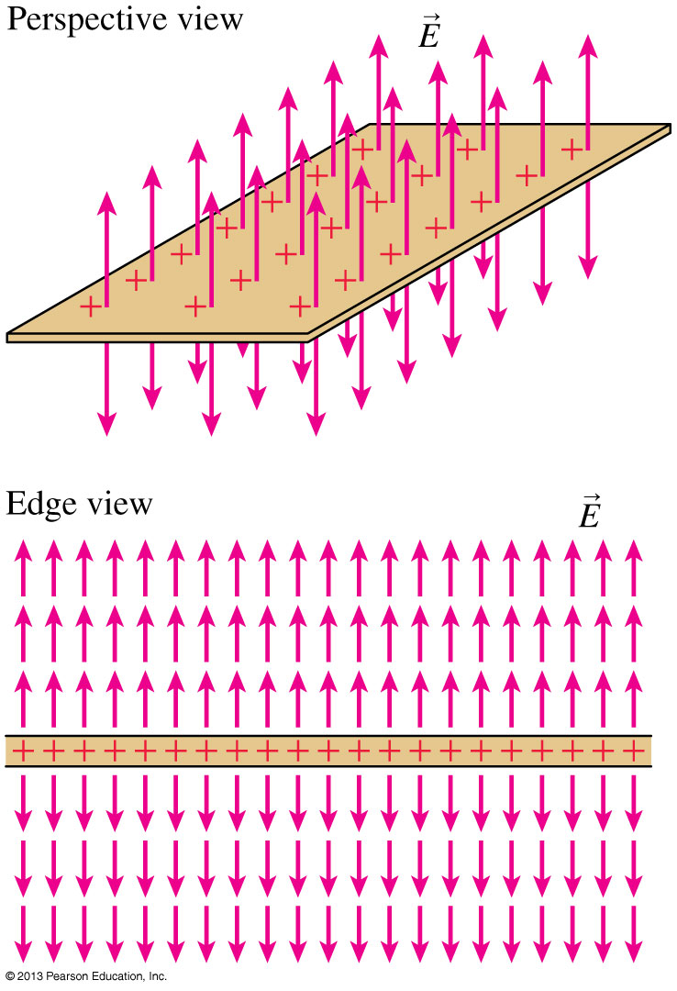
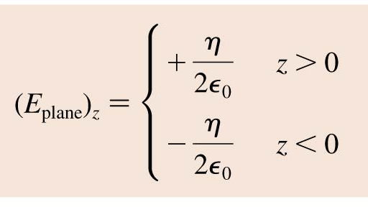
A Plane of Charge

Slide 20
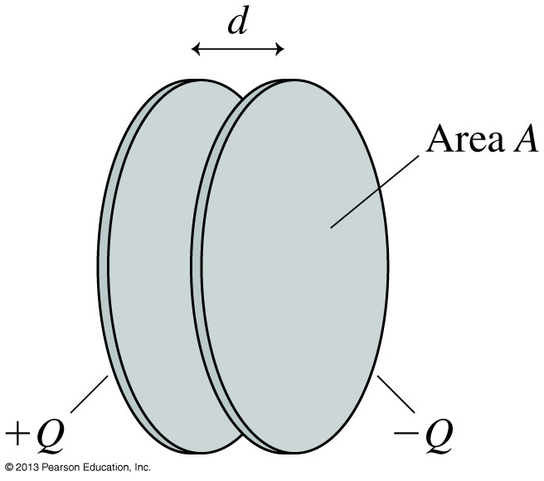
The Parallel-Plate Capacitor
The figure shows two electrodes, one with charge +Q and the other with −Q placed face-to-face a distance d apart.
This arrangement of two electrodes, charged equally but oppositely, is called a parallel-plate capacitor.
Capacitors play important roles in many electric circuits.

Slide 21
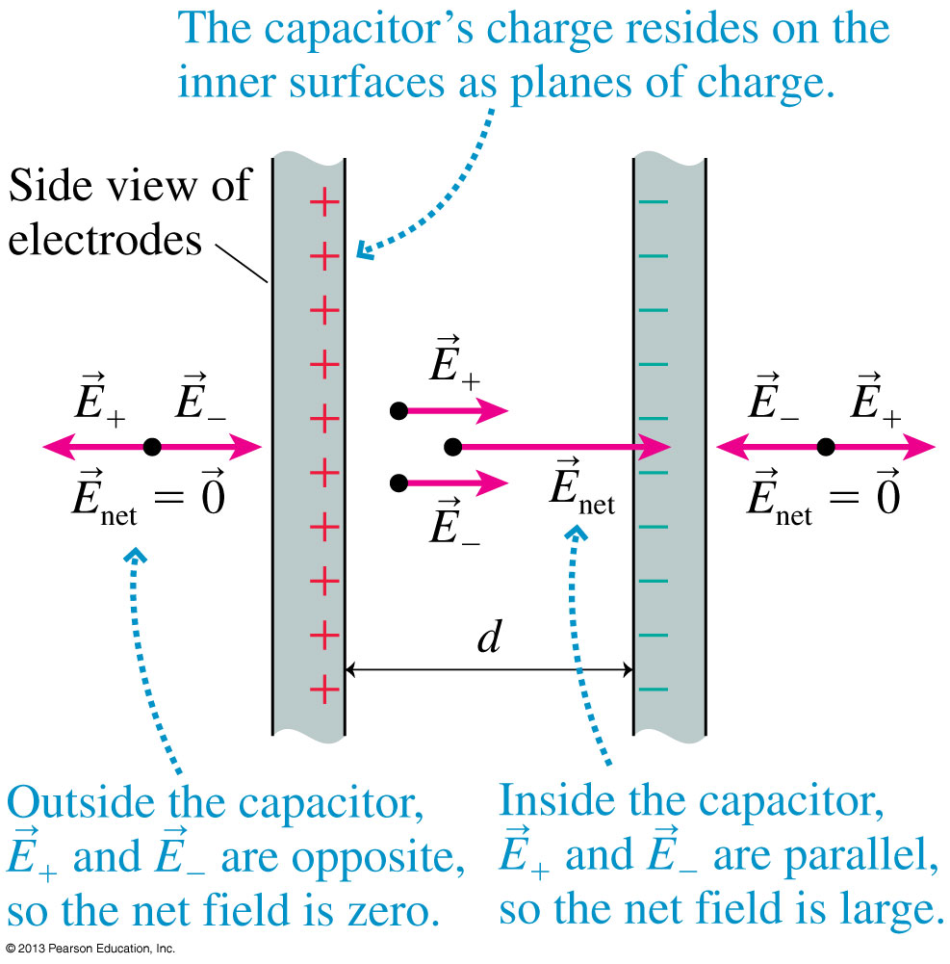
The Parallel-Plate Capacitor
The figure shows two capacitor plates, seen from the side.
Because opposite charges attract, all of the charge is on the inner surfaces of the two plates.
Inside the capacitor, the net field points toward the negative plate.
Outside the capacitor, the net field is zero.

Slide 22
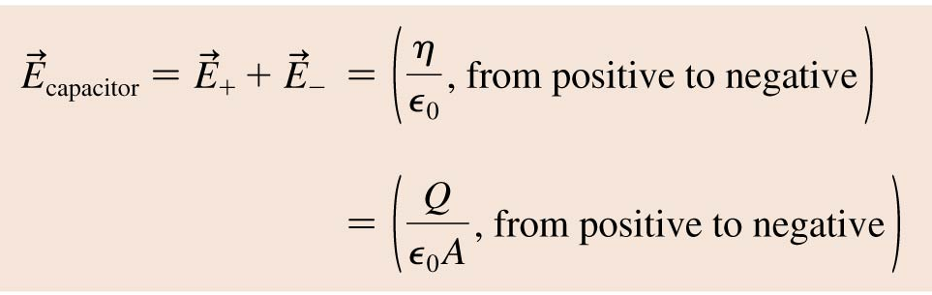
The Parallel-Plate Capacitor
The electric field inside a capacitor is
where A is the surface area of each electrode. Outside the capacitor plates, where E₊ and E₋ have equal magnitudes but opposite directions, the electric field is zero.

Slide 23
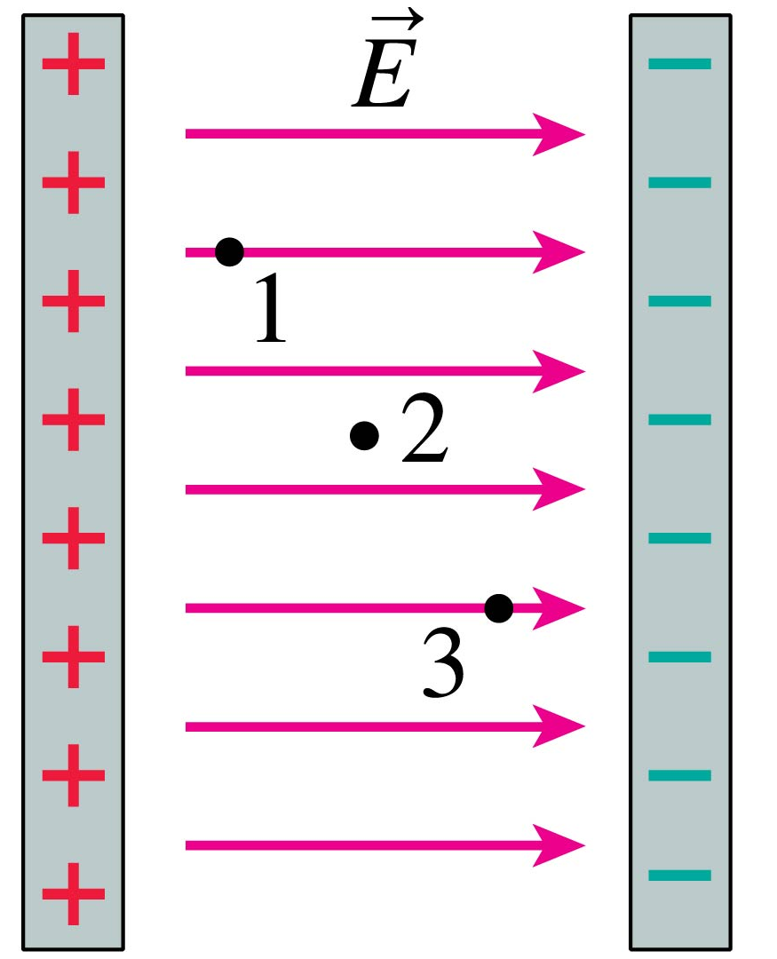
QuickCheck 26.10
Three points inside a
parallel-plate capacitor are marked. Which is true?
Assume infinite plates.
E₁ > E₂ > E₃
E₁ < E₂ < E₃
E₁ = E₂ = E₃
E₁ = E₃ > E₂
Notes:
23

Slide 24
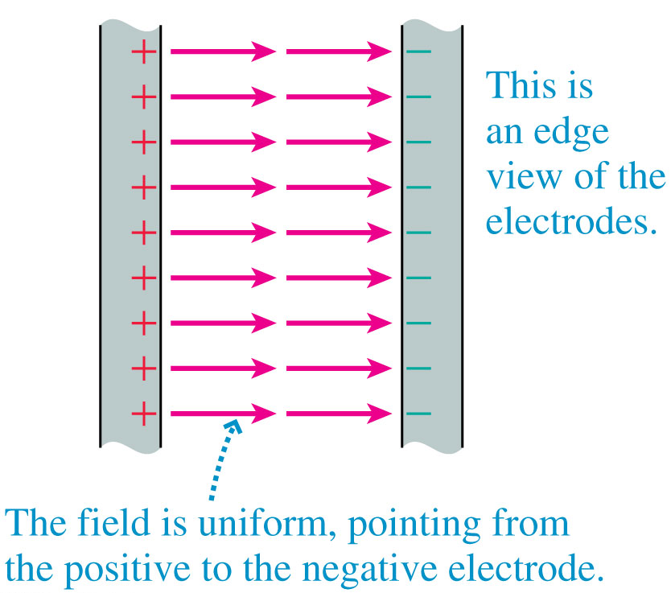
The Ideal Capacitor
The figure shows the electric field of an ideal parallel-plate capacitor constructed from two infinite charged planes
The ideal capacitor is a good approximation as long as the electrode separation d is much smaller than the electrodes’ size.

Slide 25
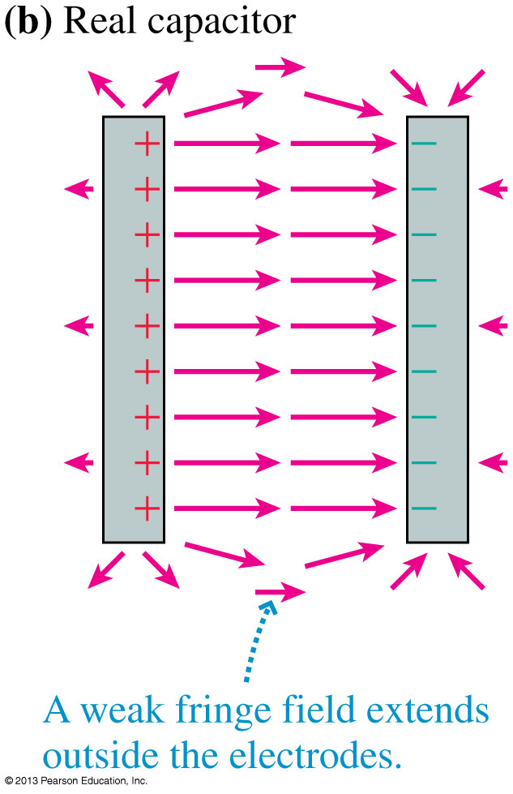
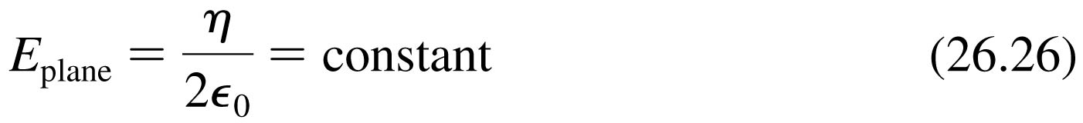
A Real Capacitor
Outside a real capacitor and near its edges, the electric field is affected by a complicated but weak fringe field.
We will keep things simple by always assuming the plates are very close together and using E = η/ ₀ for the magnitude of the field inside a parallel-plate capacitor.

Slide 26
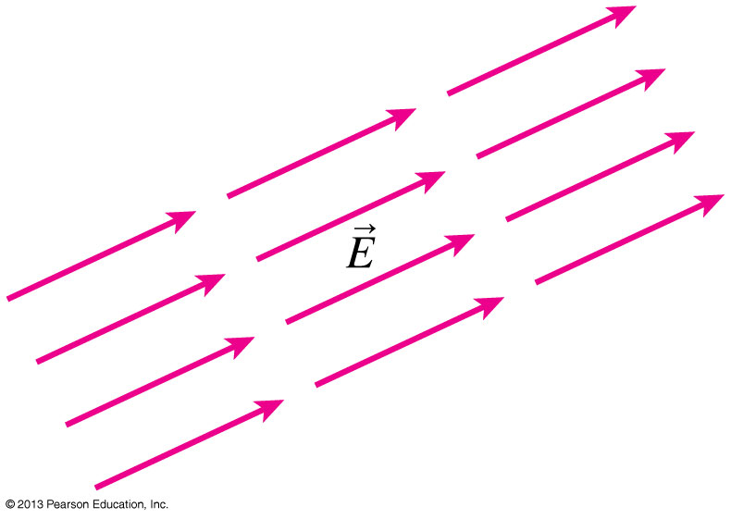
Uniform Electric Fields
The figure shows an electric field that is the same—in strength and direction—at every point in a region of space.
This is called a uniform electric field.
The easiest way to produce a uniform electric field is with a parallel-plate capacitor.

Slide 27

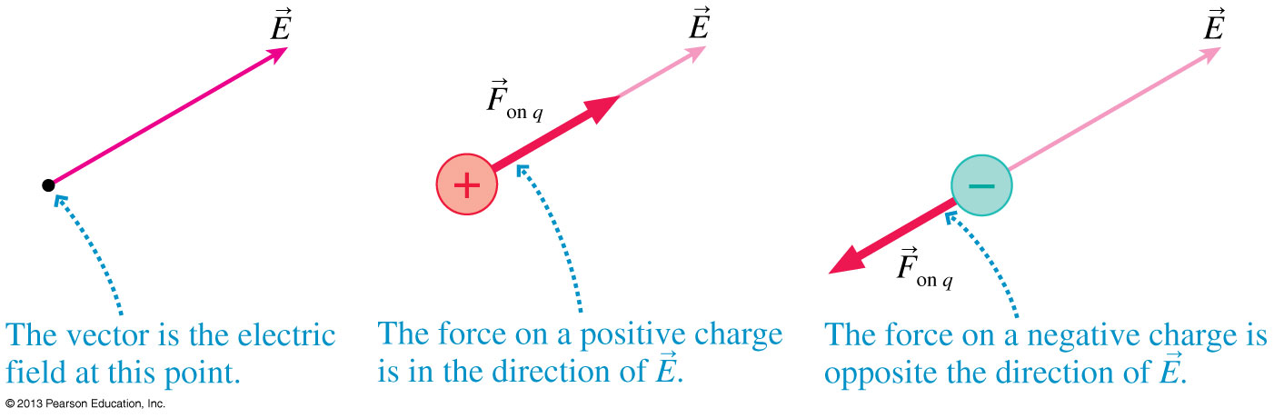
Motion of a Charged Particle in an Electric Field
Consider a particle of charge q and mass m at a point where an electric field E has been produced by other charges, the source charges.
The electric field exerts a force F_{on q} = qE.

Slide 28
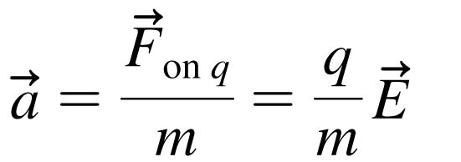
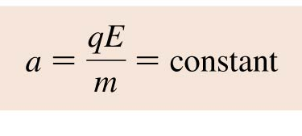
Motion of a Charged Particle in an Electric Field
The electric field exerts a force F_{on q} = qE on a charged particle.
If this is the only force acting on q, it causes the charged particle to accelerate with
In a uniform field, the acceleration is constant:

Slide 29
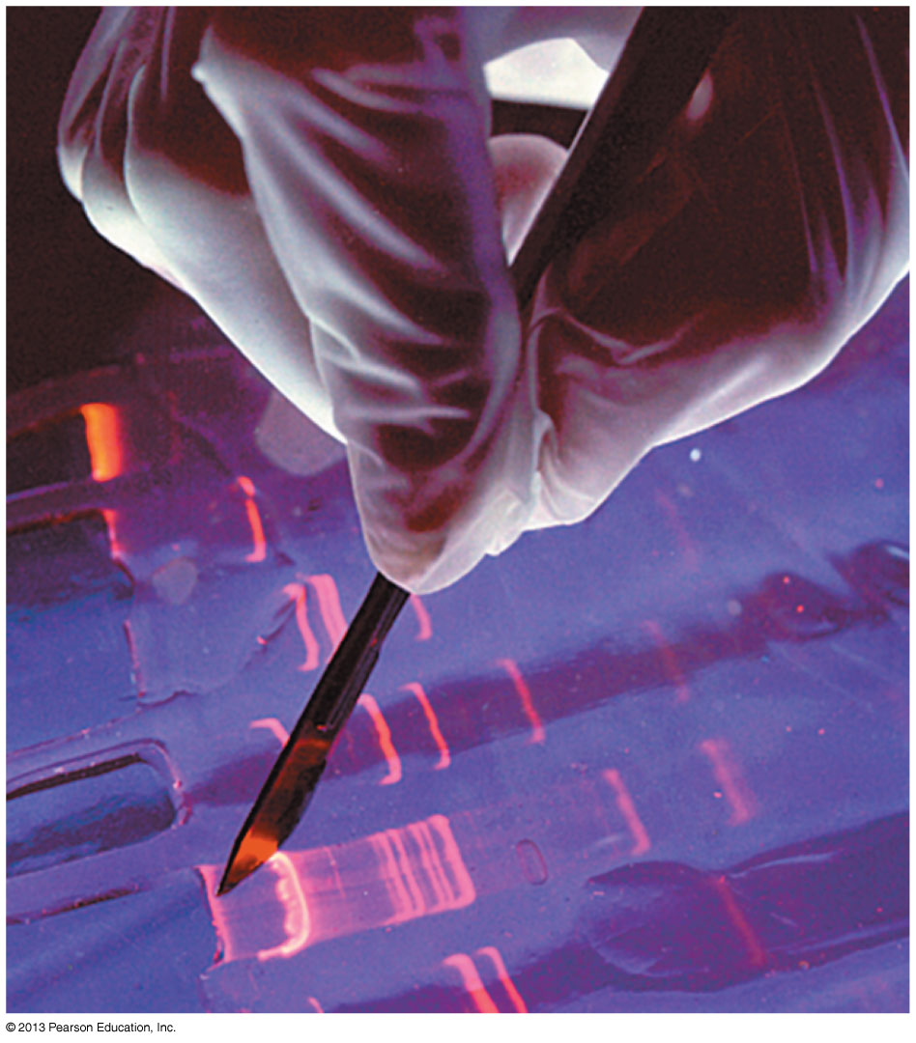
Motion of a Charged Particle in an Electric Field
“DNA fingerprints” are measured with the technique of gel electrophoresis.
A solution of negatively charged DNA fragments migrate through the gel when placed in a uniform electric field.
Because the gel exerts a drag force, the fragments move at a terminal speed inversely proportional to their size.

Slide 30
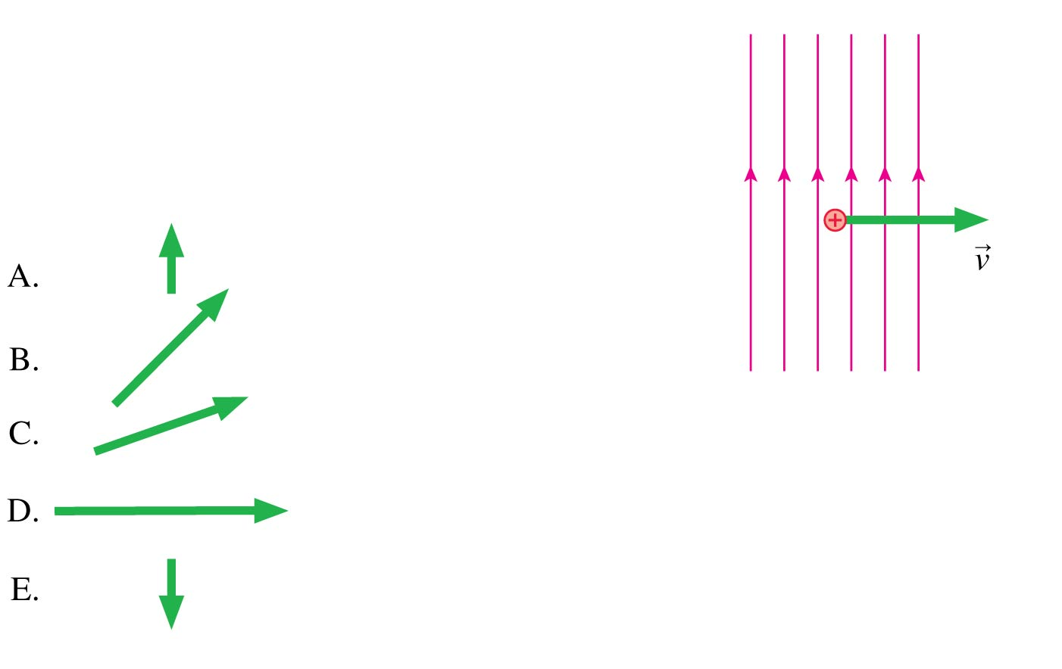
QuickCheck 26.11
A proton is moving to the right in a vertical electric field. A very short time later, the proton’s velocity is
Notes:
30

Slide 31
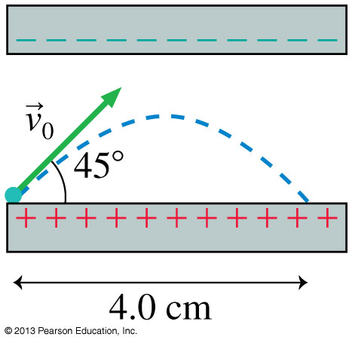
Problem 26.50
An electron is launched at a 45° angle at a speed of 5 × 10⁶ m/s from the positive plate of the parallel plate capacitor shown. The electron lands 4 cm away. What is the electric field strength inside the capacitor?

Slide 33
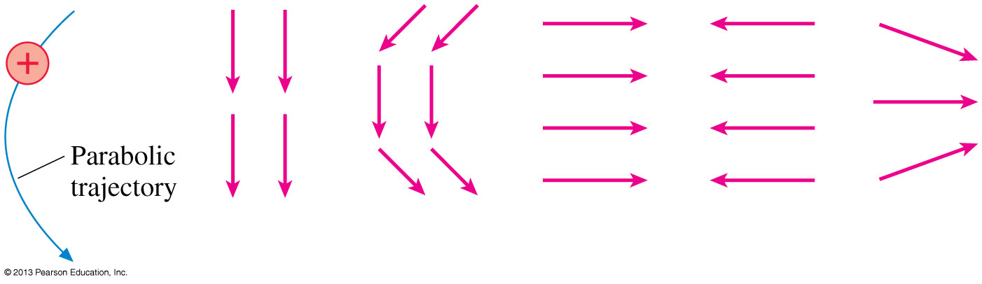
QuickCheck 26.12
Which electric field is probably responsible for the proton’s trajectory?
A.
B.
C.
D.
E.
Notes:
33

Slide 34
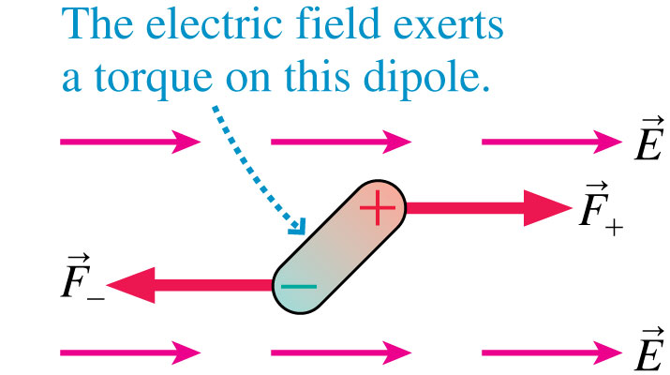
Dipoles : we will work on this on Monday…
The figure shows an electric dipole placed in a uniform external electric field.
The net force on the dipole is zero.
The electric field exerts a torque on the dipole which causes it to rotate.

Slide 35
Before Class 11 on Monday
Complete Problem Set 4 on MasteringPhysics due Sunday at 11:59pm on Ch. 26.
Please read Knight Pgs. 810-818: Ch. 28, sections 28.1-28.3 (we are skipping Ch.27)
Please do the short pre-class quiz on MasteringPhysics by Sunday night.
Something to think about: If a fixed charge repels a moving charge, does it do work on the charge? Does this increase the energy of the system?

