Slide 1

PHY132 Introduction to Physics II
Class 11 – Outline:
Finishing Chapter 26 on dipoles..
Electric Potential Energy of:
  Point Charges
  Dipoles
Electric Potential: V
Voltage: ΔV

Slide 2
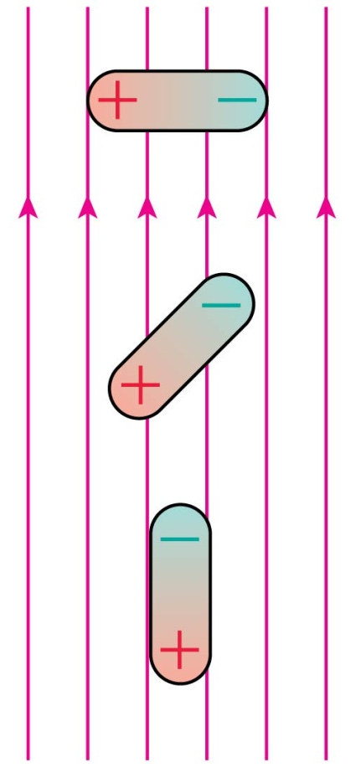
QuickCheck 26.13
Which dipole experiences no net force in the electric field?
A.
Dipole A.
Dipole B.
Dipole C.
Both dipoles A and C.
All three dipoles.
B.
C.
Notes:
2

Slide 3
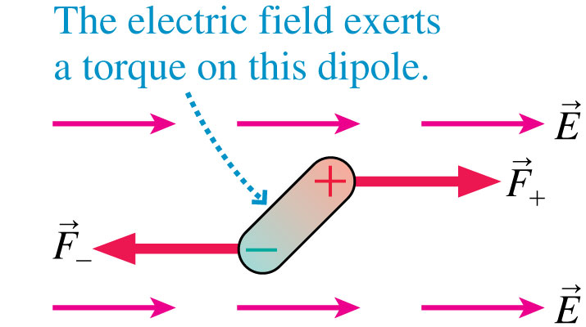
Dipoles in a Uniform Electric Field
The figure shows an electric dipole placed in a uniform external electric field.
The net force on the dipole is zero.
The electric field exerts a torque on the dipole which causes it to rotate.

Slide 4
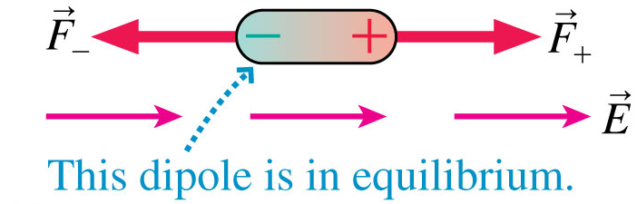
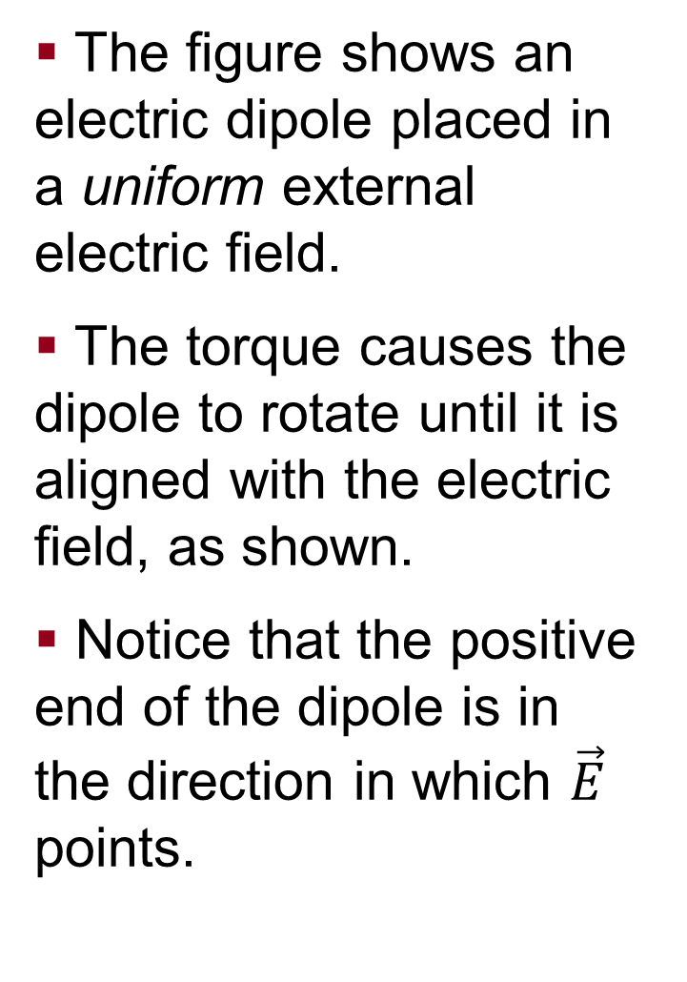
Dipoles in a Uniform Electric Field
The figure shows an electric dipole placed in a uniform external electric field.
The torque causes the dipole to rotate until it is aligned with the electric field, as shown.
Notice that the positive end of the dipole is in the direction in which $\vec{E}$ points.

Slide 5
QuickCheck 26.14
Which dipole experiences no net torque in the electric field?
A.
Dipole A.
Dipole B.
Dipole C.
Both dipoles A and C.
All three dipoles.
B.
C.
Notes:
5

Slide 6
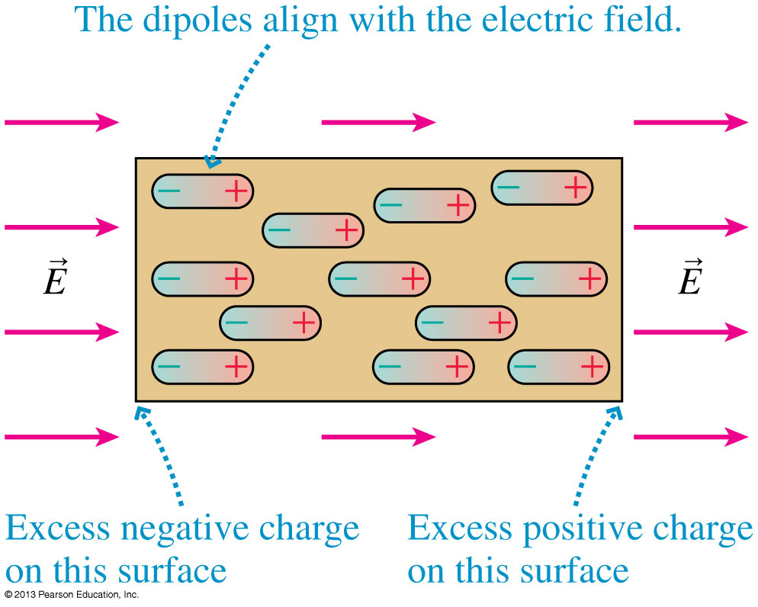
Dipoles in a Uniform Electric Field
The figure shows a sample of permanent dipoles, such as water molecules, in an external electric field.
All the dipoles rotate until they are aligned with the electric field.
This is the mechanism by which the sample becomes polarized.

Slide 7
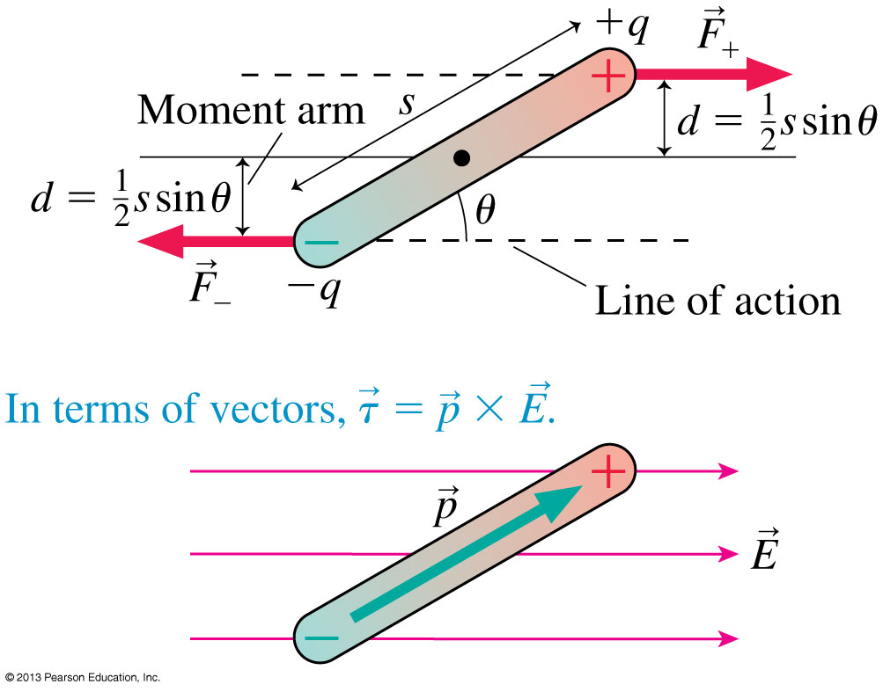
The Torque on a Dipole
The torque on a dipole placed in a uniform external electric field is

Slide 8
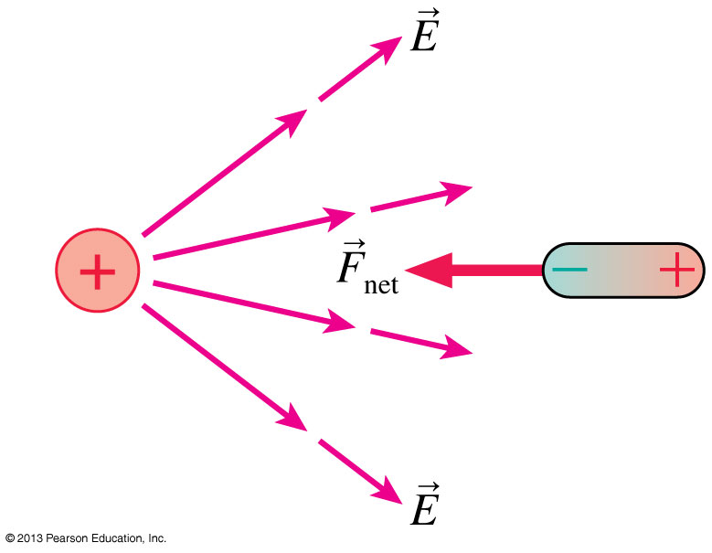
Dipoles in a Nonuniform Electric Field
Suppose that a dipole is placed in a nonuniform electric field, such as the field of a positive point charge.
The first response of the dipole is to rotate until it is aligned with the field.
Once the dipole is aligned, the leftward attractive force on its negative end is slightly stronger than the rightward repulsive force on its positive end.
This causes a net force to the left, toward the point charge.

Slide 9
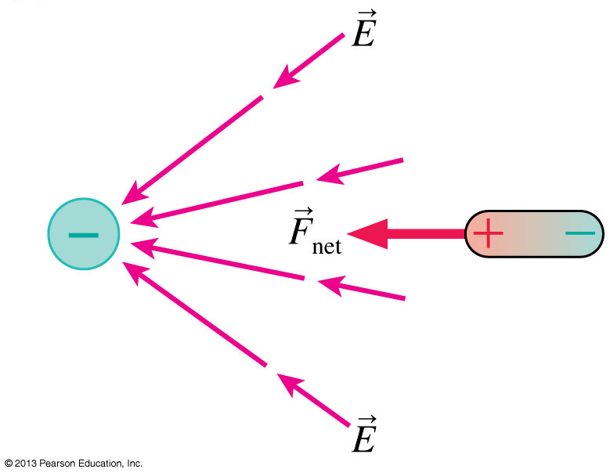
Dipoles in a Nonuniform Electric Field
A dipole near a negative point charge is also attracted toward the point charge.
The net force on a dipole is toward the direction of the strongest field.
Because field strength increases as you get closer to any finite-sized charged object, we can conclude that a dipole will experience a net force toward any charged object.

Slide 10
What is Potential Energy?
mgh
When an object has the potential to speed up.
Voltage
½ k(Δx)²

Slide 11
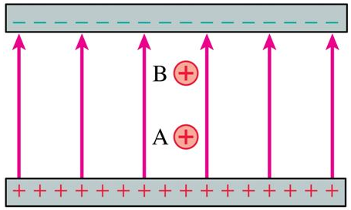
Class 11 Preclass Quiz on MasteringPhysics
74% got: Two positive charges are equal. Charge A has more electric potential energy.
Both of these charges have the potential to accelerate toward the negative plate, speeding up.

Slide 12
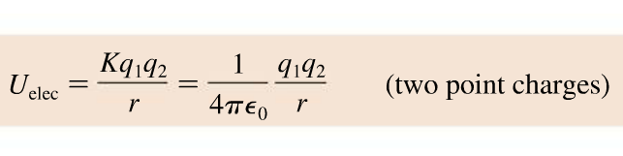
Class 11 Preclass Quiz on MasteringPhysics
70% of students got: The electric potential energy of a system of two point charges is proportional to the inverse of the distance between the two charges.

Slide 13

Class 11 Preclass Quiz on MasteringPhysics
49% of students got: A positive and a negative charge are released from rest in vacuum. They move toward each other. As they do a negative potential energy becomes more negative.

Slide 14
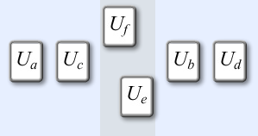
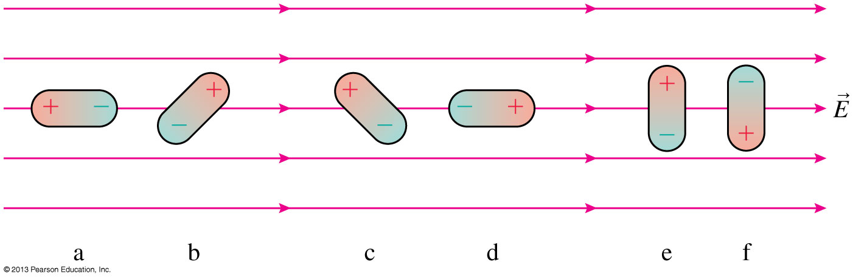
Class 11 Preclass Quiz on MasteringPhysics
56% of students got:
“Dipole d has the smallest potential energy because it is aligned with the electric field. The greater the angle between the positive to the direction of the electric field, the greater the electric potential.”

Slide 15
Class 11 Preclass Quiz – Student Comments…
“If charged particle moves perpendicular to the electric field direction, does its potential not change then?”
Harlow answer: Correct. If the charge moves perpendicular to the electric field, then the electric force does zero work and the electric potential energy is unchanged.
“for the equation of electric potential energy in a uniform field, is the Uo always zero?”
U_{elec} = U₀ + qEs
Harlow answer: No! U₀ is arbitrary. You choose a convenient value of s where U₀ = 0. (similar to the zero-point in gravitational potential energy.)

Slide 16
Class 11 Preclass Quiz – Student Comments…
“What is the name of Sherlock Ohms' assistant...Dr. WATTSon!”
“Q: What would you call a power failure?
A: A current event.”

Slide 17
Energy
The kinetic energy of a system, K, is the sum of the kinetic energies K_{i} = 1/2m_{i}v_{i}² of all the particles in the system.
The potential energy of a system, U, is the interaction energy of the system.
The change in potential energy, ΔU, is −1 times the work done by the interaction forces:
If all of the forces involved are conservative forces (such as gravity or the electric force) then the total energy K + U is conserved; it cannot be created or destroyed.

Slide 18
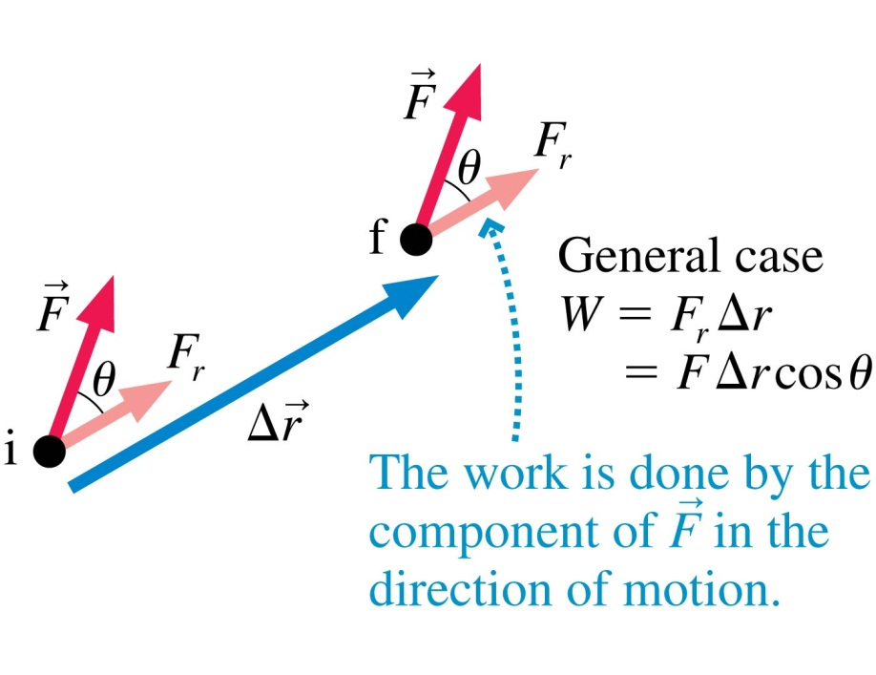
Work Done by a Constant Force
Recall that the work done by a constant force depends on the angle θ between the force F and the displacement Δr.
If θ = 0°, then W = FΔr.
If θ = 90°, then W = 0.
If θ = 180°, then W = −FΔr.

Slide 19
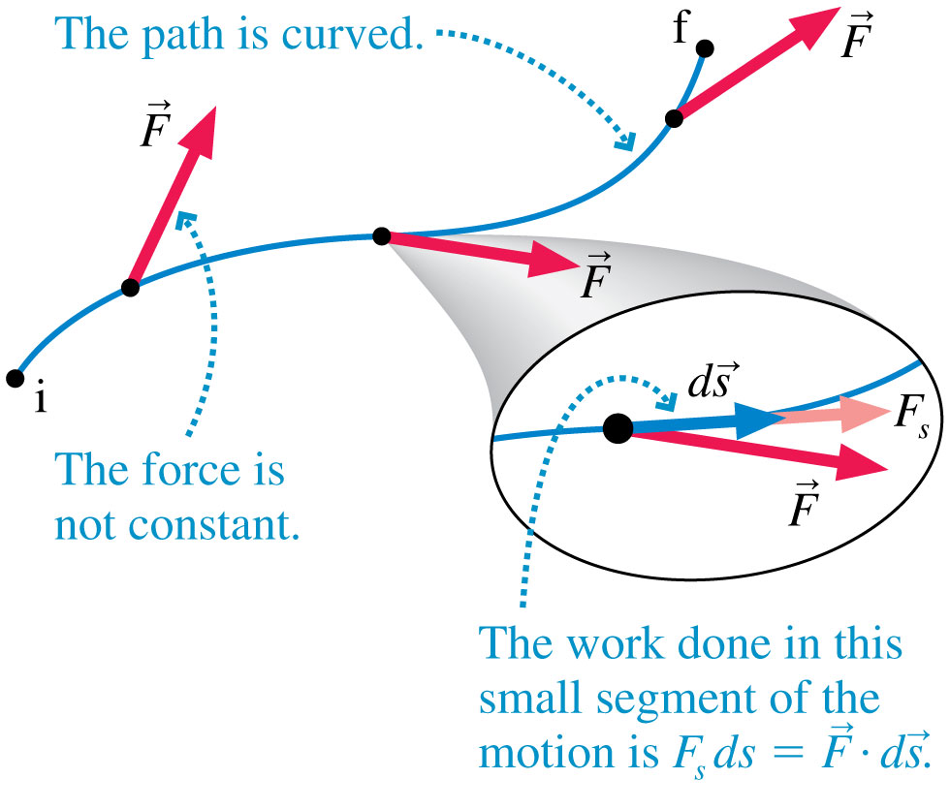
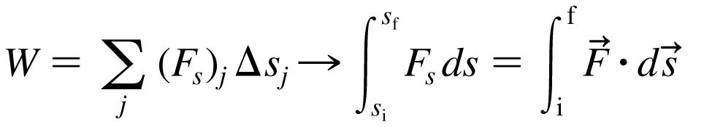
Work
If the force is not constant or the displacement is not along a linear path, we can calculate the work by dividing the path into many small segments.

Slide 20
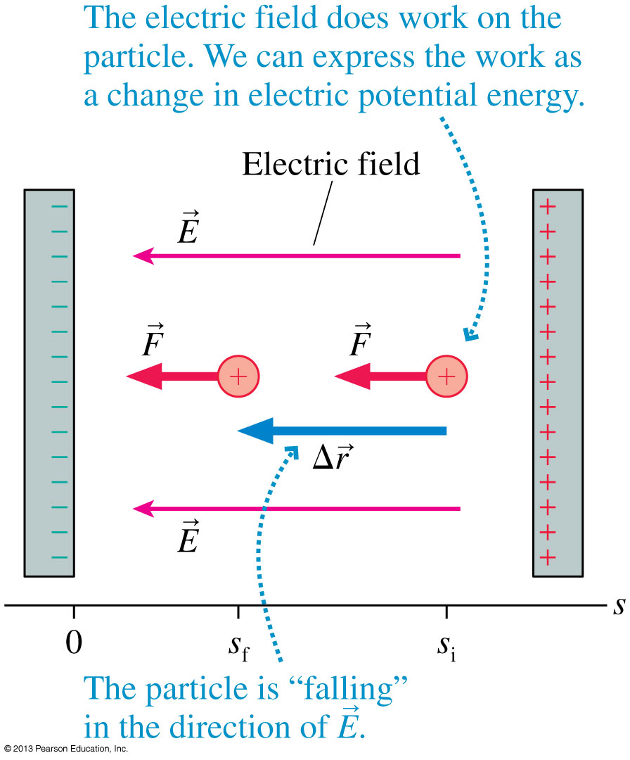
Electric Potential Energy in a Uniform Field
A positive charge q inside a capacitor speeds up as it “falls” toward the negative plate.
There is a constant force
F = qE in the direction of the displacement.
The work done is:
W_{elec} = qEs_{i} − qEs_{f}
The change in electric potential energy is:
ΔU_{elec} = −W_{elec}
where
U_{elec} = U₀ + qEs

Slide 21
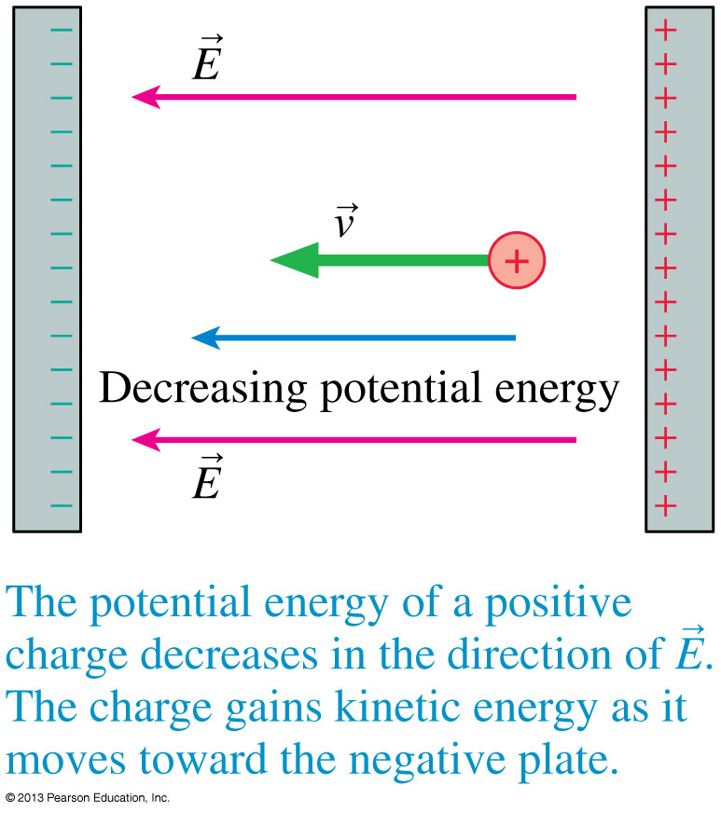
Electric Potential Energy in a Uniform Field
A positively charged particle gains kinetic energy as it moves in the direction of decreasing potential energy.

Slide 22
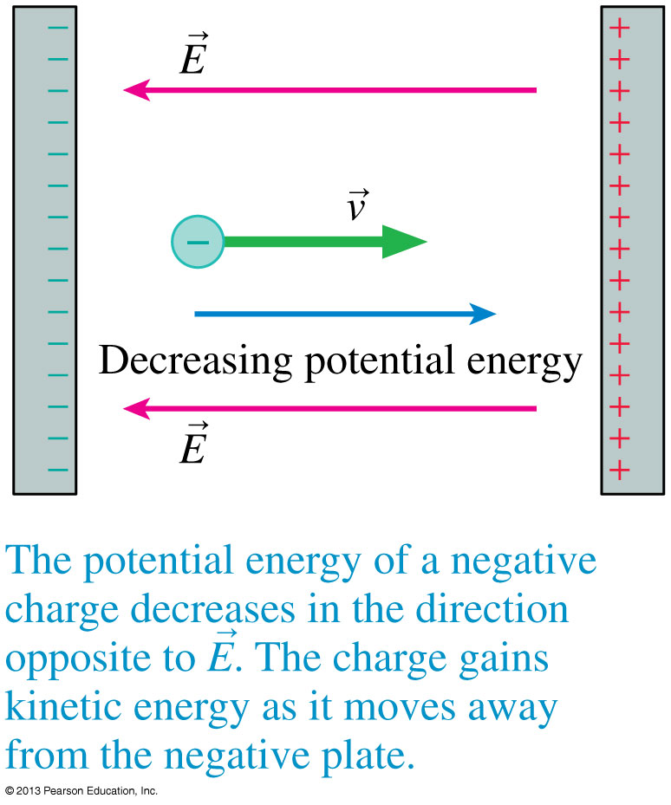
Electric Potential Energy in a Uniform Field
A negatively charged particle gains kinetic energy as it moves in the direction of decreasing potential energy.

Slide 23
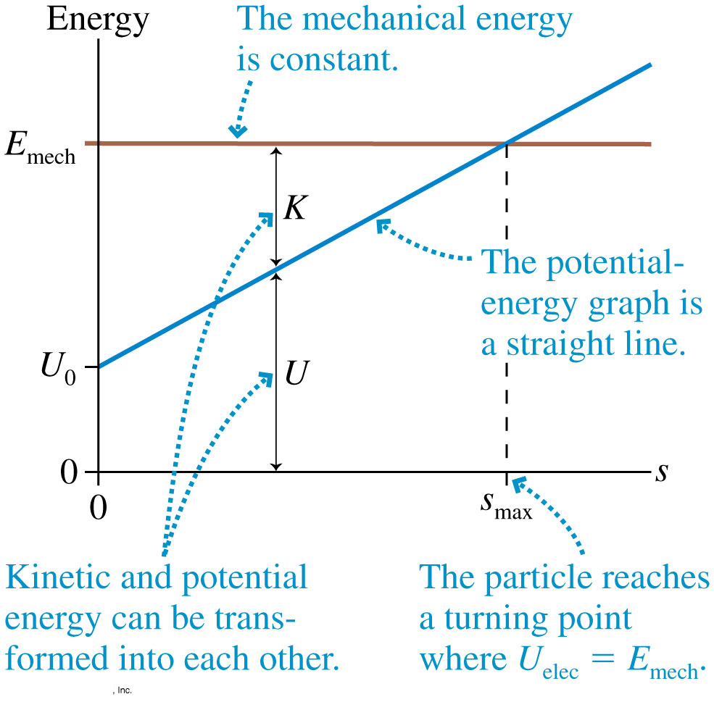
Electric Potential Energy in a Uniform Field
The figure shows the energy diagram for a positively charged particle in a uniform electric field.
The potential energy increases linearly with distance, but the total mechanical energy E_{mech} is fixed.

Slide 24
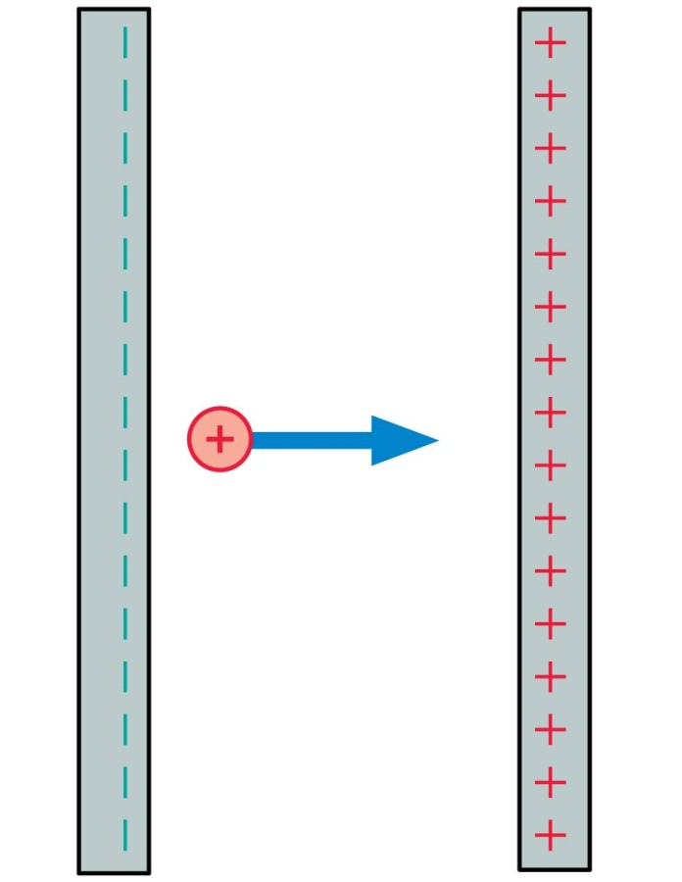
QuickCheck 28.4
A positive charge moves as shown. Its kinetic energy
Increases.
Remains constant.
Decreases.
Notes:
24

Slide 25
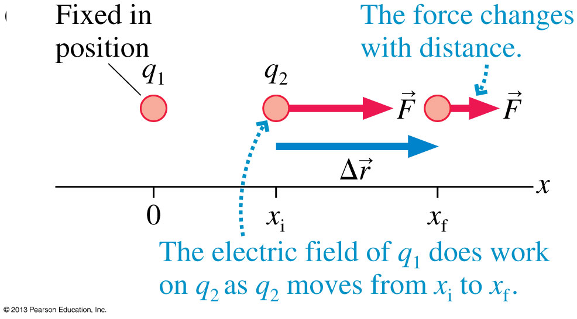
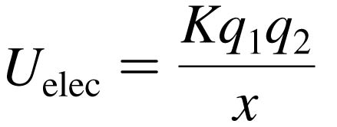
The Potential Energy of Two Point Charges
Consider two like charges q₁ and q₂.
The electric field of q₁ pushes q₂ as it moves from x_{i} to x_{f}.
The work done is:
The change in electric potential energy of the system is ΔU_{elec} = −W_{elec} if:

Slide 26

The Potential Energy of Point Charges
The Potential Energy of Two Point Charges
Consider two point charges, q₁ and q₂, separated by a distance r. The electric potential energy is
This is explicitly the energy of the system, not the energy of just q₁ or q₂.
Note that the potential energy of two charged particles approaches zero as r → ∞.

Slide 27
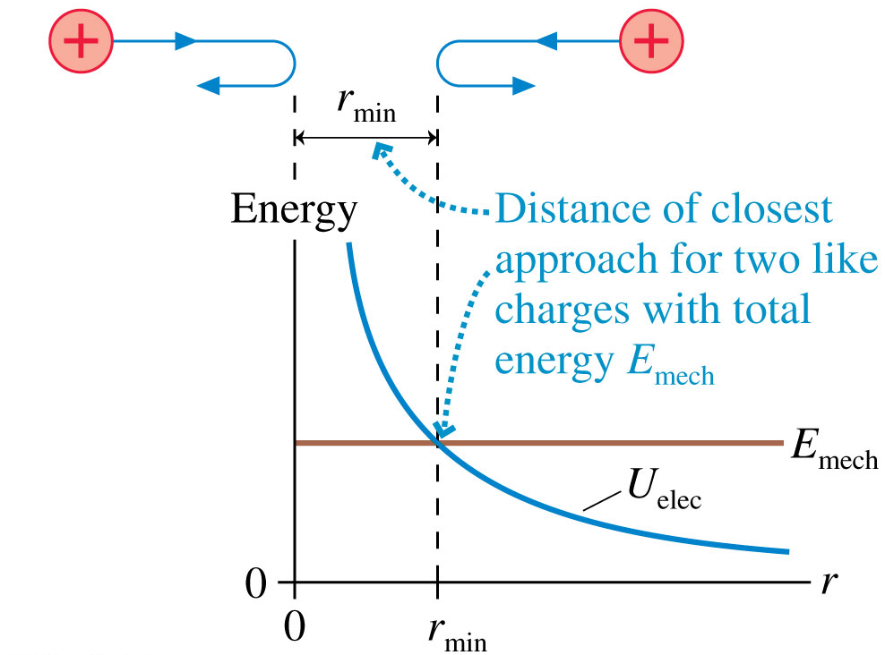
The Potential Energy of Two Point Charges
Two like charges approach each other.
Their total energy is E_{mech} > 0.
They gradually slow down until the distance separating them is r_{min}.
This is the distance of closest approach.

Slide 28
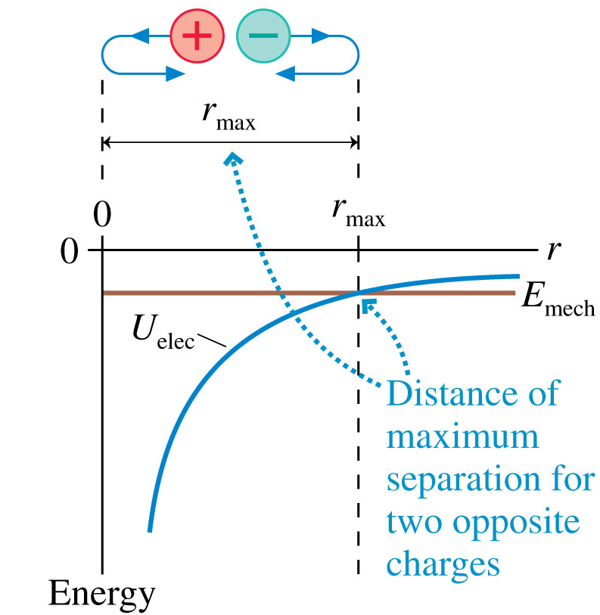
The Potential Energy of Two Point Charges
Two opposite charges are shot apart from one another with equal and opposite momenta.
Their total energy is
E_{mech} < 0.
They gradually slow down until the distance separating them is r_{max}.
This is their maximum separation.

Slide 29
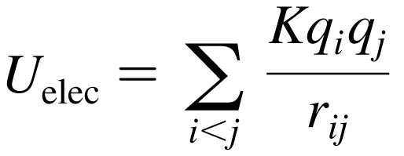
The Potential Energy of Multiple Point Charges
The Potential Energy of Multiple Point Charges
Consider more than two point charges, the potential energy is the sum of the potential energies due to all pairs of charges:
where r_{ij} is the distance between q_{i} and q_{j}.
The summation contains the i < j restriction to ensure that each pair of charges is counted only once.

Slide 30
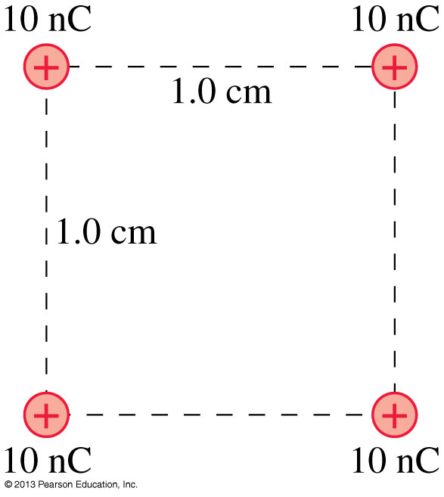
Problem 28.37
The four 1.0 g spheres shown in the figure are released simultaneously and allowed to move away from each other.
What is the speed of each sphere when they are very far apart?

Slide 32
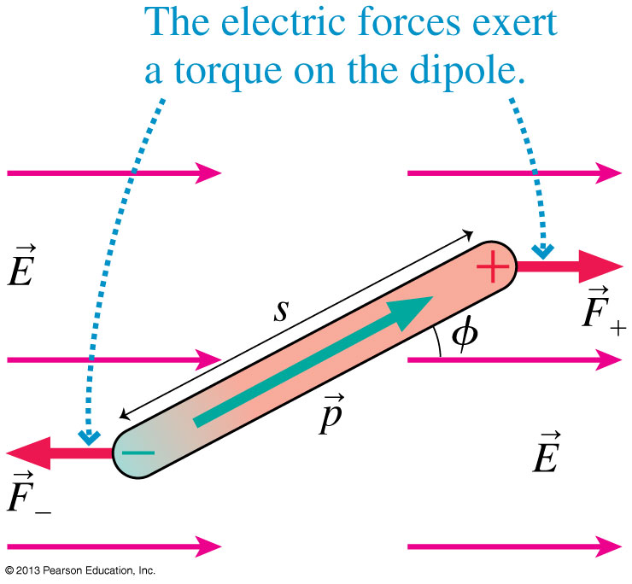
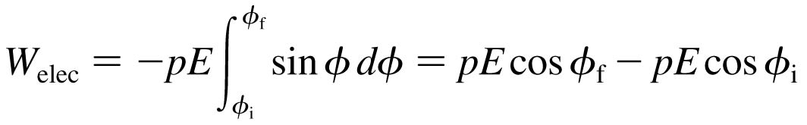
The Potential Energy of a Dipole
Consider a dipole in a uniform electric field.
The forces F₊ and F₋ exert a torque on the dipole.
The work done is:
The change in electric potential energy of the system is ΔU_{elec} = −W_{elec} if:

Slide 33
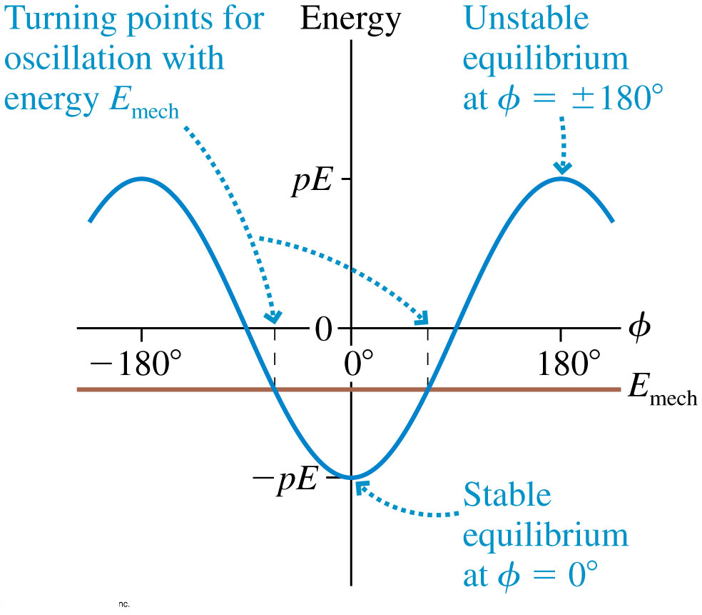
The Potential Energy of a Dipole
The potential energy of a dipole is φ = 0° minimum at where the dipole is aligned with the electric field.
A frictionless dipole with mechanical energy E_{mech} will oscillate back and forth between turning points on either side of φ = 0°.

Slide 34
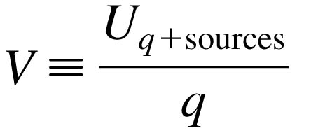

The Electric Potential
We define the electric potential V (or, for brevity, just the potential) as
This is NOT the same as electric potential energy. (different units, for one thing).
The unit of electric potential is the joule per coulomb, which is called the volt V:

Slide 35
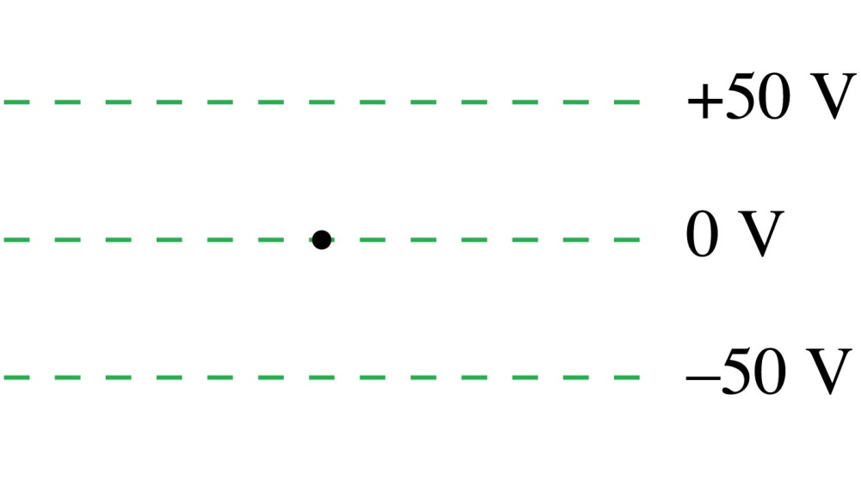
QuickCheck 28.6
A proton is released from rest at the dot. Afterward, the proton
Remains at the dot.
Moves upward with steady
speed.
Moves upward with an increasing speed.
Moves downward with a steady speed.
Moves downward with an increasing speed.
Notes:
35

Slide 36


Before Class 12 on Wednesday
(my last class…)
Please finish reading Knight Ch. 28
Please do the short pre-class quiz on MasteringPhysics by tomorrow night.
Something to think about. A battery is designed to supply a steady amount of which of the following quantities?
  Energy
  Power
  Electric potential difference
  Electric current
(Hint: only one of these is correct!)

