Slide 1
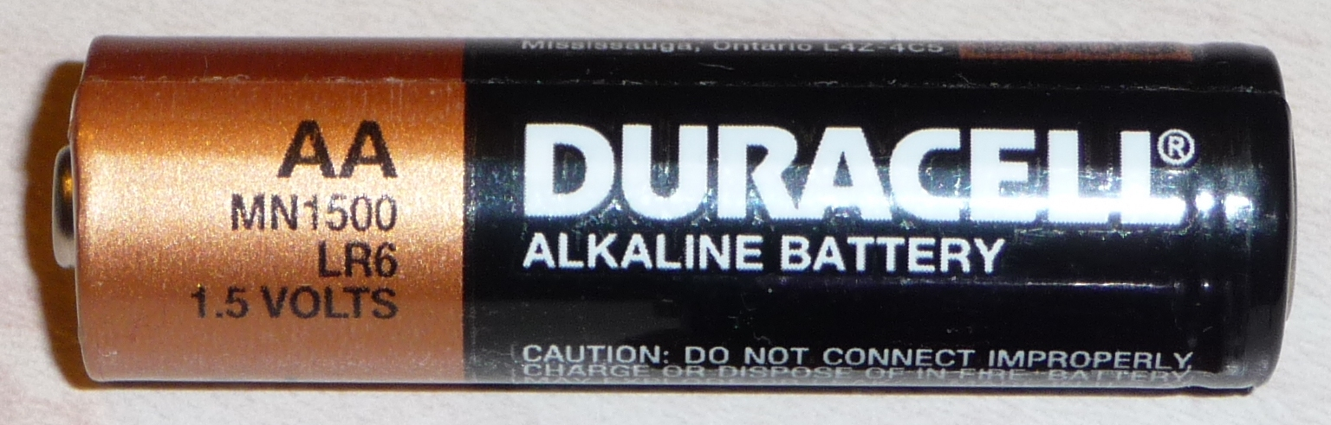
PHY132 Introduction to Physics II
Class 12 – Outline:
Electric Potential Difference: a.k.a. “Voltage”
Electric Potential of:
  Parallel Plate Capacitor
  Point Charge
  Many Charges
Next week: no classes
Week of Feb.23: new teams in Practicals, Andrew takes over lectures.

Slide 2
A battery is designed to supply a steady amount of which of the following quantities?
  Energy
  Power
  Electric potential difference
  Electric current

Slide 3
Class 12 Preclass Quiz on MasteringPhysics
97% got:The units of potential difference are Volts.
78% got: New units for the electric field were introduced in chapter 28. Old units were N/C. The new units are V/m.
You can show that these units are equivalent to each other:
1 N/C = 1 V/m

Slide 4
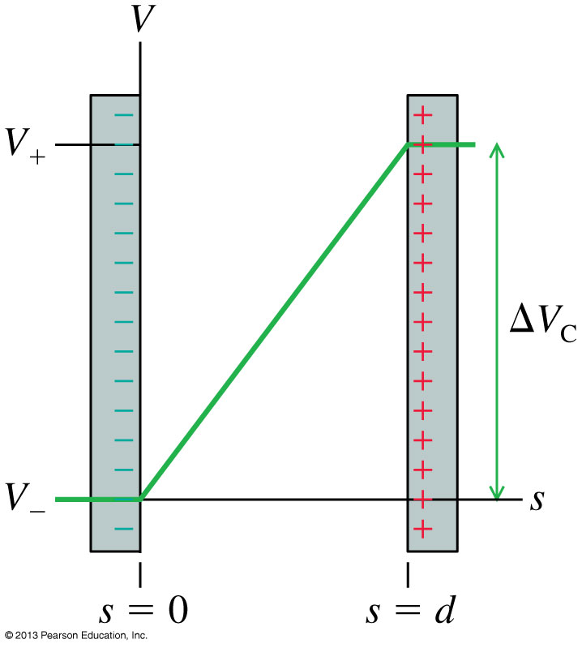
Class 12 Preclass Quiz on MasteringPhysics
76% got:The electric potential inside a capacitor increases linearly from the negative to the positive plate.

Slide 5
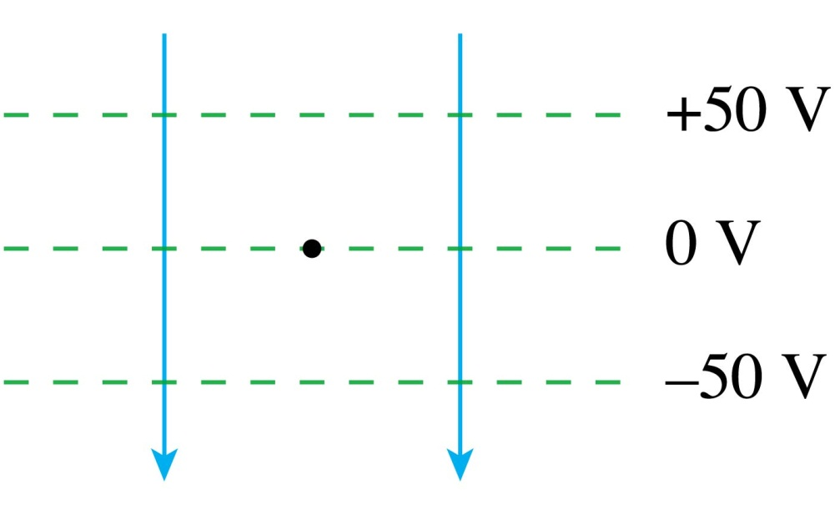
QuickCheck 28.6
Class 12 Preclass Quiz on MasteringPhysics
A proton is released from rest at the dot. Afterward, the proton
Decreasing PE
Increasing KE
81% got: Moves downward with an increasing speed.
Notes:
5

Slide 6
Class 12 Preclass Quiz – Student Comments…
“Can the voltage ever be negative?”
Harlow answer: Yes! Electric potential is just the electric potential energy divided by charge of the probe charge. The E.P.E. can be negative, so electric potential can be negative too.
“Is there a real difference between a "normal" capacitor and a parallel-plate capacitor?”
Harlow answer: Parallel plate capacitor is more specific. There are many different geometries of capacitors out there, including ones rolled up like a burrito.

Slide 7
Class 12 Preclass Quiz – Student Comments…
“I just wish there was a bigger difference in the naming between potential energy and electric potential difference. The day when physics runs out of names for quantities...”
Harlow answer: agreed. “electric potential” is in Volts, “electric potential energy” is in Joules… They sound the same, but they are not.
“when is the next midterm?”
Harlow answer: Tue. Mar.10 at 6:00pm – about 4 weeks from now.

Slide 8

Class 12 Preclass Quiz – Student Comments…
Q: What did one quantum physicist say when he wanted to fight another quantum physicist?
A: Let me atom!
Did you hear oxygen and magnesium got together?
OMg!
What type of rodent causes another creature to accelerate when near it?
A field mouse!

Slide 9
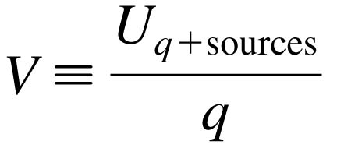

The Electric Potential
We define the electric potential V (or, for brevity, just the potential) as
This is NOT the same as electric potential energy. (different units, for one thing).
The unit of electric potential is the joule per coulomb, which is called the volt V:

Slide 10
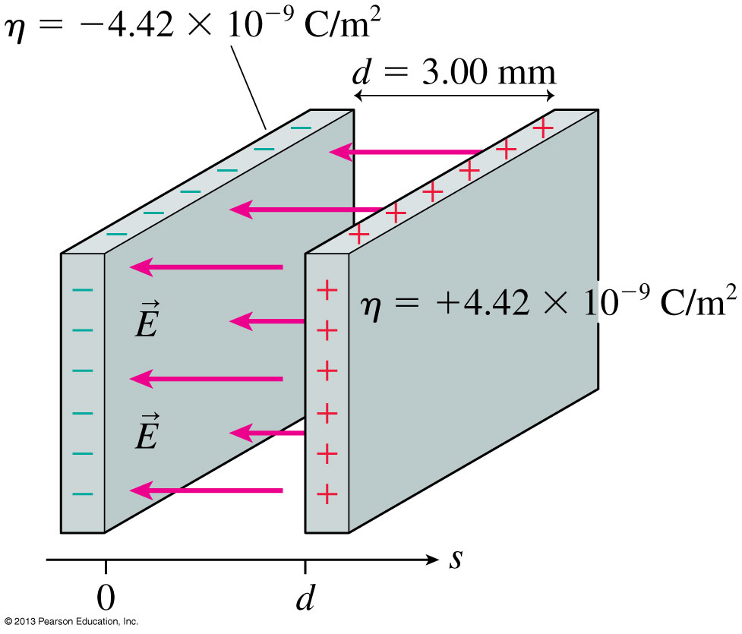
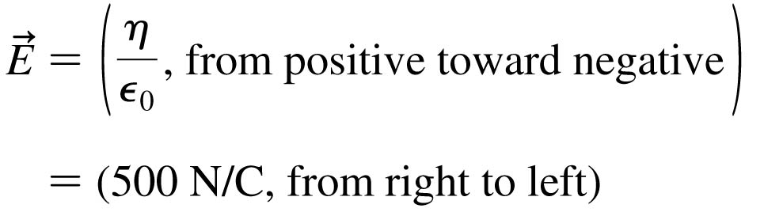
The Electric Field Inside a Parallel-Plate Capacitor
This is a review of Chapter 26.

Slide 11
The Electric Potential Inside a Parallel-Plate Capacitor
The electric potential inside a parallel-plate capacitor is
where s is the distance from the negative electrode.
The potential difference ΔV_{C}, or “voltage” between the two capacitor plates is

Slide 12
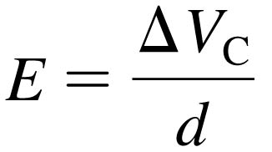
Units of Electric Field
If we know a capacitor’s voltage ΔV and the distance between the plates d, then the electric field strength within the capacitor is:
This implies that the units of electric field are volts per meter, or V/m.
Previously, we have been using electric field units of newtons per coulomb.
In fact, as you can show as a homework problem, these units are equivalent to each other:
1 N/C = 1 V/m

Slide 13
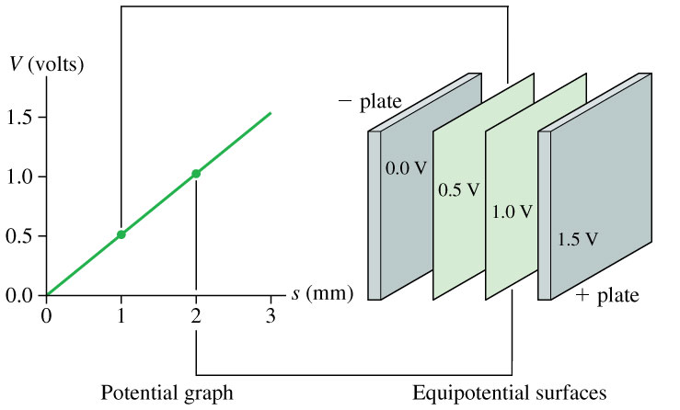
The Electric Potential Inside a Parallel-Plate Capacitor

Slide 14
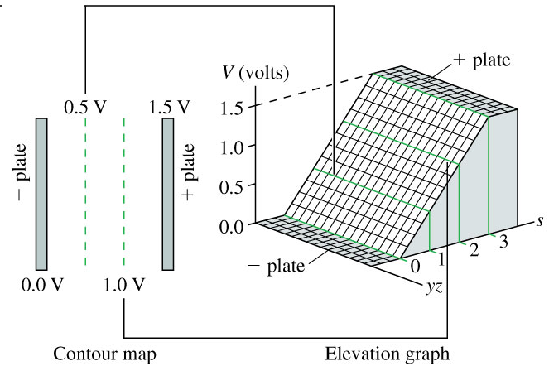
The Electric Potential Inside a Parallel-Plate Capacitor

Slide 15
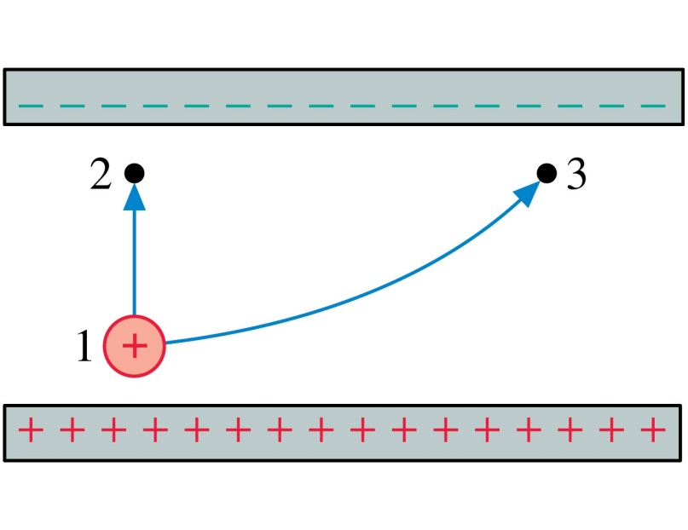
QuickCheck 28.9
Two protons, one after the other, are launched from point 1 with the same speed. They follow the two trajectories shown. The protons’ speeds at points 2 and 3 are related by
v₂ > v₃.
v₂ = v₃.
v₂ < v₃.
Not enough information to compare their speeds.
Notes:
15

Slide 16
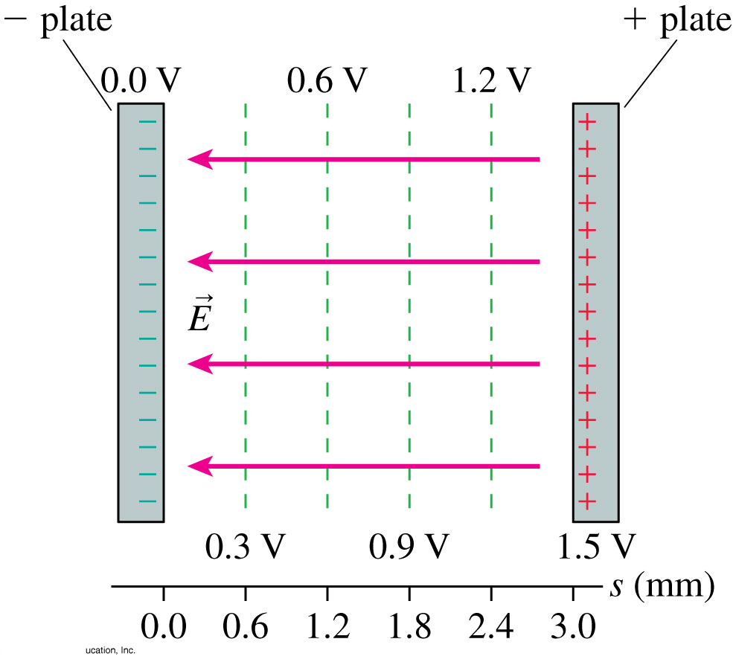
The Parallel-Plate Capacitor
The figure shows the contour lines of the electric potential and the electric field vectors inside a parallel-plate capacitor.
The electric field vectors are perpendicular to the equipotential surfaces.
The electric field points in the direction of decreasing potential.

Slide 17
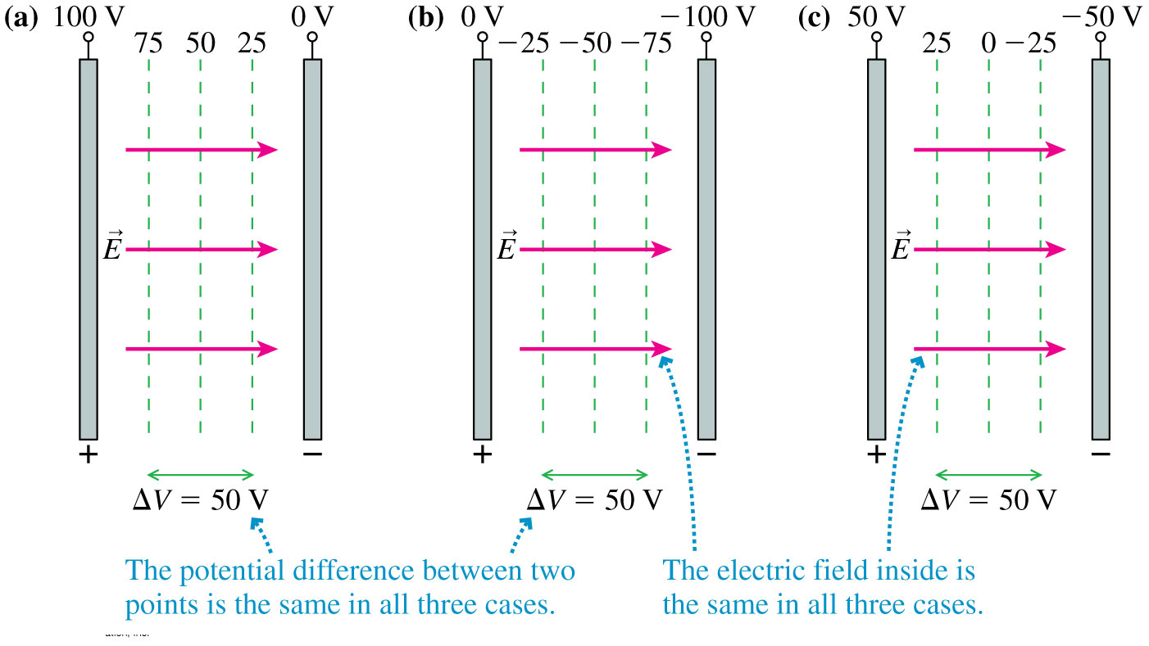
The Zero Point of Electric Potential
Where you choose V = 0 is arbitrary. The three contour maps below represent the same physical situation.

Slide 18
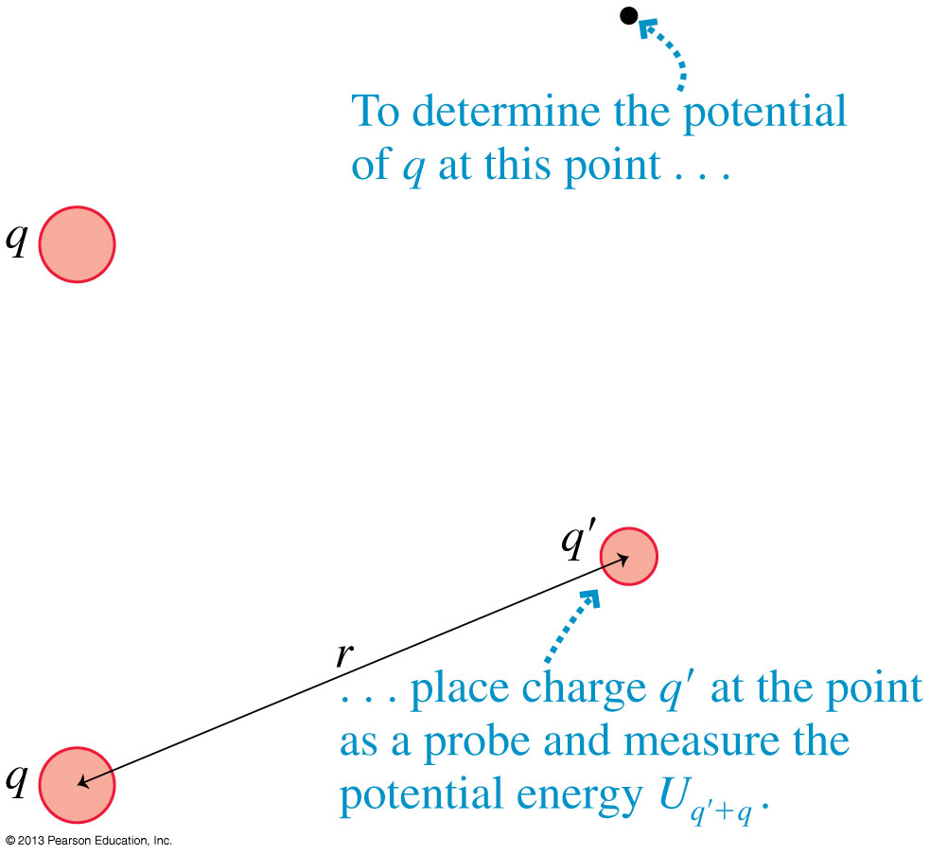
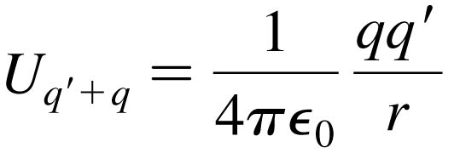
The Electric Potential of a Point Charge
Let q in the figure be the source charge, and let a second charge q', a distance r away, probe the electric potential of q.
The potential energy of the two point charges is

Slide 19
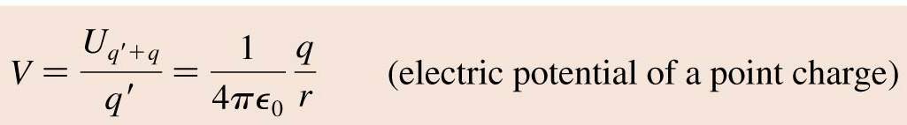
The Electric Potential of a Point Charge
The electric potential due to a point charge q is
The potential extends through all of space, showing the influence of charge q, but it weakens with distance as 1/r.
This expression for V assumes that we have chosen V = 0 to be at r = ∞.

Slide 20
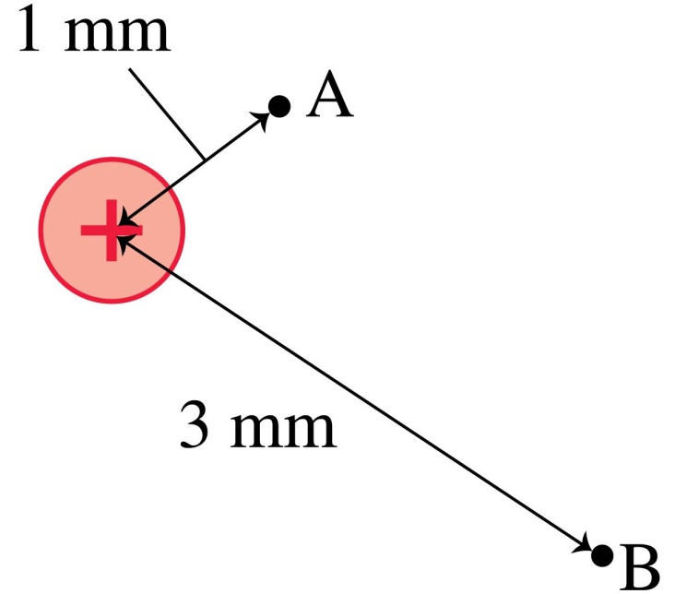
QuickCheck 28.10
What is the ratio V_{B}/V_{A} of the electric potentials at the two points?
9.
3.
1/3.
1/9.
Undefined without knowing the charge.
Notes:
20

Slide 21
Quick Equations Quiz.. [1/4]
Which is which?
The magnitude of the force, in Newtons, on a point charge that is near another point charge is:
A.
C.
B.
D.
Notes:
Answer: D

Slide 22
Quick Equations Quiz.. [2/4]
Which is which?
The magnitude of the Electric Field, in Newtons per Coulomb, near a point charge is:
A.
C.
B.
D.
Notes:
Answer: D

Slide 23
Quick Equations Quiz.. [3/4]
Which is which?
The electric potential energy, in Joules, of two point charges is:
A.
C.
B.
D.
Notes:
Answer: D

Slide 24
Quick Equations Quiz.. [4/4]
Which is which?
The electric potential, in Volts, near a point charge is:
A.
C.
B.
D.
Notes:
Answer: D

Slide 25
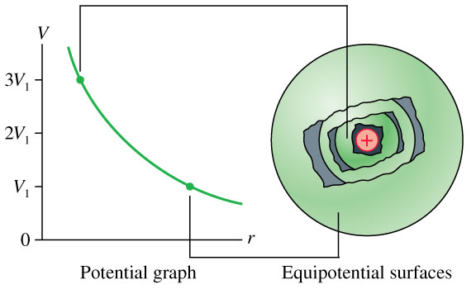
The Electric Potential of a Point Charge

Slide 26
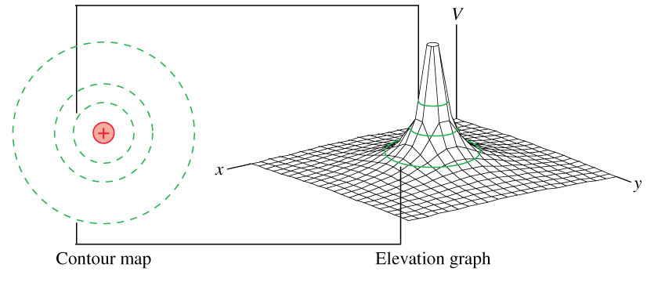
The Electric Potential of a Point Charge

Slide 27
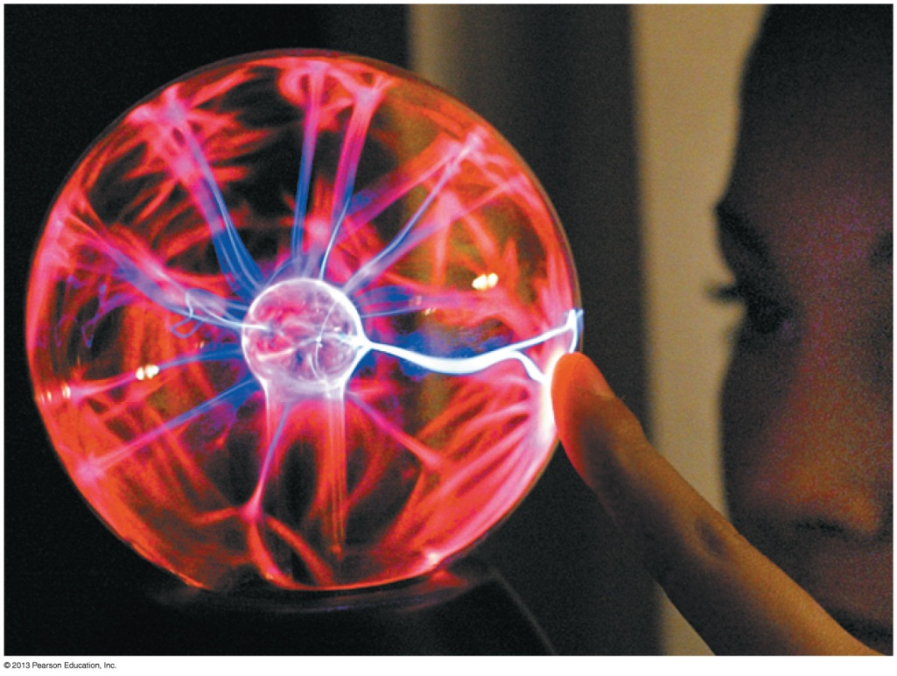
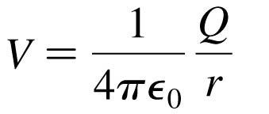
The Electric Potential of a Charged Sphere
Outside a uniformly charged sphere of radius R, the electric potential is identical to that of a point charge Q at the center.
where r > R.
If the potential at the surface V₀ is known, then the potential at
r > R is:

Slide 28
Class 12 Preclass Quiz – Student Comments…
“What is the difference between R and r in the equation for the electric potential of a charged sphere?”
Harlow answer: R is a constant: the radius of the sphere. r is the distance from the centre of the sphere (independent variable)

Slide 29
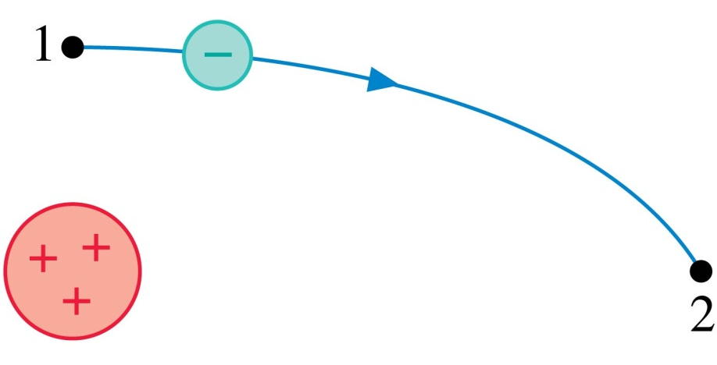
QuickCheck 28.11
An electron follows the trajectory shown from point 1 to point 2. At point 2,
v₂ > v₁.
v₂ = v₁.
v₂ < v₁.
Not enough information to compare the
speeds at these points.
Notes:
29

Slide 30
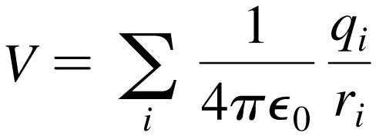
The Electric Potential of Many Charges
The Electric Potential of Many Charges
The electric potential V at a point in space is the sum of the potentials due to each charge:
where r_{i} is the distance from charge q_{i} to the point in space where the potential is being calculated.
The electric potential, like the electric field, obeys the principle of superposition.

Slide 31
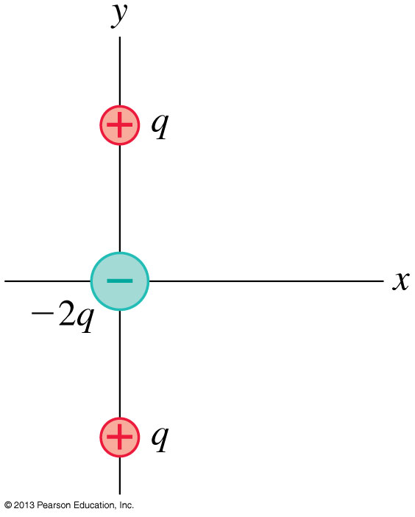
Problem 28.66
The arrangement of charges shown is called a linear electric quadrupole. The positive charges are located at y = ± s.
Find an expression for the electric potential on the y-axis at a distance y >> s.

Slide 33
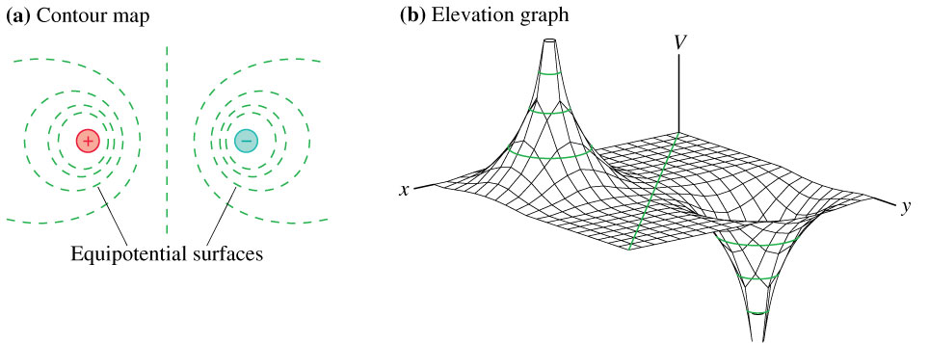
The Electric Potential of an Electric Dipole

Slide 34
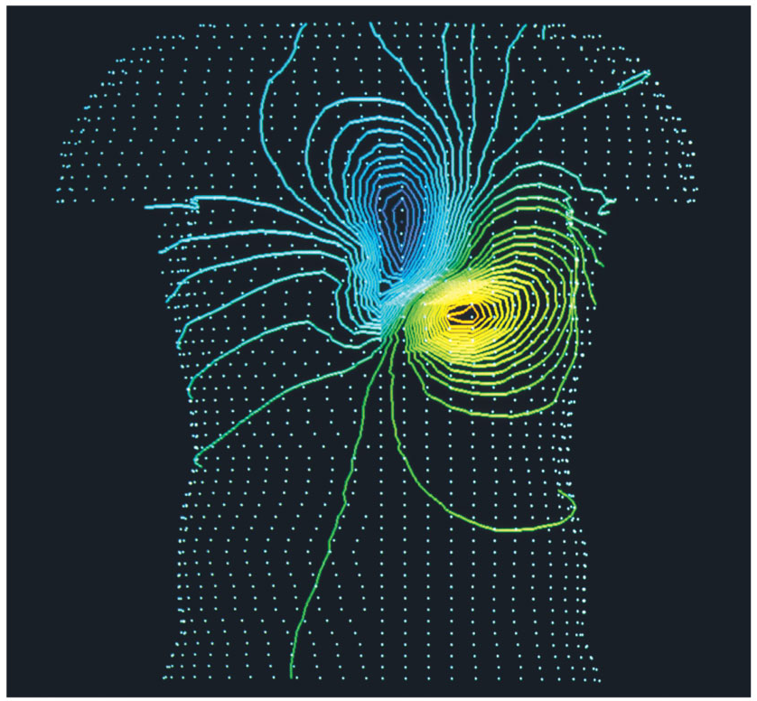
The Electric Potential of a Human Heart
The Electric Potential of a Human Heart
Electrical activity within the body can be monitored by measuring equipotential lines on the skin.
The equipotentials near the heart are a slightly distorted but recognizable electric dipole.

Slide 35
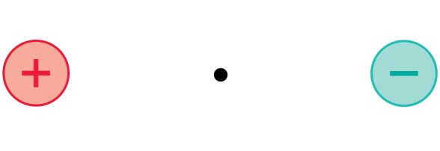

QuickCheck 28.12
At the midpoint between these two equal but opposite charges,
E = 0; V = 0.
E = 0; V > 0.
E = 0; V < 0.
E points right; V = 0.
E points left; V = 0.
Notes:
35

Slide 36
The next test…
Term Test 2 is in 4 weeks:
Tuesday, Mar. 10 6:10pm in room TBA
This will cover Chapters 25, 26, 28, 29 and conceptual questions (clicker-style questions) from Chapter 30
Remember the second half of chapter 23 on lenses will not be tested on the midterm or final exam.

Slide 37

Have a great Reading Week!!
I hope you enjoy the rest of your semester, and please keep coming to see me in office hours: Tuesdays 12-1 and Fridays 10-11am, plus any time you see my door is open on your way to Practicals!! Feel free to stop by and even just say hi!
Exception: Next week, Reading Week, I do not have office hours.
When you get back on Feb. 23, Professor Meyertholen will start where I am leaving off: Chapter 29, connecting Electric Potential with Electric Field.
And even after you are no longer my students, please stay in touch and drop by whenever you like!

