Slide 1
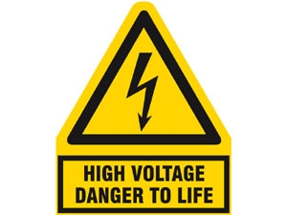
PHY132 Introduction to Physics II
Class 12 – Outline:
Electric Potential of:
  Parallel Plate Capacitor
  Point Charge
  Many Charges

Slide 2
Last time I asked you to consider…
A battery is designed to supply a steady amount of which of the following quantities?
  Energy
  Power
  Electric potential difference
  Electric current

Slide 3
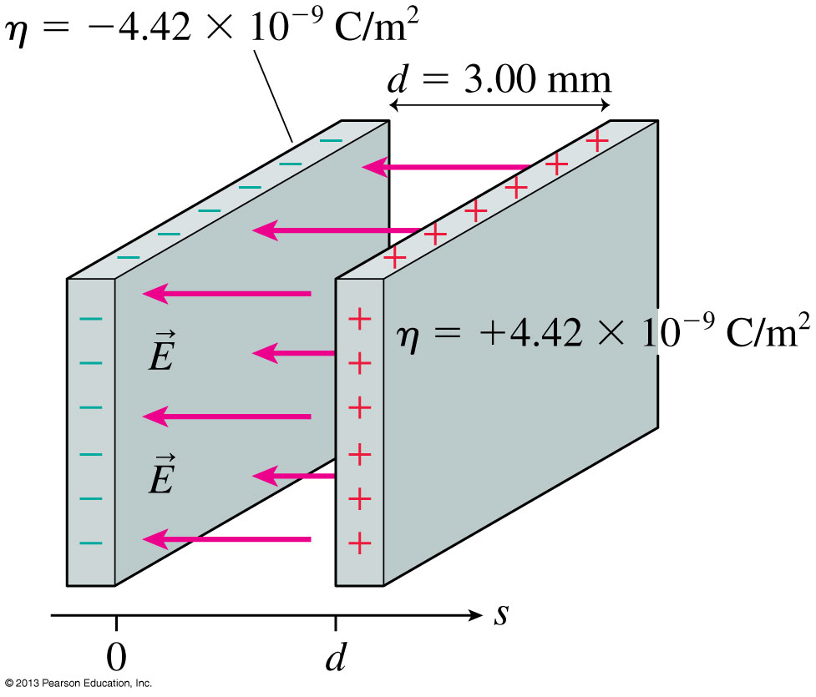
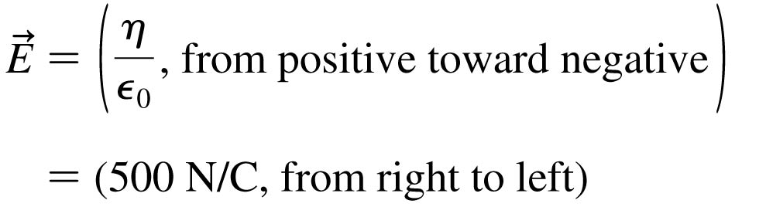
The Electric Field Inside a Parallel-Plate Capacitor
This is a review of Chapter 26.

Slide 4
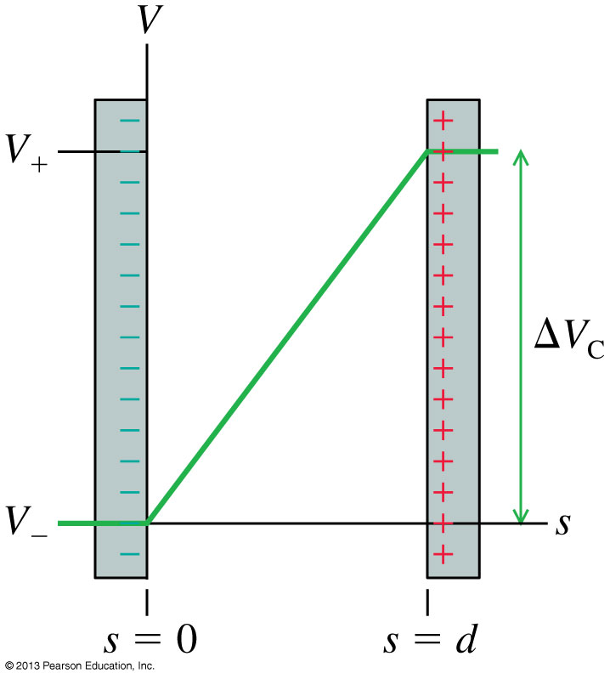
The Electric Potential Inside a Parallel-Plate Capacitor
The electric potential inside a parallel-plate capacitor is
where s is the distance from the negative electrode.
The potential difference ΔV_{C}, or “voltage” between the two capacitor plates is

Slide 5
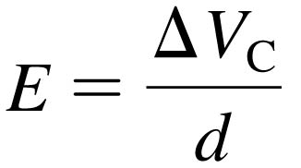
Units of Electric Field
If we know a capacitor’s voltage ΔV and the distance between the plates d, then the electric field strength within the capacitor is:
This implies that the units of electric field are volts per meter, or V/m.
Previously, we have been using electric field units of newtons per coulomb.
In fact, as you can show as a homework problem, these units are equivalent to each other:
1 N/C = 1 V/m

Slide 6
Electric Potential = Electric Potential Energy per charge

Slide 7
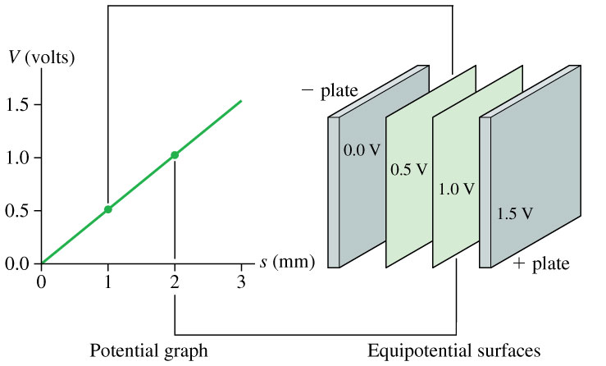
The Electric Potential Inside a Parallel-Plate Capacitor

Slide 8
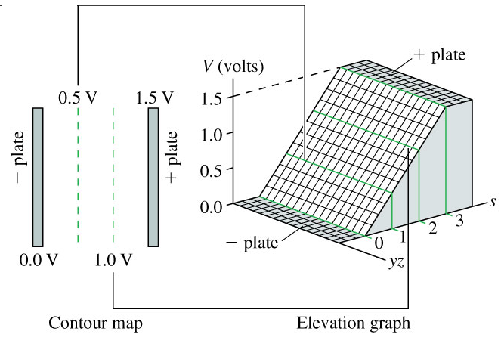
The Electric Potential Inside a Parallel-Plate Capacitor

Slide 9
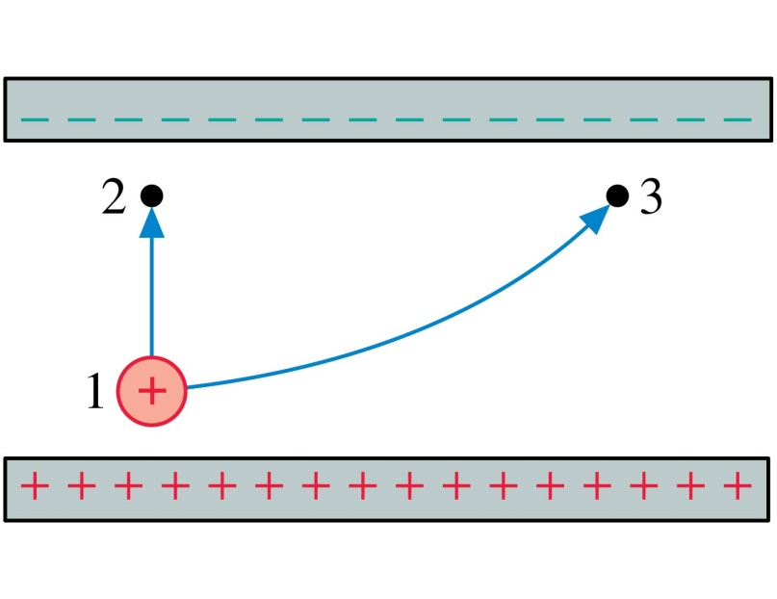
QuickCheck 28.9
Two protons, one after the other, are launched from point 1 with the same speed. They follow the two trajectories shown. The protons’ speeds at points 2 and 3 are related by
v₂ > v₃.
v₂ = v₃.
v₂ < v₃.
Not enough information to compare their speeds.
Notes:
9

Slide 10
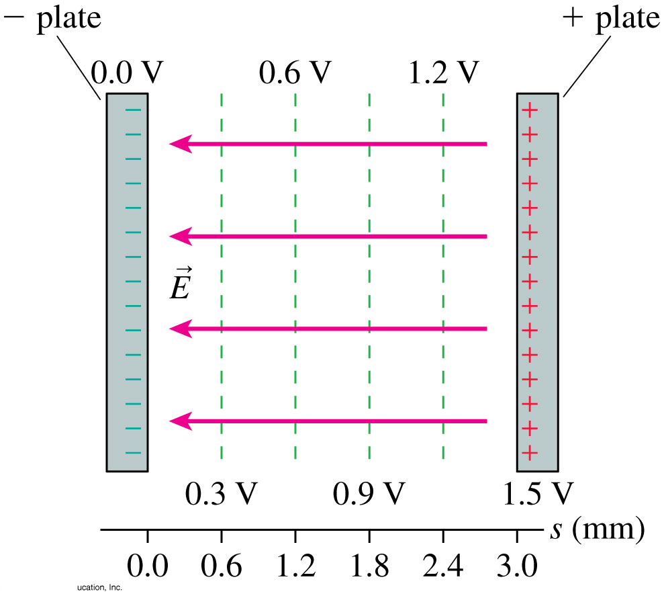
The Parallel-Plate Capacitor
The figure shows the contour lines of the electric potential and the electric field vectors inside a parallel-plate capacitor.
The electric field vectors are perpendicular to the equipotential surfaces.
The electric field points in the direction of decreasing potential.

Slide 11
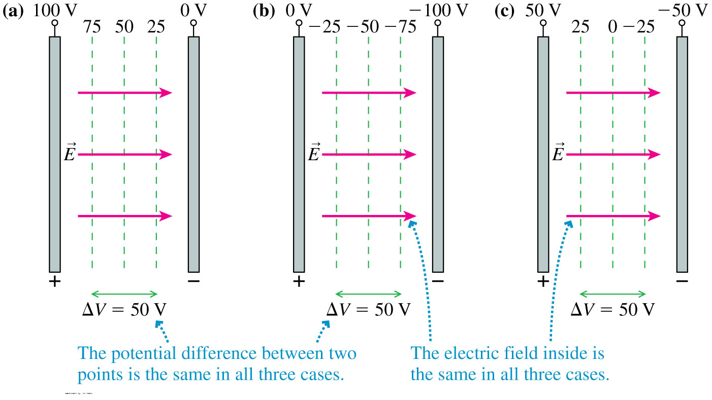
The Zero Point of Electric Potential
Where you choose V = 0 is arbitrary. The three contour maps below represent the same physical situation.

Slide 12
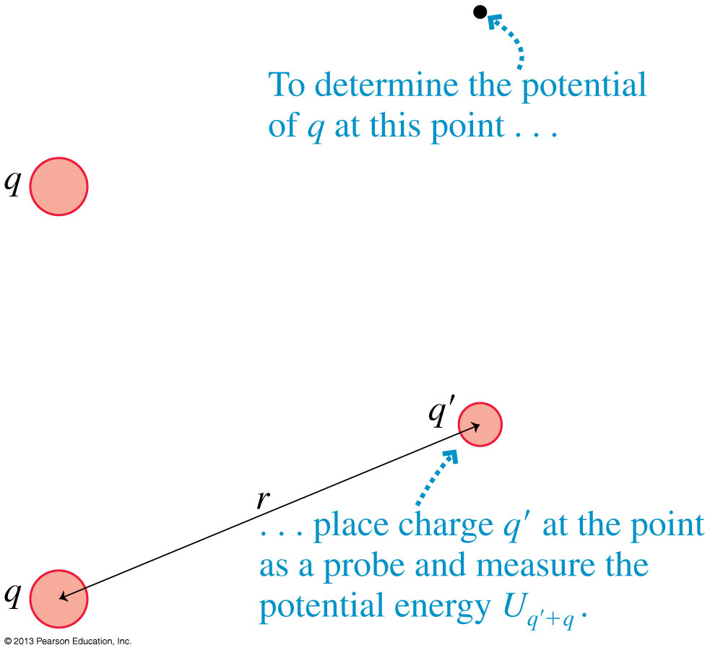
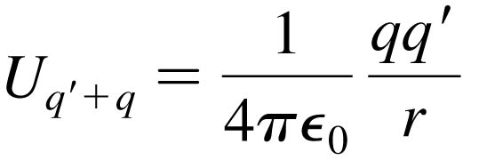
The Electric Potential of a Point Charge
Let q in the figure be the source charge, and let a second charge q', a distance r away, probe the electric potential of q.
The potential energy of the two point charges is

Slide 13

The Electric Potential of a Point Charge
The electric potential due to a point charge q is
The potential extends through all of space, showing the influence of charge q, but it weakens with distance as 1/r.
This expression for V assumes that we have chosen V = 0 to be at r = ∞.

Slide 14
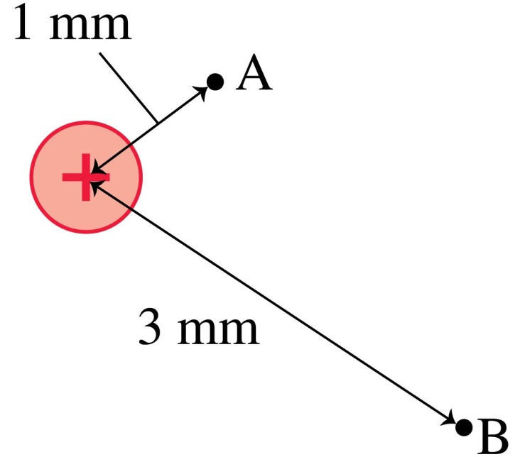
QuickCheck 28.10
What is the ratio V_{B}/V_{A} of the electric potentials at the two points?
9.
3.
1/3.
1/9.
Undefined without knowing the charge.
Notes:
14

Slide 15
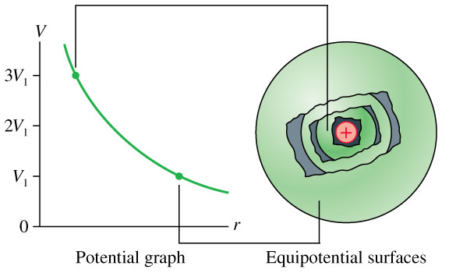
The Electric Potential of a Point Charge

Slide 16
Quick Equations Quiz.. [1/4]
Which is which?
The magnitude of the force, in Newtons, on a point charge that is near another point charge is:
A.
C.
B.
D.
Notes:
Answer: D

Slide 17
Quick Equations Quiz.. [2/4]
Which is which?
The magnitude of the Electric Field, in Newtons per Coulomb, near a point charge is:
A.
C.
B.
D.
Notes:
Answer: D

Slide 18
Quick Equations Quiz.. [3/4]
Which is which?
The electric potential energy, in Joules, of two point charges is:
A.
C.
B.
D.
Notes:
Answer: D

Slide 19
Quick Equations Quiz.. [4/4]
Which is which?
The electric potential, in Volts, near a point charge is:
A.
C.
B.
D.
Notes:
Answer: D

Slide 20
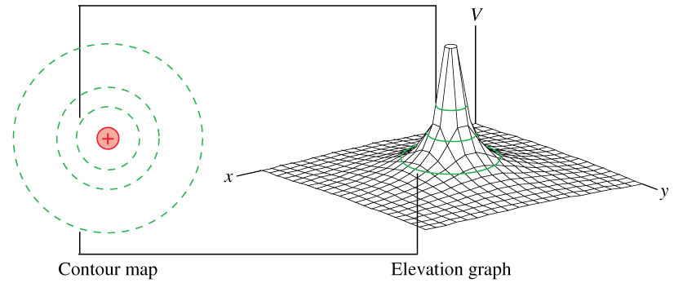
The Electric Potential of a Point Charge

Slide 21
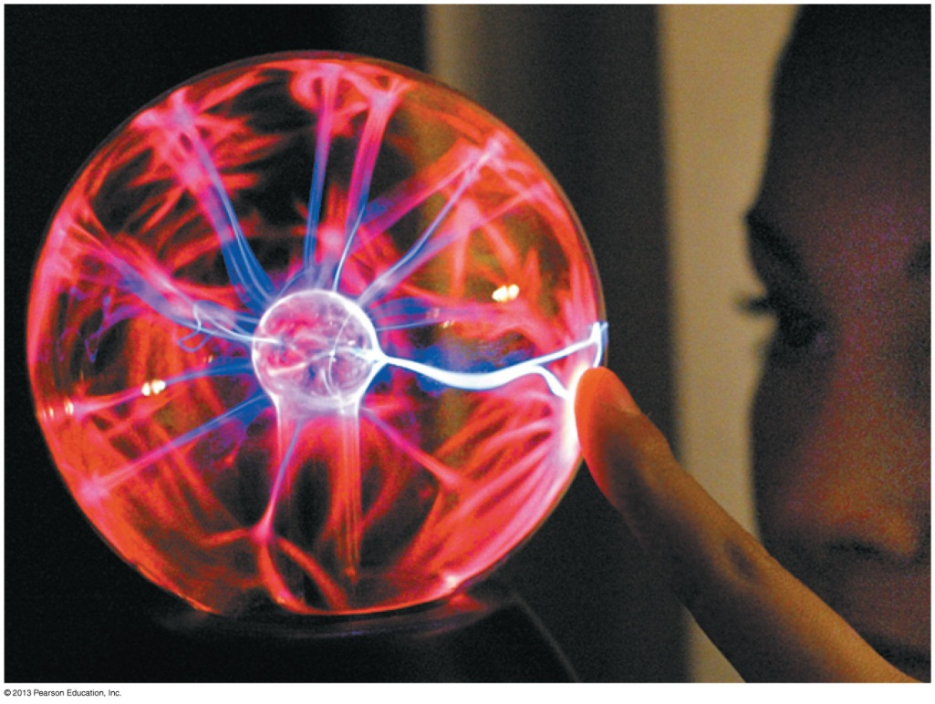
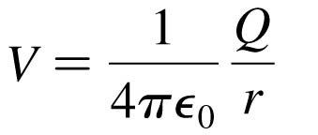
The Electric Potential of a Charged Sphere
Outside a uniformly charged sphere of radius R, the electric potential is identical to that of a point charge Q at the center.
where r > R.
If the potential at the surface V₀ is known, then the potential at
r > R is:

Slide 22
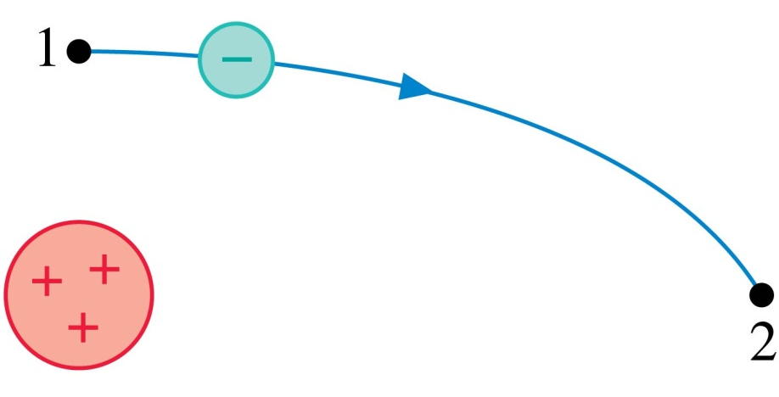
QuickCheck 28.11
An electron follows the trajectory shown from point 1 to point 2. At point 2,
v₂ > v₁.
v₂ = v₁.
v₂ < v₁.
Not enough information to compare the
speeds at these points.
Notes:
22

Slide 23
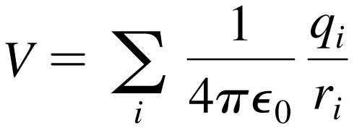
The Electric Potential of Many Charges
The Electric Potential of Many Charges
The electric potential V at a point in space is the sum of the potentials due to each charge:
where r_{i} is the distance from charge q_{i} to the point in space where the potential is being calculated.
The electric potential, like the electric field, obeys the principle of superposition.

Slide 24
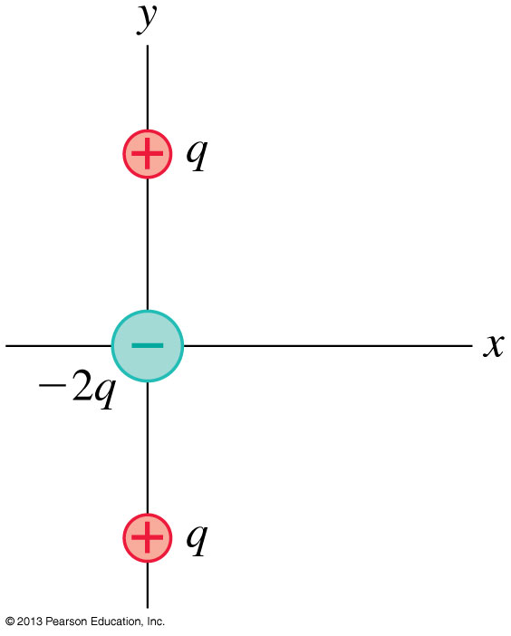
Problem 28.66
The arrangement of charges shown is called a linear electric quadrupole. The positive charges are located at y = ± s.
Find an expression for the electric potential on the y-axis at a distance y >> s.

Slide 25
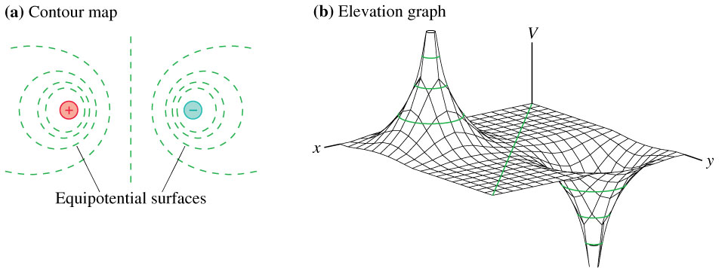
The Electric Potential of an Electric Dipole

Slide 26
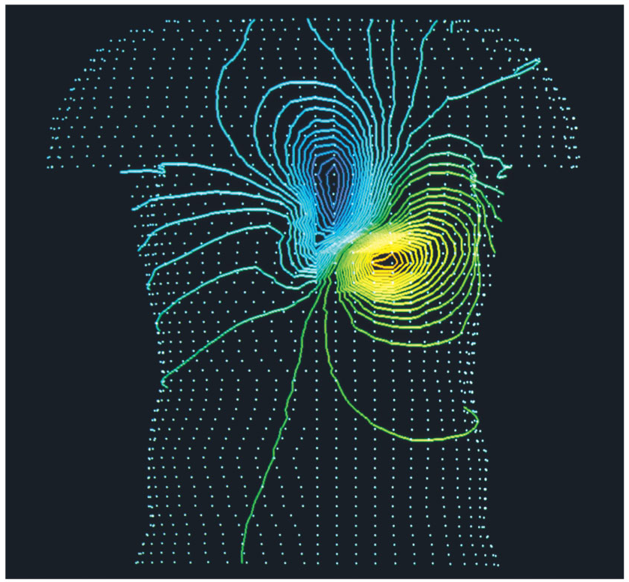
The Electric Potential of a Human Heart
The Electric Potential of a Human Heart
Electrical activity within the body can be monitored by measuring equipotential lines on the skin.
The equipotentials near the heart are a slightly distorted but recognizable electric dipole.

Slide 27
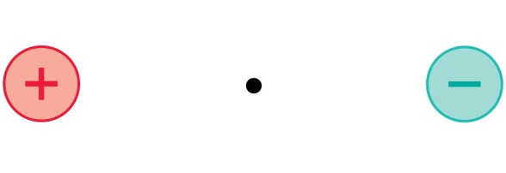

QuickCheck 28.12
At the midpoint between these two equal but opposite charges,
E = 0; V = 0.
E = 0; V > 0.
E = 0; V < 0.
E points right; V = 0.
E points left; V = 0.
Notes:
27

Slide 28
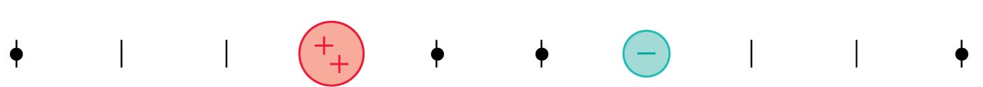
QuickCheck 28.13
At which point or points is the electric potential zero?
A.
B.
C.
D.
E. More than one of these.
Notes:
28

Slide 29
The next test…
Term Test 2 is in 4 weeks:
Tuesday, Mar. 10 6:10pm in room TBA
This will cover Chapters 25, 26, 28, 29 and conceptual questions (clicker-style questions) from Chapter 30
Remember the second half of chapter 23 on lenses will not be tested on the midterm or final exam.

Slide 30
Have a great Reading Week!!
Happy Valentine’s Day tomorrow!
Sorry, no office hours for me next week.
When you get back on Feb. 23, Professor Meyertholen will start where I am leaving off: Chapter 29, connecting Electric Potential with Electric Field.
I hope you enjoy the rest of your semester, and please keep coming to see me in office hours; you are my students until the final exam is done!
And even after you are no longer my students, please stay in touch and drop by whenever you like!
Best wishes and see you around!

