Slide 1
Behind every great man, there is a great woman
The role of Mileva Marić Einstein
Pauline Gagnon
1

Slide 2
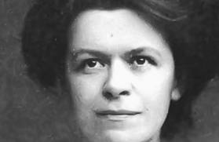
Plan
Examine how Mileva Marić and Albert Einstein worked together for nearly 20 years
Look at the historical
and social context
Give justice to Mileva

Slide 3
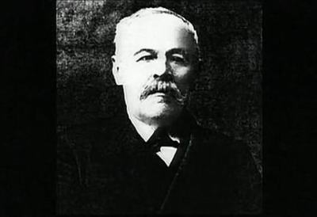
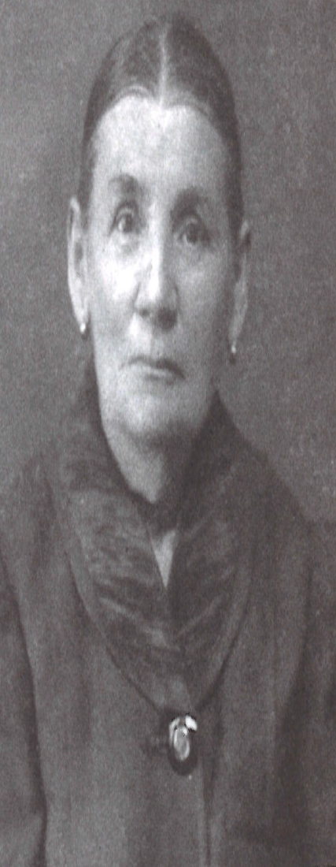
Mileva’s family
Father
Miloš Marić
(1846-1922)
Mother
Marija Ruzić
(1846-1935)
Sister
Zorka
(1883-1938)
Brother
Miloš
(1885-1944)
Mileva
(1875-1948)

Slide 4
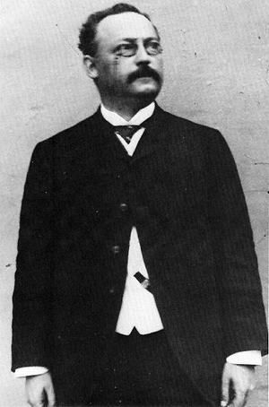
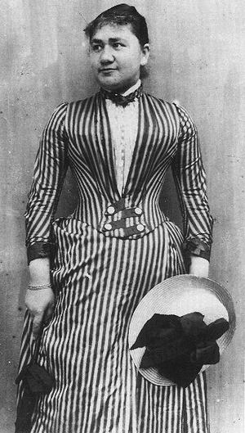
Albert’s family
Père
Milos Marić
(1846-1922)
Mère
Marija Ruzić
(1846-1935)
Father
Hermann Einstein
(1847-1902)
Mother
Pauline Koch
(1858-1920)
Soeur
Zorka
(18XX-19XX)
Frère
Milos
(1885-1944)
Sister
Maja
(1881-1951)
Mileva
(1875-1948)
Albert
(1878-1955)
Liserl
1903-?
Hans-Albert
1904-1973
Eduard
1910-19

Slide 5
Mileva’s studies
Mileva attended high school the last year girls were accepted in that school
1892: Special authorization to attend physics lectures in Zagreb
1894: Completed her high school degree in Zurich in Switzerland

Slide 6
Her temperament
His temperament
Mileva was brilliant but reserved
Not talkative
Perseverant and determined
Got to the bottom of things
Kept going towards her goals
Albert was inquisitive
Bohemian and rebel
Not very disciplined
Easily changed his mind
Hated discipline in German schools
Ended his high school studies in Switzerland

Slide 7
Joined Polytechnic Institute in Zurich in 1896 (ETH)

Slide 8
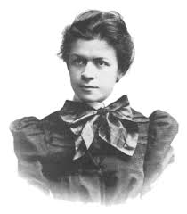
Both were admitted to the physics-mathematics section in 1896
Mileva Marić (21 yrs)
Albert Einstein (17.5 yrs)
Marcel Grossman (18 yrs)
Louis Kollros (18 yrs)
Jakob Ehrat (20 yrs)
In 1897, she goes to Heidelberg in Germany for one semester

Slide 9
Beginning (1896-1900)
Shared passion for:
Physics, music, each other
They spent countless hours studying together
Mileva was methodical and organized
She helped him channel his energy
She guided his studies

Slide 10
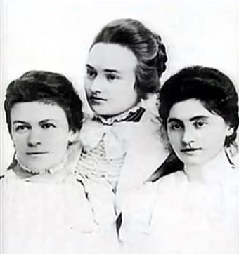
Mileva’s friends
Mileva met Milana Bota and Helene Kaufler Savić
They spoke of Albert’s continuous presence at Mileva’s place
Albert came in and out freely to borrow books
Mileva Marić, Milana Bota and Ružica Dražic in 1899

Slide 11
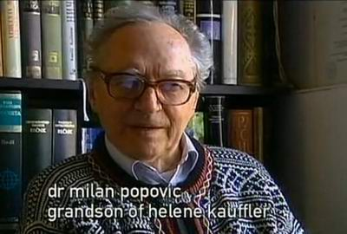
Mileva’s letters to Helene Kaufler Savić

Slide 12
The beginning of their collaboration

Slide 13
Correspondence from 1899-1903
43 letters from Albert to Mileva
10 letters from Mileva to Albert
Radmila Milentijević notes that Albert’s letters are peppered with terms such as « our new studies », « our research », « our viewpoint », « our theory », « our article », « our work on relative motion».
Radmila Milentijević Mileva Marić Einstein:
Life with Albert Einstein
Bookbaby, 2015
Renn and Schulmann
Albert Einstein / Mileva Marić
The Love Letters, 1992

Slide 14
First letter - 1899
« When I read Helmholtz for the first time, it seemed so odd that you were not at my side and today, this is not getting better. I find the work we do together very good, healing and also easier.»
Letter from Albert to Mileva, August 1899

Slide 15
Mileva helps Albert to better focus
“… the climate here does not suit me at all, and while I miss work, I find myself filled with dark thoughts – in other words, I miss having you nearby to kindly keep me in check and prevent me from meandering”.
Letter from Albert to Mileva 2 October 1899

Slide 16
Academic results (maximum grade: 6) (according to Desanka Trbuhović-Gjurić)
1896-1897 | Mileva | Albert
Calculus | 4,5 4,5 | 4,5 5
Analytic geometry | 4,5 | 5,0
Descriptive geometry | 4,5 4 | 4,5 4
Projective geometry | 3,5 | 5
Differential equations | 4,5 | 5
1897-1898 | Mileva | Albert
Differential equations |  | 5
Physics | 5 | 5 5
Projective geometry |  | 4
Applied physics | 5 | 1
Physics laboratory | 5 | 5
Geography | 5 | 4,5
1899-1900 | Mileva | Albert
Physics laboratory | 5 | 6 5
Topology | 5

Slide 17
Oral exam - 27 July 1900
Minkowski gave 11/12 to every
one except Mileva with 5 points
Their overall average (Krstić)
Albert Einstein: 4,6
Mileva Marić: 4,7
Albert got his degree but Mileva did not
Oral exam
Louis Kollros | 5,45
Marcel Grossman | 5,23
Jakob Ehrat | 5,14
Albert Einstein | 4,91
Mileva Marić | 4,00

Slide 18
Without a job

Slide 19
July 1900 - June 1902
The 3 other students get an academic position
Albert sends application all over Europe
He suspects that Prof. Weber is blocking him
Without a job, he refuses to marry Mileva
They give private lessons to make ends meet and « continue to live and work as before. »
Letter from Mileva to Helene Savić

Slide 20
Albert confirms their collaboration
« I look forward to resume our new common work. You must now continue with your research – how proud I will be to have a doctor for my spouse when I’ll only be an ordinary man. »
Letter from Albert to Mileva – mid-September 1900
Back to Zurich in October to complete their theses – they resume their common studies

Slide 21
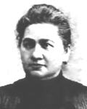
1900: Albert’s mother opposes the relationship
She finds Mileva too old:
“By the time you’re 30, she’ll already be an old hag!”
Letter from Albert to Mileva - 27 July 1900
« She cannot enter a respectable family »
Mileva is not Jewish, nor German
She has a limp and is too intellectual
Prejudice against Slavic people
Albert’s father also requests that his son finds work before getting married

Slide 22
First article on capillarity submitted on 13 December 1900
“We will send a private copy to Boltzmann to see what he thinks and I hope he will answer us.”
Letter from Mileva to Helene Savić – 20 December 1900
Albert’s friend Michele Besso“visited his uncle Prof. Jung on my behalf, one of the most influents physicists in Italy and gave him a copy of our article.”
Letter from Albert to Mileva – 4 April 1901

Slide 23
Why was this article signed only by Albert?
Did Mileva wish to help promote Albert’s career?
For Mileva, they were one unique entity
Krstić thinks that, since so few women published articles in Annalen der Physik, this could have cast a shadow on his credibility
Dord Krstić: Mileva & Albert Einstein: Their Love and Scientific Collaboration, Didakta, 2004

Slide 24
Proof of their collaboration from Albert Einstein’s own hand
March 1901: Albert returns to Milan
« How happy and proud I will be when the two of us together will have brought our work on relative motion to a victorious conclusion! »
Letter from Albert to Mileva – 27 March 1901

Slide 25
Mileva’s destiny changed

Slide 26
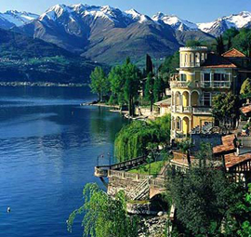
Love escapade to Lake Como
May 1901: the lovers meet in Lake Como
Mileva get pregnant
Still without a job, Albert refuses to marry her

Slide 27
Marriage promise
“I will look for work right away, no matter how humble it could be. My scientific goals and my own vanity will not prevent me from accepting even a subordinate position. The moment I get a job, I will marry you and will take you with me without saying anything to anyone until all is settled.”
Letter from Albert to Mileva - July 1901

Slide 28
Second attempt to the oral exam
Mileva fails again on 27 July 1901
Prof. Weber, the one who is blocking Albert’s career, give her a low grade.
“I abandoned my studies, despite the fact that, thanks to Weber, I did not receive my doctorate degree. Because of him, I have suffered a lot and do not wish to ever return to him.”
Letter from Mileva to Helene Savić – fall 1901

Slide 29
Back to Novi Sad
Mileva came back to Serbia in Fall 1901
6 month pregnant, she comes back to Zurich to try to convince Albert to marry her
Gave birth to Liserl in January 1902
No one knows what happened to her
Mileva alone joined Albert in Bern in June 1902

Slide 30
First job
In a letter sent on her birthday (19 December 1901), Albert mentions a post at the Patent Office in Bern, thanks to the intervention of his friend Marcel Grossmann’s father.
« When you will be my little wife, we shall resume diligently our scientific work, such as to not become Philistines. »
Letter from Albert to Mileva – 28 December 1901

Slide 31
Bern - 1902
23 June: Albert starts at the Patent Office in Bern
Mileva made 2 brief visits on short-term visas
10 October 1902: Hermann Einstein grants his permission for a marriage on his death bed
Liserl was most likely given for adoption in the fall

Slide 32
Marriage on 6 January 1903

Slide 33
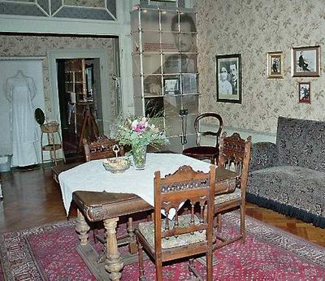
Married life in Bern
Albert works 8 hours a day, 6 days a week at the Patent Office
Mileva assumes the domestic tasks
They work together in the evenings, sometimes late in the night

Slide 34
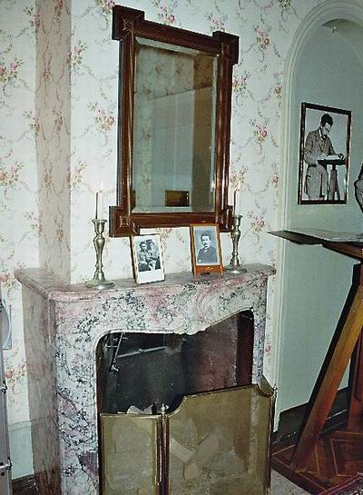
Albert mentions this in a letter to a friend, Hans Wohlwend
Mileva writes the same to Helene Savić on 20 march 1903.
She is sorry to see Albert working so hard at the office, saying how demanding his work is

Slide 35
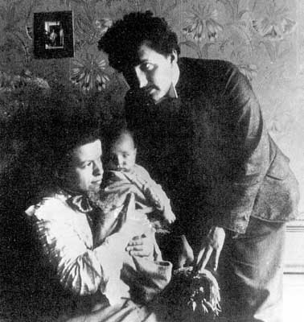
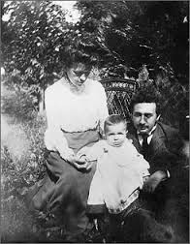
14 may 1904: birth of Hans-Albert

Slide 36
1905
The miracle year

Slide 37
Publications in 1905
Albert signed 5 articles in the Annalen für Physik
On photoelectric effect (Nobel Prize in 1921)
2 papers on Brownian motion
Special relativity
Equivalence between mass and energy (E = mc²)
Commented also on 21 scientific papers
Submitted his doctoral thesis in April on the dimensions of molecules. Received his degree in July.

Slide 38
Birth of Special Relativity
Three years before his death, Albert Einstein told R. S. Shankland that his work on relativity « had been with him for more than 7 years » and the photoelectric effect, 5 years
His thinking about relativity dates back to 1898, when he and Mileva spent all their time discussing and studying
Shankland, Conversations with Albert Einstein, Am. J. Phys. 31, 47 (1963)

Slide 39
Peter Michelmore, Einstein’s biographer
Michelmore wrote that after having spent five weeks to complete the article containing the basis of special relativity, Albert
« spent two weeks in bed while Mileva read the article over and over before posting it ».
Summer 1905: the Einstein family went to Serbia

Slide 40
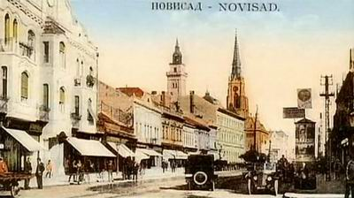
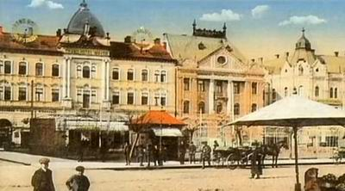
Visited Novi Sad in 1905, 1907 and 1913

Slide 41
Testimonies

Slide 42
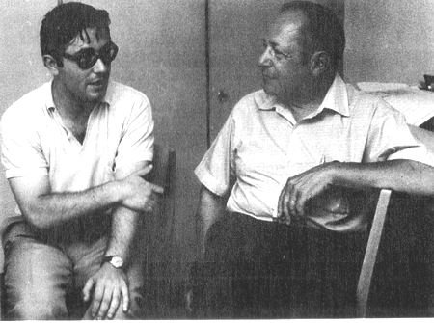
Dord Krstić with Hans-Albert Einstein in 1973
Hans-Albert recalled having seen his parents working next to each other in the evenings at the dining room table

Slide 43
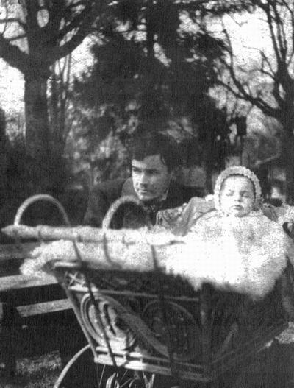
Mileva’s brother’s visits in 1904-1905
Dord Krstić writes: Miloš Marić, who stayed with the Einstein family, had a chance to see close up exactly how Mileva and Albert lived and worked together.

Slide 44
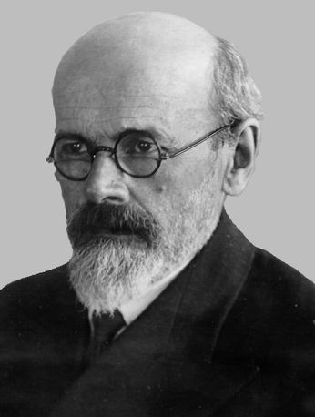
Testimonies on Miloš Marić
« He (Miloš) described how during the evenings and at night, when silence fell upon the town, the young married couple would sit together at the table and at the light of a kerosene lantern, they would work together on physics problems. Miloš Jr. spoke of how they calculated, wrote, read and debated. »
Dord Krstić got this information directly from two close relatives of Mileva Marić: Sidonija Gajin in May 1955, then from Sofija Galić Golubović in 1961.
Miloš was known for his integrity
Stuck to facts instead of his own opinions

Slide 45
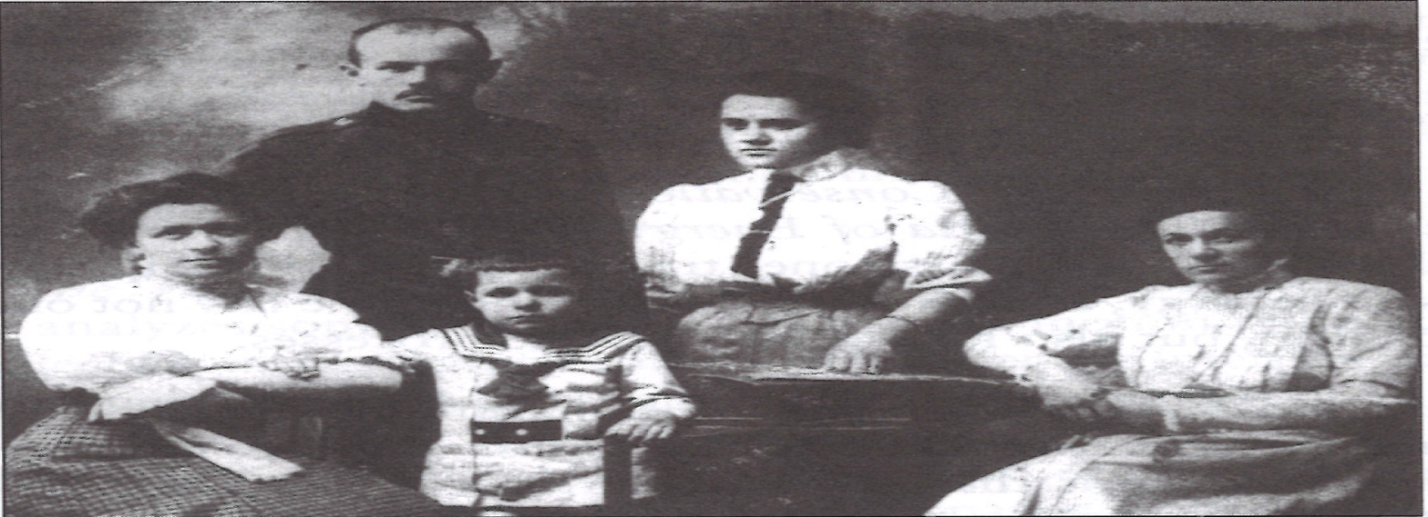
Other testimonies
« Before our departure, we finished an important scientific work which will make my husband known around the world.»
Mileva to her father during their visit to Novi Sad in 1905
Dord Krstić heard this in 1961 from Mileva’s cousin, Sofija Galić Golubović. She was present when Mileva said this to her father.
Two other people, Simonija
Gajin and Zarko Marić, reported separately
the same sentence, one in 1955, the other in 1961.
They had both heard it from Mileva’s father.
front: Mileva, Hans-Albert and Zorka
rear: brother Miloš and Sofija Galić in 1907

Slide 46
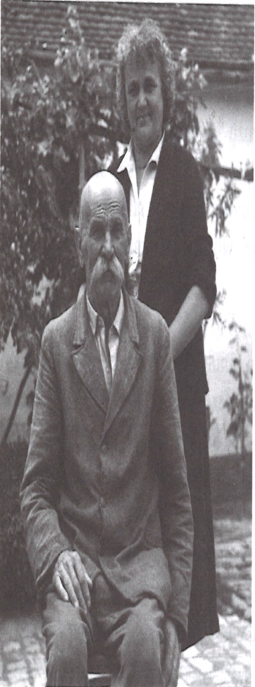
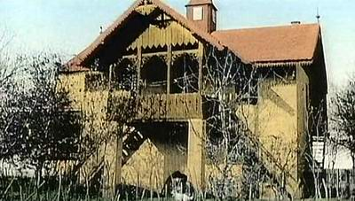
Zarko Marić lived in Villa Kula during both visits in 1905 and 1907
His wife Leposava cooked
Mileva took care of the kids
She calculated, wrote and worked with Albert
They discussed physics sitting in the shade
Harmony and mutual respect was visible
Zarko Marić and daughter Djurdjinka in 1961
Villa Kula (the tower) in Kać

Slide 47
Boarder’s testimony
The son of a mathematics professor from Zagreb University, Svetozar Varićak, boarded with the Einstein family.
Svetozar’s daughter recalls having heard her father tell the story on how Einstein sometimes assisted his wife with domestic tasks, feeling sorry for her when he saw her often staying up past midnight to solve his mathematical problems from his notes.
Quoted by Desanka Trbuhović-Gjurić

Slide 48
1905-1909
They continue to collaborate and to write several articles on relativity, the mass-energy equivalence, gas theory and Brownian motion.
The few preserved letters refer to this. Albert always mentions the details of his researches in his letters.

Slide 49
Einstein-Habicht patent in 1908
Construction of an ultra-sensitive voltmeter with Conrad Habicht
« When they were both satisfied, they let Albert the task of describing the apparatus, since he was a patent expert.»
According to Desanka Trbuhović-Gjurić
Mileva’s reply to Habicht:
« Warum? Wir beide sind nur ein Stein », (« Why? The two of us are just one stone », i.e. we are one unique entity).

Slide 50
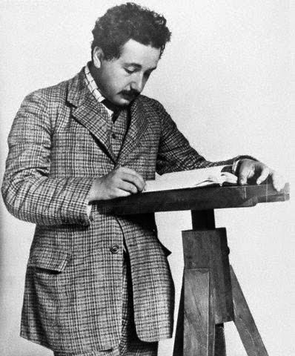
First academic posts
Lecturer position at Bern University in 1908
Unpaid work done after his office job
A post opened for him at Zurich University
Moved to Zurich in October 1909, then
Prag in 1911, back to Zurich in 1912
Eduard’s birth on 28 July 1910

Slide 51
First successes, first worries
« He is now regarded as the best of the German-speaking physicists, and they give him a lot of honours. I am very happy for his success, because he fully deserves it; I only hope and wish that fame does not have a harmful effect on his humanity. »
Letter from Mileva to Helene Savić – 3 September 1909
« With all this fame, he has little time for his wife. […]What is there to say, with notoriety, one gets the pearl, the other the shell. »
Letter from Mileva to Helene Savić ca. December 1909

Slide 52
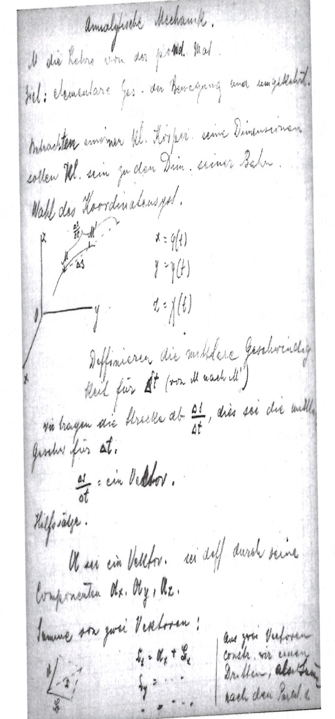
Mileva helps Albert with his lectures
Zurich, October 1909: he gives his first lectures in analytical mechanics
Eight pages of his hand-written notes were from Mileva’s hand
Albert Einstein Archives, Hebraic University in Jerusalem, published by Dord Krstić

Slide 53
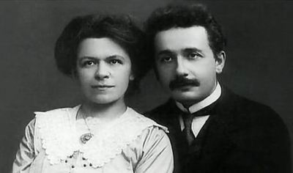
Collaboration in Zurich
Max Planck asked for Albert’s opinion
Draft of this letter written by Mileva in 1910
Now kept at the Hebraic University Archives
Albert (and Mileva) published 3 articles while in Zurich

Slide 54
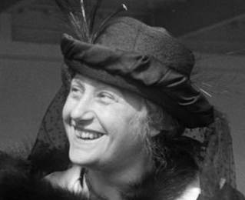
Their relationship crumbles
Up to 1911, Albert and Mileva still exchange affectionate postcards
April 1912: he begins an affair with his cousin Elsa Löwenthal during a visit in Berlin

Slide 55
Family interference
Albert is now famous and his family feels that Mileva does not suit him
Mileva mentions how Albert’s family mingles with their private life in several letters to her family and to her friend
Albert maintains a secret correspondence with his cousin Elsa over two years (21 letters)

Slide 56
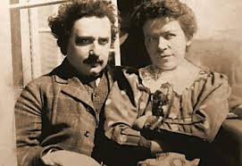
1913-1914
In July 1913, Albert obtains a position in Berlin. He writes right away to Elsa
Summer 1913: Albert’s last visit in Novi Sad
Brief affair with the Jewish baker’s wife
The family moves to
Berlin in April 1914

Slide 57
Albert’s conditions in July 1914
You care:
That my clothes and linen are in good order and in good repair,
That I receive regularly three daily rations in my room,
That my bedroom and study room are properly tidy and also extra, that the writing table is available only for me.
You renounce all personal relations with me, with the exception of necessities owing to social reasons. Especially, you renounce:
From me sitting beside you at home,
To walk or travel together with me.
You are strictly obliged in your relations with me to take into account the following items:
You dare me not reproach me that I do not show you tenderness but I also do not expect any from you at all,
You stop any conversation with me, if I do demand so,
You must at once leave my room or my working space upon request.
You will not humble me in front of the children

Slide 58
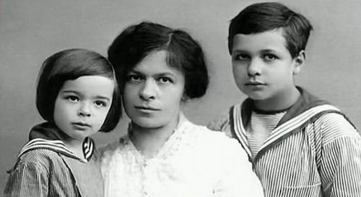
Back to Zurich on 29 July 1914
Eduard is in poor health
Mileva dedicates all her energy to her sons
Manages from the alimony she receives from Albert and private lessons
Eduard, Mileva et Hans-Albert, 1914

Slide 59
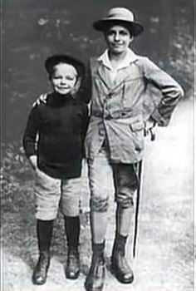
Difficult years
Several costly stays in the sanatorium
Mileva also has serious health problems in 1916-17
All her life, she will struggle financially
Hans-Albert et Eduard vers 1918

Slide 60
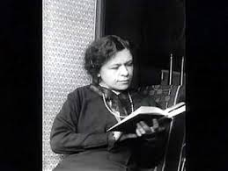
Divorce in 1919
One of the divorce clauses states that if Albert receives the Nobel Prize, she will get the all the prize money
Albert would get the fame,
Mileva the money

Slide 61
Comment to Helene Savić
« Even my closest friends still feel a great deal of admiration for his scientific achievements and transfer that to the personal sphere. You alone understand me best when you were able to say: I no longer care for him… »
Letter to Helene Savić dated from 1922

Slide 62
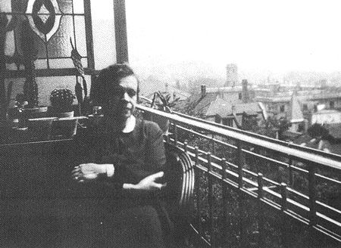
Money from the Nobel Prize
Bought 2 small apartment buildings and lived off the rent money
Buried under debts due to the cost of medical expenses for Eduard

Slide 63
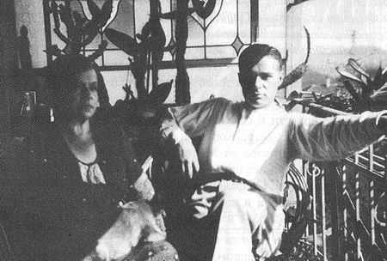
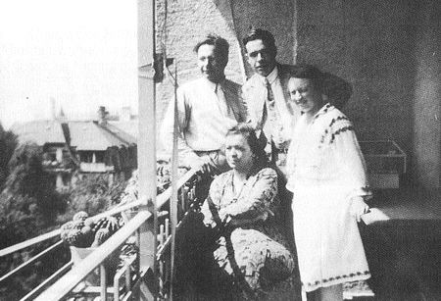
Eduard suffered from schizophrenia starting in his twenties
Will be permanently hospitalized a few years later

Slide 64
Attempt to claim her share
In 1925, Albert wrote in his will that the money from the Nobel Prize was his sons’ inheritance
Mileva strongly opposed this, stating this money was hers and considered proving she had contributed to his work.
« You made me laugh when you started threatening me with your recollections. Have you ever considered, even just for a second, that nobody would ever pay attention to your says if the man you talked about had not accomplished something important. When someone is completely insignificant, there is nothing else to say to this person but to remain modest and silent. This is what I advise you to do. »
Letter from Albert to Mileva – 24 October 1925
Quoted by Radmila Milentijević, AEA 75-364

Slide 65
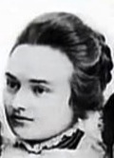
Declaration from Milana Bota
« Mica [Mileva] would be the most relevant one to give information about the genesis of his theory [special relativity] because she personally was involved in its creation. Five, six years ago, Mica spoke to me about that, but with grief. Perhaps it was difficult for her to evoke the memories of her most pleasant hours, or maybe she didn’t want to ‘reduce’ the great glory of her ex-husband. »
Interview given my Milana Bota to a Serbian newspaper, Politika, in 1929
« Such publications in newspapers do not suit my nature at all, but I believe that all that was for Milana’s joy, and that she probably thought that this would also be a joy for me, and I can only suppose that she wanted to help me receive some public rights with regard to Einstein. She has written to me in that way, and I let it be accepted that way, for otherwise the whole thing would be nonsense. »
Letter from Mileva to Helene Savić – 13 June 1929

Slide 66
Confidences from Mileva
Mileva wrote a letter to her godparents explaining how she had always collaborated with Albert and how he had ruined her life. (according to Dord Krstić)
She also confided to one of her students, Maja Shucan, that she had « always collaborated with Einstein » (quoted by Highfield, p. 232)
She also talked about her scientific collaboration with her son Hans-Albert, her mother and sister.
(according to Dord Krstić)

Slide 67
Albert’s bad conscience
« When Mileva will no longer be there, I’ll be able to die in peace. »
Letter from Albert to Dr Karl Zürcher - 29 July 1947
(Swiss lawyer in charge of his divorce)

Slide 68
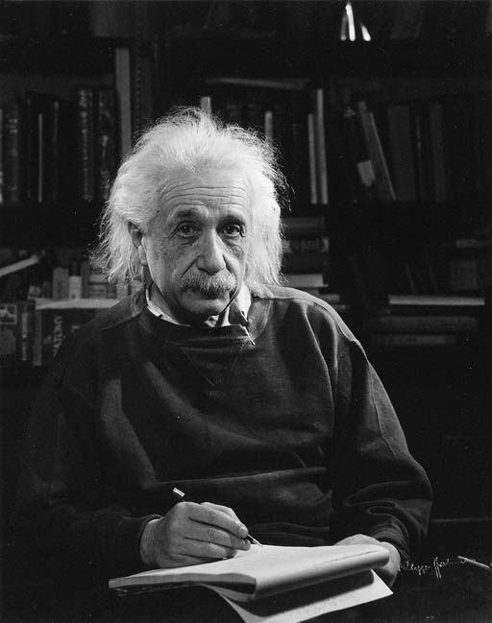
World fame
1915: General Relativity is published with
Marcel Grossmann
The eclipse of 1919 confirmed that light is deviated when passing nearby a massive object like the Sun
Established Albert Einstein’s fame and popularity

Slide 69
The Einstein’s myth
Helen Dukas, Albert’s personal secretary 1928-55
moved to the USA with him in 1933, and
Otto Nathan, economist, executor after Einstein’s death
Did everything they could to hide Mileva’s existence
Legally prevented Hans-Albert and his wife Frieda from publishing the letters he had from his parents
Blocked until their death (1982 and 1987) the publication of the correspondence between Albert et Mileva, and their appearance in the Collected Papers of Albert Einstein (Princeton University)
Nathan « visited » Mileva’s apartment after her death

Slide 70
Another myth
Maja and Albert Einstein in 1953

Slide 71
Conclusion

Slide 72
Proofs of their collaboration
Clearest evidence comes from Albert’s hand when he refers to « our work on relative motion »
One must look at how they interacted and lived together
Numerous testimonies (Hans-Albert, friends and family in Novi Sad, Mileva’s brother Miloš, Milana Bota, Mileva’s student, a boarder, etc.)
Hand-written documents from Mileva’s hand: letter to Planck, lectures note in Zurich

Slide 73
More indirect proofs
Nobel Prize money given to Mileva
Decline in Albert Einstein’s productivity and creativity after their separation
Joffe’s comment on the Einstein-Marity signature in 1905 (there is no proof of this so this could be pure speculation)

Slide 74
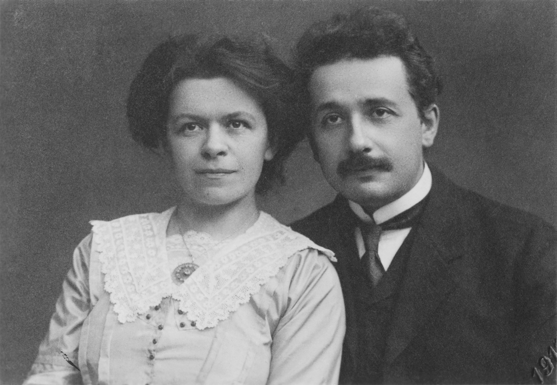
My opinion
Union based on love and respect
Together, they produced uncommon work
Their individual contributions will never be known
She was the first person to believe in his talent
Without her, he would never have succeeded
She abandoned her own aspirations, happy to work with him and contribute to his success
For her, they were one unique entity, ein Stein
Once started, it became impossible to back-track

Slide 75
Why did she remain silent?
Reserved
Not after honour and fame
Spoke little about herself
Maybe that, as a woman, she
felt she dis not deserve these honours
She always loved him

Slide 76
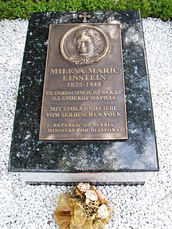
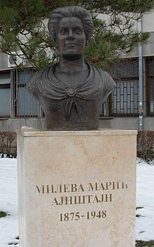
Memorials in Zurich and Novi Sad
With pride and love, the people of Serbia

Slide 78
Main References
Desanka Trbuhović-Gjurić
Mileva Marić Einstein: In Albert Einstein’s shadow (Serbia, 1969). In German, 1982 and French, 1991).
Dord Krstić: Mileva & Albert Einstein: Their Love and Scientific Collaboration, Didakta, 2004
The Collected Papers of Albert Einstein Princeton University, 1987
Renn and Schulmann
Albert Einstein / Mileva Marić
The Love Letters, 1992
Radmila Milentijević:
Mileva Marić Einstein:
Life with Albert Einstein
Bookbaby, 2015
Milan Popović:
In Albert’s Shadow, the Life
and Letters of Mileva Marić,
Einstein’s First Wife
2003, The John Hopkins
University Press

Slide 79
