Slide 1
Note on Posted Slides
These are the slides that I intended to show in class on Mon. Jan. 7, 2013.
They contain important ideas and questions from your reading.
Due to time constraints, I was probably not able to show all the slides during class.
They are all posted here for completeness.

Slide 2

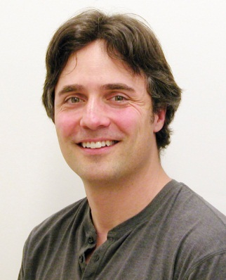
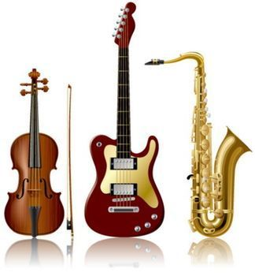
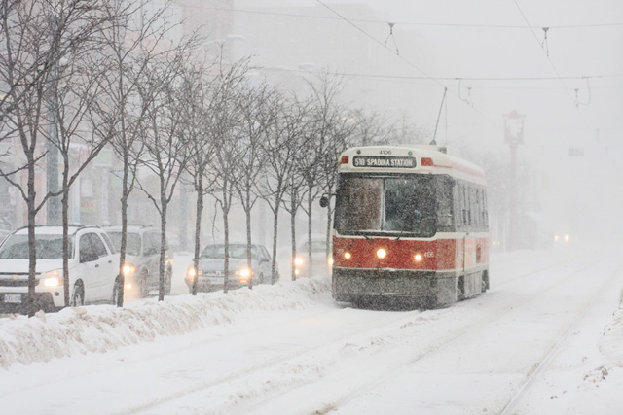
PHY205H1S
Physics of Everyday Life
Class 1
Welcome - please make yourself comfortable!
I am Jason Harlow, the instructor for this course
Today I will introduce the course, and start in on the first chapter:
Chapter 2: Newton’s First Law of Motion – Inertia
Conceptual Physics by P.G.Hewitt

Slide 3
Today’s Outline
Introduction Who am I? What is physics?
Run of the Course Clickers, Tutorials, Problem Sets,Tests and Exam
Starting Chapter 2 of Conceptual Physics (we are skipping chapter 1..)
Motion, Force, Inertia
Newton’s First Law

Slide 4
Who am I?
Jason Harlow, Senior Lecturer
B.Sc. in Physics at U of Toronto 1993
Ph.D. in Astronomy and Astrophysics at Penn State 2000
I have been teaching at U of T for 8 years
Contact Info: jharlow@physics.utoronto.ca
416-946-4071 Office: MP121B
Office hours: Mondays: 4-5PM, Fridays: 9-10AM. In addition to these hours, you have are invited to call or email for an appointment, or just drop by my office.

Slide 5
Other Important Contacts
Ms. April Seeley, Course Administrative Assistant
seeley@physics.utoronto.ca
416-946-0531
Office: MP129
Office hours: Monday,Tuesday, Thursday, Friday 9:30am to 5:00pm, and Wednesdays from 9:30am to 4:30pm
Your T.A. – you will meet Jan.9-14

Slide 6
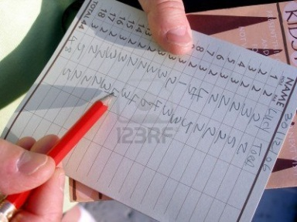
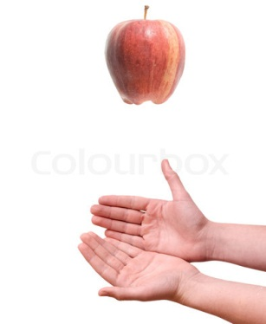
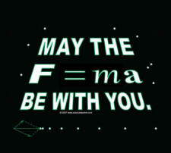
What is Physics?
Paul Hewitt, the author of the course textbook, says:
    “You know you can’t enjoy a game unless you know its rules; whether it’s a ball game, a computer game, or simply a party game. Likewise, you can’t fully appreciate your surroundings until you understand the rules of nature.
    Physics is the study of these rules, which show how everything in nature is beautifully connected. So the main reason to study physics is to enhance the way you see the physical world.
    You’ll see the mathematical structure of physics in frequent equations, but more than being recipes for computation, you’ll see the equations as guides to thinking.”

Slide 7
Physics—The Basic Science
Physical sciences include geology, astronomy, chemistry, and physics.
Life sciences include biology, zoology, and botany.
Physics underlies all the sciences.

Slide 8
Physics at U of T
Some of the top research fields in our department are:
Atmospheric – Observational and Computational
Biological Physics
Condensed Matter Physics – Theoretical and Experimental
High Energy Particle Physics – Theoretical and Experimental
Geophysics
Quantum Optics
Physics Education Research

Slide 9
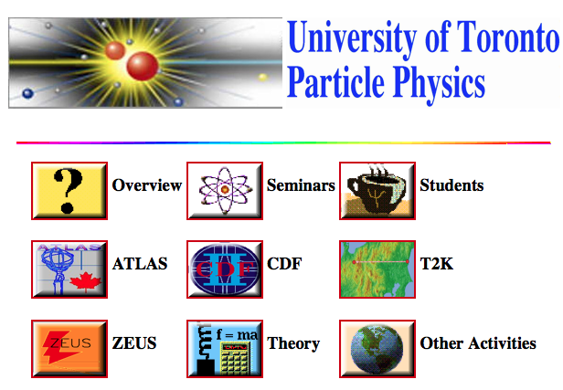
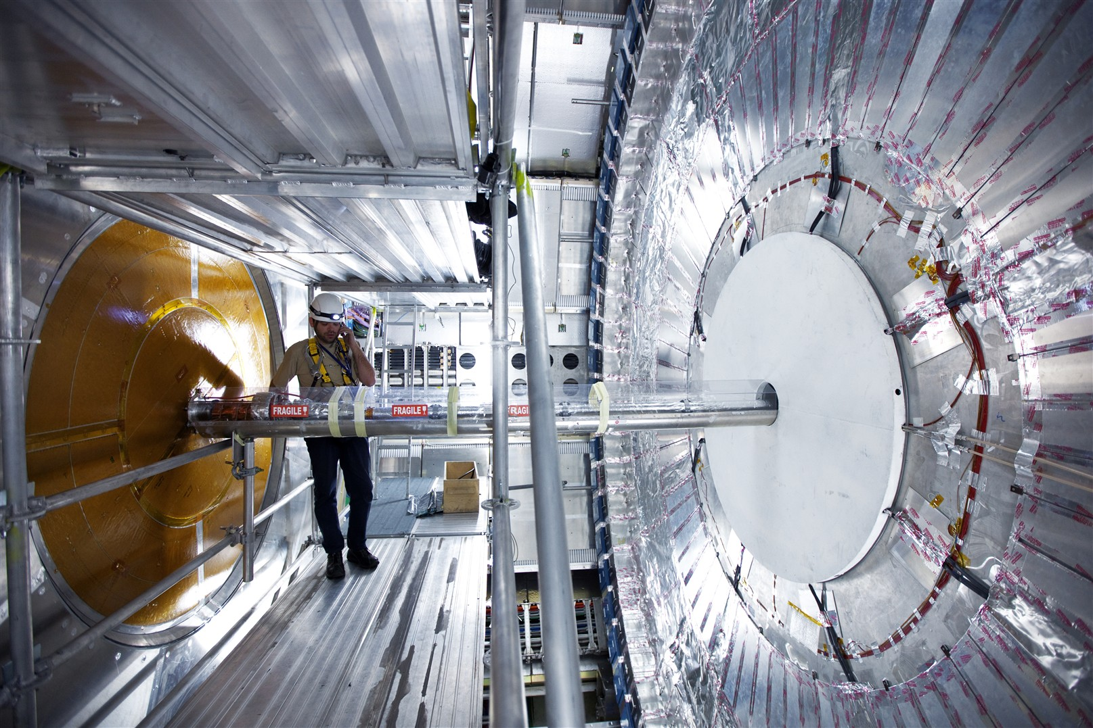
Physics at U of T

Slide 10
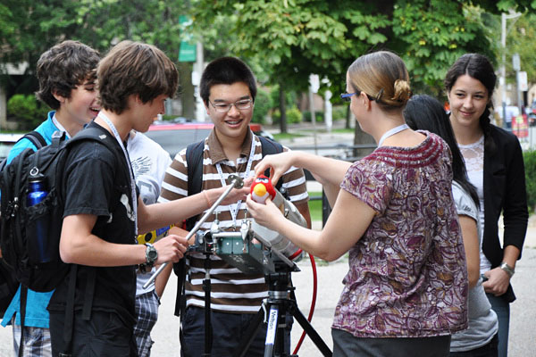
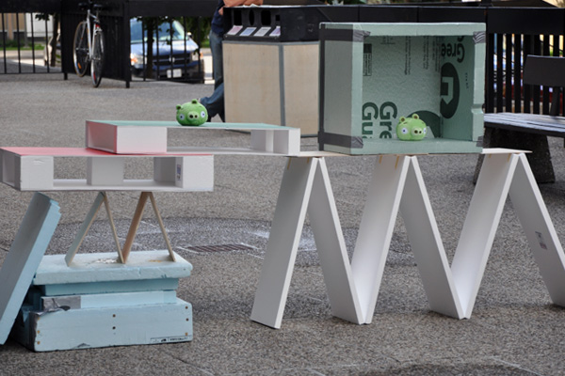
Physics at U of T
Angry Birds at Summer Science Camp, led by Professor Sabine Stanley (Earth, Atmospheric and Planetary Physics)

Slide 11
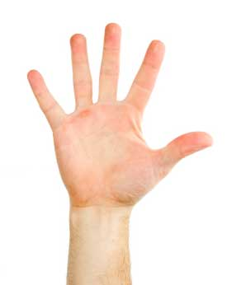
Show of hands
What would you describe as your main area of study at U of T?
  Humanities (Arts)
  Rotman Commerce
  Computer Science
  Social Sciences
  Other?

Slide 12
Who Should be Taking This Course?
To do well in this course, you must be familiar with life on earth, including moving, breathing and eating.
It also helps if you have some experience thinking about light, sound or music, and if you have ever used an electric device, or played with magnets.
There are no pre-requisites for this course but there are exclusions!
This course is primarily intended to be a breadth course for students in the humanities, social sciences, commerce, etc. You may not take this course if you have ever taken or are taking PHY131, PHY151, or any equivalent laboratory-based first year physics course.

Slide 13
My Goals for You
Begin to see physics in everyday life
Learn that physics isn’t frightening
Learn to think logically in order to solve physics problems
Develop and expand your physical intuition
Learn how things work
Begin to understand that the universe is predictable rather than magical
Obtain a perspective on the history of science and technology

Slide 14
My Goals for Me
To try to teach well and explain physics clearly, at an appropriate level.
To treat you with courtesy, respect and kindness.
To be fair.
To be in my office at scheduled office hours.
To answer emails within 48 hours.
To begin class at 10 after the hour and end on the hour.

Slide 15
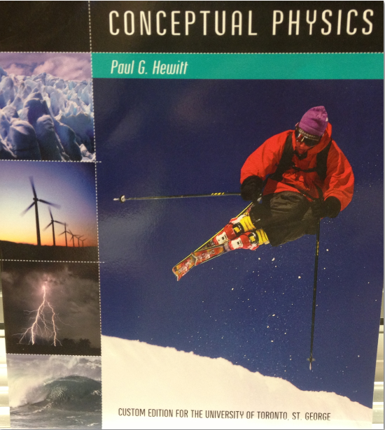
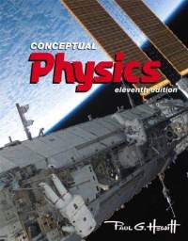
What you need to buy (3 things)
The required textbook: "Conceptual Physics" 11th edition, by Paul Hewitt ©2011 by Pearson Education. There is a custom edition for U of T St. George at the campus bookstore which includes only the chapters we will be covering in this course: 2-8, 12-16, and 19-28. It also contains an i-clicker rebate coupon.
Custom cover:
Regular cover

Slide 16

What you need to buy (3 things)
2. An i-clicker personal remote. Available at the campus bookstore New: $36, used: $27. You will be registering this online with your UTORid for marks.

Slide 17
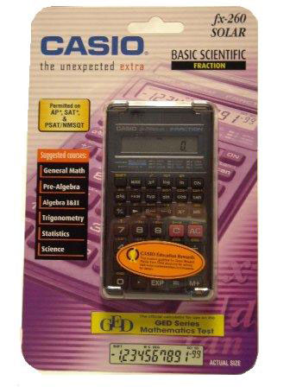
What you need to buy (3 things)
3. A calculator - this doesn’t need to be too fancy, but it must have SIN, COS, TAN buttons on it. For example a new Casio fx-260 is $16.

Slide 18
Tutorials
Tutorials begin this Wednesday
You should go to your tutorial section every Wednesday, Friday or Monday
See the web-site for your room location based on what TUT section you are enrolled in
Tutorial worksheets are worth 5% of the course mark.
Problem Set 1 will be distributed in tutorial this week and next Monday.

Slide 19
Tests
Test 1 is Wednesday, Jan. 30 during class time in EX100
Test 2 is Wednesday, Mar. 6 during class time in EX100
Each test is worth 17.5% of the course mark.
The tests will involve a combination of multiple choice and written questions, which will test your understanding of course material and ability to think and apply what you have learned to simple problems and explaining phenomena.
A simple pocket calculator and a 5"×3" index card with your own hand-written notes will be permitted during the tests.

Slide 20
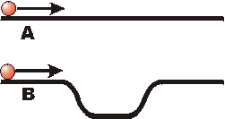
Two balls are launched along a pair of tracks with equal velocities, as shown. Both balls reach the end of the track. Predict: Which ball will reach the end of the track first?
A
B
C: They will reach the end of the track at the same time

Slide 21
Demo: Two balls were launched along a pair of tracks with equal velocities. Both balls reached the end of the track. Observe: Which ball reached the end of the track first?
A
B
C: They reached the end of the track at the same time

Slide 22
Why does ball B reach the end of the track first?
Explanation:
Balls A and B start and end with the same speed.
But while ball B is on the lower part, it is going faster than ball A because gravity has sped it up.
Its average speed is greater, so it gets there first!

Slide 23
Galileo’s Inertia Experiment
A ball rolls down a hill, along a flat part, and then up a hill again
It tends to roll up to the same height from which it was released (or a little less)
What if there was no second hill?
Q: What keeps an object going if it is already moving?
A: Its inertia.

Slide 24
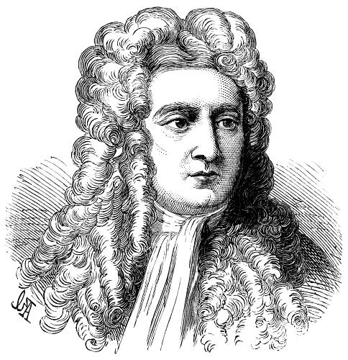
Isaac Newton
Born in 1643, the year Galileo died.
Was a “physicist, mathematician, astronomer, natural philosopher, alchemist, and theologian and one of the most influential people in human history.” (http://en.wikipedia.org/wiki/Isaac_Newton)
In Philosophiæ Naturalis Principia Mathematica, published 1687, he described universal gravitation and the three laws of motion, laying the groundwork for classical mechanics.

Slide 25
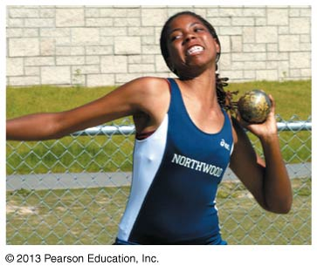
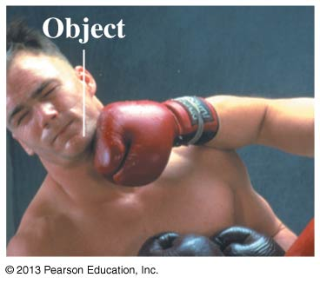
What is a force?
A force is a push or a pull
A force acts on an object
Pushes and pulls are applied to something
From the object’s perspective, it has a force exerted on it
The S.I. unit of force is the Newton (N)
1 N = 1 kg m s^{–2}

Slide 26
What is a force?
Vector quantity
a quantity whose description requires both magnitude (how much) and direction (which way)
can be represented by arrows drawn to scale, called vectors
  length of arrow represents magnitude and arrowhead shows direction

Slide 27
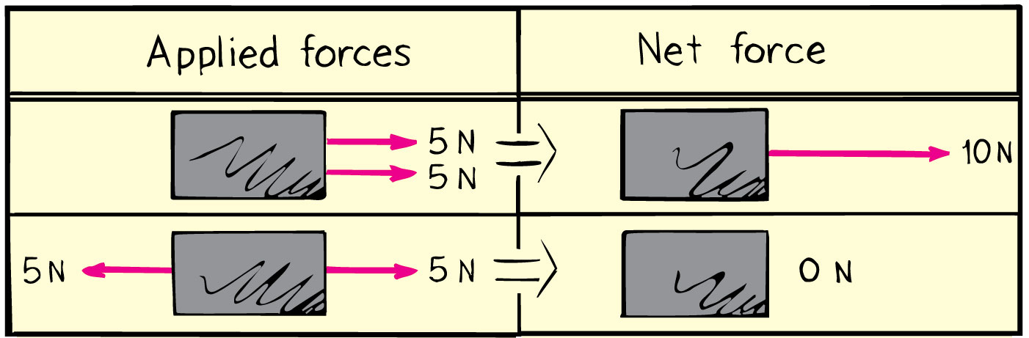
Net Force
Net force is the combination of all forces that change an object’s state of motion.
Examples:

Slide 28
Net Force
One person pushes a cart to the right with a force of 5 N.
At the same time, a second person pushes the same cart to the left with a force of 10 N.
What is the magnitude of the net force on the cart?
0 N
5 N
10 N
15 N
Notes:
28
Answer: A

Slide 29
Net Force
One person pushes a cart to the right with a force of 5 N.
At the same time, a second person pushes the same cart to the left with a force of 10 N.
What is the direction of the net force on the cart?
To the left
To the right
Notes:
29
Answer: A

Slide 30
Net Force
One person pushes a cart to the right with a force of 5 N.
At the same time, a second person pushes the same cart to the left with a force of 10 N.
The net force on the cart is 5 N to the left.
Two forces are in opposite directions, so they subtract.
The direction is determined by the direction of the larger force.
Notes:
30
When you take a 15N force to the right added to a 20 N force to the left, because the two forces are in opposite directions, they in fact subtract, rather than add.
So, the larger 20 force to the left is cut back by the 15N force to the right, so that the remaining force i.e. the Net force is only 5N to the left.

Slide 31
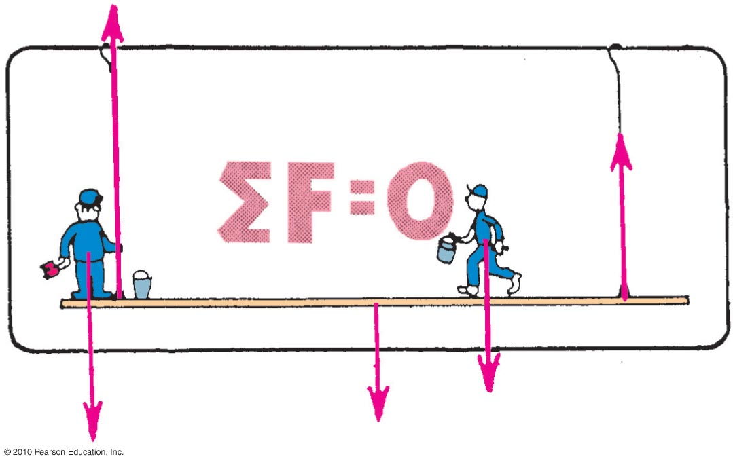
The Equilibrium Rule
The vector sum of forces acting on a non-accelerating object equals zero.
In equation form: ΣF = 0.

Slide 32
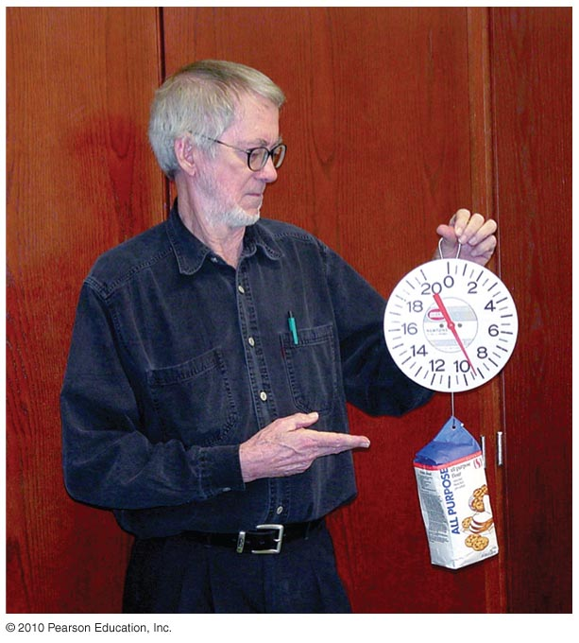
The Equilibrium Rule : Example
A string holding up a bag of flour
Two forces act on the bag of flour:
  Tension force acts upward.
  Weight acts downward.
Both are equal in magnitude and opposite in direction.
  When added, they cancel to zero.
  So, the bag of flour remains at rest.

Slide 33
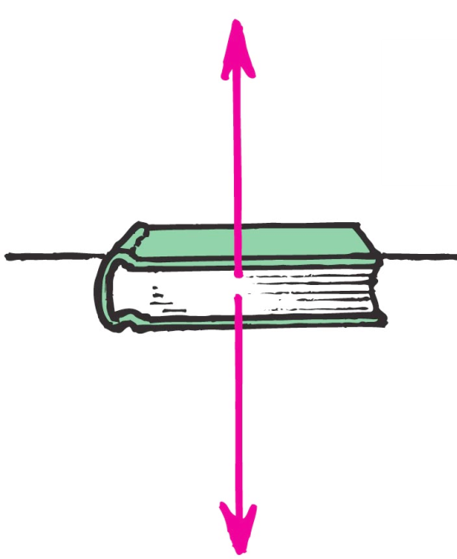
Normal Force
The normal force on an object resting on a flat surface is an upward force on an object that is opposite to the force of gravity.
Example: A book on a table compresses
Atoms in the table, and the compressed
atoms produce the support force.

Slide 34
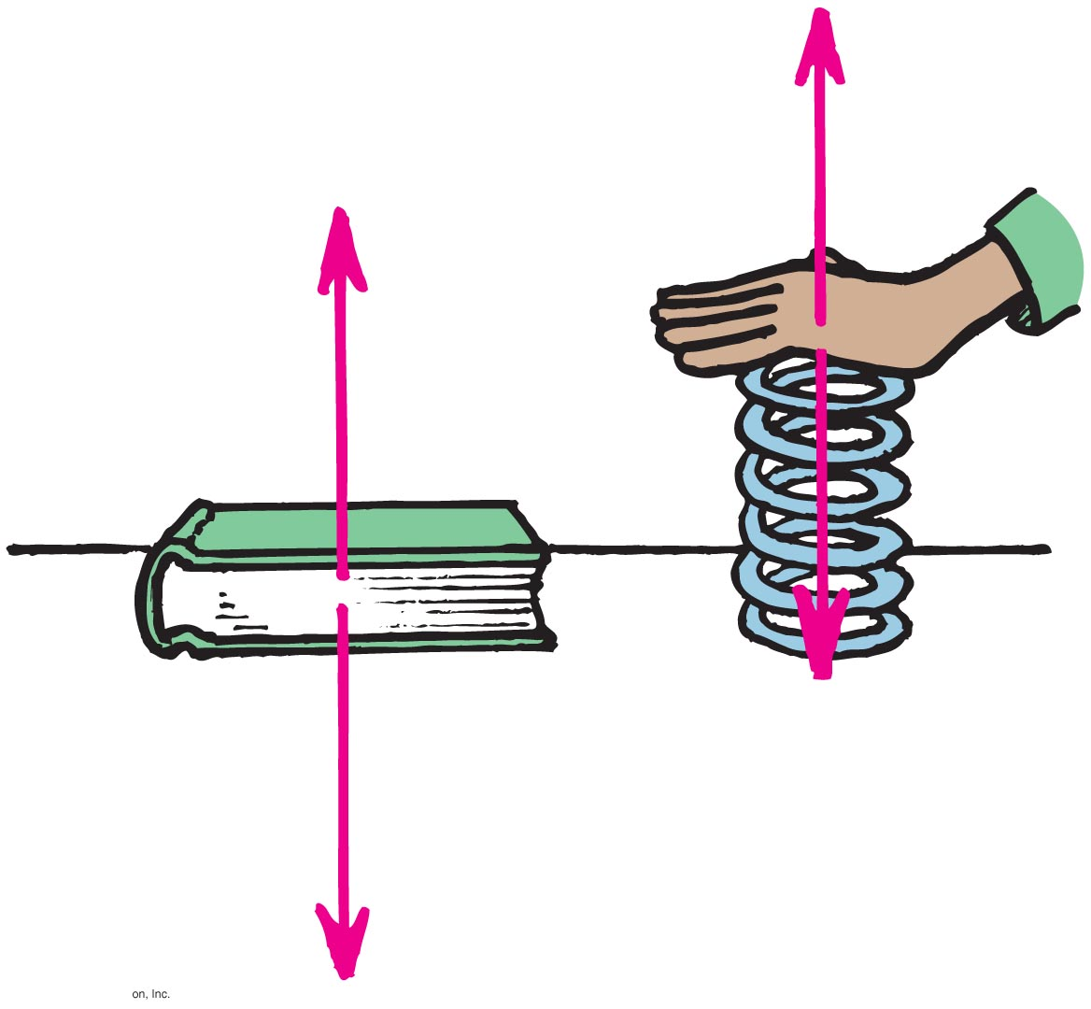
Understanding Normal Force
When you push down on a spring, the spring pushes back up on you.
Similarly, when a book pushes down on a table, the table pushes back up on the book.

Slide 35
Equilibrium of Moving Things
Equilibrium: a state of no change with no net force acting
  Static equilibrium
  Example: hockey puck at rest on slippery ice
  Dynamic equilibrium
  Example: hockey puck sliding at constant speed on slippery ice

Slide 36
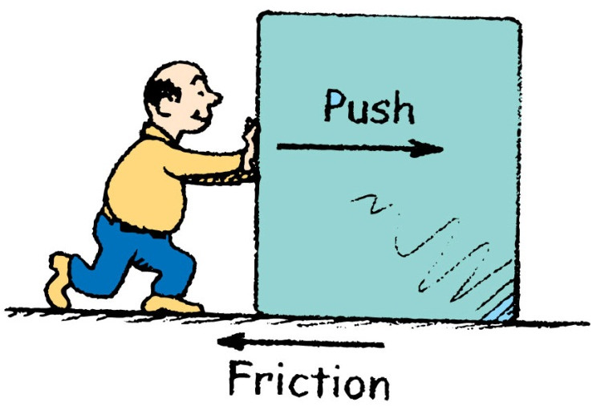
Equilibrium of Moving Things
A man pushes a crate with a force to the right.
The downward gravity force is balanced by an upward normal force.
normal
push
gravity
Can this crate move at a constant velocity?
Yes
No, there must be another force involved.

Slide 37

Equilibrium of Moving Things
Equilibrium test: whether something undergoes changes in motion
  Example: A crate at rest is in static equilibrium.
  Example: When pushed at a steady speed, it is in dynamic equilibrium.

Slide 38
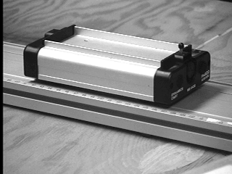
1
Newton’s First Law
The natural state of an object with no net external force on it is to either remain at rest or continue to move in a straight line with a constant velocity.

Slide 39
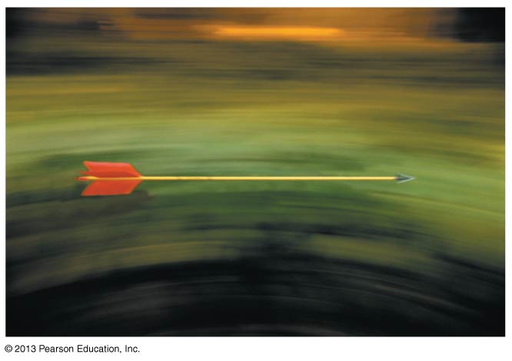
Thinking About Force
Forces exist due to interactions happening now, not due to what happened in the past
Consider a flying arrow
A pushing force was required to accelerate the arrow as it was shot
However, no force is needed to keep the arrow moving forward as it flies
It continues to move because of inertia

Slide 40
The Reference Frame of a Moving Car
Is it possible to juggle in a car that is moving at 100 km/h on the highway?
Yes!
Velocity is relative.
If your laboratory is enclosed inside the back of a truck with no windows, there is no experiment you can do to determine whether the truck is at rest or moving along the highway at a steady speed.

