Slide 1
Note on Posted Slides
These are the slides that I intended to show in class on Mon. Jan. 14, 2013.
They contain important ideas and questions from your reading.
Due to time constraints, I was probably not able to show all the slides during class.
They are all posted here for completeness.

Slide 2
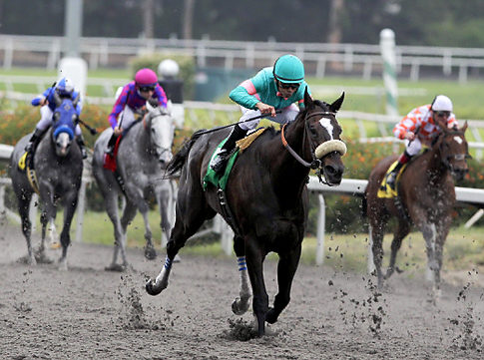
PHY205H1S
Physics of Everyday Life
Class 3
Force Causes Acceleration
Friction
Mass and Weight
Mass Resists Acceleration
Newton’s Second Law of Motion
Free Fall
Non-Free Fall

Slide 3
Chapter 4 Pre-Class Reading Question
The unit of mass is the kilogram. What is the unit of weight?
m/s²
the newton
metric mass
the kilogram also
the joule

Slide 4
Chapter 4 Pre-Class Reading Question
A constant net force acts on an object. What about the object must be changing as a result?
position
velocity
acceleration
All of the above
A and B, but not C

Slide 5

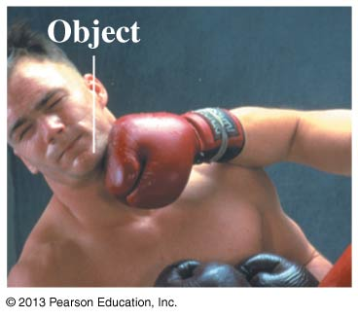
Review from Class 1: What is a force?
A force is a push or a pull
A force acts on an object
Pushes and pulls are applied to something
From the object’s perspective, it has a force exerted on it
The S.I. unit of force is the Newton (N)
1 N = 1 kg m s^{–2}

Slide 6
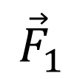
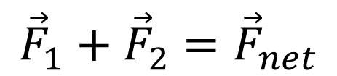
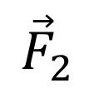
Net Force
Net force is the combination of all forces that change an object’s state of motion.
Net force is the vector sum of all the forces acting on an object.
$${\vec{F}}_{1}$$
$${{\vec{F}}_{1}+{\vec{F}}_{2}=\vec{F}}_{net}$$
$${\vec{F}}_{2}$$

Slide 7

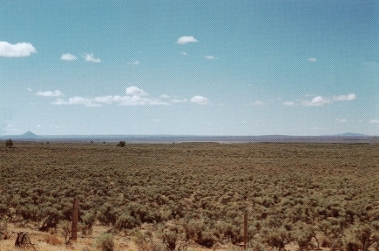
The Force of Gravity – a.k.a. Weight
Weight = mg
g = 10 m/s²
The direction of the weight is toward the centre of the earth.
Weight is measured in newtons.
“The Earth exerts a gravity force on the angry bird.”

Slide 8

Normal Force – a.k.a. Support Force
“The diving board exerts a normal force on the dog.”

Slide 9
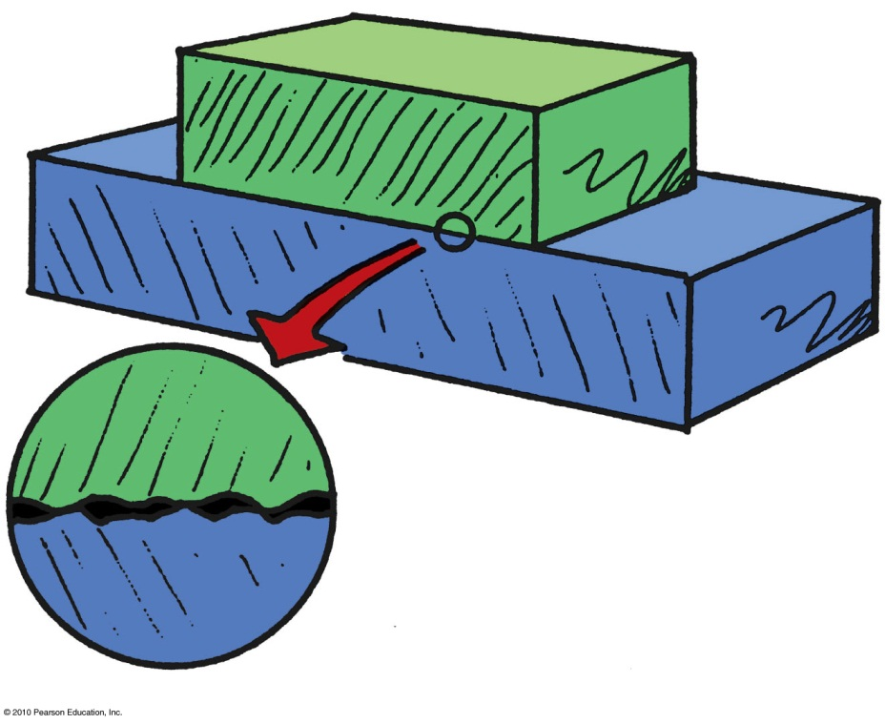
The Force of Friction
depends on the kinds of material and how much they are pressed together.
is due to tiny surface bumps and to “stickiness” of the atoms on a material’s surface.
Example: Friction between a crate on a smooth wooden floor is less than that on a rough floor.

Slide 10
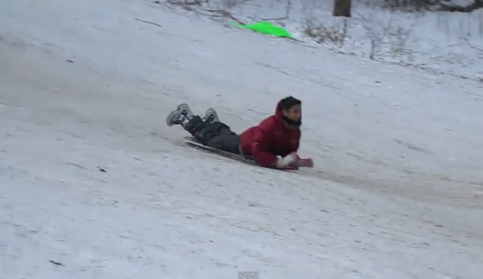
Sliding Friction
“The ground exerts a sliding friction force on Suleyman.”

Slide 11
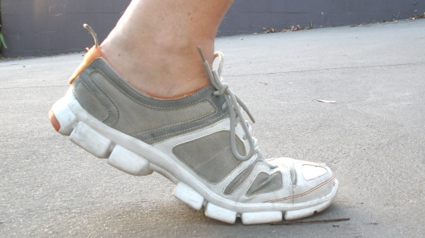
Static Friction
“The ground exerts a static friction force on the shoe.”

Slide 12
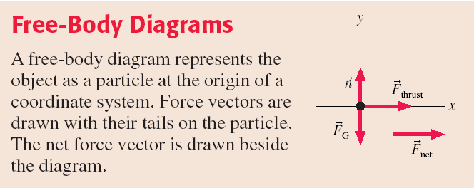

Slide 13
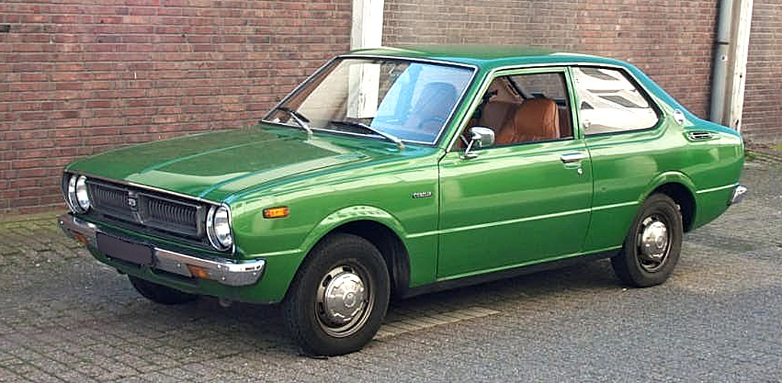
Multiple Forces on a Single Object
A car is parked on flat, horizontal pavement.
Which of the following forces are acting on the car?
Gravity
Normal
Static friction
All of the above
A and B, but not C

Slide 14
The Net Force
A car is parked on flat, horizontal pavement.
The “net force” is the vector sum of all the forces on the car.
What is the direction of the net force on the car?
Up
Down
The net force is zero

Slide 15
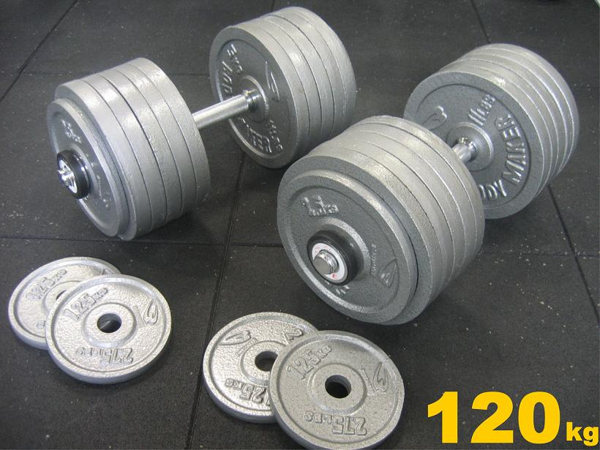
What is Mass?
Mass is a scalar quantity that describes an object’s inertia.
The unit of mass is kg
It describes the amount of matter in an object.
Mass is an intrinsic property of an object.
It tells us something about the object, regardless of where the object is, what it’s doing, or whatever forces may be acting on it.

Slide 16
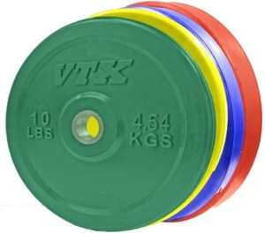
Mass and Weight
1 kilogram weighs 10 newtons
(9.8 newtons to be precise).
Relationship between kilograms and pounds:
1 kg weighs 2.2 lb = 10 N at Earth’s surface
1 lb = 4.45 N
4.54 kg weighs 10 lbs

Slide 17
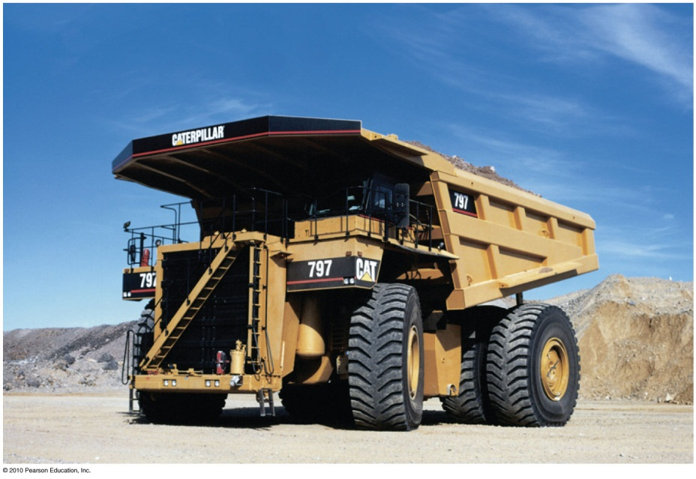
Mass Resists Acceleration
The same force applied to
Twice the mass produces half the acceleration.
3 times the mass, produces 1/3 the acceleration.
Acceleration is inversely proportional to mass.

Slide 18
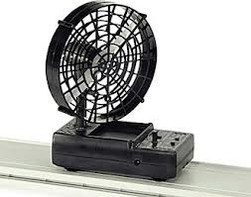
2
Newton’s Second Law
The acceleration of an object is directly proportional to the net force acting on it, and inversely proportional to its mass.

Slide 19
A fan attached to a cart causes it to accelerate at 2 m/s².
Suppose the same fan is attached to a second cart with smaller mass.
The mass of the second cart plus fan is half the mass of the first cart plus fan. The acceleration of the second cart is
16 m/s².
8 m/s².
4 m/s².
2 m/s².
1 m/s².
Notes:
Answer: D

Slide 20

Example
Chapter 4, Problem 7
A rock band’s tour bus of mass M is accelerating away from a stop sign at a rate of 1.2 m/s².
Suddenly a piece of heavy metal, mass M/6, falls onto the top of the bus and remains there.
What is the acceleration of the bus + metal?

Slide 21
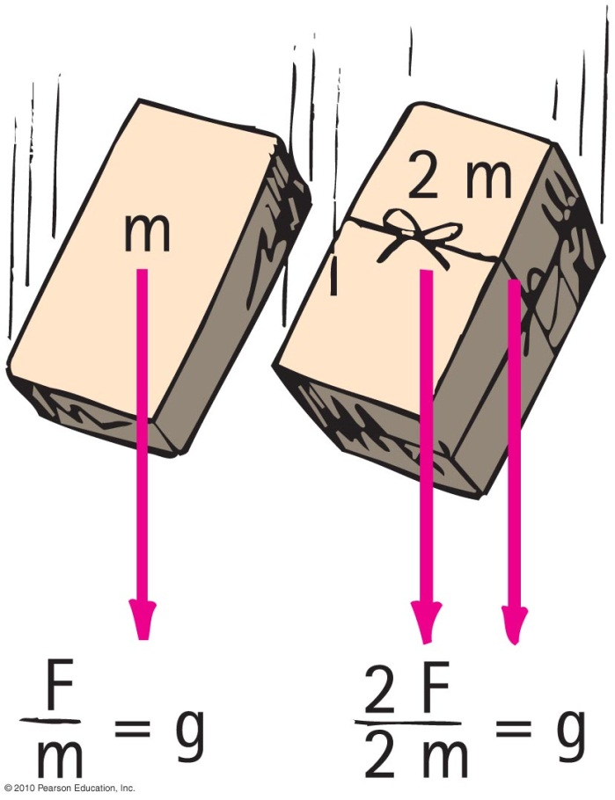
Free Fall
The greater the mass of the object…
the greater its force of attraction toward the Earth.
the smaller its tendency to move i.e., the greater its inertia.
So, the acceleration is the same.
It is equal to the acceleration due to gravity: 10 m/s²
(precisely 9.8 m/s²).

Slide 22
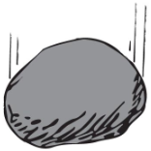
Free Fall
When acceleration is g—free fall
Newton’s second law provides an explanation for the equal accelerations of freely falling objects of various masses.
Acceleration is equal when air resistance is negligible.
Acceleration depends on force (weight) and inertia.

Slide 23
A 600 g basketball and a 60 g tennis ball are dropped from rest at a height of 3 m above the ground. As they fall to the ground, air resistance is negligible.
Which of the following statements is true for the balls as they fall?
Free Fall
CHECK YOUR NEIGHBOR
The force of gravity is 10 times greater on the basketball than on the tennis ball
The force of gravity is the same on both balls
The force of gravity is slightly larger on the basketball than on the tennis ball
Notes:
B. the same.

Slide 24
A 600 g basketball and a 60 g tennis ball are dropped from rest at a height of 3 m above the ground. As they fall to the ground, air resistance is negligible.
Which of the following statements is true for the balls as they fall?
Free Fall
CHECK YOUR NEIGHBOR
The acceleration of the basketball is 10 times greater than the acceleration of the tennis ball
The acceleration of both balls is the same
The acceleration of the basketball is slightly larger than the acceleration of the tennis ball
Notes:
B. the same.

Slide 25
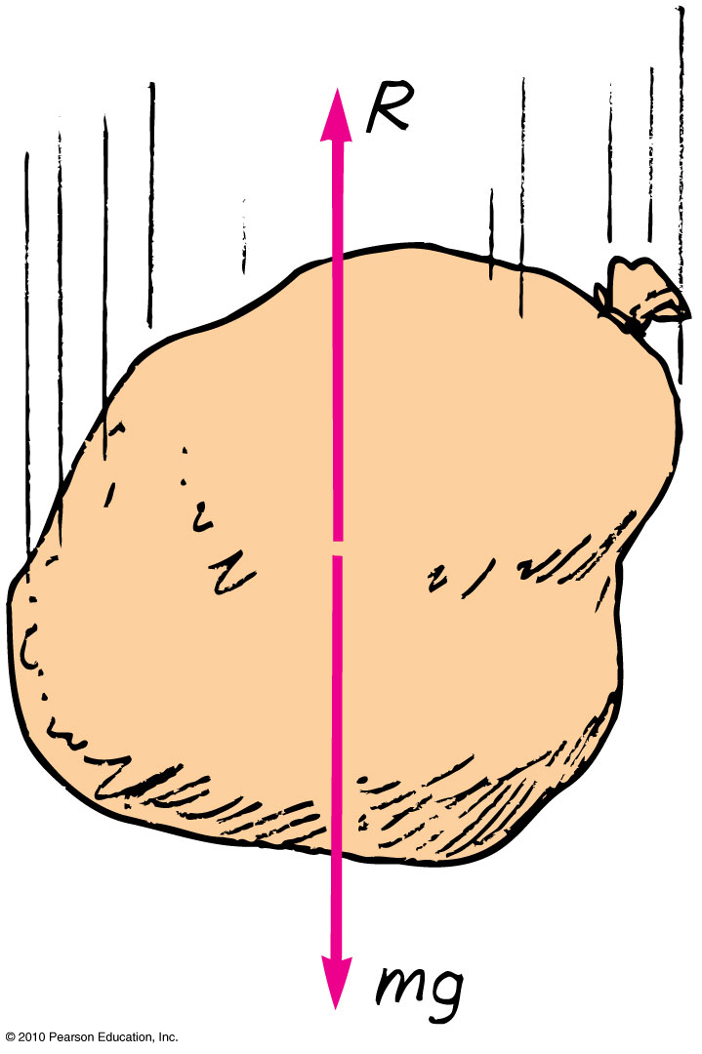
Non-Free Fall
When an object falls downward through the air it experiences:
force of gravity pulling it downward.
air drag force acting upward.
R depends on the speed of the object relative to the air, and the size of the object

Slide 26
Air Resistance – the nitty gritty
Air resistance, or drag, is complex and involves fluid dynamics.
For most objects flying through the air that we encounter, there is an approximate equation which predicts the magnitude of air resistance:
where A is the cross-sectional area of the object, ρ is the density of the air, C is called the drag coefficient, and v is the speed.
The direction of air resistance is opposite to the direction of motion relative to the air.
It depends on the size and shape of the object, and its speed, but not its mass.

Slide 27
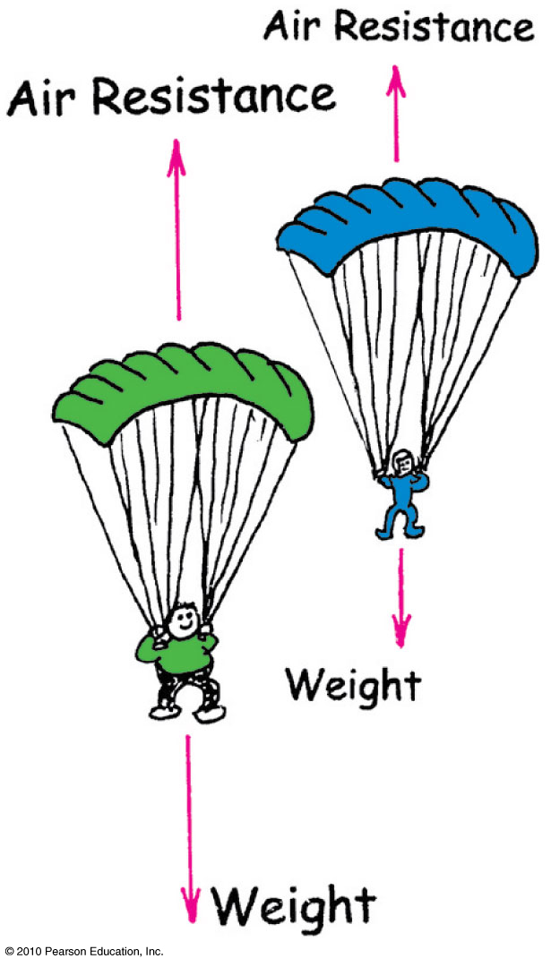
Terminal Speed
R increases with speed
Net force goes to zero when the object is moving fast enough so that R = mg (air resistance = weight)
Then no net force
  No acceleration
  Velocity does not change

Slide 28
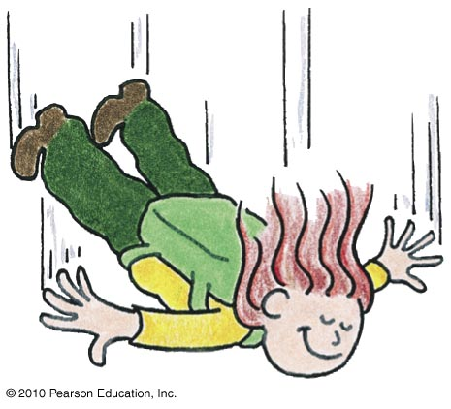
Non-Free Fall—Example
A skydiver jumps from plane.
Weight is the only force until air resistance acts.
As falling speed increases, air resistance on diver builds up, net force is reduced, and acceleration becomes less.
When air resistance equals the diver’s weight, net force is zero and acceleration terminates.
Diver reaches terminal velocity, then continues the fall at constant speed.

Slide 29
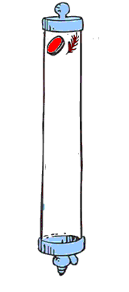
Free Fall vs. Non-Free Fall
Coin and feather fall with air present
Feather reaches terminal velocity very quickly and falls slowly at constant speed, reaching the bottom after the coin does.
Coin falls very quickly and air resistance
doesn’t build up to its weight over
short-falling distances, which is why
the coin hits the bottom much sooner
than the falling feather.

Slide 30
Free Fall vs. Non-Free Fall
Coin and feather fall in vacuum
There is no air, because it is vacuum.
So, no air resistance.
Coin and feather fall together.

Slide 31

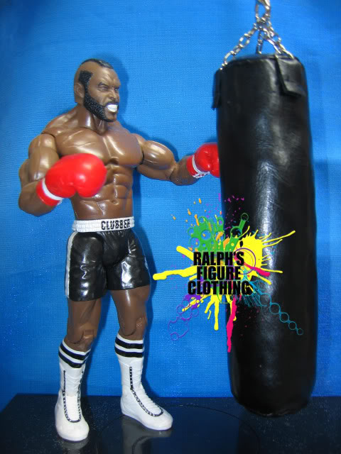
Before Class 4 on Wednesday
Please read Chapter 5, or at least watch the 10-minute pre-class video for class 4
Something to think about:
A boxer can hit a heavy bag with great force. Why can’t he hit a piece of tissue paper in midair with the same amount of force?

