Slide 1
Conceptual Physics 11th Edition
Chapter 5:
NEWTON’S THIRD LAW OF MOTION
Forces and Interactions
Newton’s Third Law of Motion
Vectors

Slide 2
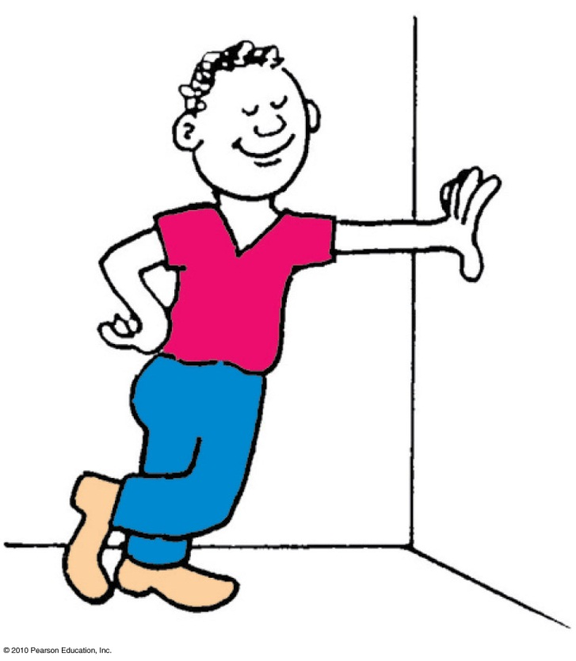
Forces and Interactions
Interaction
is between one thing and another.
requires a pair of forces acting on two objects.
Example: interaction of hand and wall pushing on each other
Force pair—you push on wall; wall pushes on you.

Slide 3
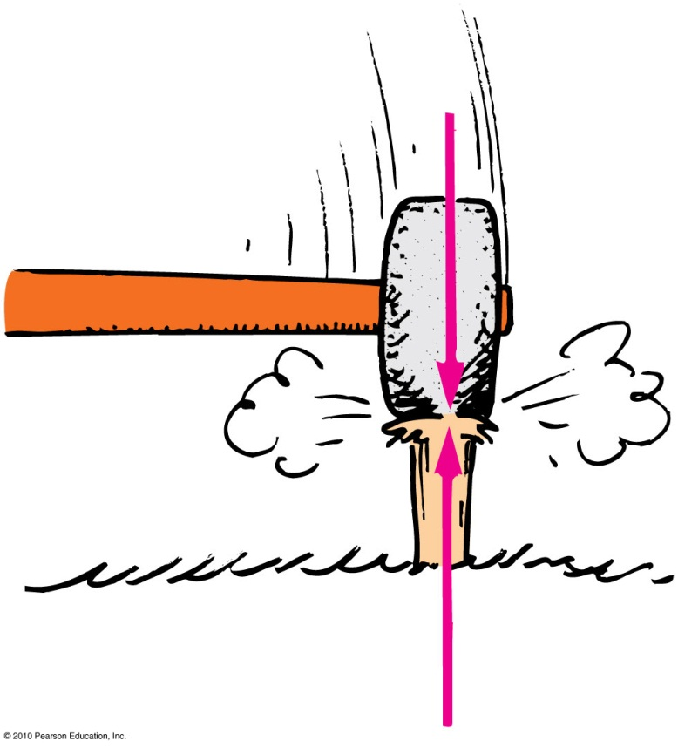
Newton’s Third Law of Motion
Whenever one object exerts a force on a second object, the second object exerts an equal and opposite force on the first.

Slide 4
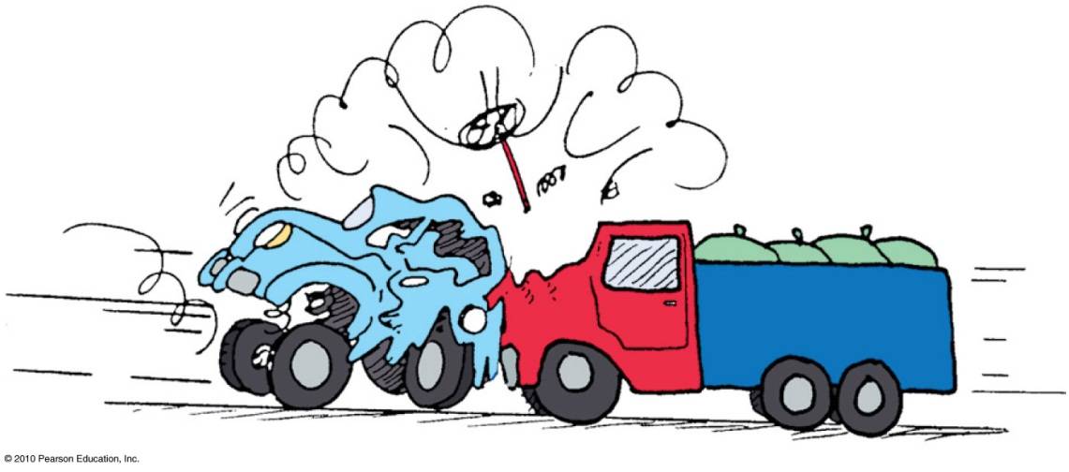
Action and reaction forces
one force is called the action force; the other force is called the reaction force.
are co-pairs of a single interaction.
neither force exists without the other.
are equal in strength and opposite in direction.
always act on different objects.

Slide 5
Reexpression of Newton’s third law: To every action there is always an opposed equal reaction.
Example: Tires of car push back against the road while the road pushes the tires forward.

Slide 6
Simple rule to identify action and reaction
Identify the interaction—one thing interacts with another
Action: Object A exerts a force on object B.
Reaction: Object B exerts a force on object A.
Example: Action—rocket (object A) exerts force on gas (object B).
Reaction—gas (object B) exerts force on rocket (object A).

Slide 7
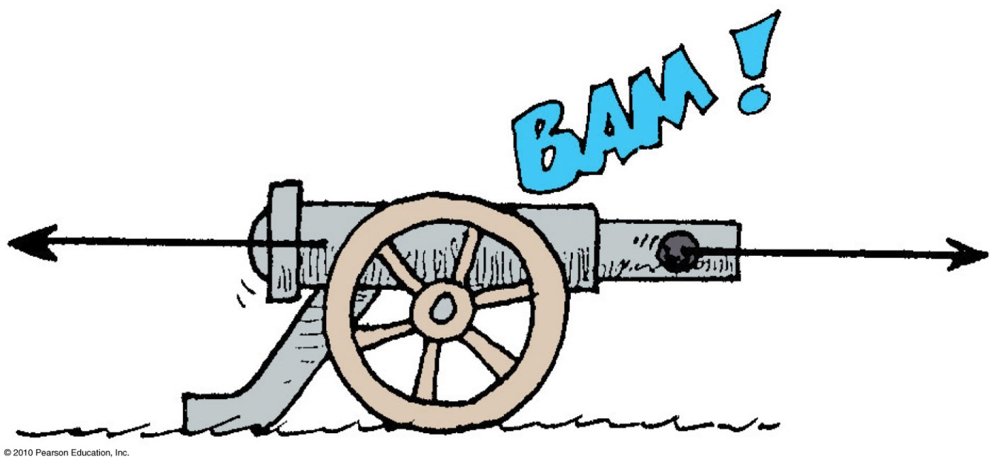
Action and Reaction on Different Masses
Cannonball:
Cannon:
The same force exerted on a small mass produces a large acceleration.
The same force exerted on a large mass produces a small acceleration.
F
= a
m
F
m
= a

Slide 8
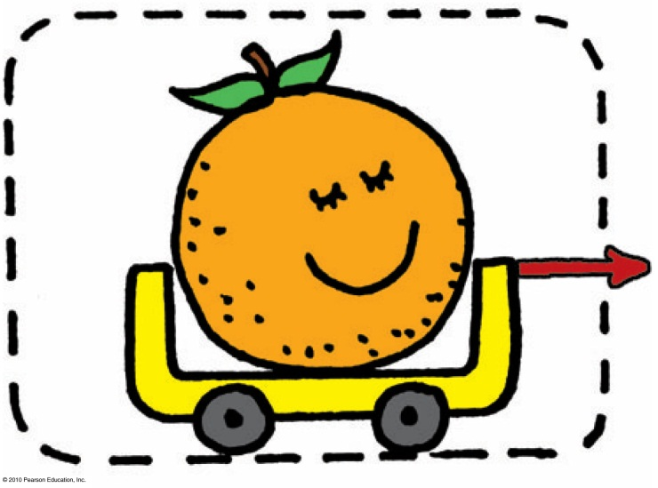
Defining Your System
Consider a single enclosed orange.
Applied external force causes the orange to accelerate in accord with Newton’s second law.
Action and reaction pair of forces is not shown.

Slide 9
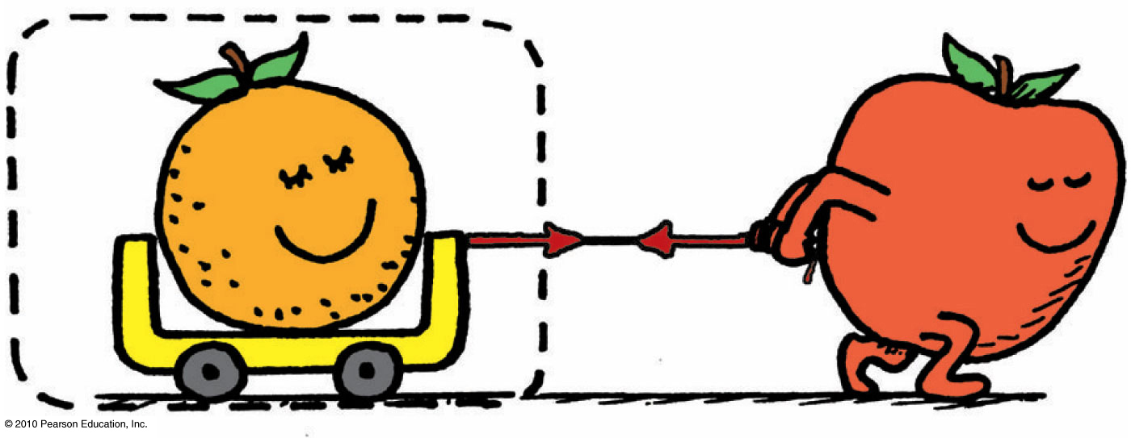
Consider the orange and the apple pulling on it.
Action and reaction do not cancel (because they act on different things).
External force by apple accelerates the orange.

Slide 10
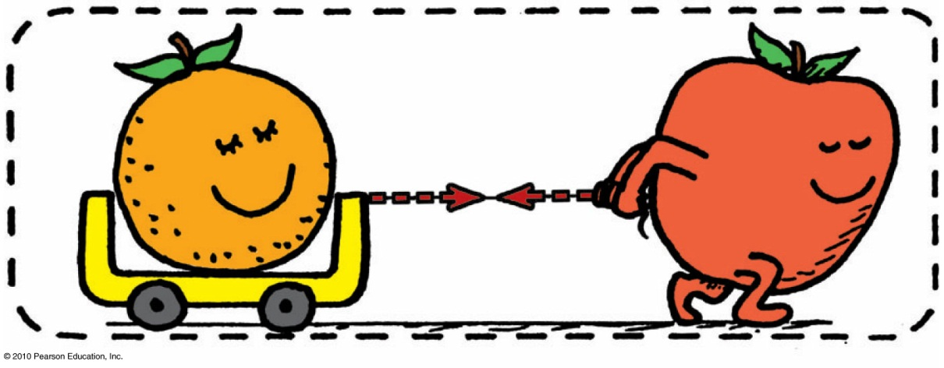
Consider a system comprised of both the orange and the apple
The apple is no longer external to the system.
Force pair is internal to system, which doesn’t cause acceleration.
Action and reaction within the system cancel.
With no external forces, there is no acceleration of system.

Slide 11
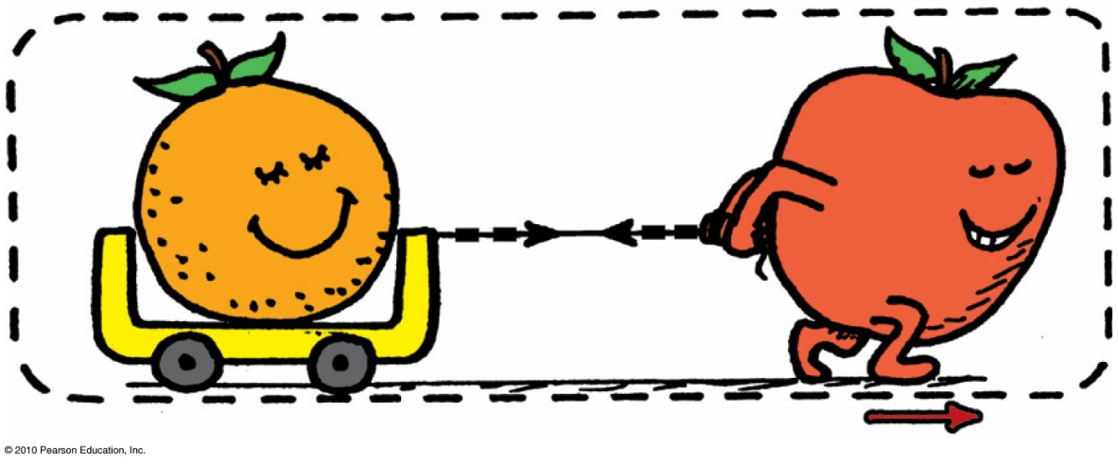
Consider the same system, but with external force of friction on it.
Same internal action and reaction forces (between the orange and apple) cancel.
A second pair of action-reaction forces (between the apple’s feet and the floor) exists.

Slide 12
One of these acts by the system (apple on the floor) and the other acts on the system (floor on the apple).
External frictional force of floor pushes on the system, which accelerates.
Second pair of action and reaction forces do not cancel.

Slide 13
Vectors & Scalars
Vector quantity
has magnitude and direction.
is represented by an arrow.
Example: velocity, force, acceleration
Scalar quantity
has magnitude.
Example: mass, volume, speed

Slide 14
Vector Addition
The sum of two or more vectors
For vectors in the same direction, add arithmetically.
For vectors in opposite directions, subtract arithmetically.
Two vectors that don’t act in the same or opposite direction:
use parallelogram rule.
Two vectors at right angles to each other
use Pythagorean Theorem: R² = V ² + H ².

Slide 15
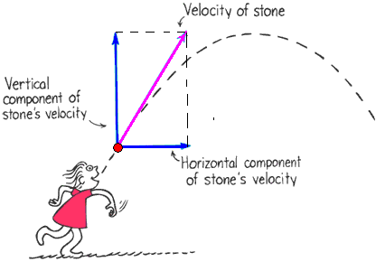
Vector components
Vertical and horizontal components of a vector are perpendicular to each other
The components add to give the actual vector

Slide 16
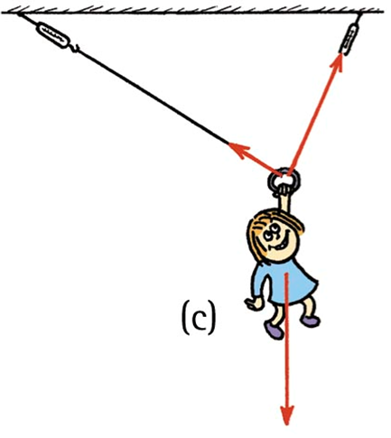
Vectors
Nellie Newton hangs from a rope as shown.
Which side has the greater tension?
There are three forces acting on Nellie:
her weight,
a tension in the left-hand side of the rope,
and a tension in the right-hand side of the rope.

Slide 17
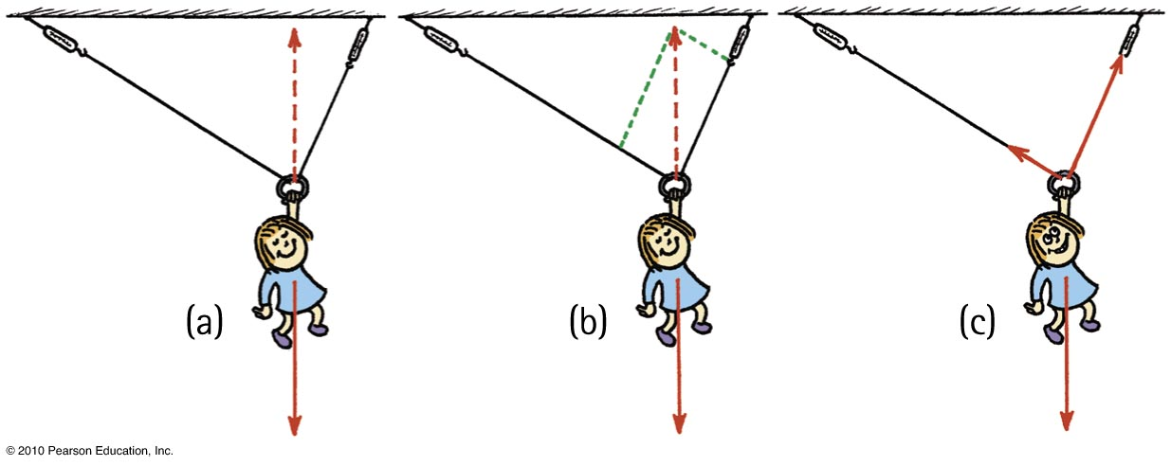
Because of the different angles, different rope tensions will occur in each side.
Nellie hangs in equilibrium, so her weight is supported by two rope tensions, adding vectorially to be equal and opposite to her weight.
The parallelogram rule shows that the tension in the right-hand rope is greater than the tension in the left-hand rope.

