Slide 1
Note on Posted Slides
These are the slides that I intended to show in class on Wed. Jan. 16, 2013.
They contain important ideas and questions from your reading.
Due to time constraints, I was probably not able to show all the slides during class.
They are all posted here for completeness.

Slide 2
PHY205H1S Physics of Everyday Life Class 4
Forces and Interactions
Newton’s Third Law of Motion
Vectors

Slide 3
Chapter 5 Pre-Class Reading Question
A boxer cannot exert much force on a piece of tissue paper suspended in air because
the time of the interaction is too brief
there is little follow-through with the punch
the tissue lacks enough strength
the tissue paper has too little mass to exert much force on the boxer's fist

Slide 4
Chapter 5 Pre-Class Reading Question
In the apple-pulling-the-orange sequence in this chapter, what is the force that accelerates the system across the floor?
The backward pull by the orange
Friction between the apple and the floor
The resistance to motion by the orange
Internal forces

Slide 5
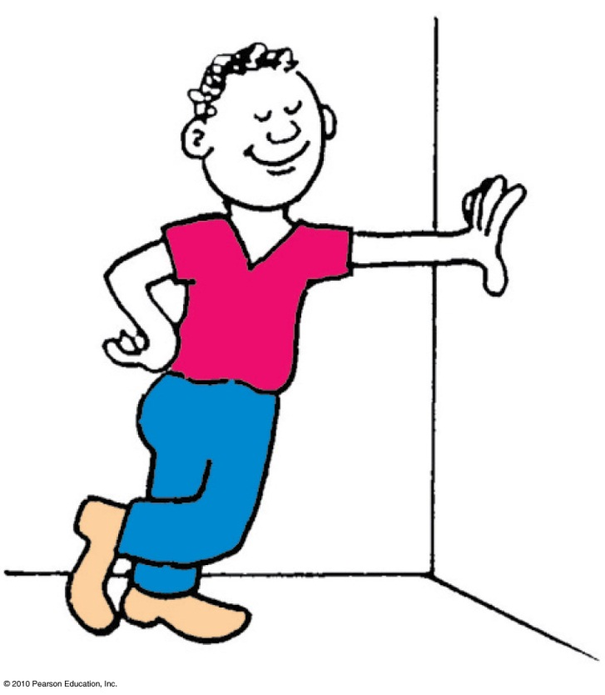
Forces and Interactions
Interaction
is between one thing and another.
requires a pair of forces acting on two objects.
Example: interaction of hand and wall pushing on each other
Force pair—you push on wall; wall pushes on you.

Slide 6
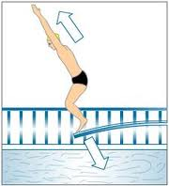
3
Newton’s Third Law
If object 1 acts on object 2 with a force, then object 2 acts on object 1 with an equal force in the opposite direction.

Slide 7
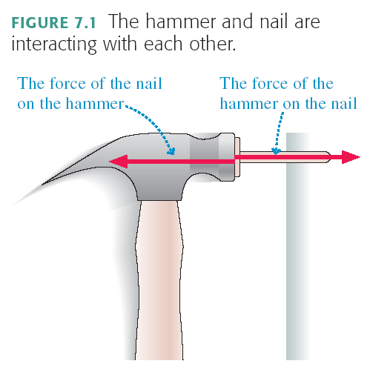

Slide 8
A Mack Truck drives North on the highway, and collides head-on with a mosquito. Which is true?
The Mack Truck exerts a greater force on the mosquito than the mosquito exerts on the Mack Truck.
The mosquito exerts a greater force on the Mack Truck than the Mack Truck exerts on the mosquito.
The Mack Truck exerts the same force on the mosquito as the mosquito exerts on the Mack Truck.
Impossible to determine without knowing the speeds of the truck and mosquito.
Don’t know or none of the above

Slide 9
A Mack Truck drives North on the highway, and collides head-on with a mosquito. Which is true?
The Mack Truck does more damage to the mosquito than the mosquito does to the Mack Truck.
The mosquito does more damage to the Mack Truck than the Mack Truck does to the mosquito.
The Mack Truck does the same amount of damage to the mosquito as the mosquito does to the Mack Truck.
Impossible to determine without knowing the speeds of the truck and mosquito.
Don’t know or none of the above

Slide 10
F = ma or a = F / m
If the force is equal on the truck and the mosquito, is the acceleration equal?
Acceleration is higher if m is lower ( F divided by m)
Mosquito accelerates more, so it receives more damage.

Slide 11
The entire Earth accelerates toward the Moon, due to this pulling force.
To find the total acceleration, you use the force as calculated for the centre-to-centre distance.
Since F_{G} = GMm/r², the force on the ocean nearer to the moon will be greater, so it will accelerate more than the rest of the Earth, bulging out.

Slide 12
Similarly, since F_{G} = GMm/r², the force on the ocean further from the moon will be less, so it will accelerate less than the rest of the Earth, remaining behind, forming a bulge.
In general, tidal effects tend to stretch objects both toward and away from the object causing the tides.

Slide 13
Simple rule to identify action and reaction
Identify the interaction—one thing interacts with another
Action: Object A exerts a force on object B.
Reaction: Object B exerts a force on object A.
Example: Action—rocket (object A) exerts force on gas (object B).
Reaction—gas (object B) exerts force on rocket (object A).

Slide 14
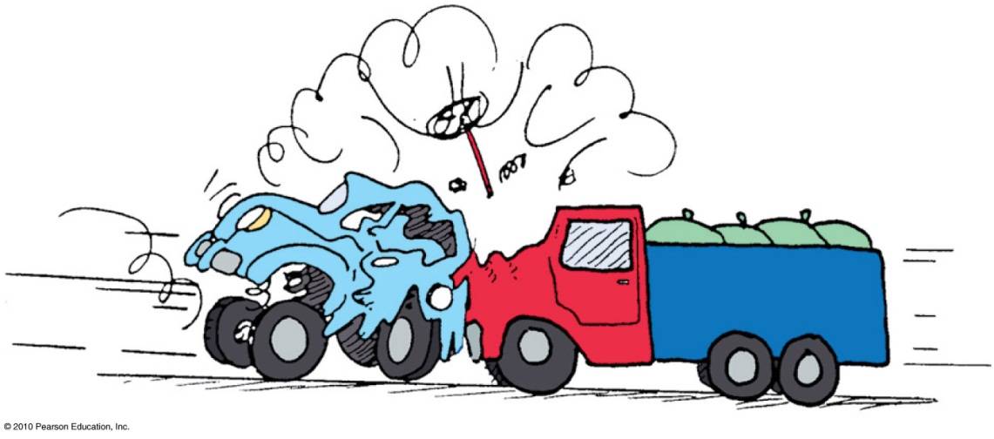
Action and reaction forces
one force is called the action force; the other force is called the reaction force.
are co-pairs of a single interaction.
neither force exists without the other.
are equal in strength and opposite in direction.
always act on different objects.

Slide 15
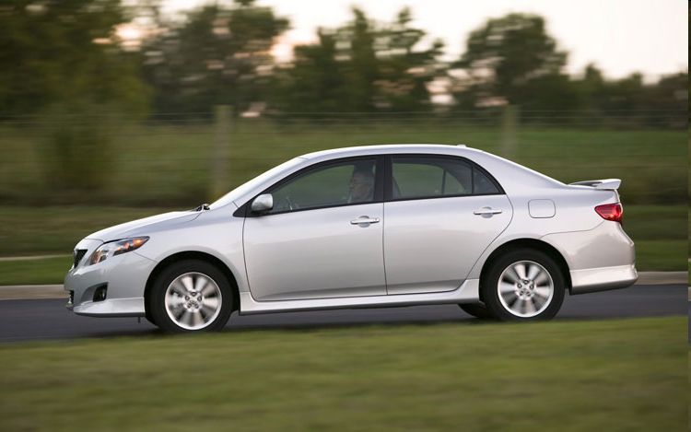
Identifying Action / Reaction Pairs
Consider an accelerating car.
Action: tire pushes on road.
Reaction: road pushes on tire

Slide 16
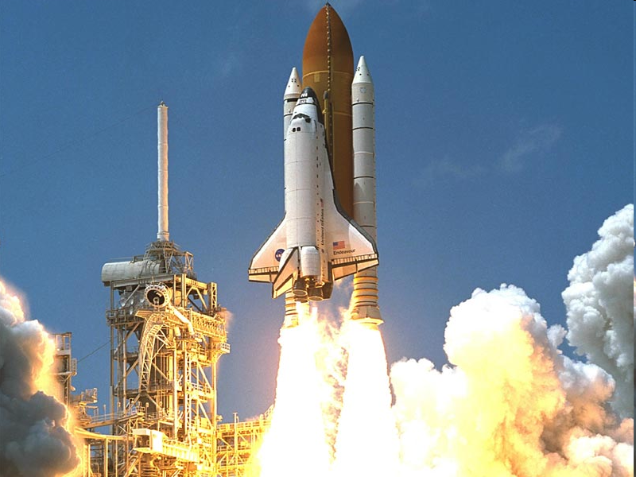
Identifying Action / Reaction Pairs
Consider a rocket accelerating upward.
Action: rocket pushes on gas.
Reaction: gas pushes on rocket

Slide 17
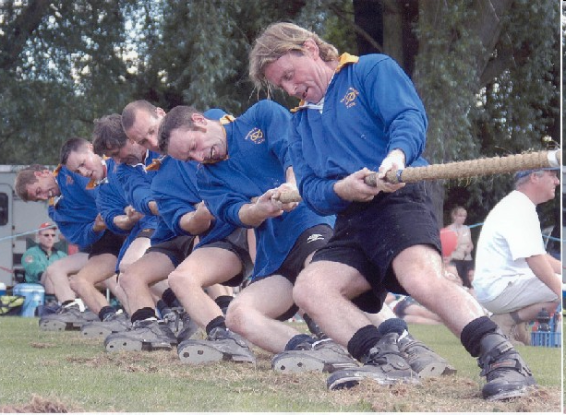
Identifying Action / Reaction Pairs
Action force: man pulls on rope to the left.
Reaction force?
Feet push on ground to the right.
Ground pushes on feet to the left.
Rope pulls on man to the right.
Gravity of Earth pulls man down.
Gravity of man pulls Earth up.

Slide 18
Identifying Action / Reaction Pairs
Consider a stationary man pulling a rope.
Action: man pulls on rope
Reaction: rope pulls on man

Slide 19
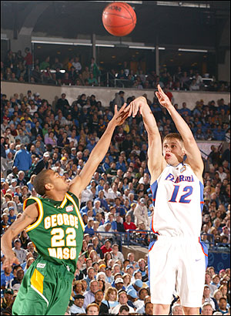
Identifying Action / Reaction Pairs
Consider a basketball in freefall.
Action force: gravity of Earth pulls ball down.
Reaction force?
Feet push ground down.
Ground pushes feet up.
Gravity of Earth pulls man down.
Gravity of ball pulls Earth up.
Air pushes ball up.

Slide 20
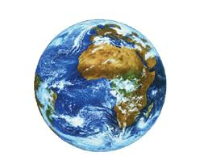
Identifying Action / Reaction Pairs
F
a =
m
m
F
a =
Consider a basketball in freefall.
Action: Earth pulls on ball
Reaction: ball pulls on Earth

Slide 21
Ride the MP Elevator!
In the corner of every elevator in the tower part of this building, there is a mass hanging on a spring.
If you look closely at the spring, it has a scale which reads Newtons.
This is how much upward force is needed to support the hanging mass.
In your next tutorial you will be going with your team to look more carefully at this scale, and record how it changes as the elevator accelerates!

Slide 22
Example: Chapter 5, Problem 1
A boxer punches a piece of kleenex in midair and brings it from rest up to a speed of 25 m/s in 0.05 s.
(a) What acceleration does the kleenex have while being punched?
(b) If the mass of the kleenex is 0.003 kg, what force does the boxer exert on it?
(c) How much force does the paper exert on the boxer?

Slide 23
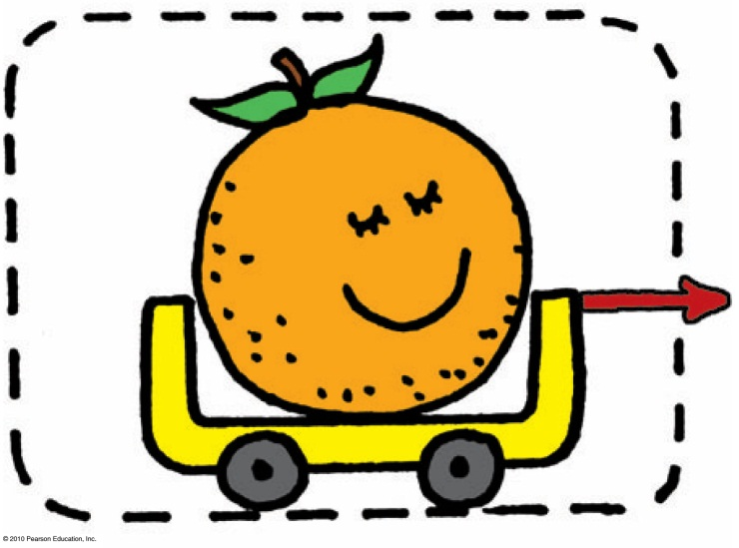
Defining Your System
Consider a single enclosed orange.
Applied external force causes the orange to accelerate in accord with Newton’s second law.
Action and reaction pair of forces is not shown.

Slide 24
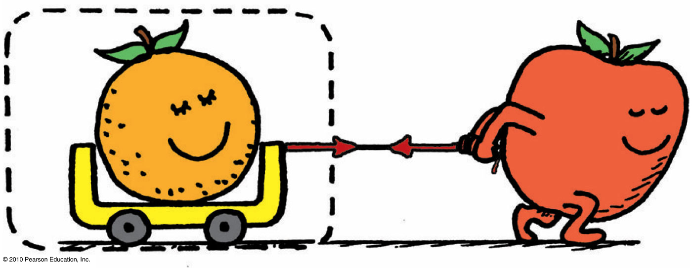
Consider the orange and the apple pulling on it.
Action and reaction do not cancel (because they act on different things).
External force by apple accelerates the orange.

Slide 25
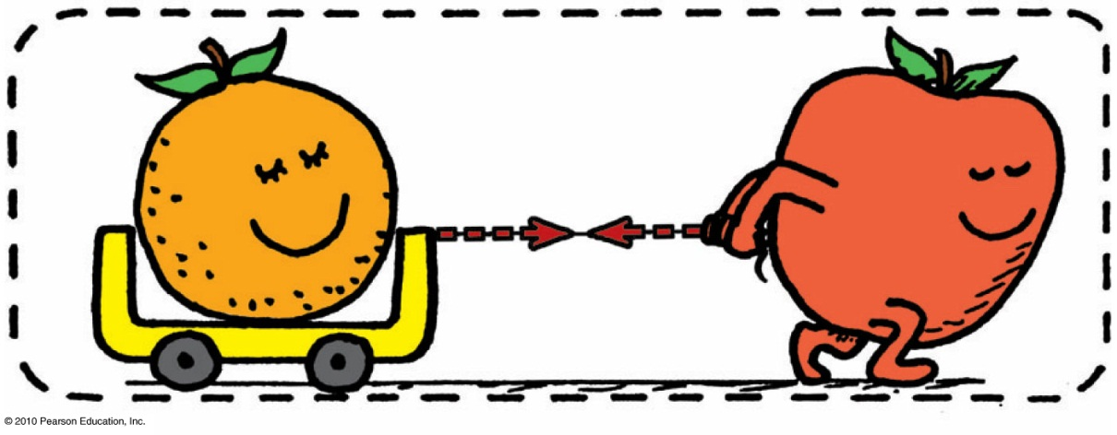
Consider a system comprised of both the orange and the apple
The apple is no longer external to the system.
Force pair is internal to system, which doesn’t cause acceleration.
Action and reaction within the system cancel.
With no external forces, there is no acceleration of system.

Slide 26
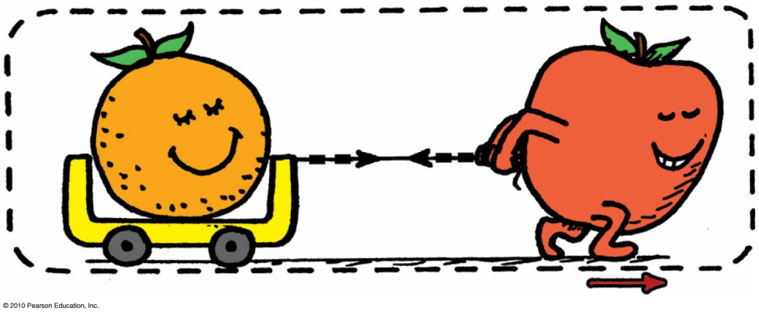
Consider the same system, but with external force of friction on it.
Same internal action and reaction forces (between the orange and apple) cancel.
A second pair of action-reaction forces (between the apple’s feet and the floor) exists.

Slide 27
One of these acts by the system (apple on the floor) and the other acts on the system (floor on the apple).
External frictional force of floor pushes on the system, which accelerates.
Second pair of action and reaction forces do not cancel.

Slide 28
A bird flies by
Newton’s Third Law
CHECK YOUR NEIGHBOR
A. flapping its wings.
pushing air down so that the air pushes it upward.
hovering in midair.
inhaling and exhaling air.
Notes:
B. pushing air down so that the air pushes the bird upward.

Slide 29
Slightly tilted wings of airplanes deflect
Newton’s Third Law
CHECK YOUR NEIGHBOR
A. oncoming air downward to produce lift.
oncoming air upward to produce lift.
Both A and B.
Neither A nor B.
Notes:
A. oncoming air downward to produce lift.

Slide 30
Summary of Newton’s Three Laws of Motion
Newton’s first law (the law of inertia)
An object at rest tends to remain at rest; an object in motion tends to remain in motion at constant speed along a straight-line path.
Newton’s second law (the law of acceleration)
When a net force acts on an object, the object will accelerate. The acceleration is directly proportional to the net force and inversely proportional to the mass.
Newton’s third law (the law of action and reaction)
Whenever one object exerts a force on a second object, the second object exerts an equal and opposite force on the first.

Slide 31
Vectors & Scalars
Vector quantity
has magnitude and direction.
is represented by an arrow.
Example: velocity, force, acceleration
Scalar quantity
has magnitude.
Example: mass, volume, speed

Slide 33
Vector Addition
The sum of two or more vectors
For vectors in the same direction, add arithmetically.
For vectors in opposite directions, subtract arithmetically.
Two vectors that don’t act in the same or opposite direction:
use parallelogram rule.
Two vectors at right angles to each other
use Pythagorean Theorem: R² = V ² + H ².

Slide 34
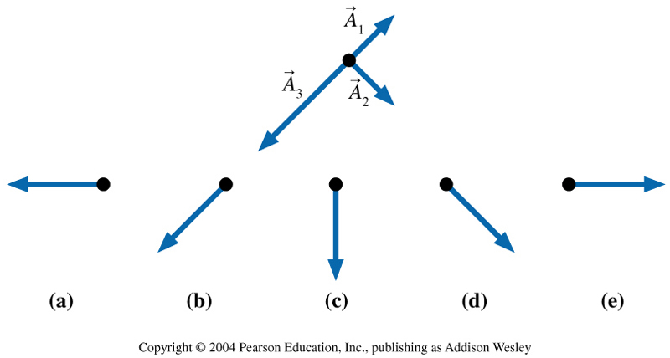
Which figure shows ?
Notes:
Answer C

Slide 35
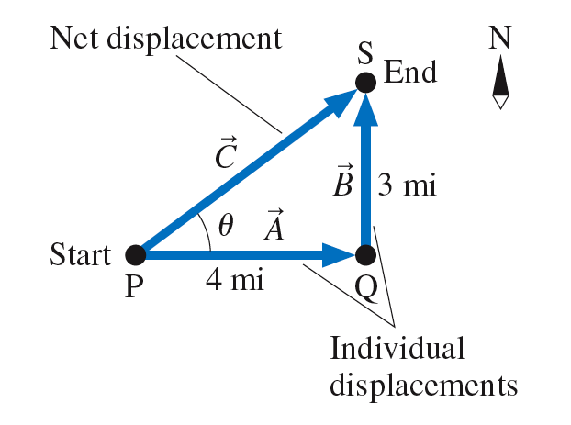

Slide 36
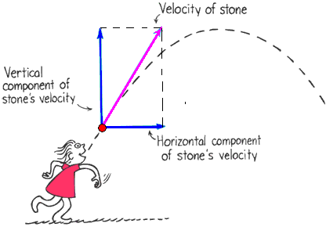
Vector components
Vertical and horizontal components of a vector are perpendicular to each other
The components add to give the actual vector

Slide 37
You run horizontally at 4 m/s in a vertically falling rain that falls at 4 m/s. Relative to you, the raindrops are falling at an angle of
Vectors
CHECK YOUR NEIGHBOR
A. 0°.
45°.
53°.
90°.
Notes:
B. 45°.

Slide 38
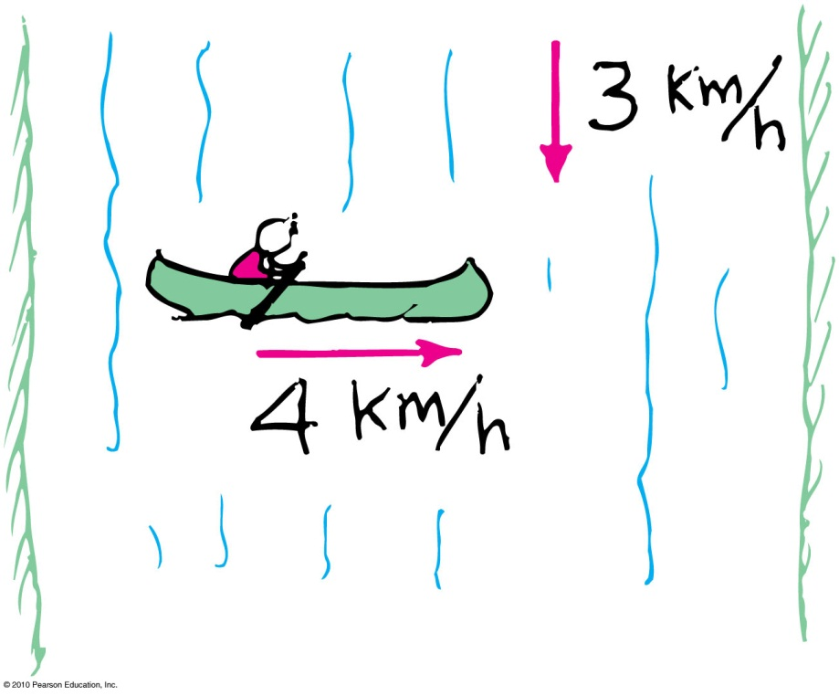
Example: Chapter 5, Problem 6
You are paddling a canoe at a speed of 4 km/h directly across a river that flows at 3 km/h, as shown.
(a) What is your resultant speed relative to the shore
(b) In approximately what direction should you paddle the canoe so that it reaches a destination directly across the river?

Slide 39
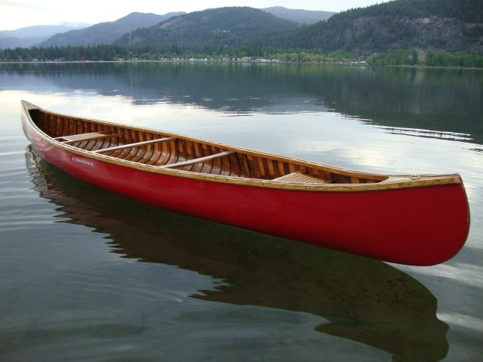
Before Class 5 on Monday
Please read Chapter 6, or at least watch the 10-minute pre-class video for class 5
Something to think about:
Imagine you are trapped in a canoe in the middle of a still lake with no paddles. There is a large pile of heavy rocks in the canoe. If you start throwing rocks, can you propel the canoe this way? If so, and you want to get to shore, which way should you throw the rocks?
[image downloaded Jan.16 2013 from http://campbellpost.wordpress.com/2012/01/26/canoe/ ]

