Slide 1
Conceptual Physics 11th Edition
Chapter 6:
MOMENTUM
Momentum
Impulse
Impulse Changes Momentum
Bouncing
Conservation of Momentum
Collisions
More Complicated Collisions

Slide 2
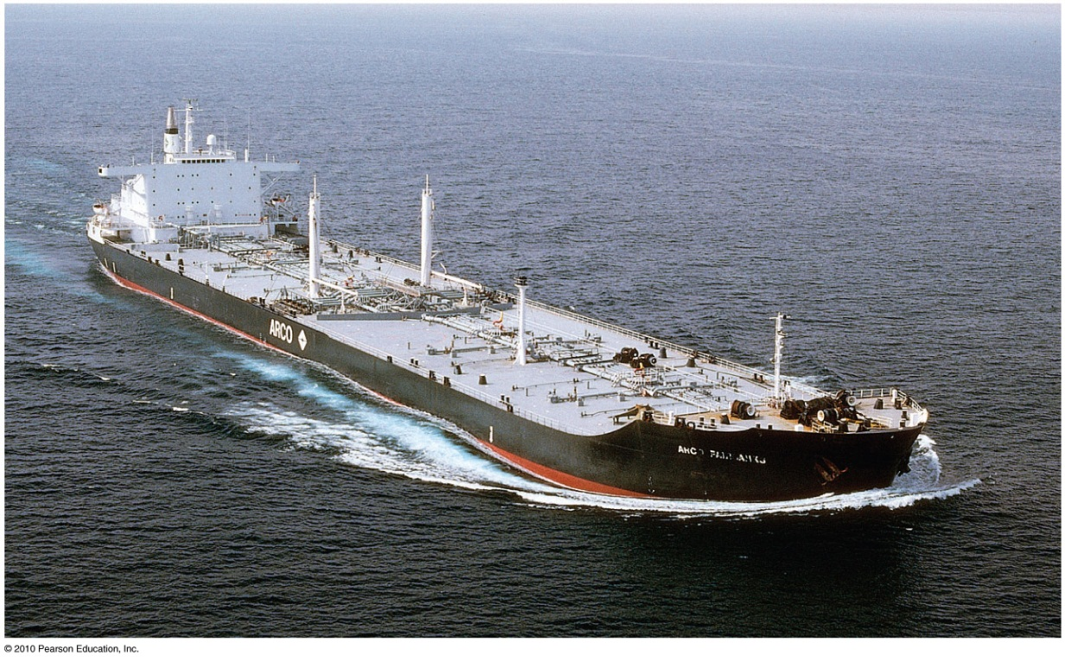
Momentum
a property of moving things
means inertia in motion
more specifically, mass of an object multiplied by its velocity
in equation form:
Momentum = mass × velocity

Slide 3
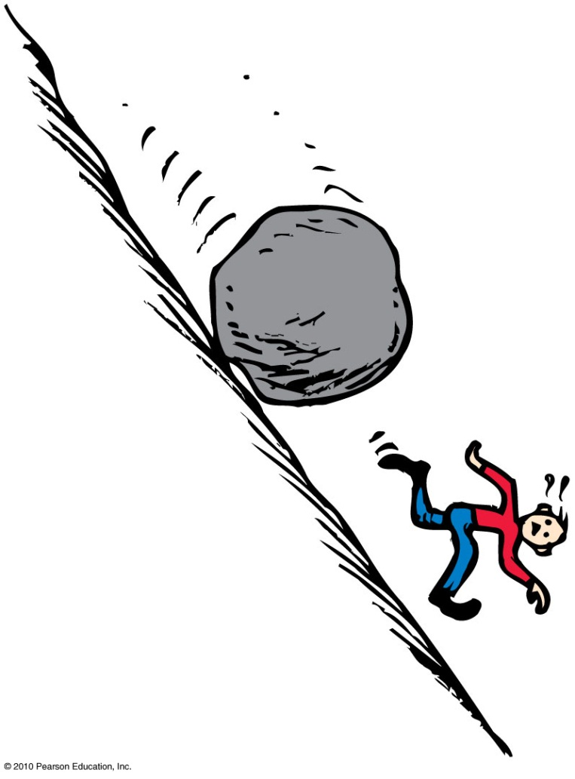
Momentum
Examples:
A moving boulder has more momentum than a stone rolling at the same speed.
A fast boulder has more momentum than a slow boulder.
A boulder at rest has no momentum.

Slide 4
Impulse
Product of force and time (force × time)
In equation form: Impulse = Ft
Example:
A brief force applied over a short time interval produces a smaller change in momentum than the same force applied over a longer time interval.
or
If you push with the same force for twice the time, you impart twice the impulse and produce twice the change in momentum.

Slide 5
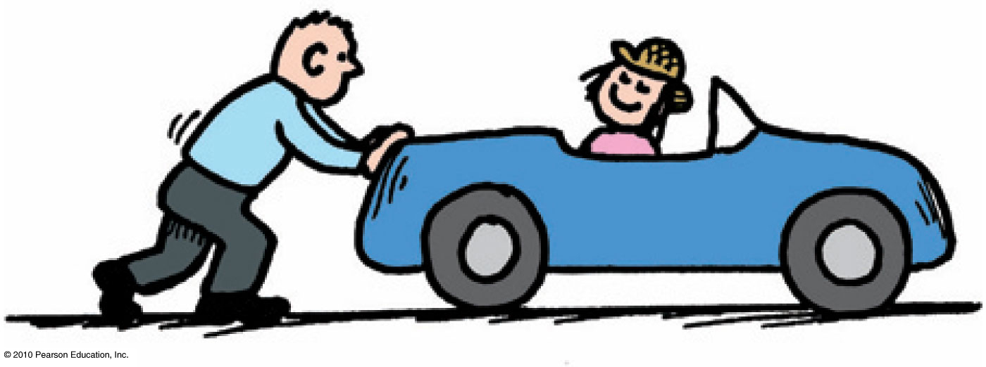
Impulse Changes Momentum
The greater the impulse exerted on something, the greater the change in momentum.
In equation form: Ft = Δ(mv)

Slide 6
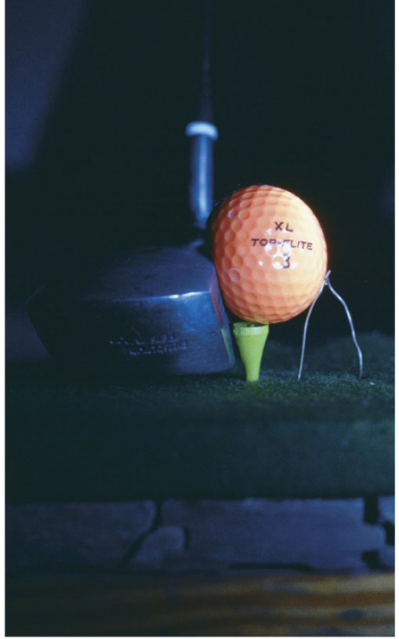
Impulse Changes Momentum
Case 1: increasing momentum
Apply the greatest force for as long as possible and you extend the time of contact.
Force can vary throughout the duration of contact.
Examples:
Golfer swings a club and
follows through.
Baseball player hits a ball and
follows through.

Slide 7
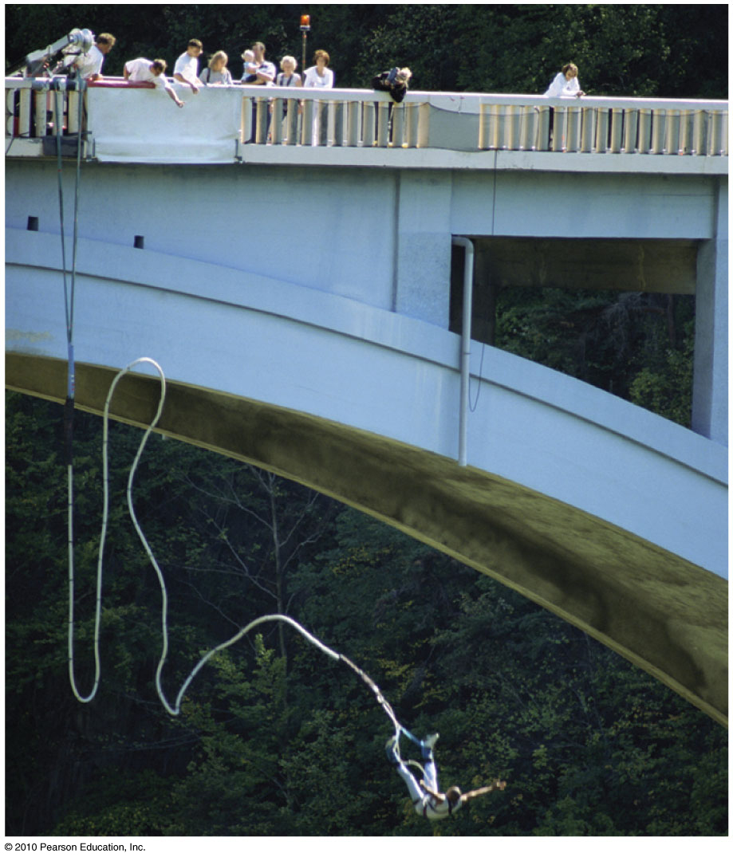
Impulse Changes Momentum
Case 2: decreasing momentum over a long time
extend the time during which momentum is reduced

Slide 8
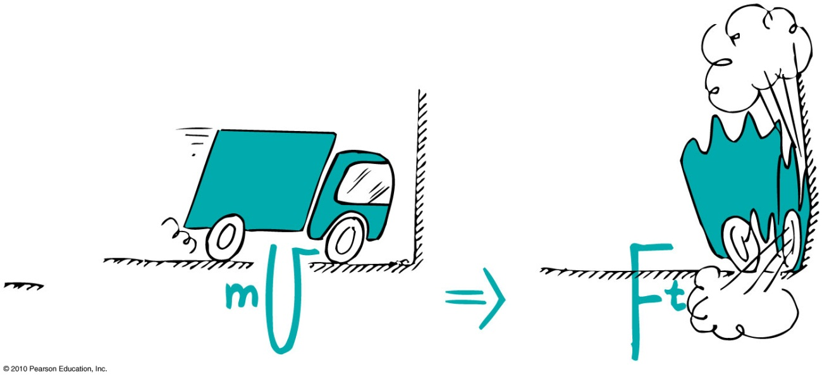
Impulse Changes Momentum
Examples:
When a car is out of control, it is better to hit a haystack than a concrete wall.
Physics reason: Same impulse either way, but extension of hitting time reduces the force.

Slide 9
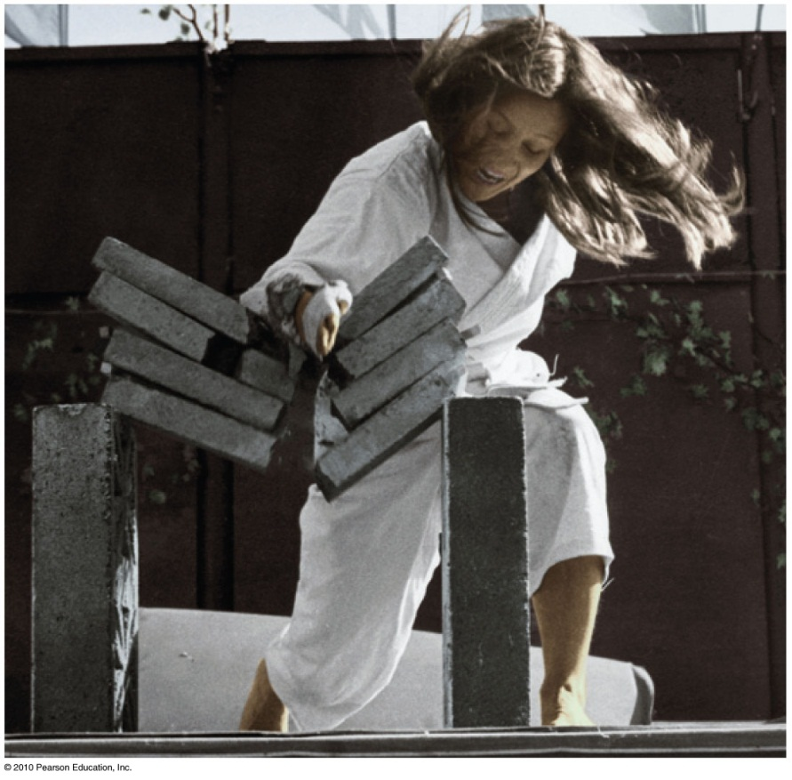
Impulse Changes Momentum
Case 3: decreasing momentum over a short time
short time interval produces large force.
Example: Karate expert splits a
stack of bricks by bringing her arm and hand swiftly against
the bricks with considerable
momentum. Time of contact is
brief and force of impact is huge.

Slide 10
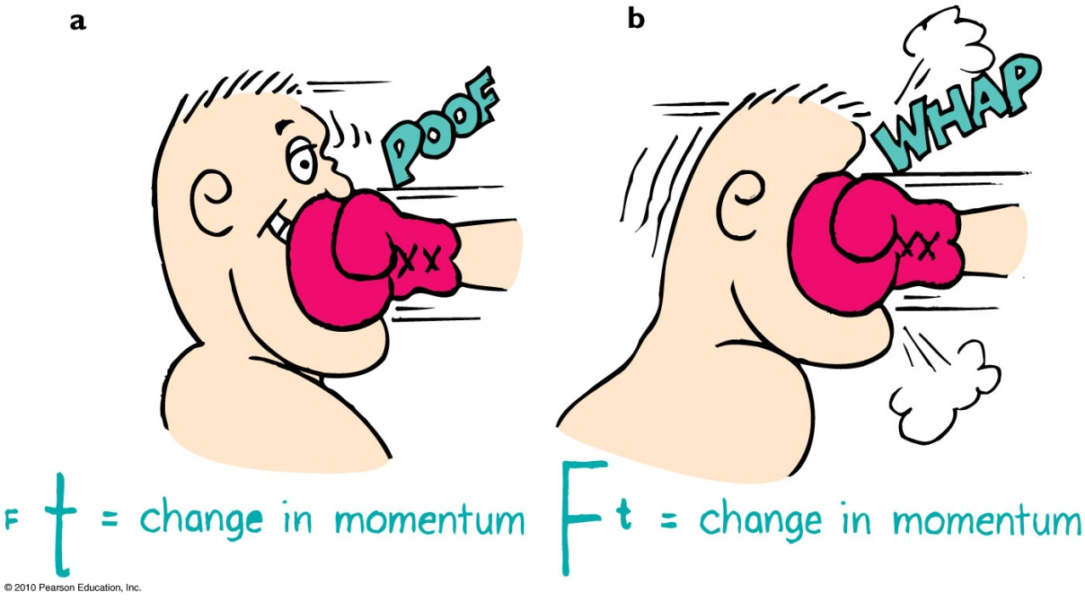
Impulse Changes Momentum
Example (continued):
In jumping, bend your knees when your feet make contact with the ground because the extension of time during your momentum decrease reduces the force on you.
In boxing, ride with the punch.

Slide 11
Bouncing
Impulses are generally greater when objects bounce.
Example:
Catching a falling flower pot from a shelf with your hands. You provide the impulse to reduce its momentum to zero. If you throw the flower pot up again, you provide an additional impulse. This “double impulse” occurs when something bounces.

Slide 12
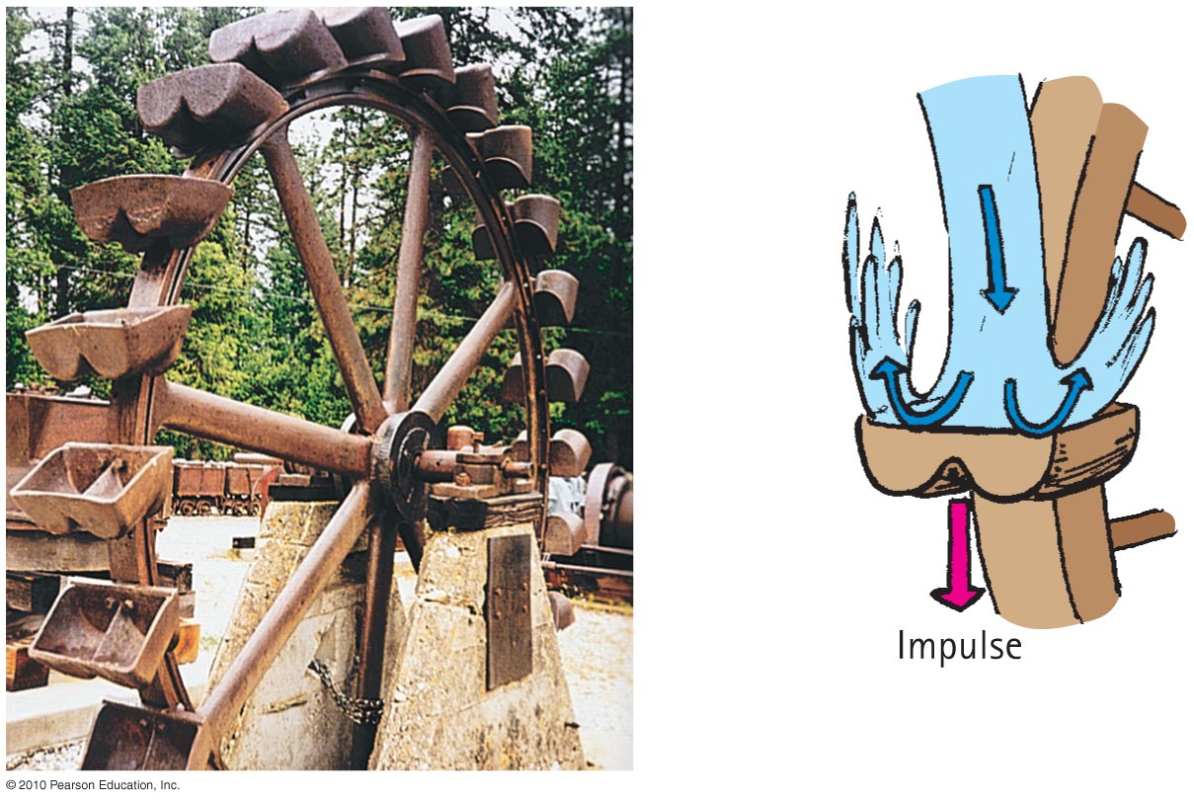
Bouncing
Pelton wheel designed to “bounce” water when it makes a U-turn on impact with the curved paddle

Slide 13
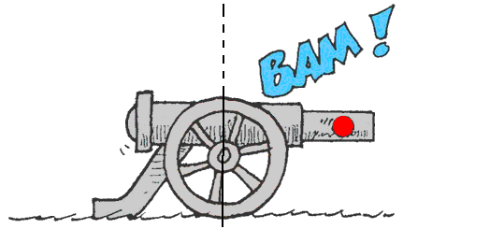
Law of conservation of momentum:
In the absence of an external force, the momentum of a system remains unchanged.
When a cannon is fired, the force on the cannonball inside the cannon barrel is equal and opposite to the force of the cannonball on the cannon.
The cannonball gains momentum, while the cannon gains an equal amount of momentum in the opposite direction—the cannon recoils.

Slide 14
Conservation of Momentum
Examples:
Internal molecular forces within a baseball come in pairs, cancel one another out, and have no effect on the momentum of the ball.
Molecular forces within a baseball have no effect on its momentum.
Pushing against a car’s dashboard has no effect on its momentum.

Slide 15
Collisions
For all collisions in the absence of external forces,
net momentum before collision equals net momentum after collision.
in equation form:
(net mv)_{before} = (net mv)_{after}

Slide 16
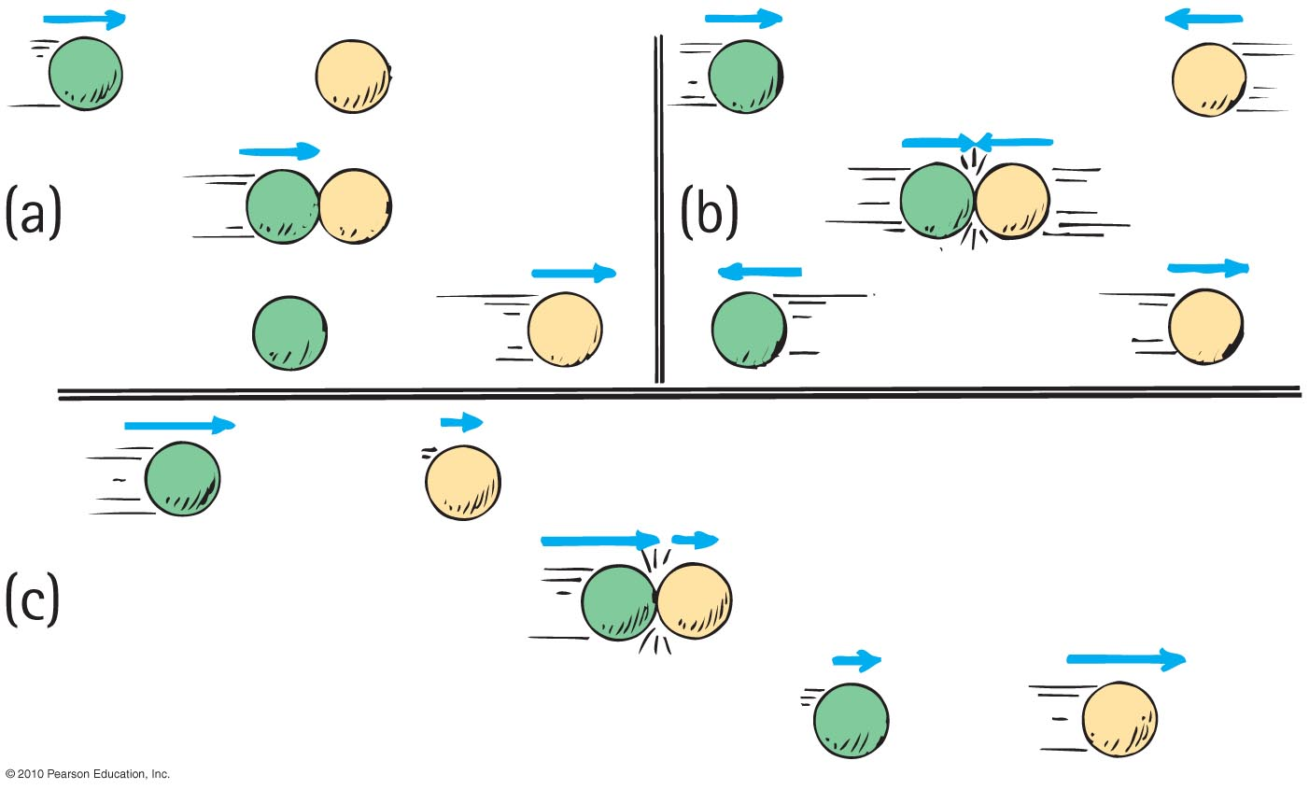
Elastic collision
occurs when colliding objects rebound without lasting deformation or any generation of heat.

Slide 17
Inelastic collision
occurs when colliding objects result in deformation and/or the generation of heat.
Single car moving at 10 m/s collides with another car of the same mass, m, at rest.
From the conservation of momentum,
(net mv)_{before} = (net mv)_{after}
(m × 10)_{before} = (2m × V)_{after}
V = 5 m/s

Slide 18
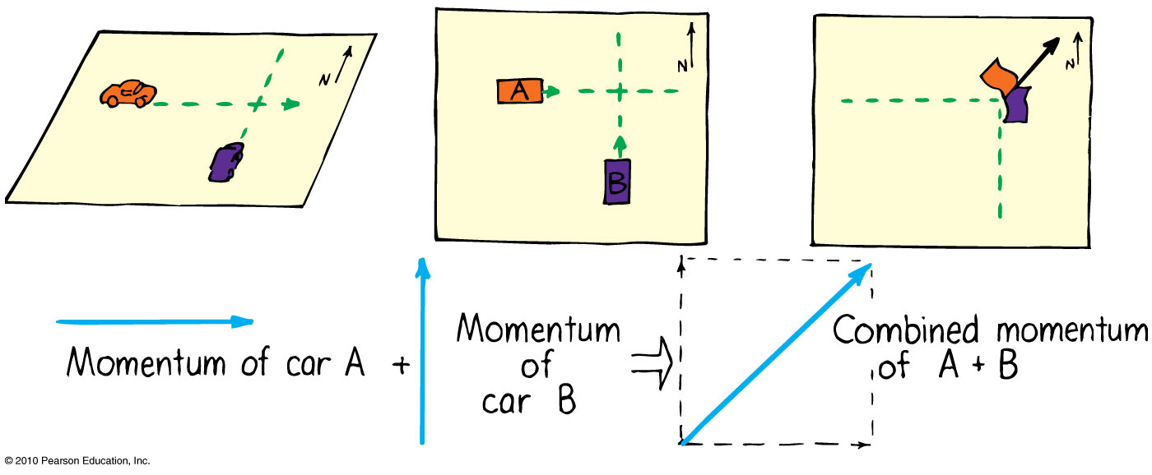
Sometimes the colliding objects are not moving in the same straight line.
In this case you create a parallelogram of the vectors describing each initial momentum to find the combined momentum.
Example: collision of two cars at a corner

Slide 19
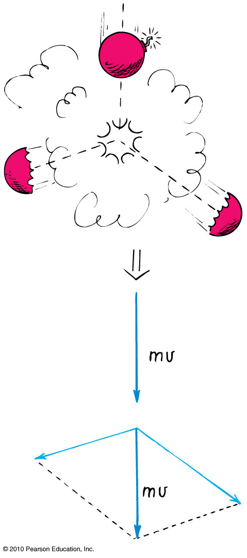
Explosions
Another example:
A firecracker exploding; the total momentum of the pieces after the explosion can be added vectorially to get the initial momentum of the firecracker before it exploded.

