Slide 1
Conceptual Physics 11th Edition
Chapter 7:
ENERGY
Energy
Work
Power
Mechanical Energy : Potential and Kinetic
Work-Energy Theorem
Conservation of Energy
Machines
Efficiency
Recycled Energy
Energy for Life
Sources of Energy

Slide 2
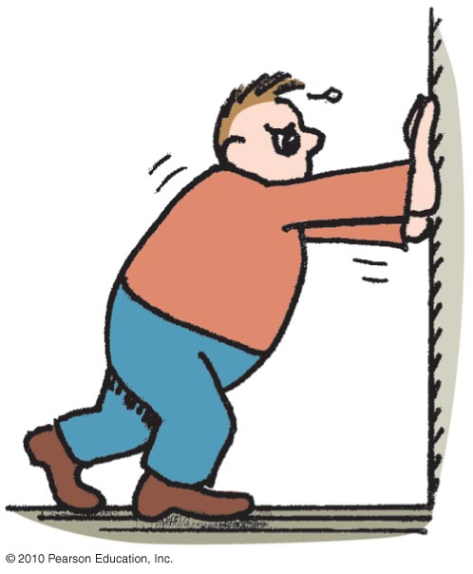
Work
involves force and distance.
is force × distance.
in equation form: W = Fd.
Two things occur whenever work is done:
application of force
movement of something by that force
Unit of work:
newton-meter (N·m)
or joule (J)

Slide 3
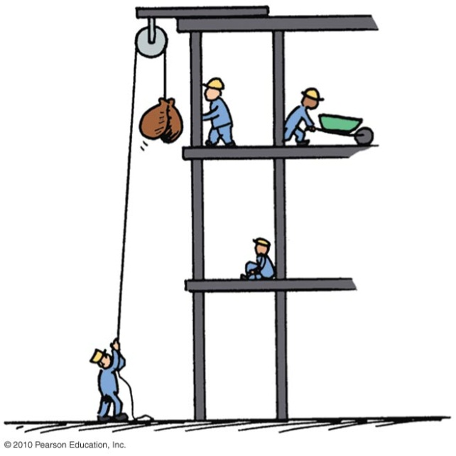
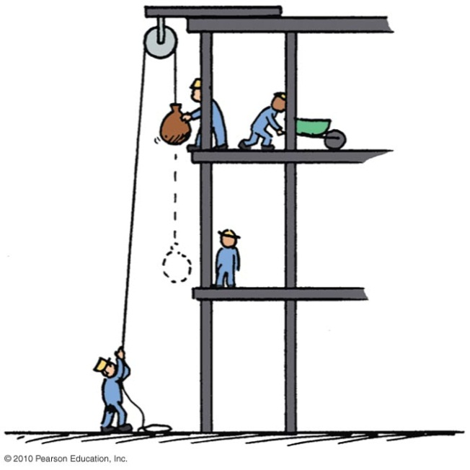
Work
Examples:
Twice as much work is done in lifting 2 loads 1 story high versus lifting 1 load the same vertical distance.
Reason: force needed to lift twice the load is twice as much.
Twice as much work is done in lifting a load 2 stories instead of 1 story.
Reason: distance is twice as great.

Slide 4
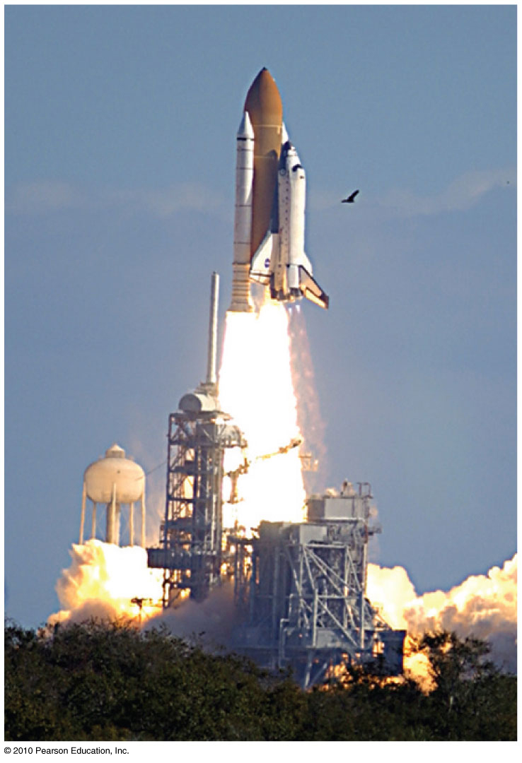
Power
Measure of how fast work is done
In equation form:
Unit of power
joule per second, called the watt after James Watt, developer of the steam engine
1 joule/second = 1 watt
1 kilowatt = 1000 watts

Slide 5
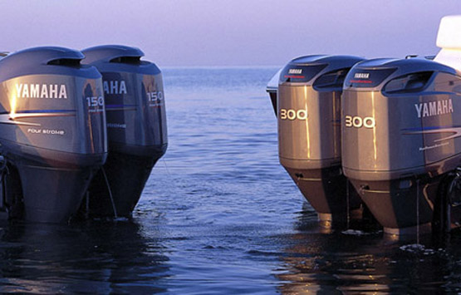
Power
Examples:
A worker uses more power running up the stairs than climbing the same stairs slowly.
Twice the power of an engine can do twice the work of one engine in the same amount of time, or the same amount of work of one engine in half the time.
1 horsepower = 746 watts

Slide 6
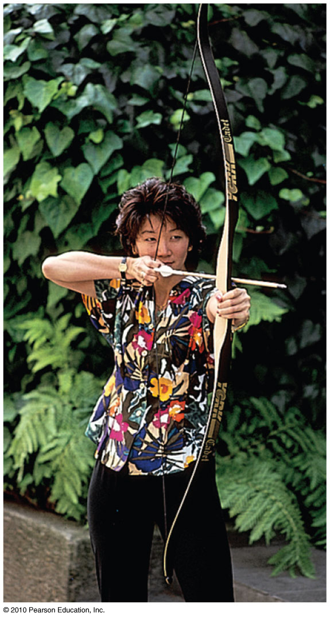
Elastic Potential Energy
Stored energy held in readiness with a potential for doing work
Examples:
A stretched bow has stored energy that can do work on an arrow.
A stretched rubber band of a slingshot has stored energy and is capable of doing work.

Slide 7
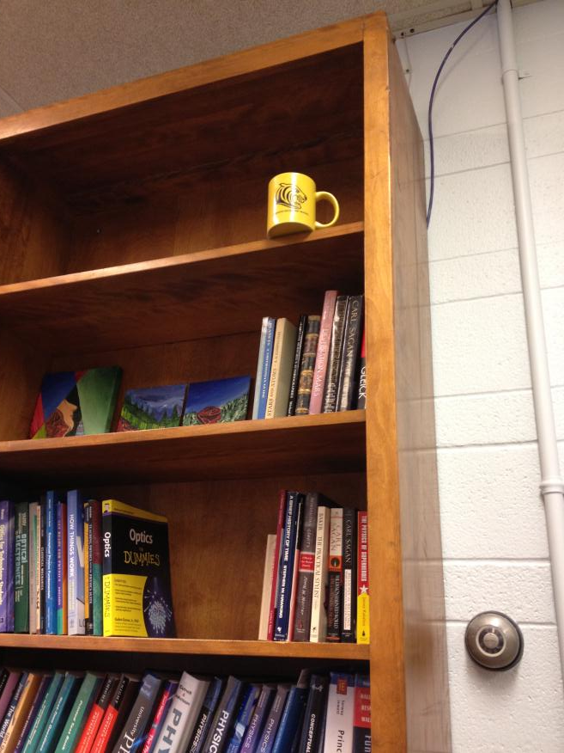
Gravitational Potential Energy
Potential energy due to elevated position
Example:
coffee mug on the top shelf
In equation form:
Potential energy
= mass × acceleration due to gravity × height
= mgh

Slide 8
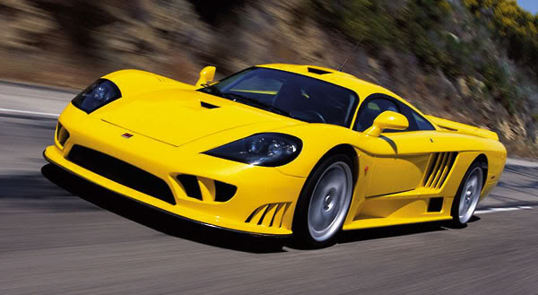
Kinetic Energy
Energy of motion
Depends on the mass of the object and square of its speed
Include the proportional constant 1/2 and
kinetic energy = 1/2 × mass × speed × speed
If object speed is doubled ⇒ kinetic energy is quadrupled.

Slide 9
Work and Kinetic Energy
Kinetic energy and work of a moving object
Equal to the work required to bring it from rest to that speed, or the work the object can do while being brought to rest
In equation form: net force × distance =
kinetic energy, or Fd = 1/2 mv²

Slide 10
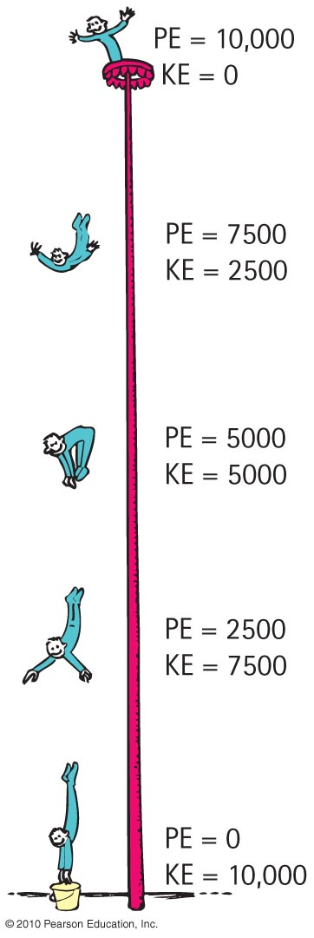
Law of Conservation of Energy:
“Energy cannot be created or destroyed; it may be transformed from one form into another, but the total amount of energy never changes.”

Slide 11
Machines
Devices for multiplying forces or changing the direction of forces
Cannot create energy but can transform energy from one form to another, or transfer energy from one location to another
Cannot multiply work or energy

Slide 12
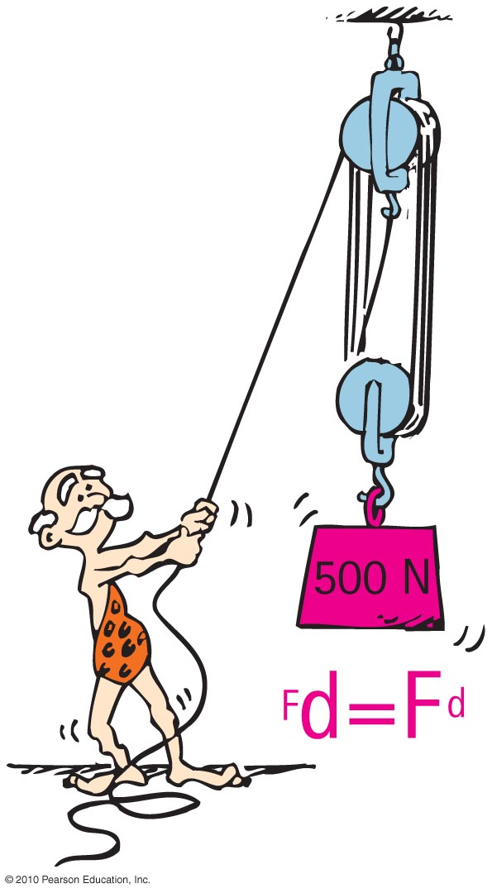
Machines
Principles of a machine:
Conservation of energy concept:
Work input = work output
Input force × input distance =
Output force × output distance
(Force × distance)_{input} = (force × distance)_{output}

Slide 13
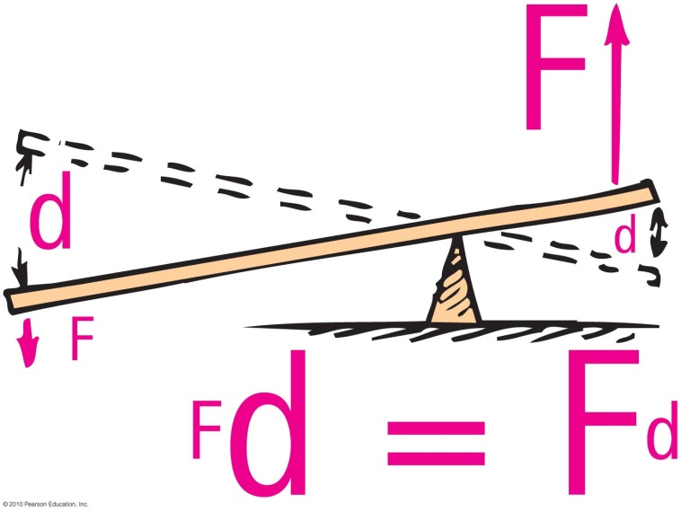
Simplest machine:
Lever
rotates on a point of support called the fulcrum
allows small force over a large distance and large force over a short distance

Slide 14
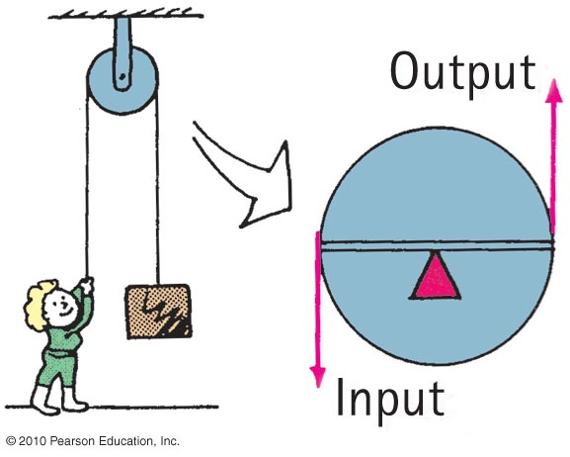
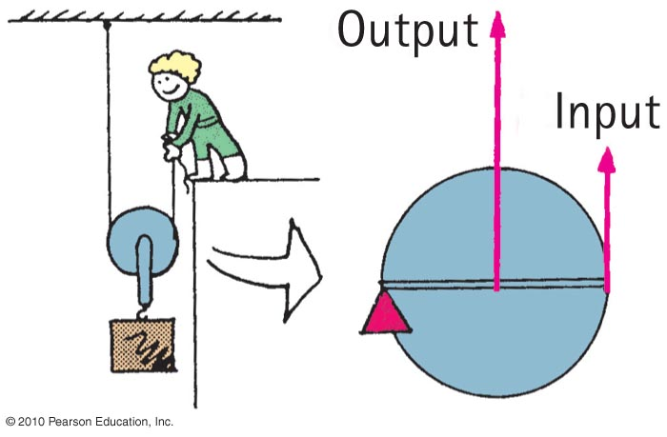
Pulleys
This arrangment operates like a lever with equal arms— changes the direction of the input force:
This arrangement can allow a load to be lifted with half the input force:

Slide 15
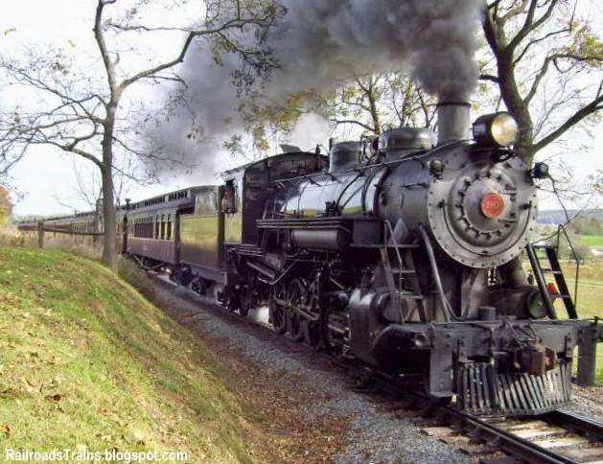
Efficiency
Percentage of work put into a machine that is converted into useful work output
In equation form:
useful energy output
Efficiency =
total energy input

Slide 16
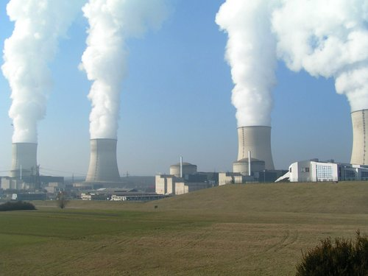
Recycled Energy
Re-employment of energy that otherwise would be wasted.
Edison used heat from his power plant in New York City to heat buildings.
Typical power plants waste about 30% of their energy to heat because they are built away from buildings and other places that use heat.

Slide 17
Sources of Energy
Sun
Examples:
Sunlight evaporates water; water falls as rain; rain flows into rivers and into generator turbines; then back to the sea to repeat the cycle.
Wind power turns generator turbines.

Slide 18
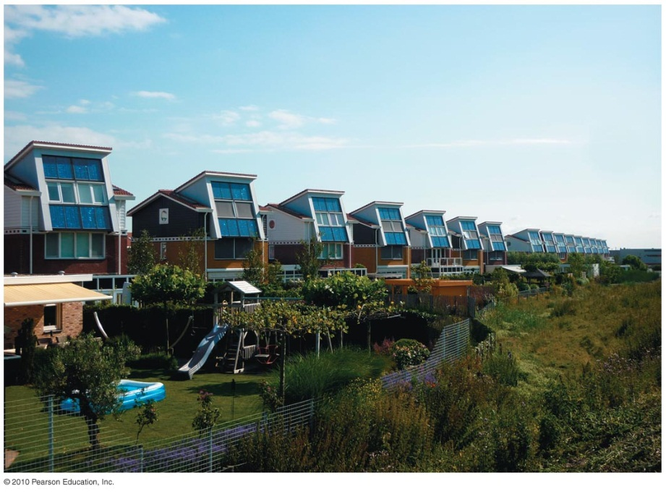
Sources of Energy
Example:
Photovoltaic cells on rooftops catch the solar energy and convert it to electricity.
More energy from the Sun hits Earth in 1 hour than all of the energy consumed by humans in an entire year!

Slide 19
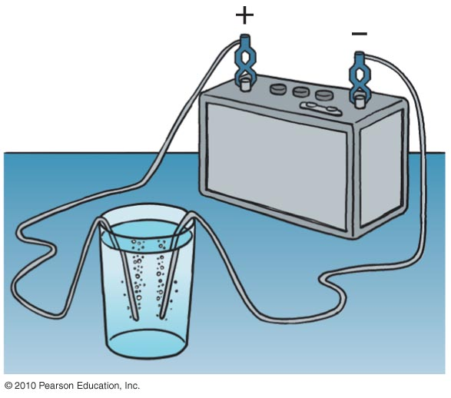
Sources of Energy
Fuel cell
Runs opposite to the battery shown (where electricity separates water into hydrogen and oxygen).
In a fuel cell, hydrogen and oxygen are compressed at electrodes and electric current is produced at electrodes.

Slide 20
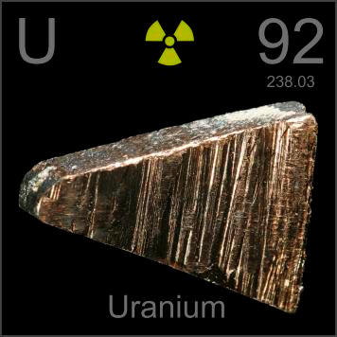
Sources of Energy
Concentrated energy
Nuclear power
stored in uranium and plutonium
doesn’t pollute our atmosphere
creates radioactive waste which, if stored near humans, can be toxic.

