Slide 1

Conceptual Physics
11th Edition
Chapter 8:
ROTATION
Circular Motion
Rotational Inertia
Torque
Center of Mass and Center of Gravity
Centripetal Force
Centrifugal Force
Rotating Reference Frames
Simulated Gravity
Angular Momentum
Conservation of Angular Momentum

Slide 2
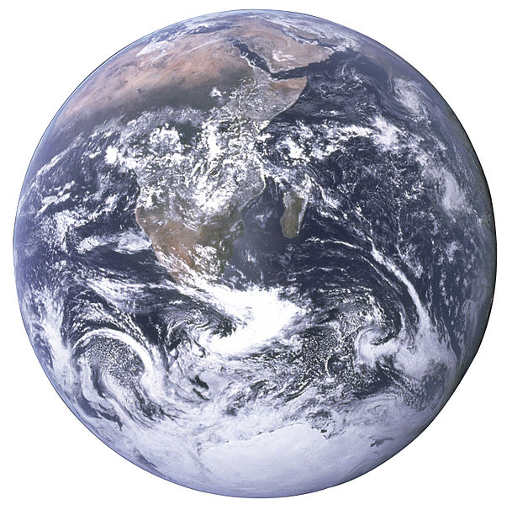
Circular Motion
When an object turns about an internal axis, it is undergoing circular motion or rotation.
Circular Motion is characterized by two kinds of speeds:
  tangential (or linear) speed.
  rotational (or circular) speed.
[Image from http://www.nasa.gov/images/content/115334main_image_feature_329_ys_full.jpg ]

Slide 3
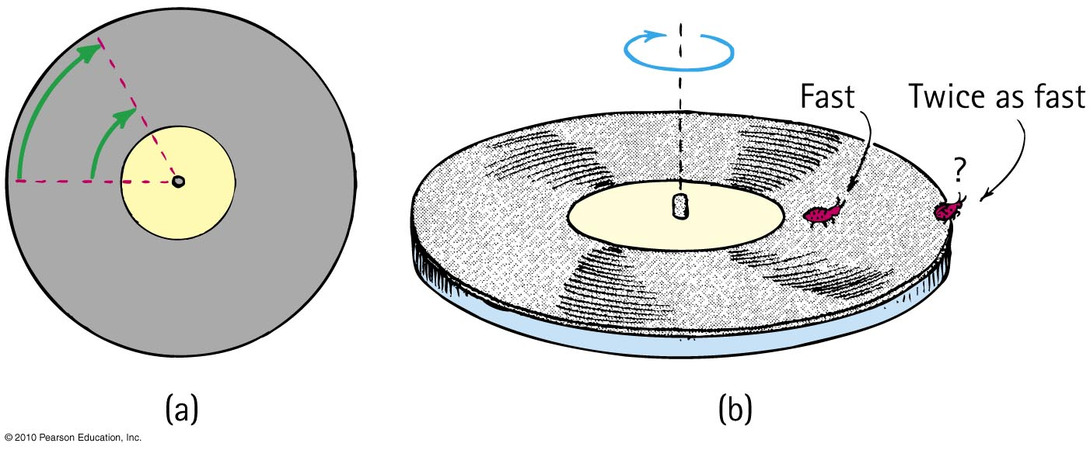
Circular Motion—Tangential Speed
The distance traveled by a point on the rotating object divided by the time taken to travel that distance is called its tangential speed (symbol v).
Points closer to the circumference have a higher tangential speed that points closer to the center.

Slide 4
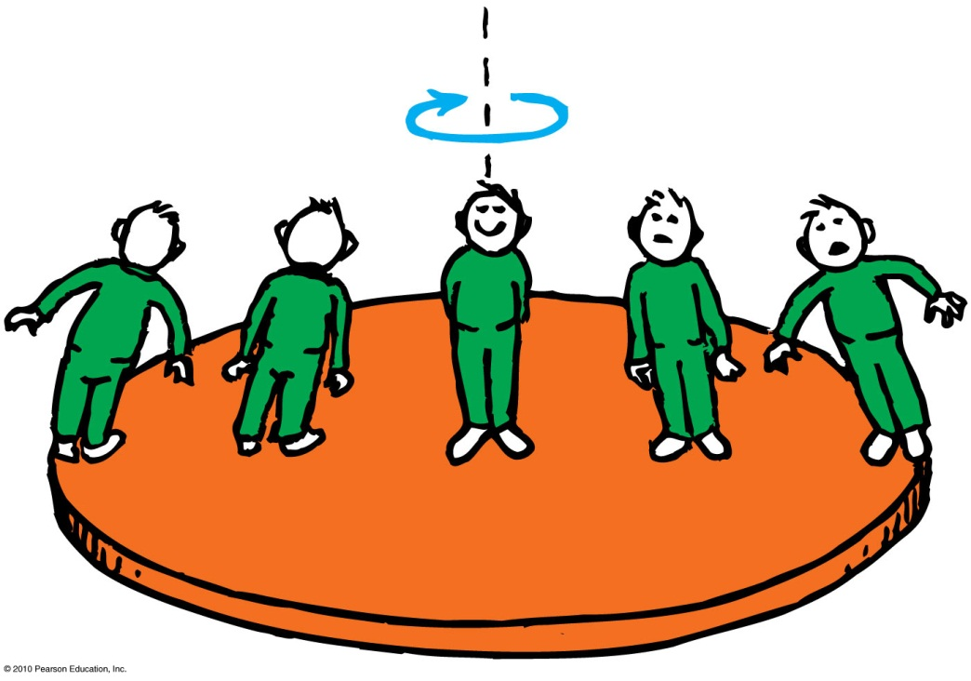
Circular Motion – Rotational Speed
Rotational (angular) speed is the number of radians of angle per unit of time (symbol ω).
All parts of a rigid merry-go-round or turntable turn about the axis of rotation in the same amount of time.
So, all parts have the same rotational speed.
Tangential speed
= Radial Distance × Rotational Speed
ν = rω

Slide 5

Rotational Inertia
An object rotating about an axis tends to remain rotating about the same axis at the same rotational speed unless interfered with by some external influence.
The property of an object to resist changes in its rotational state of motion is called rotational inertia (symbol I).
[Image downloaded Jan.10, 2013 from http://images.yourdictionary.com/grindstone ]

Slide 6
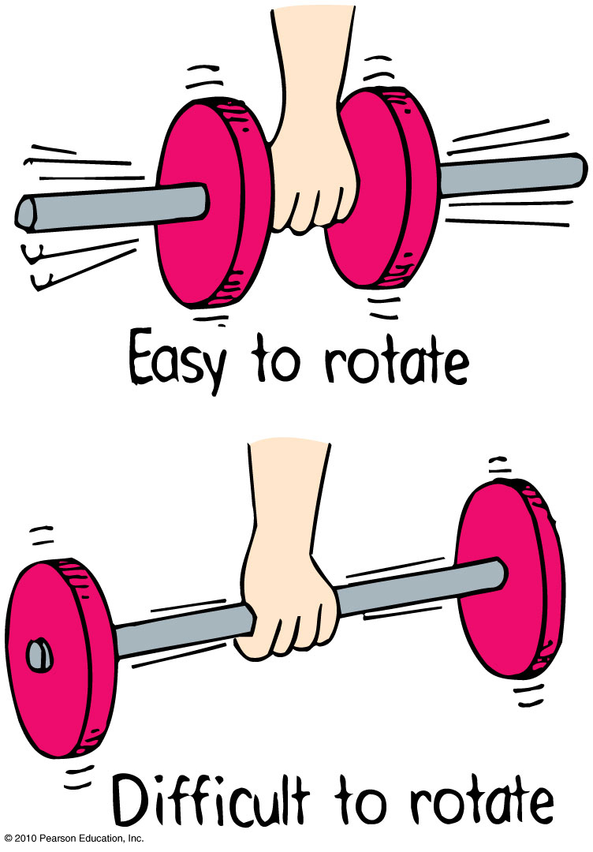
Rotational Inertia
Depends upon:
mass of object.
distribution of mass around axis of rotation.
  The greater the distance between an object’s mass concentration and the axis, the greater the rotational inertia.

Slide 7
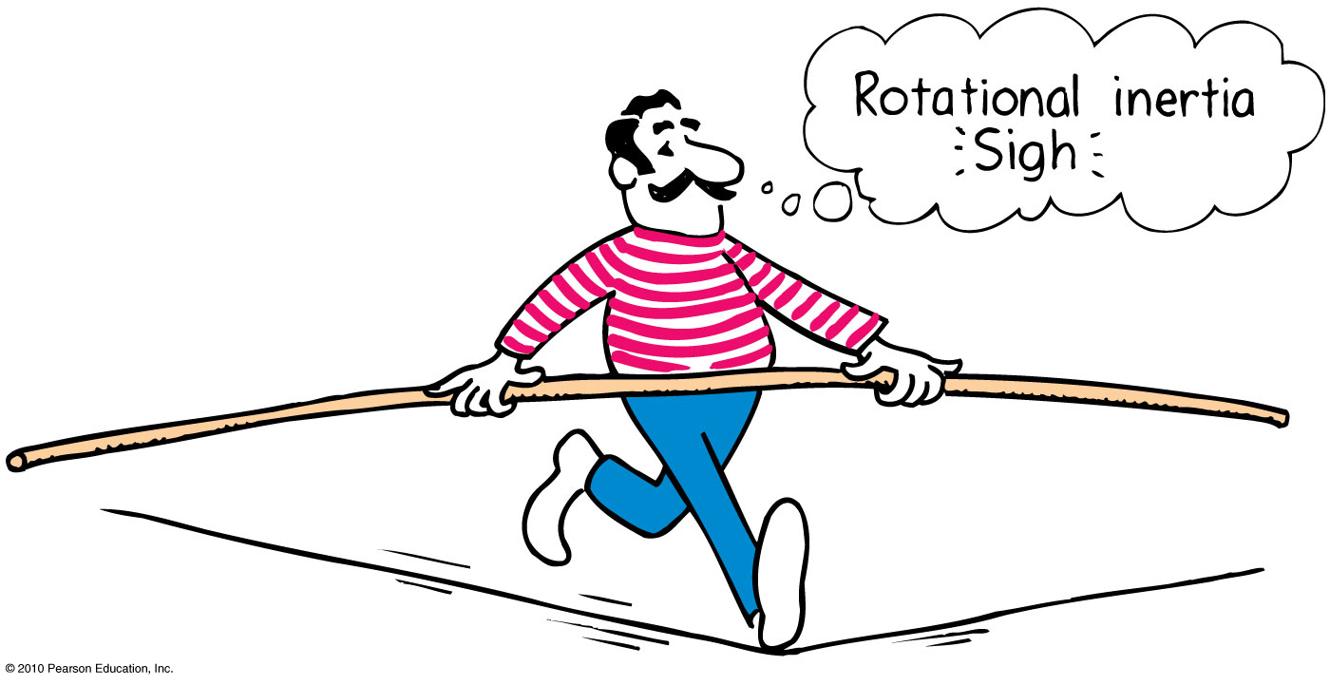
Rotational Inertia
The greater the rotational inertia, the harder it is to change its rotational state.
  A tightrope walker carries a long pole that has a high rotational inertia, so it does not easily rotate.
  Keeps the tightrope walker stable.

Slide 8
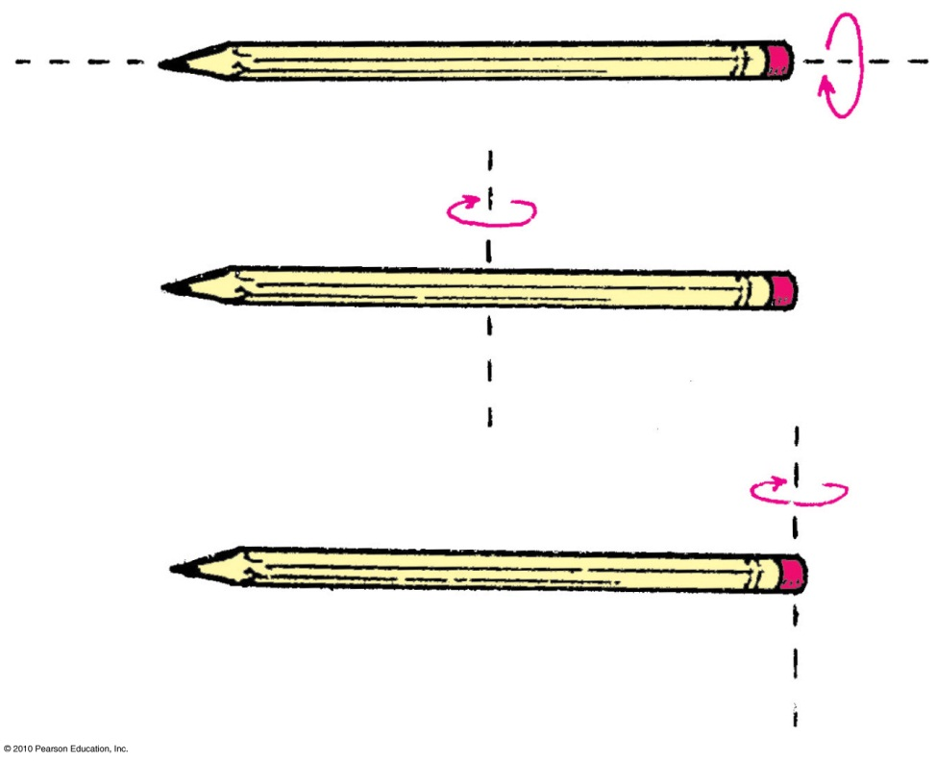
Rotational Inertia
Depends upon the axis around which it rotates
Easier to rotate pencil around an axis passing through it.
Harder to rotate it around vertical axis passing through center.
Hardest to rotate it around vertical axis passing through the end.

Slide 9
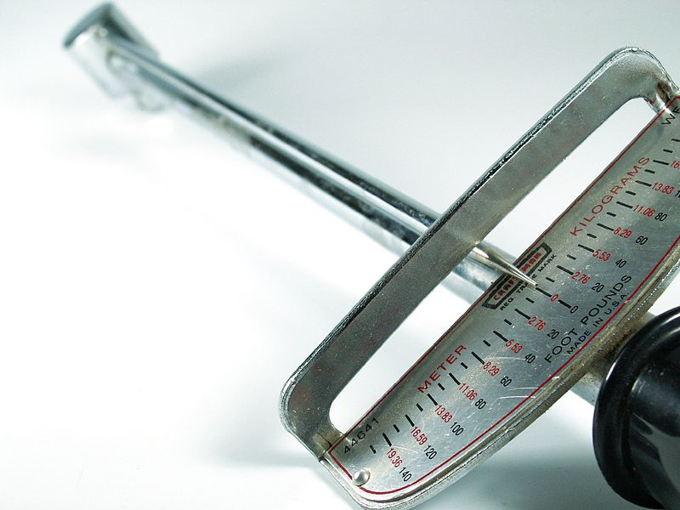
Torque
The tendency of a force to cause rotation is called torque.
Torque depends upon three factors:
  Magnitude of the force
  The direction in which it acts
  The point at which it is applied on the object
Image by John Zdralek, retrieved Jan.10 2013 from http://en.wikipedia.org/wiki/File:1980_c1980_Torque_wrench,_140ft-lbs_19.36m-kg,_nominally_14-20in,_.5in_socket_drive,_Craftsman_44641_WF,_Sears_dtl.jpg ]

Slide 10
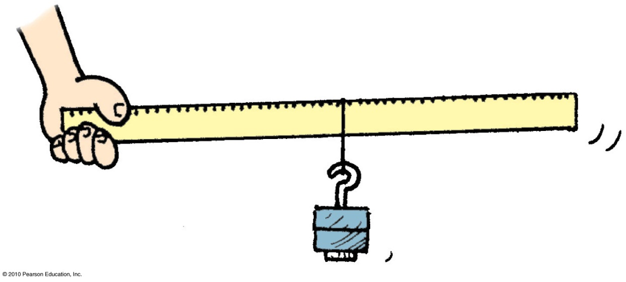
Torque
The equation for Torque is
The lever arm depends upon
  where the force is applied.
  the direction in which it acts.
Torque = lever arm × force

Slide 11
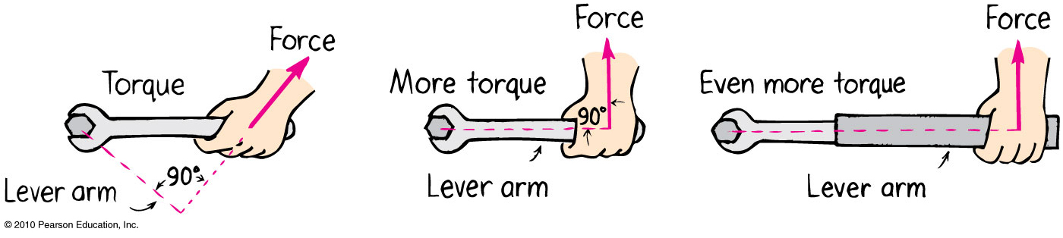
Torque—Example 1 of 3
Lever arm is less than length of handle because of direction of force.

Slide 12
Torque—Example 2 of 3
Lever arm is equal to length of handle.

Slide 13
Torque—Example 3 of 3
Lever arm is longer than length of handle.

Slide 14
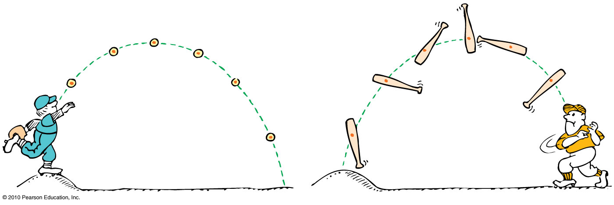
Center of mass is the average position of all the mass that makes up the object.
Center of gravity (CG) is the average position of weight distribution.
  Since weight and mass are proportional, center of gravity and center of mass usually refer to the same point of an object.

Slide 15
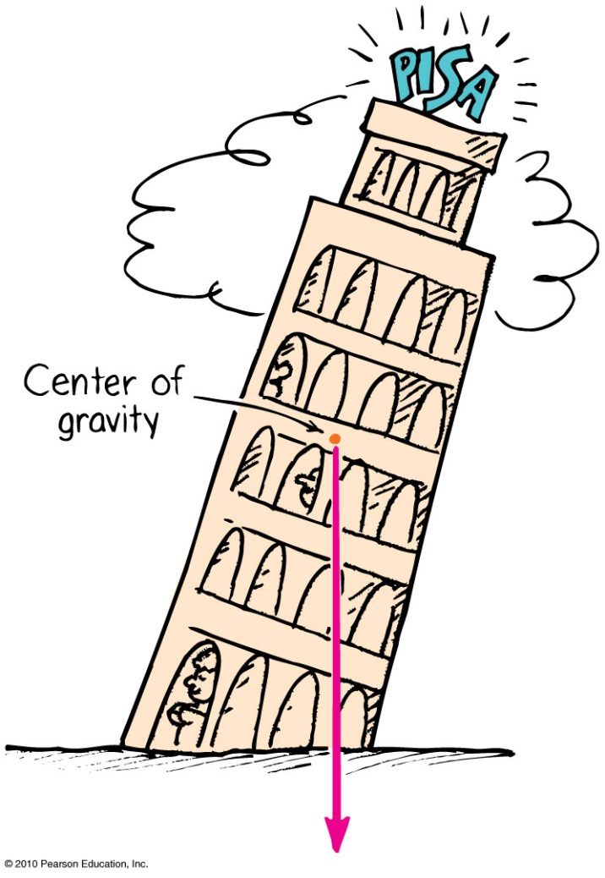
Center of Gravity—Stability
The location of the center of gravity is important for stability.
If we draw a line straight down from the center of gravity and it falls inside the base of the object, it is in stable equilibrium; it will balance.
If it falls outside the base, it is unstable.

Slide 16
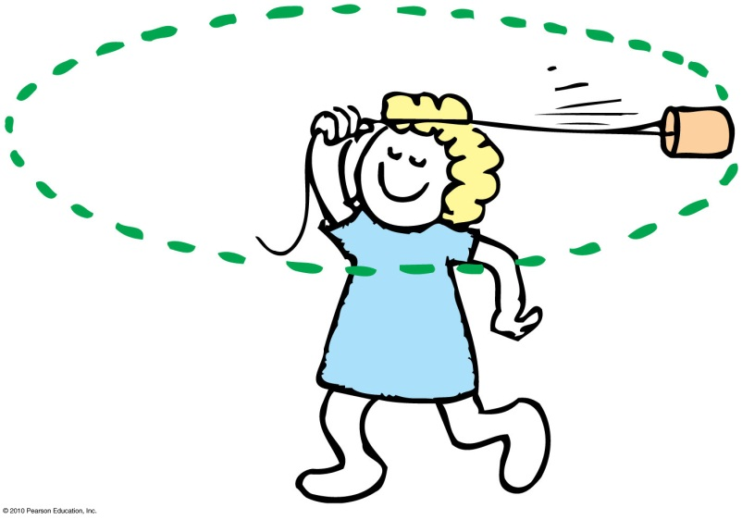
Centripetal Force
Any force directed toward a fixed center is called a centripetal force.
Centripetal means “center-seeking” or “toward the center.”
Example: To whirl a tin can at the end of a string, you pull the string toward the center and exert a centripetal force to keep the can moving in a circle.

Slide 17
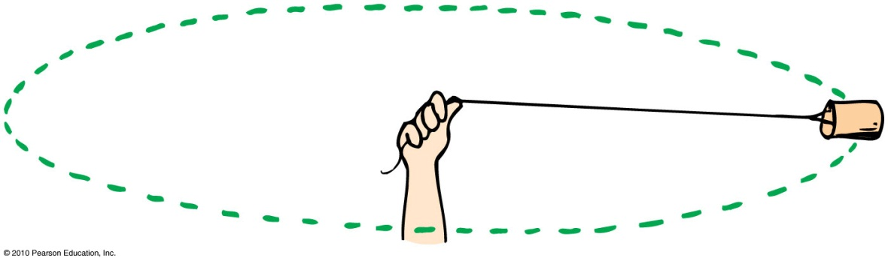
Centripetal Force
Depends upon
  mass of object.
  tangential speed of the object.
  radius of the circle.
In equation form:
m
a
s
s
×
t
a
n
g
e
n
t
i
a
l
s
p
e
e
d
2
C
e
n
t
r
i
p
e
t
a
l
f
o
r
c
e
=
r
a
d
i
u
s

Slide 18
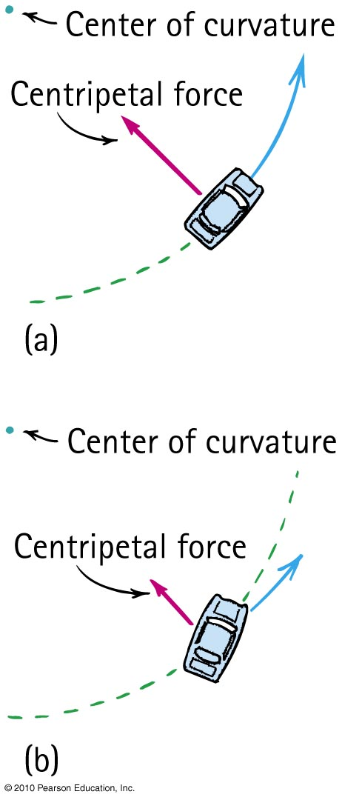
Centripetal Force Example
When a car rounds a curve, the centripetal force prevents it from skidding off the road.
If the road is wet, or if the car is going too fast, the centripetal force is insufficient to prevent skidding off the road.

Slide 19
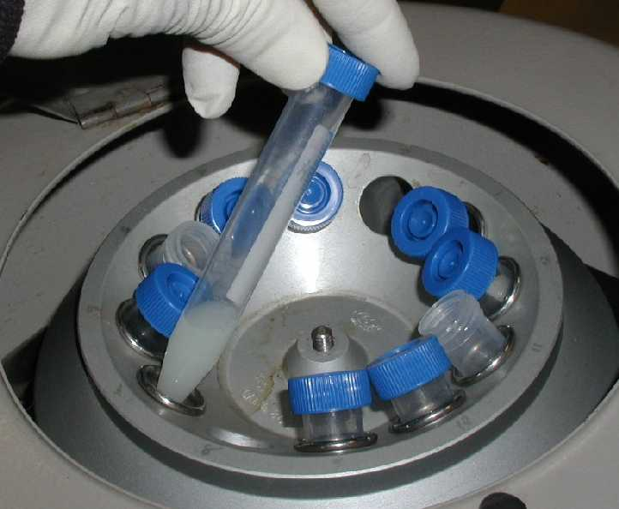
Centrifugal Force
Although centripetal force is center directed, an occupant inside a rotating system seems to experience an outward force.
This apparent outward force is called centrifugal force.
Centrifugal means “center-fleeing” or “away from the center.”
[Image downloaded Jan.10 2013 from http://www.et.byu.edu/~wanderto/homealgaeproject/Harvesting%20Algae.html ]

Slide 20
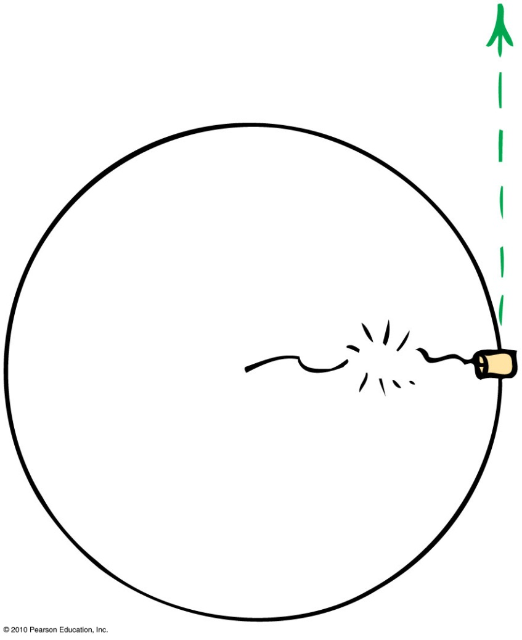
Centrifugal Force
– A Common Misconception
It is a common misconception that a centrifugal force pulls outward on an object.
Example:
  If the string breaks, the object doesn’t move radially outward.
  It continues along its tangent straight-line path—because no force acts on it. (Newton’s first law)

Slide 21
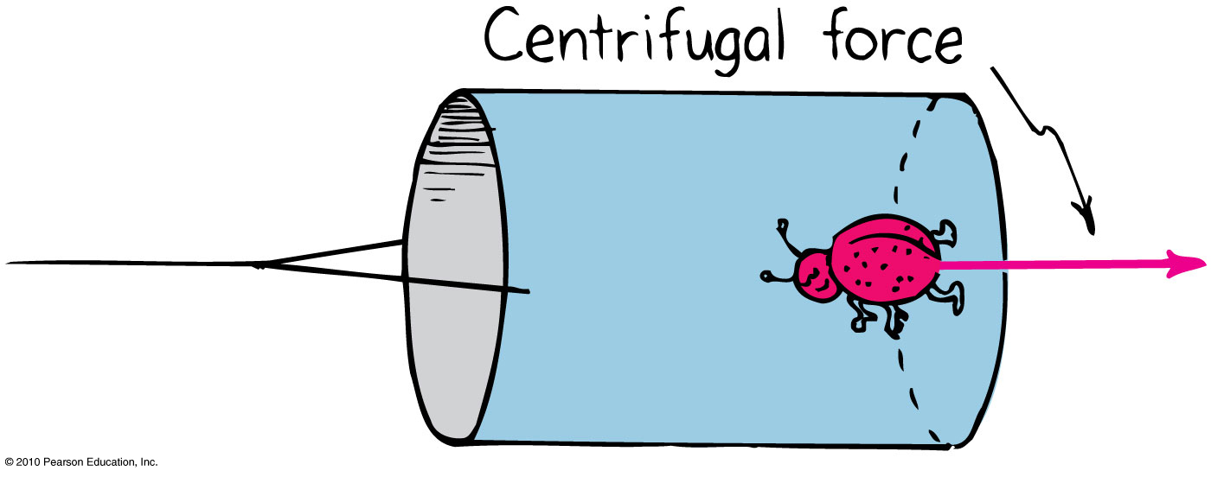
Rotating Reference Frames
Centrifugal force in a rotating reference frame is a force in its own right – as real as any other force, e.g. gravity.
Example:
  The bug at the bottom of the can experiences a pull toward the bottom of the can.

Slide 22
Angular Momentum
The “inertia of rotation” of rotating objects is called angular momentum.
  This is analogous to “inertia of motion”, which was momentum.
Angular momentum
= rotational inertia × angular velocity
  This is analogous to
  Linear momentum = mass × velocity

Slide 23
Angular Momentum
For an object that is small compared with the radial distance to its axis, magnitude of
Angular momentum = mass tangential speed × radius
  This is analogous to magnitude of
  Linear momentum = mass × speed
Examples:
  Whirling ball at the end of a long string
  Planet going around the Sun

Slide 24
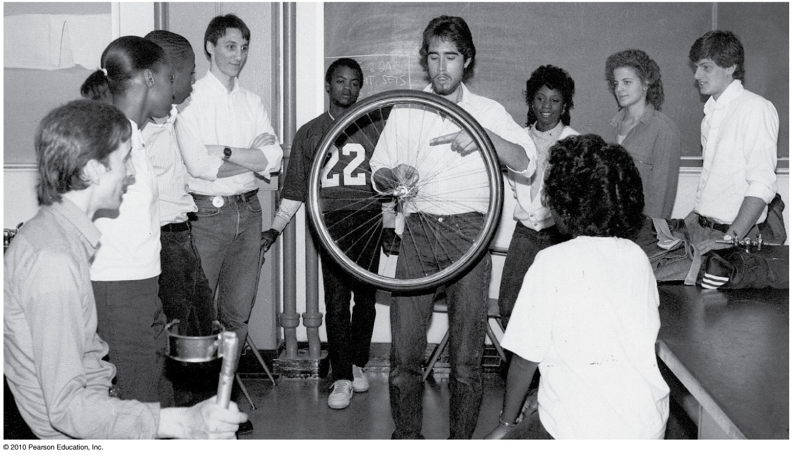
An external net torque is required to change the angular momentum of an object.
Rotational version of Newton’s first law:
  An object or system of objects will maintain its angular momentum unless acted upon by an external net torque.

Slide 25
Conservation of Angular Momentum
The law of conservation of angular momentum states:
  If no external net torque acts on a rotating system, the angular momentum of that system remains constant.
Analogous to the law of conservation of linear momentum:
  If no external force acts on a system, the total linear momentum of that system remains constant.

Slide 26
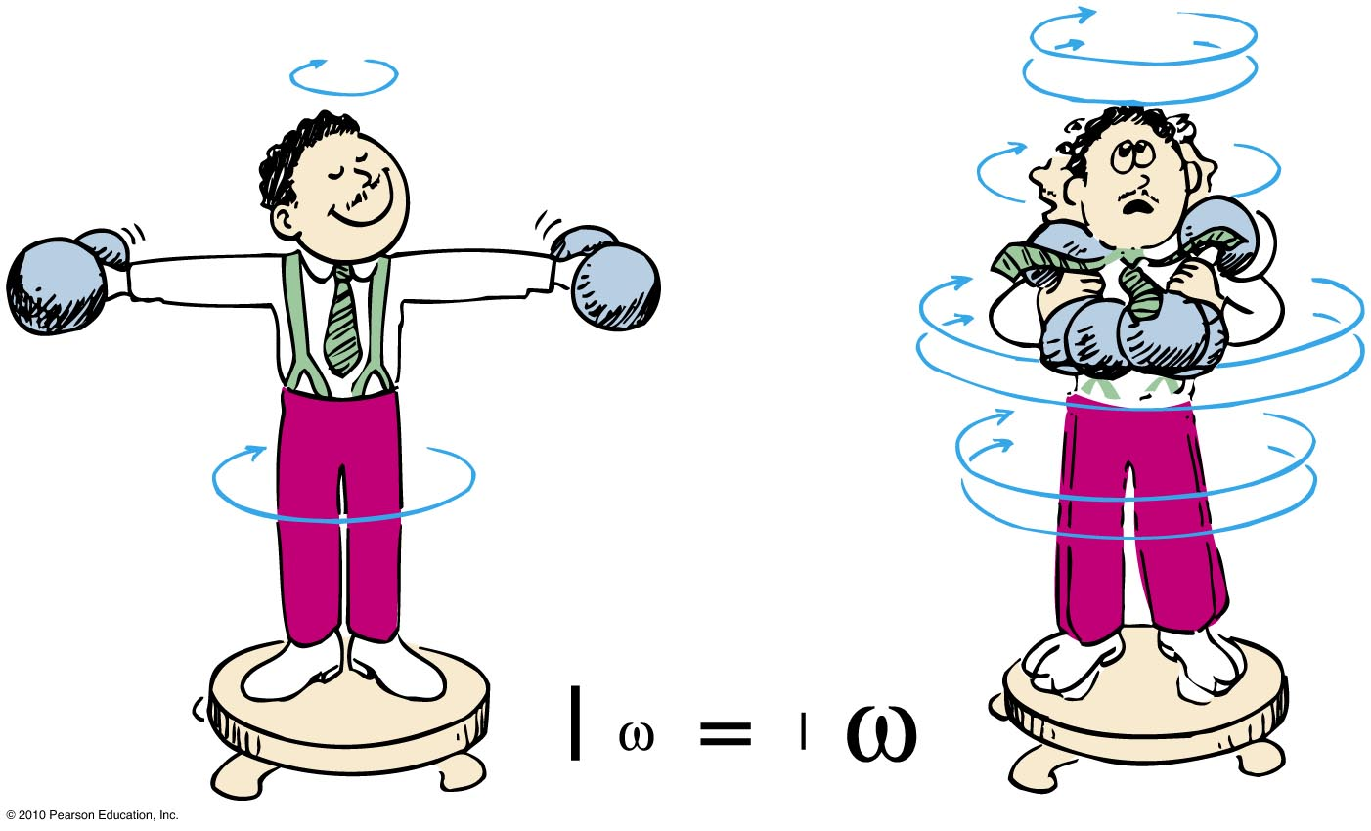
Conservation of Angular Momentum
Example:
When the man pulls the weights inward, his rotational speed increases!

