Slide 1
Note on Posted Slides
These are the slides that I intended to show in class on Mon. Jan. 28, 2013.
They contain important ideas and questions from your reading.
Due to time constraints, I was probably not able to show all the slides during class.
They are all posted here for completeness.

Slide 2
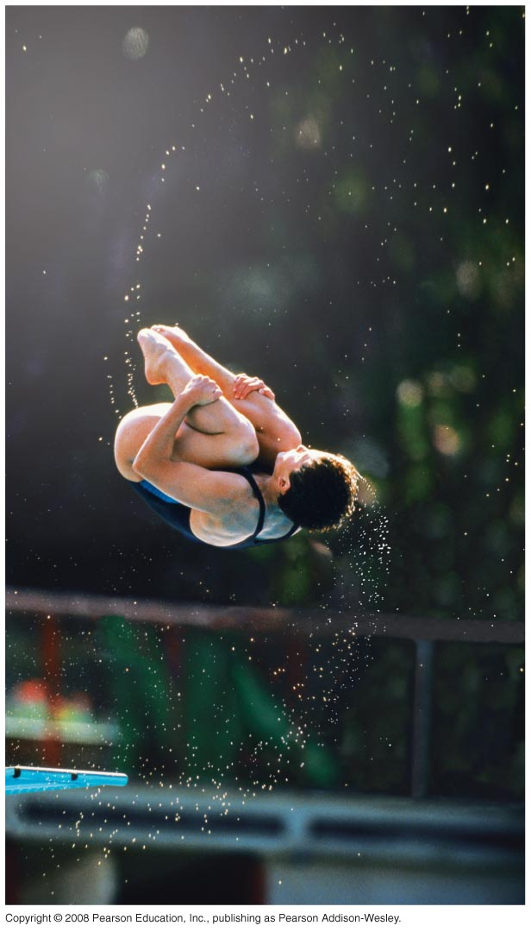
PHY205H1S
Physics of Everyday Life
Class 7: Rotation
Circular Motion
Rotational Inertia
Torque
Centre of Mass and Centre of Gravity
Centripetal Force
Centrifugal Force
Angular Momentum

Slide 3

Chapter 8. Pre-Class Reading Question
The rotational speed on the outer edge of a rotating roulette wheel is
less than toward the centre.
the same as toward the centre.
greater than toward the centre.
Roulette wheel image from http://yourfamilyfinances.com/2012/09/01/payday-loans-debt-trap/ ]

Slide 4
Chapter 8. Pre-Class Reading Question
The tangential speed on the outer edge of a rotating roulette wheel is
less than toward the centre.
the same as toward the centre.
greater than toward the centre.
Roulette wheel image from http://yourfamilyfinances.com/2012/09/01/payday-loans-debt-trap/ ]

Slide 5

Circular Motion
When an object turns about an internal axis, it is undergoing circular motion or rotation.
Circular Motion is characterized by two kinds of speeds:
  tangential speed, v in m/s.
  rotational speed, ω in radians / s.
1 radian ≈ 57°, and is a unit of angle.
[Image from http://www.coolgraphic.org/festival-graphics/earth-day/earth-rotating-earth-day/ ]

Slide 6
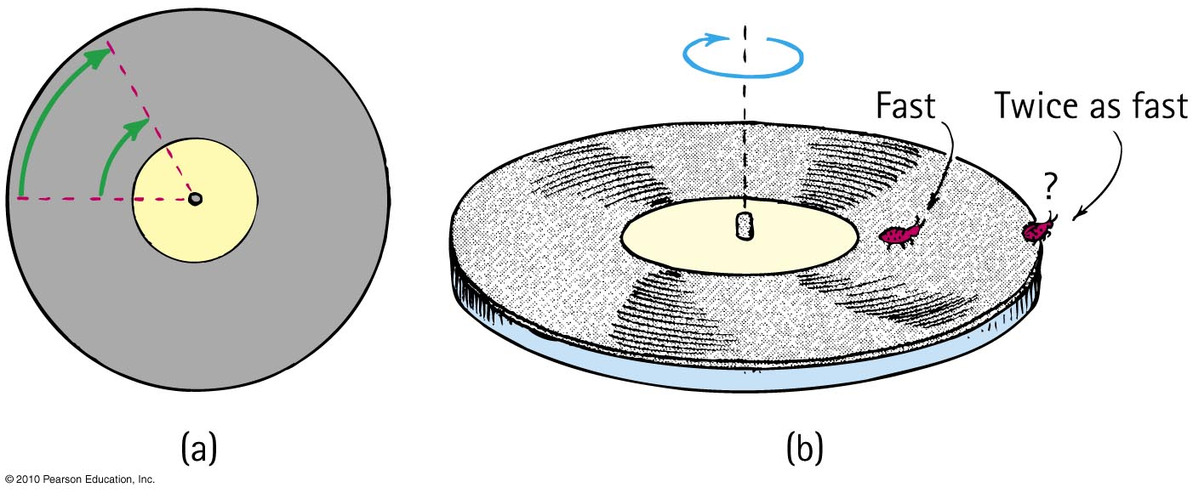
Circular Motion—Tangential Speed
The distance traveled by a point on the rotating object divided by the time taken to travel that distance is called its tangential speed, v.
Points closer to the circumference have a higher tangential speed that points closer to the centre.

Slide 7
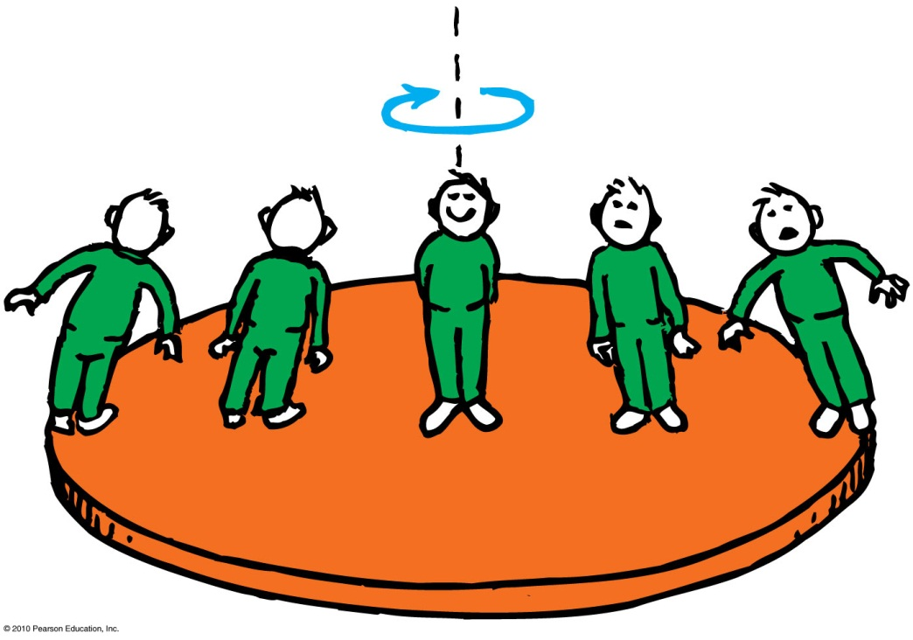
Circular Motion – Rotational Speed
Rotational (angular) speed is the number of radians of angle per unit of time (symbol ω).
All parts of a rigid merry-go-round or turntable turn about the axis of rotation in the same amount of time.
So, all parts have the same rotational speed.
Tangential speed
= Radial Distance × Rotational Speed
ν = rω

Slide 8
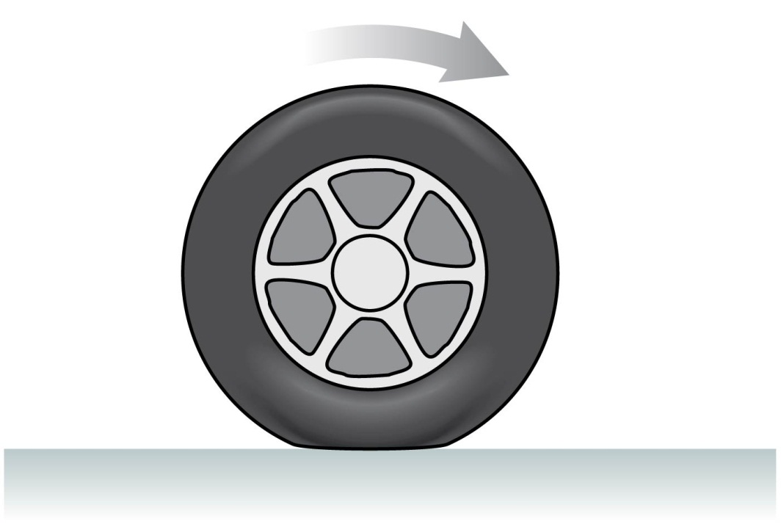
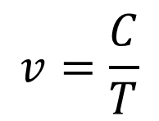
Rolling Without Slipping
Under normal driving conditions, the portion of the rolling wheel that contacts the surface is stationary, not sliding
In this case the speed of the centre of the wheel is:
$$v=\frac{C}{T}$$
where C = circumference [m] and T = Period [s]
If your car is accelerating or decelerating or turning, it is static friction of the road on the wheels that provides the net force which accelerates the car

Slide 9
Discussion Question
The circumference of the tires on your car is 0.9 m.
The onboard computer in your car measures that your tires rotate 10 times per second.
What is the speed as displayed on your speedometer?
0.09 m/s
0.11 m/s
0.9 m/s
1.1 m/s
9 m/s

Slide 10

Rotational Inertia
An object rotating about an axis tends to remain rotating about the same axis at the same rotational speed unless interfered with by some external influence.
The property of an object to resist changes in its rotational state of motion is called rotational inertia (symbol I).
[Image downloaded Jan.10, 2013 from http://images.yourdictionary.com/grindstone ]

Slide 11
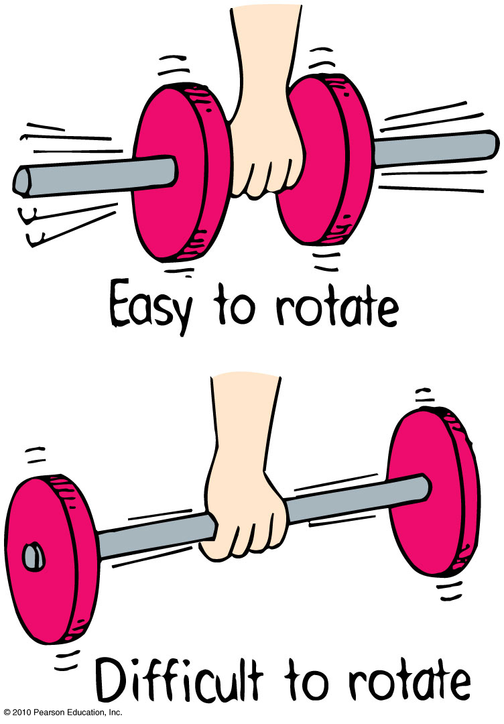
Rotational Inertia
Depends upon:
mass of object.
distribution of mass around axis of rotation.
  The greater the distance between an object’s mass concentration and the axis, the greater the rotational inertia.

Slide 12
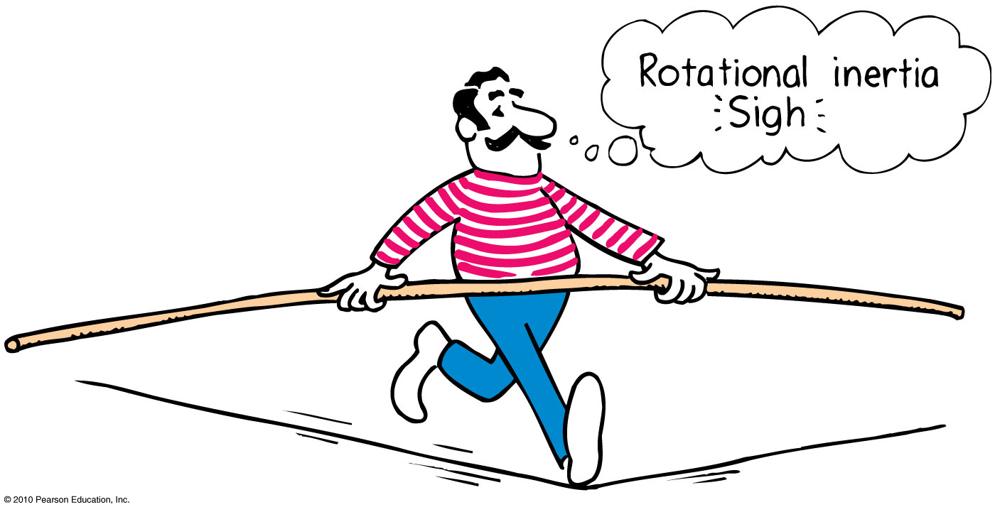
Rotational Inertia
The greater the rotational inertia, the harder it is to change its rotational state.
  A tightrope walker carries a long pole that has a high rotational inertia, so it does not easily rotate.
  Keeps the tightrope walker stable.

Slide 13
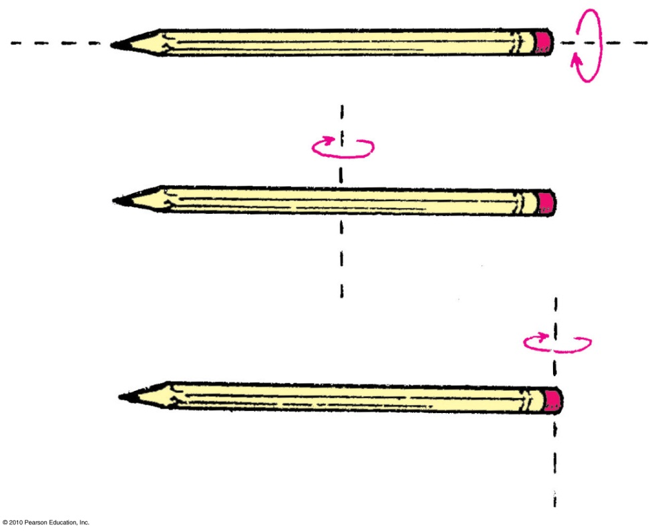
Rotational Inertia
Which pencil has the largest rotational inertia?
The pencil rotated around an axis passing through it.
The pencil rotated around a vertical axis passing through centre.
The pencil rotated around vertical axis passing through the end.

Slide 14
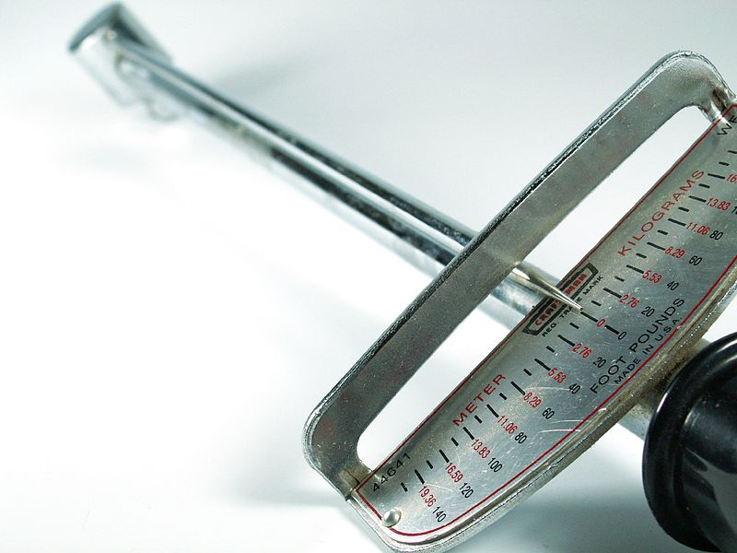
Torque
The tendency of a force to cause rotation is called torque.
Torque depends upon three factors:
  Magnitude of the force
  The direction in which it acts
  The point at which it is applied on the object
Image by John Zdralek, retrieved Jan.10 2013 from http://en.wikipedia.org/wiki/File:1980_c1980_Torque_wrench,_140ft-lbs_19.36m-kg,_nominally_14-20in,_.5in_socket_drive,_Craftsman_44641_WF,_Sears_dtl.jpg ]

Slide 15
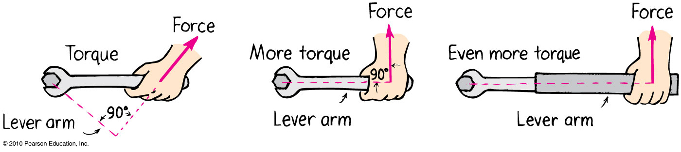
Torque—Example 1 of 3
Lever arm is less than length of handle because of direction of force.

Slide 16
Torque—Example 2 of 3
Lever arm is equal to length of handle.

Slide 17
Torque—Example 3 of 3
Lever arm is longer than length of handle.

Slide 18
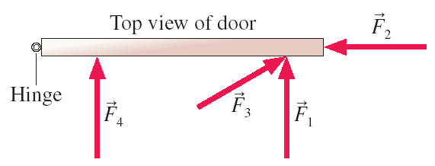
Torque
Consider the common experience of pushing open a door. Shown is a top view of a door hinged on the left. Four pushing forces are shown, all of equal strength. Which of these will be most effective at opening the door?
F₁
F₂
F₃
F₄

Slide 19
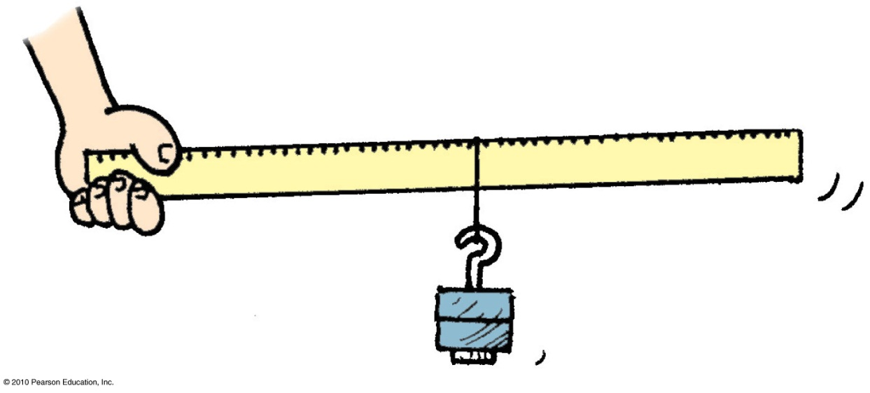
Torque
The equation for Torque is
The lever arm is the perpendicular distance between the line along which the force is applied, and the rotation axis.
Torque = lever arm × force

Slide 20
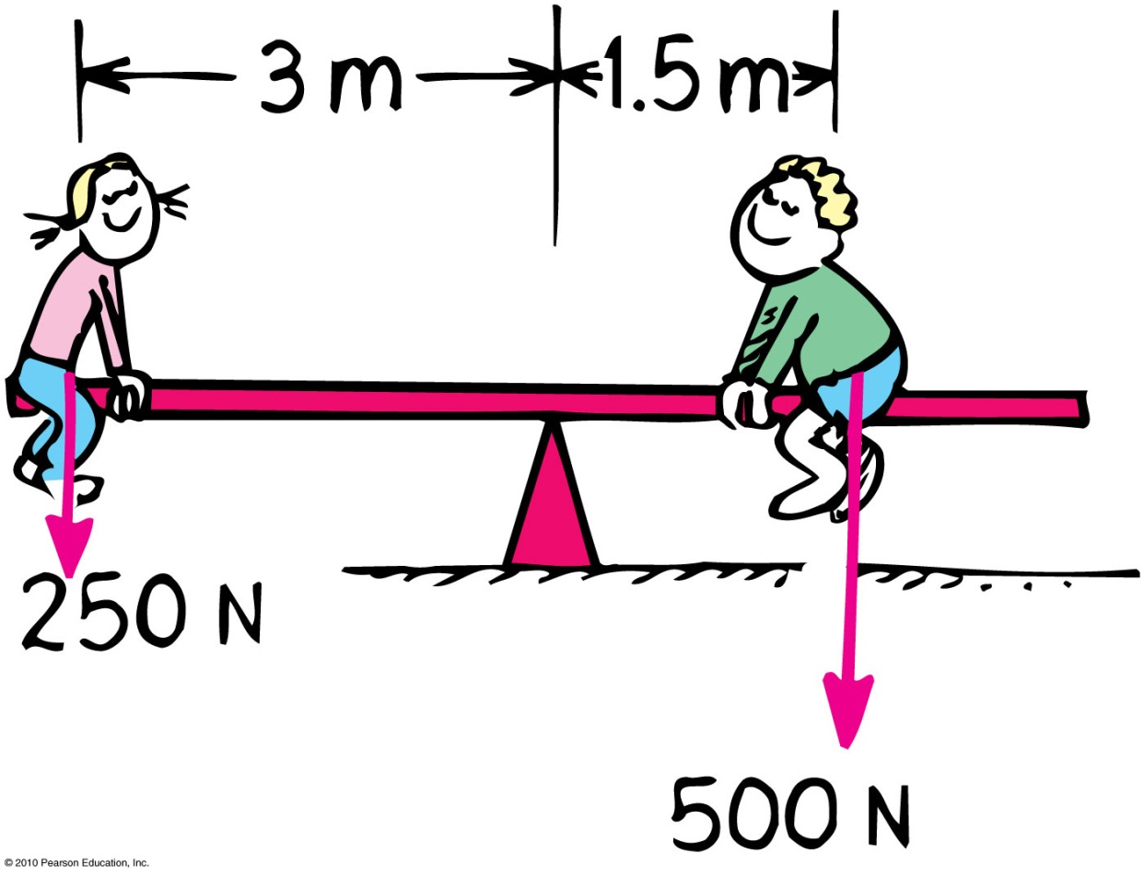
Rotational Inertia
CHECK YOUR NEIGHBOR
Suppose the girl on the left suddenly is handed a bag of apples weighing 50 N. Where should she sit order to balance, assuming the boy does not move?
1 m from pivot
1.5 m from pivot
2 m from pivot
2.5 m from pivot
Notes:
20

Slide 21
Test on Wednesday during class time
Location: EX100, which is 255 McCaul St.
Test will begin promptly at 10 minutes after the hour and will be 50 minutes long – if you can be there a bit early that would be great.
Please bring a calculator, and, if you wish, a 3x5 notecard upon which you may write anything you wish on both sides
Test will cover Hewitt chapters 2-8, and will include:
3 short-answer problems for which you must show your reasoning
12 multiple choice questions – you fill in a bubble sheet
Questions will be similar in style and level to the Exercises and Problems at the end of the chapters in Hewitt

Slide 22
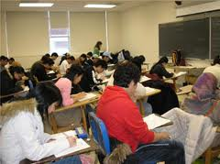

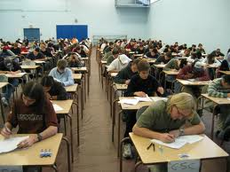
Tips for the 50 minute Test
No phones / ipods etc allowed. You will need a regular calculator, and a watch could be handy as well!
Time Management:
  Skim over the entire test from front to back before you begin. Look for problems that you have confidence to solve first.
  If you start a problem but can’t finish it, leave it, make a mark on the edge of the paper beside it, and come back to it after you have solved all the easy problems.
Bring your T-card or other photo ID, as we will be collecting signatures

Slide 23
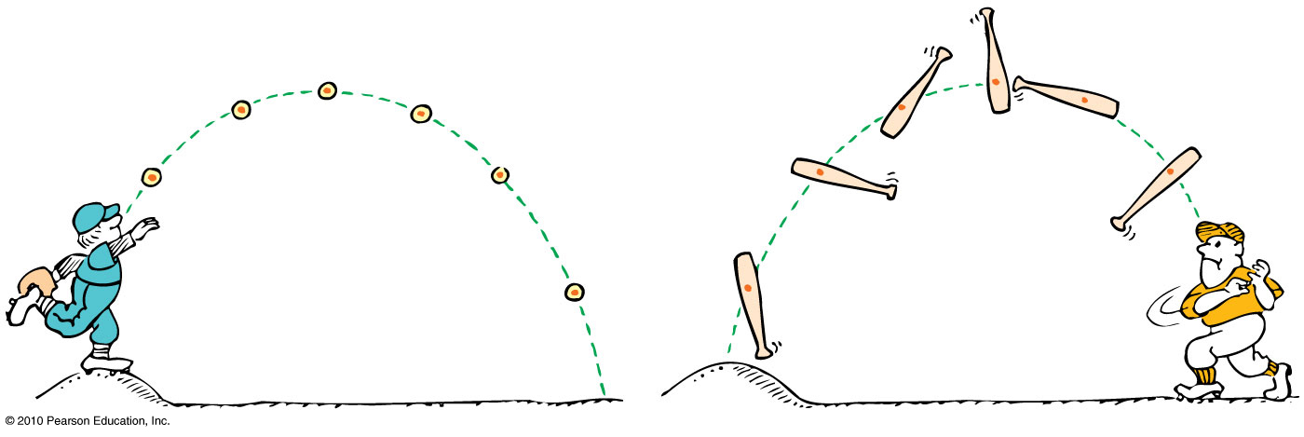
Centre of mass is the average position of all the mass that makes up the object.
Centre of gravity (CG) is the average position of weight distribution.
  Since weight and mass are proportional, centre of gravity and centre of mass usually refer to the same point of an object.

Slide 24
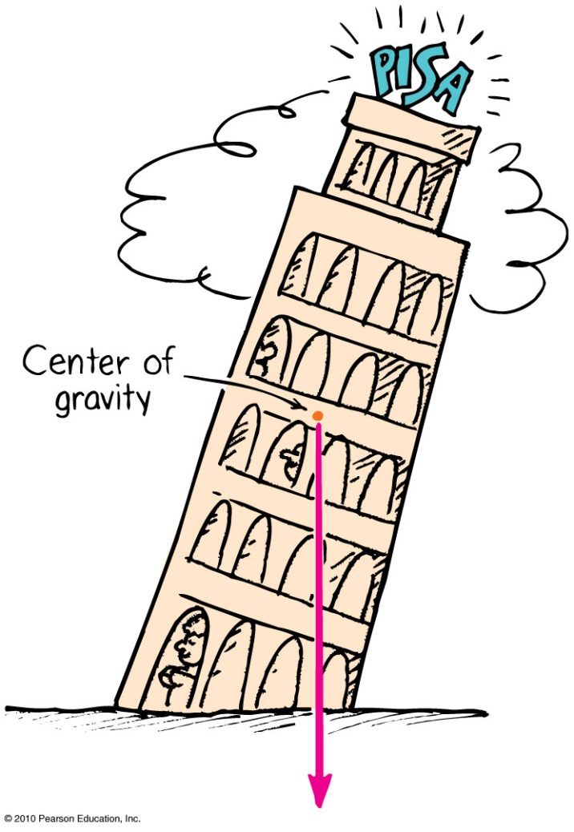
Centre of Gravity—Stability
The location of the centre of gravity is important for stability.
If we draw a line straight down from the centre of gravity and it falls inside the base of the object, it is in stable equilibrium; it will balance.
If it falls outside the base, it is unstable.

Slide 25
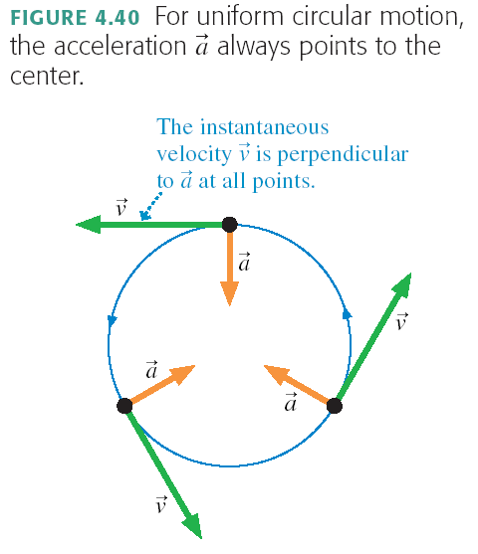
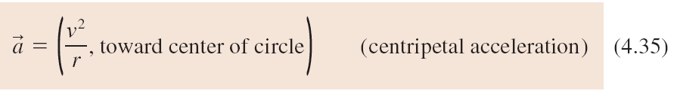
Centripetal Acceleration

Slide 26
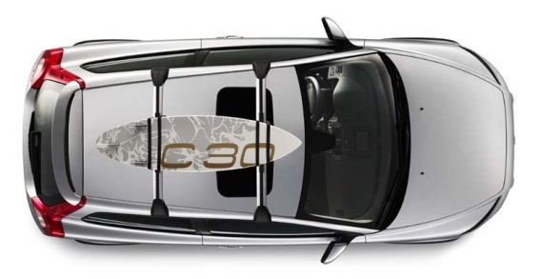
A car is traveling East at a constant speed of 100 km/hr. Without speeding up of slowing down, it is turning left, following the curve in the highway. What is the direction of the acceleration?
N
W
E
S
North
East
North-East
North-West
None; the acceleration is zero.

Slide 27
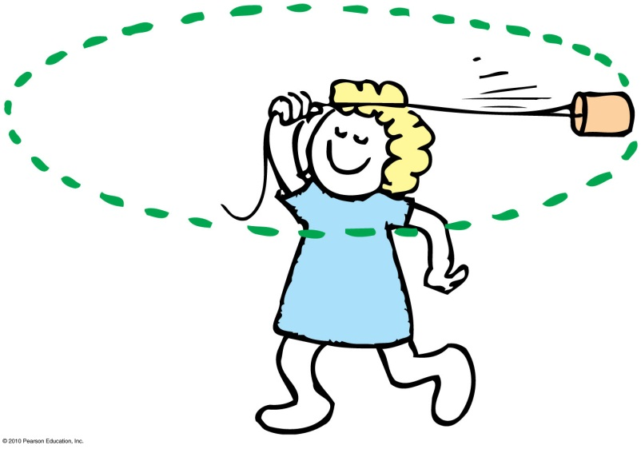
Centripetal Force
Any force directed toward a fixed centre is called a centripetal force.
Centripetal means “centre-seeking” or “toward the centre.”
Example: To whirl a tin can at the end of a string, you pull the string toward the centre and exert a centripetal force to keep the can moving in a circle.

Slide 28
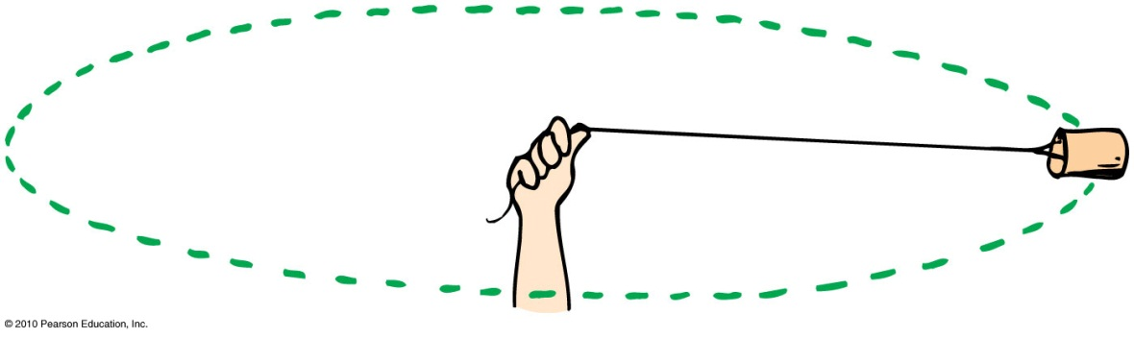

Centripetal Force
Depends upon
  mass of object, m.
  tangential speed of the object, v.
  radius of the circle, r.
In equation form:
$$F=\frac{mv^{2}}{r}$$

Slide 29
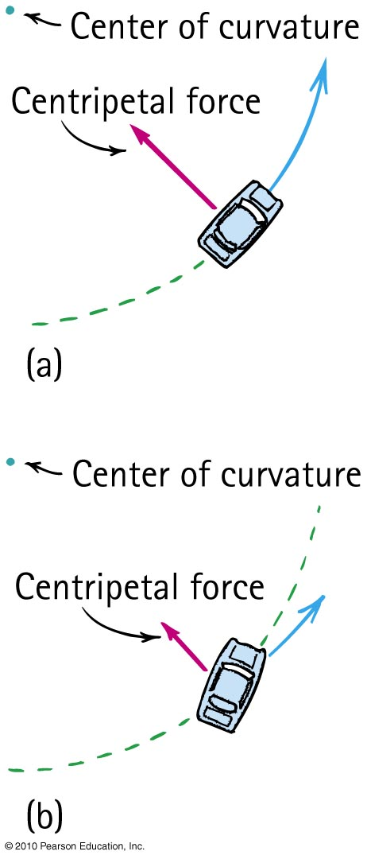
Centripetal Force Example
When a car rounds a curve, the centripetal force prevents it from skidding off the road.
If the road is wet, or if the car is going too fast, the centripetal force is insufficient to prevent skidding off the road.

Slide 30
Centripetal Force
CHECK YOUR NEIGHBOR
Suppose you double the speed at which you round a bend in the curve, by what factor must the centripetal force change to prevent you from skidding?
Double
Four times
Half
One-quarter
Notes:
30

Slide 31
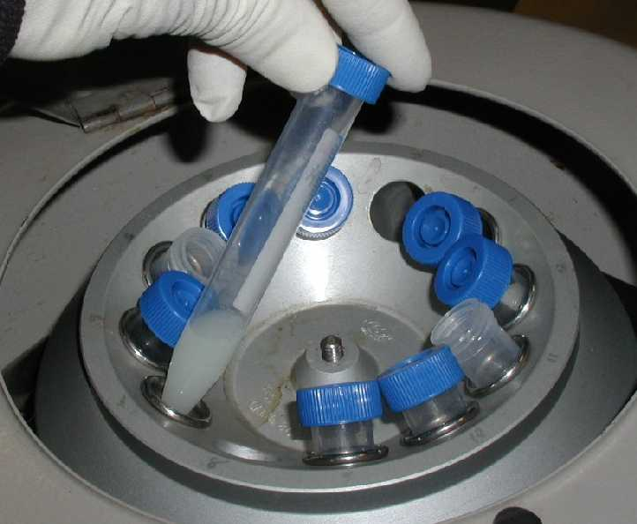
Centrifugal Force
Although centripetal force is centre directed, an occupant inside a rotating system seems to experience an outward force.
This apparent outward force is called centrifugal force.
Centrifugal means “centre-fleeing” or “away from the centre.”
[Image downloaded Jan.10 2013 from http://www.et.byu.edu/~wanderto/homealgaeproject/Harvesting%20Algae.html ]

Slide 32
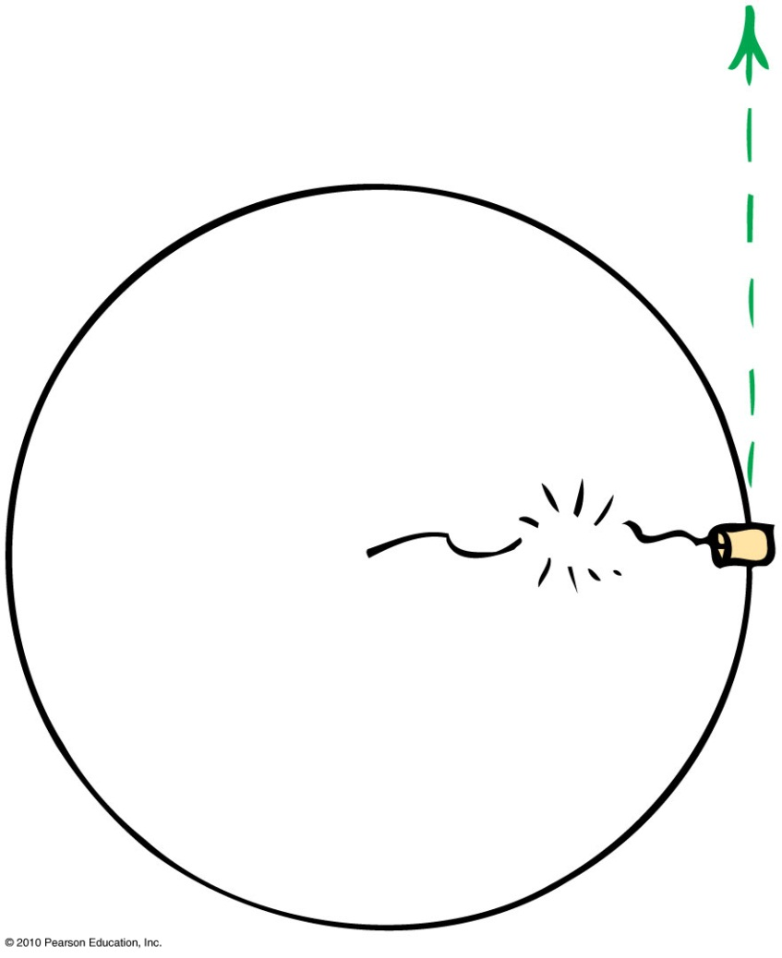
Centrifugal Force
– A Common Misconception
It is a common misconception that a centrifugal force pulls outward on an object.
Example:
  If the string breaks, the object doesn’t move radially outward.
  It continues along its tangent straight-line path—because no force acts on it. (Newton’s first law)

Slide 33
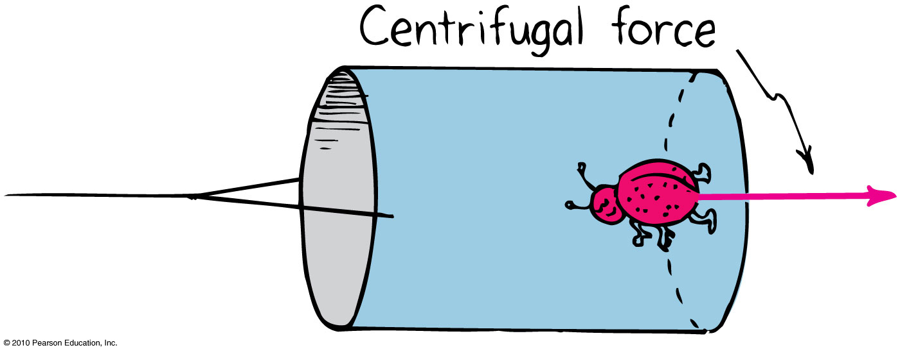
Rotating Reference Frames
Centrifugal force in a rotating reference frame is a force in its own right – feels as real as any other force, e.g. gravity.
Example:
  The bug at the bottom of the can experiences a pull toward the bottom of the can.

Slide 34
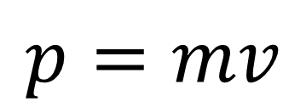

Angular Momentum
The “inertia of rotation” of rotating objects is called angular momentum.
  This is analogous to “inertia of motion”, which was momentum.
Angular momentum
= rotational inertia × rotational velocity
  This is analogous to
  Linear momentum = mass × velocity
$$L=Iω$$
$$p=mv$$

Slide 35
Angular Momentum
For an object that is small compared with the radial distance to its axis, magnitude of
Angular momentum = mass x tangential speed × radius
  This is analogous to magnitude of
  Linear momentum = mass × speed
Examples:
  Whirling ball at the end of a long string
  Planet going around the Sun

Slide 36
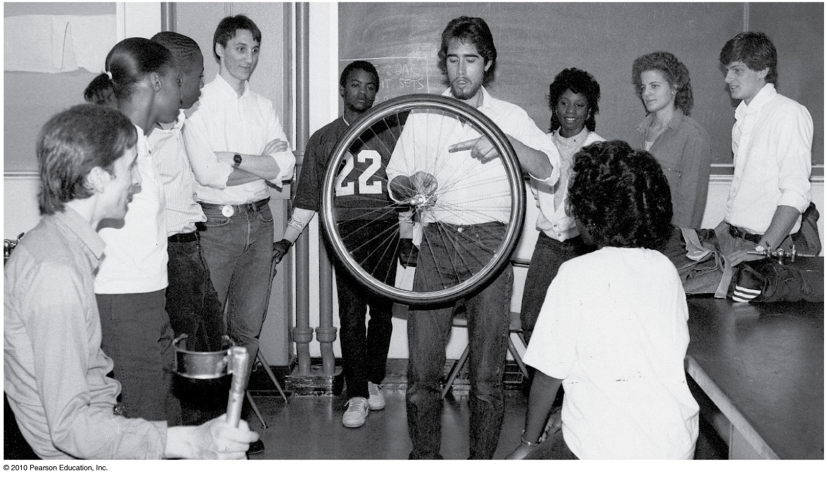
An external net torque is required to change the angular momentum of an object.
Rotational version of Newton’s first law:
  An object or system of objects will maintain its angular momentum unless acted upon by an external net torque.

Slide 37
Conservation of Angular Momentum
The law of conservation of angular momentum states:
  If no external net torque acts on a rotating system, the angular momentum of that system remains constant.
Analogous to the law of conservation of linear momentum:
  If no external force acts on a system, the total linear momentum of that system remains constant.

Slide 38

Angular Momentum
CHECK YOUR NEIGHBOR
Suppose you are swirling a can around and suddenly decide to pull the rope in halfway; by what factor would the speed of the can change?
Double
Four times
Half
One-quarter
Notes:
38

Slide 39
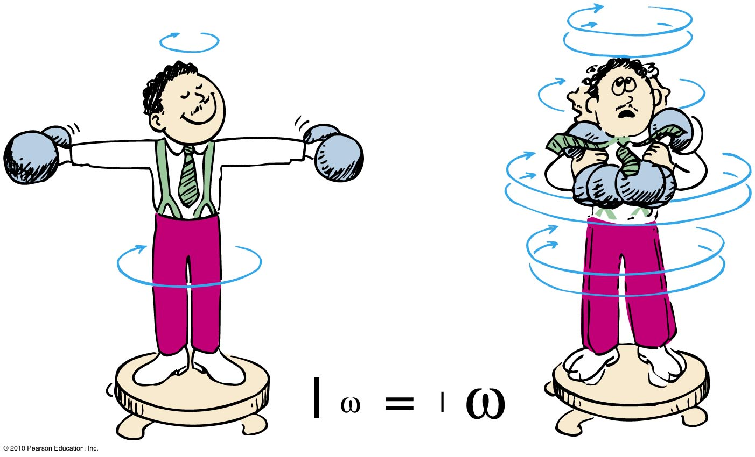
Angular Momentum
CHECK YOUR NEIGHBOR
Your professor is rotating at some rotational speed ω with some rotational inertia set partly by the fact that he is holding masses in his outstretched arms.
Suppose by pulling the weights inward, the rotational inertia of the professor reduces to half its original value. By what factor would his rotational speed change?
Double
Three times
Half
One-quarter
Notes:
39
A. double

Slide 40
Conservation of Angular Momentum
Example:
When the professor pulls the weights inward, his rotational speed increases!

Slide 41

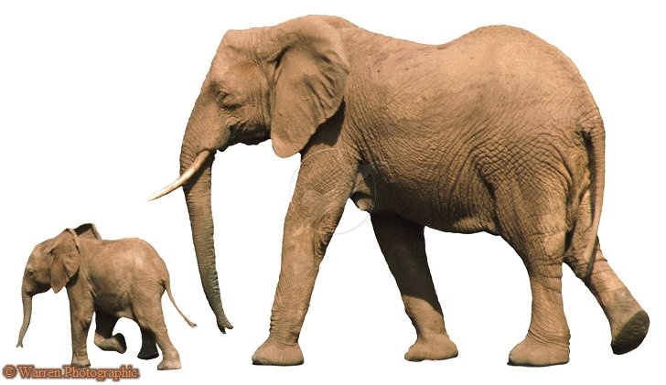

Before Class 8 on Monday
Please read Chapter 12, or at least watch the 10-minute pre-class video for class 8
We are now done the “Mechanics” part of the course, and will be starting next on solids, liquids, gases, and thermal physics.
Something to think about over the weekend:
Which has the greater surface area to volume ratio: an ant or an elephant?

