Slide 1
Conceptual Physics 11th Edition
Chapter 12:
SOLIDS
Atoms, Elements
Molecules, Compounds
Crystal Structure
Density
Elasticity
Tension and Compression
Arches
Scaling

Slide 2
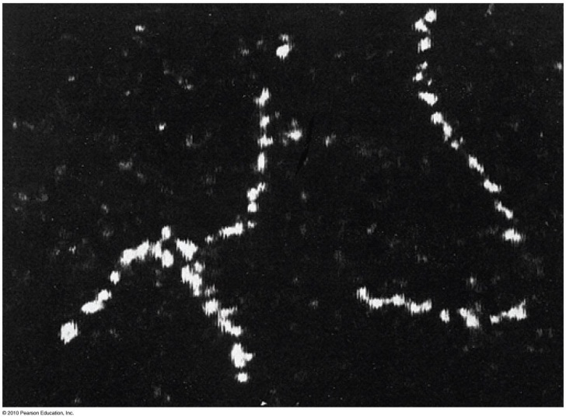
Atoms
Atoms are the building blocks of all matter
They are too small to be seen with visible light
Atoms were first directly observed as chains of individual thorium atoms in a 1970 electron micrograph image

Slide 3
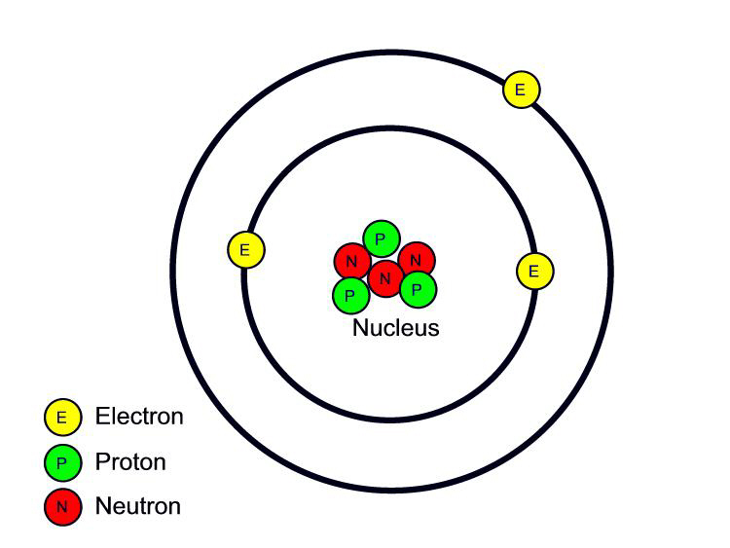
Atomic structure is composed of:
An atomic nucleus, which contains nearly all the mass
Orbiting electrons
The nucleus is composed of protons and neutrons, which are in turn made of smaller quarks
Protons have electric charge +1
Electrons have electric charge -1
All neutral atoms have the same number of protons as electrons
[Image retrieved Jan.10, 2013 from http://www.safetyoffice.uwaterloo.ca/hse/radiation/rad_sealed/matter/atom_structure.htm ]

Slide 4
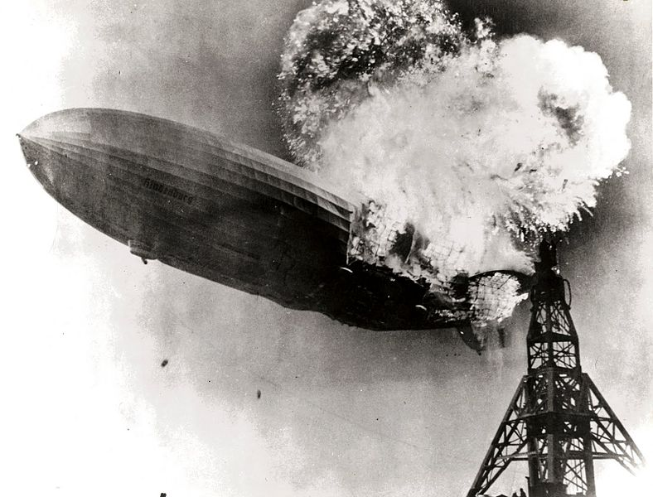
The Elements
Atoms
Refer to particles that make up a substance
Elemental substance
Composed of only one kind of atom
Lightest and most abundant is hydrogen.
To date, about 115 are known.
90 occur in nature.
Others produced in laboratory are unstable.
Words atom and element can be used interchangeably.
[Image retrieved Jan.11 2013 from http://en.wikipedia.org/wiki/File:Hindenburg_burning.jpg ]

Slide 5
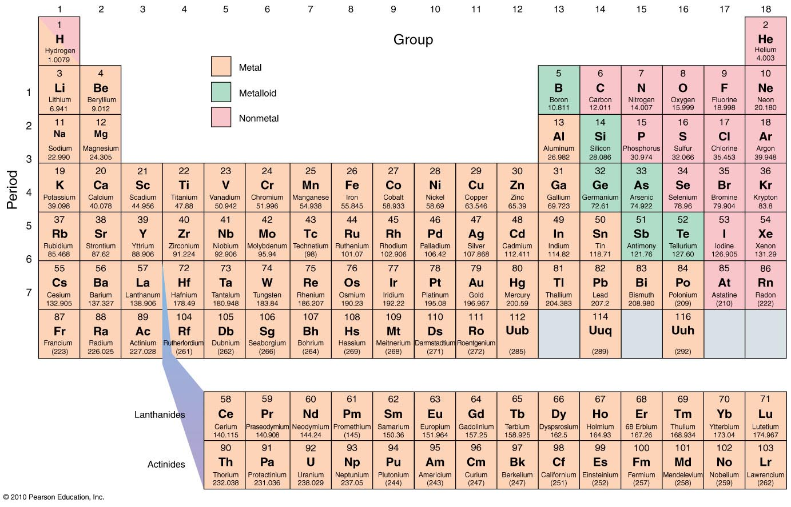
Periodic Table of the Elements

Slide 6
Compounds are made of Molecules
Molecules
Two or more atoms bonded together
Example:
NH₃ (ammonia)
3 atoms of hydrogen and 1 atom of nitrogen

Slide 7
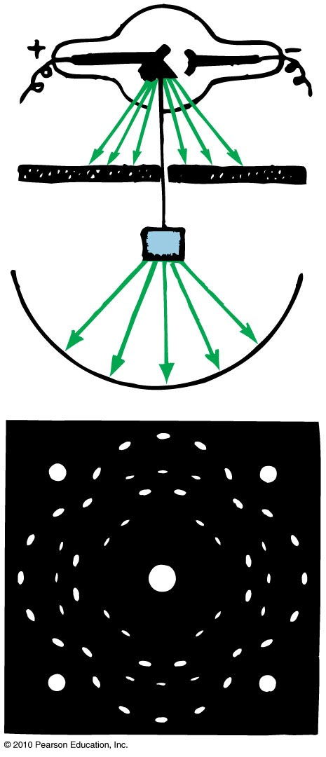
Crystal Structure
Atoms in a solid are arranged in a regular array called a crystal.
If you shine an X-ray beam on a solid and it produces an X-ray diffraction pattern, this is evidence of the crystalline nature of the solid.
Solids that do not have atoms arranged in a regular array are called amorphous solids.

Slide 8
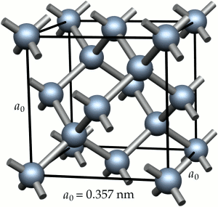
Crystal Structure
The following kinds of bonds can exist between atoms in a solid:
Ionic
Covalent
Metallic
Van der Waals—the weakest
The properties of a solid are dependent upon the kind of bonds that exists between the atoms.
[Image retrieved Jan.11 2013 from http://www.e6cvd.com/cvd/page.jsp?pageid=361 ]

Slide 9
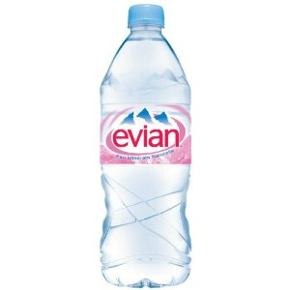
Density
Amount of mass per unit volume of a material.
Unit of density is kg/m³ or g/cm³.
Example: Density of water is 1000 kg/m³, or 1 g/cm³.
mass
Density
=
volume
[Image retrieved Jan. 11, 2013 from http://www.amazon.com/Evian-Water-Liter-Pack/dp/B0041HVMU0 ]

Slide 10
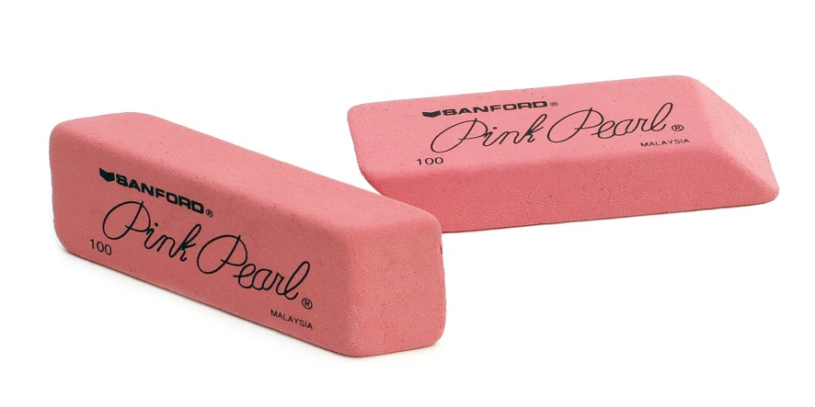
Elasticity
A solid object subjected to external forces may undergo changes in shape and/or size.
A body’s elasticity is a measure of how much it changes when a deforming force is exerted on it and how well it returns to its original shape.
Materials that do not return to their original shape are inelastic.
[Image retrieved Jan. 11 2013 from http://en.wikipedia.org/wiki/File:Office-pink-erasers.jpg ]

Slide 11
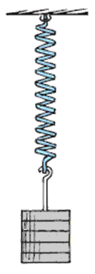
Elasticity
Hooke’s law: The extension of a spring is directly proportional to the force applied to it.
Force
~
extension
or
F
~
Δ
x

Slide 12
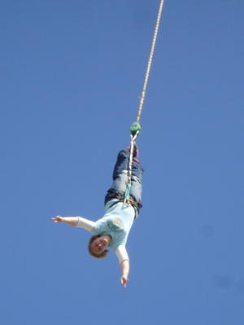
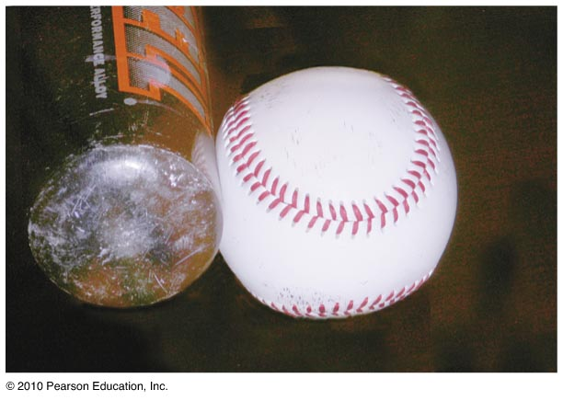
Tension and Compression
When something is
pulled it is in tension.
squashed it is in compression.
[Image retrieved Jan.11 2013 from http://busstop.typepad.com/blog/2007/07/the-blonde-and-.html ]

Slide 13
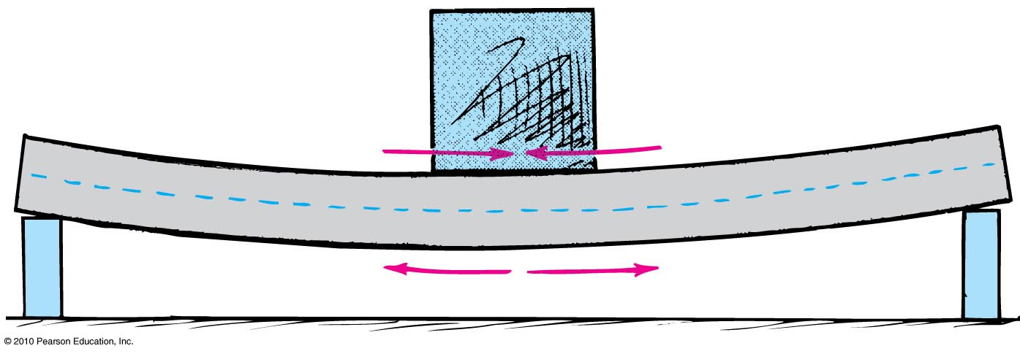
Tension and Compression
When girder is as shown, it is under
tension on the lower side.
compression on the upper side.

Slide 14
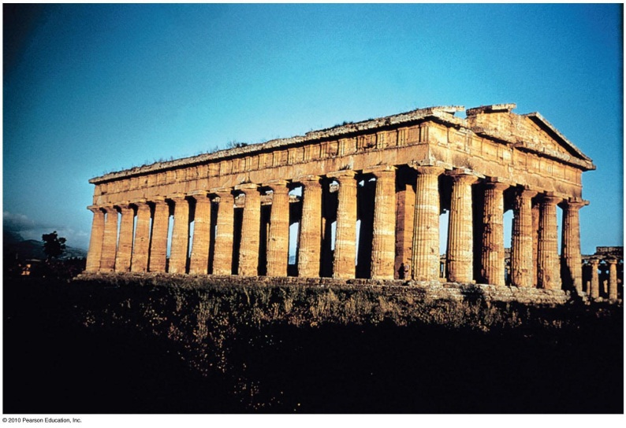
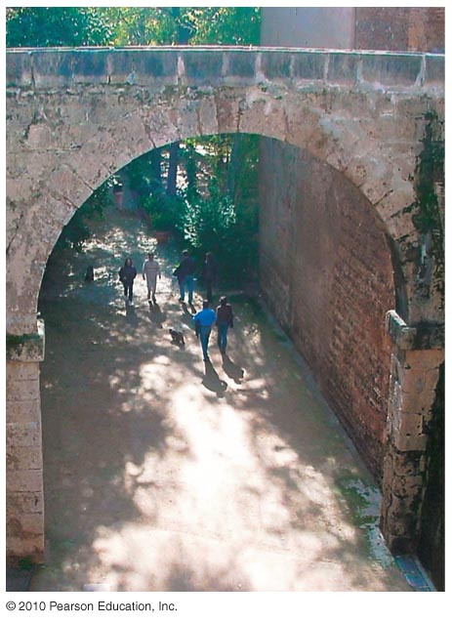
Arches
Roofs of some older buildings needed many supporting columns.
But with the discovery of arches, supporting columns were no longer needed.
Arches take advantage of the capacity of stone to withstand compression.
They use this ability of stone to increase the strength of the structure.

Slide 15
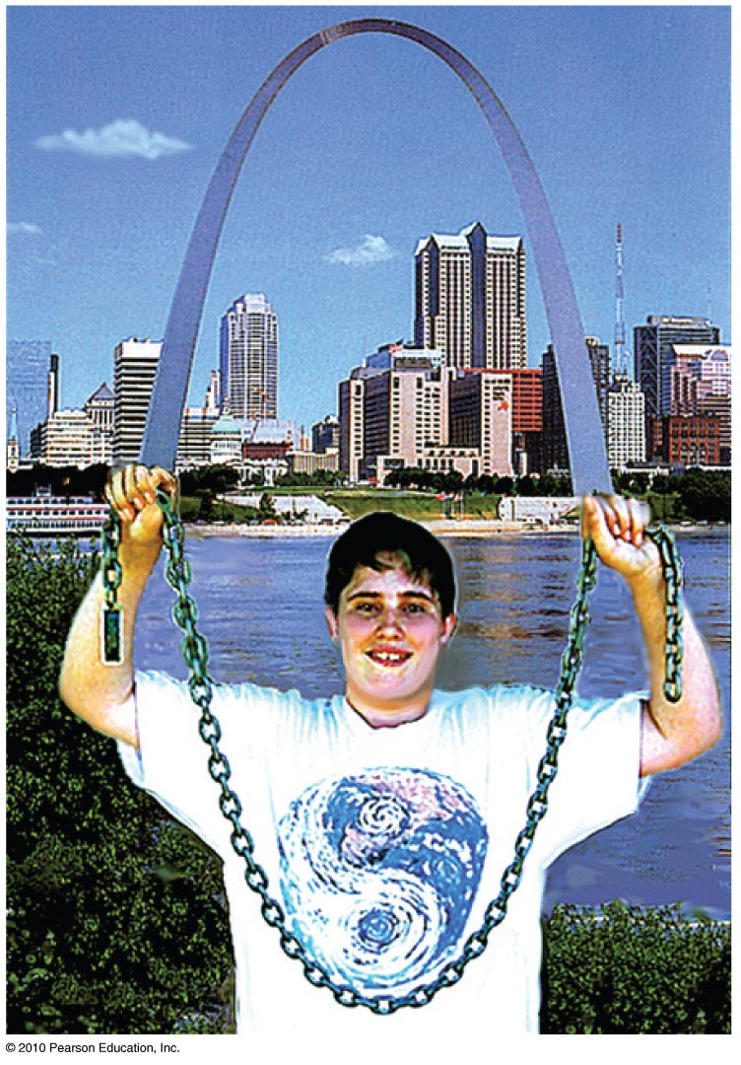
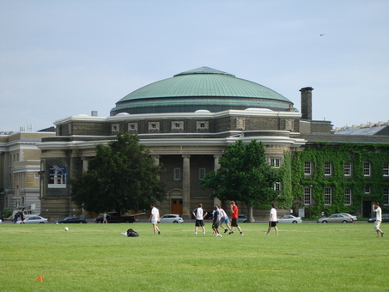
Arches
If the arch is supporting only its own weight, then the proper shape is a catenary (e.g., Arch of St. Louis).
The catenary is also the natural shape of a chain that hangs between two points.
An arch rotated around is a dome (e.g., Convocation Hall).
[Image retrieved Jan.11 2013 from http://openbuildings.com/buildings/convocation-hall-profile-7687 ]

Slide 16
Scaling
Scaling is the study of how the volume and shape (size) of any object affect the relationship of its strength, weight, and surface area.
Strength is related to the area of the cross section (which is two-dimensional and is measured in square centimeters).
Weight relates to volume (which is 3-dimensional and is measured in cubic centimeters).

Slide 17
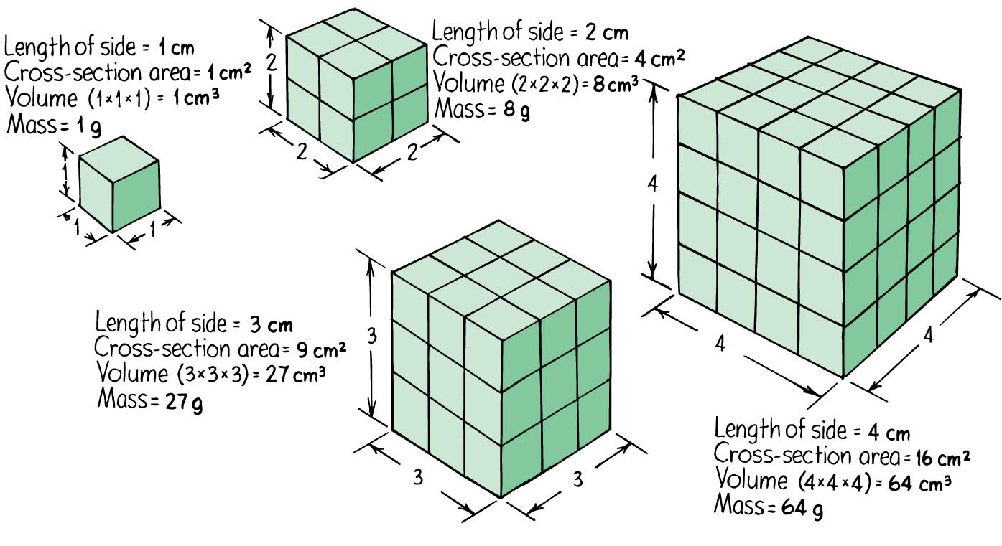
Scaling

Slide 18
So the surface area to volume ratio is
Strength to Weight Ratio decreases with increasing size.
Surface
area
size
2
1
~
~
Volume
size
3
size
[Image is © Jiri Bohdal http://www.naturephoto-cz.com/house-fly-photo-14134.html ]
[Image retrieved Jan.11, 2013 from http://en.wikipedia.org/wiki/File:African_Bush_Elephant.jpg ]

