Slide 1
Note on Posted Slides
These are the slides that I intended to show in class on Mon. Feb. 4, 2013.
They contain important ideas and questions from your reading.
Due to time constraints, I was probably not able to show all the slides during class.
They are all posted here for completeness.

Slide 2
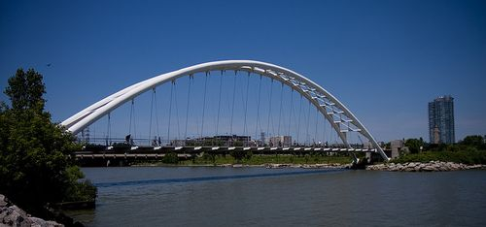
PHY205H1S Physics of Everyday Life Class 8: Solids
Image from http://www.toronto.ca/auda/elements_hon_men_arch_2001.htm
Atoms, Elements
Molecules, Compounds
Crystal Structure
Density
Elasticity
Tension and Compression
Arches
Scaling
Image from http://torontopubliclibrary.typepad.com/trl/2012/11/research-guide-to-the-humber-river-ontario.html

Slide 3
Chapter 12. Pre-Class Reading Question
According to Hooke's law, if you double the force when stretching a spring, the elongation of the spring is normally
no different, the same
twice as much
half as much
four times as much

Slide 4
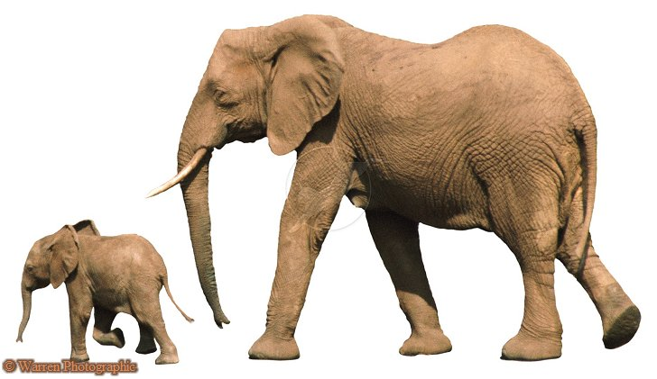
Chapter 12. Pre-Class Reading Question
Which has the greater outer surface area?
An elephant
An ant
neither

Slide 5
Chapter 12. Pre-Class Reading Question
Which has the greater outer surface area per volume?
An elephant
An ant
neither

Slide 6
Atoms
Atoms are the building blocks of all matter
They are too small to be seen with visible light
One gram of water has a volume of 1 cm³ and contains more than 10²³ atoms!
10²³ = 100,000,000,000,000,000,000,000
This is a scanning tunneling microscope image of graphite taken by Igor Fridman, a graduate student in U of T Physics
The dots are individual carbon atoms
[image from http://www.physics.utoronto.ca/~ifridman/ ]

Slide 7
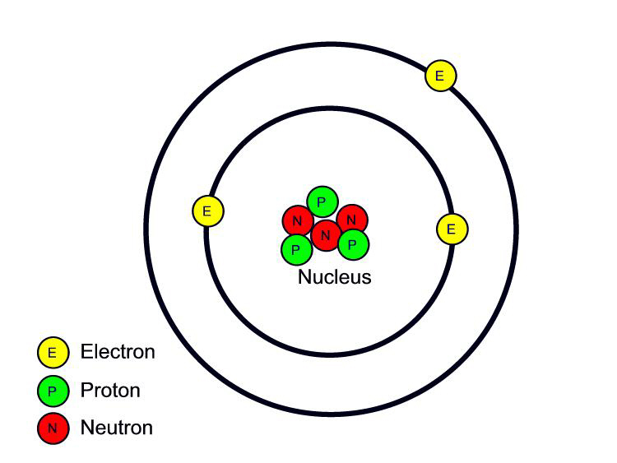
Atomic structure is composed of:
An atomic nucleus, which contains nearly all the mass
Orbiting electrons
The nucleus is composed of protons and neutrons, which are in turn made of smaller quarks
Protons have electric charge +1
Electrons have electric charge -1
All neutral atoms have the same number of protons as electrons
[Image retrieved Jan.10, 2013 from http://www.safetyoffice.uwaterloo.ca/hse/radiation/rad_sealed/matter/atom_structure.htm ]

Slide 8
The nucleus of an electrically neutral iron atom contains 26 protons. How many electrons are in this iron atom?
Atoms
Check your neighbour
52
26
24
28
zero
Notes:
C. both

Slide 9
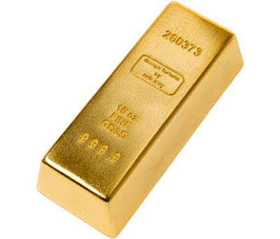
The Elements
Atoms
Refer to particles that make up a substance
Elemental substance
Composed of only one kind of atom
Lightest and most abundant is hydrogen.
To date, about 115 are known.
90 occur in nature.
Others produced in laboratory are unstable.
Words atom and element can be used interchangeably.
[Image retrieved Feb.4 2013 from http://parisbreakfasts.blogspot.ca/2011/09/financiers.html ]

Slide 10
The atomic number of an element matches the number of
Atoms
Challenge Question: Do you know it?
A. protons in the nucleus of an atom.
electrons in a neutral atom.
Both of the above.
None of the above.
Notes:
C. both

Slide 11
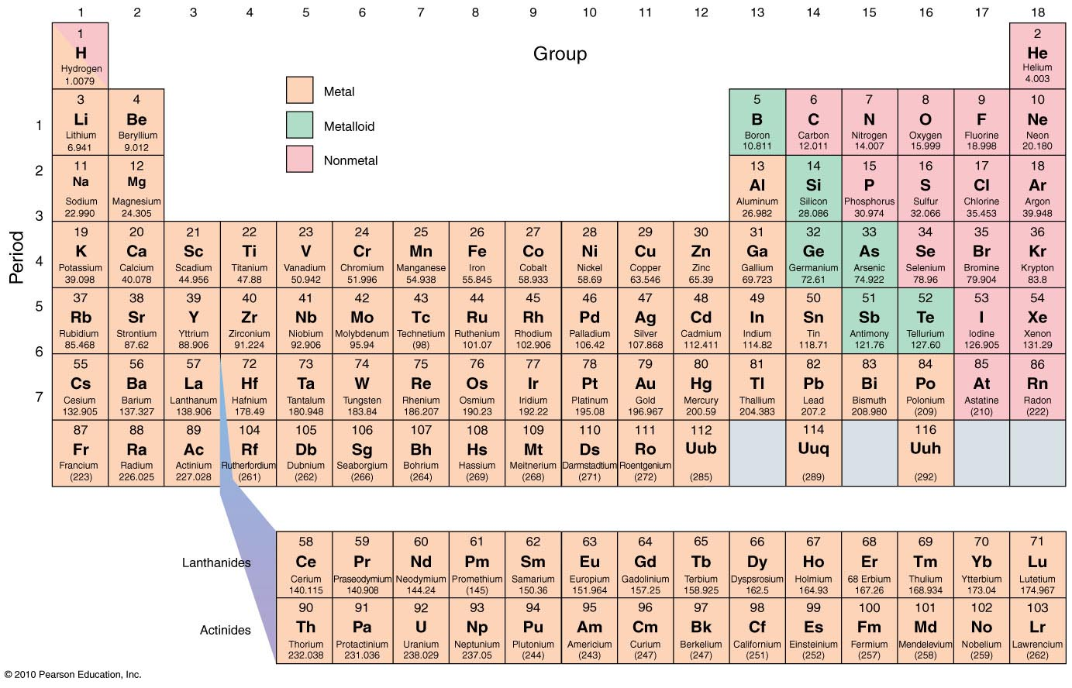
Periodic Table of the Elements

Slide 12
Compounds are made of Molecules
Molecules are two or more atoms bonded together
Example:
NH₃ (ammonia)
3 atoms of hydrogen and 1 atom of nitrogen

Slide 13
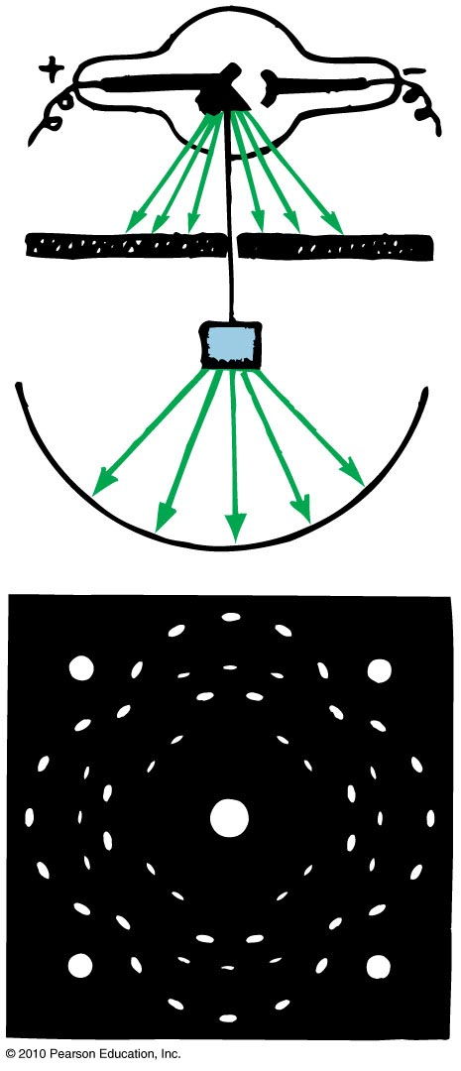
Crystal Structure
Atoms in a solid are arranged in a regular array called a crystal.
If you shine an X-ray beam on a solid and it produces an X-ray diffraction pattern, this is evidence of the crystalline nature of the solid.
Solids that do not have atoms arranged in a regular array are called amorphous solids.

Slide 14
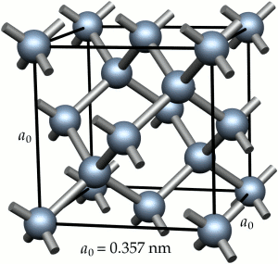
Crystal Structure
The following kinds of bonds can exist between atoms in a solid:
Ionic
Covalent
Metallic
Van der Waals—the weakest
The properties of a solid are dependent upon the kind of bonds that exists between the atoms.
[Image retrieved Jan.11 2013 from http://www.e6cvd.com/cvd/page.jsp?pageid=361 ]

Slide 15
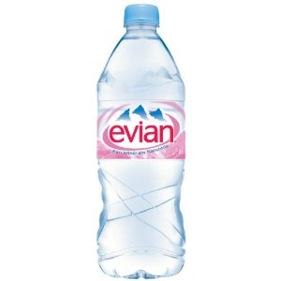
Density
Amount of mass per unit volume of a material.
Unit of density is kg/m³ or g/cm³.
Example: Density of water is 1000 kg/m³, or 1 g/cm³.
mass
Density
=
volume
[Image retrieved Jan. 11, 2013 from http://www.amazon.com/Evian-Water-Liter-Pack/dp/B0041HVMU0 ]

Slide 16
If the volume of an object were to double, with no change in mass, what would happen to its density?
Atoms
Check your neighbour
It would remain unchanged.
It would double.
It would decrease by a factor of two.
None of these.
Notes:
C. both

Slide 17
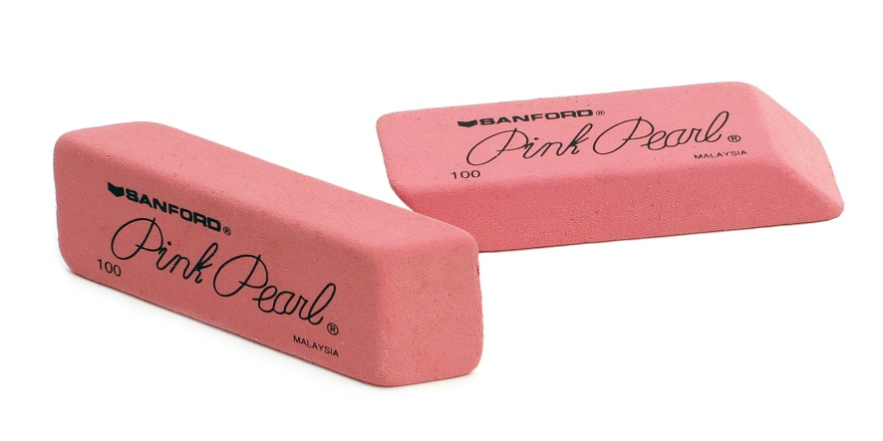
Elasticity
A solid object subjected to external forces may undergo changes in shape and/or size.
A body’s elasticity is a measure of how much it changes when a deforming force is exerted on it and how well it returns to its original shape.
Materials that do not return to their original shape are inelastic.
[Image retrieved Jan. 11 2013 from http://en.wikipedia.org/wiki/File:Office-pink-erasers.jpg ]

Slide 18
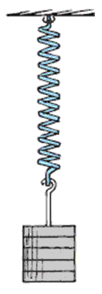
Elasticity
Hooke’s law: The extension of a spring is directly proportional to the force applied to it.
Force
~
extension
or
F
~
Δ
x

Slide 19
Elasticity
CHECK YOUR NEIGHBOR
A 10-cm-long spring extends to 12 cm when a 1-kg load is suspended from it. What would be its length if a 3-kg load were suspended from it?
14 cm
16 cm
20 cm
24 cm
Notes:
19

Slide 20
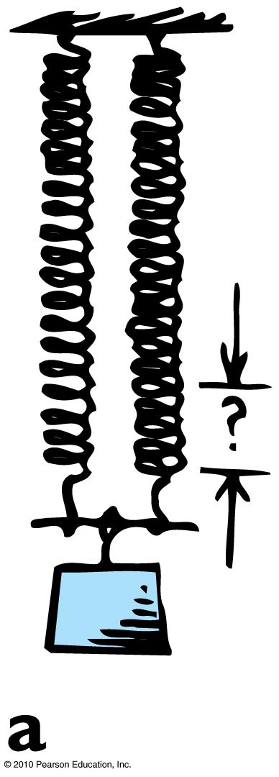
Hooke’s Law: Example 1
Consider a spring that stretches an amount d when a load of mass m is suspended from it.
How much will the spring stretch if two identical springs support the same single mass as shown?

Slide 21
Hooke’s Law: Example 2
Consider a spring that stretches an amount d when a load of mass m is suspended from it.
How much will the spring stretch if two identical springs support the same single mass as shown?

Slide 22
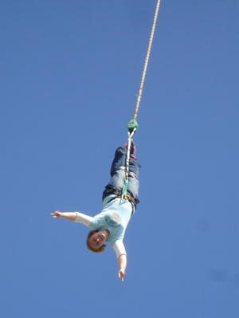
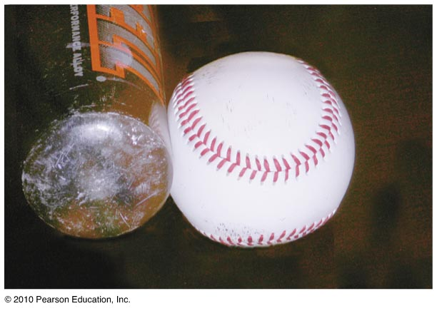
Tension and Compression
When something is
pulled it is in tension.
squashed it is in compression.
[Image retrieved Jan.11 2013 from http://busstop.typepad.com/blog/2007/07/the-blonde-and-.html ]

Slide 23
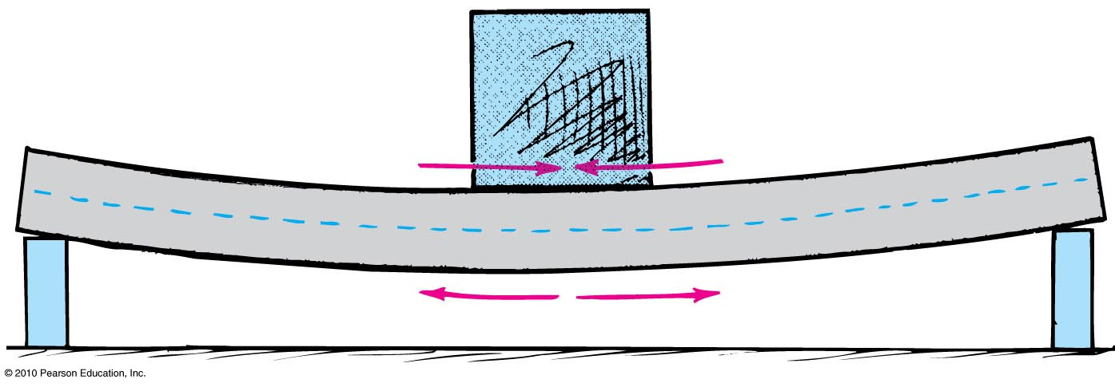
Tension and Compression
When girder is as shown, it is under
tension on the lower side.
compression on the upper side.

Slide 24
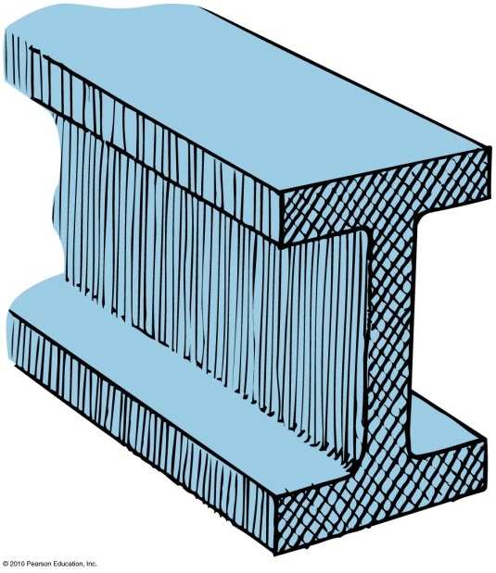
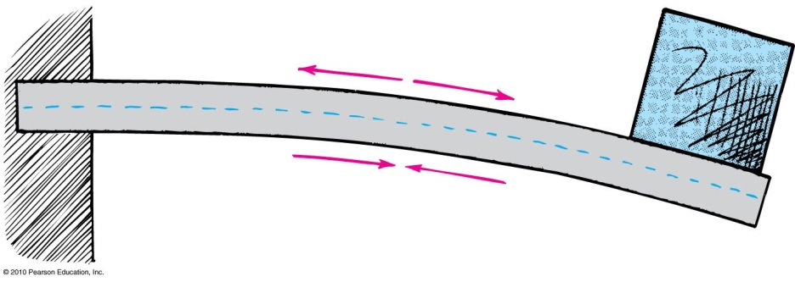
Tension and Compression
Often construction uses an I–beam, i.e., a beam with a cross-section shaped as letter I.
When the beam is used as shown, the shape of the I-beam
maximizes strength because the top (under tension) and bottom (under compression) have the most material.
minimizes weight because the middle of the beam that is not under stress has the least material.

Slide 25
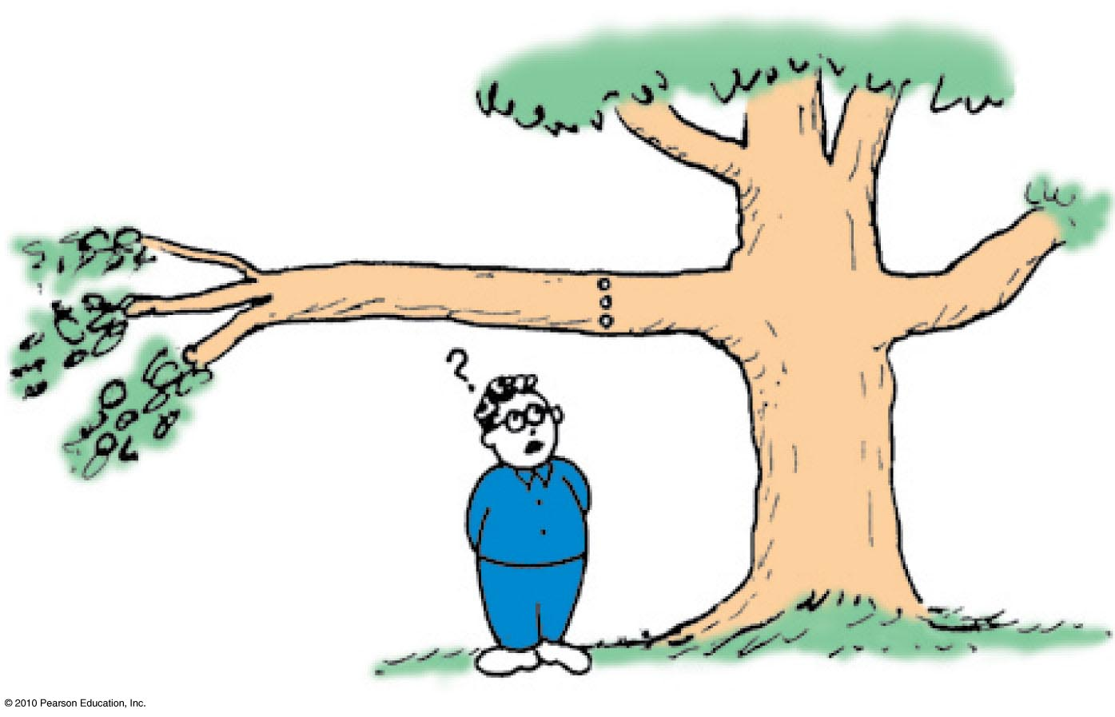
Tension and Compression
CHECK YOUR NEIGHBOR
Suppose you drill a hole horizontally through a tree branch as shown. Where will the hole weaken the branch the least?
Near the top
Near the bottom
Near the middle
It does not matter.
Notes:
25

Slide 26
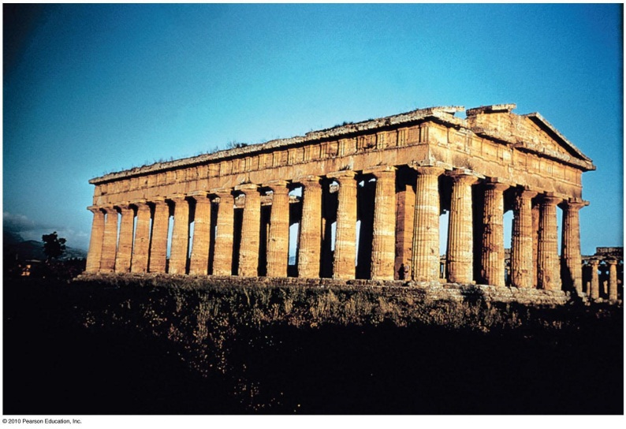
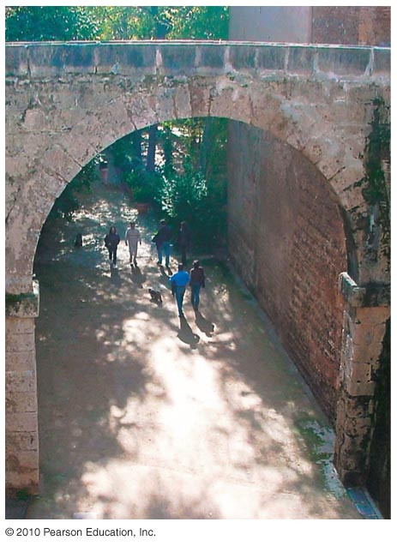
Arches
Roofs of some older buildings needed many supporting columns.
But with the discovery of arches, supporting columns were no longer needed.
Arches take advantage of the capacity of stone to withstand compression.
They use this ability of stone to increase the strength of the structure.

Slide 27
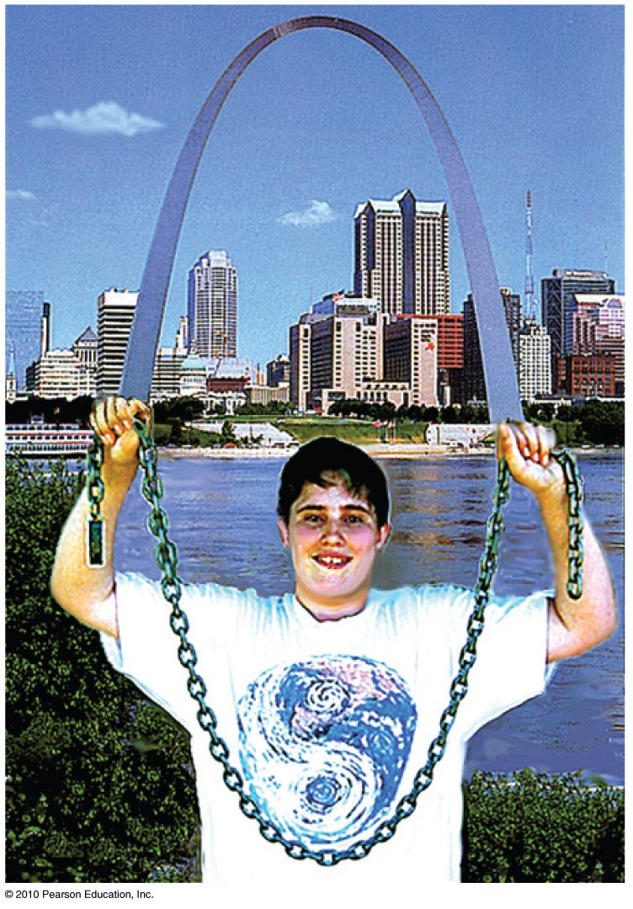
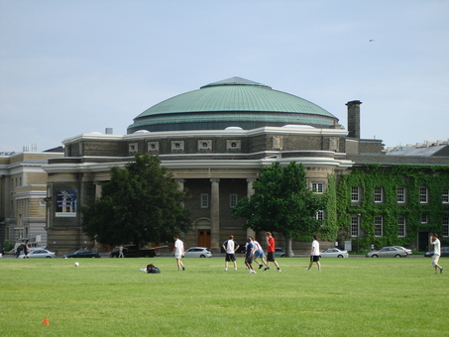
Arches
If the arch is supporting only its own weight, then the proper shape is a catenary (e.g., Arch of St. Louis).
The catenary is also the natural shape of a chain that hangs between two points.
An arch rotated around is a dome (e.g., Convocation Hall).
[Image retrieved Jan.11 2013 from http://openbuildings.com/buildings/convocation-hall-profile-7687 ]

Slide 28
Scaling
Scaling is the study of how the volume and shape (size) of any object affect the relationship of its strength, weight, and surface area.
Strength is related to the area of the cross section (which is two-dimensional and is measured in square centimeters).
Weight relates to volume (which is 3-dimensional and is measured in cubic centimeters).

Slide 29
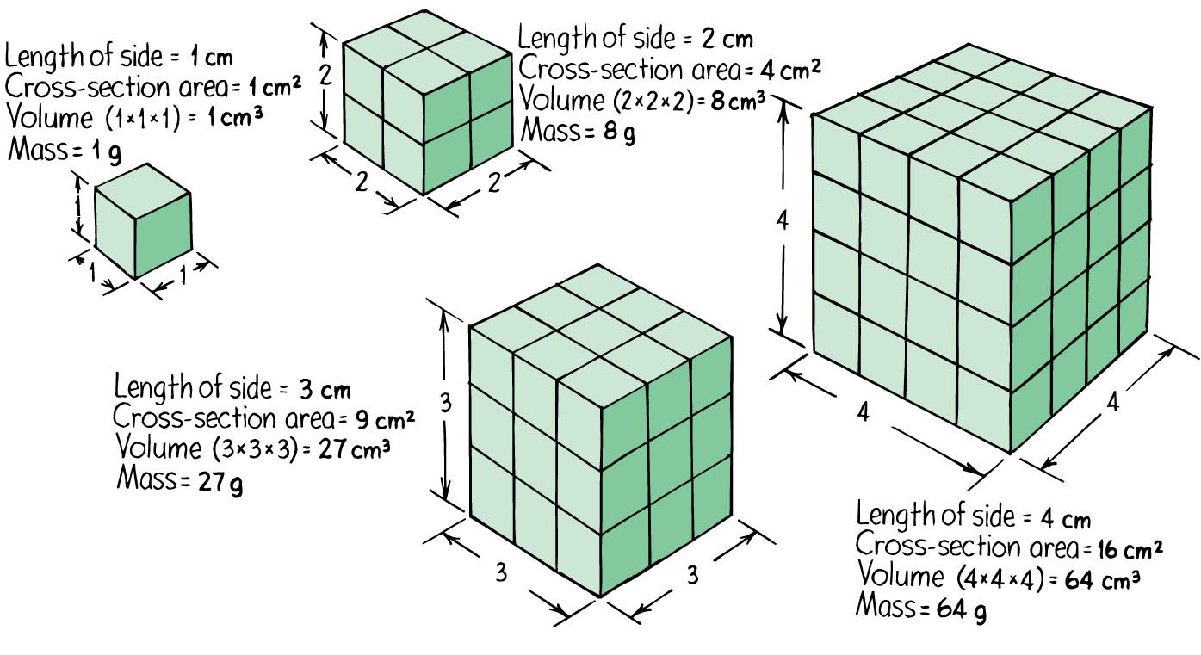
Scaling

Slide 30
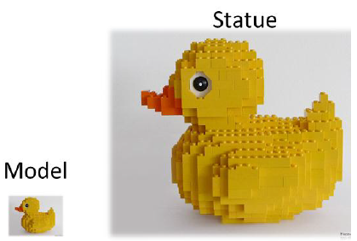
Scaling Example
A sculptor is making a statue of a duck.
She first creates a model.
To make the model requires exactly 2 kg of bronze.
The final statue will be 5 times the size of the model in all three dimensions.
How much bronze will she require to cast the final statue?
(You may find it helpful to think about the model being constructed of Lego blocks, with the final statue made of Lego blocks that are 5 times the size in each dimension as the ones used to make the model.)

Slide 31
When you scale up an object to 3 times its linear size, the surface area increases by
Atoms
Check your neighbour
3 and the volume by 3.
3 and the volume by 9.
3 and the volume by 27.
9 and the volume by 27.
4 and the volume by 8.
Notes:
C. both

Slide 32
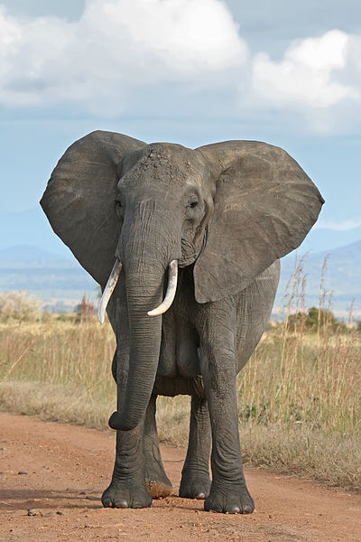
So the surface area to volume ratio is
Strength to Weight Ratio decreases with increasing size.
Surface
area
size
2
1
~
~
Volume
size
3
size
[Image is © Jiri Bohdal http://www.naturephoto-cz.com/house-fly-photo-14134.html ]
[Image retrieved Jan.11, 2013 from http://en.wikipedia.org/wiki/File:African_Bush_Elephant.jpg ]

Slide 33
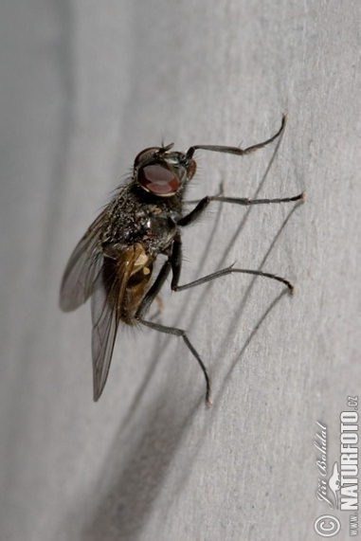
Scaling
Air resistance is proportional to surface area.
Force of gravity is proportional to mass, which is proportional to volume.
So the ratio of air resistance to weight decreases as size increases.
[Image is © Jiri Bohdal http://www.naturephoto-cz.com/house-fly-photo-14134.html ]
[Image retrieved Jan.11, 2013 from http://en.wikipedia.org/wiki/File:African_Bush_Elephant.jpg ]

Slide 34
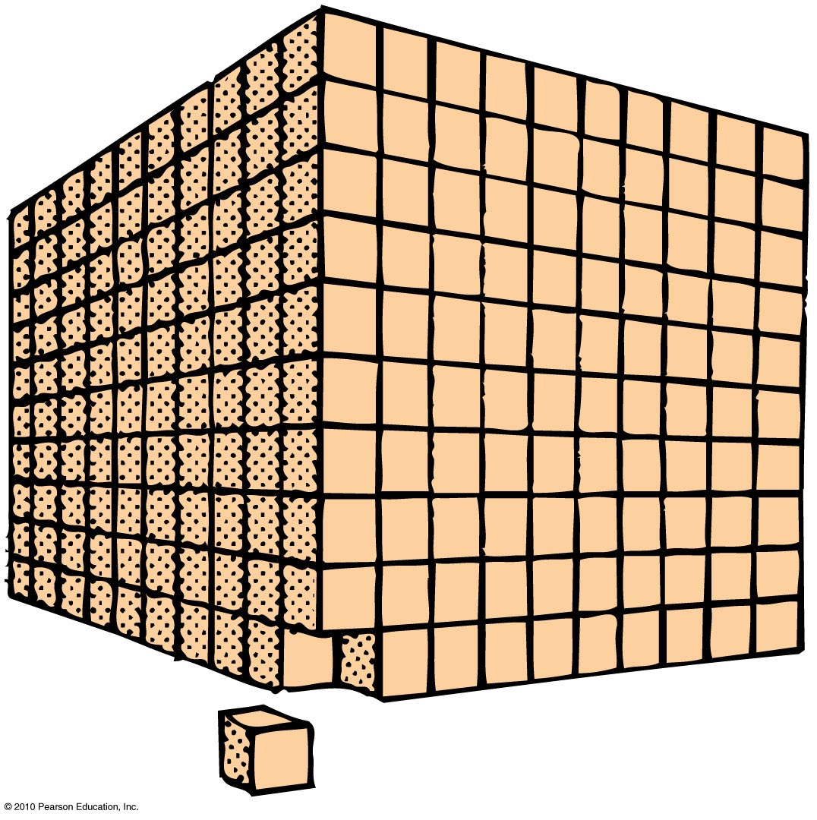
Scaling
CHECK YOUR NEIGHBOR
If a 1-cm³ cube is scaled up to a cube that is 10 cm long on each side, how does the surface area to volume ratio change?
1/100 of original
1/10 of original
10 times original
100 times original
Notes:
34

Slide 35
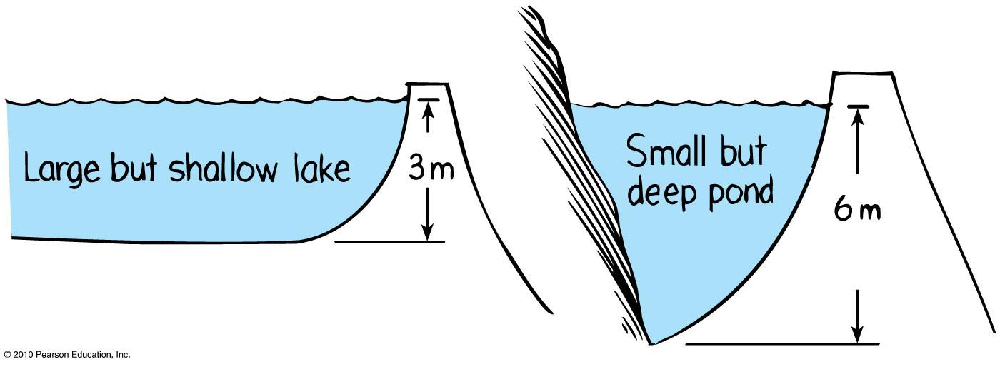
Before Class 9 on Wednesday
Please read Chapter 13, or at least watch the 10-minute pre-class video for class 9
Something to think about:
Where is the pressure greater, at the bottom of a large but shallow lake or a small but deep pond?

