Slide 1
Conceptual Physics 11th Edition
Chapter 13:
LIQUIDS
Pressure
Pressure in a Liquid
Buoyancy in a Liquid
Archimedes’ Principle
What Makes an Object Sink or Float
Flotation
Pascal’s Principle
Surface Tension
Capillarity

Slide 2
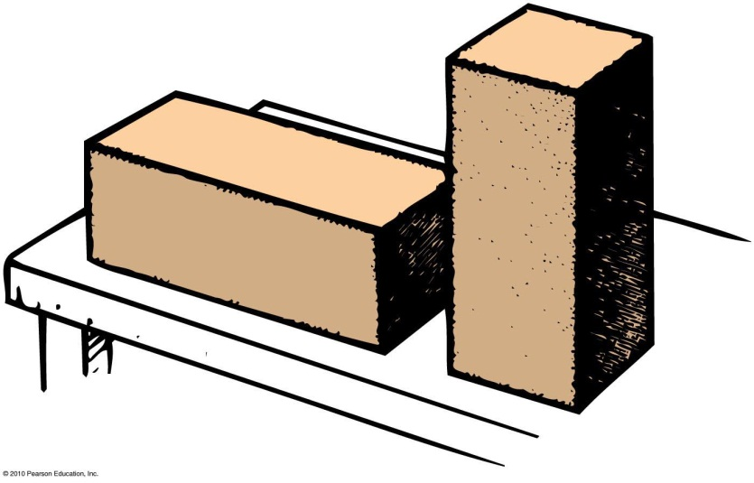
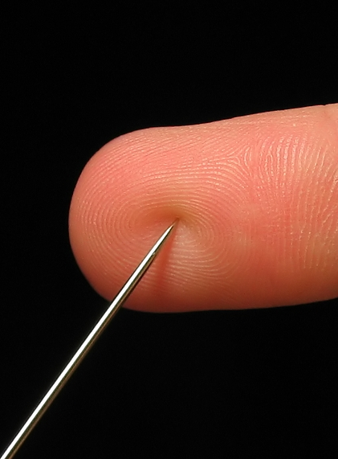
Pressure
Pressure is the force per unit area that one object exerts on another
In equation form:
Depends on area over which force is distributed
Units: N/m², or Pa (Pascals)
Pressure =
force
area

Slide 3
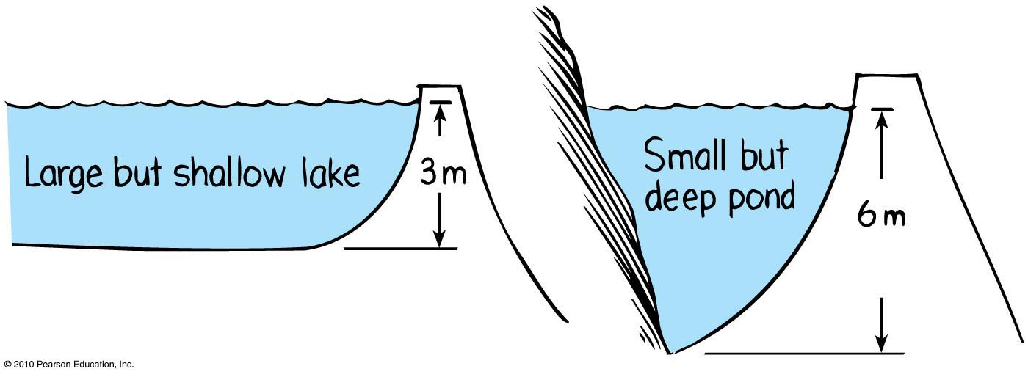
Pressure in a Liquid
Force per unit area that a liquid exerts on an object
Depth dependent and not volume dependent
Example: Swim twice as deep, then twice as much weight of water above you produces twice as much pressure on you.

Slide 4
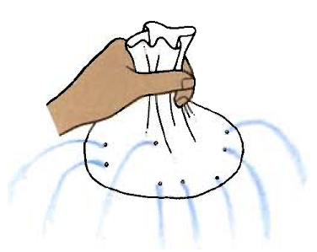
Pressure in a Liquid
Acts equally in all directions
Examples:
Your ears feel the same amount of pressure under water no matter how you tip your head.
Bottom of a boat is pushed upward by water pressure.
Pressure acts upward when pushing a beach ball under water.
[Image retrieved Jan.17 2013 from http://www.patana.ac.th/secondary/science/anrophysics/unit5/commentary.htm ]

Slide 5
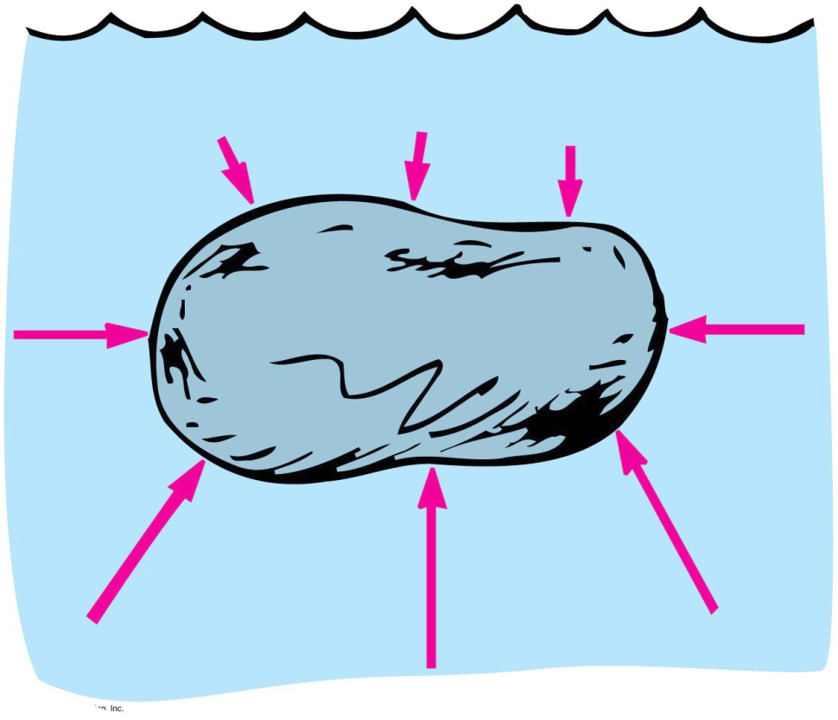
Buoyancy in a Liquid
Buoyancy
Apparent loss of weight of a submerged object
Amount equals the weight of water displaced

Slide 6
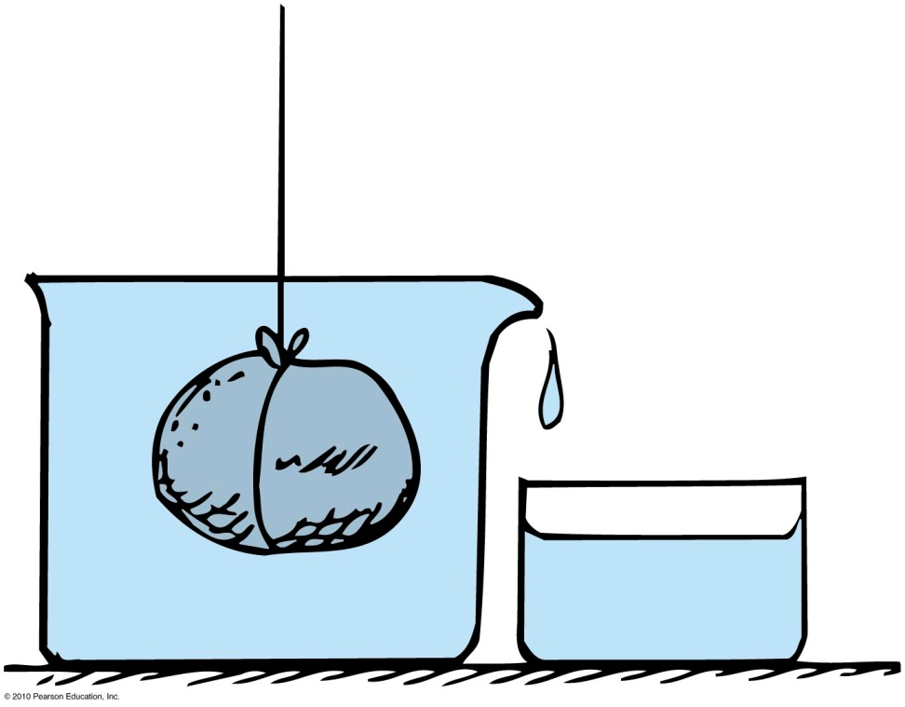
Buoyancy in a Liquid
Displacement rule:
A completely submerged object always displaces a volume of liquid equal to its own volume.
Example: Place a stone in a container that is brimful of water, and the amount of water overflow equals the volume of the stone.

Slide 7
Buoyant force
Net upward force that a fluid exerts on an immersed object = weight of water displaced
Example: The difference in the upward and downward forces acting on the submerged block is the same at any depth

Slide 8
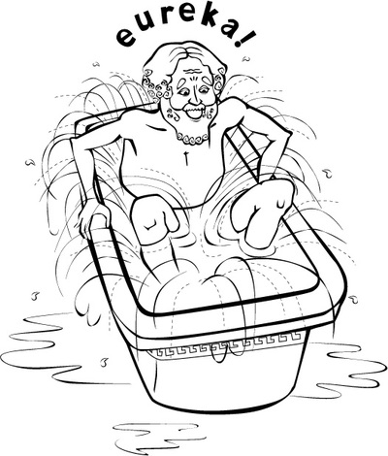
Archimedes’ Principle
Discovered by Greek scientist Archimedes in 250 BC.
Relates buoyancy to displaced liquid.
States that an immersed body (completely or partially) is buoyed up by a force equal to the weight of the fluid it displaces.
Applies to gases and liquids.
[ image retrieved Jan.17 2013 from http://personal.maths.surrey.ac.uk/st/H.Bruin/MMath/archimedes.html ]

Slide 9
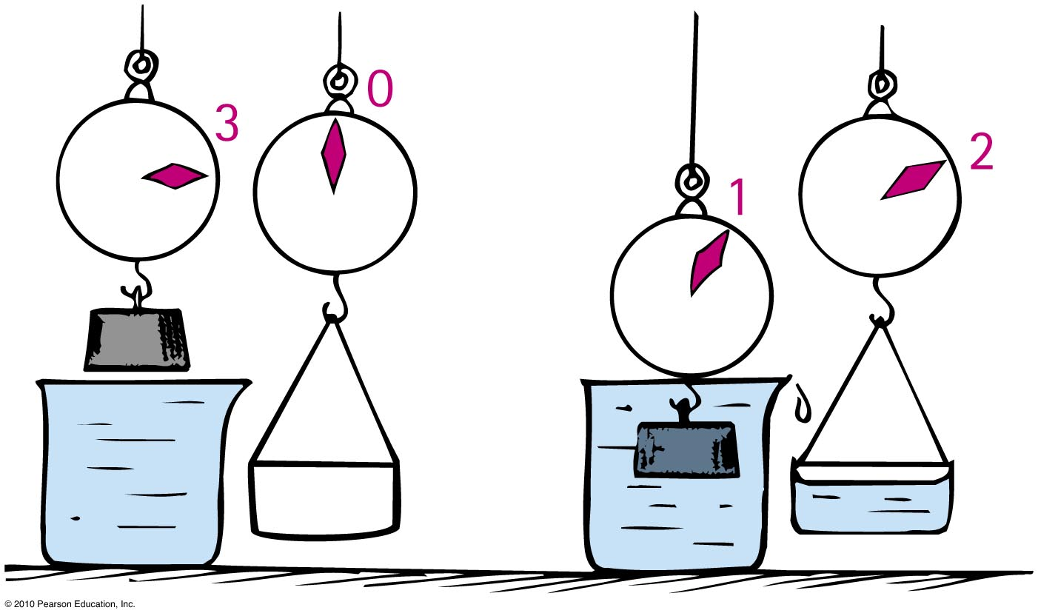
Archimedes’ Principle
Apparent weight of a submerged object
= Weight out of water minus buoyant force
Example: If a 3 N block submerged in water apparently weighs 1 N, then the buoyant force or weight of water displaced is 2 N.

Slide 10
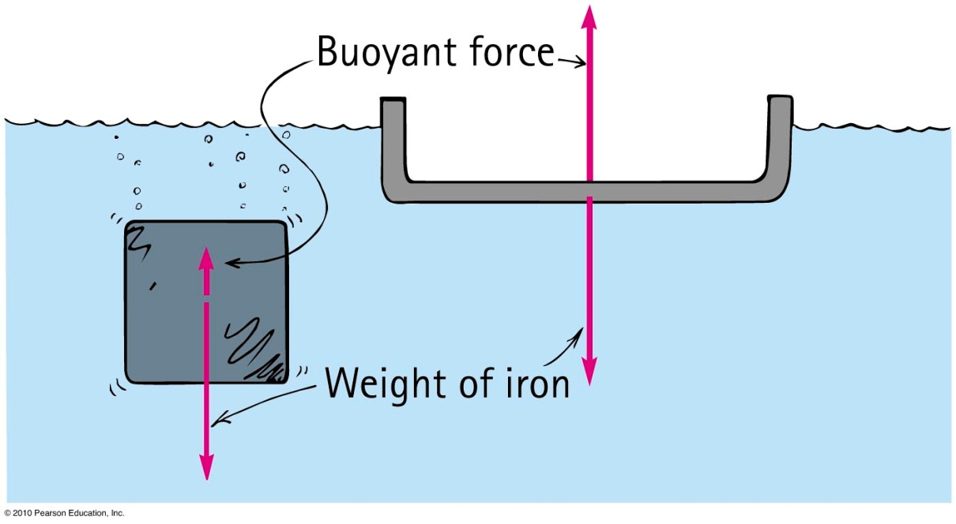
Flotation
Principle of flotation:
A floating object displaces a weight of fluid equal to its own weight.
Example: A solid iron 1-ton block may displace 1/8 ton of water and sink. The same 1 ton of iron in a bowl shape displaces a greater volume of water—the greater buoyant force allows it to float.

Slide 11
Archimedes’ Principle
Denser fluids will exert a greater buoyant force on a body than less dense fluids of the same volume.
Example: Objects will float higher in saltwater (density = 1.03 g/cm³) than in freshwater (density = 1.00 g/cm³).
[ image retrieved Jan.17, 2013 from http://famoustourisms.com/2011/05/dead-sea-enjoy-the-charm-and-sensation-swim-here/ ]

Slide 12
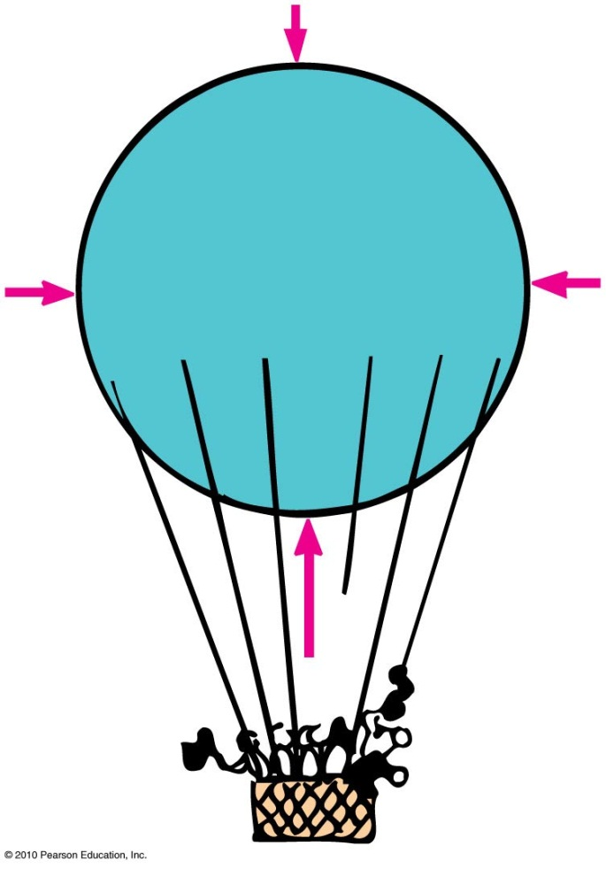
Archimedes’ Principle
Applies in air!
The more air an object displaces, the greater the buoyant force on it.
If an object displaces its weight, it hovers at a constant altitude.
If an object displaces less air, it descends.

Slide 13
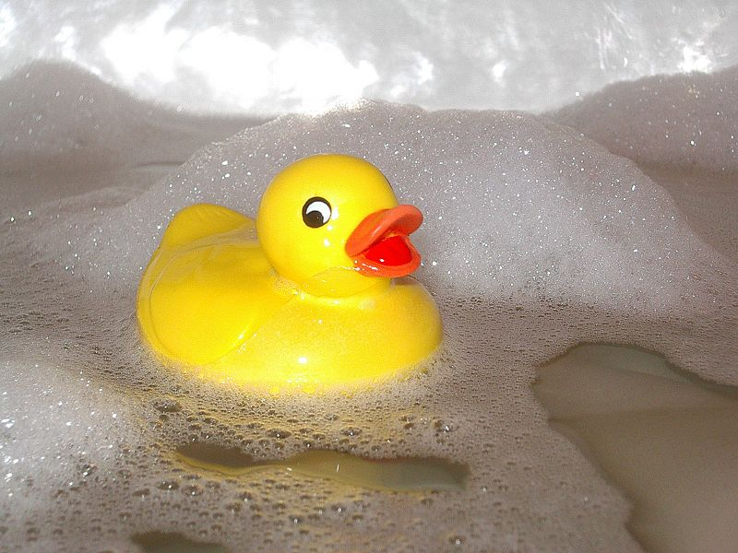
What Makes an Object Float or Sink?
Whether an object floats or sinks depends upon the
Weight of the object.
Weight of the fluid displaced.
The weight of the fluid displaced depends on volume.
So what really counts is the weight of the object per volume.
This is related to the average density of the object.
[ image retrieved Jan.17 2013 from http://en.wikipedia.org/wiki/File:Kylpyankka.jpg ]

Slide 14
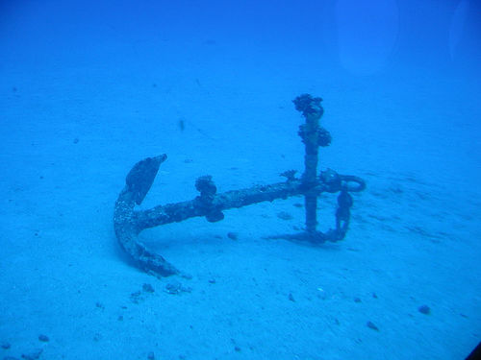
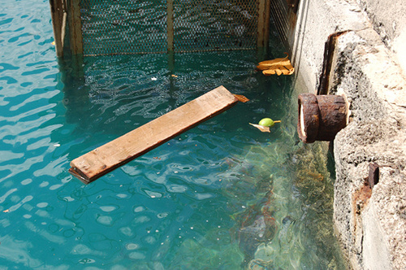
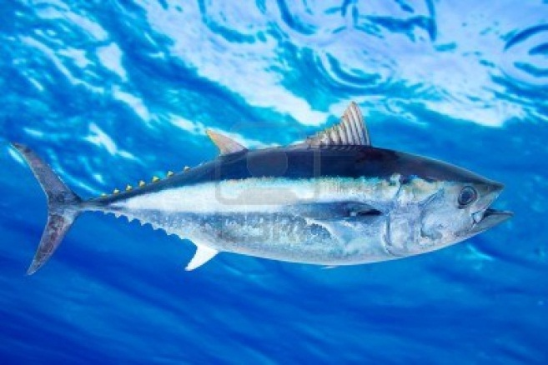
What sinks? What floats?
An object more dense than the fluid in which it is immersed will sink.
An object less dense than the fluid in which it is immersed will float.
An object having a density equal to the density of the fluid in which it is immersed will neither sink nor float.
[ from http://www.flickriver.com/photos/rhosoi/popular-interesting/ ]
[ from http://weeboopiper.wordpress.com/tag/pier-7/ ]
[ from http://www.123rf.com/photo_10758041_bluefin-tuna-thunnus-thynnus-saltwater-fish-underwater-blue-sea.html ]

Slide 15
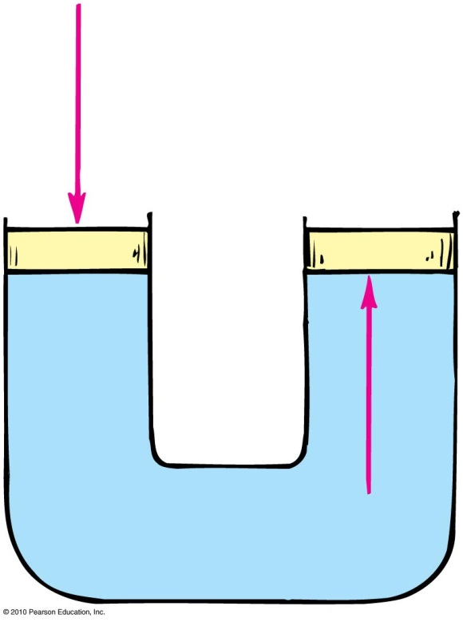
Pascal’s principle:
Discovered by Blaise Pascal, a scientist and theologian in the 17th century
States that a change in pressure at any point in an enclosed fluid at rest is transmitted undiminished to all points in the fluid
Applies to all fluids—gases and liquids

Slide 16
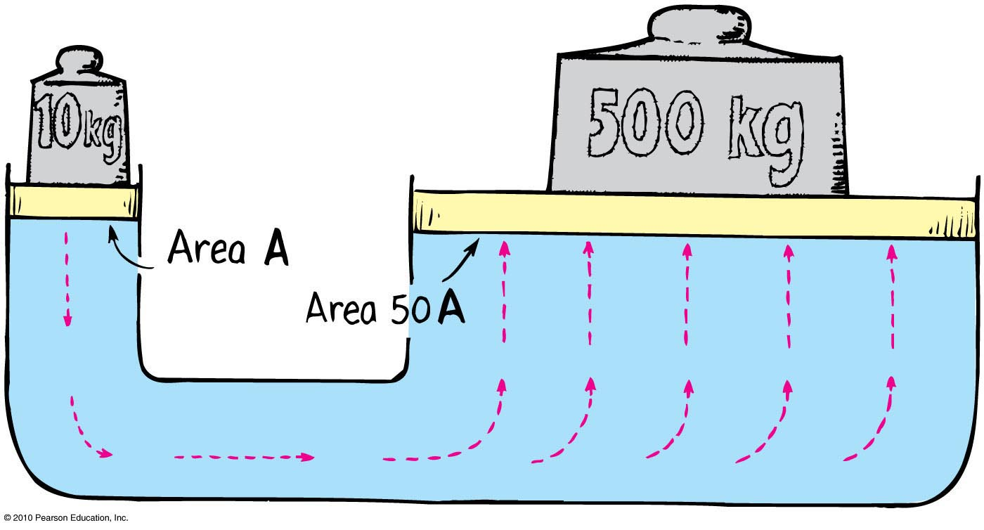
Pascal’s Principle
Application in hydraulic press
Example:
Pressure applied to the left piston is transmitted to the right piston.
A 10-kg load on small piston (left) lifts a load of 500 kg on large piston (right).

Slide 17
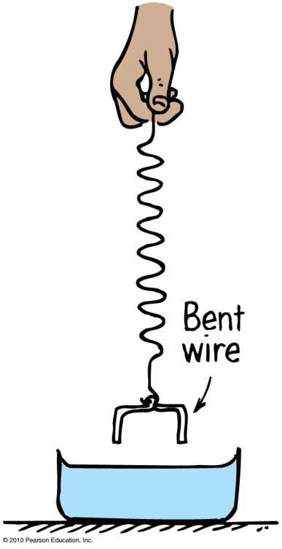
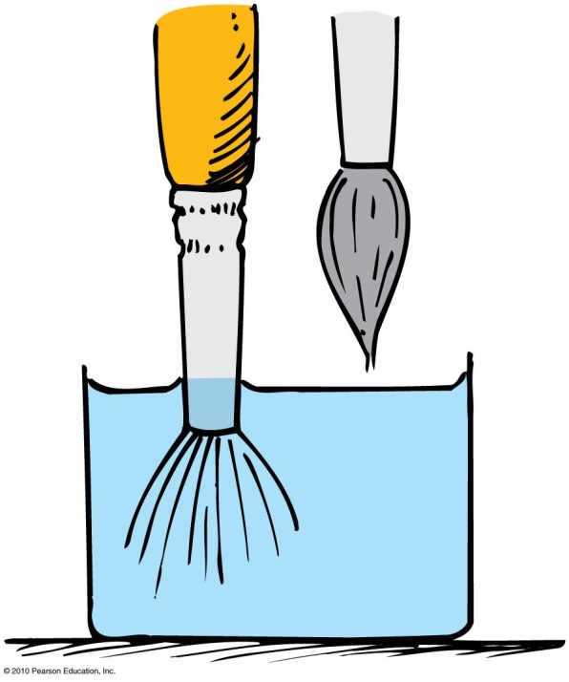
Surface Tension
The contractive tendency of the surface of liquids is due to surface tension.
Examples:
When you submerge a wire in water and pull it out with a spring, the spring stretches.
When you place a paintbrush in water and pull it out, the water contracts and pulls the hairs together.

Slide 18
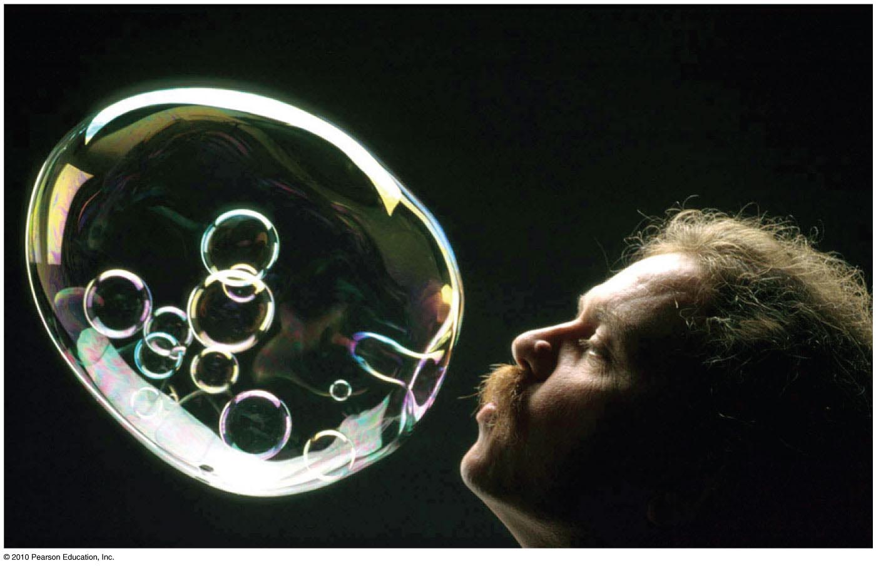
Surface Tension
Other examples:
Drops of any kind are spherical because their surfaces tend to contract and force each drop into the shape having the least surface area for a given volume – a sphere.
Bubbles are spherical for the same reason – surface tension.

Slide 19
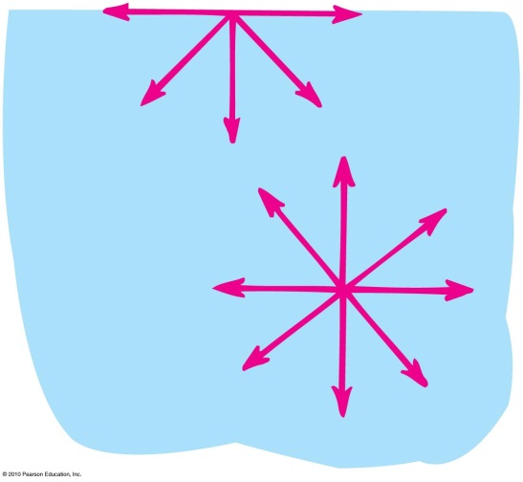
Surface Tension
Surface tension is caused by molecular attractions.
Beneath the surface, each molecule is attracted in every direction by neighboring molecules.
A molecule on the surface of a liquid is pulled only by neighbors on each side and downward from below; there is no pull upward.
These molecular attractions tend to pull the molecule from the surface into the liquid, causing surface tension.

Slide 20
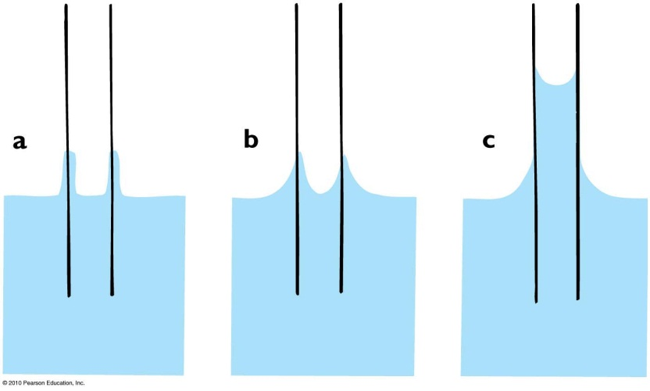
Capillarity
The rise of a liquid in a fine, hollow tube or in a narrow space is called capillarity.
Adhesion between the molecules of the glass and water draws the surface of water into the tube.
Surface tension causes the water to be pulled upward.
This raises the liquid from below to rise into the tube.
When the force of the surface tension balances out the weight of the liquid, the liquid stops rising.

Slide 21
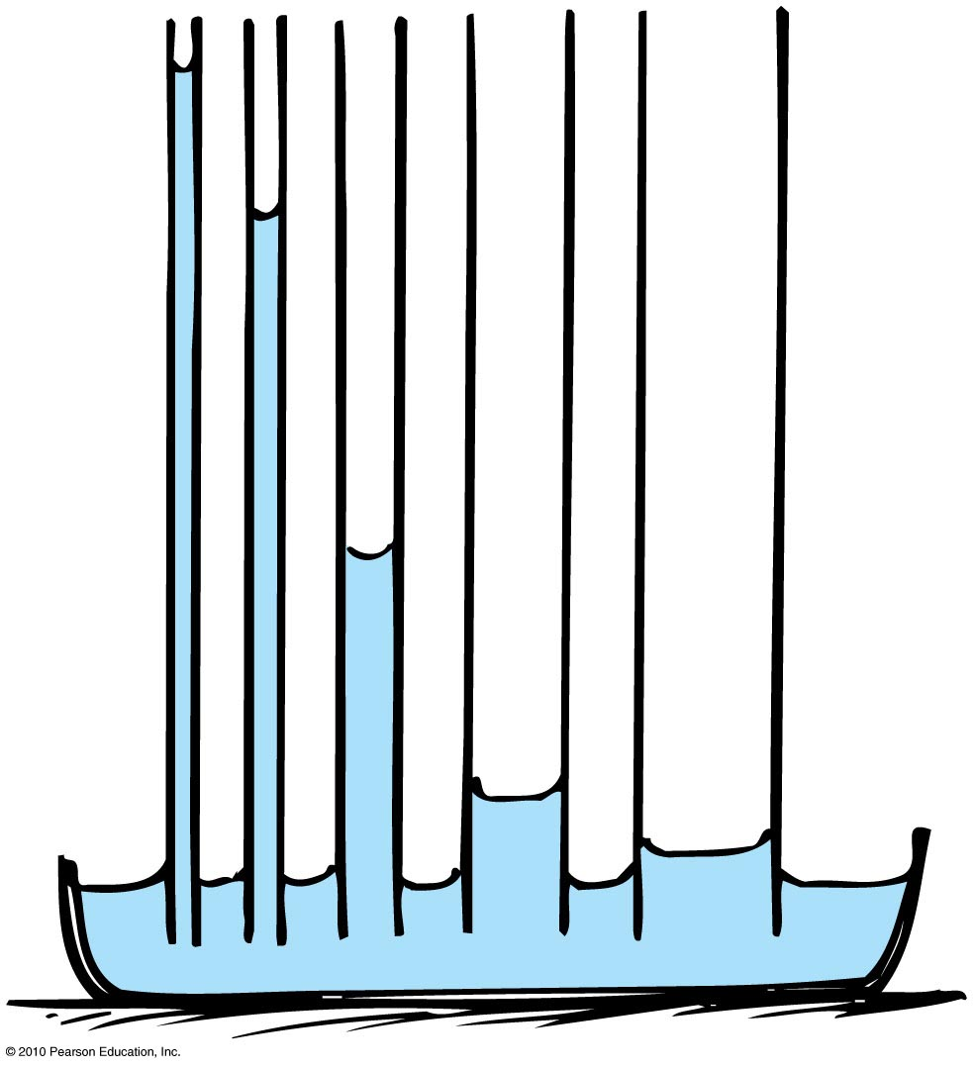
Capillarity
The height of rise depends upon the weight of the liquid and the narrowness of the tube.
The lighter the liquid, the higher the capillary rise.
The narrower the tube, the higher the capillary rise

Slide 22
Capillarity
Examples:
Oil rises in a wick.
Hair let loose in a bathtub causes the scalp to get wet.
Water is drawn up from the roots of trees
[ image retrieved Jan.17 2013 from http://hindu-hiddenfacts.blogspot.ca/2012/02/oil-used-to-light-god-lamp.html ]

