Slide 1
Note on Posted Slides
These are the slides that I intended to show in class on Wed. Feb. 6, 2013.
They contain important ideas and questions from your reading.
Due to time constraints, I was probably not able to show all the slides during class.
They are all posted here for completeness.

Slide 2
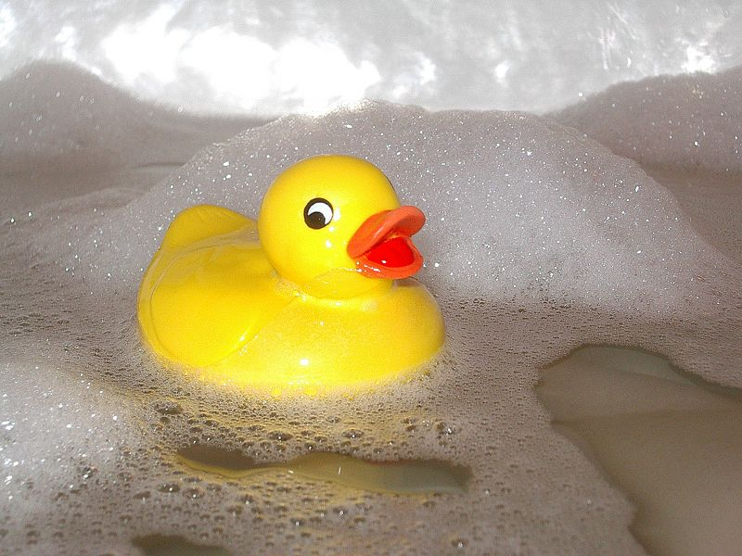
PHY205H1S Physics of Everyday Life Class 9: Liquids
Pressure
Buoyancy in a Liquid
Archimedes’ Principle
What Makes an Object Sink or Float
Pascal’s Principle
Surface Tension
Capillarity
[ image retrieved Jan.17 2013 from http://en.wikipedia.org/wiki/File:Kylpyankka.jpg ]

Slide 3
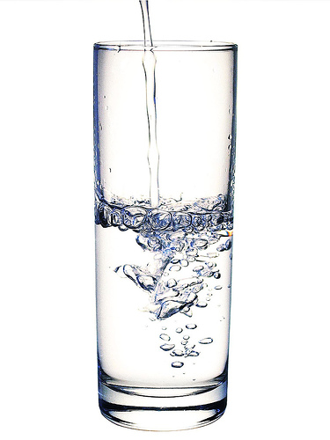
Pre-class reading question
What is the approximate density of water?
10⁻⁵ kg/m³
0.01 kg/m³
0.1 kg/m³
1 kg/m³
1000 kg/m³
Notes:
Answer: A

Slide 4
Pre-class reading question
What is Archimedes’ Principle?
A change in pressure at any point in an enclosed fluid at rest is transmitted undiminished to all points in the fluid.
An immersed object is buoyed up by a force equal to the weight of the fluid it displaces.
Energy can be neither created nor destroyed, only transformed from one form to another.
Where the speed of a fluid increases, internal pressure in the fluid decreases.

Slide 5
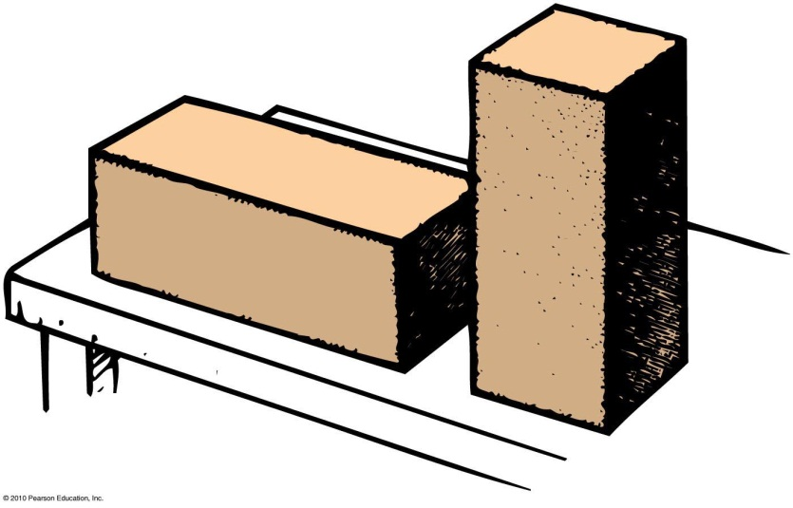
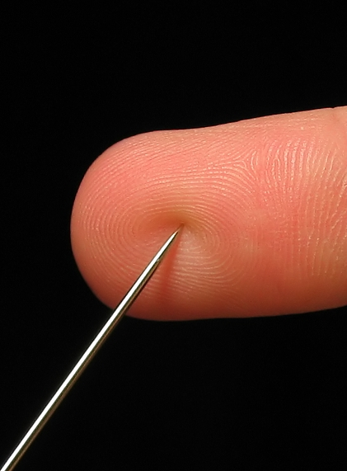
Pressure
Pressure is the force per unit area that one object exerts on another
In equation form:
Depends on area over which force is distributed
Units: N/m², or Pa (Pascals)
Pressure =
force
area

Slide 6
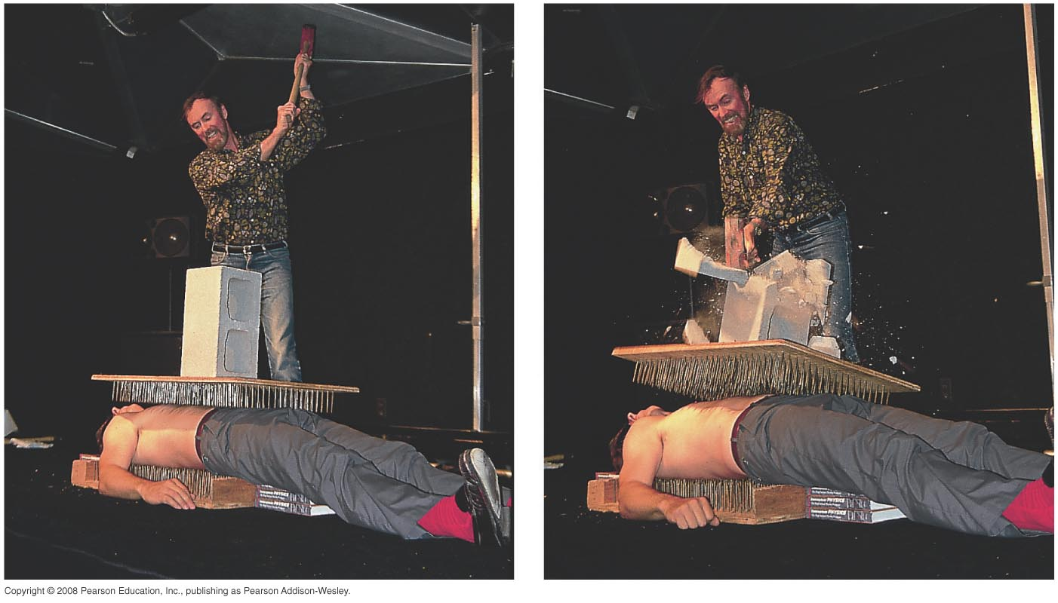
Bed of Nails
Example: The teacher between nails is unharmed because force is applied over many nails. Combined surface area of the nails results in a tolerable pressure that does not puncture the skin.

Slide 7
When you stand on one foot instead of two, the force you exert on the floor is
Pressure
CHECK YOUR NEIGHBOR
A. less.
the same.
more.
Notes:
B. the same.

Slide 8
When you stand on one foot instead of two, the pressure you exert on the floor is
Pressure
CHECK YOUR NEIGHBOR
A. less.
the same.
more.
Notes:
C. more.

Slide 9
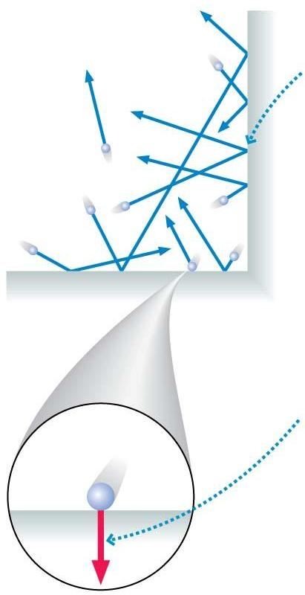
Pressure in a fluid is due to the net force of the molecules in a fluid colliding with the walls.
A very large number of collisions happen each second.
Each collision exerts a tiny net force on the wall.

Slide 10
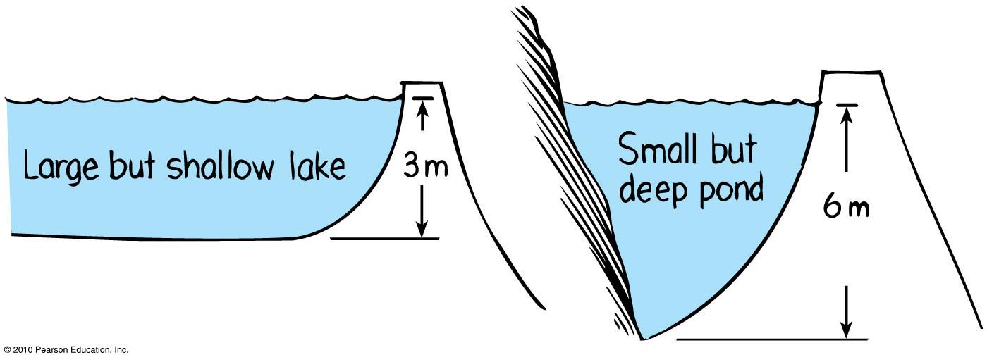
Pressure in a Liquid
Force per unit area that a liquid exerts on an object
Depth dependent and not volume dependent
Example: Swim twice as deep, then twice as much weight of water above you produces twice as much pressure on you.

Slide 11
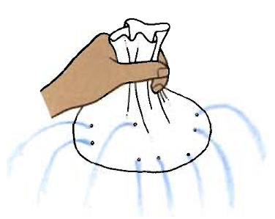
Pressure in a Liquid
Acts equally in all directions
Examples:
Your ears feel the same amount of pressure under water no matter how you tip your head.
Bottom of a boat is pushed upward by water pressure.
Pressure acts upward when pushing a beach ball under water.
[Image retrieved Jan.17 2013 from http://www.patana.ac.th/secondary/science/anrophysics/unit5/commentary.htm ]

Slide 12
Pressure in a Liquid
Independent of shape of container:
Whatever the shape of a container, pressure at any particular depth is the same.
In equation form:
Liquid pressure = weight density × depth

Slide 13
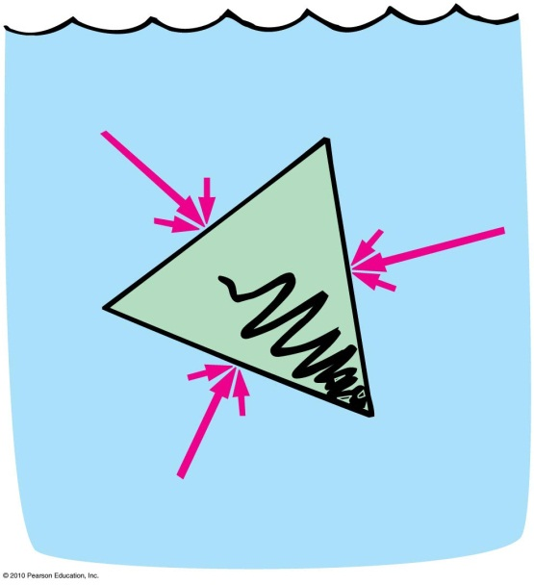
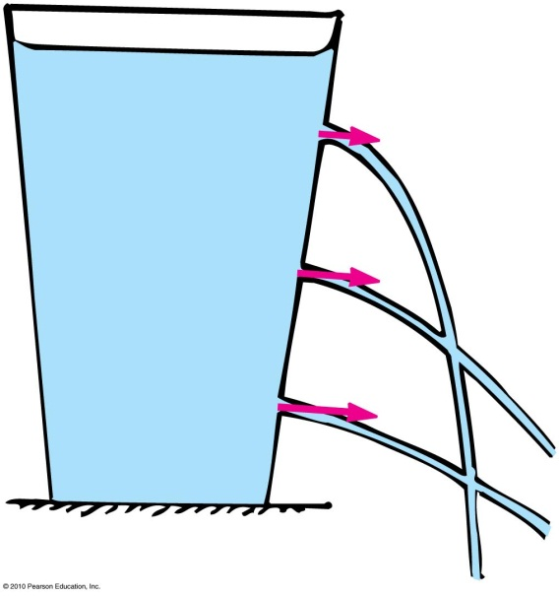
Pressure in a Liquid
Effects of water pressure
Acts perpendicular to surfaces of a container
Liquid spurts at right angles from a hole in the surface.
The greater the depth, the greater the exiting speed.

Slide 14
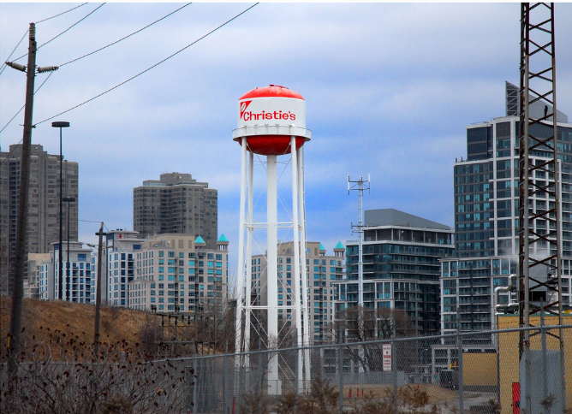
Water pressure provided by a water tower is greater if the tower
Pressure in a Liquid
CHECK YOUR NEIGHBOR
A. is taller.
holds more water.
Both A and B.
None of the above.
[image from http://www.flickr.com/photos/7677418@N02/4320015169/lightbox/ ]
Notes:
A. is taller.

Slide 15
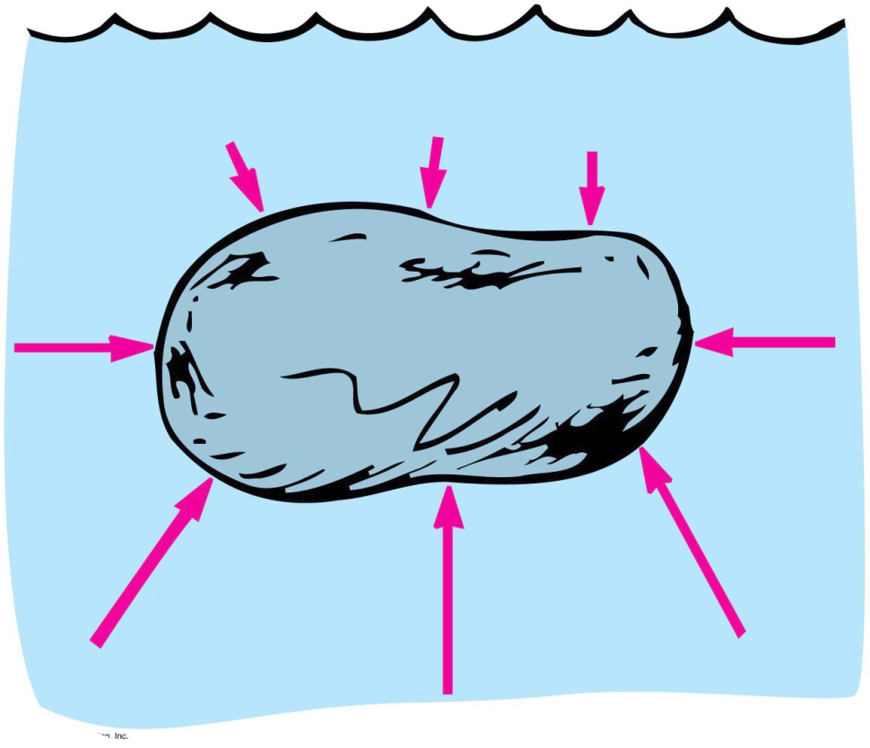
Buoyancy in a Liquid
Buoyancy
Apparent loss of weight of a submerged object
Amount equals the weight of water displaced

Slide 16
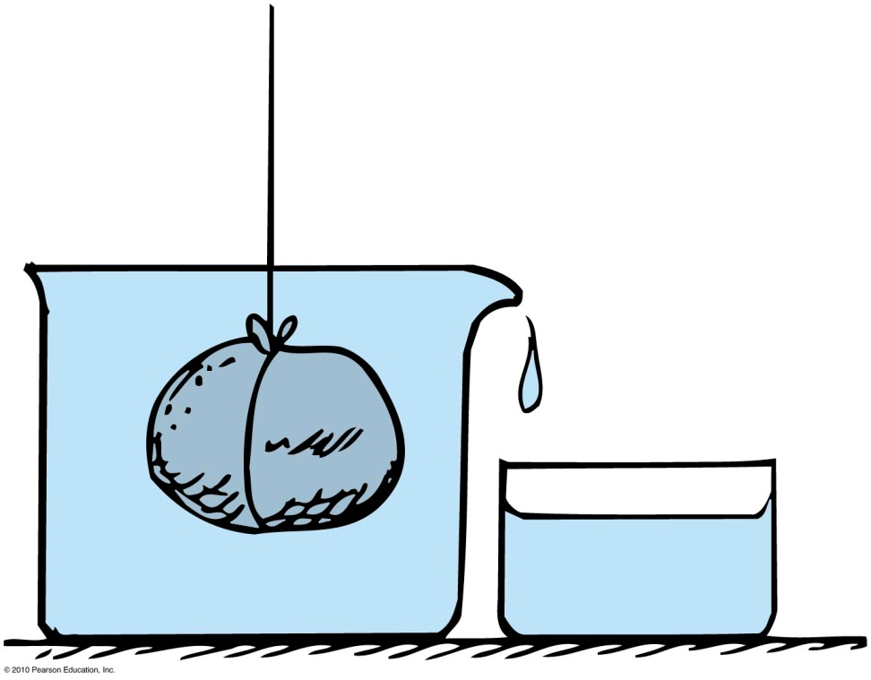
Displacement rule:
A completely submerged object always displaces a volume of liquid equal to its own volume.
Example: Place a stone in a container that is brimful of water, and the amount of water overflow equals the volume of the stone.

Slide 17
http://www.dairygoodness.ca/butter/butter-tips-tricks/how-to-measure-butter
When butter is in hard, irregular shaped pieces, fill a 2-cup liquid measuring cup with water to the 1 cup mark.
Add enough butter pieces until the level reaches 1-1/4 cups.
Drain off the water and you’re left with ¼ cup of butter!

Slide 18
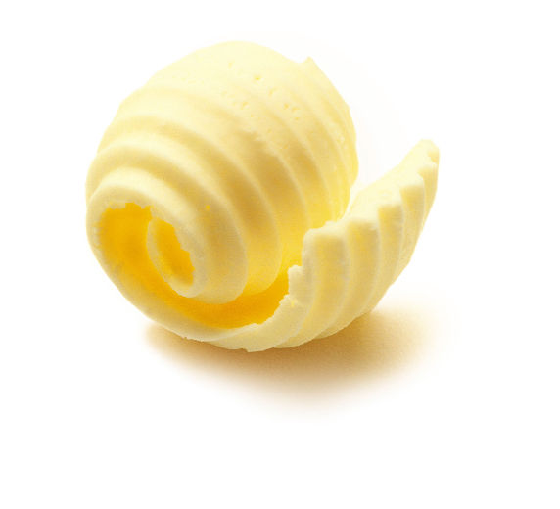
A cook who measures a specific amount of butter by placing it in a measuring cup with water in it is using the
Buoyancy in a Liquid
CHECK YOUR NEIGHBOR
A. principle of buoyancy.
displacement rule.
concept of density.
All of the above.
Notes:
B. displacement rule.

Slide 19
Buoyant force
Net upward force that a fluid exerts on an immersed object = weight of water displaced
Example: The difference in the upward and downward forces acting on the submerged block is the same at any depth

Slide 20
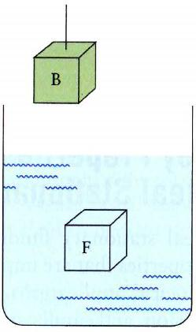
Buoyancy: Archimedes Principle
Let’s do a “thought experiment” (Gedanken).
Imagine a beaker with a fluid and a block, B, hanging near it.
There is a fluid element F with the same shape and volume as the block B.
The fluid element F is in mechanical equilibrium:
F_{up} – F_{down} – W_{F} = 0
where F_{up} is the pressure force on the bottom surface, F_{down} is the pressure force on the top surface, and W_{F} is the weight of fluid F.

Slide 21
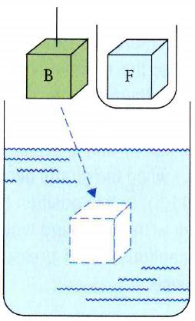
Buoyancy: Archimedes Principle
Step 1: Remove F from the beaker and place it in a small container, leaving an empty bubble of the same size in the beaker.
The bubble is not in mechanical equilibrium, since its weight is much less than that of the removed fluid, but the pressure forces are the same.:
F_{up} – F_{down} = W_{F} > 0
where F_{up} is the pressure force on the bottom surface, F_{down} is the pressure force on the top surface, and W_{F} is the weight of the removed fluid F.

Slide 22
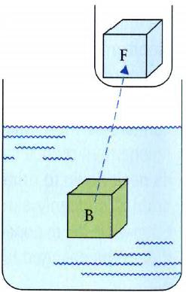
Buoyancy: Archimedes Principle
Step 2: Block B, with weight W_{B}, is placed in the bubble.
There is a net force on Block B:
F_{net} = F_{up} – F_{down} – W_{B} = W_{F} – W_{B}
where W_{F} is the weight of the removed fluid F, and W_{B} is the weight of the block B.
This is equal to the force of gravity, –W_{B} , plus a new force called “Buoyancy”,which is due to the pressure gradient in the fluid.
Archimedes’ principle: When an object is immersed in a fluid, the fluid exerts an upward force on the object equal to the weight of the fluid displaced by the object.

Slide 23
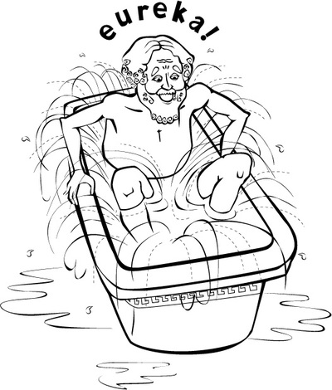
Archimedes’ Principle
Discovered by Greek scientist Archimedes in 250 BC.
Relates buoyancy to displaced liquid.
States that an immersed body (completely or partially) is buoyed up by a force equal to the weight of the fluid it displaces.
Applies to gases and liquids.
[ image retrieved Jan.17 2013 from http://personal.maths.surrey.ac.uk/st/H.Bruin/MMath/archimedes.html ]

Slide 24
Demonstration Prediction
A steel mass of 0.75 kg hangs from a spring scale.
When it is not accelerating, the spring scale reads 7.5 N.
If Harlow dips the mass into an open container of water, then stops the motion and lets the scale settle, what will be the reading on the scale?
Less than 7.5 N, but not zero
More than 7.5 N
About 7.5 N
zero

Slide 25
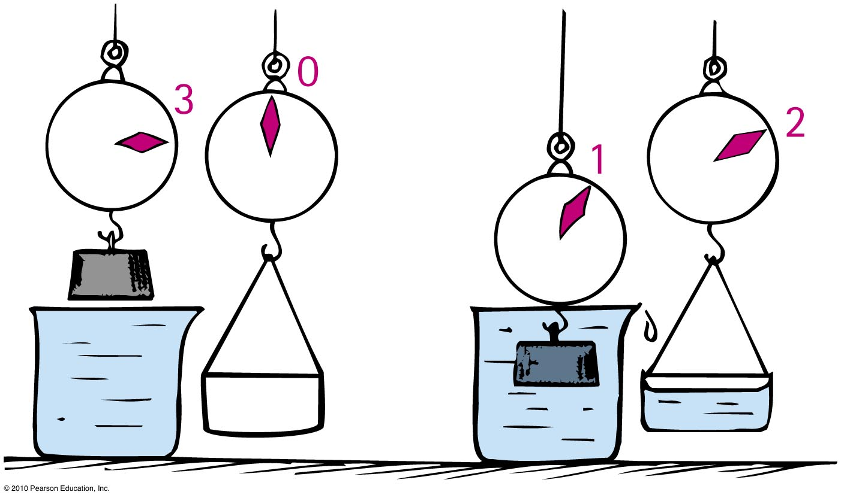
Archimedes’ Principle
Apparent weight of a submerged object
= Weight out of water minus buoyant force
Example: If a 3 N block submerged in water apparently weighs 1 N, then the buoyant force or weight of water displaced is 2 N.

Slide 26
When a fish expands its air bladder, the density of the fish
Archimedes’ Principle
CHECK YOUR NEIGHBOR
A. decreases.
increases.
remains the same.
Notes:
A. decreases

Slide 27
When a fish makes itself less dense, the buoyant force on it
Archimedes’ Principle
CHECK YOUR NEIGHBOR
A. decreases.
increases.
remains the same.
Notes:
B. increases.

Slide 28
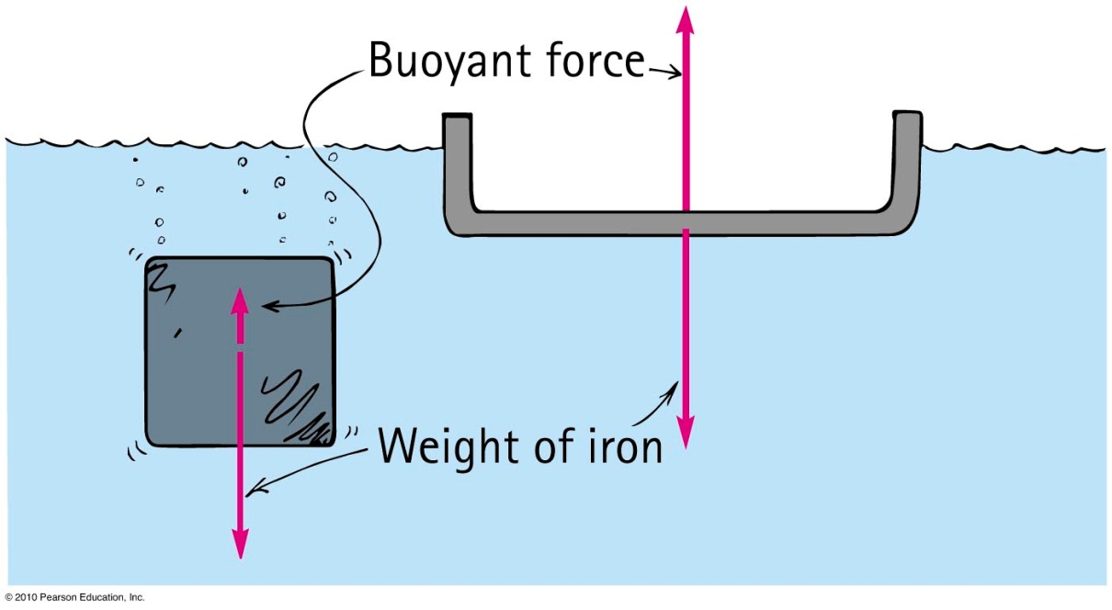
Flotation
Principle of flotation:
A floating object displaces a weight of fluid equal to its own weight.
Example: A solid iron 1-ton block may displace 1/8 ton of water and sink. The same 1 ton of iron in a bowl shape displaces a greater volume of water—the greater buoyant force allows it to float.

Slide 29
Ch.13 Problem 8
Your friend of mass 100 kg can just barely float in fresh-water. Calculate her approximate volume.
W = mg
Buoyancy = (density)(V)(g)
W = Buoyancy
mg = density(V)(g)
V = m/density = 100 kg/1000 kg/m³
V = 0.1 m³

Slide 30
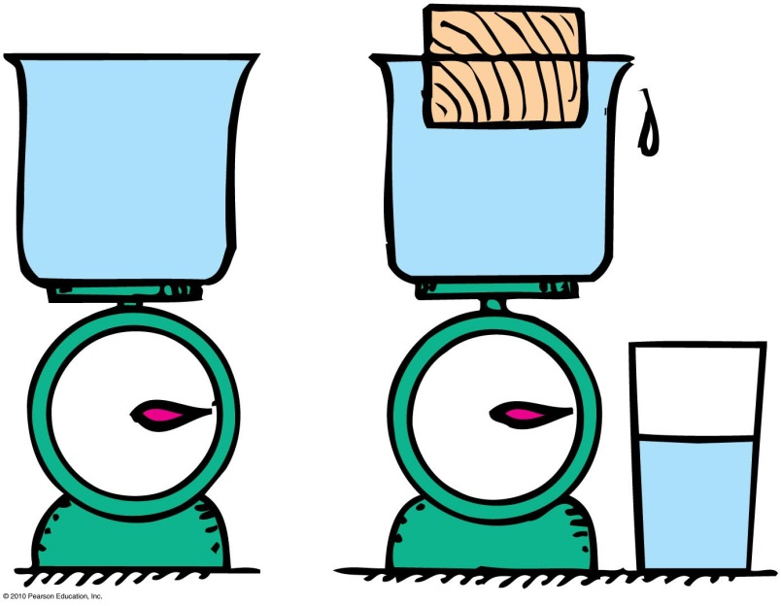
You place an object in a container that is full to the brim with water on a scale. The object floats, but some water spills out. How does the weight of the object compare with the weight of the water displaced?
Flotation
CHECK YOUR NEIGHBOR
A. Weight of object is greater than weight of water displaced.
Weight of object is less than weight of water displaced.
Weight of object is equal to weight of water displaced.
There is not enough information to decide.
Notes:
30
C. Weight of object is equal to the weight of water displaced.

Slide 31
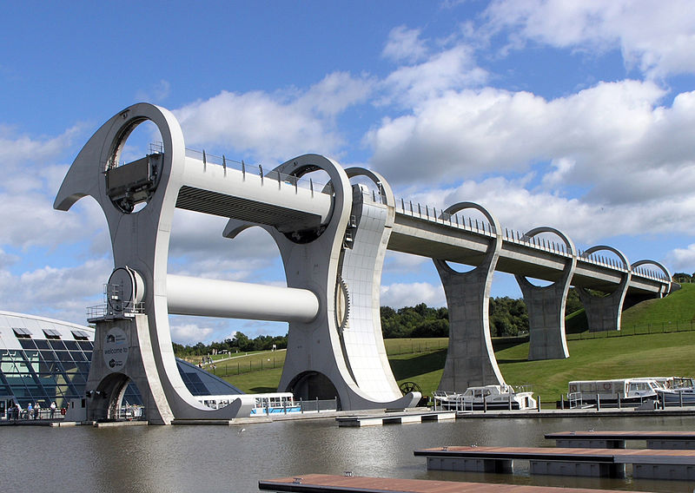
The Falkirk Wheel’s two caisson are brimful of water and the same weight, regardless of whether there are boats in them. This makes rotation and lifting almost effortless.
[image from http://en.wikipedia.org/wiki/File:FalkirkWheelSide_2004_SeanMcClean.jpg ]

Slide 32
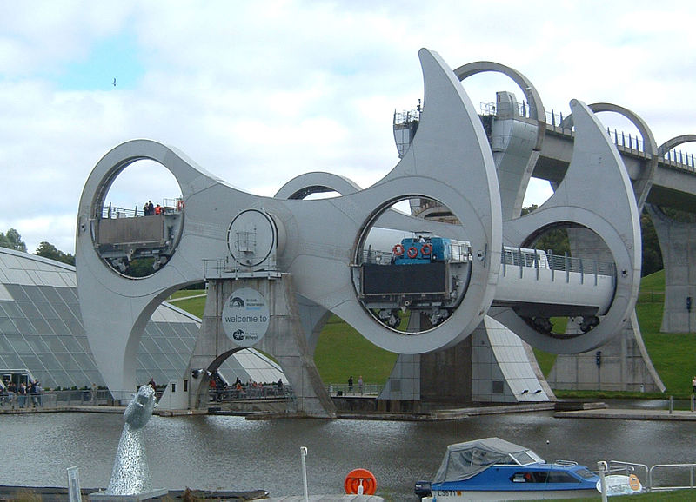
The Falkirk Wheel’s two caisson are brimful of water and the same weight, regardless of whether there are boats in them. This makes rotation and lifting almost effortless.
[image from http://en.wikipedia.org/wiki/File:Falkirk_half_way_round.jpg ]

Slide 33
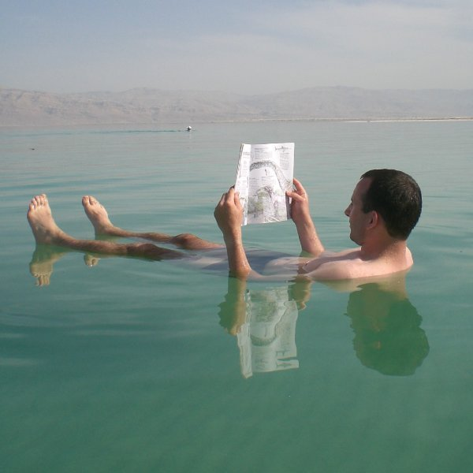
Archimedes’ Principle
Denser fluids will exert a greater buoyant force on a body than less dense fluids of the same volume.
Example: Objects will float higher in saltwater (density = 1.03 g/cm³) than in freshwater (density = 1.00 g/cm³).
[ image retrieved Jan.17, 2013 from http://famoustourisms.com/2011/05/dead-sea-enjoy-the-charm-and-sensation-swim-here/ ]

Slide 34
Archimedes’ Principle
CHECK YOUR NEIGHBOR
The buoyant force on an object submerged in a liquid depends on
the object’s mass.
the object’s volume.
the density of the liquid.
both A and B.
both B and C.
Notes:
Answer: E

Slide 35
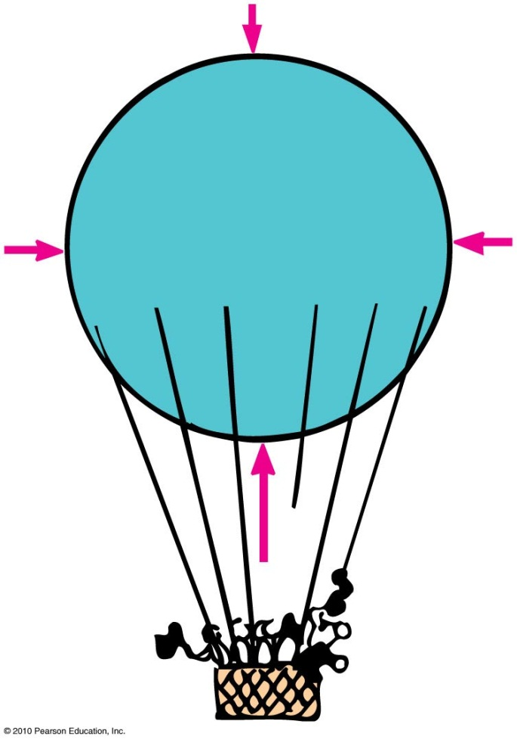
Archimedes’ Principle
Applies in air!
The more air an object displaces, the greater the buoyant force on it.
If an object displaces its weight, it hovers at a constant altitude.
If an object displaces less air, it descends.

Slide 36
What Makes an Object Float or Sink?
Whether an object floats or sinks depends upon the
Weight of the object.
Weight of the fluid displaced.
The weight of the fluid displaced depends on volume.
So what really counts is the weight of the object per volume.
This is related to the average density of the object.
[ image retrieved Jan.17 2013 from http://en.wikipedia.org/wiki/File:Kylpyankka.jpg ]

Slide 37
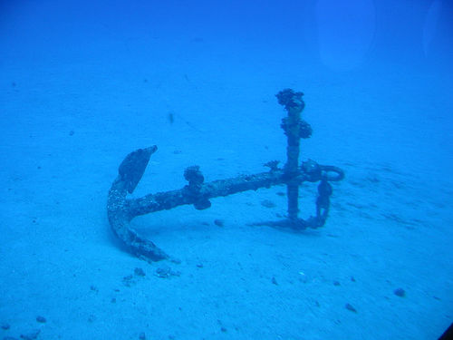
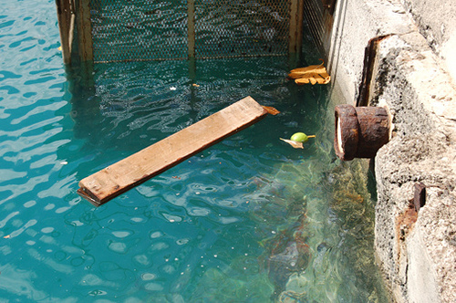
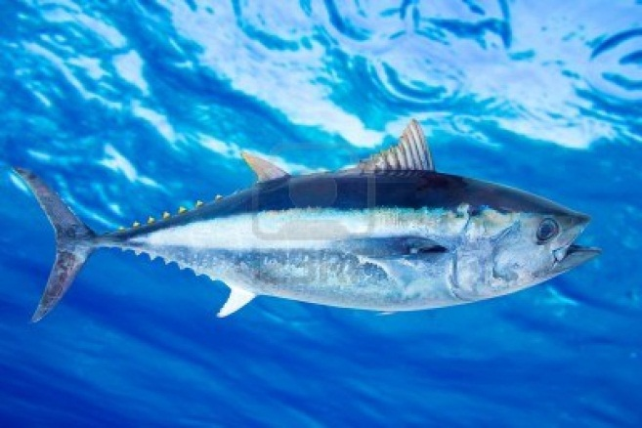
What sinks? What floats?
An object more dense than the fluid in which it is immersed will sink.
An object less dense than the fluid in which it is immersed will float.
An object having a density equal to the density of the fluid in which it is immersed will neither sink nor float.
[ from http://www.flickriver.com/photos/rhosoi/popular-interesting/ ]
[ from http://weeboopiper.wordpress.com/tag/pier-7/ ]
[ from http://www.123rf.com/photo_10758041_bluefin-tuna-thunnus-thynnus-saltwater-fish-underwater-blue-sea.html ]

Slide 38
Two solid blocks of identical size are submerged in water. One block is lead and the other is aluminum. Upon which is the buoyant force greater?
What Makes an Object Float or Sink?
CHECK YOUR NEIGHBOR
A. On the lead block
On the aluminum block
Same on both blocks
There is not enough information to decide.
Notes:
38
C. Same on both blocks.

Slide 39
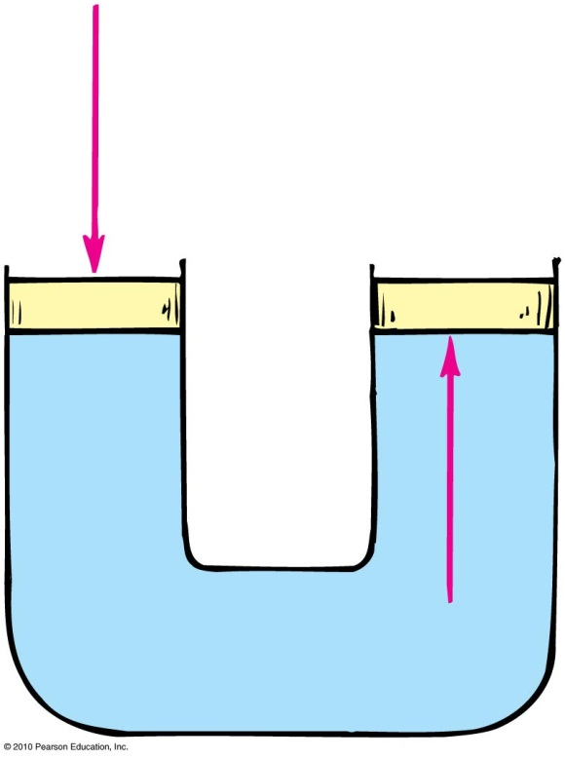
Pascal’s principle:
Discovered by Blaise Pascal, a scientist and theologian in the 17th century
States that a change in pressure at any point in an enclosed fluid at rest is transmitted undiminished to all points in the fluid
Applies to all fluids—gases and liquids

Slide 40
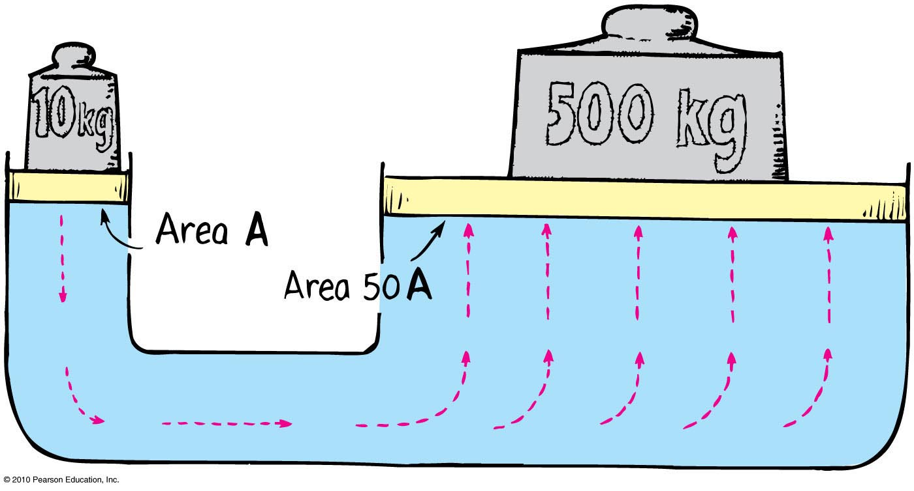
Pascal’s Principle
Application in hydraulic press
Example:
Pressure applied to the left piston is transmitted to the right piston.
A 10-kg load on small piston (left) lifts a load of 500 kg on large piston (right).

Slide 41
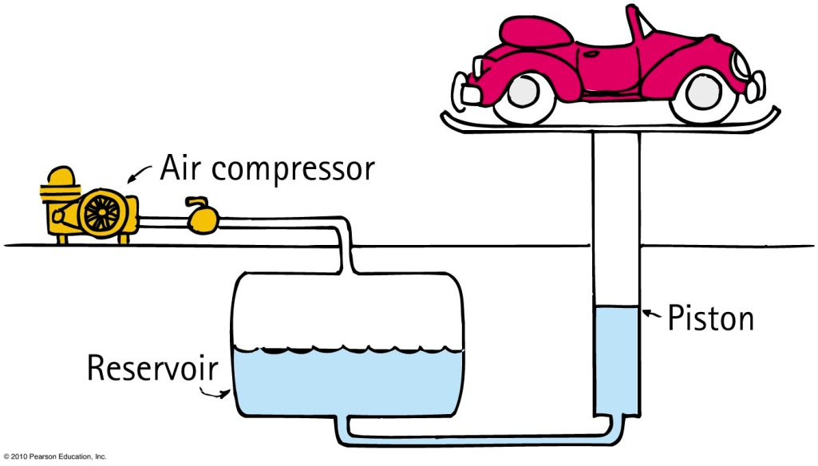
Pascal’s Principle
Application for gases and liquids:
Seen in everyday hydraulic devices used in construction
In auto lifts in service stations
Increased air pressure produced by an air compressor is transmitted through the air to the
surface of oil in an
underground reservoir.
The oil transmits the
pressure to the piston,
which lifts the auto.

Slide 42
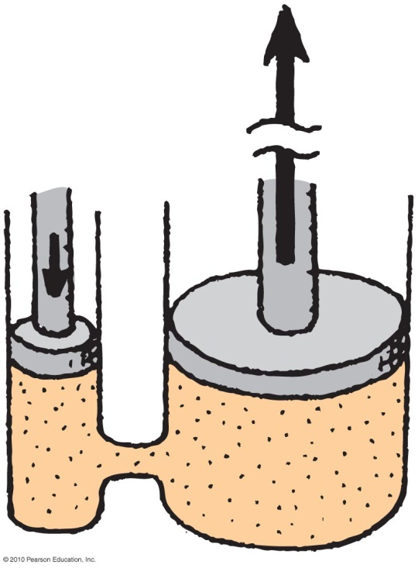
Ch.13 Problem 7
In the sketch, the small hydraulic piston has a diameter of 2 cm.
The large piston has a diameter of 6 cm.
If 1 N of downward force is applied to the small piston, how much force is exerted by the large piston?

Slide 43
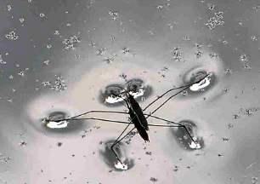
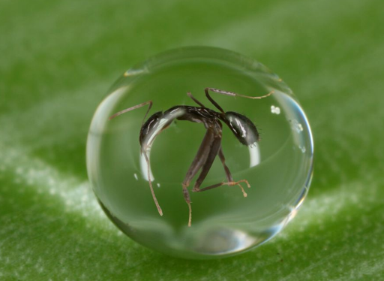
Surface Tension
The tendency of the surface of a liquid to contract in area and thus to behave like a stretched elastic membrane.
[insect image from http://austincoppock.com/2012/04/astrology-42-48-surface-tension/ ]
Examples:
Insects can stand on the surface of water, even if they are more dense than water.
In a small droplet of water, the surface will contract until it forms the shape with the smallest surface area for its volume: a sphere
[image from http://www.dailymail.co.uk/news/article-1371416/Photographer-Adam-Gormley-captures-ant-trapped-raindrop.html#axzz2K9hLsZGF ]

Slide 44
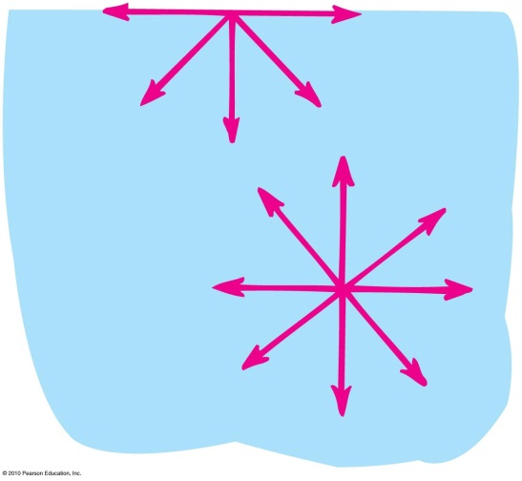
Surface Tension
Surface tension is caused by molecular attractions.
Beneath the surface, each molecule is attracted in every direction by neighboring molecules.
A molecule on the surface of a liquid is pulled only by neighbors on each side and downward from below; there is no pull upward.
These molecular attractions tend to pull the molecule from the surface into the liquid, causing surface tension.

Slide 45
What causes surface tension?
What Makes an Object Float or Sink?
CHECK YOUR NEIGHBOR
Bernoulli’s principle.
Cohesive forces between molecules in a liquid.
Adhesive forces between molecules in a liquid and a solid surface.
Archimedes’ principle
Viscosity.
Notes:
45
C. Same on both blocks.

Slide 46
Surface Tension
Factors affecting surface tension:
The type of liquid
Water has greater surface tension than oil.
What is mixed with the liquid
Soapy water has lower surface tension than water without soap.
Temperature of the liquid
The molecules in a hot liquid have higher energy and are not bound tightly as in a cooler liquid.

Slide 47
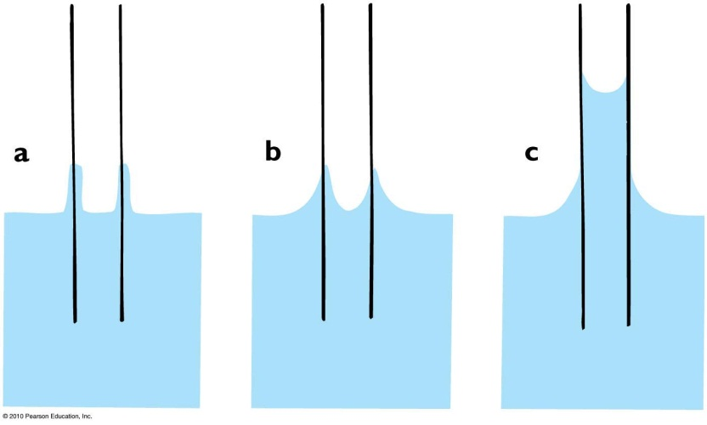
Capillarity
The rise of a liquid in a fine, hollow tube or in a narrow space is called capillarity.
Adhesion between the molecules of the glass and water draws the surface of water into the tube.
Surface tension causes the water to be pulled upward.
This raises the liquid from below to rise into the tube.
When the force of the surface tension balances out the weight of the liquid, the liquid stops rising.

Slide 48
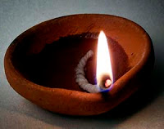
Capillarity
Examples:
Oil rises in a wick.
Hair let loose in a bathtub causes the scalp to get wet.
Water is drawn up from the roots of trees
[ image retrieved Jan.17 2013 from http://hindu-hiddenfacts.blogspot.ca/2012/02/oil-used-to-light-god-lamp.html ]

Slide 49
Test 1 has been marked
Average was 73%
Find your mark under “My Grades” on the portal page for this course.
Your test will be returned to you by your TA in your next tutorial
Bubble sheets can be viewed in MP129 by request
Please have a look over the marking; bring any concerns to me by Feb.15

Slide 50
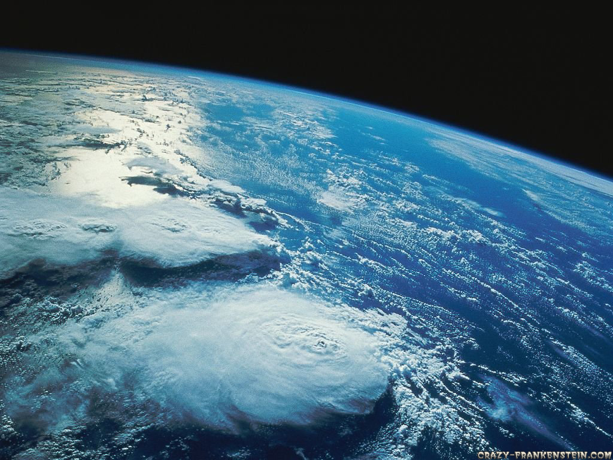
Before Class 10 on Monday
Please read Chapter 14, or at least watch the 10-minute pre-class video for class 10
Some things to think about:
Is it possible to have a region of absolute nothingness (ie empty space)?
If space is empty, why doesn’t the Earth’s atmosphere leak away?

