Slide 1

Conceptual Physics
11th Edition
Chapter 14:
GASES
The Atmosphere
Atmospheric Pressure
The Barometer
Boyle’s Law
Buoyancy of Air
Bernoulli’s Principle
Plasma

Slide 2
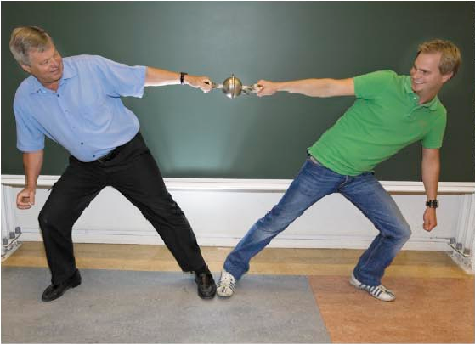
The Atmosphere
Atmosphere
  Ocean of air
  Exerts pressure
The Magdeburg-hemispheres demonstration shows the large magnitude of atmosphere’s pressure.

Slide 3
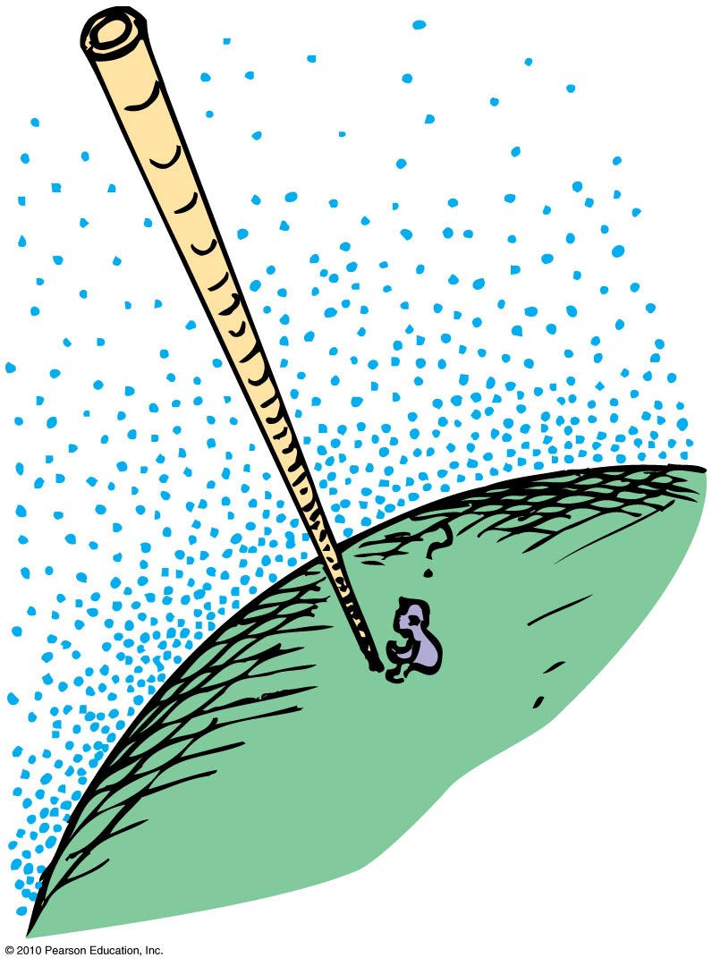
Atmospheric Pressure
Atmospheric pressure
Caused by weight of air
Varies from one locality to another
Not uniform
Measurements are used to predict weather conditions

Slide 4
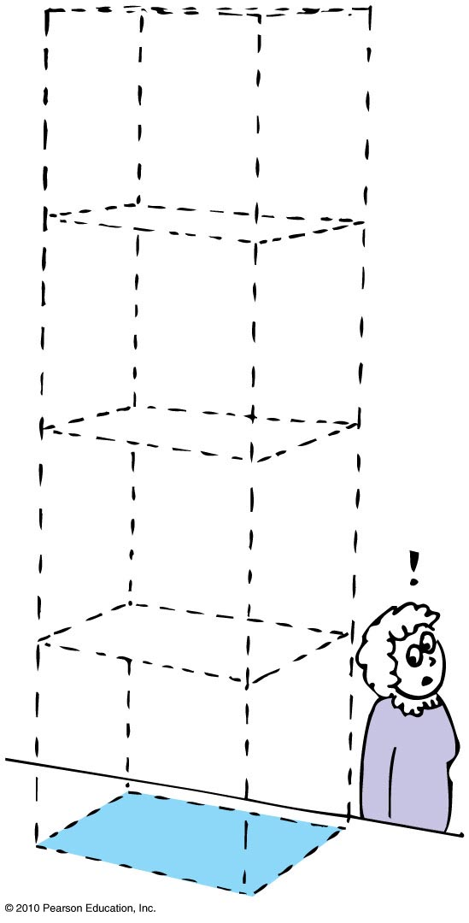
Atmospheric Pressure
Pressure exerted against bodies immersed in the atmosphere result from the weight of air pressing from above.
At sea level is 101 kilopascals
(101 kPa).
Weight of air pressing down on
1 m² at sea level ~ 100,000 N,
so atmospheric pressure
is ~ 10⁵ N/m².

Slide 5
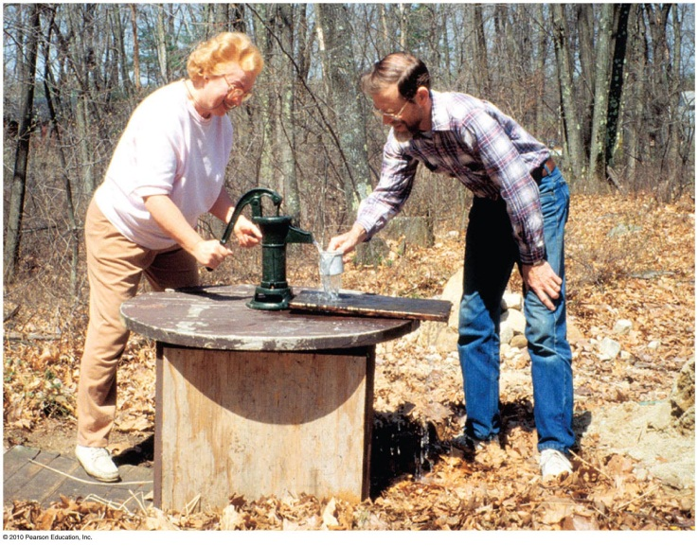
Atmospheric Pressure
Pressure at the bottom of a column of air reaching to the top of the atmosphere is the same as the pressure at the bottom of a column of water 10.3 m high.
Consequence: The highest the atmosphere can push water up into a vacuum pump is 10.3 m.
Mechanical pumps that don’t depend on atmospheric pressure don’t have the 10.3-m limit.

Slide 6
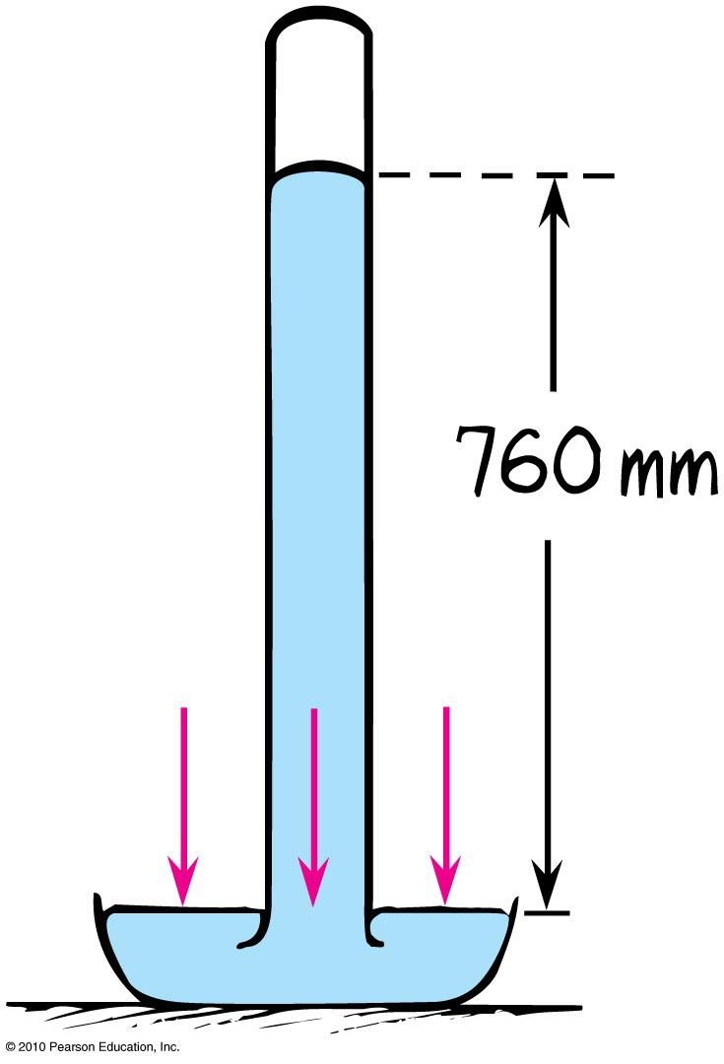
The Barometer
The barometer is a device to measure atmospheric pressure.
It consists of a mercury tube upside down in a dish filled with mercury.
The height of the mercury column tells us the atmospheric pressure.
Atmospheric pressure decreases with increasing altitude, so it also measures elevation—an altimeter.

Slide 7
The Barometer
The principle of the barometer:
Mercury column exerts pressure on the mercury in the dish.
Atmosphere exerts pressure on the mercury in the dish.
These two pressures must be equal so that the atmospheric pressure supports the mercury column.

Slide 8
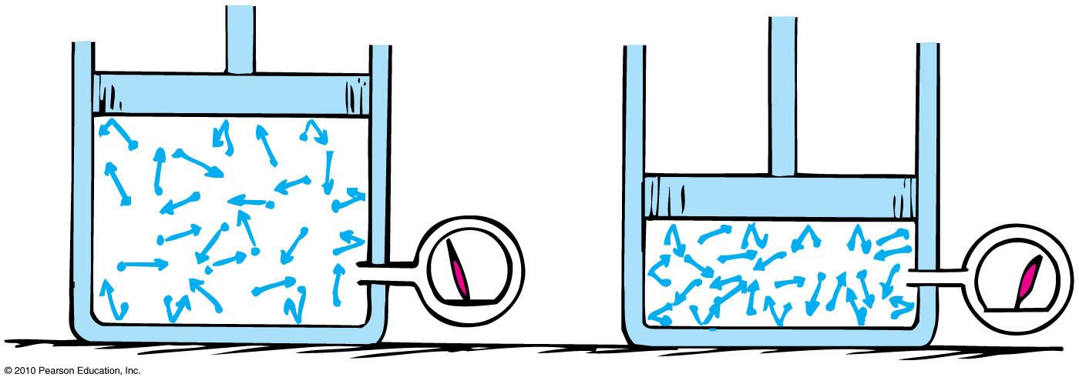
Boyle’s Law
The pressure and volume of a gas enclosed in a space are inversely proportional.
If you increase pressure, the volume will decrease by the same factor.
  Example: If pressure is doubled, volume will halve.

Slide 9
Boyle’s Law
The product of pressure and volume of a given mass of gas will always remain the same.
PV = PV
LARGE
Pressure
LARGE
Volume
Small
Volume
Small
Pressure

Slide 10
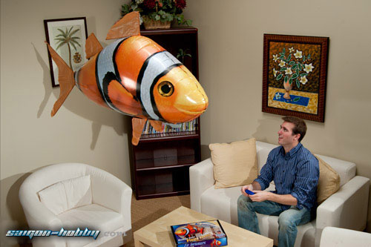
Buoyancy in Air
Archimedes’ principle applies to air as well as liquids.
  An object surrounded by air is buoyed up by a force equal to the weight of the air displaced
[image downloaded Jan.24 2013 from http://saigon-hobby.com/products/2739-air-swimmer-nemo.aspx ]

Slide 11
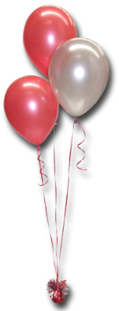
Buoyancy in Air
Rules for “lighter-than-air”objects:
When the weight of air displaced by an object is greater than the weight of the object, it rises.
When the weight of air displaced by an object equals the weight of the object, it hovers in air.
When the weight of air displaced by an object is less than the weight of the object, it is not supported by air.
[image downloaded Jan.24 2013 from http://restaurantreservationwallpaper.blogspot.ca/2012/10/helium-balloons.html ]

Slide 12
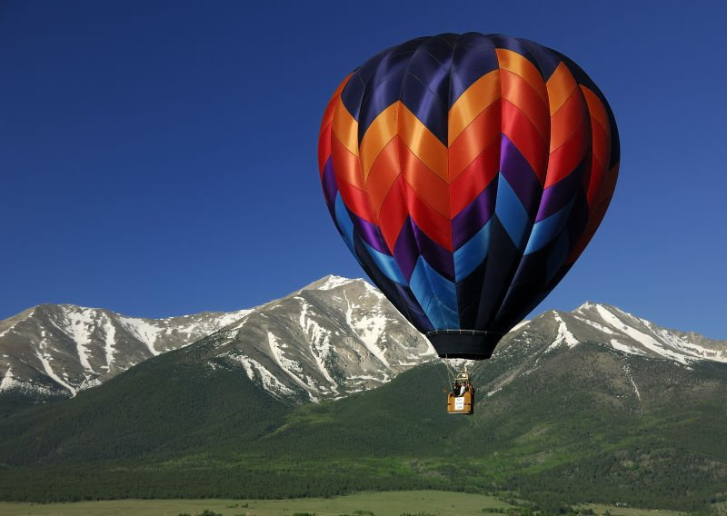
Buoyancy in Air
Gas-filled balloons
  Gas prevents atmosphere from collapsing them
  Best buoyancy with hydrogen, the lightest gas (flammable, so seldom used)
  Next-best buoyancy with helium
  Heated air used in sports balloons
As balloons rise, atmosphere becomes less dense with altitude.

Slide 13
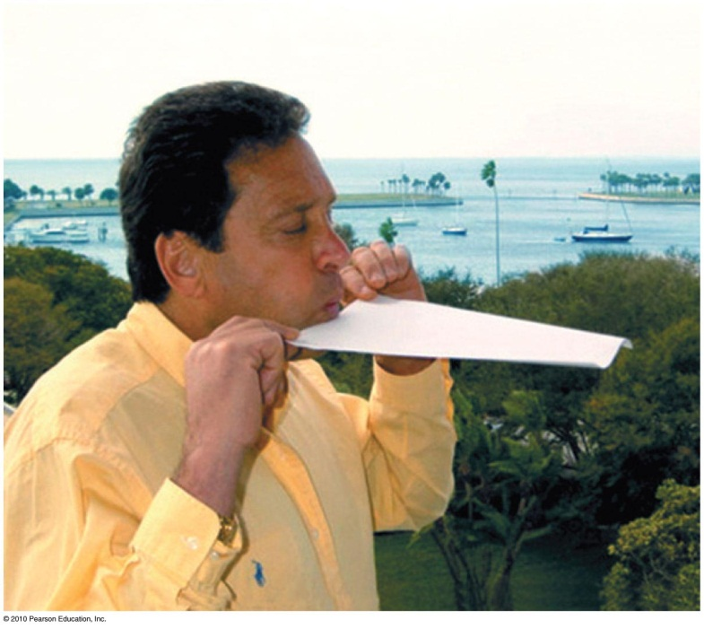
Bernoulli’s Principle
Discovered by Daniel Bernoulli, a 15th century Swiss scientist
States that where the speed of a fluid increases, internal pressure in the fluid decreases (and vice versa)
Applies to a smooth, steady flow

Slide 14
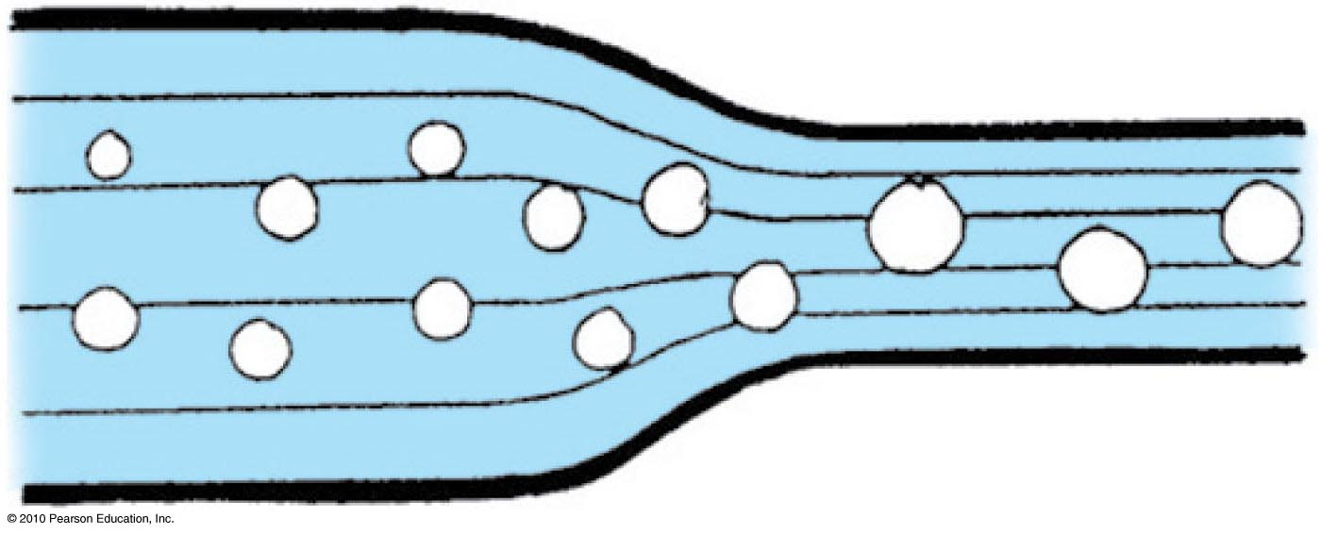
Bernoulli’s Principle
Streamlines
Thin lines representing fluid motion
Closer together, flow speed is greater and pressure within the fluid is less
Wider, flow speed is less and pressure within the fluid is greater

Slide 15
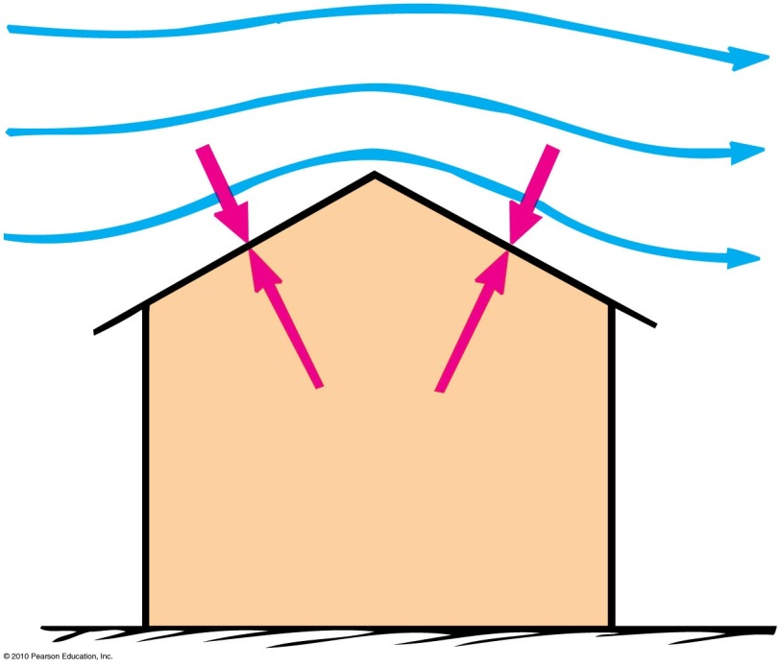
Applications of Bernoulli’s principle
Blow on the top surface of a paper and the paper rises.
  Reason: Pressure of the moving air is less than the atmospheric pressure beneath it.
Wind blowing across a peaked roof can lift the roof off the house.
  Reason: Pressure is reduced as wind gains speed as it flows over the roof. The greater pressure inside the house lifts the roof up.

Slide 16
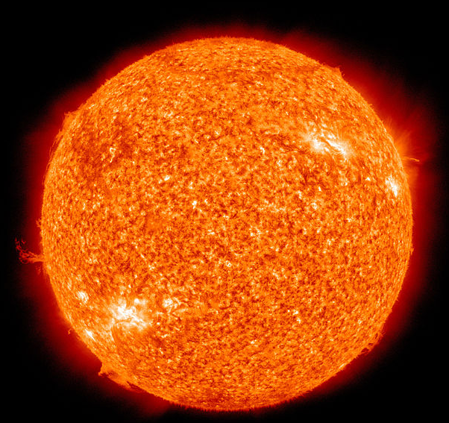
Plasma
Plasma is the fourth state of matter (after solids, liquids and gases).
A plasma is an electrified gas. The atoms that make it up are ionized, stripped of one or more electrons, with a corresponding number of free electrons.

Slide 17
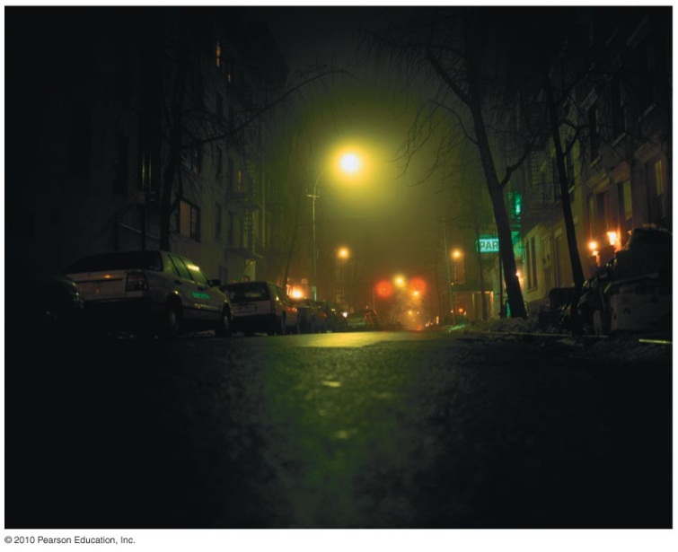
Plasma
Fluorescent lamps, neon signs
When you turn the lamp on, a high voltage between electrodes of the tube causes electrons to flow.
These electrons ionize some atoms, forming plasma.
Plasma provides a conducting path that keeps the current flowing.
The current activates some mercury atoms, causing them to emit ultraviolet radiation.
This radiation causes the phosphor coating on the tube’s inner surface to glow with visible light.

Slide 18
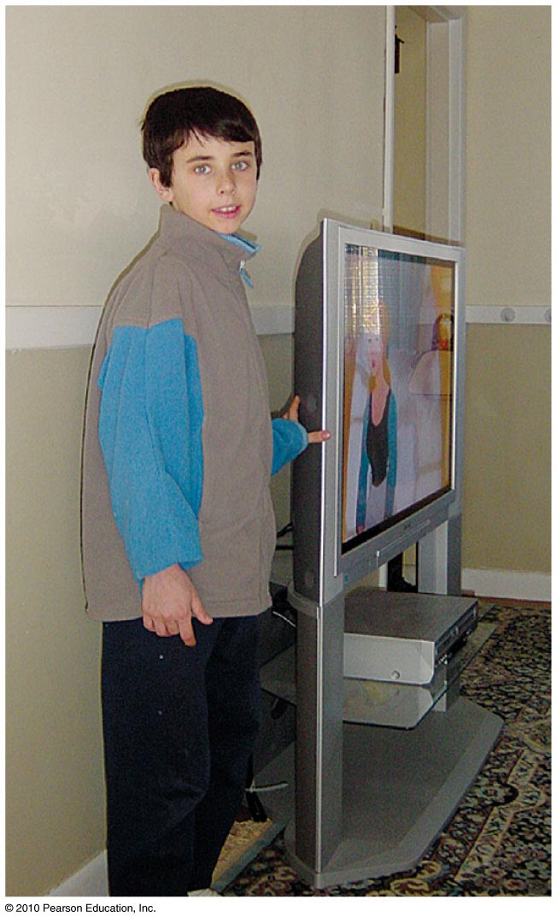
Plasma
Plasma screen TVs
Flat plasma TV screens are composed of many thousands of pixels.
Each has three separate cells—red, green and blue—each containing a different gas.
Pixels are sandwiched between a network of electrodes.
Electrodes are charged to produce electric currents flowing through cells.
Gases convert to glowing plasmas, releasing ultraviolet light to stimulate the phosphors.
The image on the screen is the blend of pixel colors activated by the TV control signal.

