Slide 1
Note on Posted Slides
These are the slides that I intended to show in class on Mon. Feb. 11, 2013.
They contain important ideas and questions from your reading.
Due to time constraints, I was probably not able to show all the slides during class.
They are all posted here for completeness.

Slide 2
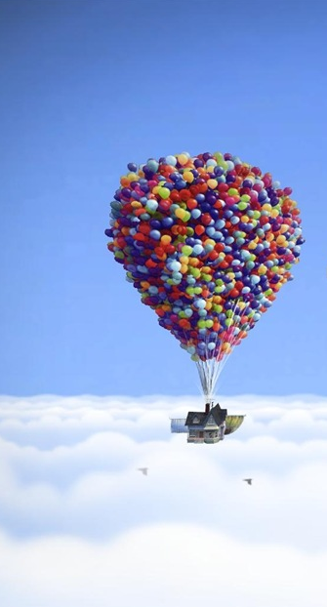
PHY205H1S Physics of Everyday Life Class 10: Gases
The Atmosphere
Atmospheric Pressure
The Barometer
Boyle’s Law
Buoyancy of Air
Bernoulli’s Principle
Plasma
[image from http://blog.testfreaks.com/information/thq-and-disney-pixars-up-the-videogame-preview/ ]

Slide 3
Chapter 14 Pre-class reading question
When a party balloon is compressed to one-third its volume with no change in temperature, what happens to the gas pressure in the balloon?
It drops by a factor of 3
It drops by a factor of 2
It remains the same
It doubles
It triples

Slide 4
Chapter 14 Pre-class reading question
Chapter 14 ends with a discussion of plasma. In this context, what is plasma?
A flowing fluid which is incompressible, nonviscous and has steady streamlines.
A fourth phase of matter, existing mainly at high temperatures, consisting of positively charged ions and free electrons.
A molecular gas such as N₂ or O₂.
Anything that flows; in particular, any liquid or gas.
The colorless fluid part of blood, lymph, or milk, in which corpuscles or fat globules are suspended.

Slide 5
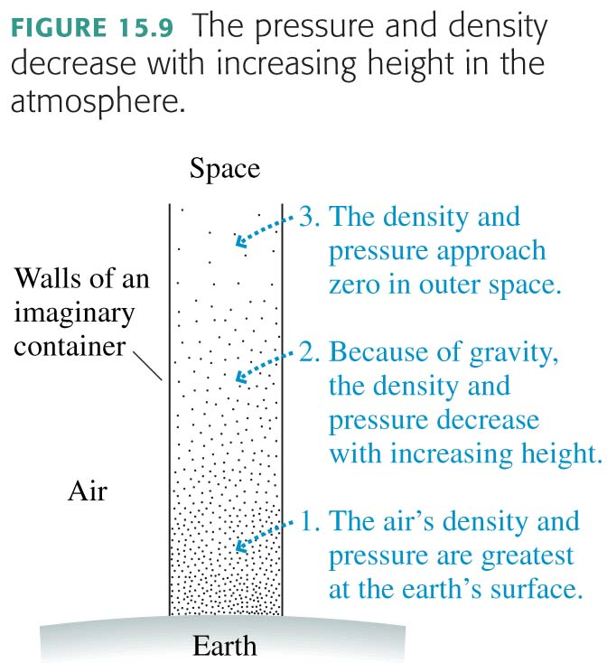
Atmospheric Pressure
The global average sea-level pressure is 100,000 Pa, or 1 atm.

Slide 6
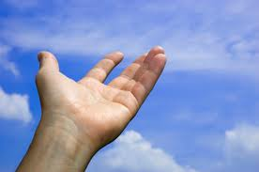
Atmospheric Pressure in this room
What is the force of air pressure on the top of your outstretched hand?
Atmospheric Pressure:
20 square inches = 300 pounds!
Why don’t you feel that force pushing your hand down?
What if all the air below your hand was removed (a vacuum)?

Slide 7
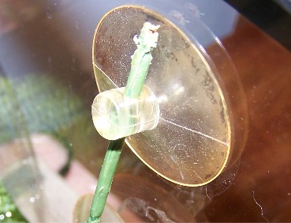
Discussion Question
A suction cup sticks to a wall. It is
pulled to the wall by the vacuum.
pushed to the wall by the atmosphere.
both of these
neither of these
[image from http://www.flippersandfins.net/bettabreedingarticle.htm ]

Slide 8
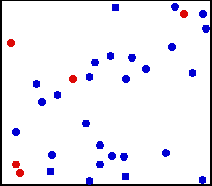
Pressure and “Suction”
A fluid can only push walls or objects; a fluid cannot pull on a wall.
What we call “suction” is when the fluid on one side has a higher pressure than the fluid on the other side.
It is the pressure difference which creates a pushing force into the lower pressure area (into the vacuum).
This is how we breath:
We expand our lung cavity, lowering the pressure inside.
The higher air pressure outside pushes air into our lungs.

Slide 9
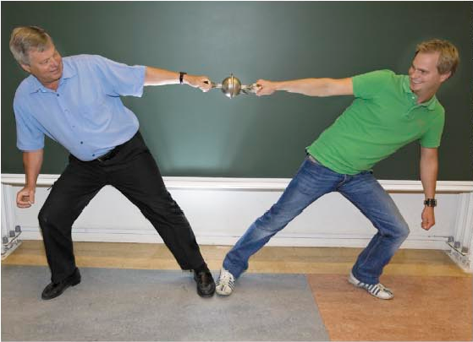
The Atmosphere
Atmosphere
Ocean of air
Exerts pressure
The Magdeburg-hemispheres demonstration shows the large magnitude of atmosphere’s pressure.

Slide 10
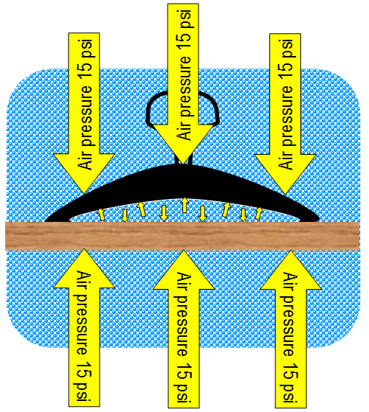
Suction Cups
When we lower the pressure inside a suction cup, it is the pushing forces of the pressurized air all around which creates the net forces.
Suction cups would not work on the moon!

Slide 11
In drinking soda or water through a straw, we make use of
Atmospheric Pressure
CHECK YOUR NEIGHBOR
capillary action.
surface tension.
atmospheric pressure.
Bernoulli's principle.
none of these
Notes:
A. is 10.3 m.

Slide 12
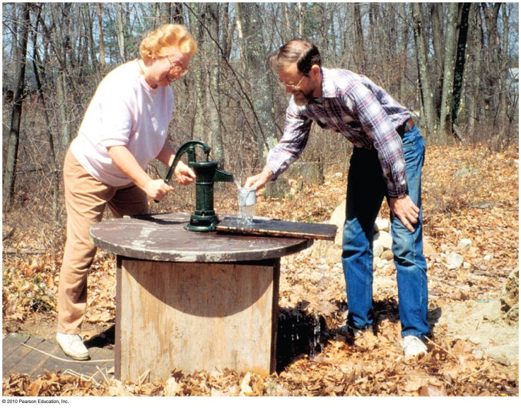
Atmospheric Pressure
Pressure at the bottom of a column of air reaching to the top of the atmosphere is the same as the pressure at the bottom of a column of water 10.3 m high.
Consequence: The highest the atmosphere can push water up into a vacuum pump is 10.3 m.
Mechanical pumps that don’t depend on atmospheric pressure don’t have the 10.3-m limit.

Slide 13
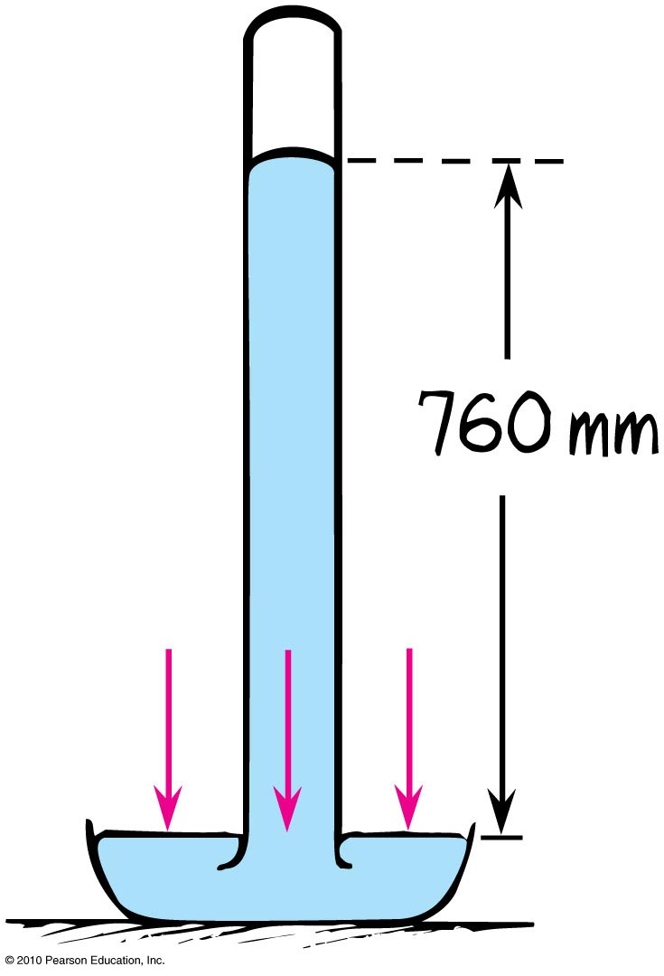
The Barometer
The barometer is a device to measure atmospheric pressure.
It consists of a mercury tube upside down in a dish filled with mercury.
The height of the mercury column tells us the atmospheric pressure.
Atmospheric pressure decreases with increasing altitude, so it also measures elevation—an altimeter.

Slide 14
The Barometer
The principle of the barometer:
Mercury column exerts pressure on the mercury in the dish.
Atmosphere exerts pressure on the mercury in the dish.
These two pressures must be equal so that the atmospheric pressure supports the mercury column.

Slide 15
Why don’t barometers use water instead of mercury?
Barometer
CHECK YOUR NEIGHBOR
A. Water cannot be used because it does not exert pressure.
Water cannot be used because it sticks to the glass.
Water can be used but the barometer will be too tall.
None of the above.
Notes:
15
C. Water can be used but the barometer will be too tall.

Slide 16
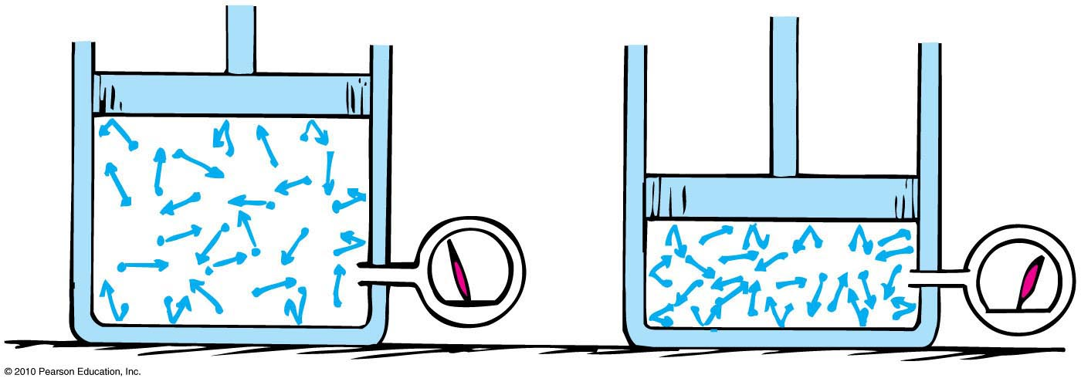
Boyle’s Law
The pressure and volume of a gas enclosed in a space are inversely proportional.
If you decrease the volume, the pressure will increase by the same factor.
Example: If volume drops by a factor of 2, the pressure will increase by a factor of 2.

Slide 17
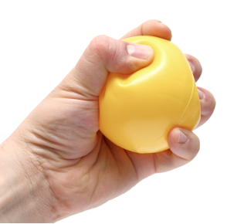
Boyle’s Law
The product of pressure and volume of a given mass of gas will always remain the same.
PV = PV
LARGE Pressure
LARGE Volume
Small Volume
Small Pressure

Slide 18
Boyle’s Law Example
A rubber ball has a volume of 0.01 m³, and an internal pressure of 100,000 Pa.
You then squeeze the ball so that its volume reduces to 0.008 m³ (80% of its original volume).
What is the new pressure inside the ball?
[image from http://blueheronhealthnews.com/site/2012/04/02/squeezing-rubber-ball-drops-blood-pressure/ ]

Slide 19
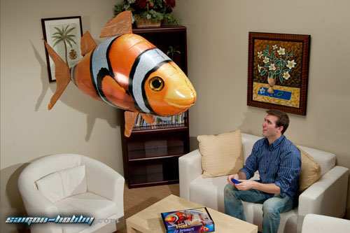
Buoyancy in Air
Archimedes’ principle applies to air as well as liquids.
An object surrounded by air is buoyed up by a force equal to the weight of the air displaced
[image downloaded Jan.24 2013 from http://saigon-hobby.com/products/2739-air-swimmer-nemo.aspx ]

Slide 20
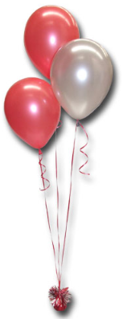
Buoyancy in Air
Rules for “lighter-than-air”objects:
When the weight of air displaced by an object is greater than the weight of the object, it rises.
When the weight of air displaced by an object equals the weight of the object, it hovers in air.
When the weight of air displaced by an object is less than the weight of the object, it is not supported by air.
[image downloaded Jan.24 2013 from http://restaurantreservationwallpaper.blogspot.ca/2012/10/helium-balloons.html ]

Slide 21
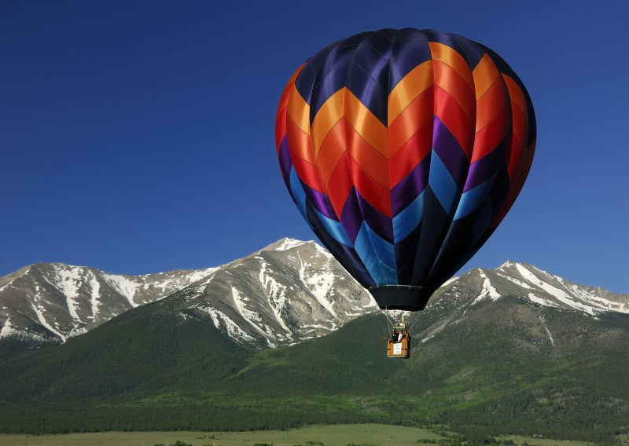
Buoyancy in Air
Gas-filled balloons
Gas prevents atmosphere from collapsing them
Best buoyancy with hydrogen, the lightest gas (flammable, so seldom used)
Next-best buoyancy with helium
Heated air used in sports balloons
As balloons rise, atmosphere becomes less dense with altitude.

Slide 22
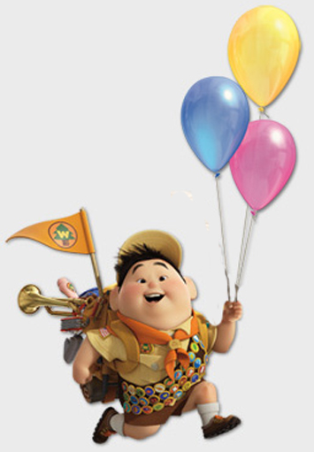
Buoyancy Example
If you wish to support a mass of 80 kg (one person) with a helium-filled balloon, how big should the balloon be?
[image from http://www.puropedomagazine.com/blog/2009/10/in-celebration-of-dvd-release-of-up-disney-sends-child-up-in-an-experimental-helium-balloon/ ]

Slide 23
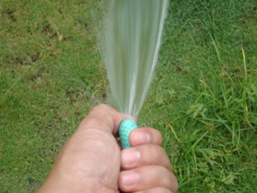
In-class Discussion Question
You put your thumb over the end of the a hose, thereby reducing the area through which water can exit the hose.
What must change about the water so that the amount coming in the hose equals the amount leaving the hose?
The velocity must increase.
The velocity must decrease.
The pressure must increase.
The pressure must decrease.

Slide 24
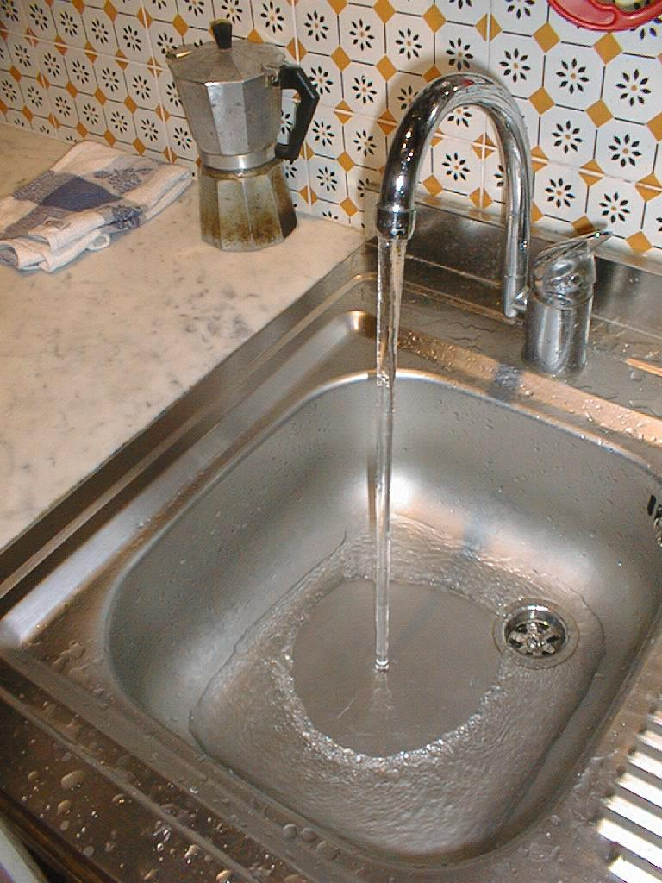
In-class Discussion Question
We study the steady flow of water from a water tap, e.g., in your kitchen sink. The jet of water
broadens as it falls.
narrows as it falls.
does not change its cross-sectional shape.
slows before hitting the bottom of the sink.

Slide 25
Bernoulli’s Law
Consider an ideal fluid, flowing through a tube which narrows.
It increases its velocity. This means the kinetic energy per volume of the fluid will increase.
How can this be? There must be a force which does work on the fluid to speed it up.
The force must come from a pressure difference.
Pressure must be lower in the region of increased fluid velocity.

Slide 26
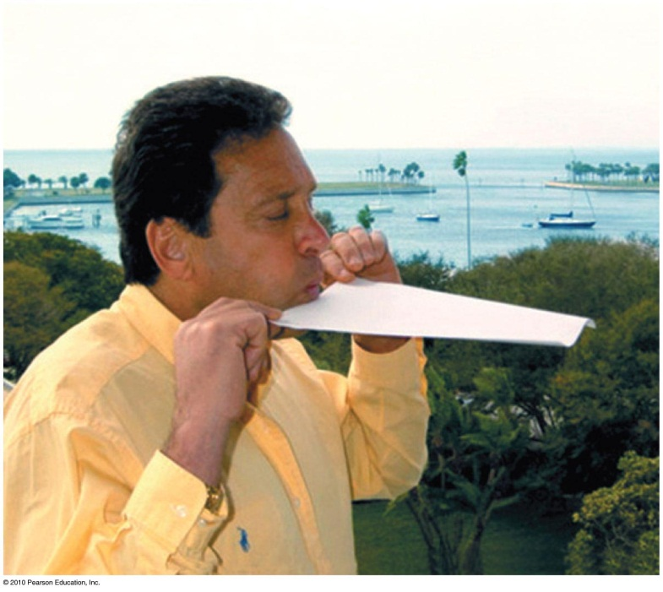
Bernoulli’s Principle
Discovered by Daniel Bernoulli, a 15th century Swiss scientist
States that where the speed of a fluid increases, internal pressure in the fluid decreases (and vice versa)
Applies to a smooth, steady flow

Slide 27
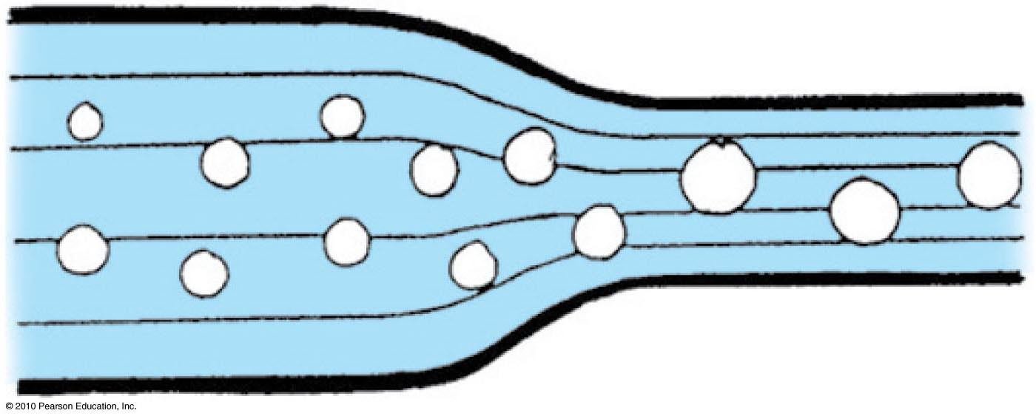
Bernoulli’s Principle
Streamlines
Thin lines representing fluid motion
Closer together, flow speed is greater and pressure within the fluid is less
Wider, flow speed is less and pressure within the fluid is greater

Slide 28
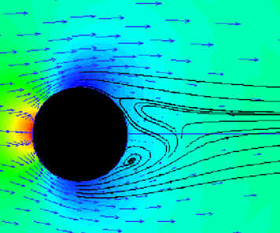
Bernoulli’s demo, lift.
If the air were flowing equally above and below the beach-ball, there would be no force on the ball due to the Bernoulli effect.
The ball would then fall due to its own weight until the point where most of the flow is over the top of the ball, reducing the pressure there.
The ball sits at a point of stable equilibrium, where these forces balance.

Slide 29
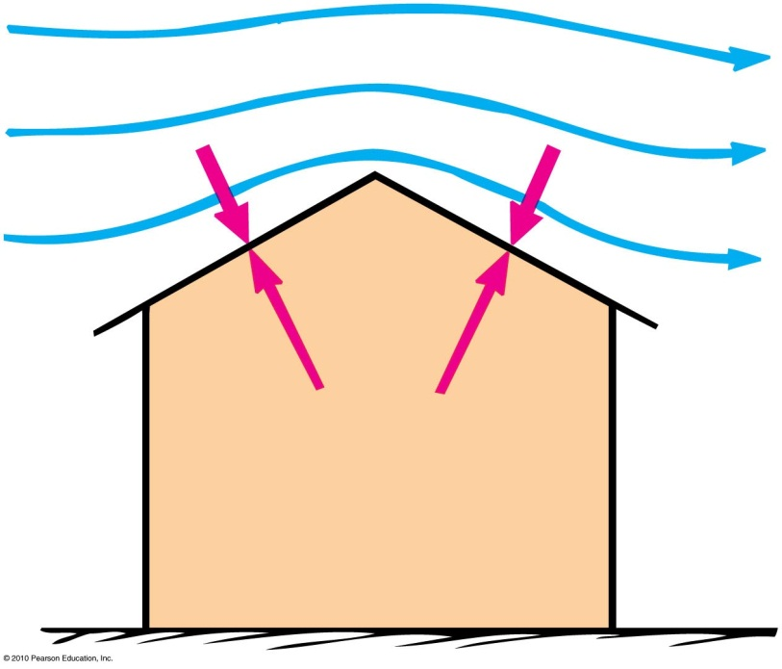
Applications of Bernoulli’s principle
Blow on the top surface of a paper and the paper rises.
Reason: Pressure of the moving air is less than the atmospheric pressure beneath it.
Wind blowing across a peaked roof can lift the roof off the house.
Reason: Pressure is reduced as wind gains speed as it flows over the roof. The greater pressure inside the house lifts the roof up.

Slide 30
In-class Discussion Question
When wind speeds up as it blows over the top of a hill, what happens to the atmospheric pressure over the hill?
It decreases
It increases
It stays the same

Slide 31
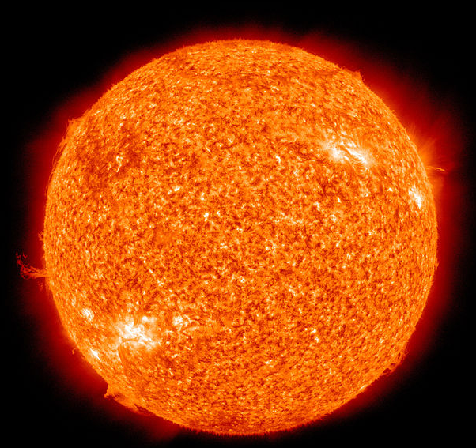
Plasma
Plasma is the fourth state of matter (after solids, liquids and gases).
A plasma is an electrified gas. The atoms that make it up are ionized, stripped of one or more electrons, with a corresponding number of free electrons.

Slide 32
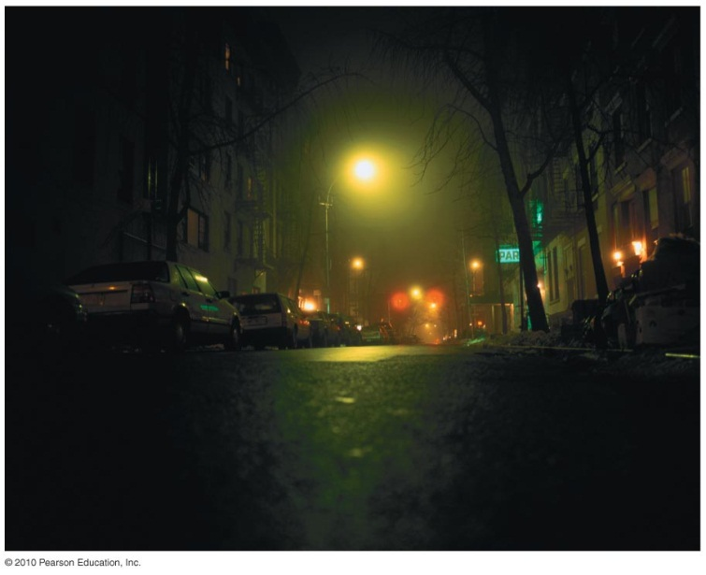
Plasma
Fluorescent lamps, neon signs
When you turn the lamp on, a high voltage between electrodes of the tube causes electrons to flow.
These electrons ionize some atoms, forming plasma.
Plasma provides a conducting path that keeps the current flowing.
The current activates some mercury atoms, causing them to emit ultraviolet radiation.
This radiation causes the phosphor coating on the tube’s inner surface to glow with visible light.

Slide 33
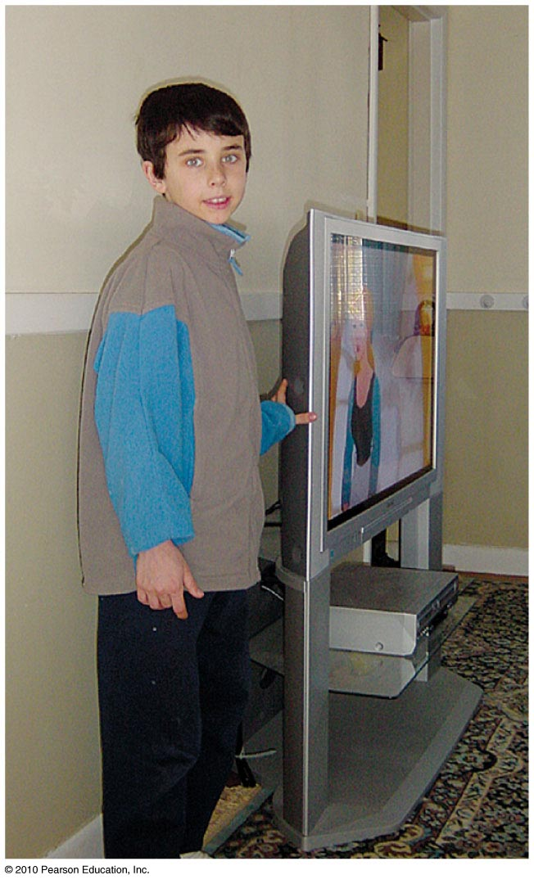
Plasma
Plasma screen TVs
Flat plasma TV screens are composed of many thousands of pixels.
Each has three separate cells—red, green and blue—each containing a different gas.
Pixels are sandwiched between a network of electrodes.
Electrodes are charged to produce electric currents flowing through cells.
Gases convert to glowing plasmas, releasing ultraviolet light to stimulate the phosphors.
The image on the screen is the blend of pixel colors activated by the TV control signal.

Slide 34
In-class Discussion Question
Which of the following is in a plasma state?
Dry ice
A torch flame
Molten lava
Liquid hydrogen
Helium gas

Slide 35
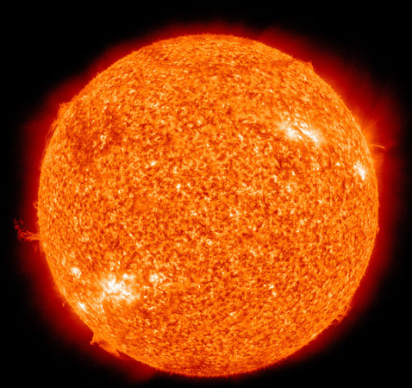
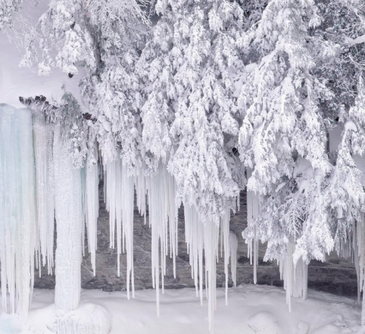
Before Class 11 on Wednesday
Please read Chapter 15, or at least watch the 10-minute pre-class video for class 11
Something to think about:
Is there an upper limit to how hot something can get?
Is there a lower limit to how cold something can get?
[image of icicles from http://ohbythewayblog.blogspot.ca/2012/12/icicles.html ]

