Slide 1
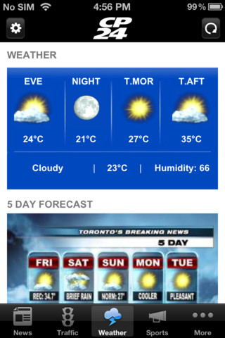
Conceptual Physics 11th Edition
Chapter 15:
TEMPERATURE, HEAT AND EXPANSION
Temperature
Heat
Specific Heat Capacity
Thermal Expansion
Thermal Expansion of Water and Ice
[iphone app image from https://itunes.apple.com/ca/app/cp24-torontos-breaking-news/id427789138?mt=8 ]

Slide 2
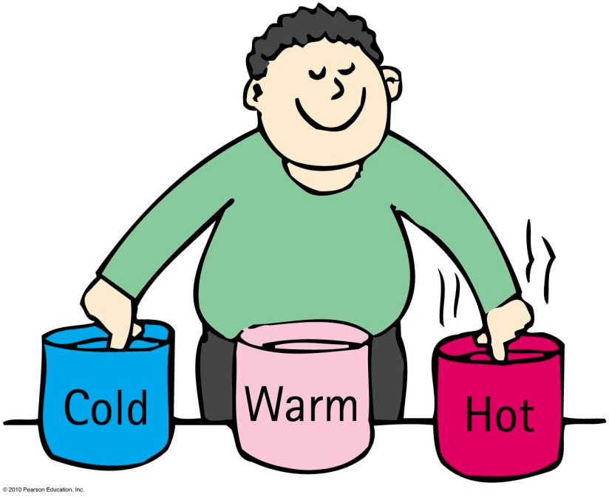
Temperature
A number that corresponds to the warmth or coldness of an object
Measured by a thermometer
Is a per-particle property
No upper limit
The lower limit is called
“absolute zero”

Slide 3
Temperature
Temperature is proportional to the average translational kinetic energy per particle in a substance.
Gas—how fast the gas particles are bouncing to and fro
Liquid—how fast particles slide and jiggle past one another
Solid—how fast particles move as they vibrate and jiggle in place
[animated gif downloaded Jan.25 2013 from http://www.deanza.edu/faculty/mccauley/6a_site_images/Translational_motion-250.gif ]

Slide 4
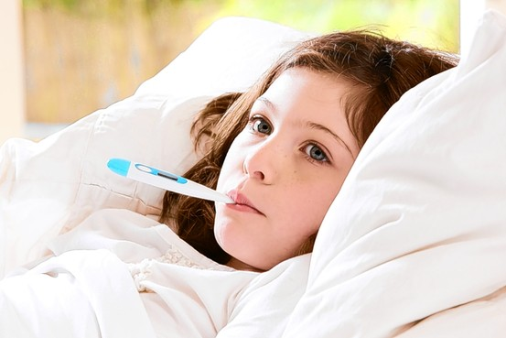
Temperature
Thermometer
Measures temperature by expansion or contraction of a liquid (mercury or colored alcohol)
Reading occurs when the thermometer and the object reach thermal equilibrium (having the same average kinetic energy per particle)
Infrared thermometers operate by sensing IR radiation
[image downloaded Jan.25 2013 from http://drrajivdesaimd.com/date/2012/10/ ]

Slide 5
Temperature scales
Celsius
0°C for freezing point of water
100°C for boiling point of water
Fahrenheit
32°F for freezing point of water
212°F for boiling point of water
Kelvin
273 K for freezing point of water
373 K for boiling point of water
0 at absolute zero
same size degrees as Celsius scale

Slide 6
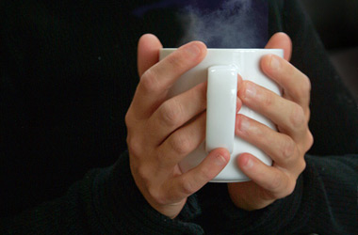
Heat is a form of energy
Heat is when internal energy is transferred from one thing to another due to a temperature difference
Heat is internal energy in transit
Flow of internal energy
Heat flows from a high-temperature substance to a low-temperature substance until thermal equilibrium is reached
Heat never flows unassisted from a low-temperature to a high-temperature substance
[image downloaded Jan.25 2013 from http://summitjourneytowellness.blogspot.ca/2010/02/journey-to-wellness_5148.html ]

Slide 7
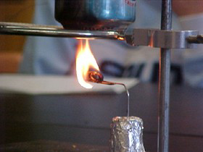
Quantity of heat
Measured in joules or calories
4.18 joules of heat are required to change the temperature of 1 gram of water by 1 Celsius degree
4.18 joules = 1 calorie
[photo by Scott Wallace, downloaded Jan.25 2013 from http://www.compadre.org/informal/index.cfm?Issue=11 ]

Slide 8
Quantity of Heat
Energy ratings of foods and fuels are determined from energy released when they are burned.
Unit of energy, the Calorie, is common for foods.
kilocalorie or 1000 calories called a Calorie
heat needed to change the temperature of 1 kg of water by 1°C

Slide 9
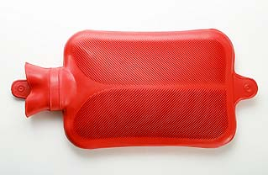
Specific heat capacity
Defined as the quantity of heat required to change the temperature of 1 kg of the substance by 1 degree Celsius
Like thermal inertia—resistance of a substance to a change in temperature
[image downloaded Jan.25 2013 from http://video.planetgreen.discovery.com/home-garden/hot-water-bottle-bed.html ]

Slide 10
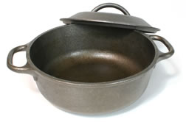
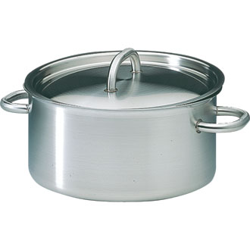
Specific Heat Capacity
Different substances have different thermal capacities for storing energy.
Example:
Takes about 2 minutes to raise the temperature of an iron pot of water to boiling temperature
Takes less than 1 minute to raise the temperature of the same quantity of water in a silver pot to boiling temperature

Slide 11
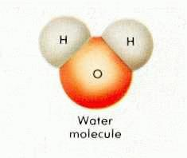
The high specific heat capacity of water
has higher capacity for storing energy than almost any other substance.
involves various ways that energy can be absorbed.
increases the jiggling motion of molecules, which raises the temperature
increases the amount of internal vibration or rotation within the molecules, which becomes potential energy and doesn’t raise temperature
water molecules can absorb energy without increasing translational kinetic energy

Slide 12
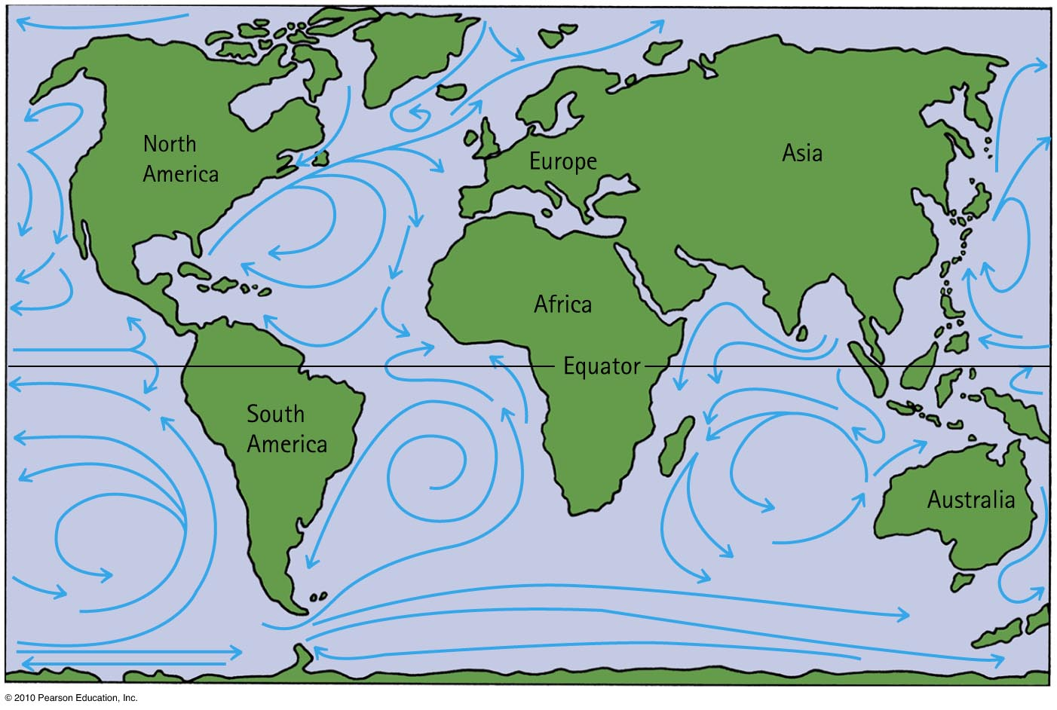
Specific heat affects climate
Land has a smaller specific heat capacity than water.
For Europeans, the Atlantic Ocean current carries warm water northeast from the Caribbean regions and retains much of its internal energy long enough to reach the North Atlantic Ocean.

Slide 13
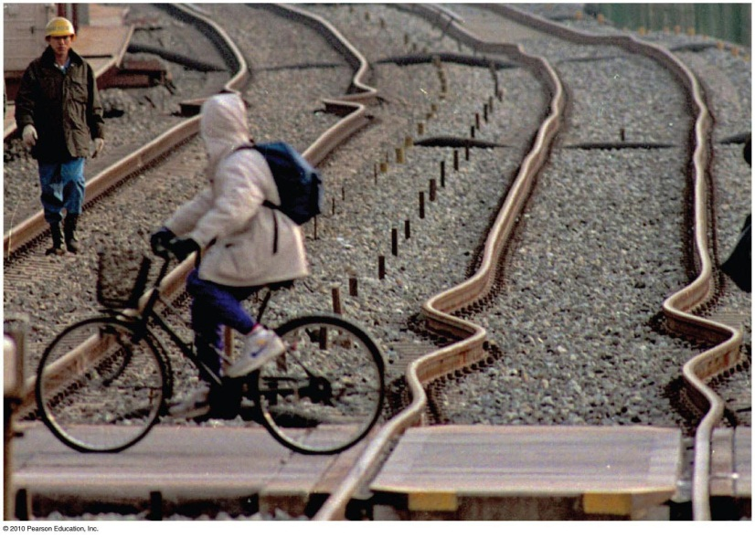
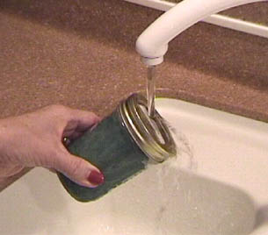
Thermal expansion
Due to rise in temperature of a substance, molecules jiggle faster and move farther apart.
Most substances expand when heated and contract when cooled.
Railroad tracks laid on winter days expand and can buckle in hot summer.
[image downloaded Jan. 25 2013 from http://hyperphysics.phy-astr.gsu.edu/hbase/thermo/jarlid.html ]
Warming metal lids on glass jars under hot water loosens the lid by more expansion of the lid than the jar.

Slide 14
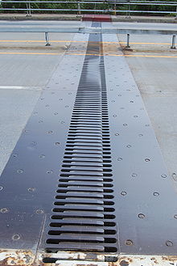
Thermal expansion
Plays a role in construction and devices.
Example:
Use of reinforcing steel with the same rate of expansion as concrete—expansion joints on bridges.
Gaps on concrete roadways and sidewalks allow for concrete expansion in the summer and contraction in the winter.

Slide 15
Thermal expansion
Different substances expand at different rates.
Example:
When the temperature of a bimetallic strip of brass and iron is increased, greater expansion occurs for the brass strip, which bends to turn a pointer, to regulate a valve, or to close a switch.
Bimetallic strips are used in heaters, oven thermometers, refrigerators, and electric toasters.

Slide 16
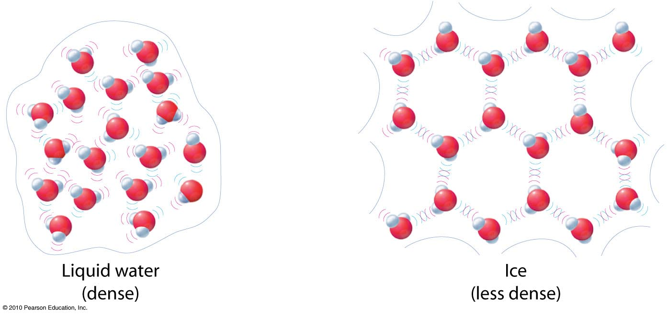
Thermal Expansion: The exception to the rule
Expansion of water to ice
When water becomes ice, it expands! Ice has open-structured crystals resulting from strong bonds at certain angles that increase its volume. This make ice less dense than water.

Slide 17
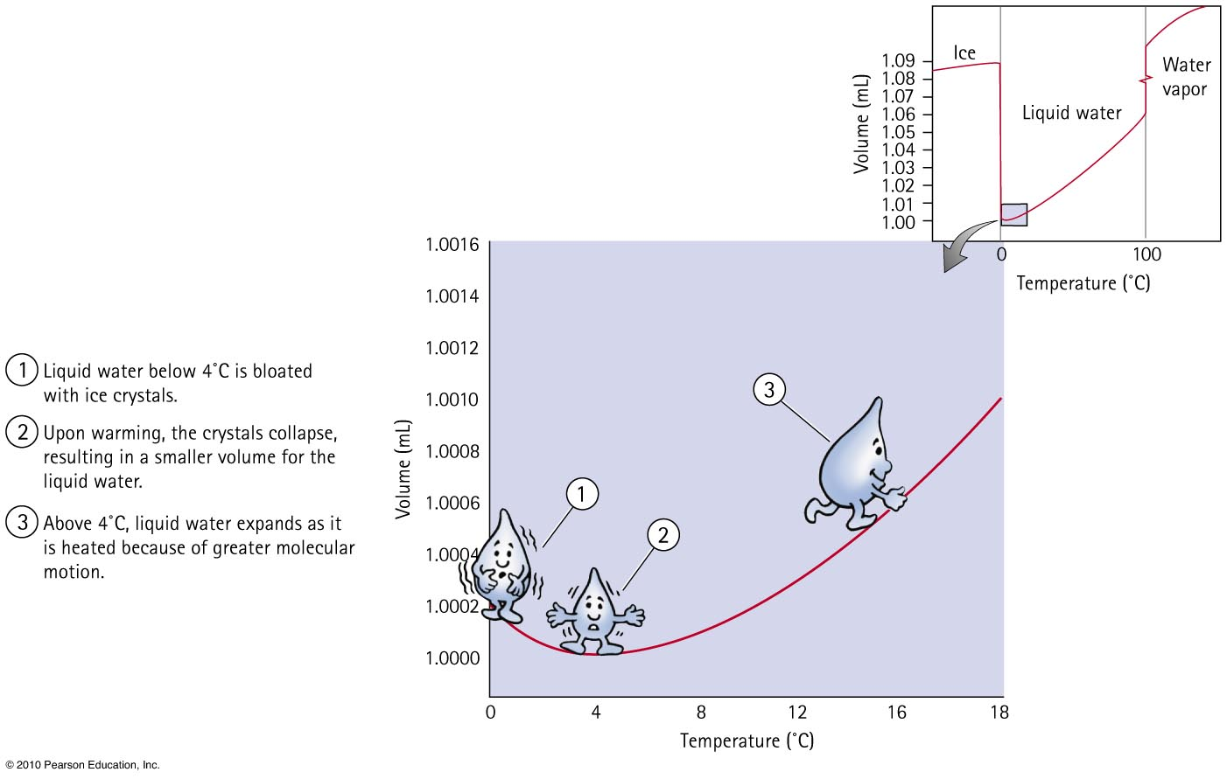

Slide 18
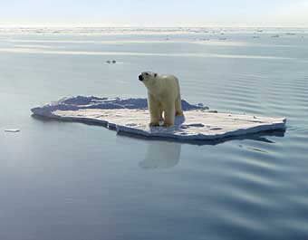
Thermal expansion of water
When ice freezes to become solid ice, its volume increases tremendously.
As solid ice cools further, it contracts.
Density of ice at any temperature is much lower than the density of water, which is why ice always floats on water.

