Slide 1
Note on Posted Slides
These are the slides that I intended to show in class on Wed. Feb. 13, 2013.
They contain important ideas and questions from your reading.
Due to time constraints, I was probably not able to show all the slides during class.
They are all posted here for completeness.

Slide 2
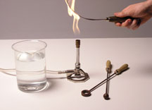
PHY205H1S Physics of Everyday Life Class 11: Temperature, Specific Heat and Thermal Expansion
Temperature
Heat
Specific Heat Capacity
Thermal Expansion
Thermal Expansion of Water and Ice
[image from http://sirius.ucsc.edu/demoweb/cgi-bin/?fl_pr_ht-thermo-expansion/ ]

Slide 3
Chapter 15 Pre-class reading question
What is the difference between a calorie and a Calorie?
The unit Calorie is used in the U.K. and Canada, while the calorie is used in the U.S.A.
One Calorie is 1000 calories.
A Calorie is a unit of heat while a calorie is a unit of food energy.
A calorie is 4.18 times smaller than a Calorie.
They are both the same.

Slide 4
Chapter 15 Pre-class reading question
An iron bar has a length of exactly 1.0000 m. If you double the temperature of this iron bar, what will happen to its length?
Its length will double.
It will get slightly longer.
It will not change.
It will get slightly shorter.
Its length will drop by a factor of 2.

Slide 5
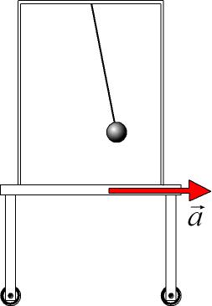
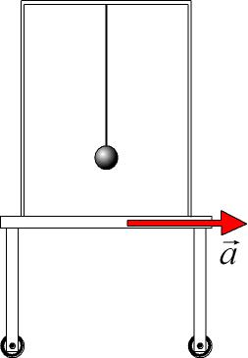
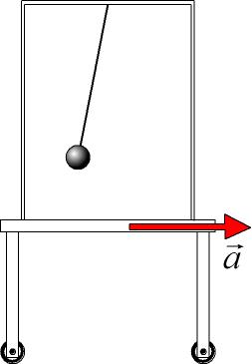
Inertia Demonstration
A cart is covered by an enclosed transparent box. A ball is attached to the top of the box by a string. Predict: As the box is accelerating toward the right, which will be the best sketch of the situation?
A
B
C

Slide 6
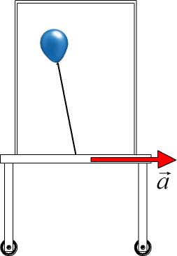
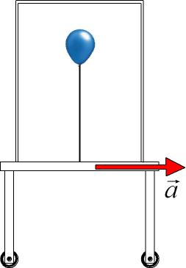
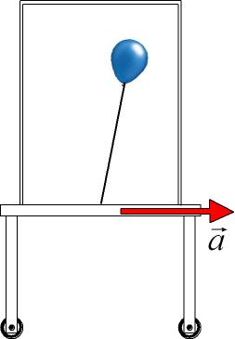
Buoyancy Demonstration
A cart is covered by an enclosed transparent box. A helium-balloon is attached to the bottom of the box by a string. Predict: As the box is accelerating toward the right, which will be the best sketch of the situation?
A
B
C

Slide 7
As the cart is accelerating to the right, the heavier air molecules are left behind, to the left, creating a tilted pressure gradient
Lower air Density, Pressure
Higher air Density, Pressure
Isobars (planes of equal pressure)
C

Slide 8
Another way of looking at it: Gravity acts like a result of acceleration. This was noted by Einstein and lead to his theory of General Relativity in 1915.
Apparent direction of gravity inside accelerating box
Apparent direction of gravity inside accelerating box

Slide 9
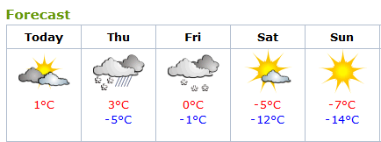
Temperature
It’s one of the first things we think about in the morning: What’s the temperature like outside?
We can measure temperature with a thermometer.
Temperature has something to do with microscopic random motions of the atoms in a material
A cold cup of coffee has a low amount of internal thermal energy
If you put it in the microwave, the microwave radiation transfers energy to the coffee, increasing its internal thermal energy, which increases its temperature.

Slide 10
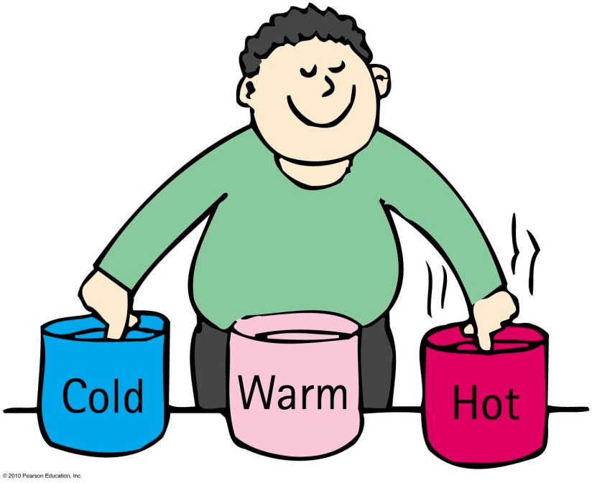
Temperature
A number that corresponds to the warmth or coldness of an object
Is a per-particle property
No upper limit
The lower limit is called
“absolute zero”

Slide 11
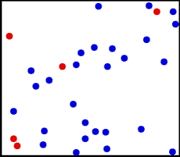
Temperature
Absolute temperature (in degrees Kelvin) is proportional to the average translational kinetic energy per particle in a substance.
Gas—how fast the gas particles are bouncing around
Liquid—how fast particles slide and jiggle past one another
Solid—how fast particles move as they vibrate and jiggle in place
[animated gif downloaded Jan.25 2013 from http://www.deanza.edu/faculty/mccauley/6a_site_images/Translational_motion-250.gif ]

Slide 12
There is twice as much molecular kinetic energy in 2 liters of boiling water as in 1 liter of boiling water. Which will be the same for both?
Temperature
CHECK YOUR NEIGHBOR
A. Temperature
Thermal energy
Both A and B.
Neither A nor B.
Notes:
A. Temperature.

Slide 13
To say that body A has a higher temperature than body B is to say that body A has more
Temperature
CHECK YOUR NEIGHBOR
A. internal energy.
mass.
kinetic energy per particle.
potential energy.
Notes:
C. kinetic energy per particle.

Slide 14
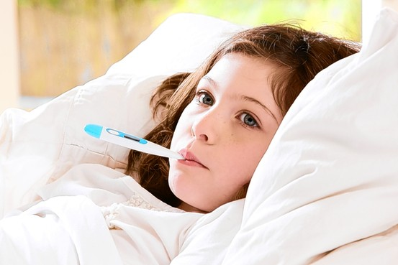
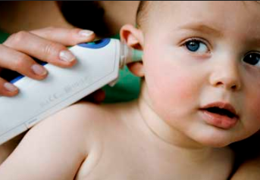
Thermometers
Measure temperature by expansion or contraction of a liquid (mercury or colored alcohol)
Reading occurs when the thermometer and the object reach thermal equilibrium (having the same average kinetic energy per particle)
Infrared thermometers operate by sensing IR radiation
[image downloaded Jan.25 2013 from http://drrajivdesaimd.com/date/2012/10/ ]

Slide 15
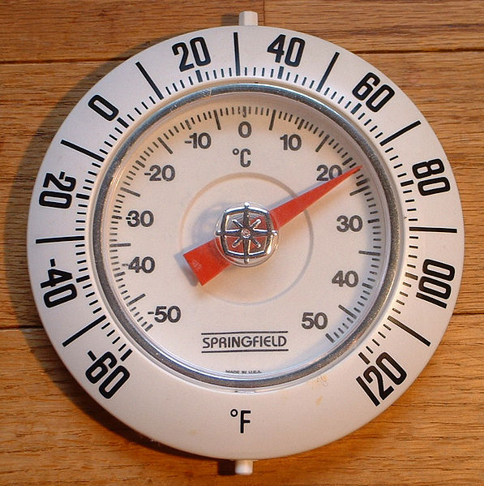
Temperature Scales
To convert T_{F} in Fahrenheit to T_{C} in Celsius:
$$T_{C}=(T_{F}−32)×\frac{5}{9}$$
To convert T_{C} in Celsius to T_{F} in Fahrenheit:
$$T_{F}=\left(T_{C}×\frac{9}{5}\right)+32$$
Though Canada officially switched to Celsius in 1970, Fahrenheit is still sometimes used, especially on kitchen appliances and in hospitals.

Slide 16
“Absolute” Temperature
Note that temperature is due to the microscopic vibrations of the atoms in a material (internal thermal energy).
The coldest possible temperature would be when this thermal energy dropped to zero: atoms STOPPED vibrating.
For all materials, this happens at −273 °C
The Kelvin temperature scale is the same as Celsius, but with a different zero point. Absolute zero has T = 0 K.
To convert T_{C} in Celsius to T in Kelvin:
$$T=T_{C}+273$$
To convert T in Kelvin to T_{C} in Celsius:
$$T_{C}=T−273$$

Slide 17
Temperature Conversion Example
The commonly accepted average core body temperature for a human (taken internally) is 98.6 degrees Fahrenheit.
What is this in Celsius?
What is this in Kelvin?

Slide 18
Is it possible for an object to have a negative Kelvin temperature?
Temperature
CHECK YOUR NEIGHBOR
Yes
No
Notes:
A. Temperature.

Slide 19
Temperature scales summary
Celsius
0°C for freezing point of water
100°C for boiling point of water
Fahrenheit
32°F for freezing point of water
212°F for boiling point of water
Kelvin
273 K for freezing point of water
373 K for boiling point of water
0 at absolute zero, when atoms have STOPPED vibrating!
same size degrees as Celsius scale

Slide 20
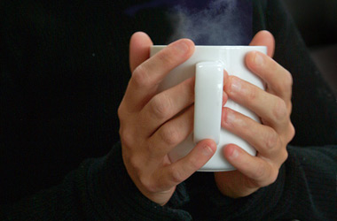
Heat is a form of energy
Heat is when internal energy is transferred from one thing to another due to a temperature difference
Heat is internal energy in transit
Flow of internal energy
Heat flows from a high-temperature substance to a low-temperature substance until thermal equilibrium is reached
Heat never flows unassisted from a low-temperature to a high-temperature substance
[image downloaded Jan.25 2013 from http://summitjourneytowellness.blogspot.ca/2010/02/journey-to-wellness_5148.html ]

Slide 21
If a red-hot thumbtack is immersed in warm water, the direction of heat flow will be from the
Heat
CHECK YOUR NEIGHBOR
A. warm water to the red-hot thumbtack.
red-hot thumbtack to the warm water.
There will be no heat flow.
Not enough information.
Notes:
B. red hot thumbtack to the warm water.

Slide 22
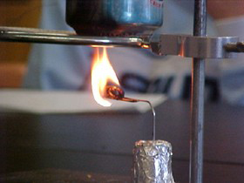
Quantity of heat
Measured in joules or calories
4.18 joules of heat are required to change the temperature of 1 gram of water by 1 Celsius degree
4.18 joules = 1 calorie
[photo by Scott Wallace, downloaded Jan.25 2013 from http://www.compadre.org/informal/index.cfm?Issue=11 ]

Slide 23
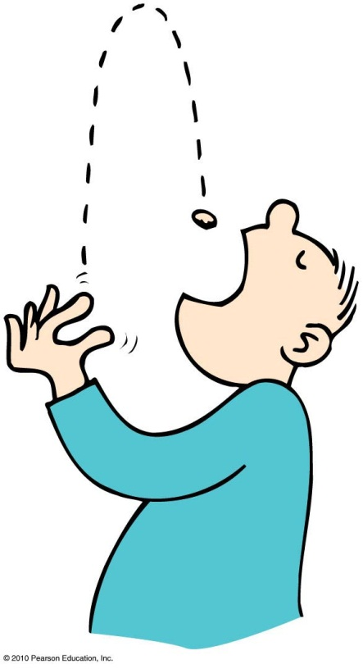
Quantity of Heat
Energy ratings of foods and fuels are determined from energy released when they are burned.
Unit of energy, the Calorie, is common for foods.
kilocalorie or 1000 calories called a Calorie
heat needed to change the temperature of 1 kg of water by 1°C

Slide 24
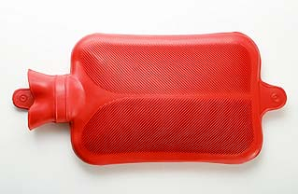
Specific heat capacity
Defined as the quantity of heat required to change the temperature of 1 kg of the substance by 1 degree Celsius
Like thermal inertia—resistance of a substance to a change in temperature
[image downloaded Jan.25 2013 from http://video.planetgreen.discovery.com/home-garden/hot-water-bottle-bed.html ]

Slide 25
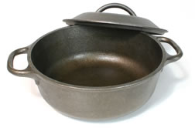
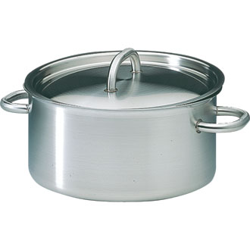
Specific Heat Capacity
Different substances have different thermal capacities for storing energy.
Example:
Takes about 2 minutes to raise the temperature of an iron pot of water to boiling temperature
Takes less than 1 minute to raise the temperature of the same quantity of water in a silver pot to boiling temperature

Slide 26
The same quantity of heat is added to different amounts of water in two equal-size containers. The temperature of the smaller amount of water
Quantity of Heat
CHECK YOUR NEIGHBOR
A. decreases more.
increases more.
does not change.
Not enough information.
Notes:
B. increases more.

Slide 27
You heat a half-cup of tea and its temperature rises by 4°C. How much will the temperature rise if you add the same amount of heat to a full cup of tea?
Quantity of Heat
CHECK YOUR NEIGHBOR
A. 0°C
2°C
4°C
8°C
Notes:
B. 2°C.

Slide 28
Specific Heat Capacities of Common Materials
Material | Specific Heat
 | (kJ/kg °C)
Alcohol | 2.3
Aluminum | 0.87
Ammonia | 1.1
Brass | 0.38
Brick | 0.9
Cement | 1.55
Chloroform | 1.05
Citron Oil | 1.84
Diamond | 0.52
Ether | 2.21
Freon | 0.91
Gasoline | 2.22
Glass | 0.84
Glycerine | 2.43
Material | Specific Heat
 | (kJ/kg °C)
Gold | 0.13
Hydrochloric acid | 3.14
Iodine | 2.15
Lava | 0.84
Mercury | 0.14
Milk | 3.93
Olive oil | 1.97
Paper | 1.34
Plastic (hard) | 1.67
Salt | 0.88
Steel | 0.49
Water | 4.18
Wood | 2
[solids data from http://www.engineeringtoolbox.com/specific-heat-solids-d_154.html ]
[fluids data from http://www.engineeringtoolbox.com/specific-heat-fluids-d_151.html ]

Slide 29
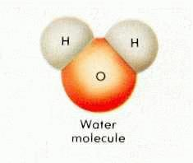
The high specific heat capacity of water
has higher capacity for storing energy than almost any other substance.
involves various ways that energy can be absorbed.
increases the jiggling motion of molecules, which raises the temperature
increases the amount of internal vibration or rotation within the molecules, which becomes potential energy and doesn’t raise temperature
water molecules can absorb energy without increasing translational kinetic energy

Slide 30
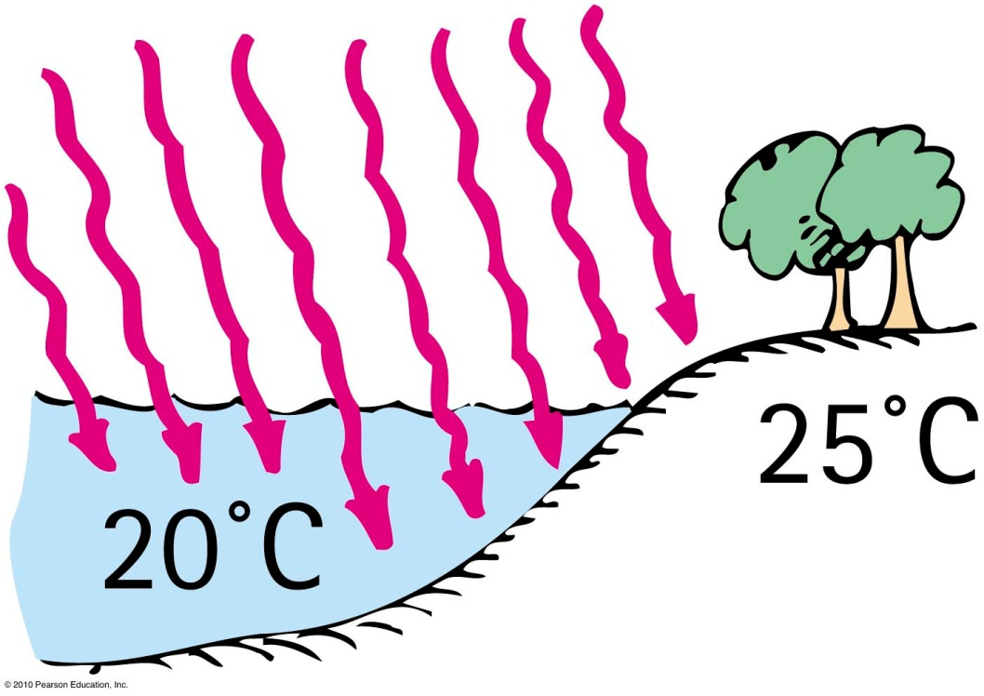
Which has the higher specific heat capacity, water or land?
Specific Heat Capacity
CHECK YOUR NEIGHBOR
A. Water
Land
Both of the above are the same.
None of the above.
Notes:
A. Water.

Slide 31
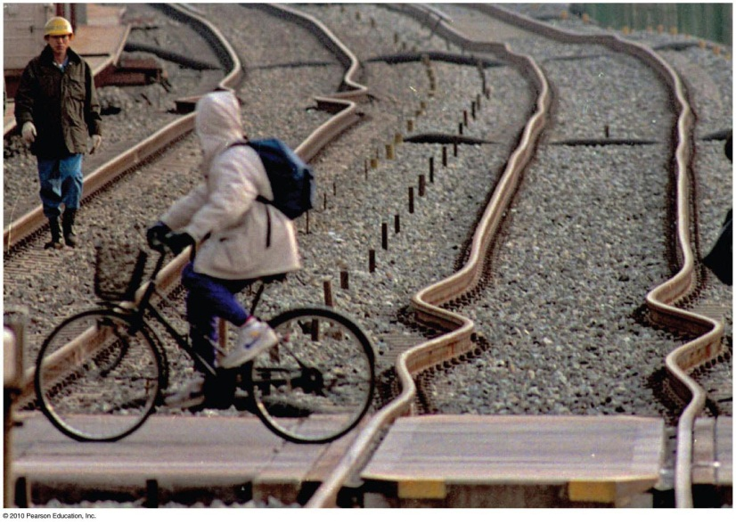
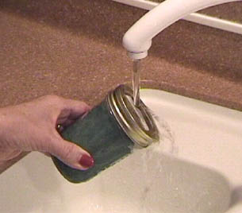
Thermal expansion
Due to rise in temperature of a substance, molecules jiggle faster and move farther apart.
Most substances expand when heated and contract when cooled.
Railroad tracks laid on winter days expand and can buckle in hot summer.
[image downloaded Jan. 25 2013 from http://hyperphysics.phy-astr.gsu.edu/hbase/thermo/jarlid.html ]
Warming metal lids on glass jars under hot water loosens the lid by more expansion of the lid than the jar.

Slide 32
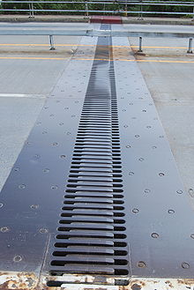
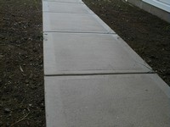
Thermal expansion
Plays a role in construction and devices.
Example:
Use of reinforcing steel with the same rate of expansion as concrete—expansion joints on bridges.
Gaps on concrete roadways and sidewalks allow for concrete expansion in the summer and contraction in the winter.

Slide 33
Thermal expansion
Different substances expand at different rates.
Example:
When the temperature of a bimetallic strip of brass and iron is increased, greater expansion occurs for the brass strip, which bends to turn a pointer, to regulate a valve, or to close a switch.
Bimetallic strips are used in heaters, oven thermometers, refrigerators, and electric toasters.

Slide 34
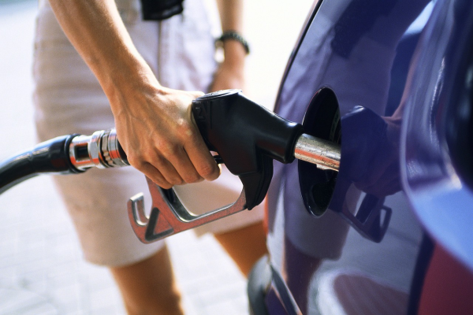
Thermal Expansion: watch out!
Increases in expansion are greater in liquids than in solids.
Example: Overflow of gasoline from a car’s tank on a hot day
Reason: Gasoline underground is cool, but when placed in the car’s tank, it warms and expands.

Slide 35
Thermal Expansion
The metal in a metal ring expands.
So the ring will get thicker and longer – more circumference, so larger.
All linear dimensions of an object expand if the temperature increases: outer diameter, and inner diameter of ring.
Also the inner diameter of a metal jar lid expands when it is heated!

Slide 36
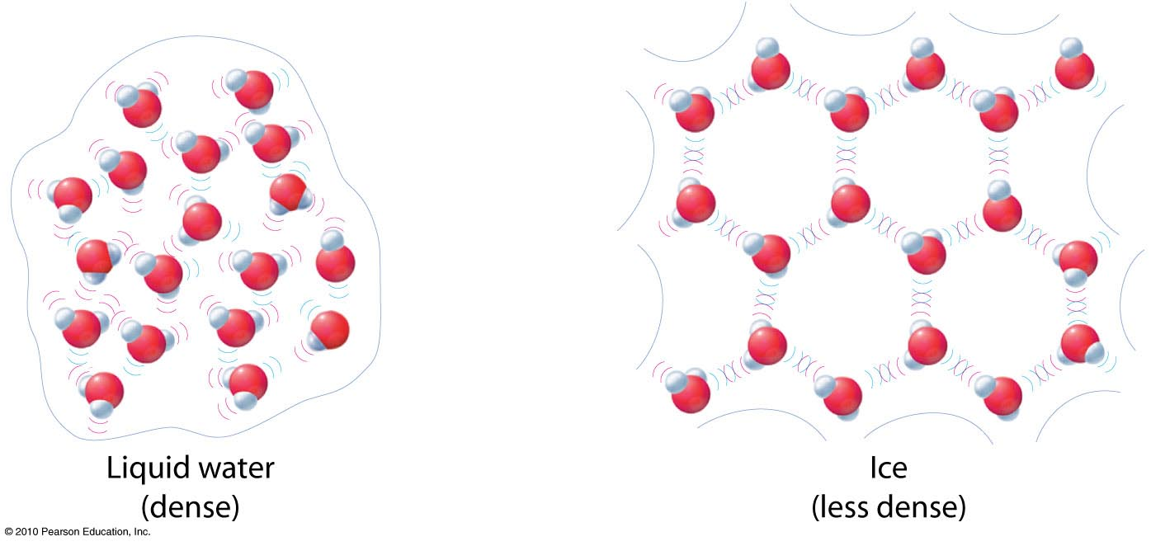
Thermal Expansion: The exception to the rule
Expansion of water to ice
When water becomes ice, it expands! Ice has open-structured crystals resulting from strong bonds at certain angles that increase its volume. This make ice less dense than water.

Slide 37
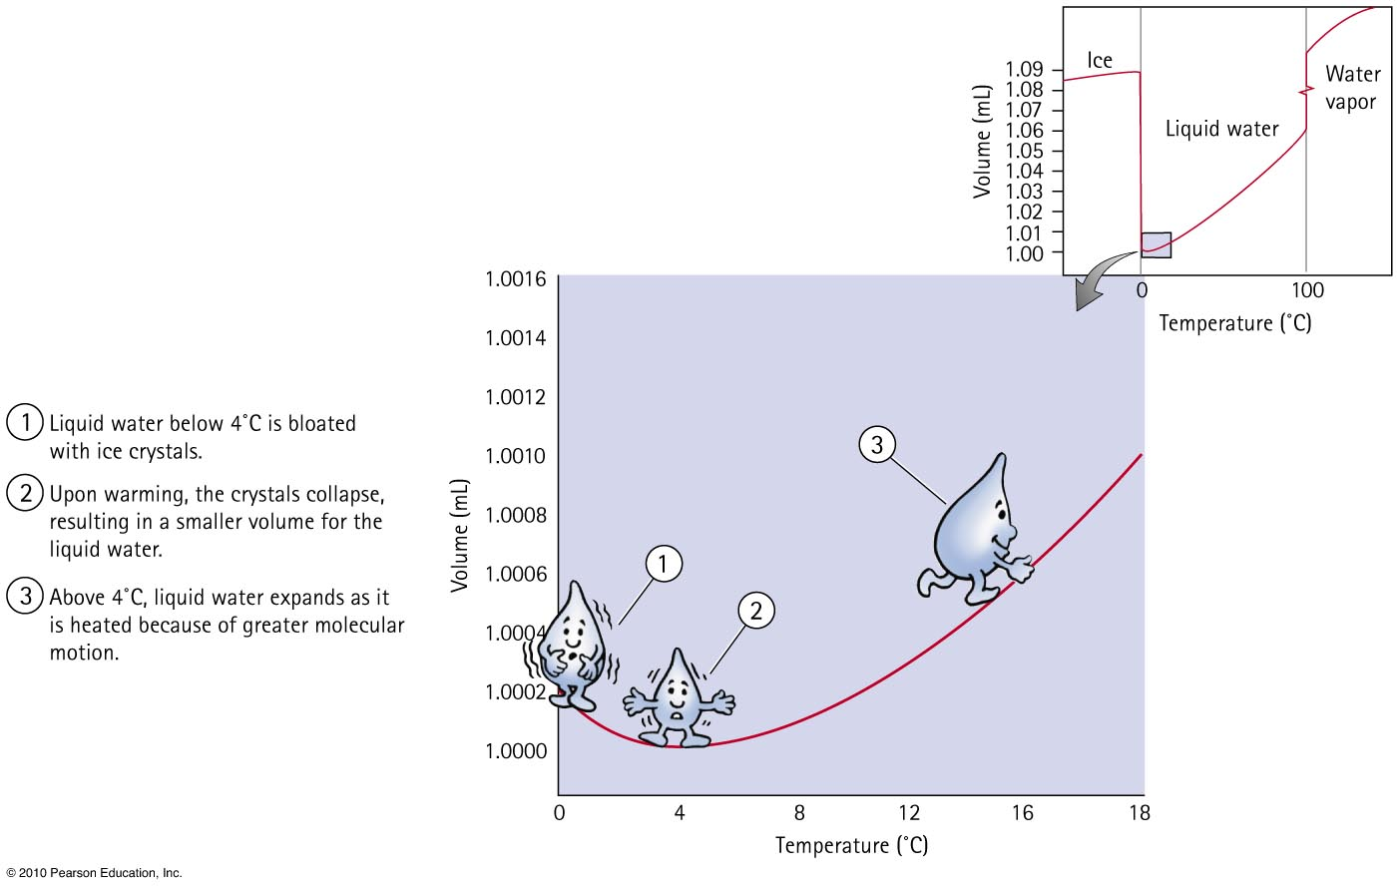

Slide 38
When a sample of 0°C water is heated, it first
Thermal Expansion
CHECK YOUR NEIGHBOR
A. expands.
contracts.
remains unchanged.
Not enough information.
Notes:
B. contracts.

Slide 39
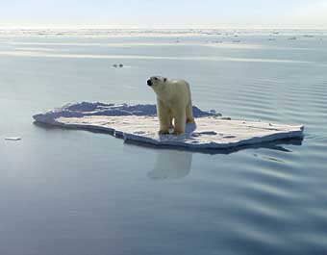
Thermal expansion of water
When water freezes to become ice, its volume increases tremendously.
As ice cools further, it contracts.
Density of ice at any temperature is much lower than the density of water, which is why ice always floats on water.

Slide 40
Have a Great Reading Week!
When we next meet on Monday Feb. 25, we will discuss Chapter 16, all about heat and heat transfer methods. Please read Chapter 16, or at least watch the 10-minute pre-class video for class 12.
Something to think about:
Psy likes to drink his coffee hot, and he likes cream in his coffee. He buys it at Starbucks but does not want to drink it until he gets to his home, which is a 5 minute walk. To keep the coffee as hot as possible, should he add the cream at Starbucks or at home?

