Slide 1
Conceptual Physics 11th Edition
Chapter 16:
HEAT TRANSFER
Conduction
Convection
Radiation
Newton’s Law of Cooling
Global Warming and Greenhouse Effect

Slide 2
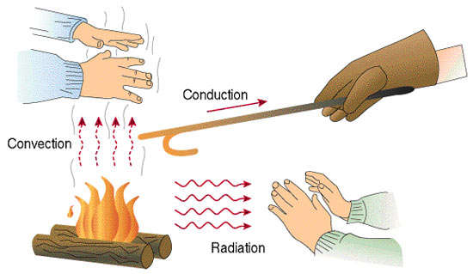
Heat Transfer
Objects in thermal contact at different temperatures tend to reach a common temperature in three ways:
[Image from Beodom.com Copyright Ecovolve S.A.S. 2006-2013. http://goo.gl/PSXR7

Slide 3
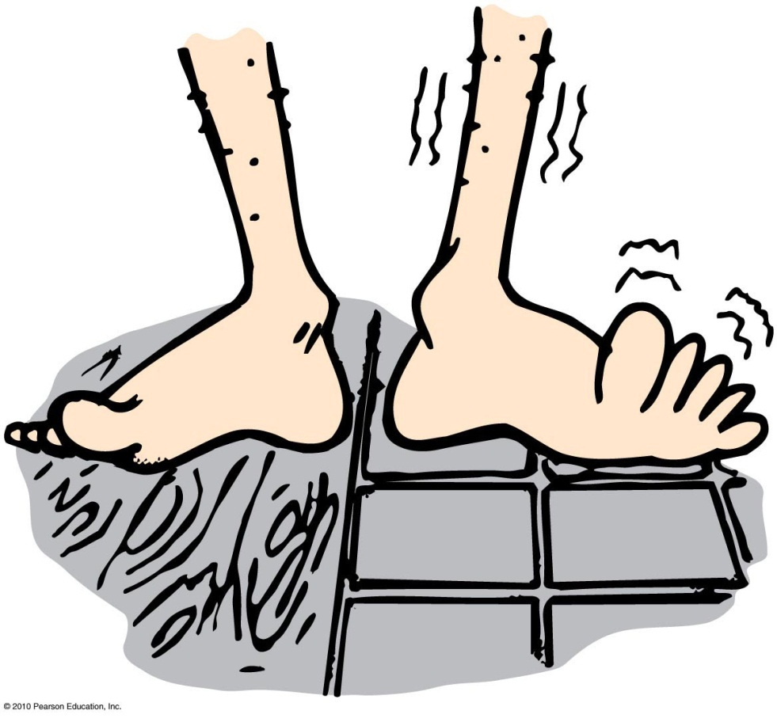
Conduction
Transfer of internal energy by electron and molecular collisions within a substance, especially a solid

Slide 4
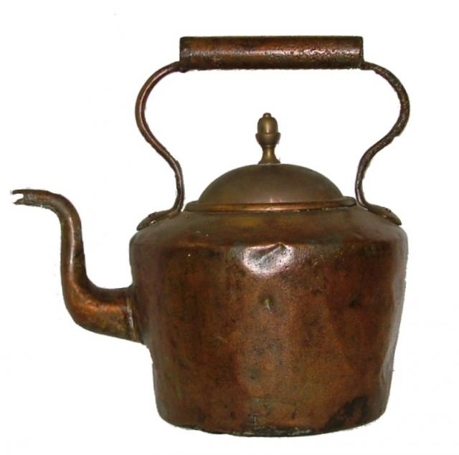
Conduction
Conductors
Good conductors conduct heat quickly.
Substances with loosely held electrons transfer energy quickly to other electrons throughout the solid.
Example: Silver, copper, and other solid metals
[image of kettle downloqaded Feb. 1 2013 from http://gallery.nen.gov.uk/asset82730_1795-.html ]

Slide 5
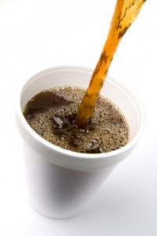
Conduction
Poor conductors are insulators.
molecules with tightly held electrons in a substance vibrate in place and transfer energy slowly—these are good insulators (and poor conductors).
Examples: Glass, wool, wood, paper, cork, plastic foam, air
[image downloaded Feb. 1 2013 from http://www.functionalfitmag.com/blog/2012/04/11/coffee-science-review/ ]

Slide 6
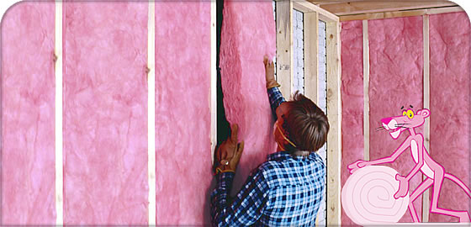
Insulation
Doesn’t prevent the flow of internal energy
Slows the rate at which internal energy flows
Example: Rock wool or fiberglass between walls slows the transfer of internal energy from a warm house to a cool exterior in winter, and the reverse in summer.
[image downloaded Feb.1 2013 from http://owenscorning.eu/en/products/residential-insulation/pink044.aspx ]

Slide 7
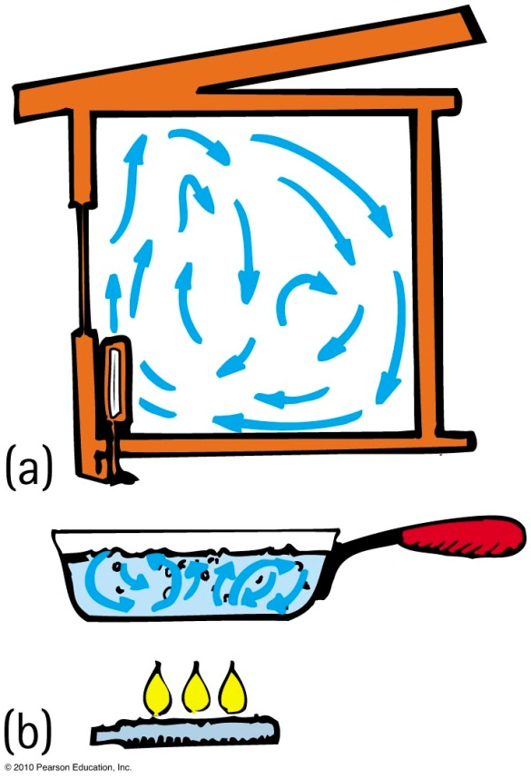
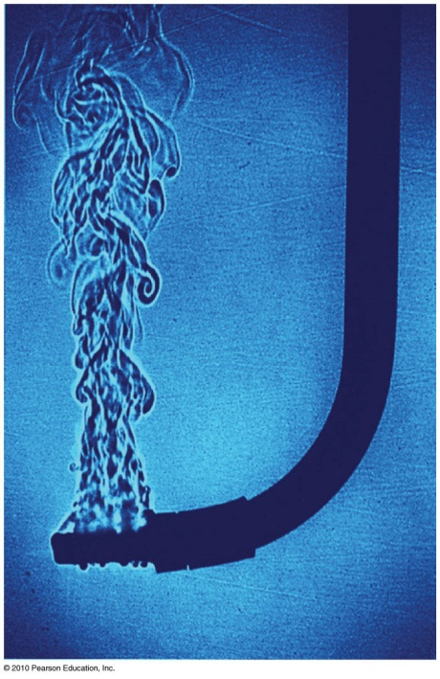
Convection
Transfer of heat involving only bulk motion of fluids
Examples:
Visible shimmer of air above a hot stove or above asphalt on a hot day
Visible shimmers in water due to temperature difference

Slide 8
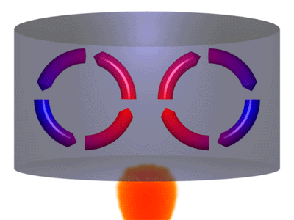
Convection
Reason warm air rises
Warm air expands, becomes less dense, and is buoyed upward.
It rises until its density equals that of the surrounding air.
Example: Smoke from a fire rises and blends with the surrounding cool air.
[animation from http://bmsscience8209.edublogs.org/files/2010/10/Convection-1zb8331.gif ]

Slide 9
Winds
Result of uneven heating of the air near the ground
Absorption of Sun’s energy occurs more readily on different parts of Earth’s surface.
Sea breeze
The ground warms more than water in the daytime.
Warm air close to the ground rises and is replaced by cooler air from above the water.
At night the ground cools faster,
and the cycle is reversed

Slide 10
Radiation
Transfer of energy via electromagnetic waves such as light or infrared.

Slide 11
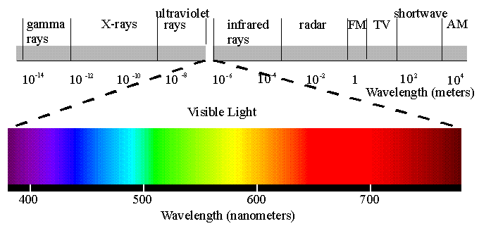
Radiation
Transferred energy
Exists as electromagnetic waves ranging from long (radio waves) to short wavelengths (X-rays)
In visible region, ranges from long waves (red) to short waves (violet)
[image from http://www.yorku.ca/eye/spectru.htm ]

Slide 12
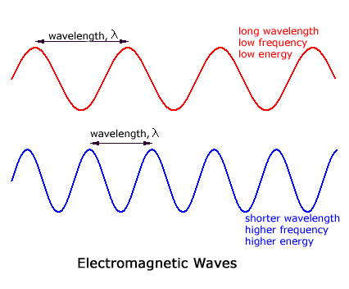
Wavelength and Frequency

Slide 13
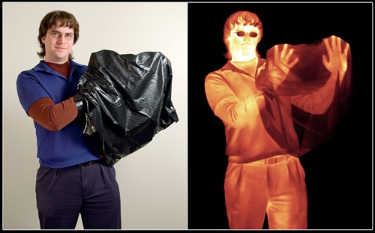
Radiation
Every object above absolute zero radiates.
From the Sun’s surface comes visible light, or solar radiation, which we can see.
From the Earth’s surface comes terrestrial radiation in the form of infrared waves below our threshold of sight.
[image downloaded Feb.1 2013 from http://www.enjoyspace.com/en/editorial-cases/herschel-the-infrared-universe ]
Image in emitted, infrared radiation
Image in reflected, visible light

Slide 14
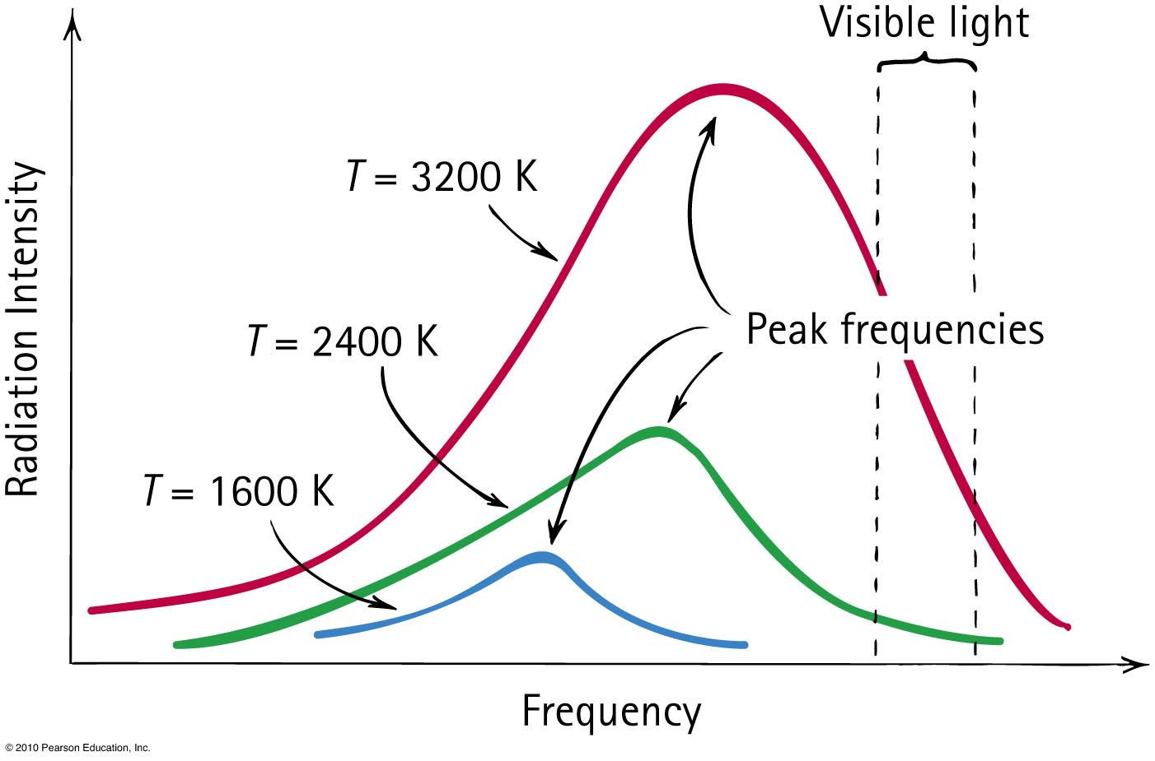
Blackbody Radiation
Frequency of radiation is proportional to the absolute temperature of the source ( ).

Slide 15
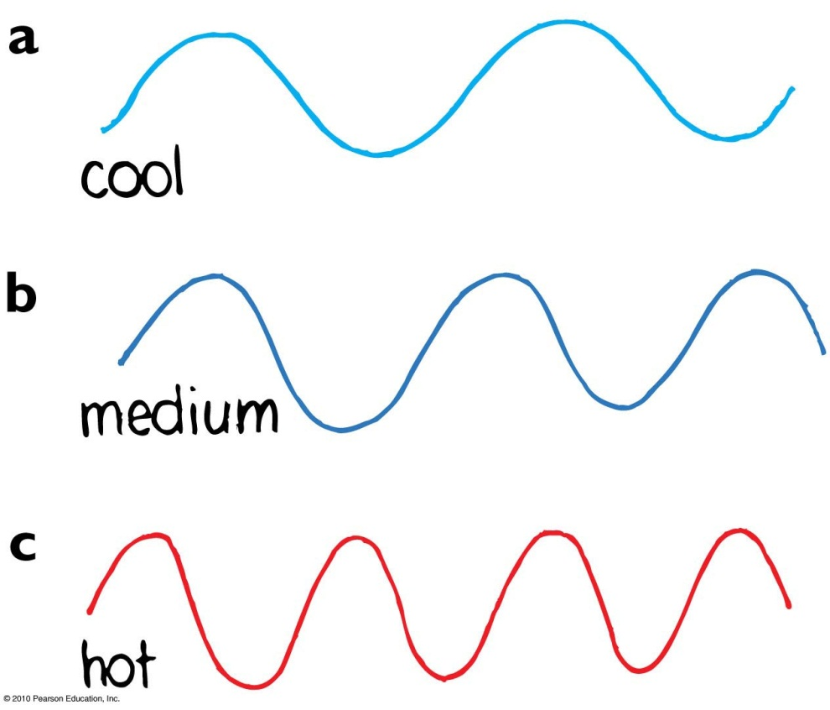
Radiation
Range of temperatures of radiating objects
Room-temperature emission is in the infrared.
Temperature above 500°C,
red light emitted, longest
waves visible.
About 600°C, yellow light
emitted.
At 1500°C, object emits
white light (whole range
of visible light).

Slide 16
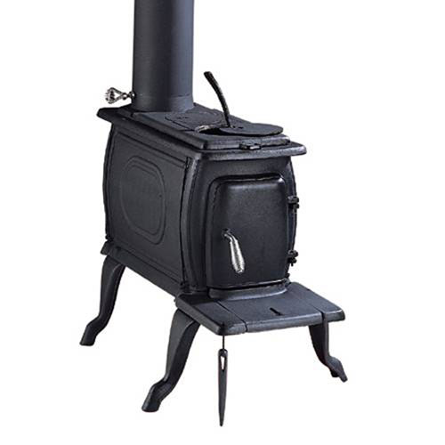
Absorption and Emission
Any material that absorbs more than it emits is a net absorber.
Any material that emits more than it absorbs is a net emitter.
Net absorption or emission is relative to temperature of surroundings.
Good absorbers are good emitters
Poor absorbers are poor emitters
[image from http://www.ironstoves.co.uk/clarke_boxwood_cast_iron_stove.html ]

Slide 17
Reflection of radiant energy
Any surface that reflects very little or no radiant energy looks dark
Examples of dark objects: eye pupils, open ends of pipes in a stack, open doorways or windows of distant houses in the daytime
Good reflectors are poor absorbers.
Poor absorbers are poor emitters.
A white container will radiate heat more slowly than a black container

Slide 18
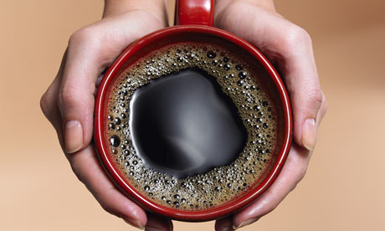
Newton’s law of cooling:
Rate of cooling ~ ΔT
Rate is proportional to the temperature difference, ΔT, between the object and its surroundings
Also applies to rate of warming
Examples:
Warmer house leaks more internal energy to the outside than a house that is less warm.
Frozen food will warm faster in a warm room than in a cold room.
[ image downloaded Feb. 1 2013 from http://www.guardian.co.uk/lifeandstyle/2009/apr/04/space-solves ]

Slide 19
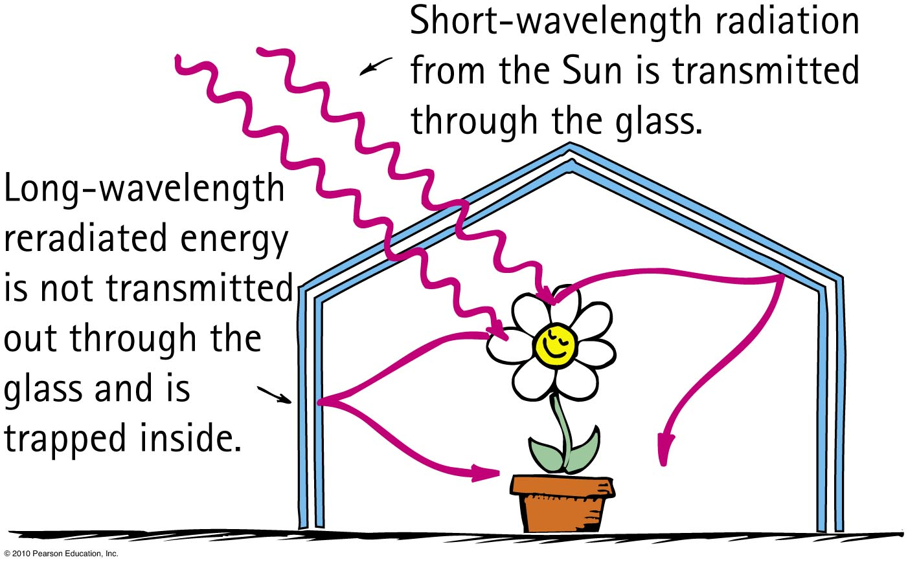
Greenhouse effect
Named for a similar temperature-raising effect in florists’ greenhouses

Slide 20
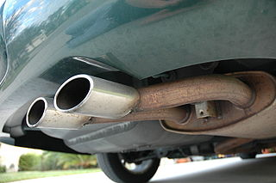
Greenhouse Gases
The Earth’s atmosphere contains mostly Nitrogen and Oxygen, both of which are transparent (non-absorbing) of both visible and infrared radiation
Certain gases are transparent for visible radiation, but absorbing for infrared radiation
These are called “greenhouse gases”:
Carbon Dioxide
Water vapour
Methane
Nitrous oxide
[image from http://en.wikipedia.org/wiki/File:Exhaust_pipe_muffler.JPG ]

Slide 21
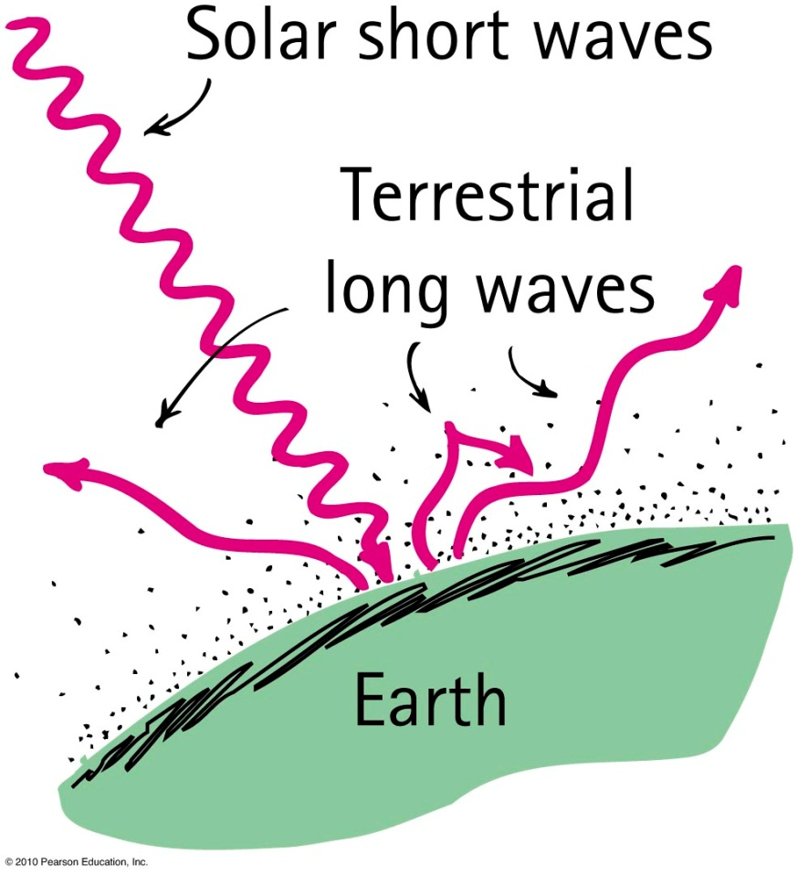
Greenhouse Effect on Earth
Energy absorbed as visible light from the Sun
Part reradiated by Earth as longer-wavelength infrared radiation
Terrestrial radiation absorbed by atmospheric greenhouse gases and re-emitted back to Earth.
Equilibrium temperature determined by concentration of greenhouse gases in the atmosphere
More greenhouse gases means higher temperature earth

Slide 22
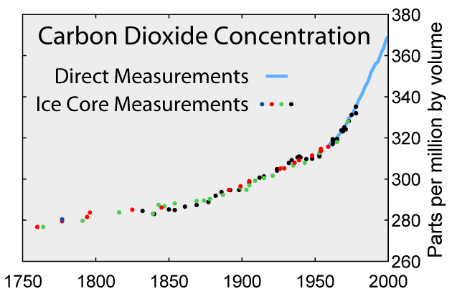
To examine times before systematic direct measurements began in 1958, scientists rely on data from bubbles trapped in polar ice cores.
For the past several thousand years, up until the last couple of centuries, average CO₂ concentration hovered in the 250 to 280 ppmv range.
http://www.windows2universe.org/earth/climate/greenhouse_effect_gases.html

