Slide 1
Note on Posted Slides
These are the slides that I intended to show in class on Mon. Feb. 25, 2013.
They contain important ideas and questions from your reading.
Due to time constraints, I was probably not able to show all the slides during class.
They are all posted here for completeness.

Slide 2
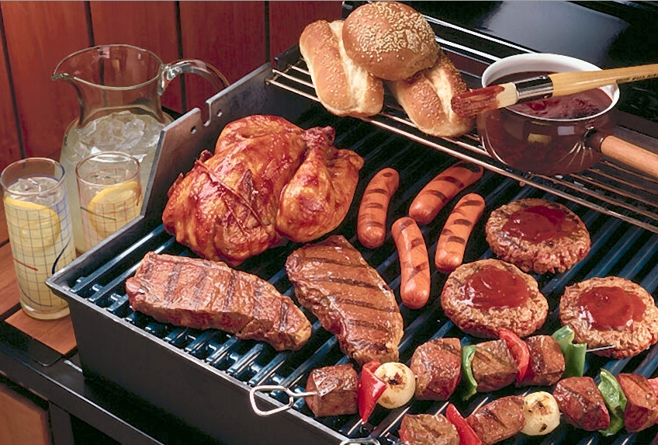
PHY205H1S Physics of Everyday Life Class 12: Heat
Conduction
Convection
Radiation
Newton’s Law of Cooling
Global Warming and Greenhouse Effect
[image from http://petticoatsandpistols.com/2008/05/21/knee-slappin-barbecue/ ]

Slide 3
Chapter 16 Pre-class reading question
2:10pm
Which of the following most prevents the escape of terrestrial radiation (infrared)?
Carbon monoxide
Air
Carbon dioxide
Molecular nitrogen
Molecular oxygen

Slide 4
Chapter 16 Pre-class reading question
2:11pm
The relation ƒ ~ T tells us that high-temperature sources emit electromagnetic waves of
low frequency
high penetrating power
high frequency
long wavelengths

Slide 5
Chapter 16 Pre-class reading question
5:10pm
When your foot stands on a tile floor, thermal energy always flows
from the tile to your foot
from your foot to the tile
upward
downward
from either your foot or the tile depending on the temperatures of the tile and your foot

Slide 6
Chapter 16 Pre-class reading question
5:11pm
A good absorber of radiation is a
good reflector.
poor emitter of radiation.
good emitter of radiation.

Slide 7
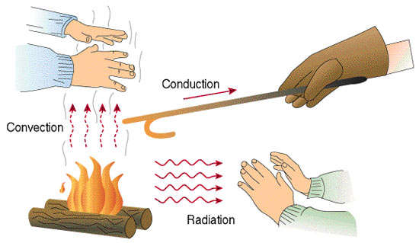
Heat Transfer
Objects in thermal contact at different temperatures tend to reach a common temperature in three ways:
[Image from Beodom.com Copyright Ecovolve S.A.S. 2006-2013. http://goo.gl/PSXR7

Slide 8
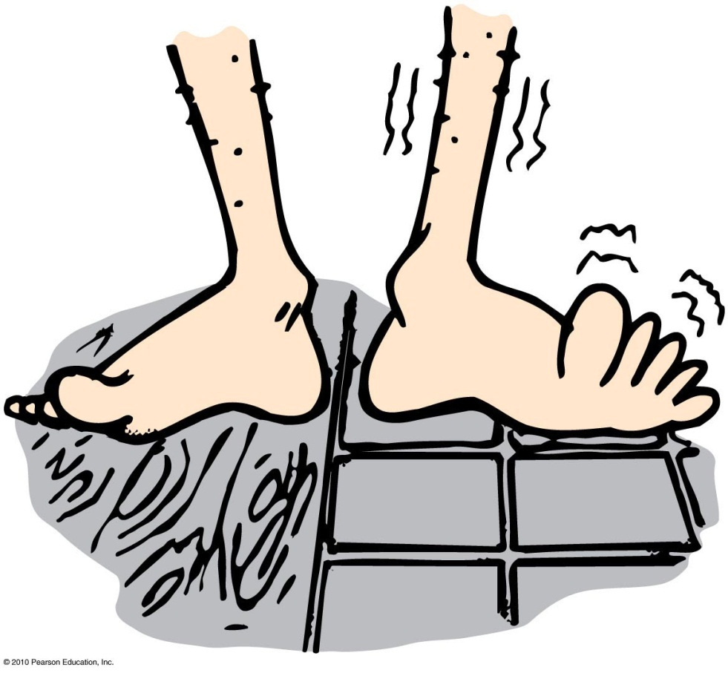
Conduction
Transfer of internal energy by electron and molecular collisions within a substance, especially a solid

Slide 9
If you hold one end of a metal bar against a piece of ice, the end in your hand will soon become cold. Does cold flow from the ice to your hand?
Conduction
CHECK YOUR NEIGHBOR
A. Yes
In some cases, yes
No
In some cases, no
Notes:
C. No.

Slide 10
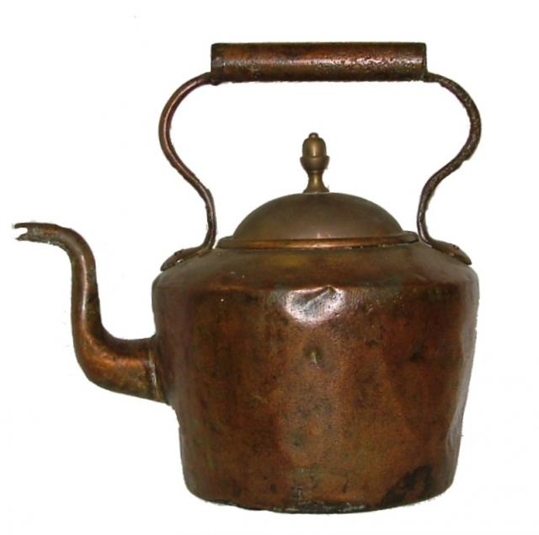
Conduction
Conductors
Good conductors conduct heat quickly.
Substances with loosely held electrons transfer energy quickly to other electrons throughout the solid.
Example: Silver, copper, and other solid metals
[image of kettle downloqaded Feb. 1 2013 from http://gallery.nen.gov.uk/asset82730_1795-.html ]

Slide 11
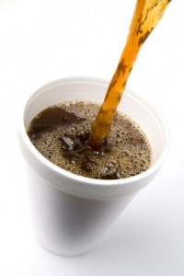
Conduction
Poor conductors are insulators.
molecules with tightly held electrons in a substance vibrate in place and transfer energy slowly—these are good insulators (and poor conductors).
Examples: Glass, wool, wood, paper, cork, plastic foam, air
[image downloaded Feb. 1 2013 from http://www.functionalfitmag.com/blog/2012/04/11/coffee-science-review/ ]

Slide 12
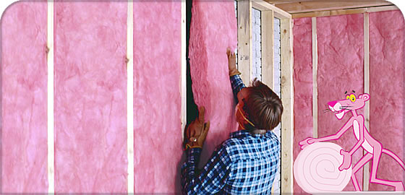
Insulation
Doesn’t prevent the flow of internal energy
Slows the rate at which internal energy flows
Example: Rock wool or fiberglass between walls slows the transfer of internal energy from a warm house to a cool exterior in winter, and the reverse in summer.
[image downloaded Feb.1 2013 from http://owenscorning.eu/en/products/residential-insulation/pink044.aspx ]

Slide 13
Conduction
Insulation (continued)
Dramatic example: Walking barefoot without burning feet on red-hot coals is due to poor conduction between coals and feet.

Slide 14
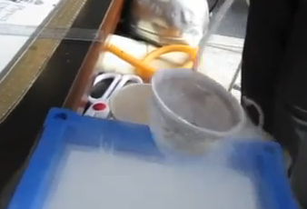
Liquid Nitrogen
Molecular Nitrogen, N₂, composes 70% of the air we breath
Below -196°C (77 Kelvin), Nitrogen is liquid
We have a big tank of liquid nitrogen (LN2) at the North end of this building
We use it to cool things to study materials – Condensed Matter Physics research
It is also good at parties to quickly cool beer

Slide 15
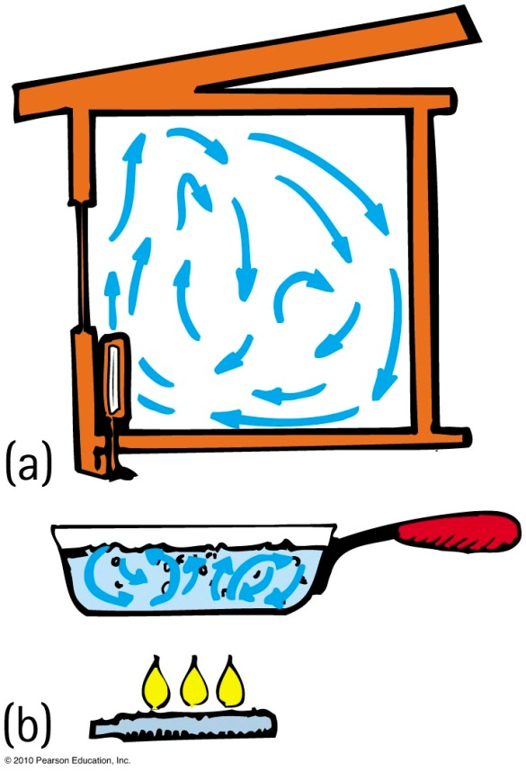
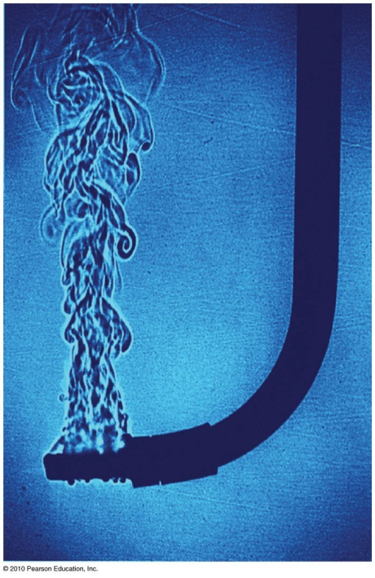
Convection
Transfer of heat involving only bulk motion of fluids
Examples:
Visible shimmer of air above a hot stove or above asphalt on a hot day
Visible shimmers in water due to temperature difference

Slide 16
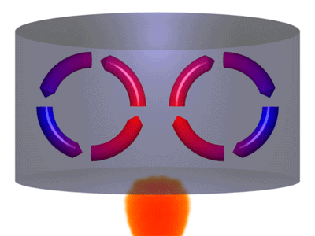
Convection
Reason warm air rises
Warm air expands, becomes less dense, and is buoyed upward.
It rises until its density equals that of the surrounding air.
Example: Smoke from a fire rises and blends with the surrounding cool air.
[animation from http://bmsscience8209.edublogs.org/files/2010/10/Convection-1zb8331.gif ]

Slide 17
Winds
Result of uneven heating of the air near the ground
Absorption of Sun’s energy occurs more readily on different parts of Earth’s surface.
Sea breeze
The ground warms more than water in the daytime.
Warm air close to the ground rises and is replaced by cooler air from above the water.
At night the ground cools faster,
and the cycle is reversed

Slide 18
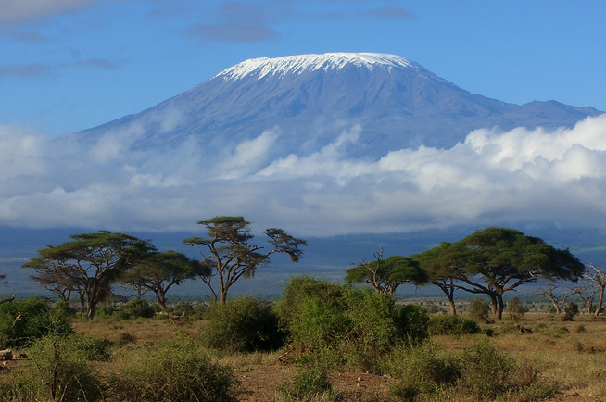
Although warm air rises, why are mountaintops cold and snow covered, while the valleys below are relatively warm and green?
Convection
CHECK YOUR NEIGHBOR
A. Warm air cools when rising.
There is a thick insulating blanket of air above valleys.
Both A and B.
None of the above.
[image of Mt. Kilamanjaro from http://www.bmycharity.com/beckysclimb ]
Notes:
C. Both of the above.

Slide 19
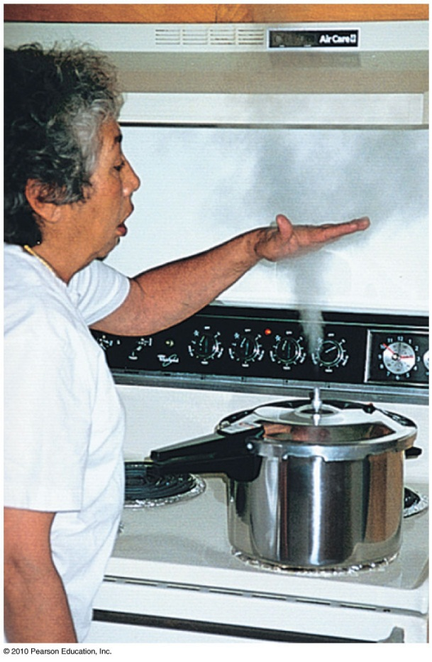
Cooling by expansion
Opposite to the warming that occurs when air is compressed
Example: The “cloudy” region above hot steam issuing from the nozzle of a pressure cooker is cool to the touch (a combination of air expansion and mixing with cooler surrounding air).
Careful, the part at the nozzle that you can’t see is steam—ouch!

Slide 20
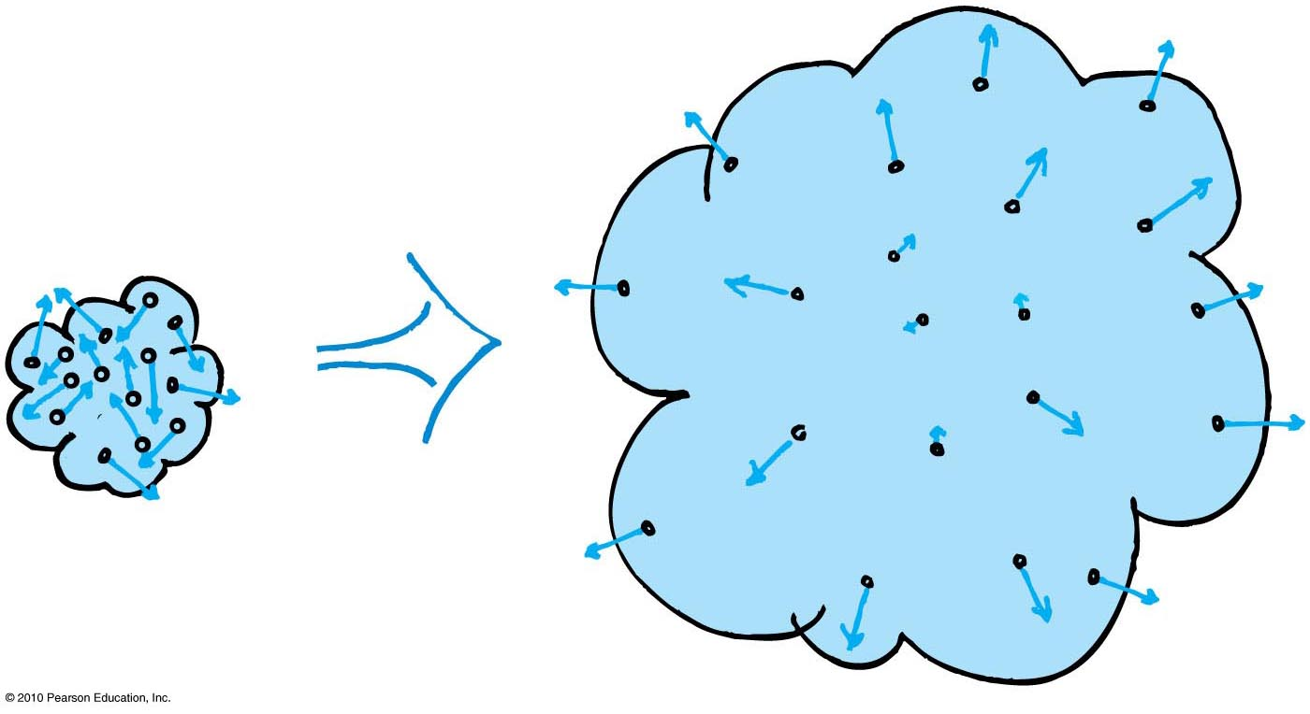
Gas Cooling By Expansion
Molecules in a region of expanding gas collide more often with receding molecules than with approaching ones
Their rebound speeds therefore tend to decrease, and, as a result, the expanding gas cools.
This phenomenon is used in refrigerators, which use cooled coils to remove heat from a low temperature environment

Slide 21
Radiation
Transfer of energy via electromagnetic waves such as light or infrared.

Slide 22
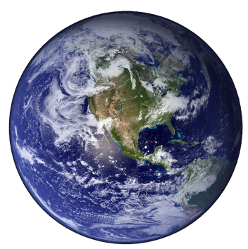
The surface of Earth loses energy to outer space due mostly to
Radiation
CHECK YOUR NEIGHBOR
A. conduction.
convection.
radiation.
radioactivity.
Notes:
C. radiation.

Slide 23
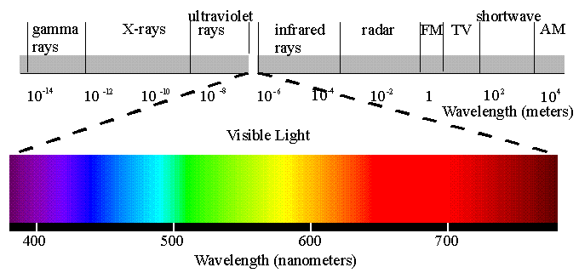
Radiation
Transferred energy
Exists as electromagnetic waves ranging from long (radio waves) to short wavelengths (X-rays)
In visible region, ranges from long waves (red) to short waves (violet)
[image from http://www.yorku.ca/eye/spectru.htm ]

Slide 24
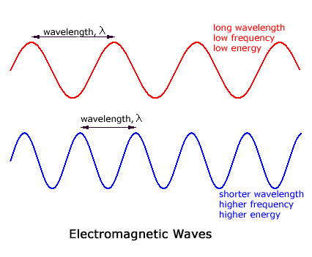
Wavelength and Frequency

Slide 25
Which body glows with electromagnetic waves?
Radiation
CHECK YOUR NEIGHBOR
A. Sun
Earth
Both A and B.
None of the above.
Notes:
C. Both A and B.

Slide 26
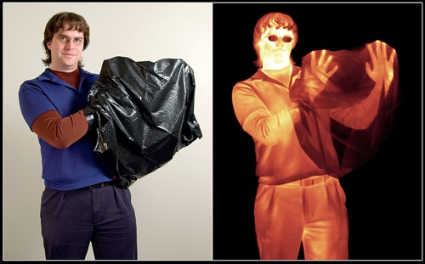
Radiation
Every object above absolute zero radiates.
From the Sun’s surface comes visible light, or solar radiation, which we can see.
From the Earth’s surface comes terrestrial radiation in the form of infrared waves below our threshold of sight.
[image downloaded Feb.1 2013 from http://www.enjoyspace.com/en/editorial-cases/herschel-the-infrared-universe ]
Image in emitted, infrared radiation
Image in reflected, visible light

Slide 27
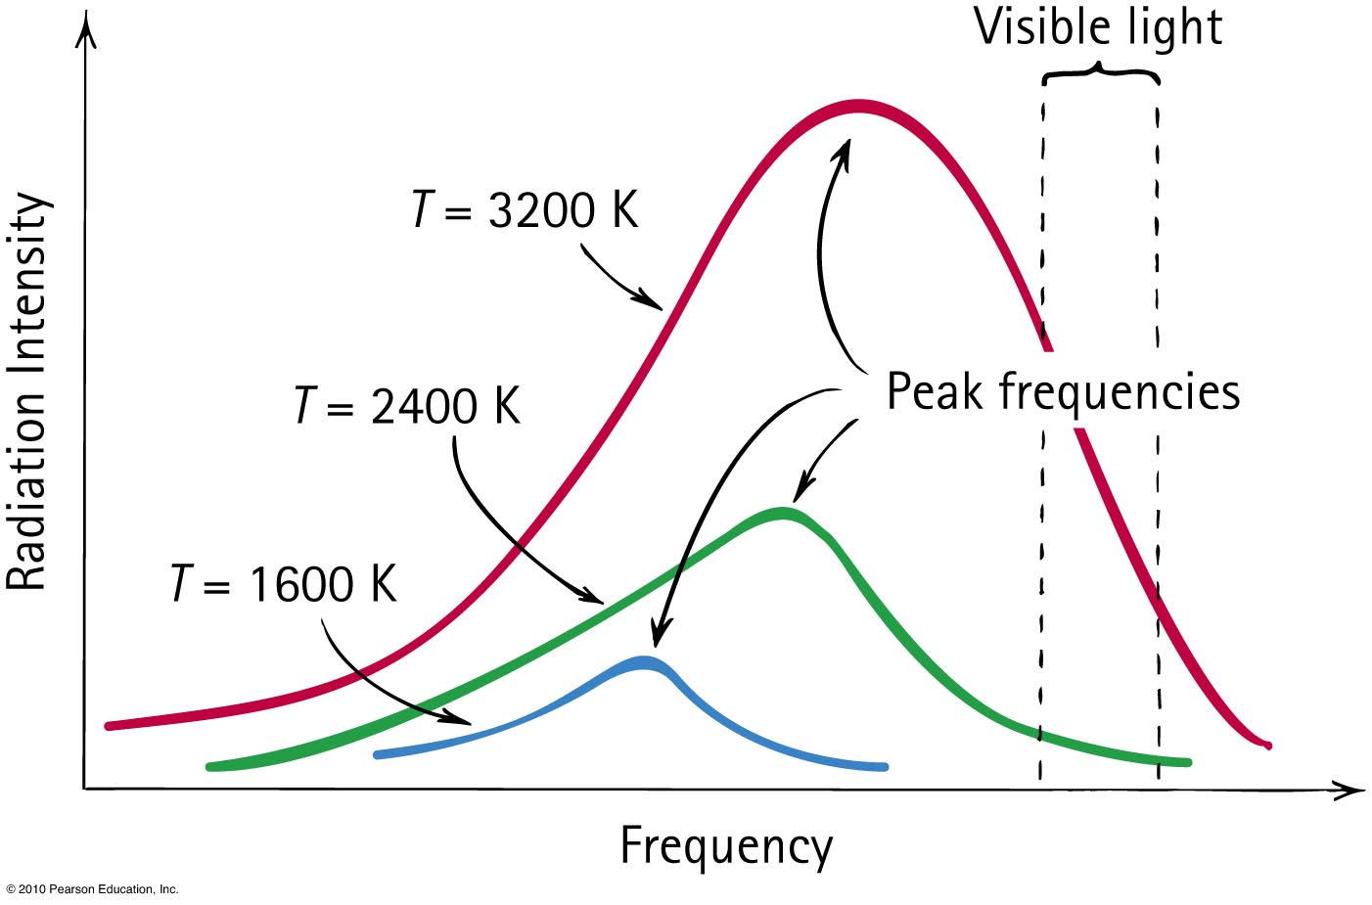
Blackbody Radiation
Frequency of radiation is proportional to the absolute temperature of the source ( ).

Slide 28
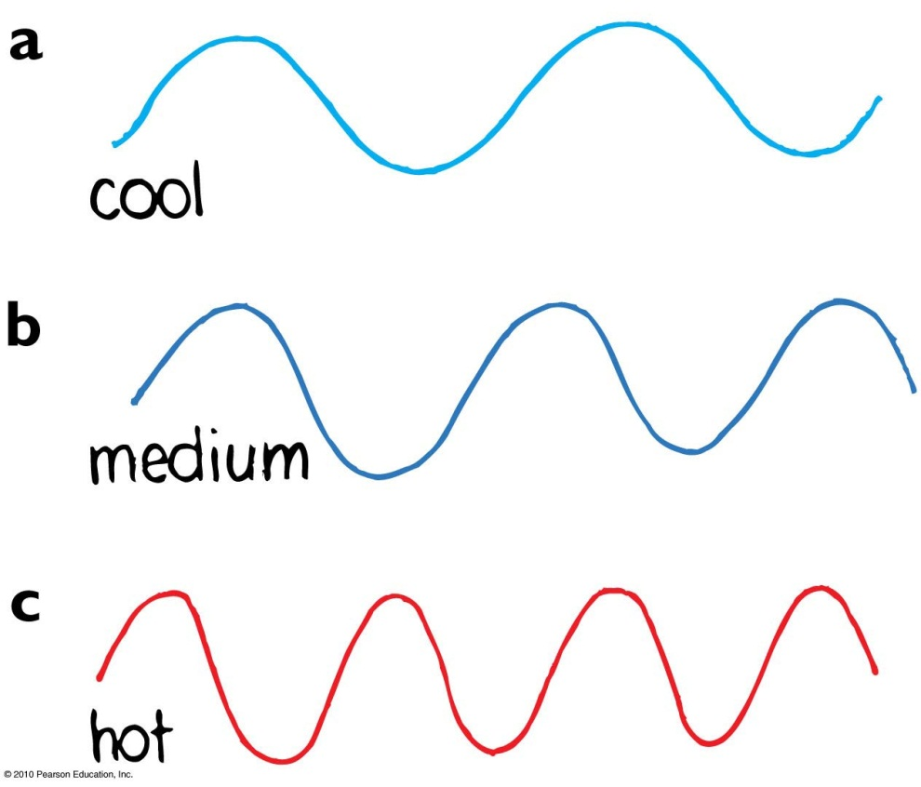
Radiation
Range of temperatures of radiating objects
Room-temperature emission is in the infrared.
Temperature above 500°C,
red light emitted, longest
waves visible.
About 600°C, yellow light
emitted.
At 1500°C, object emits
white light (whole range
of visible light).

Slide 29
Which is the better statement?
Radiation
CHECK YOUR NEIGHBOR
A. A black object absorbs energy well.
An object that absorbs energy well is black.
Notes:
B. An object that absorbs energy well is black.

Slide 30
Which melts faster in sunshine—dirty snow or clean snow?
Radiation
CHECK YOUR NEIGHBOR
A. Dirty snow
Clean snow
Both A and B.
None of the above.
Notes:
A. Dirty snow.

Slide 31
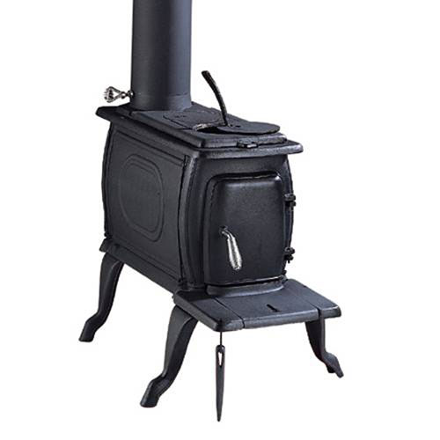
Absorption and Emission
Any material that absorbs more than it emits is a net absorber.
Any material that emits more than it absorbs is a net emitter.
Net absorption or emission is relative to temperature of surroundings.
Good absorbers are good emitters
Poor absorbers are poor emitters
[image from http://www.ironstoves.co.uk/clarke_boxwood_cast_iron_stove.html ]

Slide 32
Reflection of radiant energy
Any surface that reflects very little or no radiant energy looks dark
Examples of dark objects: eye pupils, open ends of pipes in a stack, open doorways or windows of distant houses in the daytime
Good reflectors are poor absorbers.
Poor absorbers are poor emitters.
A white container will radiate heat more slowly than a black container

Slide 33
A hot pizza placed in the snow is a net
Radiation
CHECK YOUR NEIGHBOR
A. absorber.
emitter.
neither
Notes:
B. emitter.

Slide 34
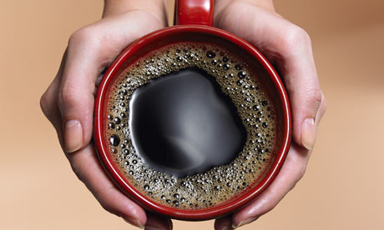
Newton’s law of cooling:
Rate of cooling ~ ΔT
Rate is proportional to the temperature difference, ΔT, between the object and its surroundings
Also applies to rate of warming
Examples:
Warmer house leaks more internal energy to the outside than a house that is less warm.
Frozen food will warm faster in a warm room than in a cold room.
[ image downloaded Feb. 1 2013 from http://www.guardian.co.uk/lifeandstyle/2009/apr/04/space-solves ]

Slide 35
When to add cream to coffee…
Psy likes to drink his coffee hot, and he likes cream in his coffee. He buys it at Starbucks but does not want to drink it until he gets to his home, which is a 5 minute walk. To keep the coffee as hot as possible, should he add the cream at Starbucks or at home?
Starbucks, before the 5-minute walk
At home, just before drinking
It doesn’t matter

Slide 36
When to add cream to coffee…
Psy likes to drink his coffee hot, and he likes cream in his coffee. He buys it at Starbucks but does not want to drink it until he gets to his home, which is a 5 minute walk. To keep the coffee as hot as possible, should he add the cream at Starbucks or at home?
Best student answer from the facebook discussion page:
“Starbucks. Because if we add cream at first, the temperature of the coffee decreases a little bit first, but can maintain this "hotness" longer than if we don’t add cream at first. The reason is because the environment does not take as much heat from the creamed coffee.”
This is because of Newton’s Law of Cooling.
The higher is ΔT, the greater the rate of heat loss to the environment. Adding cream cools the coffee and reduces ΔT.

Slide 37
When to add cream to coffee…
My reasoning:
When you add the cream to the coffee, it is going to decrease its temperature by some amount; this is about the same whether you do it at home or at Starbucks.
When you carry the coffee through the environment for 5 minutes, it will be losing heat, since the coffee temperature is higher than the environment.
The rate of heat loss over this 5 minutes is proportional to ΔT
If you added the cream first, ΔT is less while you carry it, so it is going to lose less heat en route.
In the end, this leads to hotter coffee when you eventually drink it.
$$ΔT=T_{coffee}−T_{env}$$

Slide 38
It is commonly thought that a can of beverage will cool faster in the coldest part of a refrigerator. Knowledge of Newton’s law of cooling
Newton’s Law of Cooling
CHECK YOUR NEIGHBOR
A. supports this knowledge.
shows this knowledge is false.
may or may not support this knowledge.
may or may not contradict this knowledge.
Notes:
A. supports this knowledge.

Slide 39
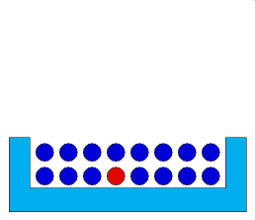
Heat Transfer by Evaporation
Fourth heat transfer mechanism, not mentioned in Hewitt
Molecules in a liquid are continuously moving and jiggling against one another
At the surface, sometimes a collision is such that a molecule ends up with enough energy to escape
When the molecule leaves the liquid, it takes thermal energy with it, and so this is a mode of heat transfer
[animation from http://www.design-simulation.com/ip/simulationlibrary/evaporation.php ]

Slide 40
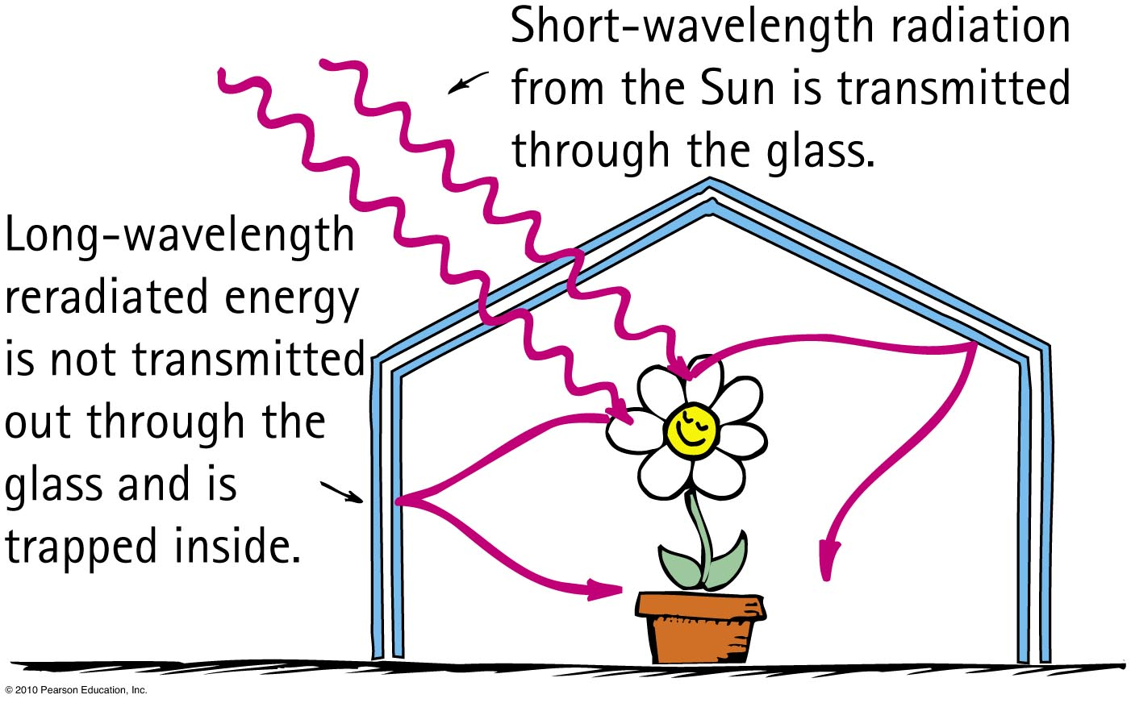
Greenhouse effect
Named for a similar temperature-raising effect in florists’ greenhouses

Slide 41
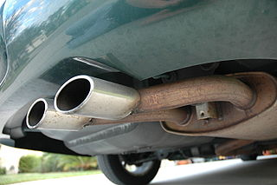
Greenhouse Gases
The Earth’s atmosphere contains mostly Nitrogen and Oxygen, both of which are transparent (non-absorbing) of both visible and infrared radiation
Certain gases are transparent for visible radiation, but absorbing for infrared radiation
These are called “greenhouse gases”:
Carbon Dioxide
Water vapour
Methane
Nitrous oxide
[image from http://en.wikipedia.org/wiki/File:Exhaust_pipe_muffler.JPG ]

Slide 42
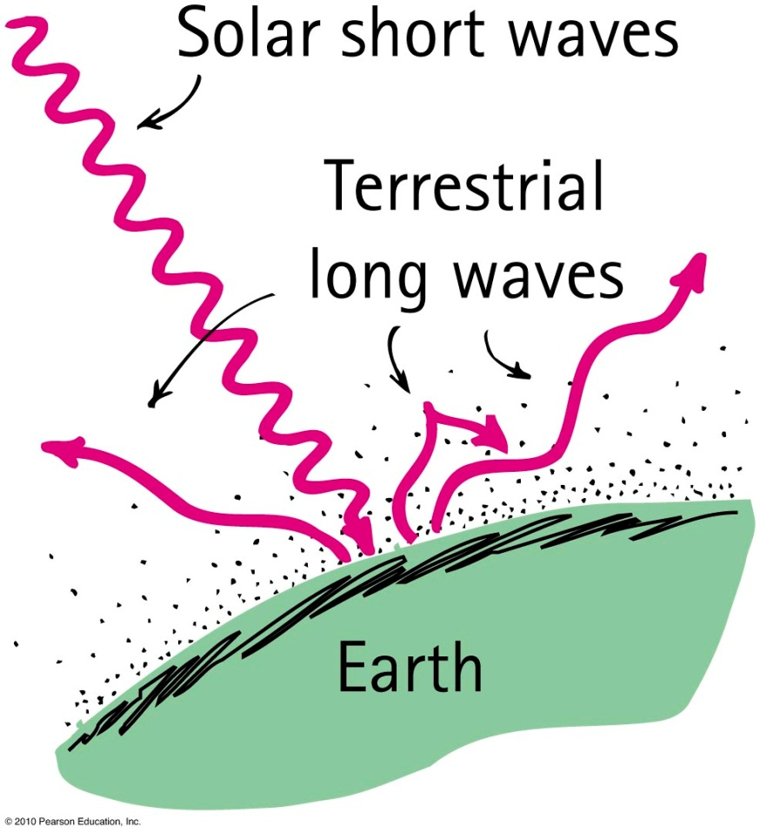
Greenhouse Effect on Earth
Energy absorbed as visible light from the Sun
Part reradiated by Earth as longer-wavelength infrared radiation
Terrestrial radiation absorbed by atmospheric greenhouse gases and re-emitted back to Earth.
Equilibrium temperature determined by concentration of greenhouse gases in the atmosphere
More greenhouse gases means higher temperature earth

Slide 43
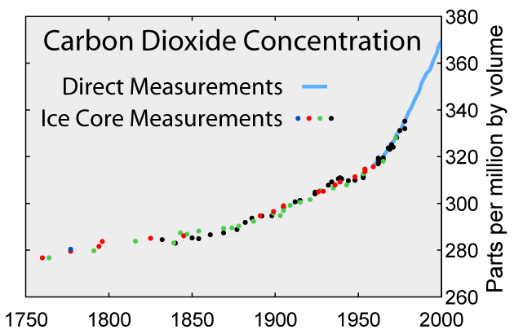
To examine times before systematic direct measurements began in 1958, scientists rely on data from bubbles trapped in polar ice cores.
For the past several thousand years, up until the last couple of centuries, average CO₂ concentration hovered in the 250 to 280 ppmv range.
http://www.windows2universe.org/earth/climate/greenhouse_effect_gases.html

Slide 44
The “greenhouse gases” that contribute to global warming absorb
Global Warming and the Greenhouse Effect
CHECK YOUR NEIGHBOR
A. more visible radiation than infrared.
more infrared radiation than visible.
visible and infrared radiation about equally.
very little radiation of any kind.
Notes:
B. more infrared radiation than visible.

Slide 45
Solar Power
More energy from the sun hits Earth in 1 hour than all of the energy consumed by humans in an entire year.
— Nathan S. Lewis, California Institute of Technology

Slide 46
Solar Research at U of T
Ted Sargent is a professor in the Department of Electrical and Computer Engineering at U of T
Dr. Sargent and his group are working on a paint-on solution that could turn almost any surface into a photovoltaic cell
Because the particles in the coating are sensitive to infrared, the new cells could potentially capture twice as much solar energy
The technology could even be applied to clothing. “Your jacket could be solar,” speculates Dr. Sargent.
See more at http://www.light.utoronto.ca/

Slide 47
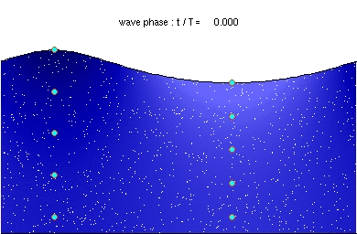
Before class on Wednesday…
[image from http://en.wikipedia.org/wiki/File:Deep_water_wave.gif ]
Please read Chapter 19, or at least watch the 10-minute pre-class video for class 13.
Something to think about:
As some water waves pass you, your boat bobs up and down with a frequency of 0.5 Hz. What is the period of these waves?
If the wavelength is 3 m, what is the speed of these waves?

