Slide 1
Note on Posted Slides
These are the slides that I intended to show in class on Wed. Feb. 27, 2013.
They contain important ideas and questions from your reading.
Due to time constraints, I was probably not able to show all the slides during class.
They are all posted here for completeness.

Slide 2
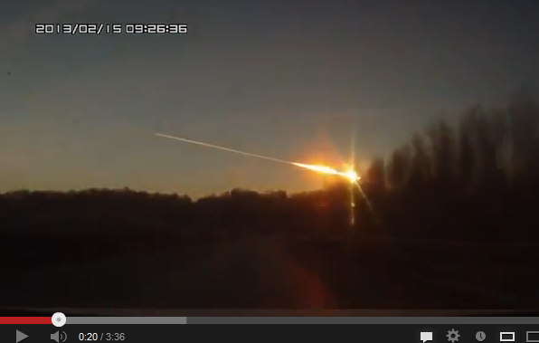
PHY205H1S Physics of Everyday Life Class 13: Vibrations and Waves
[still from video at http://www.youtube.com/watch?v=Rp5eg_lk8zA ]
Vibrations of a Pendulum
Wave Description
Wave Speed
Transverse Waves
Longitudinal Waves
Wave Interference
Standing Waves
Doppler Effect
Bow Waves
Shock Waves

Slide 3
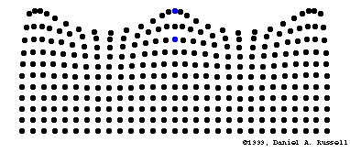
Vibrations and Waves
A vibration is a periodic linear motion of a particle about an equilibrium position.
When many particles vibrate and carry energy through space, this is a wave. A wave extends from one place to another.
Examples are:
water waves
light, which is an electromagnetic wave
sound
[image from https://webspace.utexas.edu/cokerwr/www/index.html/waves.html ©1999 by Daniel A. Russell ]

Slide 4
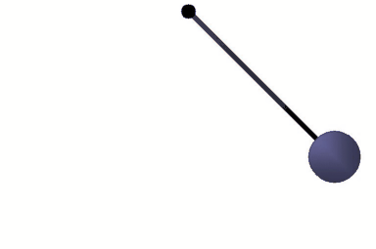
Vibrations of a Pendulum
The time of one to-and-fro swing is called the period.
The longer the length of a pendulum, the longer the period

Slide 5
Discussion Question
Two pendula have the same length, but different mass. The force of gravity, F=mg, is larger for the larger mass. Which will have the longer period?
A. the larger mass
B. the smaller mass
C. neither

Slide 6
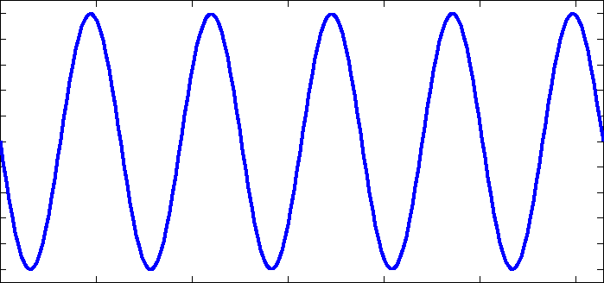
Sine Waves
A wave is pictorially represented by a sine curve.
One way to make a sine curve:
Put some sand in the pendulum and let it swing.
The sand drops through a hole in the pendulum onto a sheet of paper.
As the pendulum swings back and forth, pull the sheet of paper on which the sand falls.
The sand makes a sine curve on the paper.
[image from http://micromachine.stanford.edu/~hopcroft/Research/resonators.html ]

Slide 7
Amplitude and Wavelength
Amplitude
distance from the midpoint to the crest or to the trough
Wavelength
distance from the top of one crest to the top of the next crest, or distance between successive identical parts of the wave

Slide 8
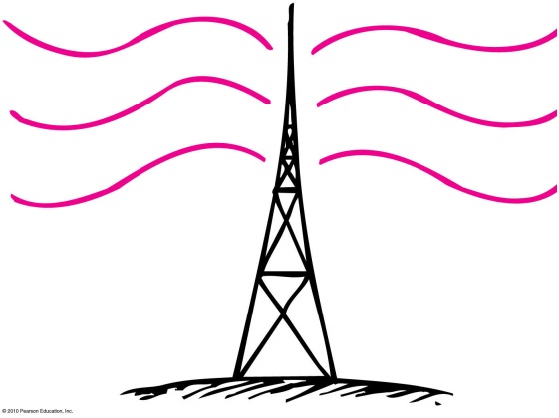
Frequency
How frequently a vibration occurs is called the frequency.
The unit for frequency is Hertz (Hz), after Heinrich Hertz
A frequency of 1 Hz is a vibration that occurs once each second.
Mechanical objects (e.g., pendulums) have frequencies of a few Hz.
Sound has a frequency of a few 100 or 1000 Hz.
Radio waves have frequencies of a few million Hz (MHz).
Cell phones operate at few billon Hz (GHz).

Slide 9
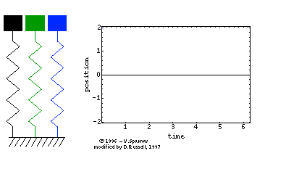
Period
Time to complete one vibration
or, vice versa,
1
Period =
frequency
1
Frequency =
period
[image from http://english.ioa.cas.cn/rs/psk/200907/t20090708_22106.html ]

Slide 10
A sound wave has a frequency of 500 Hz. What is the period of vibration of the air molecules due to the sound wave?
Wave Description
CHECK YOUR NEIGHBOR
A. 1 s
0.01 s
0.002 s
0.005 s
Notes:
C. 0.002 s

Slide 11
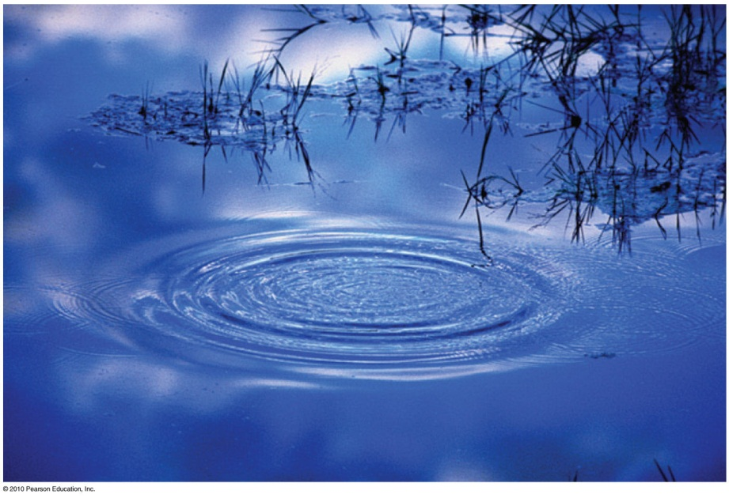
Wave Motion
Waves transport energy and not matter.
Examples:
Drop a stone in a quiet pond and the resulting ripples carry no water across the pond.
Waves travel across grass on a windy day.
Molecules in air propagate a disturbance through air.

Slide 12
Wave speed
Describes how fast a disturbance moves through a medium
Related to frequency and wavelength of a wave
Example:
A wave with wavelength 1 meter and frequency of
1 Hz has a speed of 1 m/s.
Wave speed = frequency × wavelength

Slide 13
A wave with wavelength 10 meters and time between crests of 0.5 seconds is traveling in water. What is the wave speed?
Wave Speed
CHECK YOUR NEIGHBOR
0.1 m/s
2 m/s
5 m/s
20 m/s
Notes:
D. 20 m/s

Slide 14
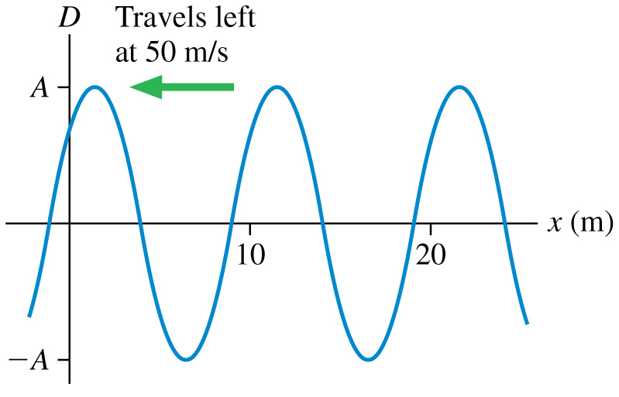
What is the frequency of this traveling wave?
0.1 Hz
0.2 Hz
2 Hz
5 Hz
10 Hz
Notes:
Answer: D

Slide 15
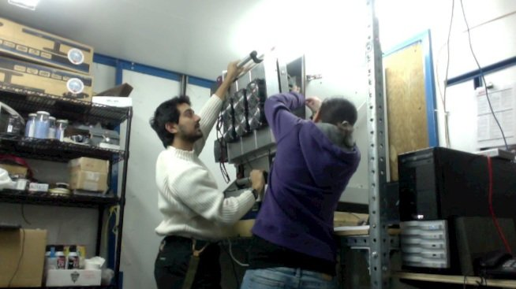
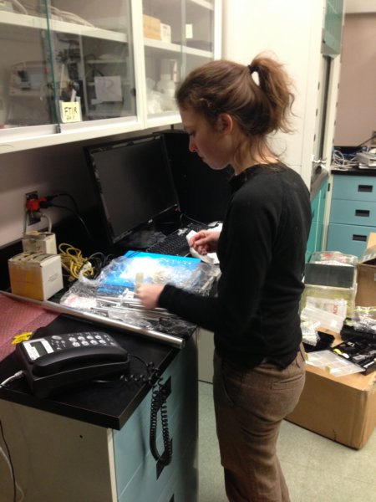
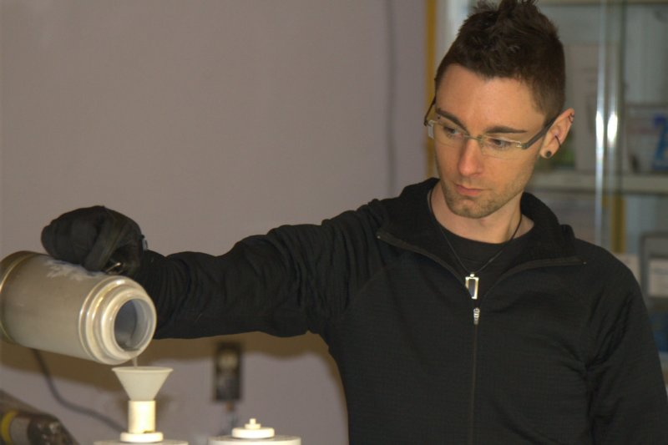
“Hi” from some TAs in Eureka
Zen
Debora
Dan

Slide 16
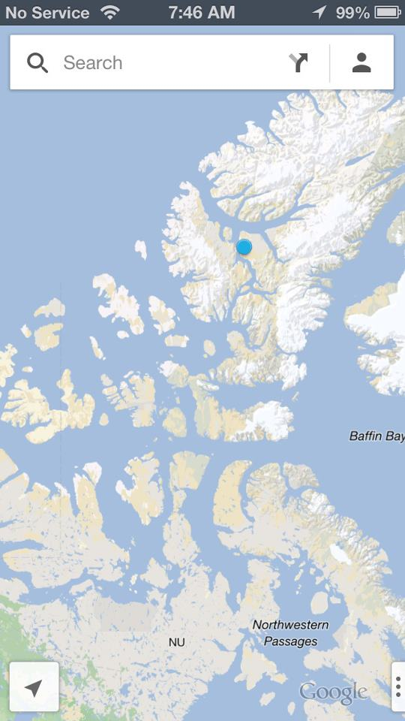
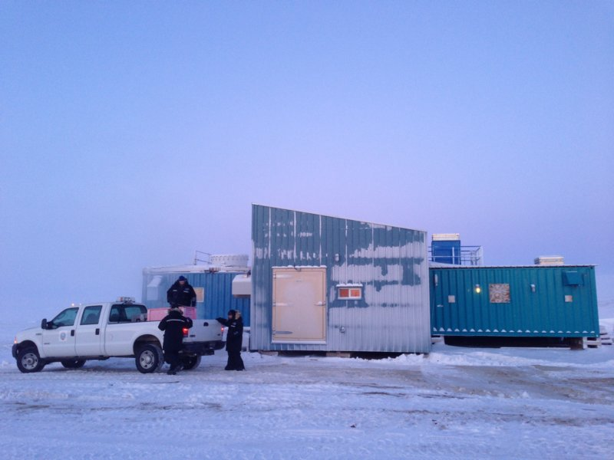
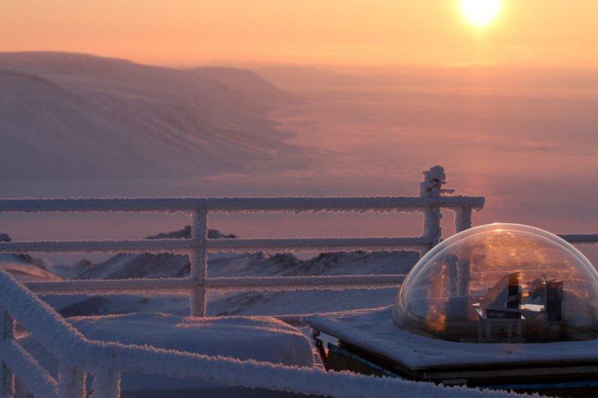
“Hi” from some TAs in Eureka
Dan, Debora and Zen are investigating a hole in the Earth’s ozone layer as the sun rises over the Arctic.

Slide 17
Tutorials continue this week…
I have arranged for substitutes for Dan, Debora and Zen
This week you will be working with your team on a worksheet on Thermal Physics and Heat
Your TA will be reviewing Chapters 12-16, 19 and 20 for the test on Mar. 6
The test is one week from right now!

Slide 18
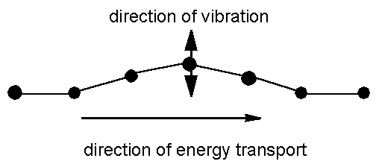
Transverse waves
Medium vibrates perpendicularly to direction of energy transfer
Side-to-side movement
Examples:
Vibrations in stretched strings of musical instruments
Electromagnetic waves, such as light and radio
[image from http://www.maths.gla.ac.uk/~fhg/waves/waves1.html ]

Slide 19
The distance between adjacent peaks in the direction of travel for a transverse wave is its
Transverse Waves
CHECK YOUR NEIGHBOR
A. frequency.
period.
wavelength.
amplitude.
Notes:
C. wavelength.

Slide 20
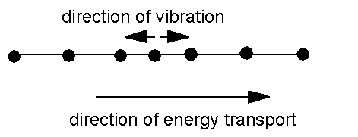
Longitudinal waves
Medium vibrates parallel to direction of energy transfer
Backward and forward movement consists of
compressions (wave compressed)
rarefactions (stretched region between compressions)
Example: sound waves in solid, liquid, gas
[image from http://www.maths.gla.ac.uk/~fhg/waves/waves1.html ]

Slide 21
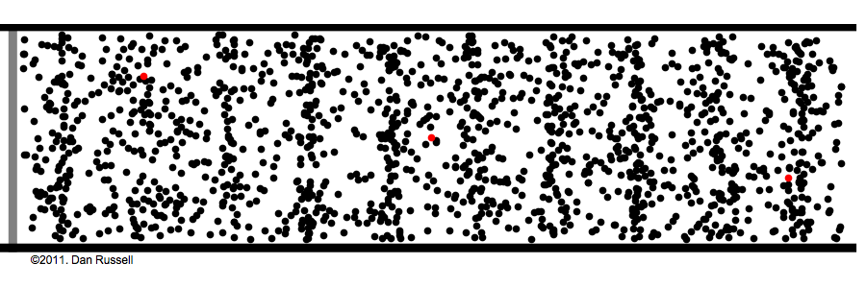
Longitudinal Waves
Sound is a longitudinal wave.
Compression regions travel at the speed of sound.
In a compression region, the density and pressure of the air is higher than the average density and pressure.

Slide 22
The wavelength of a longitudinal wave is the distance between
Longitudinal Waves
CHECK YOUR NEIGHBOR
A. successive compressions.
successive rarefactions.
Both A and B.
None of the above.
Notes:
C. Both A and B.

Slide 23
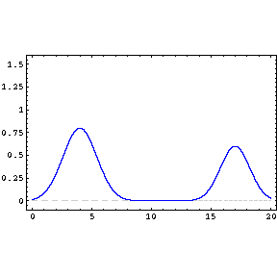
Wave interference occurs when two or more waves interact with each other because they occur in the same place at the same time.
Superposition principle: The disturbance due the interference of waves is determined by adding the disturbances produced by each wave.

Slide 24
Wave Interference
Constructive interference : When the crest of one wave overlaps the crest of another, their individual effects add together to produce a wave of increased amplitude.
Destructive interference: When the crest of one wave overlaps the trough of another, the high part of one wave simply fills in the low part of another. So, their individual effects are reduced (or even canceled out).

Slide 25
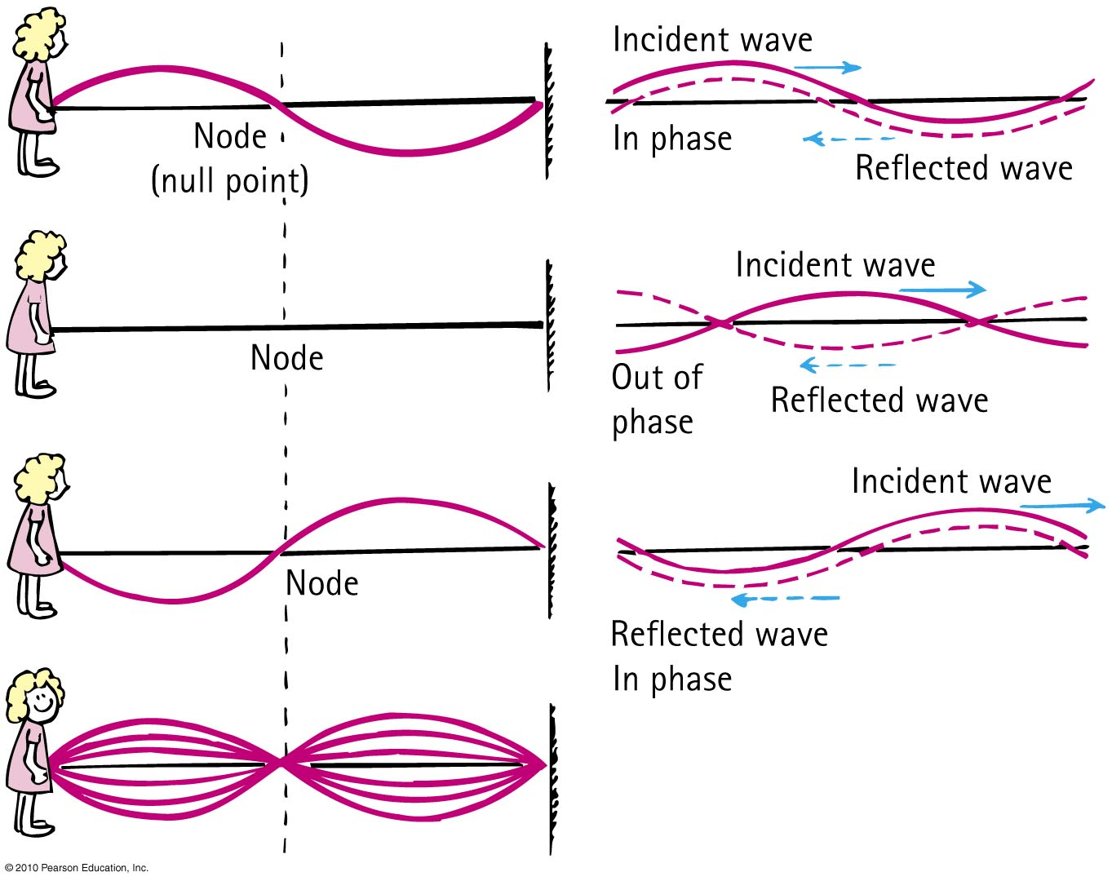
Standing Waves
If we tie a rope to a wall and shake the free end up and down, we produce a train of waves in the rope.
The wall is too rigid to shake, so the waves are reflected back along the rope.
By shaking the rope just right, we can cause the incident and reflected waves to form a standing wave.

Slide 26
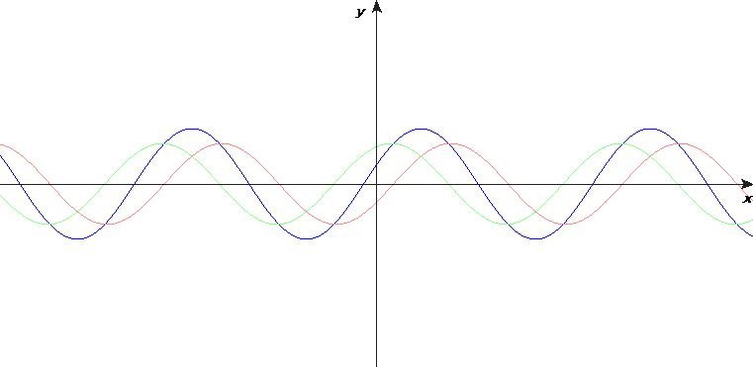
Standing Waves
Nodes are the regions of minimal or zero displacement, with minimal or zero energy.
Antinodes are the regions of maximum displacement and maximum energy.
Antinodes and nodes occur equally apart from each other.
[image from http://en.wikibooks.org/wiki/A-level_Physics_%28Advancing_Physics%29/Standing_Waves ]

Slide 27
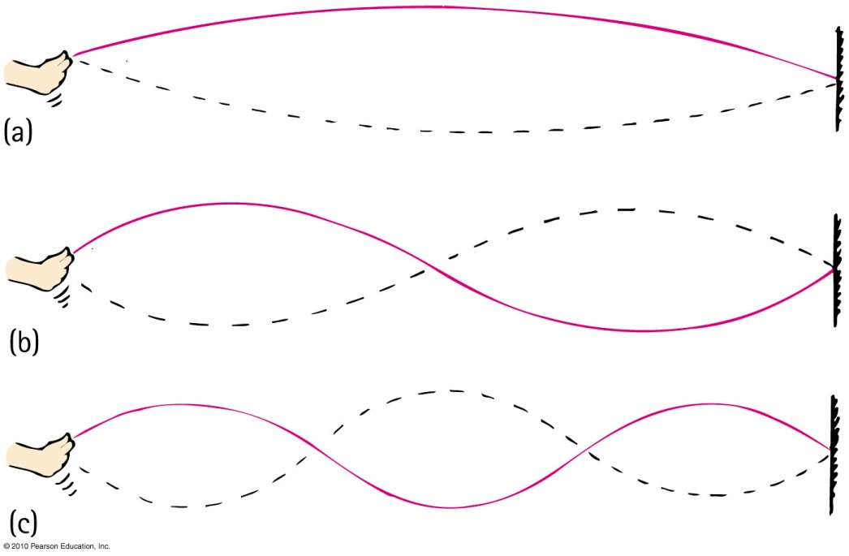
How to make a standing wave
Tie a string to a firm support. Shake the string from side to side with your hand.
If you shake the string with the right frequency, you will set up a standing wave.
If you shake the string with twice the frequency, a standing wave of half the wavelength, having two loops results.
If you shake the string with three times the frequency, a standing wave of one-third the wavelength, having three loops results.

Slide 28
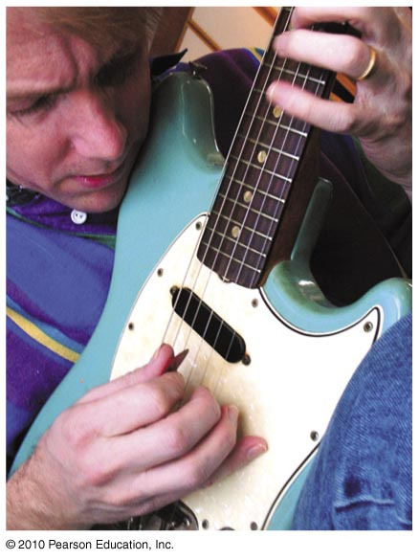
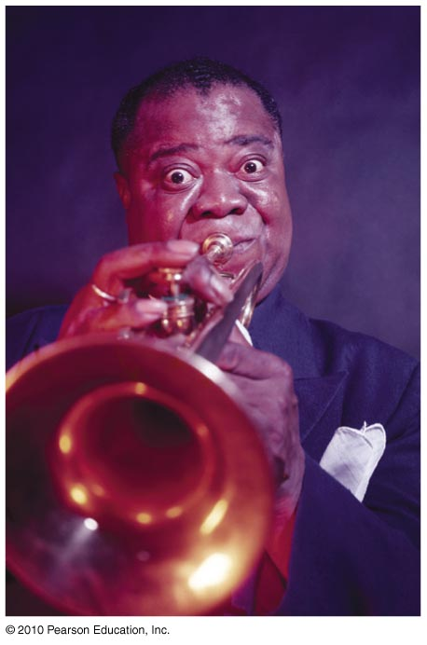
Standing Waves
Examples:
Waves in a guitar string
Sound waves in a trumpet

Slide 29
A standing wave on a string vibrates as shown at the top. Suppose the frequency is doubled while the tension and the length of the string are held constant. Which standing wave pattern is produced?
Notes:
STT21.2
Answer: A

Slide 30
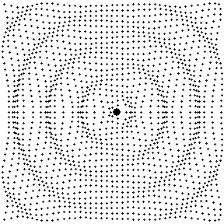
Waves in 2D or 3D
As wave energy leaves a source, the regions of crests are circles or spheres around the source, which spread out at the speed of the wave

Slide 31
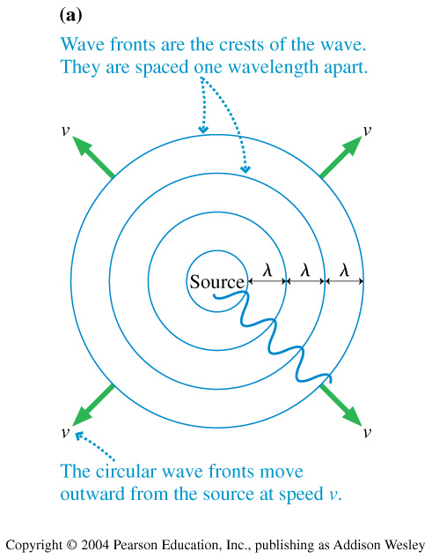
Waves in 2D or 3D

Slide 32
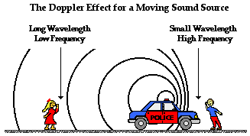
Doppler Effect
[image from http://www.physicsclassroom.com/class/waves/u10l3d.cfm ]

Slide 33
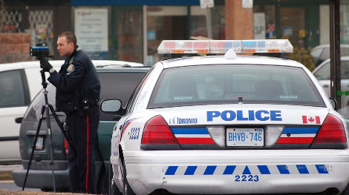
Doppler Effect
If a sound source is not moving relative to you, you hear the “rest frequency” of the emitted sound.
If the source is moving toward you, you will hear a frequency that is higher than the rest frequency.
If the source is moving away from you, you will hear a frequency that is lower than the rest frequency.
By measuring the difference between the observed and known rest frequencies, you can determine the speed of the source.

Slide 34
Which statement is true?
Valerie is standing in the middle of the road, as a police car approaches her at a constant speed, v. The siren on the police car emits a “rest frequency” of f₀.
The frequency she hears rises steadily as the police car gets closer and closer.
The frequency she hears steadily decreases as the police car gets closer and closer.
The frequency she hears does not change as the police car gets closer.
Notes:
STT20.6

Slide 35
Which statement is true?
Valerie is standing in the middle of the road, listening to the siren of a police car approaching her at a constant speed, v. Daniel is listening to a similar siren on a police car that is not moving.
The frequency Daniel hears is lower than the frequency Valerie hears.
The frequency Daniel hears is higher than the frequency Valerie hears.
The frequencies that Daniel and Valerie hear are exactly the same.
Notes:
STT20.6

Slide 36
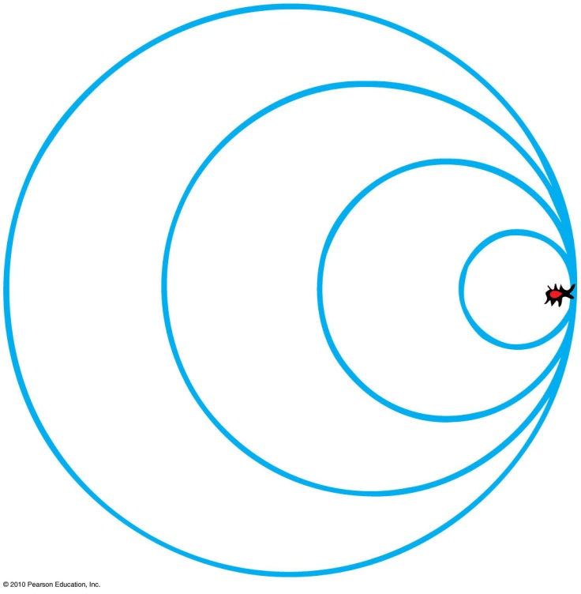
Bow Waves
Wave barrier
Waves superimpose directly on top of one another producing a “wall”.
Example: bug swimming as fast as the wave it makes

Slide 37
Bow Waves
Supersonic
Aircraft flying faster than the speed of sound.
Bow wave
V-shape form of overlapping waves when object travels faster than wave speed.
An increase in speed will produce a narrower V-shape of overlapping waves.

Slide 38
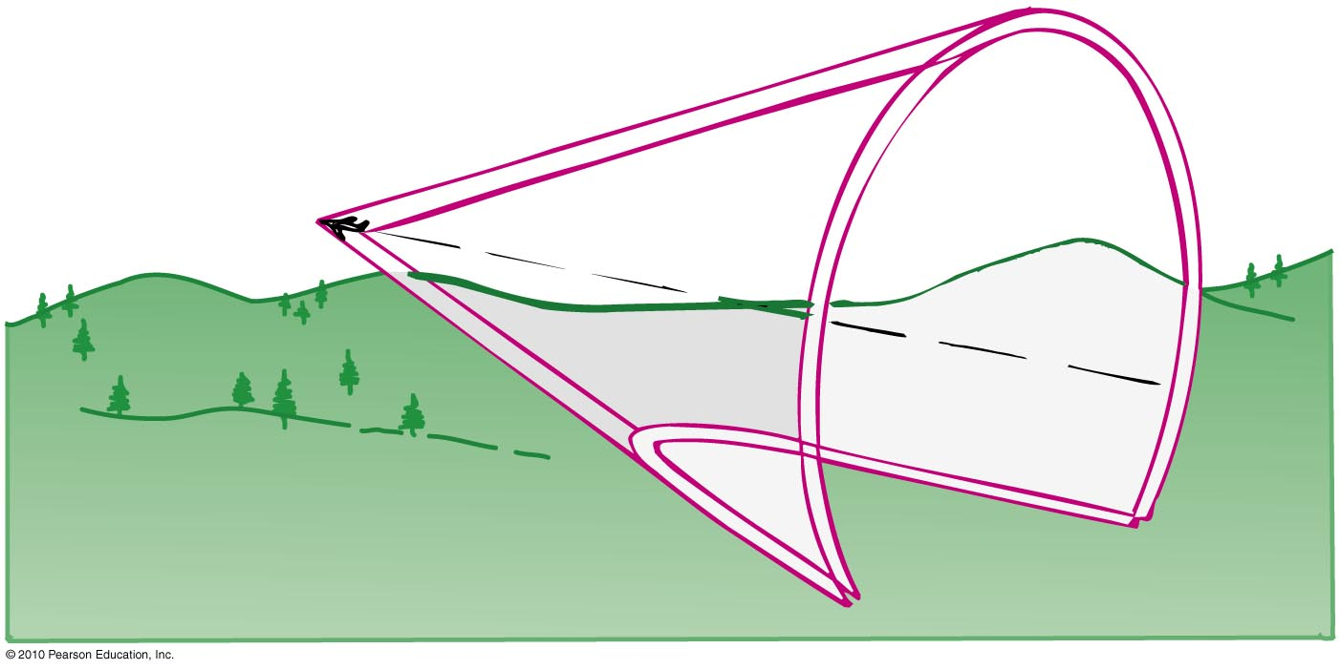
Shock Waves
Shock wave
Pattern of overlapping spheres that form a cone from objects traveling faster than the speed of sound.

Slide 39
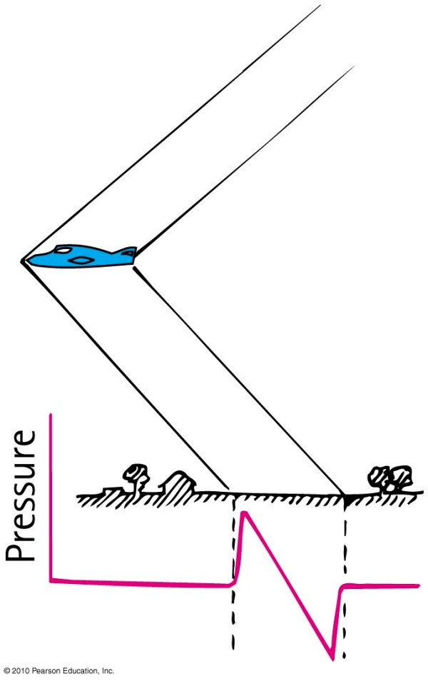
Shock Waves
Shock wave consists of two cones.
a high-pressure cone generated at the bow of the supersonic aircraft
a low-pressure cone that follows toward (or at) the tail of the aircraft
It is not required that a moving source be noisy.

Slide 40
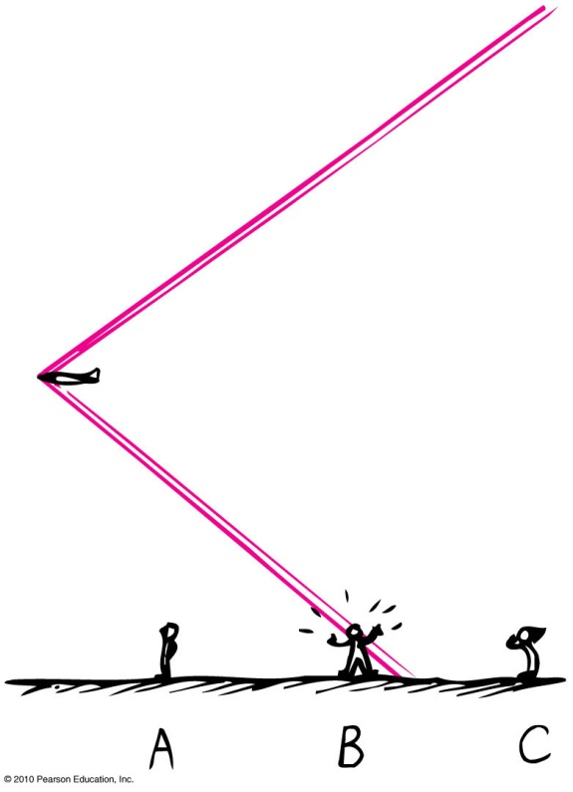
Sonic boom
Sharp cracking sound generated by a supersonic aircraft
Intensity due to overpressure and underpressure of atmospheric pressure between the two cones of the shock waves
Continually produced by any object traveling faster than the speed of sound – an observer on the ground hears a single “boom” after the object passes overhead.
Examples:
supersonic bullet
crack of circus whip

Slide 41
The source of a sonic boom
The Doppler Effect
CHECK YOUR NEIGHBOR
must itself be an emitter of sound.
is not itself an emitter of sound
may or may not be an emitter of sound.
Notes:
C. both A and B.

Slide 42
Shock Waves
[still from video at http://www.youtube.com/watch?v=Rp5eg_lk8zA ]
On Feb. 15, 2013, a meteor struck the Earth’s atmosphere over Russia
It was traveling at supersonic speeds, so produced a sonic boom
Many people were injured by the shaking and broken glass from this sonic boom
The meteor exploded and thousands of small fragments fell in the countryside.

Slide 43
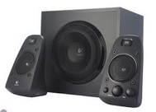
Before class on Monday…
Please read Chapter 20, or at least watch the 10-minute pre-class video for class 14.
Something to think about:
What is the difference between a forced vibration and a natural vibration?

