Slide 1
Conceptual Physics 11th Edition
Chapter 20:
SOUND
Sound in Air
Media That Transmit Sound
Reflection of Sound
Refraction of Sound
Energy in Sound Waves
Resonance
Interference
Beats

Slide 2
Nature of Sound
Sound is a form of energy that exists whether or not it is heard.
[ image from http://thinkjustdoit.blogspot.ca/2012/04/phi-3000-if-tree-falls-in-forest.html ]

Slide 3
Origin of Sound
Most sounds are waves produced by the vibrations of matter.
Examples:
In a piano, a violin, and a guitar, the sound is produced by a vibrating string;
in a saxophone, by a vibrating reed;
in a flute, by a fluttering column of air at the mouthpiece;
in your voice due to the vibration of your vocal chords.
[image from http://home.cc.umanitoba.ca/~krussll/phonetics/acoustic/harmonics.html ]

Slide 4
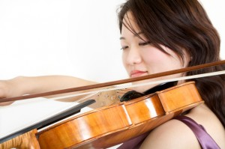
Origin of Sound
The original vibration stimulates the vibration of something larger or more massive, such as
the sounding board of a stringed instrument,
the air column within a reed or wind instrument, or
the air in the throat and mouth of a singer.
This vibrating material then sends a disturbance through the surrounding medium, usually air, in the form of longitudinal sound waves.
[image from http://umanitoba.ca/outreach/evidencenetwork/archives/9635 ]

Slide 5
Frequency and Pitch
The frequency of a sound wave is the same as the frequency of the vibrating source.
The subjective impression about the frequency of sound is called pitch.
The ear of a young person can normally hear pitches corresponding to the range of frequencies between about 20 and 20,000 Hertz.
As we grow older, the limits of this human hearing range shrink, especially at the high-frequency end.
Lowest A: 27.5 Hz
Highest C: 4186 Hz

Slide 6
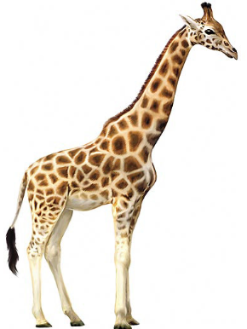
Infrasound and Ultrasound
Sound waves with frequencies below 20 hertz are infrasonic (frequency too low for human hearing).
Sound waves with frequencies above 20,000 hertz are called ultrasonic (frequency too high for human hearing).
We cannot hear infrasonic and ultrasonic sound.

Slide 7
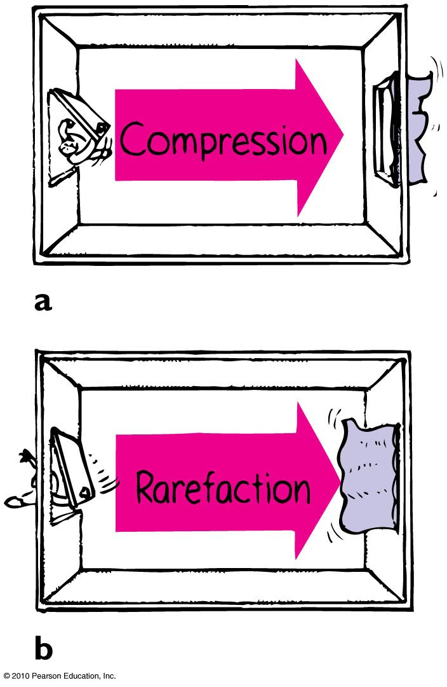
Compressions and Rarefactions
Sound waves are vibrations made of compressions and rarefactions.
In a compression region, the density and pressure are slightly greater than the average density and pressure
In a rarefaction region, the density and pressure are slightly lower than the average density and pressure

Slide 8
Wavelength of sound
Distance between successive compressions or rarefactions

Slide 9
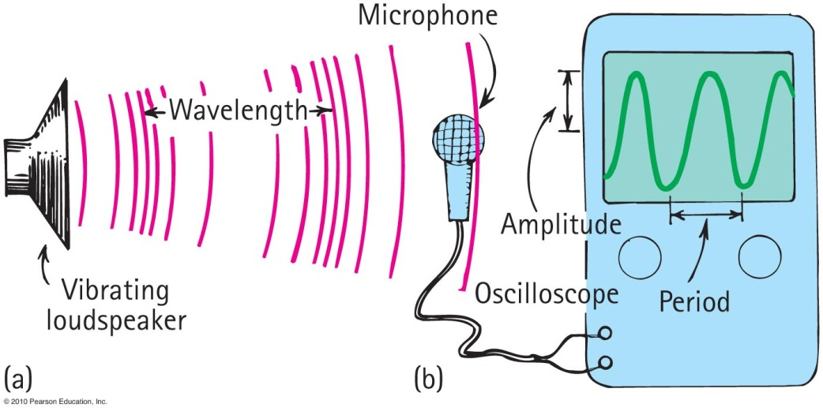
How sound is heard from a radio loudspeaker
Radio loudspeaker is a paper cone that vibrates.
Air molecules next to the loudspeaker set into vibration.
Produces compressions and rarefactions traveling in air.
Sound waves reach your ears, setting your eardrums into vibration. Or it reaches a microphone and sets up vibrations there, which are converted to an electric signal.

Slide 10
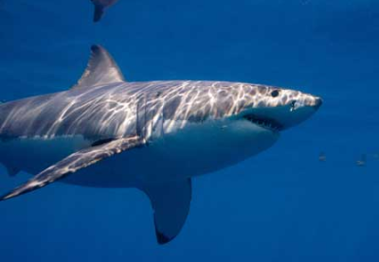
Media That Transmit Sound
Any elastic substance — solid, liquid, gas, or plasma — can transmit sound.
In liquids and solids, the atoms are relatively close together, respond quickly to one another’s motions, and transmit energy with little loss.
Sound travels about 4 times faster in water than in air and about 15 times faster in steel than in air.
[ image from http://www.flickr.com/photos/davegkelly/7457839080/ ]

Slide 11
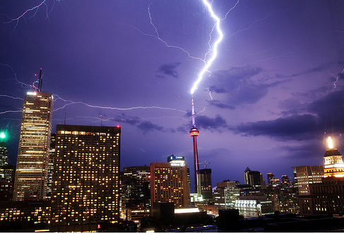
Speed of Sound in Air
Depends temperature, pressure and humidity
Speed in 0°C dry air at sea level is about 330 m/s.
In warm air faster than cold air.
Each degree rise in temperature above 0°C, speed of sound in air increases by 0.6 m/s
[image from http://www.forodecostarica.com/solaz/42155-el-jueguito-de-la-foto-13.html ]

Slide 12
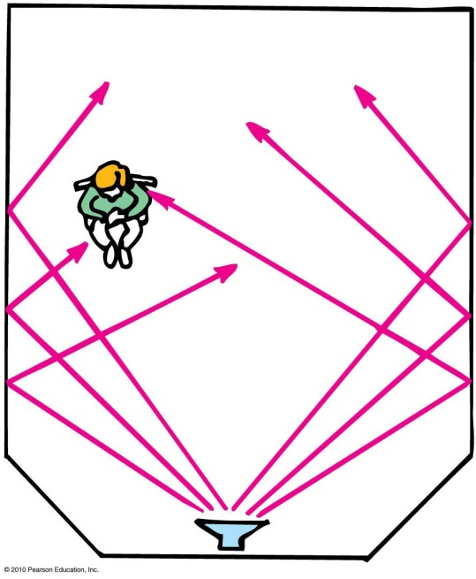
Reflection of Sound
Process in which sound encountering a surface is returned
Often called an echo
Multiple reflections—called reverberations

Slide 13
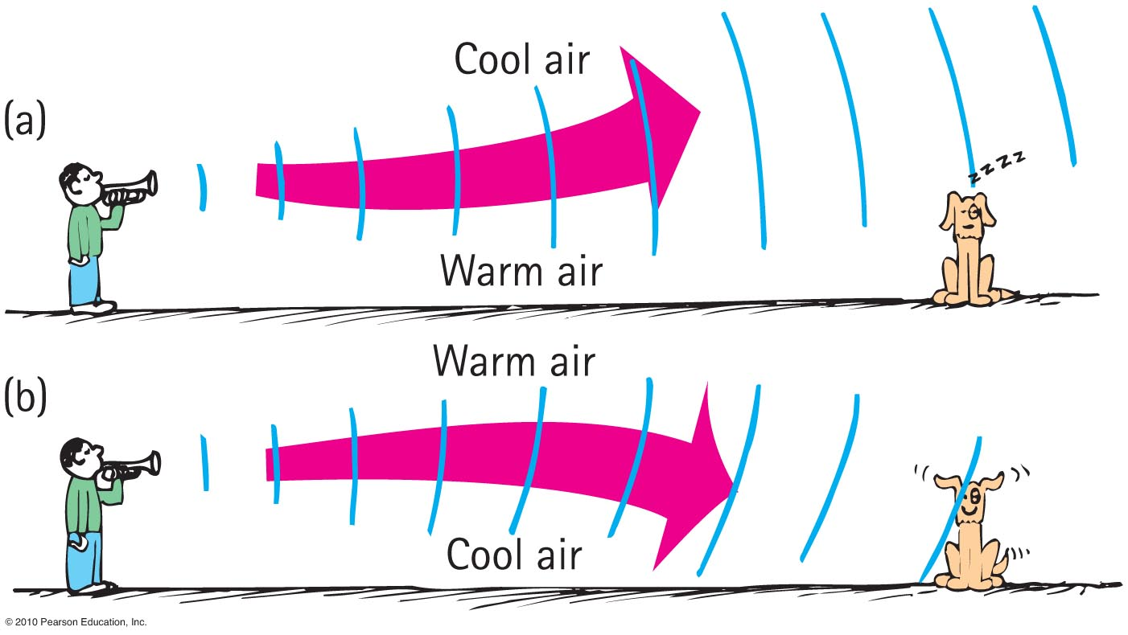
Refraction of Sound
Bending of waves—caused by changes in speed affected by temperature variations.

Slide 14
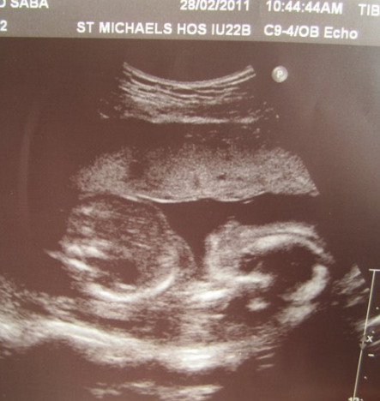
Ultrasonic Imaging
Multiple reflection and refractions of ultrasonic waves
Device sends high-frequency sounds into the body and reflects the waves more strongly from the exterior of the organs, producing an image of the organs.
Used instead of X-rays by physicians to see the interior of the body.
Image of my daughter, Zainab Harlow, when she was still in the womb.

Slide 15
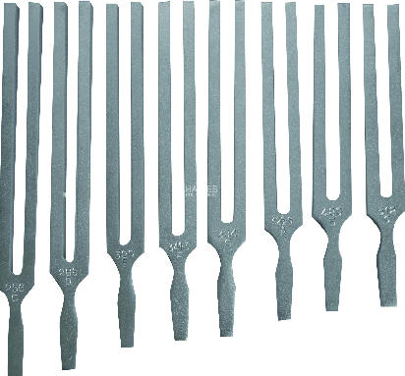
Natural Vibrations
Every object has its own unique frequency that it naturally tends to vibrate at.
Dependent on
Elasticity
Mass of object
Shape of object
Size of object
[image from http://www.haines.com.au/index.php/physics/heat-light-sound/tuning-fork-e-320-hz.html ]

Slide 16
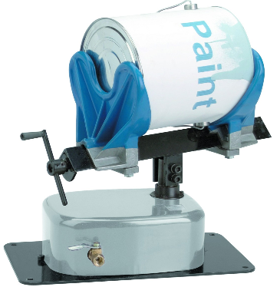
Forced Vibrations
Setting up of vibrations in an object by a vibrating force
Examples:
factory floor vibration caused by running of heavy machinery
Table vibration from paint shaker
[image from http://www.harborfreight.com/pneumatic-paint-shaker-94605.html ]

Slide 17
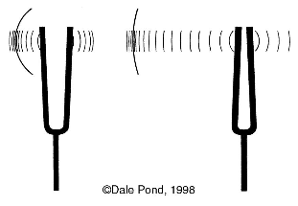
Resonance
A phenomenon in which the frequency of forced vibrations on an object matches the object’s natural frequency
Examples:
Swinging in rhythm with the natural frequency of a swing
Tuning a radio station to the “carrier frequency” of the radio station
Troops marching in rhythm with the natural frequency of a bridge (a no-no!)
[image from http://pondscienceinstitute.on-rev.com/svpwiki/tiki-index.php?page=sympathetic+vibration ]

Slide 18
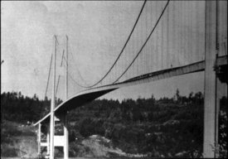
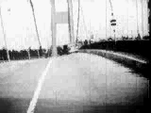
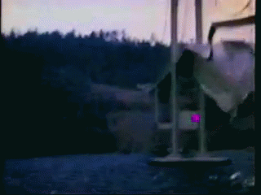
Tacoma Narrows Bridge Collapse 1940
Dramatic example of wind-generated resonance!
[left image from http://www.stkate.edu/physics/phys111/index.html ]

Slide 19
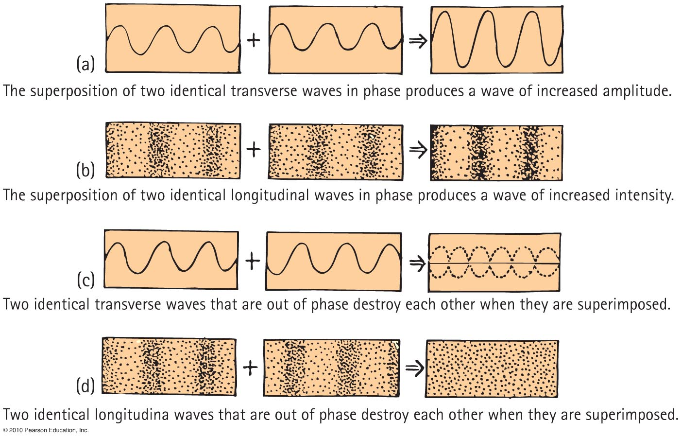
Interference

Slide 20
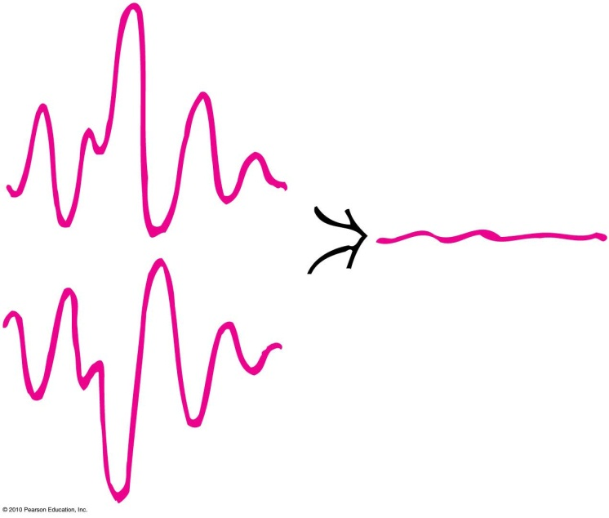
Sound Canceling Headphones
Application of sound interference
Destructive sound interference in noisy environments such as airplanes.
Headphones are equipped with microphones, and then produce mirror-image wave patterns fed to listener’s earphone, canceling the engine’s sound
[image from http://teethobsession.blogspot.ca/2011/01/afraid-of-dentist-this-active-noise.html ]

Slide 21
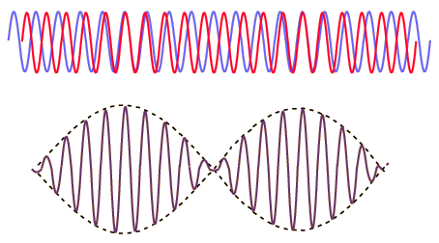
Beats
Periodic variations in the loudness of sound due to interference
Occur when two waves of similar, but not equal frequencies are superposed.
Provide a comparison of frequencies
[image from http://hyperphysics.phy-astr.gsu.edu/hbase/sound/beat.html ]

Slide 22
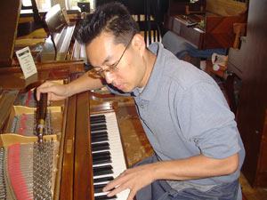
Beats
Applications
Piano tuning by listening to the disappearance of beats from a known frequency and a piano key
Tuning instruments in an orchestra by listening for beats between instruments and piano tone

