Slide 1
Note on Posted Slides
These are the slides that I intended to show in class on Mon. Mar. 11, 2013.
They contain important ideas and questions from your reading.
Due to time constraints, I was probably not able to show all the slides during class.
They are all posted here for completeness.

Slide 2
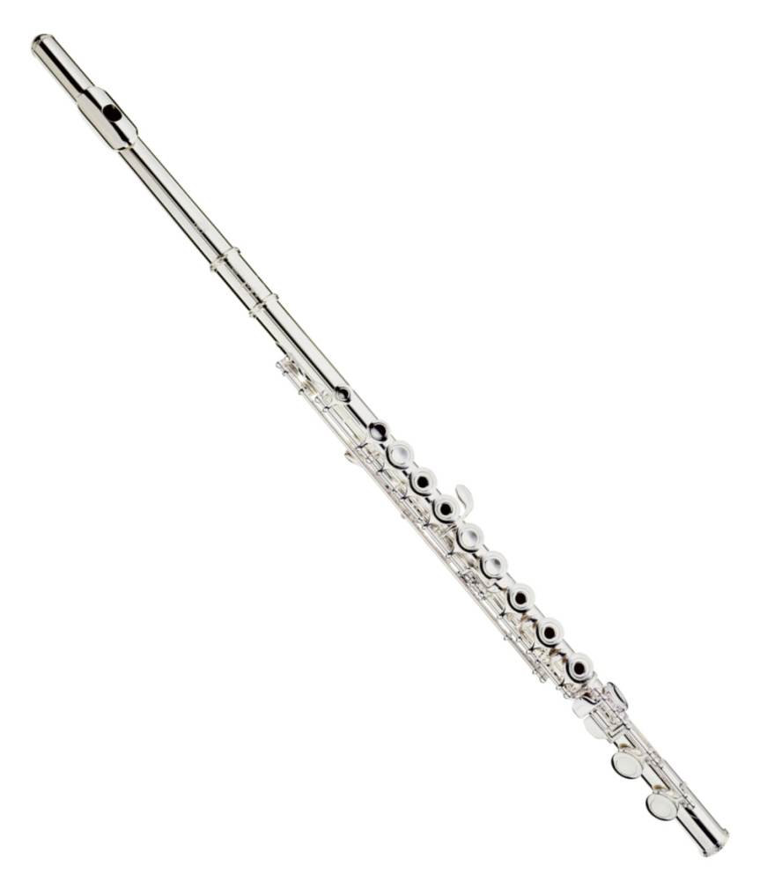
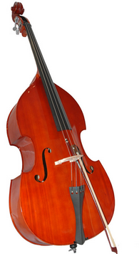
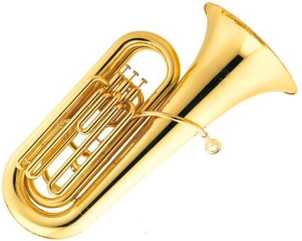
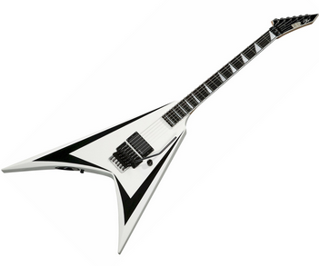
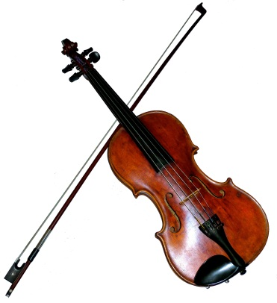
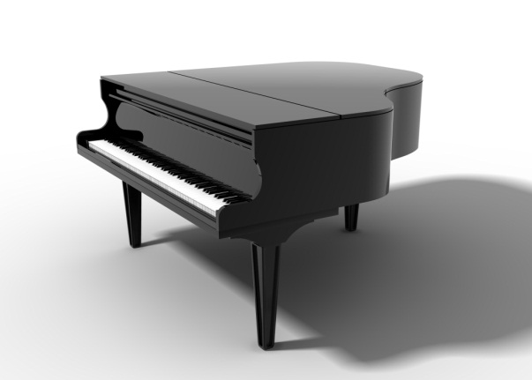
PHY205H1S Physics of Everyday Life Class 15: Musical Sounds
Noise and Music
Musical Sounds
Pitch
Sound Intensity and Loudness
Quality
Fourier Analysis
Digital Versatile Discs (DVDs)

Slide 3
Noise and Music
Noise corresponds to an irregular vibration of the eardrum produced by some irregular vibration in our surroundings, a jumble of wavelengths and amplitudes.
White noise is an even mixture of frequencies of sound, all with random phases.
Time

Slide 4
Noise and Music
Music is the art of sound and has a different character.
Musical sounds have periodic tones–or musical notes.
The line that separates music and noise can be thin and subjective.
Time

Slide 5
A Musical tone has three characteristics:
Pitch
related to the frequency of sound waves as received by the ear
determined by fundamental frequency, lowest frequency heard
Intensity
determines the perceived loudness of sound
Quality
determined by prominence of the harmonics, and the presence and relative intensity of the various partials

Slide 6
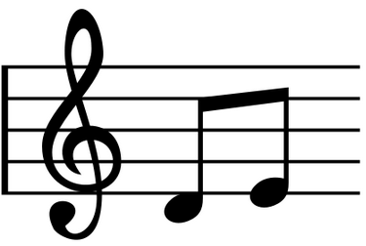
Pitch
Music is organized on many different levels. Most noticeable are musical notes.
Each note has its own pitch. We can describe pitch by frequency.
Rapid vibrations of the sound source (high frequency) produce sound of a high pitch.
Slow vibrations (low frequency) produce a low pitch.

Slide 7
Pitch
In music there are 12 distinct notes, named: C, C#, D, D#, E, F, F#, G, G#, A, A# and B
Each step in this sequence is separated by a semitone, which means a multiplicative factor in frequency of $\sqrt[12]{2}$
Multiply the frequency on any note by 2, and you have the same note at a higher pitch in the next octave.

Slide 8
Pitch
Different musical notes are obtained by changing the frequency of the vibrating sound source.
This is usually done by altering the size, the tightness, or the mass of the vibrating object.

Slide 9
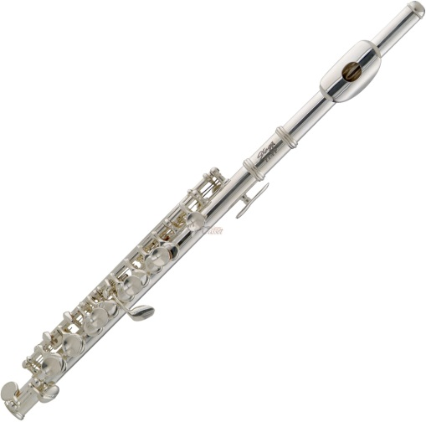
Pitch
High-pitched sounds used in music are most often less than 4000 Hz, but the average human ear can hear sounds with frequencies up to 18,000 Hz.
Some people and most dogs can hear tones of higher pitch than this.
The upper limit of hearing in people gets lower as they grow older.
A high-pitched sound is often inaudible to an older person and yet may be clearly heard by a younger one.

Slide 10
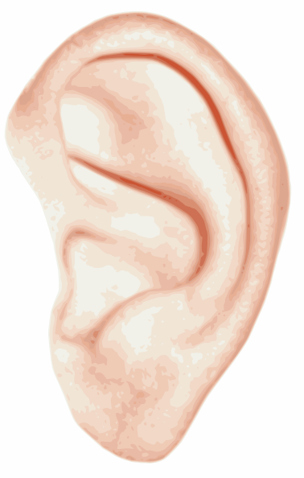
Sound Intensity and Loudness
The intensity of sound depends on the amplitude of pressure variations within the sound wave.
The human ear responds to intensities covering the enormous range from 10^{–12} W/m² (the threshold of hearing) to more than 1 W/m² (the threshold of pain).

Slide 11
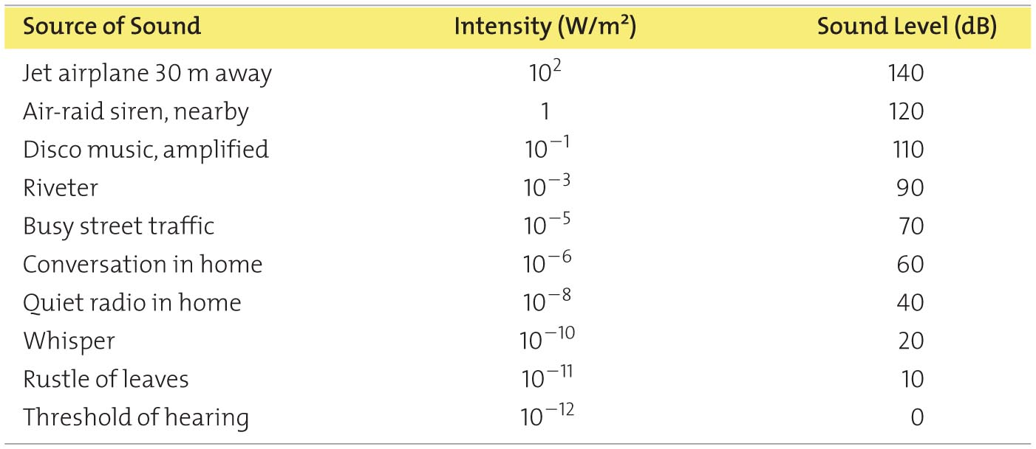
Because the range is so great, intensities are scaled by factors of 10, with the barely audible 10^{–12} W/m² as a reference intensity called 0 bel (a unit named after Alexander Bell).
A sound 10 times more intense has an intensity of 1 bel (W/m²) or 10 decibels (dB)

Slide 12
Discussion question
A sound level of 10 decibels has 10 times more intensity than a sound level of zero decibels.
A sound level of 20 decibels has ___ times more intensity than a sound level of zero decibels.
10
20
50
100
200

Slide 13
Clicker Discussion Question
When you turn up the volume on your ipod, the sound originally entering your ears at 50 decibels is boosted to 80 decibels. By what factor is the intensity of the sound has increased?
1 (no increase)
30
100
300
1000

Slide 14
Sound Intensity and Loudness
Sound intensity is a purely objective and physical attribute of a sound wave, and it can be measured by various acoustical instruments.
Loudness is a physiological sensation.
The ear senses some frequencies much better than others.
A 3500-Hz sound at 80 decibels sounds about twice as loud to most people as a 125-Hz sound at 80 decibels.
Humans are more sensitive to the 3500-Hz range of frequencies.

Slide 15
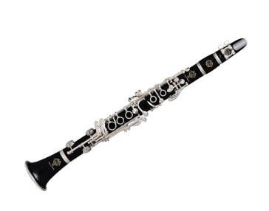
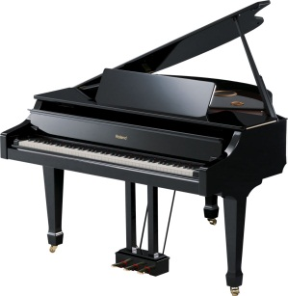
Quality
We have no trouble distinguishing between the tone from a piano and a tone of the same pitch from a clarinet.
Each of these tones has a characteristic sound that differs in quality, the “color” of a tone —timbre.
Timbre describes all of the aspects of a musical sound other than pitch, loudness, or length of tone.

Slide 16
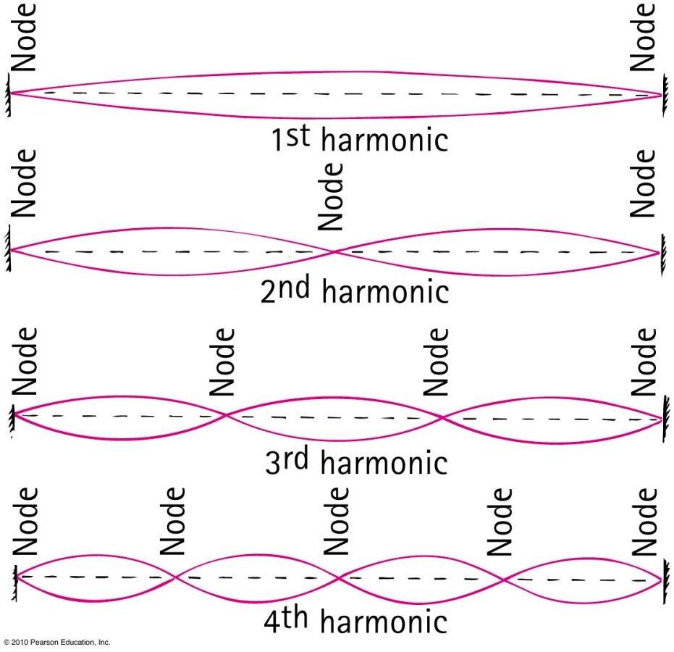
Quality
Most musical sounds are composed of a superposition of many tones differing in frequency.
The various tones are called partial tones, or simply partials. The lowest frequency, called the fundamental frequency, determines the pitch of the note.
A partial tone whose frequency is a whole-number multiple of the fundamental frequency is called a harmonic.
A composite vibration of the fundamental mode and the third harmonic is shown in the figure.

Slide 17
Quality
The quality of a tone is determined by the presence and relative intensity of the various partials.
The sound produced by a certain tone from the piano and a clarinet of the same pitch have different qualities that the ear can recognize because their partials are different.
A pair of tones of the same pitch with different qualities have either different partials or a difference in the relative intensity of the partials.

Slide 18
Musical Instruments
Vibrating strings
Vibration of stringed instruments is transferred to a sounding board and then to the air.
Vibrating air columns
Brass instruments.
Woodwinds—stream of air produced by musician sets a reed vibrating.
Fifes, flutes, piccolos—musician blows air against the edge of a hole to produce a fluttering stream.

Slide 19
Clicker Discussion Question
If I force a node at the middle of my guitar string, how will it change the note?
It will halve the frequency
The frequency will decrease slightly
It will not change the frequency
The frequency will increase slightly
It will double the frequency

Slide 20
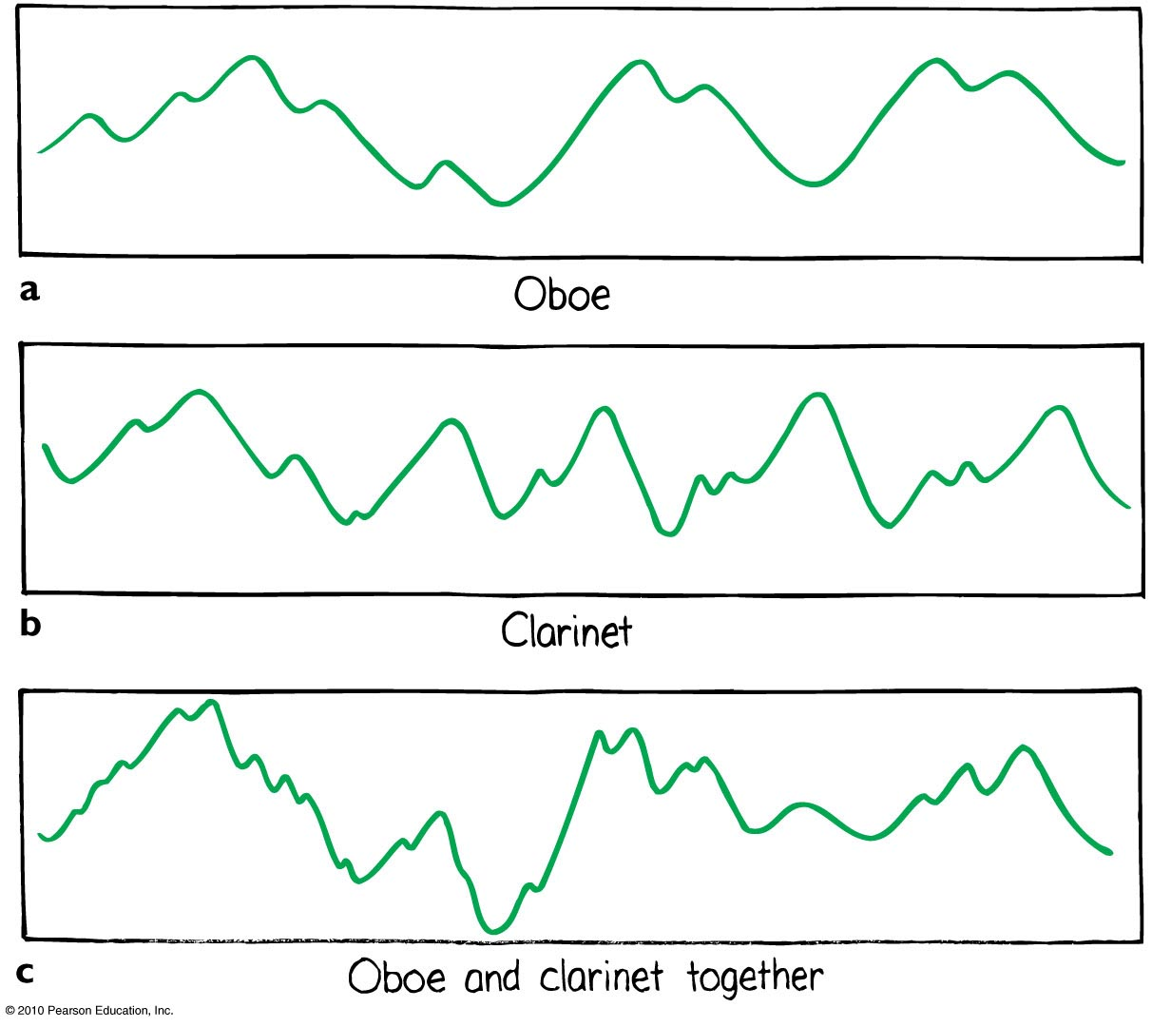
Fourier Analysis
The sound of an oboe displayed on the screen of an oscilloscope looks like this.
The sound of an clarinet displayed on the screen of an oscilloscope looks like this.
The two together look like this.

Slide 21
Fourier Analysis
Fourier discovered a mathematical regularity to the component parts of periodic wave motion.
He found that even the most complex periodic wave motion can be disassembled into simple sine waves that add together.
Fourier found that all periodic waves may be broken down into constituent sine waves of different amplitudes and frequencies.
The mathematical operation for performing this is called Fourier analysis.

Slide 22
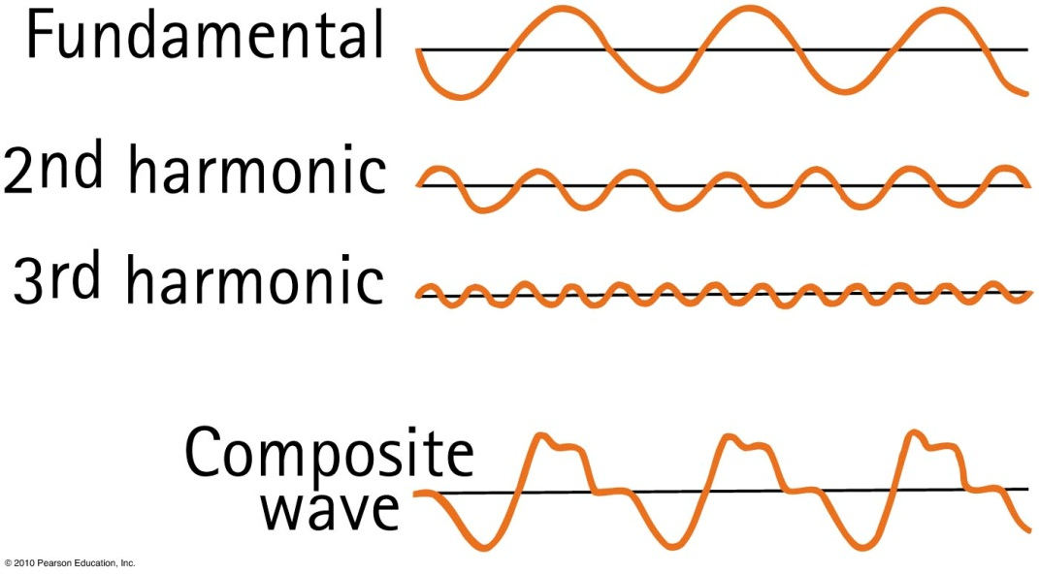
Fourier Analysis
When these pure tones are sounded together, they combine to give the tone of the violin.
The lowest-frequency sine wave is the fundamental and determines the pitch.
The higher-frequency sine waves are the partials that determine the quality.
Thus, the waveform of any musical sound is no more than a sum of simple sine waves.

Slide 23
Clicker Discussion Question
An MP3 is a file format which compresses large amounts of sound data. Once the file is uncompressed for playback, what about music does an MP3 file for a song actually store?
Pressure versus time.
Pitch, loudness and quality, all as functions of time.
Frequency and loudness versus time.
The parameters for all the musical instruments and voices, so they can be played back later using a computer simulation.

Slide 24
Audio Recording
The output of phonograph records was signals like those shown below.
This type of continuous waveform is called an analog signal.
The analog signal can be changed to a digital signal by measuring the numerical value of its pressure during each split second.

Slide 25
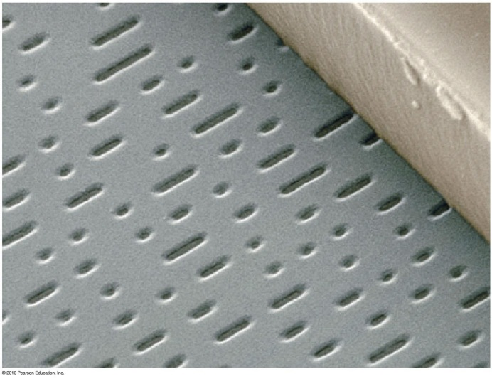
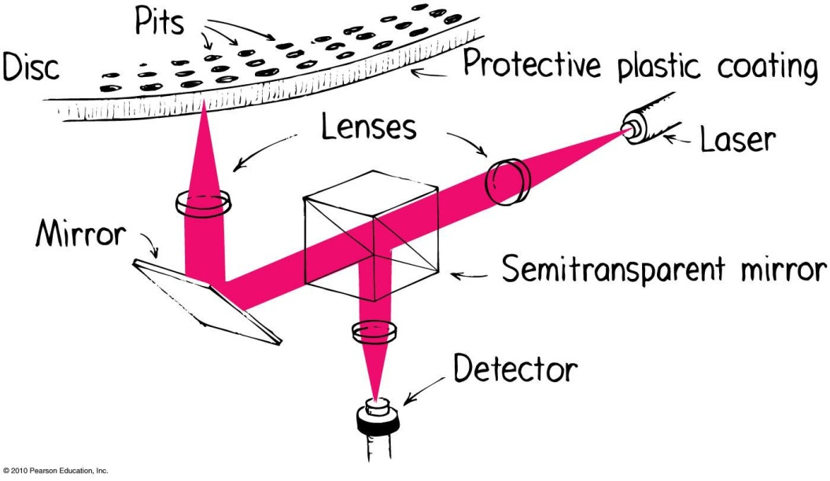
Digital Versatile Discs (DVDs)
Microscopic pits about one-thirtieth the diameter of a strand of human hair are imbedded in the CD or DVD
The short pits corresponding to 0.
The long pits corresponding to 1.
When the beam falls on a short pit, it is reflected directly into the player’s optical system and registers a 0.
When the beam is incident upon a passing longer pit, the optical sensor registers a 1.
Hence the beam reads the 1 and 0 digits of the binary code.

Slide 26
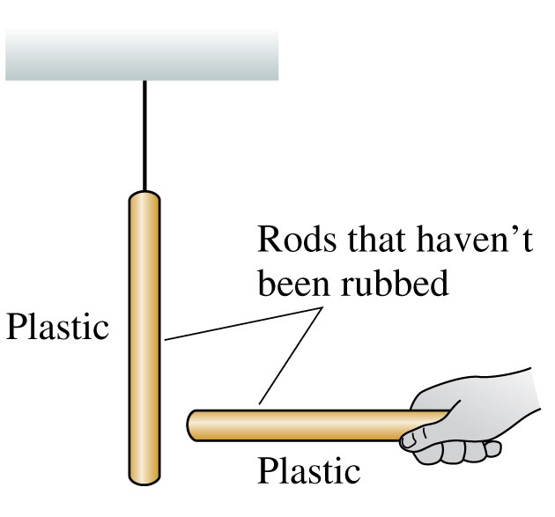
Discovering Electricity: Experiment 1
Take a plastic rod that has been undisturbed for a long period of time and hang it by a thread.
Pick up another undisturbed plastic rod and bring it close to the hanging rod.
Nothing happens to either rod.
No forces are observed.
We will say that the original objects are neutral.

Slide 27
Discussion Question
Rub two plastic rods with wool.
Hang one from a string
Place the other near it.
What will happen?
Nothing: no force observed
The hanging rod will be repelled, and move to the left
The hanging rod will be attracted, and move to the right

Slide 28
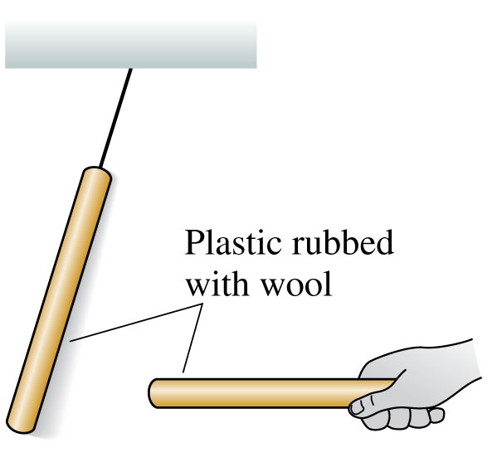
Discovering Electricity: Experiment 2
Rub both plastic rods with wool.
Now the hanging rod tries to move away from the handheld rod when you bring the two close together.
Two glass rods rubbed with silk also repel each other.
There is a long-range repulsive force, requiring no contact, between two identical objects that have been charged in the same way.

Slide 29
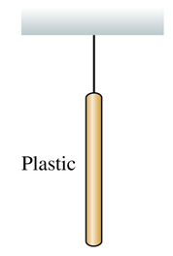
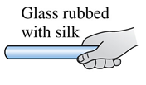
Discussion Question
Rub a plastic rod with wool, and hang it from a string.
Rub a glass rod with silk, and place it near the hanging rod.
What will happen?
Nothing: no force observed
The hanging rod will be repelled, and move to the left
The hanging rod will be attracted, and move to the right

Slide 30
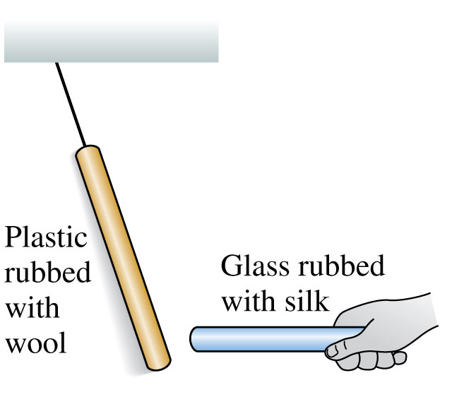
Discovering Electricity: Experiment 3
Bring a glass rod that has been rubbed with silk close to a hanging plastic rod that has been rubbed with wool.
These two rods attract each other.
These particular two types of rods are different materials, charged in a somewhat different way, and they attract each other rather than repel.

Slide 31
Discussion Question
Rub two plastic rods with wool, hang one from a string, place the other near it so it repels the hanging rod.
What happens if you increase the distance between the two rods?
Nothing: no change in force
The repulsive force will decrease
The repulsive force will increase

Slide 32
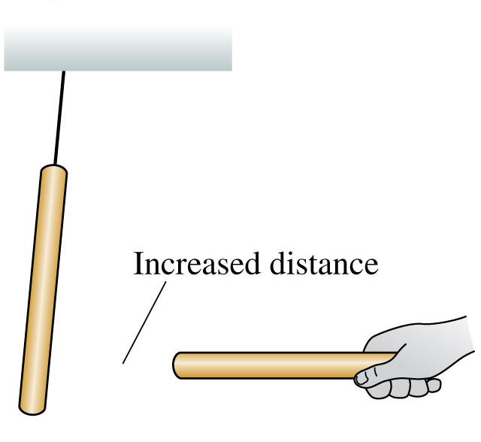
Discovering Electricity: Experiment 4
Rub rods with wool or silk and observe the forces between them.
These forces are greater for rods that have been rubbed more vigorously.
The strength of the forces decreases as the separation between the rods increases.
The force between two charged objects depends on the distance between them.

Slide 33
Discussion Question
Hang a neutral object from a string.
Rub a glass rod with silk, and place it near the hanging object.
What will happen?
Neutral Object
Nothing: no force observed
The hanging object will be repelled, and move to the left
The hanging object will be attracted, and move to the right

Slide 34
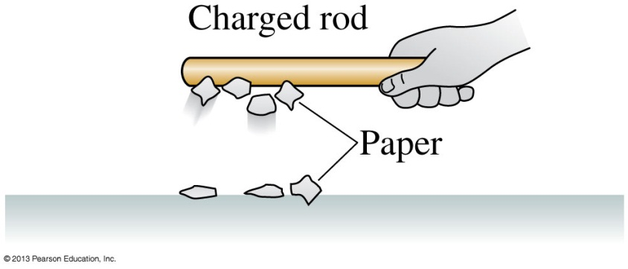
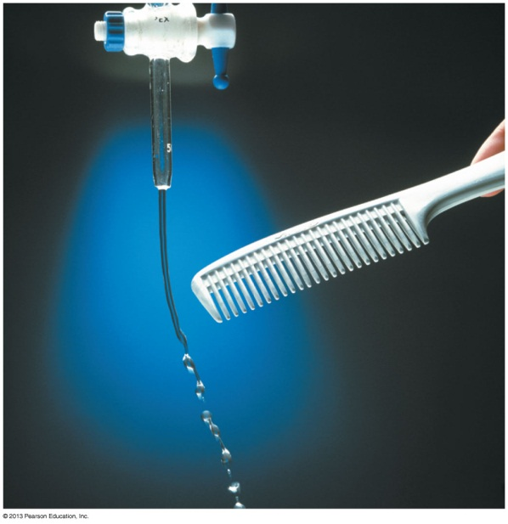
Discovering Electricity: Experiment 5
Hold a charged (i.e., rubbed) plastic rod over small pieces of paper on the table.
The pieces of paper leap up and stick to the rod.
A charged glass rod does the same.
However, a neutral rod has no effect on the pieces of paper.
There is an attractive force between a charged object and a neutral (uncharged) object.
Slide 25-23

Slide 35
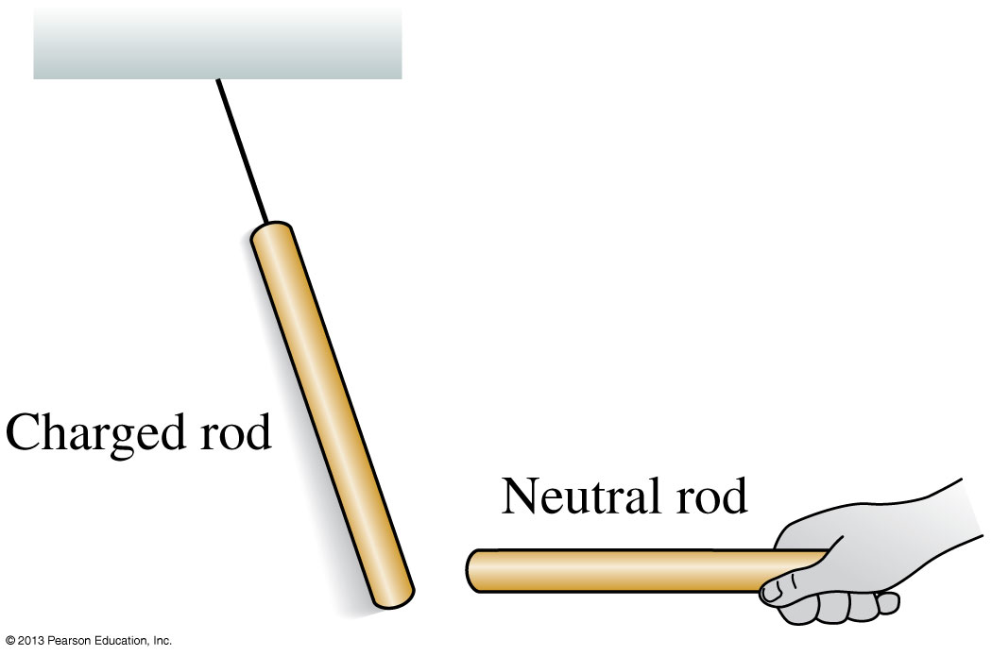
Discovering Electricity: Experiment 6
Rub a plastic rod with wool and a glass rod with silk.
Hang both by threads, some distance apart.
Both rods are attracted to a neutral object that is held close.
There is an attractive force between a charged object and a neutral (uncharged) object.
Slide 25-24

Slide 36
Before class on Wednesday
Electricity! For the next four classes we will be talking about the electricity and magnetism.
Please read Chapter 22, or at least watch the 10-minute pre-class video for class 16.
Something to think about:
The electric force can be attractive or repulsive – but a balloon always sticks to the wall after you’ve rubbed it on your head.
Why doesn’t the balloon sometimes repel the wall?

