Slide 1
Conceptual Physics 11th Edition
Chapter 22:
ELECTROSTATICS
Electrical Forces and Charges
Conservation of Charge
Coulomb’s Law
Conductors and Insulators
Charging
Charge Polarization
Electric Field
Electric Potential
Electric Energy Storage

Slide 2
Electric Force and Charges
When two objects have electric charges, there is a long-range force between them called the electric force.
The rule for the electric force is:
Opposite charges attract one another;
like charges repel.

Slide 3
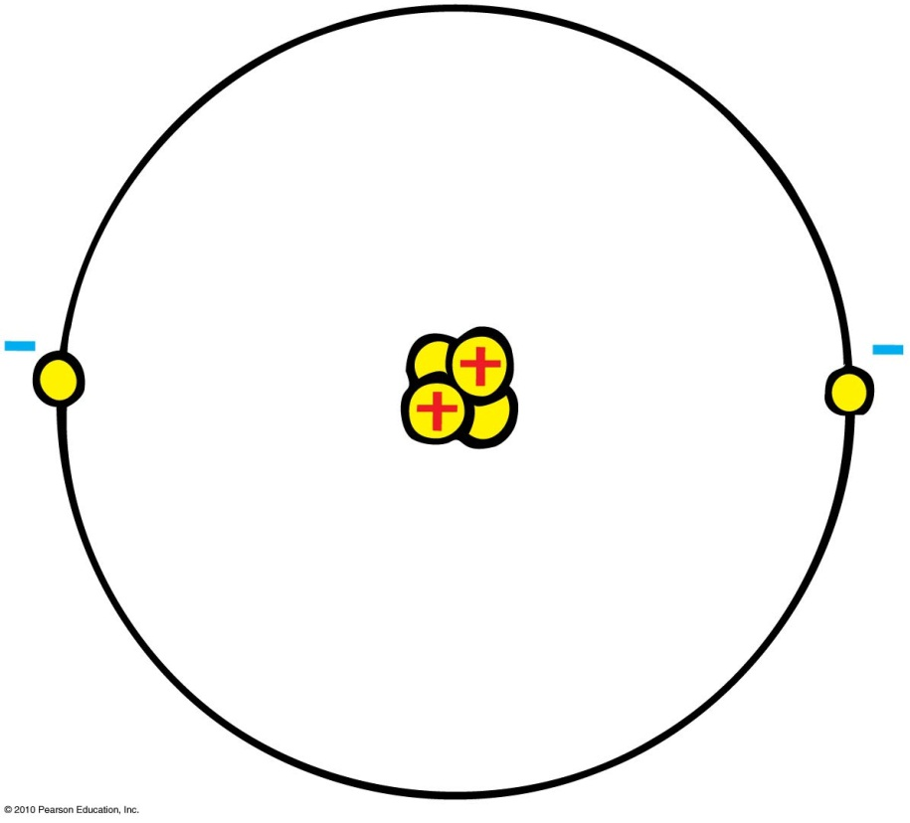
What are Atoms Made of?
Protons
Positive electric charges
Repel positives, but attract negatives
Electrons
Negative electric charges
Repel negatives, but attract positives
Neutrons
No electric charge
“neutral”

Slide 4
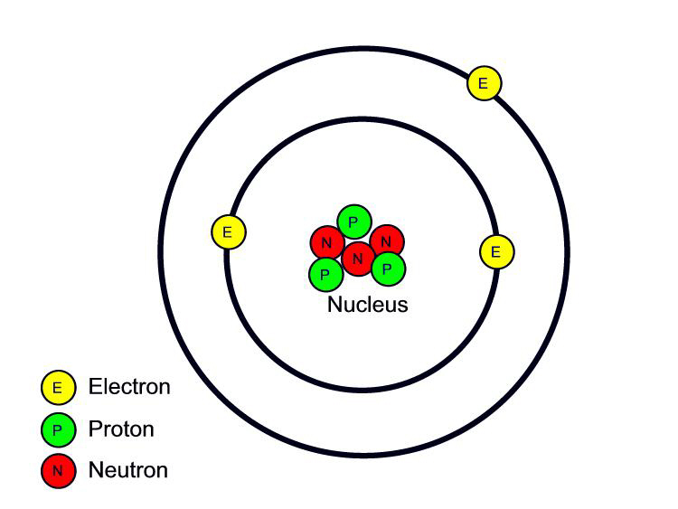
Fundamental facts about atoms
1. Every atom is composed of a positively charged nucleus surrounded by negatively charged electrons.
2. Each of the electrons in any atom has the same quantity of negative charge and the same mass.
Lithium Atom
Net charge = 0
[Image retrieved Jan.10, 2013 from http://www.safetyoffice.uwaterloo.ca/hse/radiation/rad_sealed/matter/atom_structure.htm ]

Slide 5
Fundamental facts about atoms
3. Protons and neutrons compose the nucleus. Protons are about 1800 times more massive than electrons, but each one carries an amount of positive charge equal to the negative charge of electrons. Neutrons have slightly more mass than protons and have no net charge.
Lithium Atom
Net charge = 0
[Image retrieved Jan.10, 2013 from http://www.safetyoffice.uwaterloo.ca/hse/radiation/rad_sealed/matter/atom_structure.htm ]

Slide 6
Fundamental facts about atoms
4. Atoms usually have as many electrons as protons, so the atom has zero net charge.
Lithium Atom
Net charge = 0
[Image retrieved Jan.10, 2013 from http://www.safetyoffice.uwaterloo.ca/hse/radiation/rad_sealed/matter/atom_structure.htm ]

Slide 7
An “Ion” is a charged atom
Positive ion — an atom which has lost one or more of its electrons, and so has a positive net charge.
Negative ion — an atom which has gained one or more electrons, and so has a negative net charge.

Slide 8
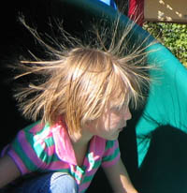
Electrons in an atom
Innermost—attracted very strongly to oppositely charged atomic nucleus
Outermost—attracted loosely and can be easily dislodged
Examples:
When rubbing a comb through your hair, electrons transfer from your hair to the comb. Your hair has a deficiency of electrons (positively charged).
When rubbing a glass rod with silk, electrons transfer from the rod onto the silk and the rod becomes positively charged.
[image from http://www.sciencebuddies.org/blog/2011/02/the-shock-of-static-electricity.php ]

Slide 9
Conservation of Charge
Conservation of charge
In any charging process, no electrons are created or destroyed. Electrons are simply transferred from one material to another.

Slide 10
Coulomb’s Law
$$q_{1}$$
$$d$$
$$q_{2}$$
If the charges are alike in sign, the force is repelling; if the charges are not alike, the force is attractive.
In equation form:
k = 9×10⁹ Nm²/C²
Unit of charge is coulomb, C
Similar to Newton’s law of gravitation for masses
Underlies the bonding forces between molecules
Electrical forces may be either attractive or repulsive.
Gravitational forces are only attractive.
$$F=k\frac{q_{1}q_{2}}{d^{2}}$$

Slide 11
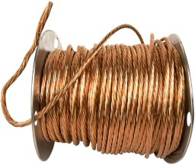
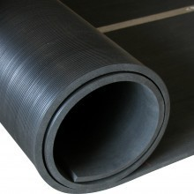
Conductors and Insulators
Conductors: Materials in which one or more of the electrons in the outer shell of its atoms are not anchored to the nuclei of particular atoms but are free to wander in the material
Example: Metals such as copper and aluminum
Insulators: Materials in which electrons are tightly bound and belong to particular atoms and are not free to wander about among other atoms in the material, making them flow
Example: Rubber, glass

Slide 12
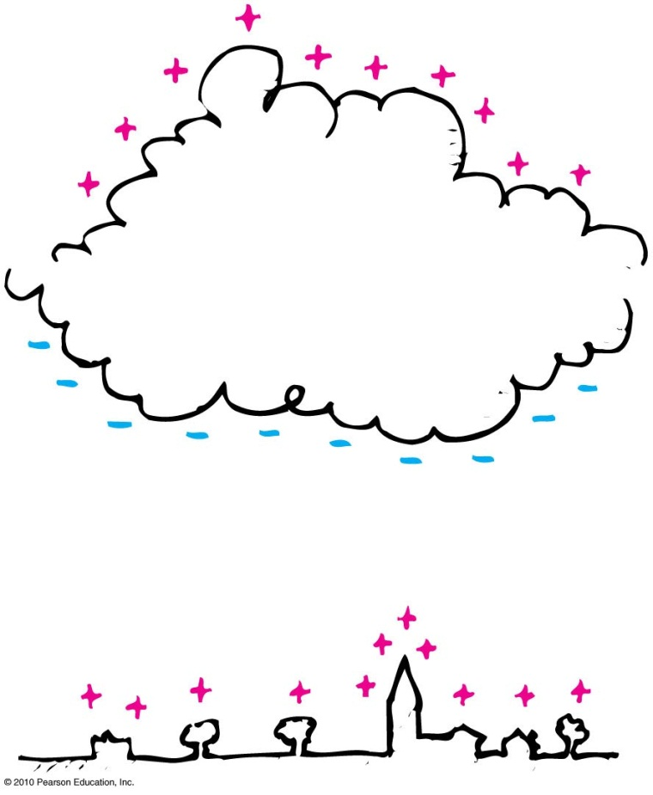
Charging by induction
If you bring a charged object near a conducting surface, electrons are made to move in the surface material, even without physical contact.
Example: The negative charge at the bottom of the cloud induces a positive charge on the buildings below.

Slide 13
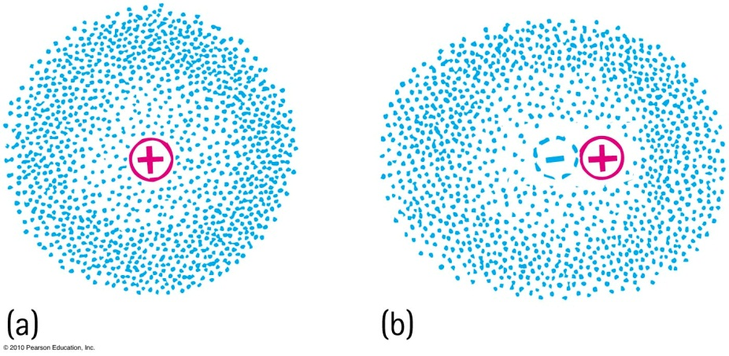
Charge Polarization
One side of the atom or molecule is induced into becoming more negative (or positive) than the opposite side. The atom or molecule is said to be electrically polarized.
An electron buzzing around the atomic nucleus produces an electron cloud.
a. The center of the negative cloud normally coincides with the center of the positive nucleus in an atom.
b. When an external negative charge is brought nearby to the right, the electron cloud is distorted so that the centers of negative and positive charge no longer coincide. The atom is now electrically polarized

Slide 14
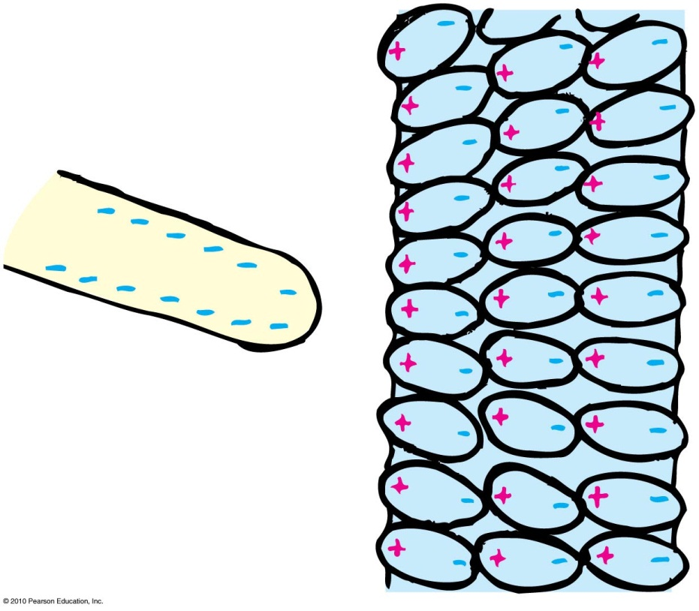
Charge Polarization
If the charged rod is negative, then the positive part of the atom or molecule is tugged in a direction toward the rod, and the negative side of the atom or molecule is pushed in a direction away from the rod.
The positive and negative parts of the atoms and molecules become aligned. They are electrically polarized.

Slide 15
Charge Polarization
When a charged comb is brought nearby, molecules in the paper are polarized.
The sign of charge closest to the comb is opposite to the comb’s charge.
Charges of the same sign are slightly more distant. Closeness wins, and the bits of paper experience a net attraction.

Slide 16
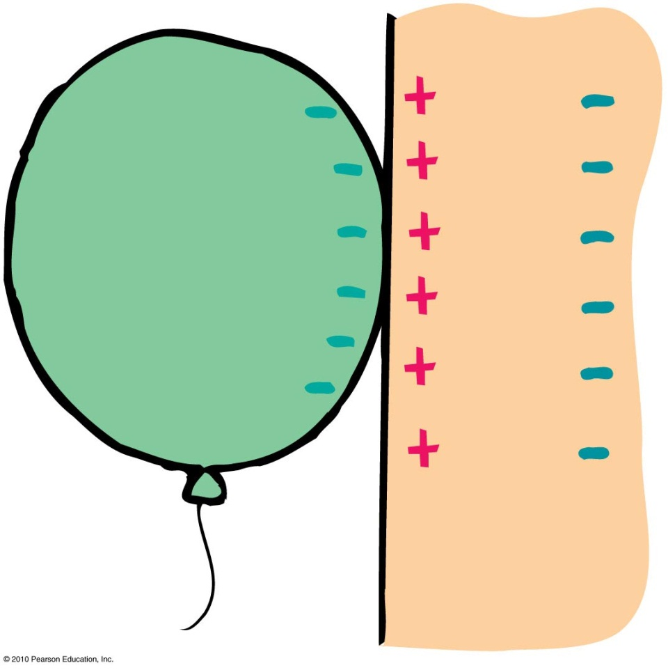
Charge Polarization
Rub an inflated balloon on your hair, and it becomes charged.
Place the balloon against the wall, and it sticks.
This is because the charge on the balloon induces an opposite surface charge on the wall.
Again, closeness wins, for the charge on the balloon is slightly closer to the opposite induced charge than to the charge of same sign

Slide 17
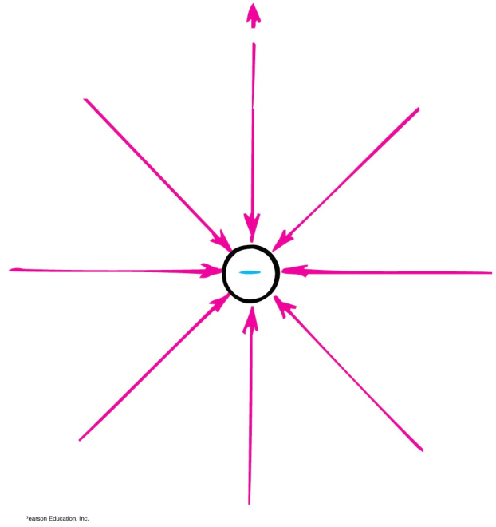
Electric Field
Space surrounding an electric charge (an energetic aura)
Describes electric force
Around a charged particle obeys inverse-square law
Force per unit charge

Slide 18
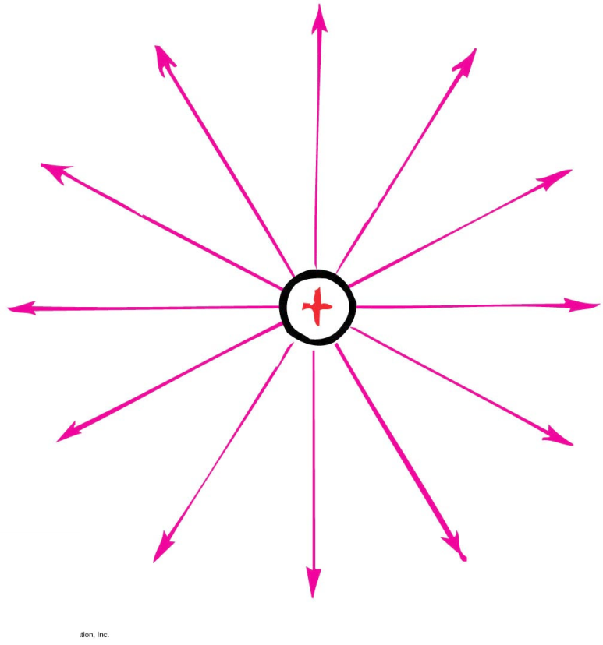
Electric Field
Electric field direction
Same direction as the force on a positive charge
Opposite direction to the force on an electron

Slide 19
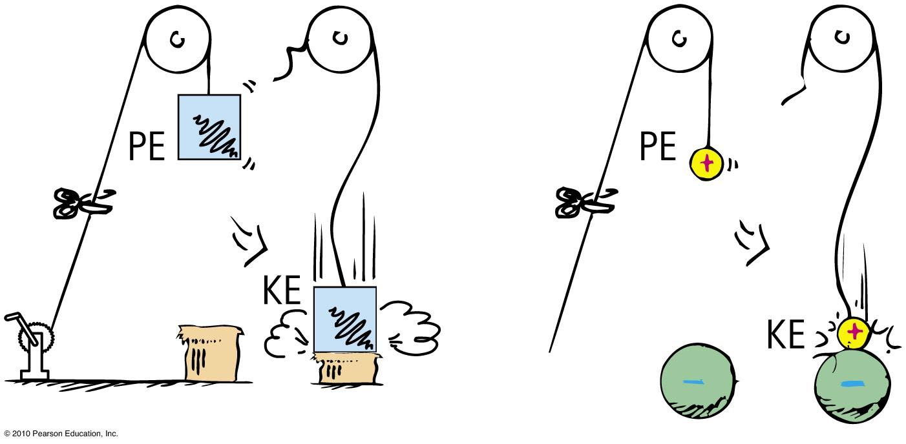
Electric Potential
Electric potential energy
Energy possessed by a charged particle due to its location in an electric field. Work is required to push a charged particle against the electric field of a charged body.

Slide 20
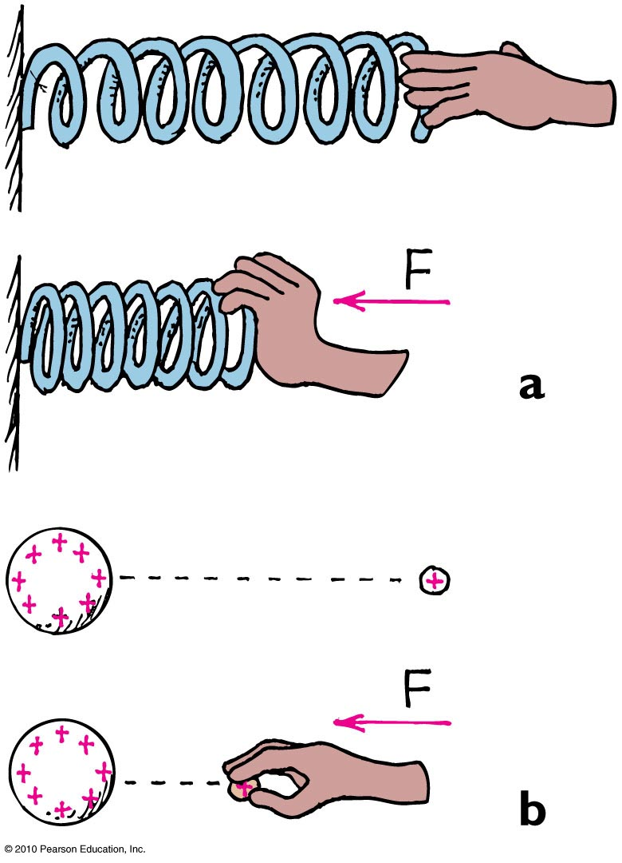
Electric Potential
The spring has more elastic PE when compressed.
The small charge similarly has more PE when pushed closer to the charged sphere. In both cases, the increased PE is the result of work input.

Slide 21
Electric Potential
Electric potential (voltage)
Energy per charge possessed by a charged particle due to its location
May be called voltage—potential energy per charge
In equation form:
electric potential energy
Electric potential =
amount of charge

Slide 22
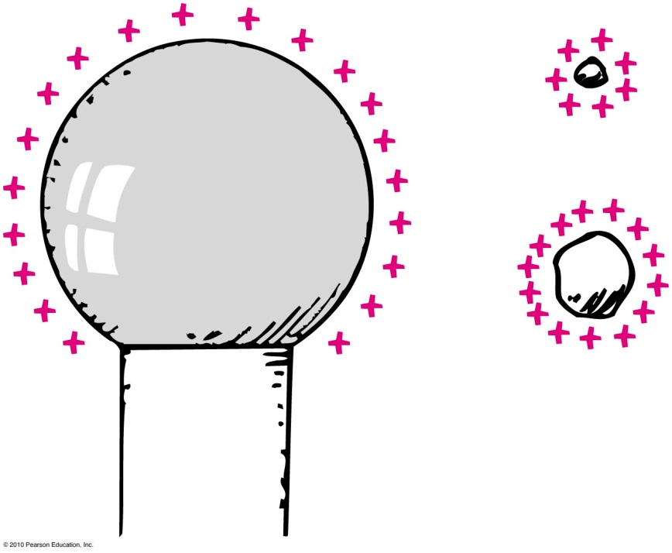
Electric Potential
Electric potential (voltage)
Unit of measurement: volt,
Example:
Twice the charge in same location has twice the electric potential energy but the same electric potential.
1 volt =
1 joule
1 coulomb

Slide 23
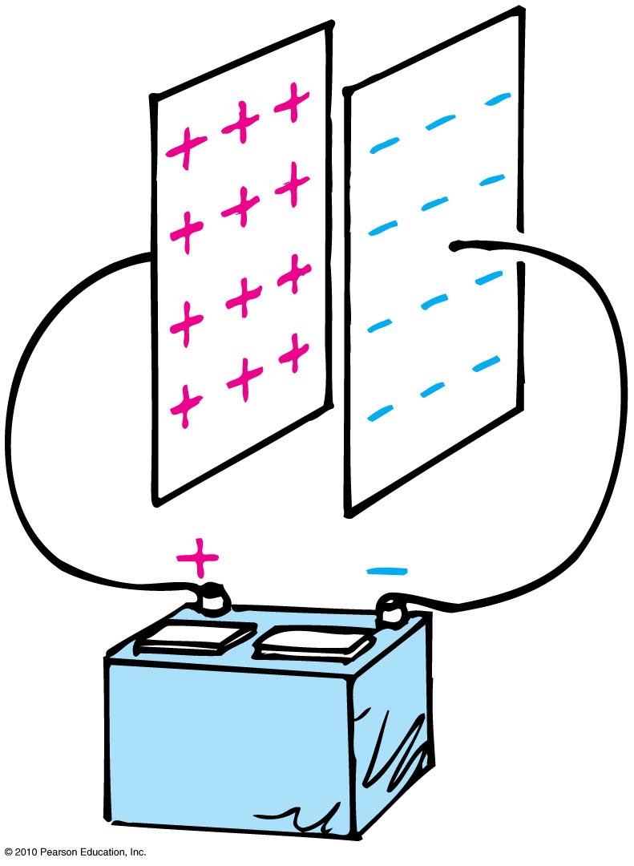
Electric Energy Storage
Electrical energy can be stored in a common device called a capacitor.
The simplest capacitor is a pair of conducting plates separated by a small distance, but not touching each other.
When the plates are connected to a charging device, such as the battery, electrons are transferred from one plate to the other.

Slide 24
Electric Energy Storage
This occurs as the positive battery terminal pulls electrons from the plate connected to it.
These electrons, in effect, are pumped through the battery and through the negative terminal to the opposite plate.

