Slide 1
Note on Posted Slides
These are the slides that I intended to show in class on Wed. Mar. 13, 2013.
They contain important ideas and questions from your reading.
Due to time constraints, I was probably not able to show all the slides during class.
They are all posted here for completeness.

Slide 2
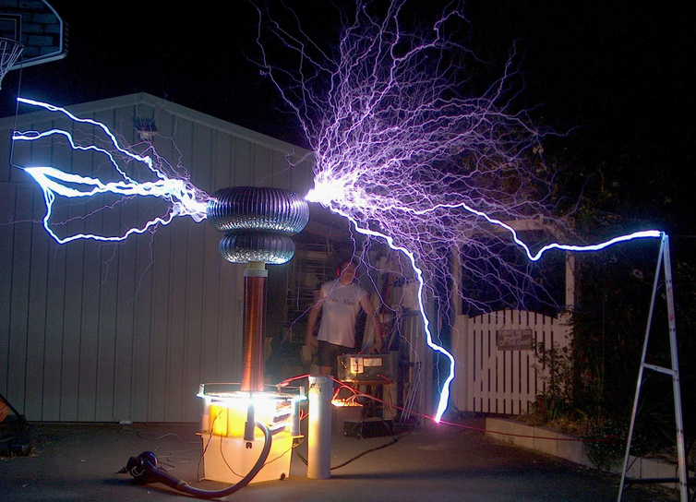
PHY205H1S Physics of Everyday Life Class 16: Electrostatics
Electrical Forces and Charges
Conservation of Charge
Coulomb’s Law
Conductors and Insulators
Charging
Charge Polarization
Electric Field
Electric Potential
Electric Energy Storage

Slide 3
Electricity
Electricity is the name given to a wide range of electrical phenomena, such as
lightning.
spark when we strike a match.
what holds atoms together.
Electrostatics involves electric charges,
the forces between them,
the aura that surrounds them, and
their behavior in materials.

Slide 4
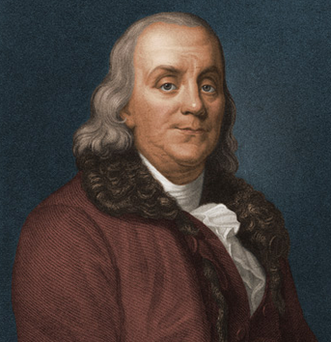
Benjamin Franklin (1706-1790)
Recognized that there were two types of electric charge.
When a glass rod was rubbed with silk, it became charged in one way; Franklin called this “positive”
When a piece of amber was rubbed with animal fur, it became charged in the opposite way; Franklin called this “negative”.

Slide 5
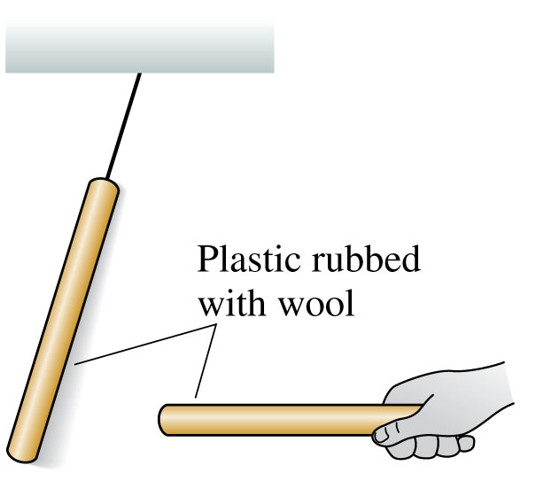
Discovering Electricity: Experiment 2
Rub both plastic (or amber!) rods with wool or fur.
Now the hanging rod tries to move away from the handheld rod when you bring the two close together.
Two glass rods rubbed with silk also repel each other.
There is a long-range repulsive force, requiring no contact, between two identical objects that have been charged in the same way.

Slide 6
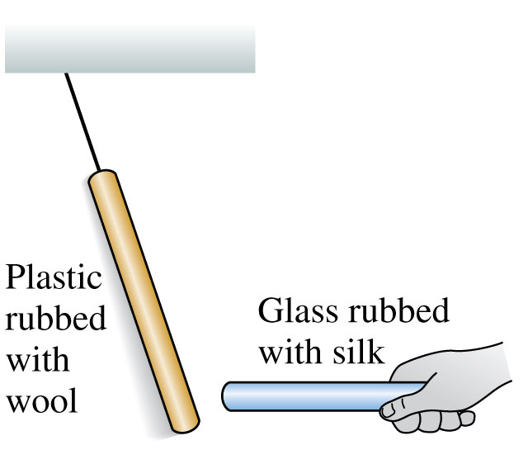
Discovering Electricity: Experiment 3
Bring a glass rod that has been rubbed with silk close to a hanging plastic rod that has been rubbed with wool.
These two rods attract each other.
These particular two types of rods are different materials, charged in a somewhat different way, and they attract each other rather than repel.

Slide 7
Electric Force
When two objects have electric charges, there is a long-range force between them called the electric force.
The rule for the electric force is:
Opposite charges attract one another;
like charges repel.

Slide 8
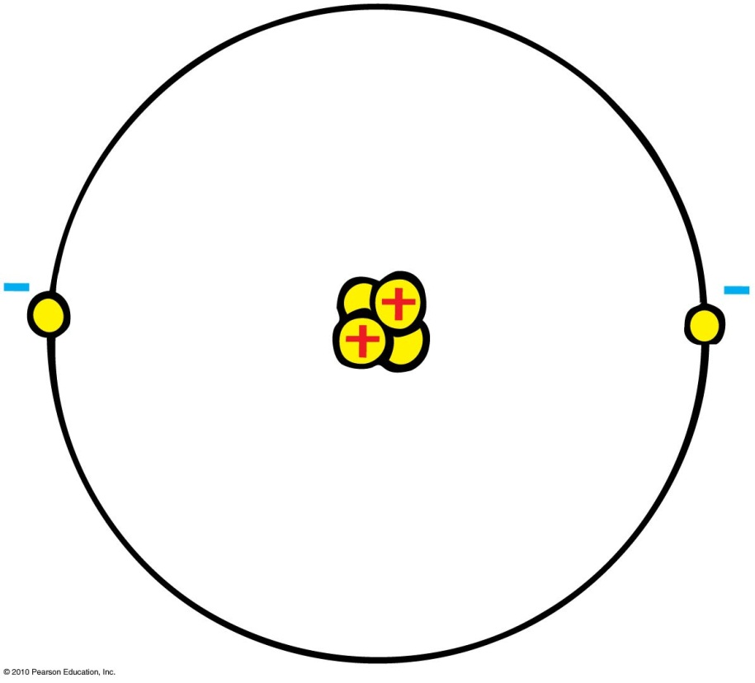
20th Century Discovery: Atomic Structure
Protons
Positive electric charges
Repel positives, but attract negatives
Electrons
Negative electric charges
Repel negatives, but attract positives
Neutrons
No electric charge
“neutral”

Slide 9
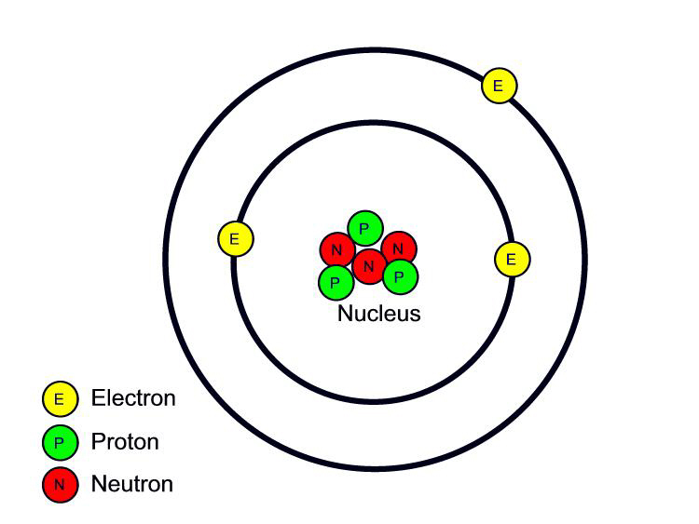
Fundamental facts about atoms
1. Every atom is composed of a positively charged nucleus surrounded by negatively charged electrons.
2. Each of the electrons in any atom has the same quantity of negative charge and the same mass.
Lithium Atom
Net charge = 0
[Image retrieved Jan.10, 2013 from http://www.safetyoffice.uwaterloo.ca/hse/radiation/rad_sealed/matter/atom_structure.htm ]

Slide 10
Fundamental facts about atoms
3. Protons and neutrons compose the nucleus. Protons are about 1800 times more massive than electrons, but each one carries an amount of positive charge equal to the negative charge of electrons. Neutrons have slightly more mass than protons and have no net charge.
Lithium Atom
Net charge = 0
[Image retrieved Jan.10, 2013 from http://www.safetyoffice.uwaterloo.ca/hse/radiation/rad_sealed/matter/atom_structure.htm ]

Slide 11
Fundamental facts about atoms
4. Atoms usually have as many electrons as protons, so the atom has zero net charge.
Lithium Atom
Net charge = 0
[Image retrieved Jan.10, 2013 from http://www.safetyoffice.uwaterloo.ca/hse/radiation/rad_sealed/matter/atom_structure.htm ]

Slide 12
An “Ion” is a charged atom
Positive ion — an atom which has lost one or more of its electrons, and so has a positive net charge.
Negative ion — an atom which has gained one or more electrons, and so has a negative net charge.

Slide 13
When you rub a glass rod with silk, the glass rod becomes positively charged. (As per Benjamin Franklin’s definition of “positive”.) What is going on here?
Electric Force and Charges
CHECK YOUR NEIGHBOR
The silk is adding electrons to the glass.
The silk is adding protons to the glass.
The silk is removing electrons from the glass.
The silk is removing protons to the glass.
The frictional force is generating positive charge within the glass.
Notes:
A. positive.

Slide 14
When you rub a plastic rod with fur or wool, the plastic rod becomes negatively charged. (As per Benjamin Franklin’s definition of “negative”.) What is going on here?
Electric Force and Charges
CHECK YOUR NEIGHBOR
The fur or wool is adding electrons to the plastic.
The fur or wool is adding protons to the plastic.
The fur or wool is removing electrons from the plastic.
The fur or wool is removing protons to the plastic.
The frictional force is generating positive charge within the plastic.
Notes:
A. positive.

Slide 15
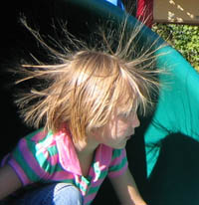
Electrons in an atom
Innermost—attracted very strongly to oppositely charged atomic nucleus
Outermost—attracted loosely and can be easily dislodged
Examples:
When rubbing a comb through your hair, electrons transfer from your hair to the comb. Your hair has a deficiency of electrons (positively charged).
When rubbing a glass rod with silk, electrons transfer from the rod onto the silk and the rod becomes positively charged.
[image from http://www.sciencebuddies.org/blog/2011/02/the-shock-of-static-electricity.php ]

Slide 16
Conservation of Charge
Conservation of charge
In any charging process, no electrons are created or destroyed. Electrons are simply transferred from one material to another.

Slide 17
When you rub a glass rod with silk, the glass rod becomes positively charged. What do you expect will happen to the piece of silk?
Electric Force and Charges
CHECK YOUR NEIGHBOR
The silk will also become positively charged.
The silk will become negatively charged.
The silk will remain neutral.
Notes:
A. positive.

Slide 18
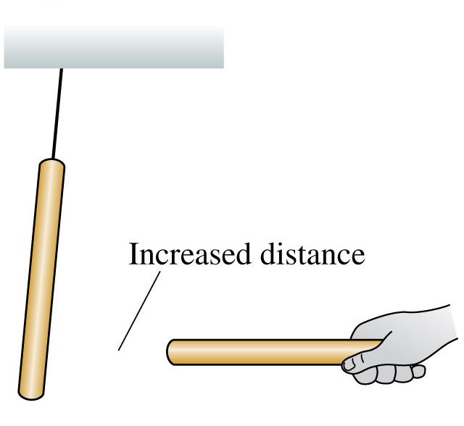
Discovering Electricity: Experiment 4
Rub rods with wool or silk and observe the forces between them.
These forces are greater for rods that have been rubbed more vigorously.
The strength of the forces decreases as the separation between the rods increases.
The force between two charged objects depends on the distance between them.

Slide 19
Coulomb’s Law
$$q_{1}$$
$$d$$
$$q_{2}$$
The magnitude of the force, F, between two point charges depends on the product of their charges, and the distance between them.
In equation form:
k = 9×10⁹ Nm²/C²
Unit of charge is coulomb, C
Similar to Newton’s law of gravitation for masses
Underlies the bonding forces between molecules
Electrical forces may be either attractive or repulsive.
Gravitational forces are only attractive.
$$F=k\frac{q_{1}q_{2}}{d^{2}}$$

Slide 20
According to Coulomb’s law, a pair of particles that are placed twice as far apart will experience forces that are
Coulomb’s Law
CHECK YOUR NEIGHBOR
A. half as strong.
one-quarter as strong.
twice as strong.
4 times as strong.
Notes:
B. one quarter as strong.

Slide 21
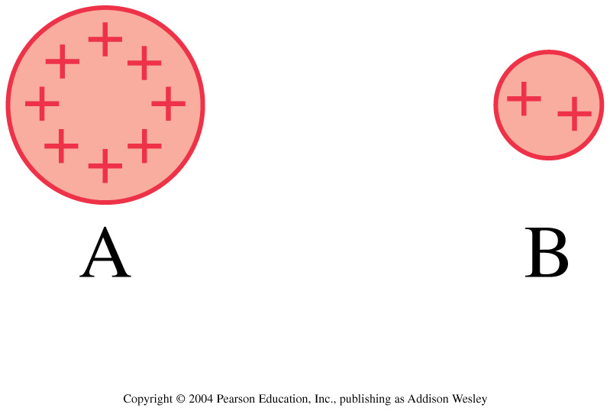
Discussion question.
Charges A and B exert repulsive forces on each other. q_{A} = 4q_{B}. Which statement is true?
F_{A on B} > F_{B on A}
F_{A on B} < F_{B on A}
F_{A on B} = F_{B on A}
Notes:
STT25.4

Slide 22
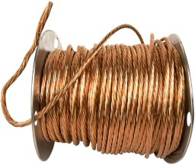
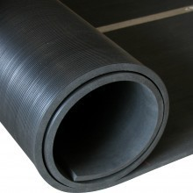
Conductors and Insulators
Conductors: Materials in which one or more of the electrons in the outer shell of its atoms are not anchored to the nuclei of particular atoms but are free to wander in the material
Example: Metals such as copper and aluminum
Insulators: Materials in which electrons are tightly bound and belong to particular atoms and are not free to wander about among other atoms in the material, making them flow
Example: Rubber, glass

Slide 23
Superconductors
Superconductors: Materials acquire zero resistance (infinite conductivity) to the flow of charge.
Once electric current is established in a superconductor, the electrons flow indefinitely.
With no electrical resistance, current passes through a superconductor without losing energy.
No heat loss occurs when charges flow.

Slide 24
When you buy a water pipe in a hardware store, the water isn’t included. When you buy copper wire, electrons
Conductors and Insulators
CHECK YOUR NEIGHBOR
A. must be supplied by you, just as water must be supplied for a water pipe.
are already in the wire.
may fall out, which is why wires are insulated.
None of the above.
Notes:
B. are already in the wire.

Slide 25
Test 2 is marked
Versions 1 and 2, written at 2pm, contain completely different questions than versions 3 and 4, written at 5pm.
180 students wrote the 2pm test and their raw average was 23.9 / 36.
164 students wrote the 5pm test, and their raw average was 25.4 / 36.
I believe the reason for the different averages was that the 2pm test was a bit more difficult
Therefore, I adjusted the marks of every student who wrote version 1 or 2 by +1.5.
There was no adjustment for versions 3 or 4.
The adjusted average is 25.4 / 36 = 71%

Slide 26
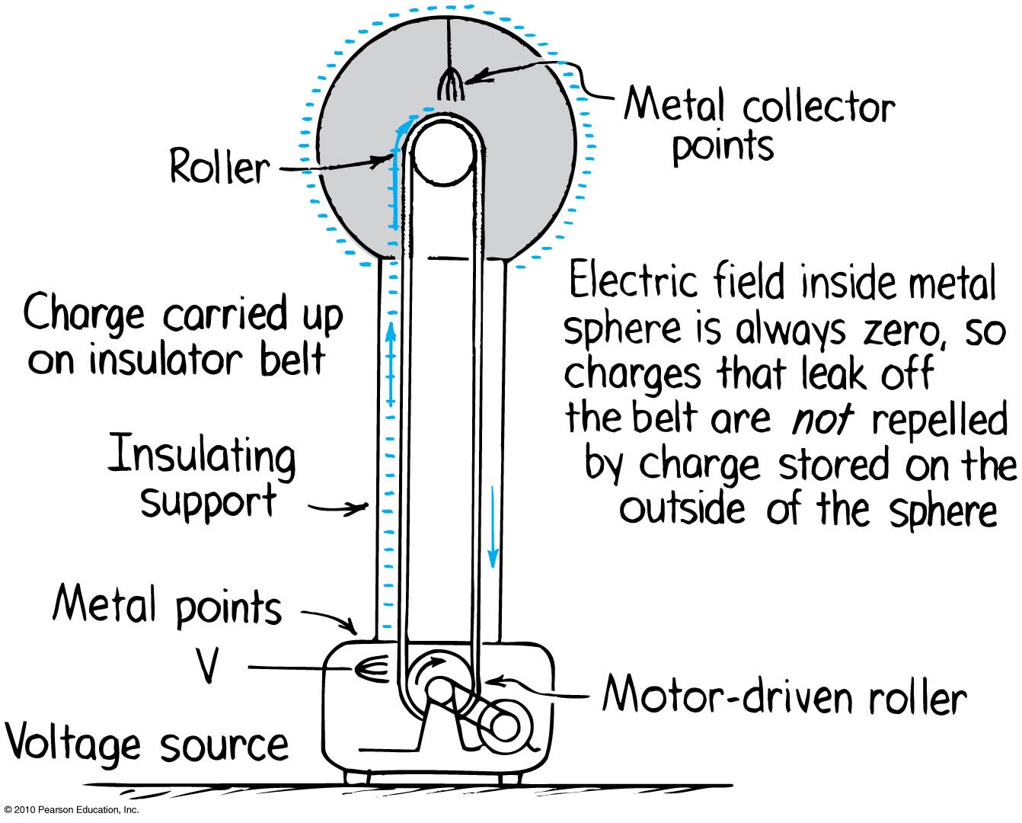
Electric Energy Storage
A common laboratory device for producing high voltages and creating static electricity is the Van de Graaff generator.

Slide 27
Charging
Charging by friction and contact.
Example:
Stroking cats fur, combing your hair, rubbing your shoes on a carpet
Electrons transfer from one material to another by simply touching. For example,
when a negatively charged rod is placed in contact with a neutral object, some electrons will move to the neutral object.

Slide 28
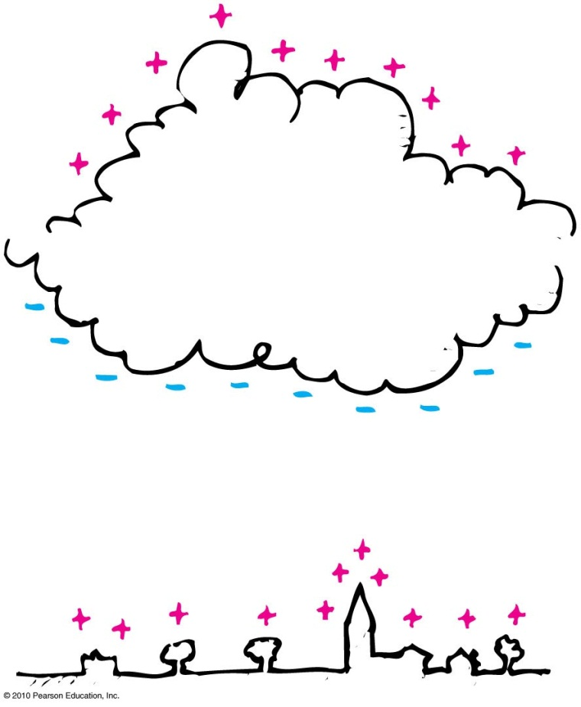
Charging by induction
If you bring a charged object near a conducting surface, electrons are made to move in the surface material, even without physical contact.
Example: The negative charge at the bottom of the cloud induces a positive charge on the buildings below.

Slide 29
Charging by Induction
Induction: Consider two insulated metal spheres A and B.
They touch each other, so in effect they form a single uncharged conductor.
When a negatively charged rod is brought near A, electrons in the metal, being free to move, are repelled as far as possible until their mutual repulsion is big enough to balance the influence of the rod. The charge is redistributed.
If A and B are separated while the rod is still present, each will be equal and oppositely charged.

Slide 30
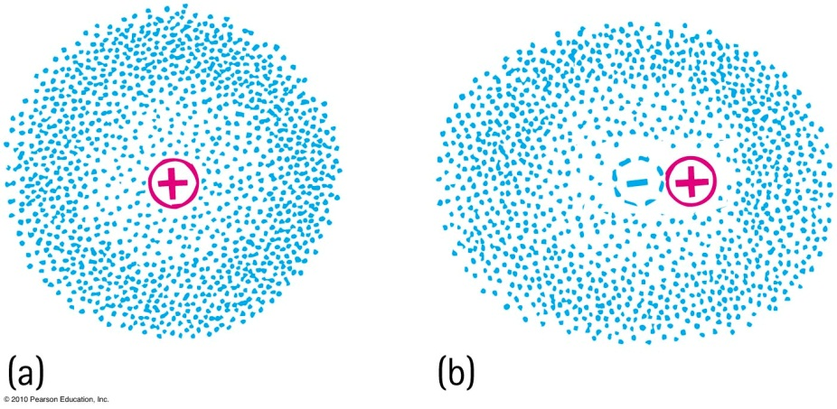
Charge Polarization
One side of the atom or molecule is induced into becoming more negative (or positive) than the opposite side. The atom or molecule is said to be electrically polarized.
An electron buzzing around the atomic nucleus produces an electron cloud.
a. The center of the negative cloud normally coincides with the center of the positive nucleus in an atom.
b. When an external negative charge is brought nearby to the right, the electron cloud is distorted so that the centers of negative and positive charge no longer coincide. The atom is now electrically polarized

Slide 31
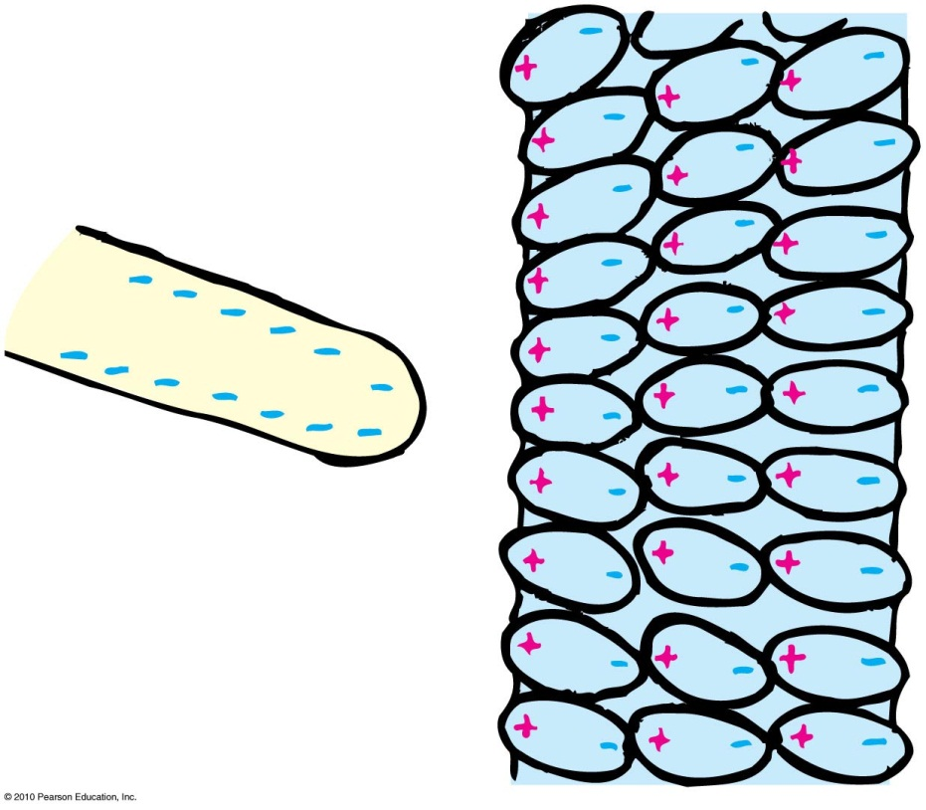
Charge Polarization
If the charged rod is negative, then the positive part of the atom or molecule is tugged in a direction toward the rod, and the negative side of the atom or molecule is pushed in a direction away from the rod.
The positive and negative parts of the atoms and molecules become aligned. They are electrically polarized.

Slide 32
Charge Polarization
When a charged comb is brought nearby, molecules in the paper are polarized.
The sign of charge closest to the comb is opposite to the comb’s charge.
Charges of the same sign are slightly more distant. Closeness wins, and the bits of paper experience a net attraction.

Slide 33
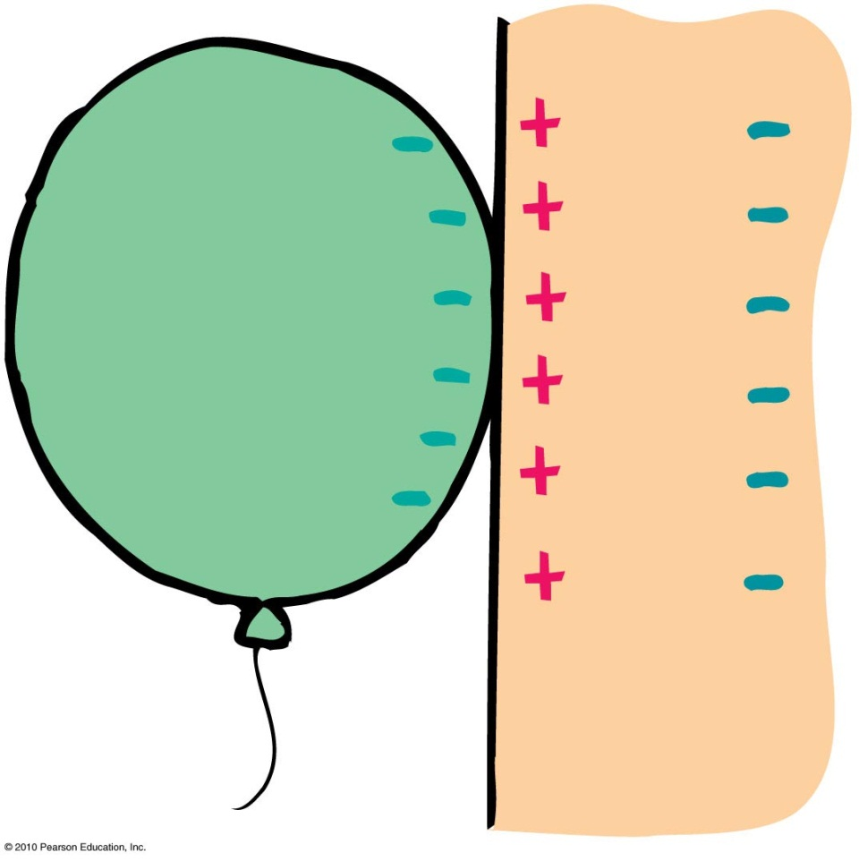
Charge Polarization
Rub an inflated balloon on your hair, and it becomes charged.
Place the balloon against the wall, and it sticks.
This is because the charge on the balloon induces an opposite surface charge on the wall.
Again, closeness wins, for the charge on the balloon is slightly closer to the opposite induced charge than to the charge of same sign

Slide 34
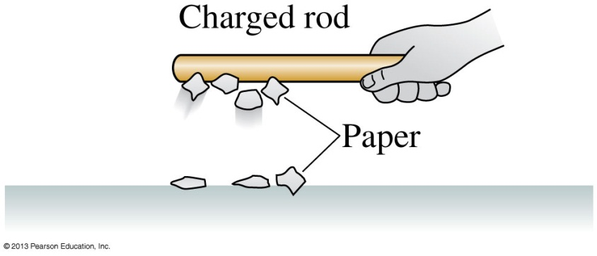
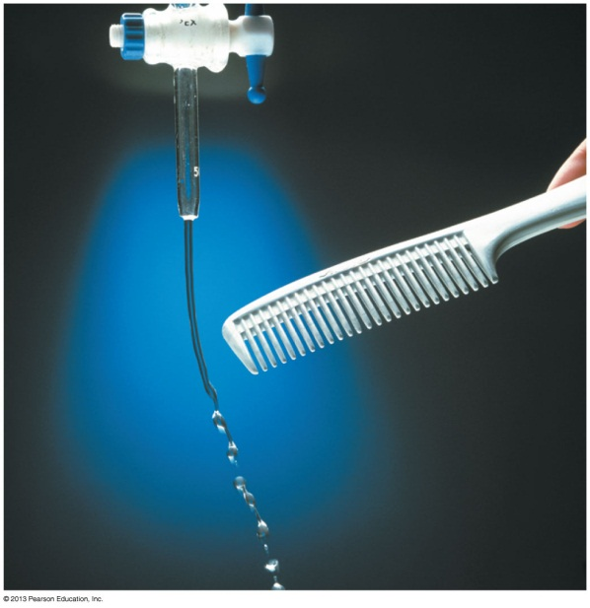
Discovering Electricity: Experiment 5
Hold a charged (i.e., rubbed) plastic rod over small pieces of paper on the table.
The pieces of paper leap up and stick to the rod.
A charged glass rod does the same.
However, a neutral rod has no effect on the pieces of paper.
There is an attractive force between a charged object and a neutral (uncharged) object.
Slide 25-23

Slide 35
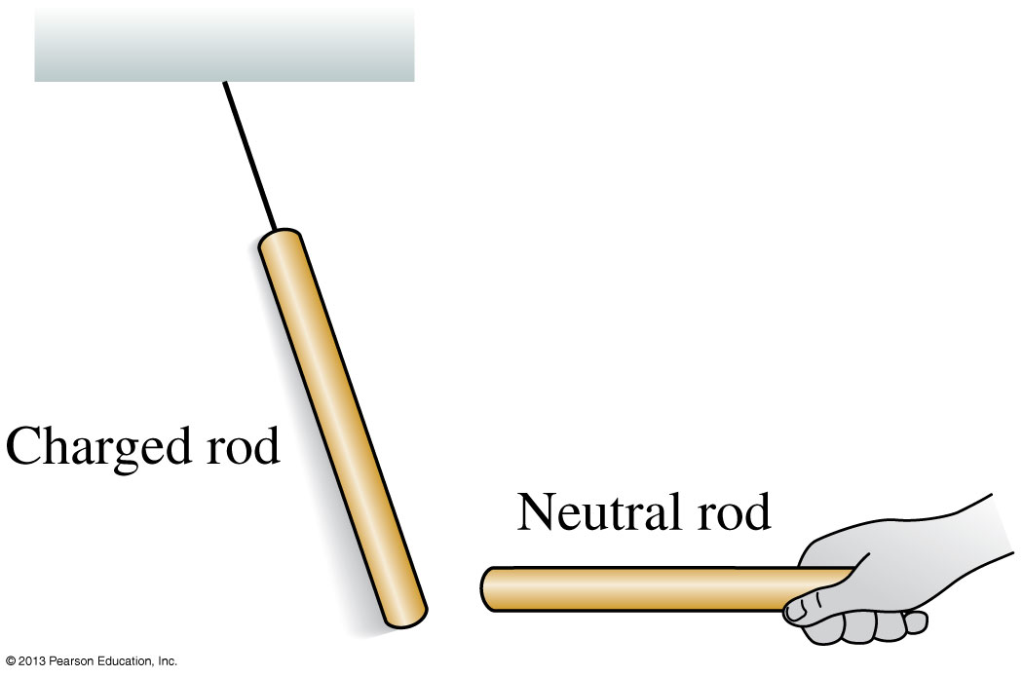
Discovering Electricity: Experiment 6
Rub a plastic rod with wool and a glass rod with silk.
Hang both by threads, some distance apart.
Both rods are attracted to a neutral object that is held close.
There is an attractive force between a charged object and a neutral (uncharged) object.
Slide 25-24

Slide 36
Discussion Question
A sock has just come out of the dryer. You hypothesize that the sock might have a positive charge. To test your hypothesis, which of the following experiments might work?
see if the sock attracts a negatively charged plastic rod.
see if the sock repels a positively charged glass rod.
Both A and B.
Either A or B.
Notes:
STT25.1
Answer: B

Slide 37
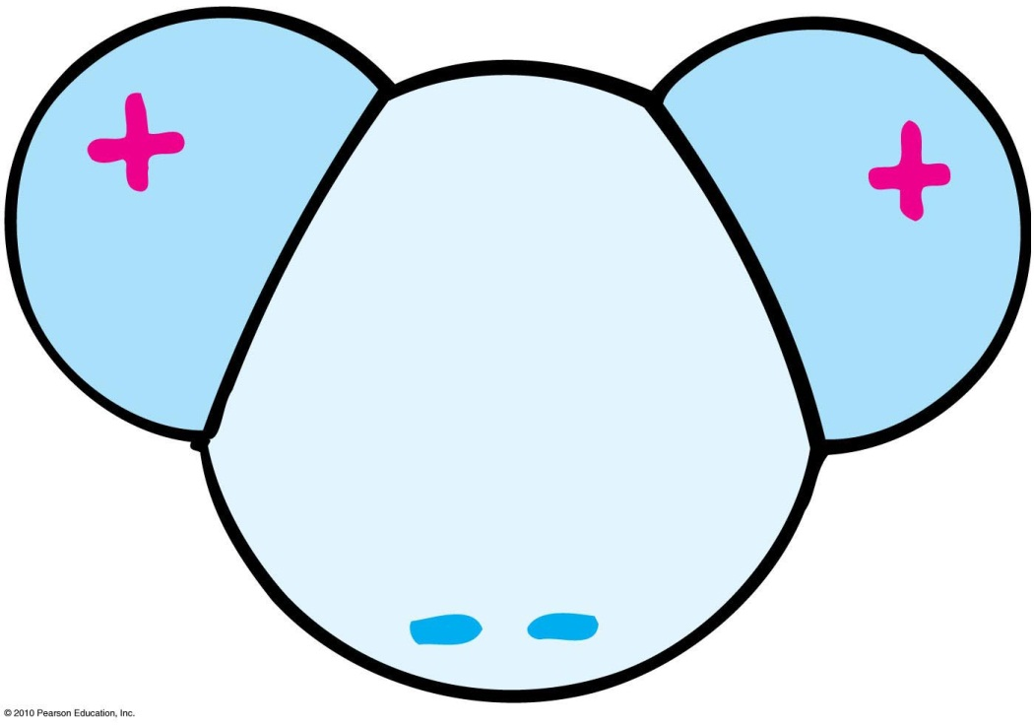
Charge Polarization
Many molecules—H₂O, for example—are electrically polarized in their normal states.
The distribution of electric charge is not perfectly even.
There is a little more negative charge on one side of the molecule than the other.
Such molecules are said to be electric dipoles.

Slide 38
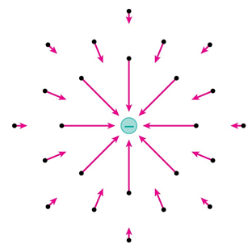
Electric Field
Space surrounding an electric charge (an energetic aura)
Describes electric force
Around a charged particle obeys inverse-square law
Force per unit charge

Slide 39
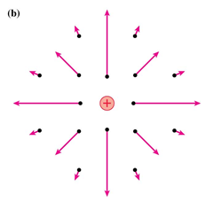
Electric Field
Electric field direction
Same direction as the force on a positive charge
Opposite direction to the force on an electron

Slide 40
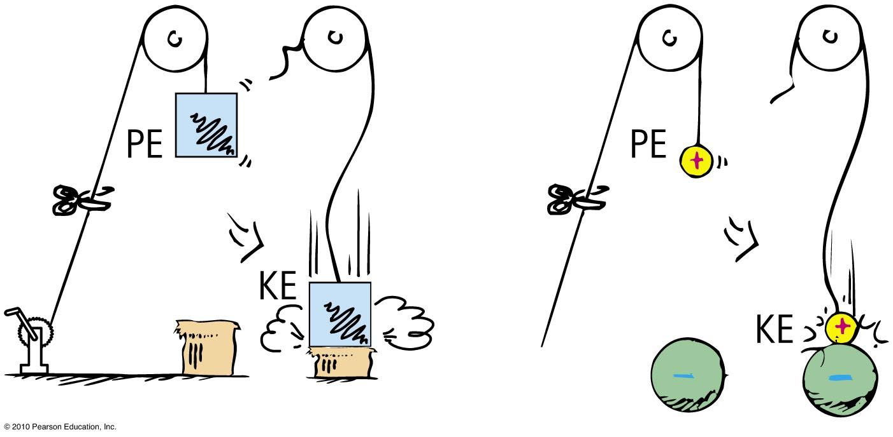
Electric Potential
Electric potential energy
Energy possessed by a charged particle due to its location in an electric field. Work is required to push a charged particle against the electric field of a charged body.

Slide 41
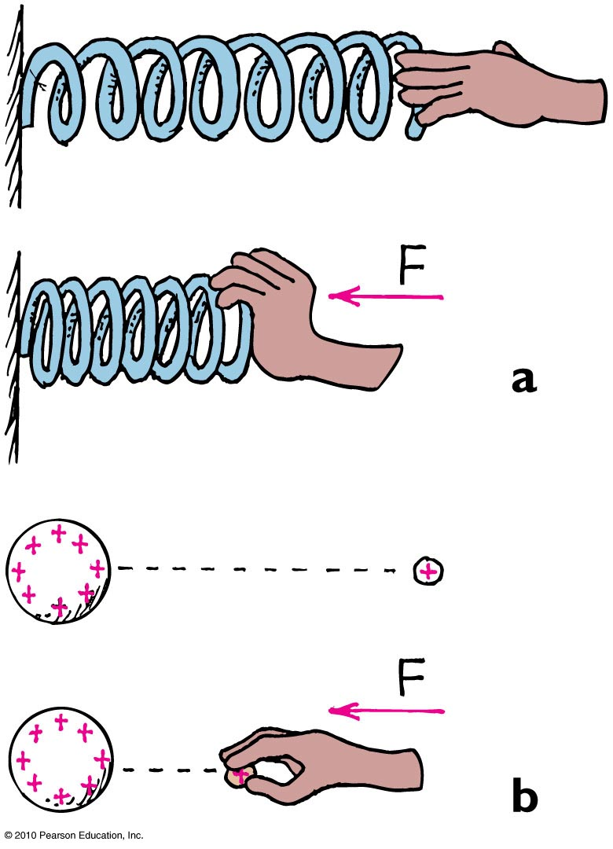
Electric Potential Energy
The spring has more elastic PE when compressed.
The small charge similarly has more PE when pushed closer to the charged sphere. In both cases, the increased PE is the result of work input.

Slide 42
Electric Potential
Electric potential (voltage)
Energy per charge possessed by a charged particle due to its location
May be called voltage—potential energy per charge
In equation form:
electric potential energy
Electric potential =
amount of charge

Slide 43
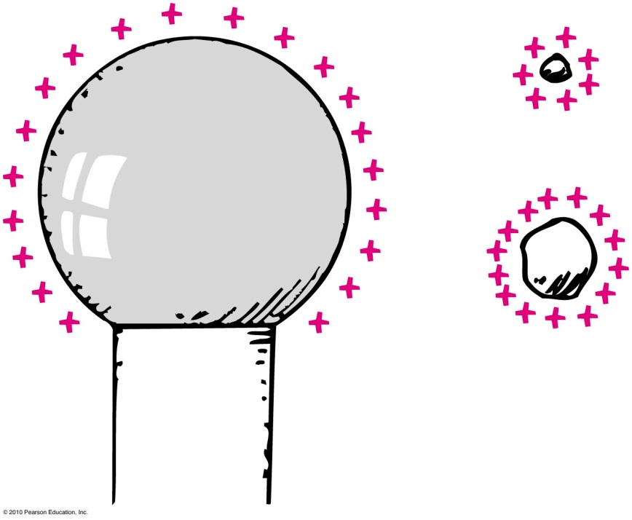
Electric Potential
Electric potential (voltage)
Unit of measurement: volt,
Example:
Twice the charge in same location has twice the electric potential energy but the same electric potential.
1 volt =
1 joule
1 coulomb

Slide 44
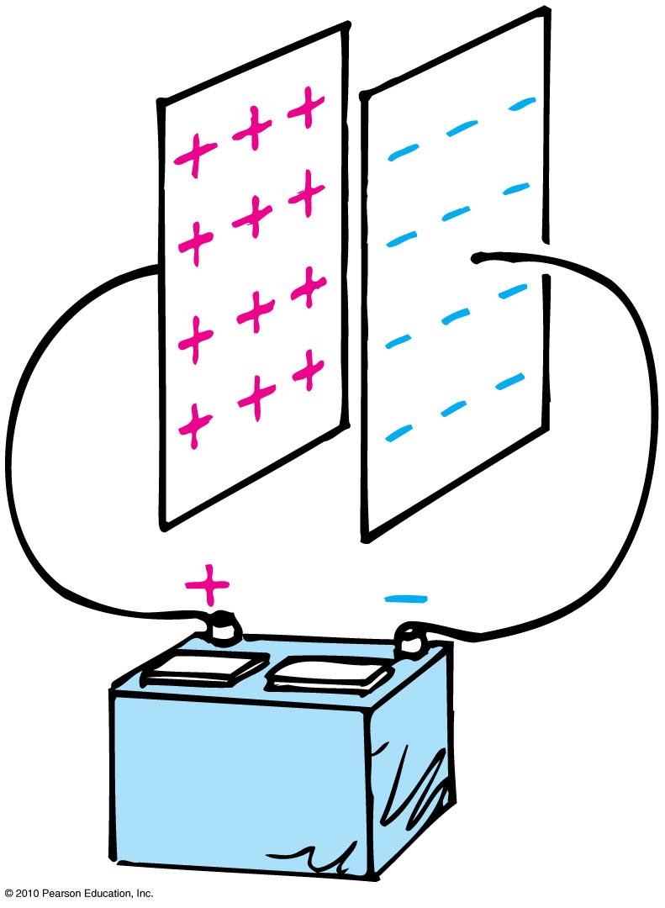
Electric Energy Storage
Electrical energy can be stored in a common device called a capacitor.
The simplest capacitor is a pair of conducting plates separated by a small distance, but not touching each other.
When the plates are connected to a charging device, such as the battery, electrons are transferred from one plate to the other.

Slide 45
Electric Energy Storage
This occurs as the positive battery terminal pulls electrons from the plate connected to it.
These electrons, in effect, are pumped through the battery and through the negative terminal to the opposite plate.

Slide 46
Electric Energy Storage
The charging process is complete when the potential difference between the plates equals the potential difference between the battery terminals—the battery voltage.
The greater the battery voltage, and the larger and closer the plates, the greater the charge that can be stored.
The energy stored in a capacitor comes from the work required to charge it.
Once charged, an electric field exists inside the capacitor, pointing from the + to the - plate.

Slide 47
The electric potential inside a capacitor
is constant.
increases from the negative to the positive plate.
decreases from the negative to the positive plate.
Notes:
Answer: D

Slide 48
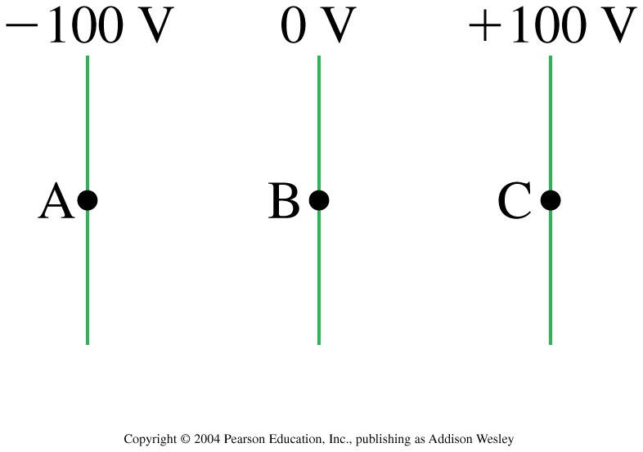
A proton is released from rest at point B, where the potential is 0 V. Afterward, the proton
moves toward A with a steady speed.
moves toward A with an increasing speed.
moves toward C with a steady speed.
moves toward C with an increasing speed.
remains at rest at B.
Notes:
STT29.3
Answer: B

Slide 49
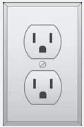
Before class on Monday
Please read Chapter 23, or at least watch the 12-minute pre-class video for class 17.
In tutorial you will receive the last problem set of the semester: Problem Set 5.
Something to think about:
When you “blow a fuse” in your house and the lights go off, what has happened, and why?

