Slide 1
Conceptual Physics 11th Edition
Chapter 23:
ELECTRIC CURRENT
Flow of Charge
Electric Current
Voltage Sources
Electrical Resistance
Ohm’s Law
DC and AC
Speed and Source of Electrons in a Circuit
Electric Power
Electric Circuits

Slide 2
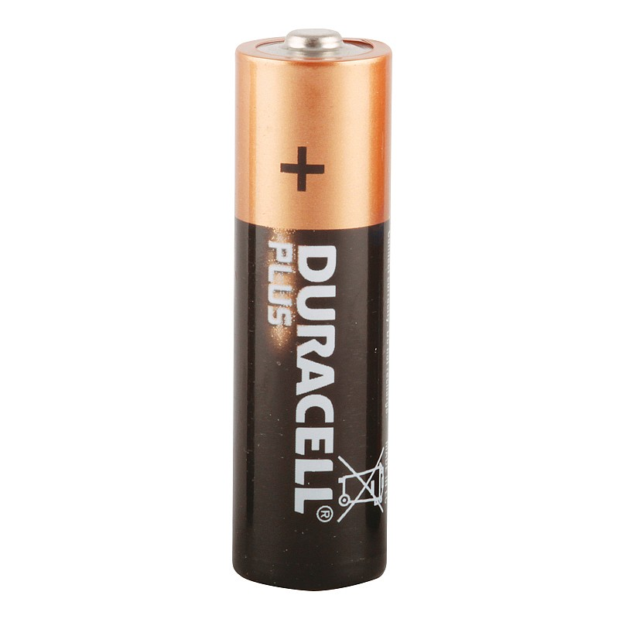
Flow of Charge
When the ends of an electrical conductor are at different electric potentials, charge flows from one end to the other.
Electrical Conductor
Motion of charge
High Electric Potential
Low Electric Potential

Slide 3
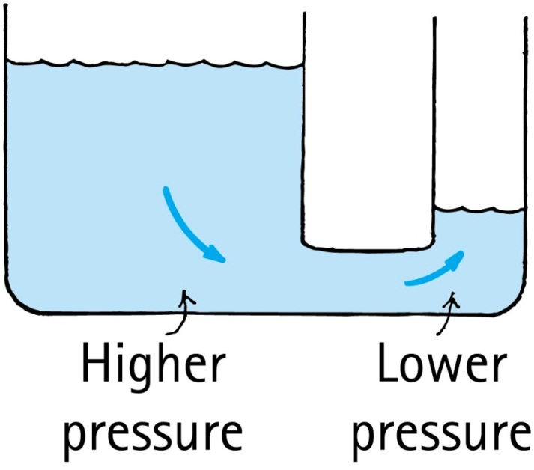
Electricity/Water Analogy:
Electric charge flows from higher potential to lower potential, if it can.
Water flows from higher pressure to lower pressure, if it can.
Higher Potential
Lower Potential

Slide 4
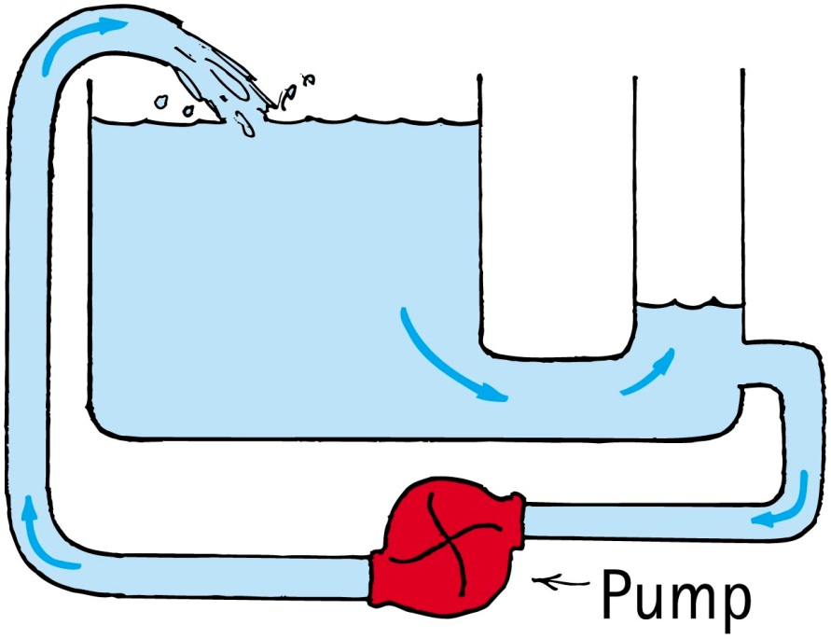
Continuing the Analogy…
To maintain a continuing flow of charge in a conductor, a battery must be provided to maintain the potential difference (=voltage).
To maintain a continuing flow of water in a pipe, a pump must be provided to maintain the pressure difference
Battery

Slide 5
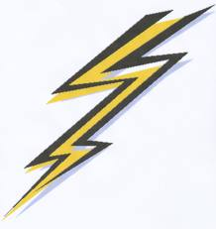
Electric Current
When charged particles move, transferring electric charge from one place to another, this is called electric current
A “conductor” is a material having free charged particles that easily flow through it when an electric force acts on them
In a conducting solid metal, negatively charged electrons are free to move around while the positive nuclei remain fixed in the atomic lattice
In certain types of solid semiconductors, positively charged electron holes are free to move around
In ionic liquids, positive or negative ions can carry electric charge from one place to another

Slide 6
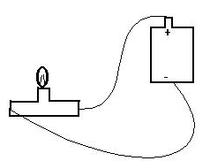
Electric Current is a Number
Electric current is the rate that charge moves from one point to another
The common symbol for current is I
The unit of current is Coulombs per second (C/s)
1 C/s = 1 Ampere = 1 Amp = 1 A
$$I=\frac{Δq}{Δt}$$
[image from http://people.oregonstate.edu/~joneski/electric.htm ]

Slide 7
Voltage is a Number
Electric potential difference is called “voltage”
Voltage between two points causes electric current in a conductor flow from higher potential to lower potential.
No current flows when the voltage is zero
The unit of voltage is Volts
1 Volt = 1 V = 1 Joule per Coulomb
We say that when voltage is set up across a conducting object, it can cause a current to flow through the conducting object.
[image from http://people.oregonstate.edu/~joneski/electric.htm ]

Slide 8
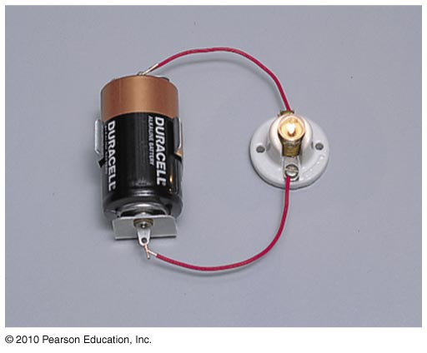
How Does a Battery Work?
Energy is stored in a battery in chemical bonds
When current flows through a battery, work is done by chemical disintegration of zinc or lead in acid
This energy is carried by the electric charges as they travel through the circuit, and can be used to power a light-bulb, for example

Slide 9
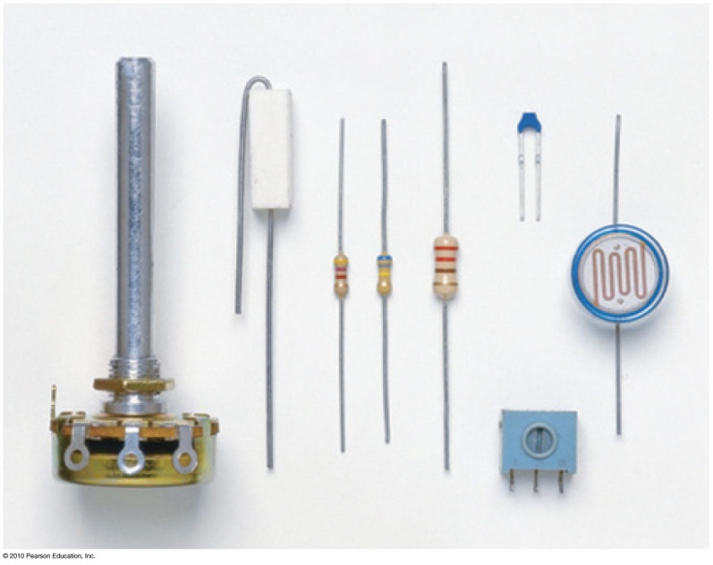
Electric Resistance
Current in a circuit depends on:
voltage.
electrical resistance.
Resistors are circuit elements that use up energy; usually they create heat
In a circuit diagram, the symbol for a resistor is:

Slide 10
Resistance is a Number
When you apply a voltage across an object, the amount of current depends on the object’s resistance.
Resistance of an object is measured in Ohms
1 Ohm = 1 Ω = 1 Volt per Amp
The higher the resistance of an object, the less current will flow through it for a given voltage.
[image from http://people.oregonstate.edu/~joneski/electric.htm ]

Slide 11
Electric Resistance
Factors affecting electrical resistance of an object:
Material
Rubber is much more resistive than copper
Cross-sectional area
Thin wires have more resistance than thick wires
Length
An object twice as long has twice as much resistance.

Slide 12
Ohm’s Law
The current in a circuit varies in direct proportion to the potential difference, or voltage, and inversely with the resistance
voltage
Current =
resistance
$$I=\frac{V}{R}$$
Examples:
For a constant resistance, current will be twice as much for twice the voltage.
For twice the resistance and twice the voltage, current will be unchanged.

Slide 13
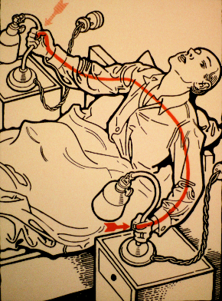
You are a resistor!!
The human body has a resistance, which depends on the exact path through your body, and whether your hands are wet or dry.
If your hands are moist, the resistance between them can be as low as 500 Ω
So if there is a voltage of 120 V between your hands, this will set up a current of 0.24 A, straight through your heart!
Electrical current traveling through your body can damage tissue, and interfere with the beating of your heart (which is electrical)
Also it really really hurts!
[image from http://www.retronaut.com/2012/10/30-ways-to-die-by-electrocution ]

Slide 14
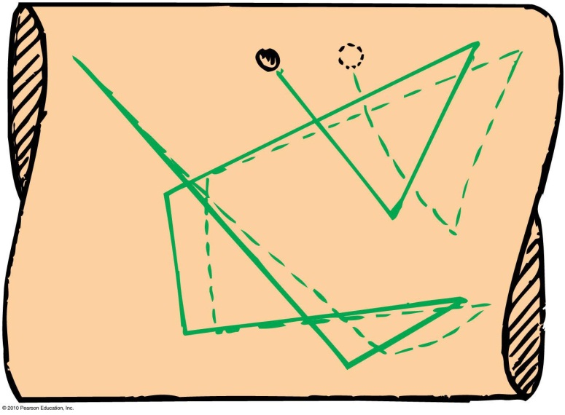
Direction of Electron Velocity in a Metal Wire
When we flip the light switch on a wall and the circuit, an electric field is established inside the conductor.
The electrons continue their random motions while simultaneously being nudged by the electric field.
The current, as we have defined it, travels in the direction of the electric field: + toward -
The actual charge carriers in a metal wire are negative electrons, so their drift velocity is in the opposite direction of the current.
+
-
Electric Field direction

Slide 15
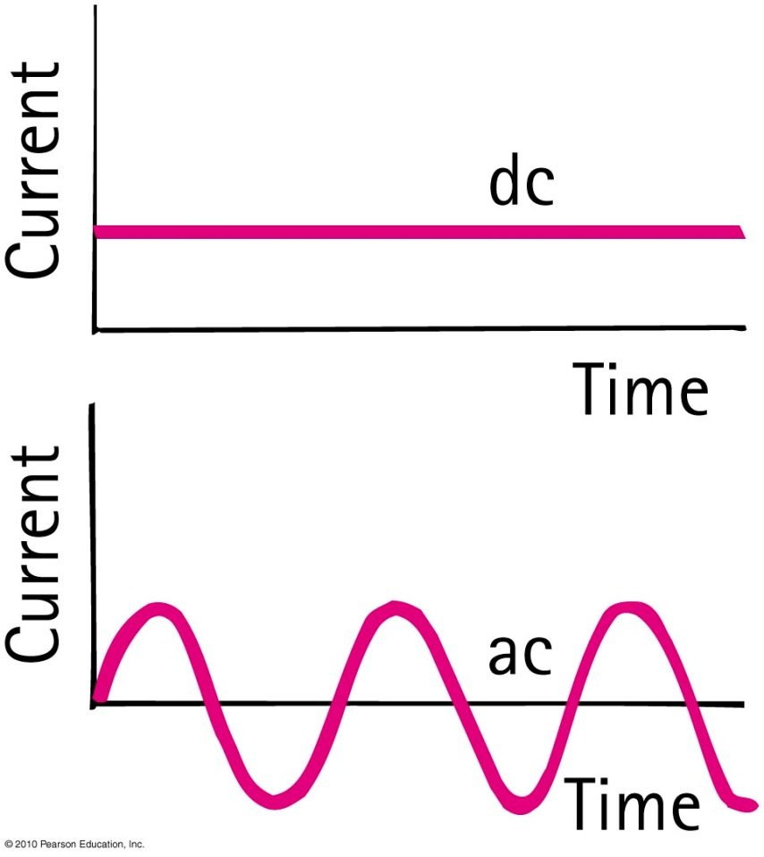
Direct and Alternating Current
Direct current (dc)
Flows in one direction only.
Current always flows from the positive terminal toward the negative terminal.
Alternating Current (ac)
Current in the circuit flows first in one direction and then in the opposite direction, alternating to and fro many times per second.
This is accomplished by alternating the polarity of voltage at the generator or other voltage source.

Slide 16
Direct and Alternating Current
Commercial electricity in North America is alternating current (ac):
60 cycles per second
Voltage is 120 V
Power transmission is more efficient at higher voltages.
Europe adopted 220 V as its standard.
Canada and the U.S. continued with 120 V because so much equipment was already installed.

Slide 17
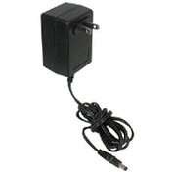
Direct and Alternating Current
Converting from ac to dc
Household current is ac, but current in laptop or cell phone is dc.
The AC to DC converter uses a diode, a tiny electronic device that acts as a one-way valve to allow electron flow in one direction only.
AC in
DC out

Slide 18
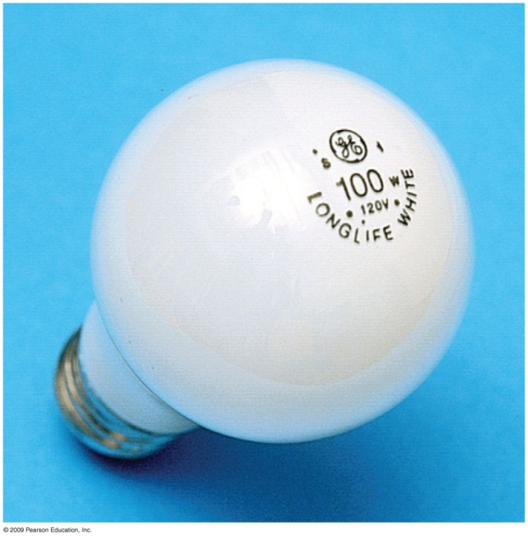
Electric Power
Power is the rate at which electric energy is used up in a circuit.
Power = current × voltage
Units:
$$P=IV$$
$$Amps×Volts=\left(\frac{Coulombs}{second}\right)×\left(\frac{Joules}{Coulomb}\right)=\left(\frac{Joules}{second}\right)=Watts$$
Example:
How much current is drawn by a 100 Watt light bulb?
$$I=\frac{P}{V}=\frac{100 W}{120 V}=0.8 A$$

Slide 19
Electric Circuits
Connected in two common ways:
Series
forms a single pathway for electron flow between the terminals of the battery, generator, or wall outlet
Parallel
forms branches, each of which is a separate path for the flow of electrons

Slide 20
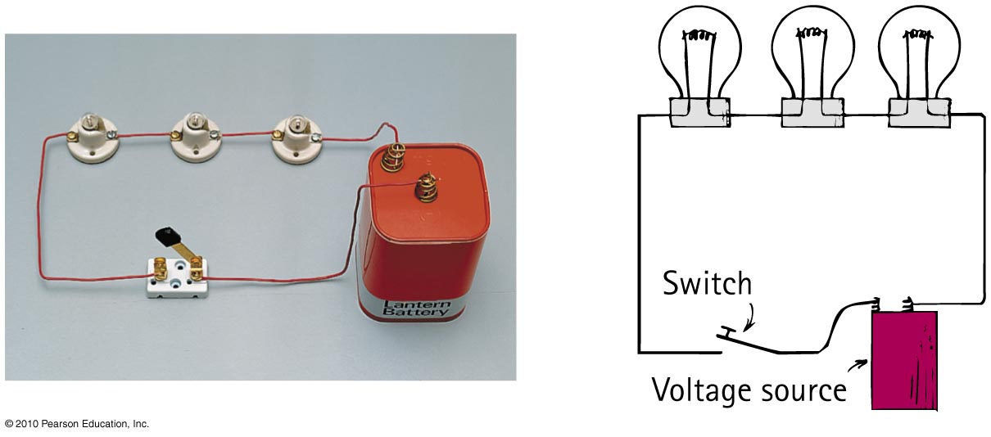
Series Circuits
Characteristics of series circuits
1. Electric current through a single pathway.
2. Total resistance to current is the sum of individual resistances.
3. If one device fails, current in the entire circuit ceases.

Slide 21
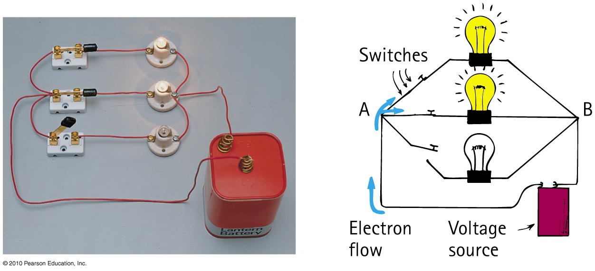
Parallel Circuits
Characteristics of parallel circuit
1. Voltage is the same across each device.
2. As the number of parallel branches is increased, the overall resistance of the circuit is decreased.
3. A break in one path does not interrupt the flow of charge in the other paths.

Slide 22
Parallel Circuits
The more parallel resistors are added, the lower the total resistance of the circuit, since there are more paths for the current to go through
If one path breaks, the current continues through the remaining paths

Slide 23
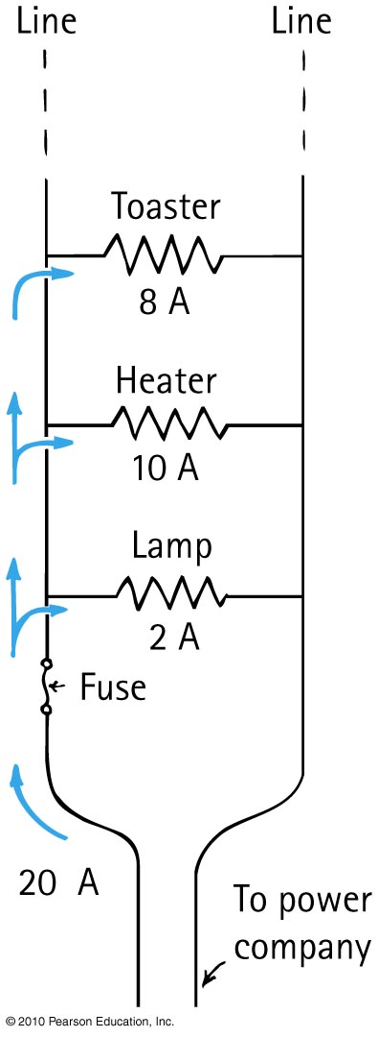
Circuit Breakers (Fuses)
Homes are wired in parallel.
As more and more devices are connected to a circuit, more current moves through the main line.
When the current in a line is excessive, overheating can result in a fire.

Slide 24
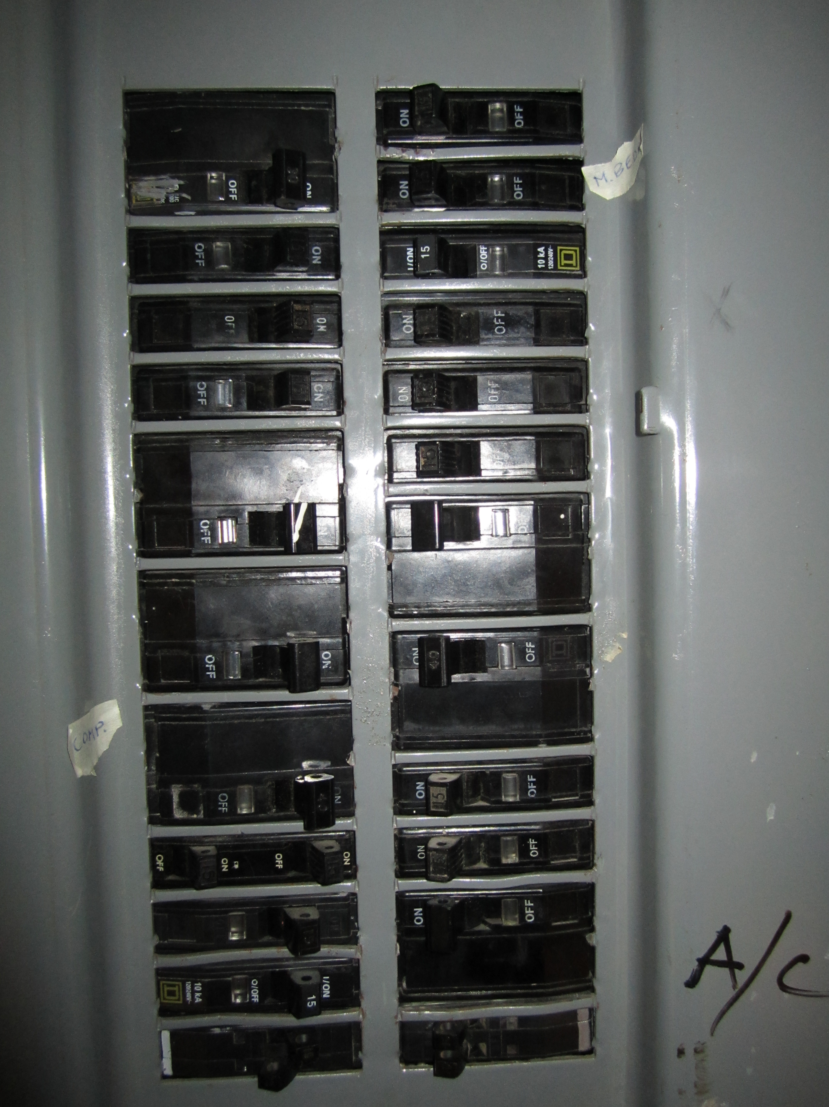
Circuit Breakers (Fuses)
A circuit breaker is an automatic switch that turns off when the current exceeds a certain value.
Circuit breakers can prevent electrical fires from occurring
Unlike a fuse, which operates once and then must be replaced, a circuit breaker can be reset multiple times.
This is the breaker panel in Harlow’s basement.

