Slide 1
Conceptual Physics 11th Edition
Chapter 24:
MAGNETISM
Magnetic Force
Magnetic Poles
Magnetic Field
Magnetic Domains
Electric Currents and Magnetic Fields
Electromagnets
Magnetic Force on Moving Charged Particles
Magnetic Force on Current Carrying Wires
Earth’s Magnetic Field

Slide 2
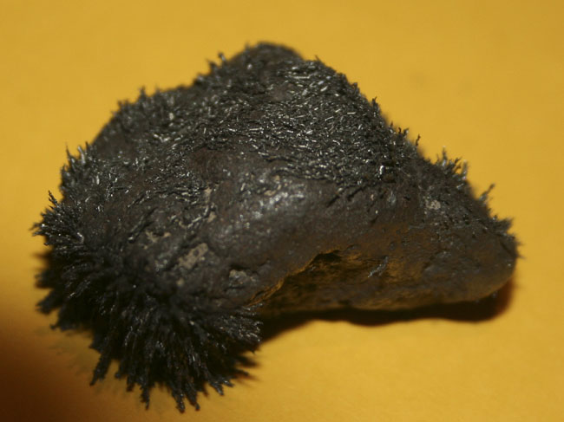
Magnetism
The term magnetism comes from the name Magnesia, a coastal district of ancient Thessaly, Greece.
Unusual stones were found by the Greeks more than 2000 years ago.
These stones, called lodestones, had the intriguing property of attracting pieces of iron.
Magnets were first fashioned into compasses and used for navigation by the Chinese in the 12th century.
[image from http://www.crystalvibrations.org/crystal%20healing%20photo%20gallery18.html ]

Slide 3
The Magnetic Force
The electric force between any two charged particles depends on the product of their charges and their distance of separation, as specified in Coulomb’s law.
If the charged particles are moving with respect to each other, there is an additional force between them, called the magnetic force.
The electric and magnetic forces turn out to be related to one another under one theory of electromagnetism, but, for now, we will treat them as separate forces.

Slide 4
Magnetic Poles
Every permanent magnet contains billions of tiny spinning charges which gives rise to the magnetic force.
We call one end of a permanent magnet “N” or North, and the other end of a permanent magnet “S” or South
The N and S are called magnetic poles – every magnet has both
N
S

Slide 5
The Magnetic Force
Opposite poles attract, like poles repel.
N
S
N
S
N
S
S
N
S
N
N
S

Slide 6
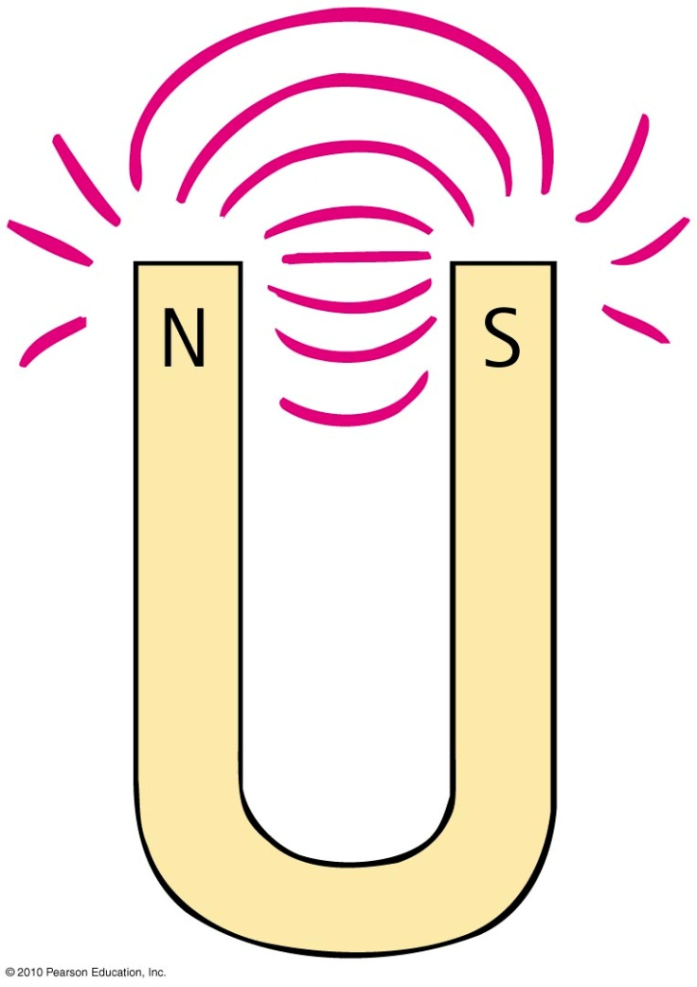
Magnetic Poles
In all magnets — you can’t have one pole without the other
No single pole is known to exist
Examples:
simple bar magnet—poles at the two ends
horseshoe magnet: bent U shape—poles at ends

Slide 7
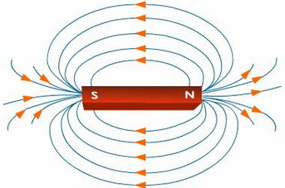
Magnetic Fields
Region of magnetic influence surrounding magnetic poles
Shape revealed by lines that spread from one pole to the other
By convention, direction is from the north pole to the south pole, produced by motions of electric charge in atoms
[image from http://www.tutorvista.com/content/science/science-ii/magnetic-effects-electric-current/mapping-magnetic-lines.php ]

Slide 8
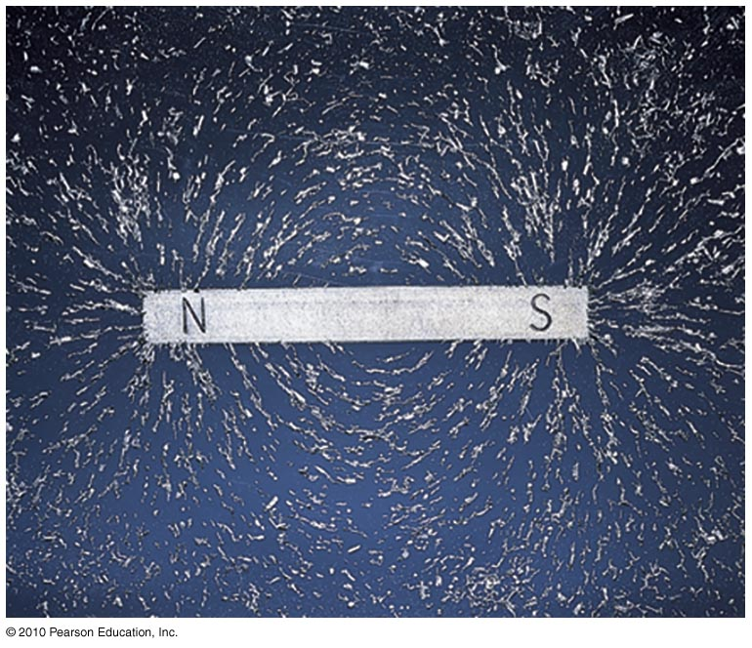
Magnetic Fields
Strength indicated by closeness of the lines
lines close together; strong magnetic field
lines farther apart; weak magnetic field

Slide 9
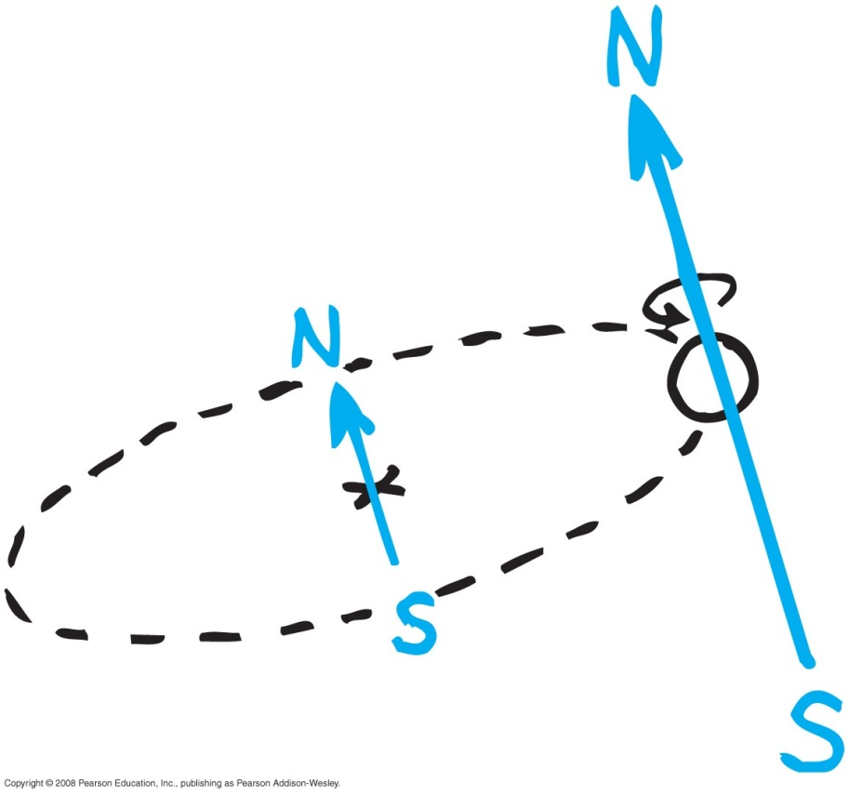
Magnetic Fields
Produced by two kinds of electron motion
Electron orbits
Electron spin
main contributor to magnetism
pair of electrons spinning in opposite direction cancels magnetic field of the other
unpaired electron spins give rise to net magnetic field of iron

Slide 10
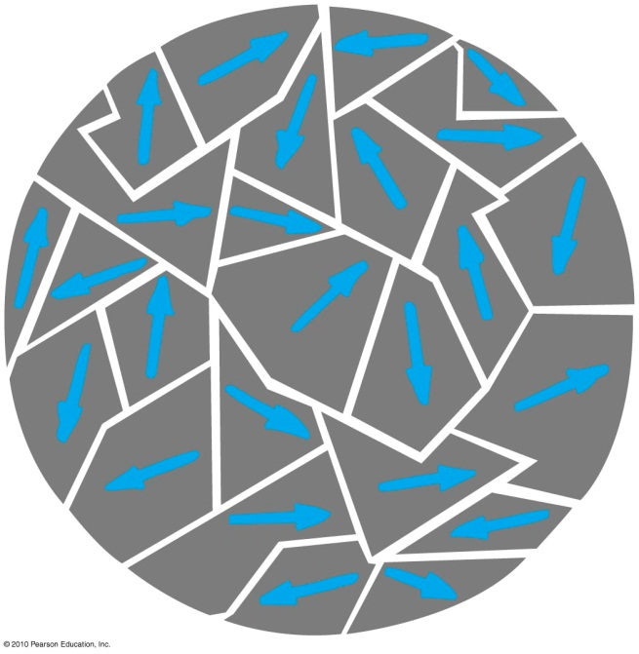
Magnetic Domains
Clusters of aligned magnetic atoms are called magnetic domains
Permanent magnets made by
placing pieces of iron or similar magnetic materials in a strong magnetic field.
stroking material with a magnet to align the domains.

Slide 11
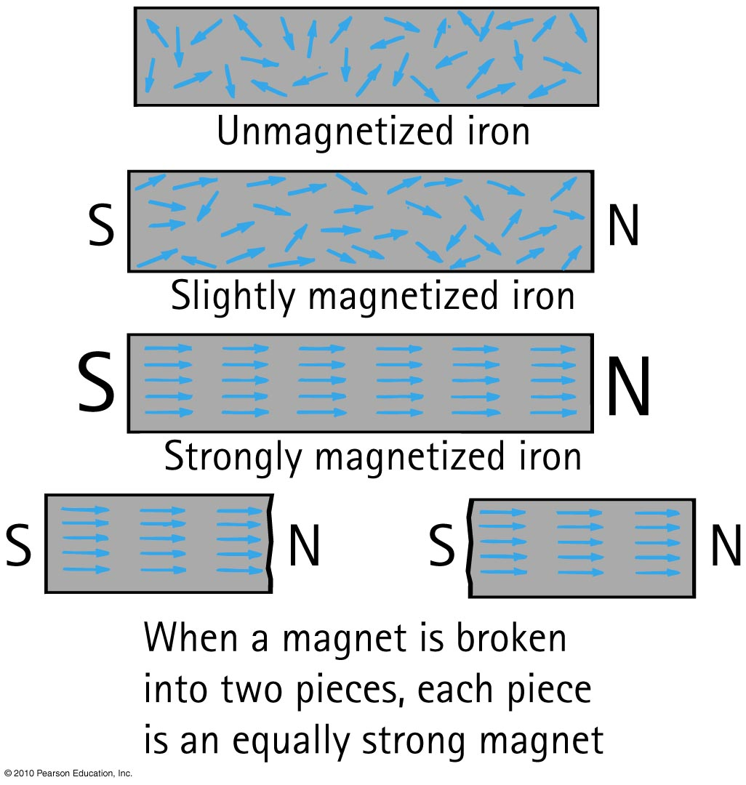
Permanent Magnets

Slide 12
Magnetic Domains
In a Permanent Magnet, the alignment of domains remains once external magnetic field is removed
In a Temporary Magnet, the alignment of domains returns to random arrangement once external magnetic field is removed

Slide 13
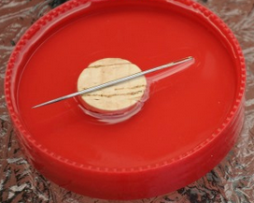
Compass
A compass is a small permanent magnet that is free to rotate about a vertical axis
It aligns itself with the magnetic field
The needle shown floating on a cork below is a compass
It’s N side will point away from any nearby N-pole of another permanent magnet
N
S
S
N

Slide 14
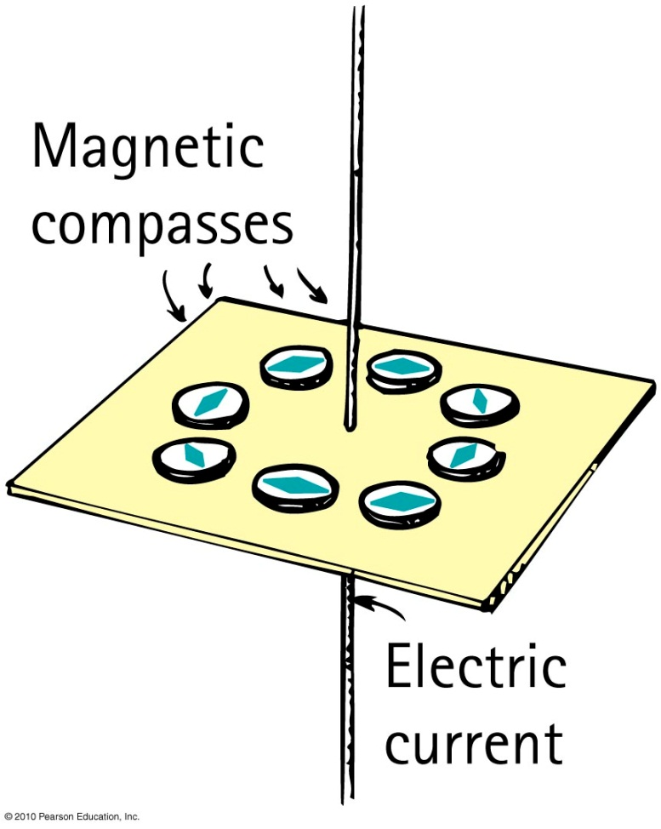
Connection between electricity and magnetism
Magnetic field forms a pattern of concentric circles around a current-carrying wire.
When current reverses direction,
the direction of the field lines
reverse.

Slide 15
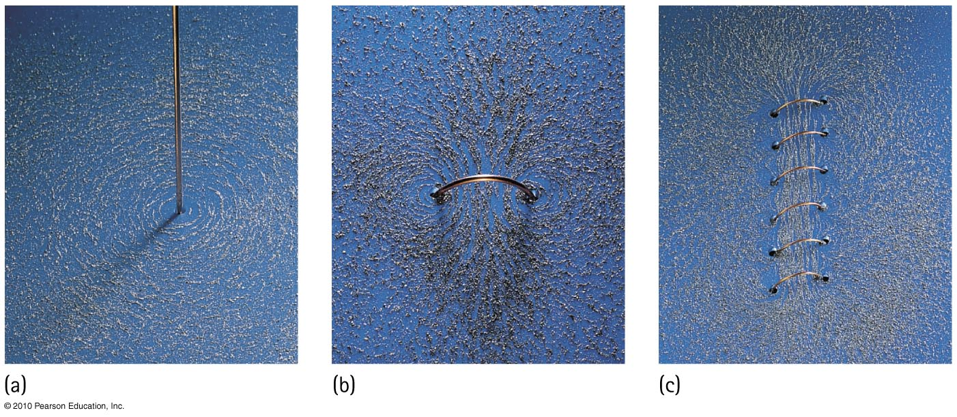
Magnetic field intensity increases as the number of loops increase in a current-carrying coil temporary magnet.

Slide 16
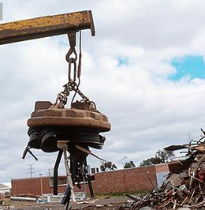
Electromagnets
A current-carrying coil of wire is an electromagnet.
The strength of an electromagnet is increased by
increasing the current through the coil
increasing the number of turns in the coil
having a piece of iron within the coil.
Magnetic domains in the iron core are induced into alignment, adding to the field.

Slide 17
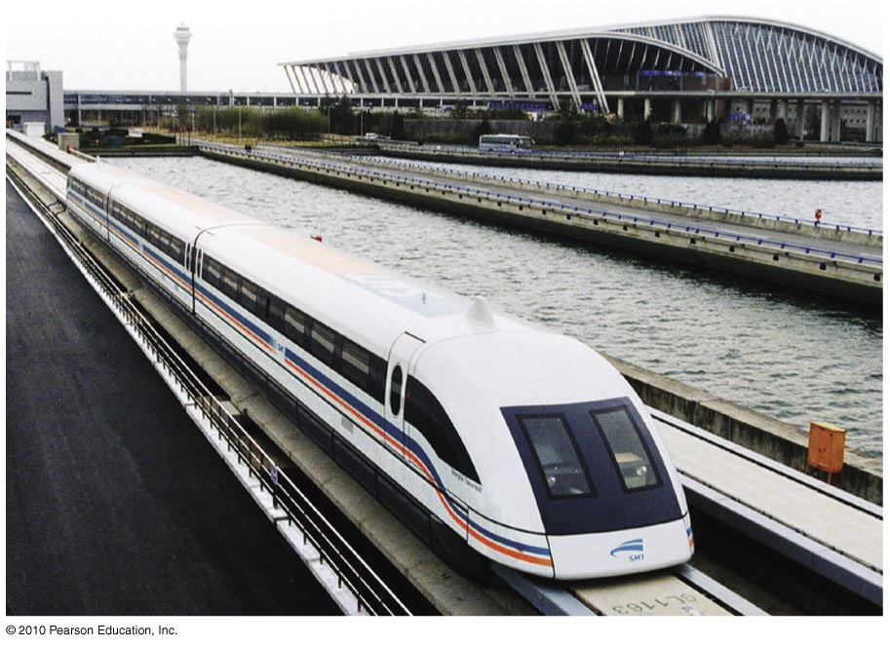
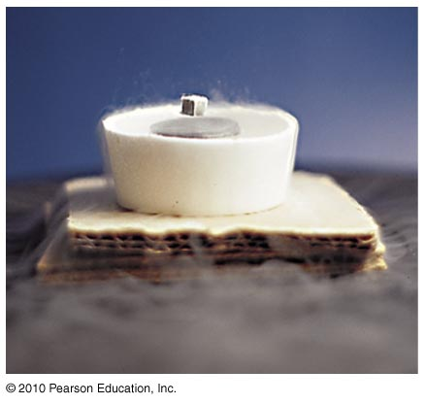
Electromagnets
Electromagnets without iron cores are used in magnetically levitated, or “maglev,” transportation.
Levitation is accomplished by magnetic coils that run along the track, called a guideway.
The coils repel large magnets on the train’s undercarriage.
Continually alternating electric current fed to the coils continually alternates their magnetic polarity, pulling and pushing the train forward.
Electromagnets that utilize superconducting coils produce extremely strong magnetic fields—and they do so very economically because there are no heat losses.

Slide 18
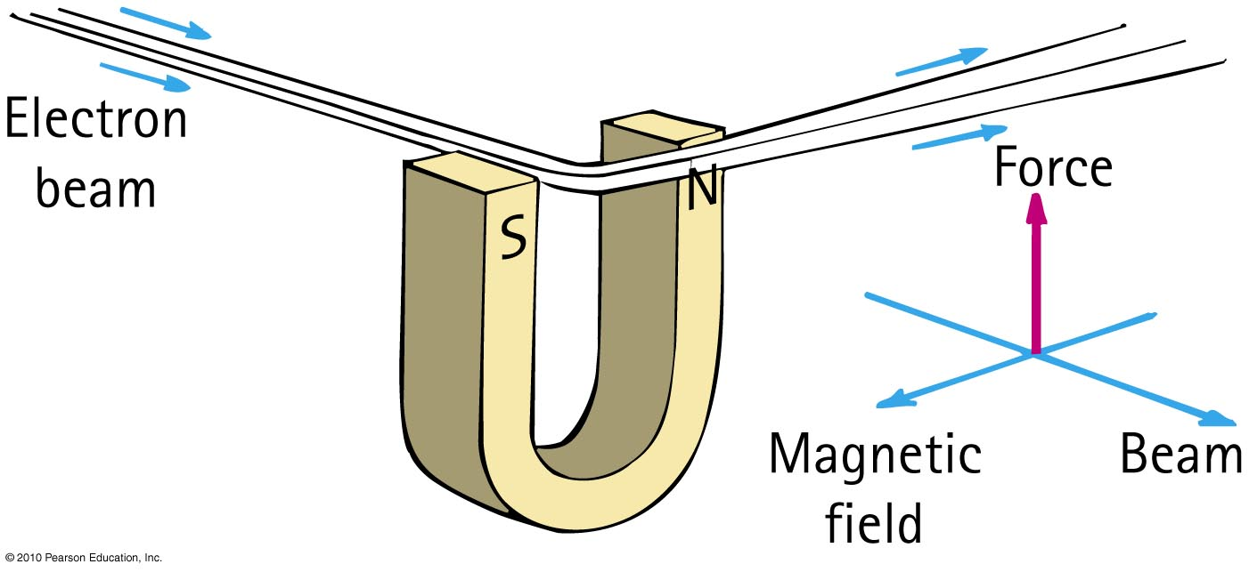
Magnetic Forces on Moving Charges
The magnetic force on a charged particle is perpendicular to the magnetic field and the particle’s velocity.

Slide 19
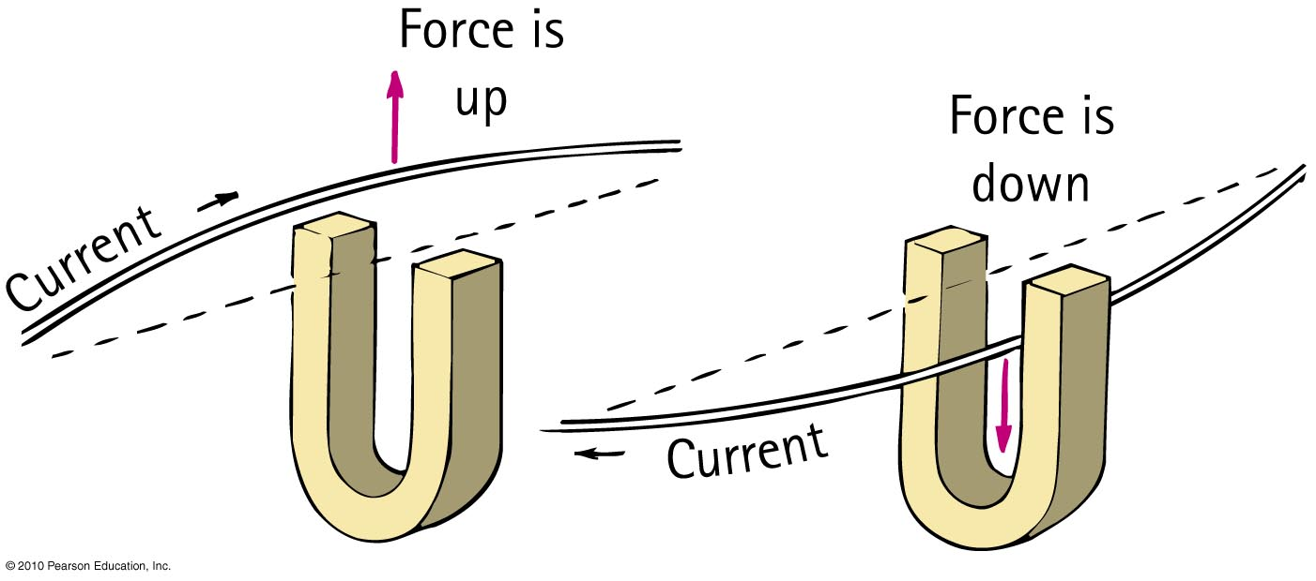
Magnetic Force on Current-Carrying Wires
Electric current moving through a magnetic field experiences a deflecting force.
Direction is perpendicular to both magnetic field and current (perpendicular to wire).
Force is strongest when current is perpendicular to the magnetic field lines.

Slide 20
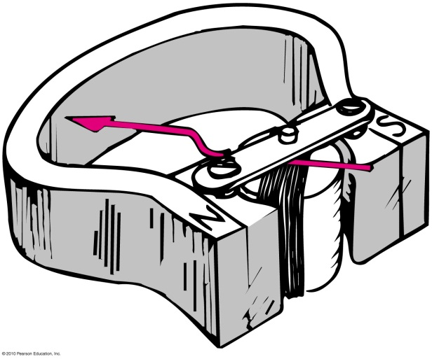
Galvanometer
Current-indicating device named after Luigi Galvani
Determines the current in a wire by measuring the magnetic force due to a permanent magnet
Called ammeter when calibrated to measure current (amperes)
Called voltmeter when calibrated to measure electric potential (volts)

Slide 21
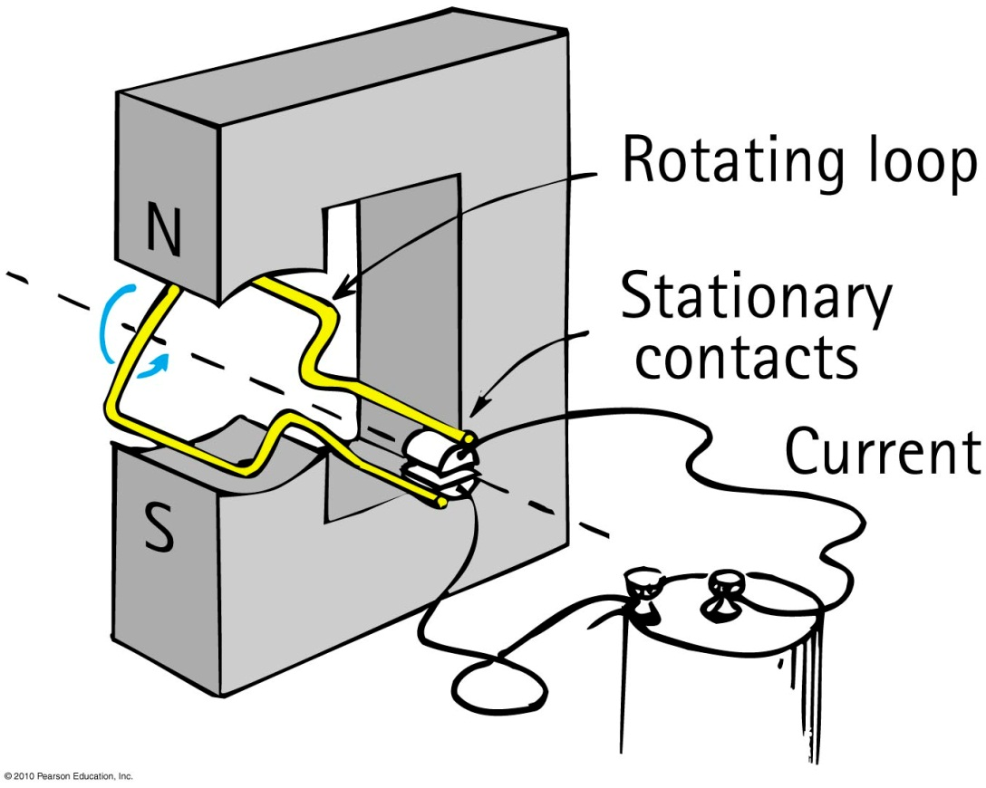
Electric Motor
Different from galvanometer in that each time the coil makes a half rotation, the direction of the current changes in cyclic fashion to produce continuous rotation.

Slide 22
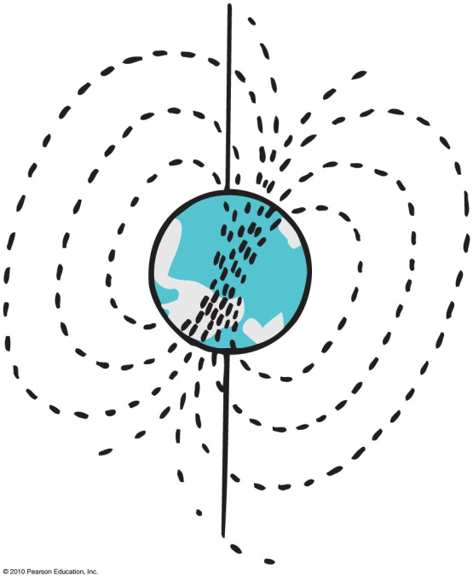
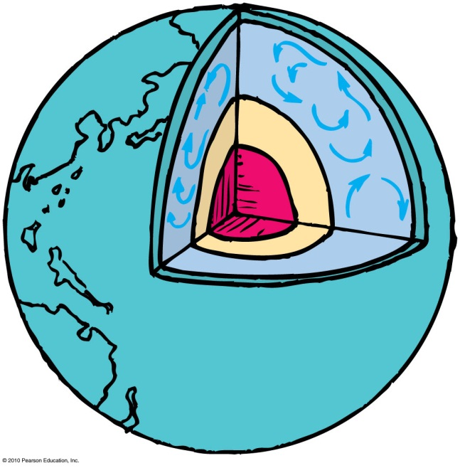
Earth’s Magnetic Field
Earth is itself a huge magnet.
The magnetic poles of Earth are widely separated from the geographic poles.
The magnetic field of Earth is not due to a giant magnet in its interior—it is due to electric currents.
Most Earth scientists think that moving charges looping around within the molten part of Earth create the magnetic field.
Earth’s magnetic field reverses direction: 20 reversals in last 5 million years.

Slide 23
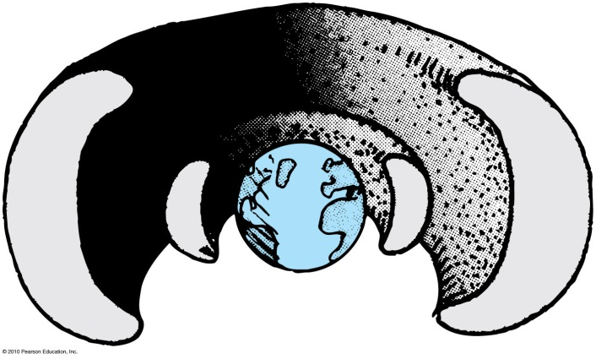
Earth’s Magnetic Field
Universe is a shooting gallery of charged particles called cosmic rays.
Cosmic radiation is hazardous to astronauts.
Cosmic rays are deflected away from Earth by Earth’s magnetic field.
Some of them are trapped in the outer reaches of Earth’s magnetic field and make up the Van Allen radiation belts

Slide 24
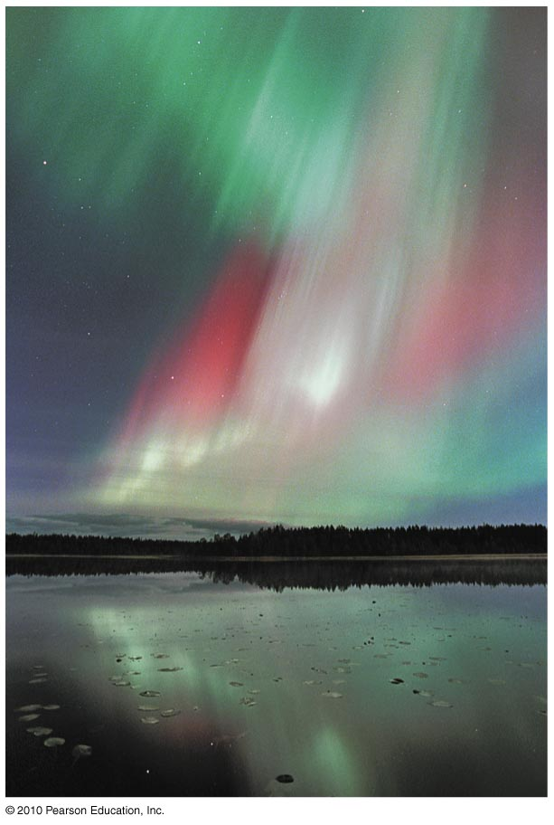
Earth’s Magnetic Field
Storms on the Sun hurl charged particles out in great fountains, many of which pass near Earth and are trapped by its magnetic field.
The trapped particles follow corkscrew paths around the magnetic field lines of Earth and bounce between Earth’s magnetic poles high above the atmosphere.
Disturbances in Earth’s field often allow the ions to dip into the atmosphere, causing it to glow like a fluorescent lamp.
Hence the aurora borealis or aurora australis.

