Slide 1
Note on Posted Slides
These are the slides that I intended to show in class on Wed. Mar. 20, 2013.
They contain important ideas and questions from your reading.
Due to time constraints, I was probably not able to show all the slides during class.
They are all posted here for completeness.

Slide 2
PHY205H1S Physics of Everyday Life Class 18: Magnetism
Electromagnets
Magnetic Force on Moving Charged Particles
Magnetic Force on Current Carrying Wires
Earth’s Magnetic Field
Magnetic Force
Magnetic Poles
Magnetic Field
Magnetic Domains
Electric Currents and Magnetic Fields

Slide 3
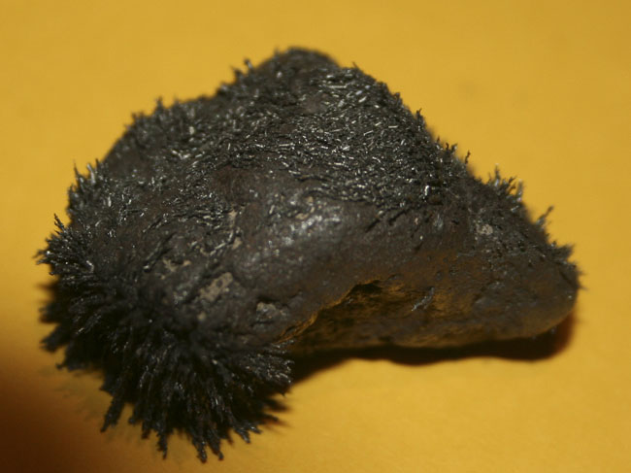
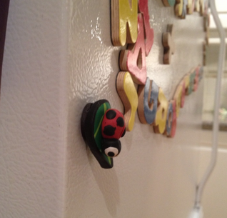
Magnetism
Magnets exist in nature.
We play with them, and use them to hold things on the refrigerator.
[image from http://www.crystalvibrations.org/crystal%20healing%20photo%20gallery18.html ]

Slide 4
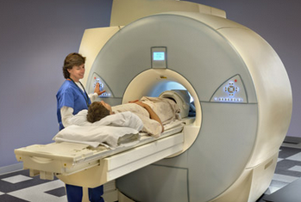
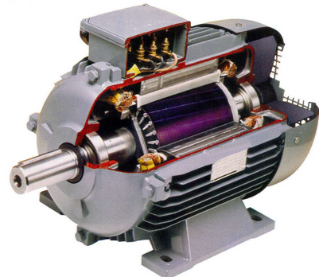
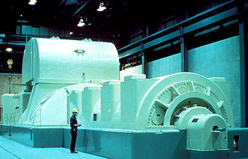
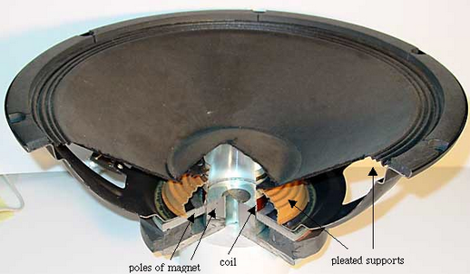
Magnetism
Magnets are essential components of many devices used in everyday life.

Slide 5
The Electric Force
$$q_{1}$$
$$d$$
$$q_{2}$$
Any two charged particles exert an electric force upon each other, as determined by Coulomb’s Law.
This is true whether or not they are stationary or moving.

Slide 6
The Magnetic Force
$${\vec{v}}_{1}$$
$$q_{2}$$
$$q_{1}$$
$${\vec{v}}_{2}$$
If two charged particles are moving, they can exert a magnetic force on each other, in addition to the electric force.
A Magnetic field is created by a moving charged particle.

Slide 7
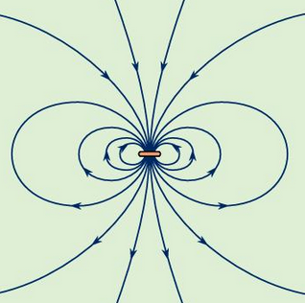
The Magnetic Force
This is the magnetic field surrounding a current loop.
Electric charge is moving in a tiny circular path, perpendicular to the screen.

Slide 8
Permanent Magnets
Every permanent magnet contains billions of tiny current loops which gives rise to the magnetic force.
We call one end of a permanent magnet “N” or North, and the other end of a permanent magnet “S” or South
The N and S are called magnetic poles – every magnet has both
N
S

Slide 9
The Magnetic Force
Opposite poles attract, like poles repel.
N
S
N
S
N
S
S
N
S
N
N
S

Slide 10
A weak and strong magnet repel each other. The greater repelling force is experienced by the
Magnetic Poles
CHECK YOUR NEIGHBOR
A. stronger magnet.
weaker magnet.
Both the same.
None of the above.
Notes:
C. Both the same

Slide 11
Magnetic Poles
If you break one magnet in half, you get two magnets, each with two poles again.
N
S
N
S
N
S
N
S
No single isolated magnetic monopole has been found to exist in nature.
Poles always come in N+S pairs like this.

Slide 12
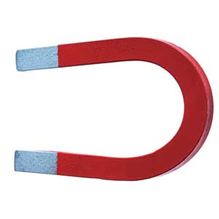
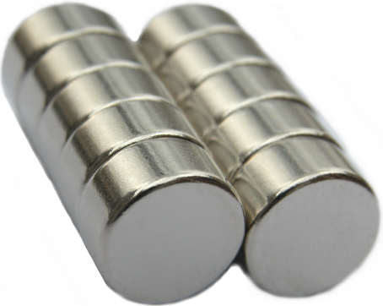
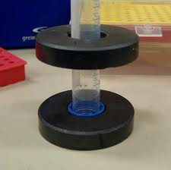
Permanent Magnets
Magnets can come in many shapes; each one always has an N side and an S side.
S
N
S
S
N
N
S
N
S
N
N

Slide 13
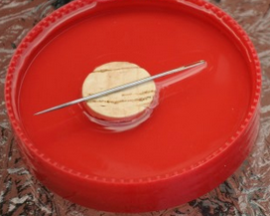
Compass
A compass is a small bar magnet that is free to rotate about a vertical axis
It aligns itself with the magnetic field
The needle shown floating on a cork below is a compass
It’s N side is the “arrow”, showing which way the compass points.
N
S
S
N

Slide 14
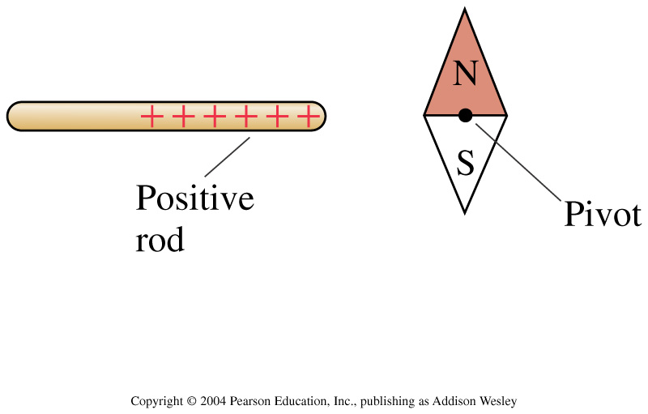
Does the compass needle rotate clockwise (cw), counterclockwise (ccw) or not at all?
Clockwise
Counterclockwise
Not at all
Notes:
STT32.1
Answer: C

Slide 15
N
S
Does the compass needle rotate clockwise (cw), counterclockwise (ccw) or not at all?
Clockwise
Counterclockwise
Not at all
Notes:
STT32.1
Answer: C

Slide 16
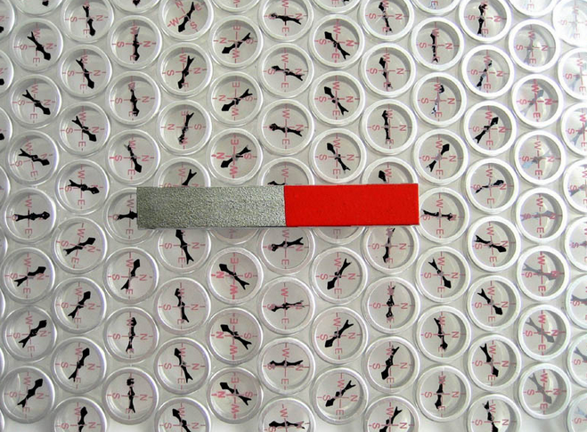
Compass
Compasses point in the direction of the magnetic field.
S
N
[image from http://twistedsifter.com/2012/05/visualizing-magnetic-fields-compasses-iron-filings/ ]

Slide 17
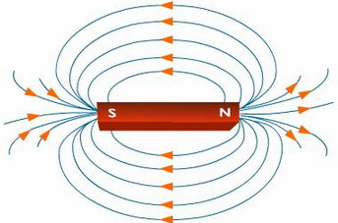
Magnetic Fields
The direction of the magnetic field surrounding a bar magnet is from the north pole to the south pole.
S
N
[image from http://www.tutorvista.com/content/science/science-ii/magnetic-effects-electric-current/mapping-magnetic-lines.php ]

Slide 18
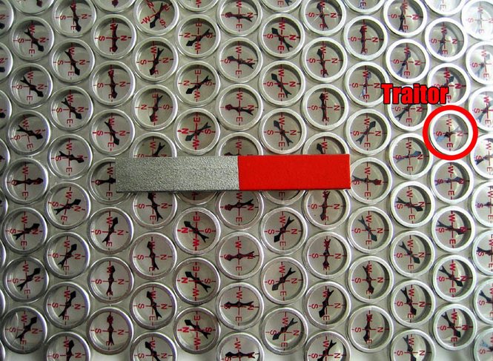
Compass
A mis-labeled compass can point in the direction opposite to the magnetic field.
S
N
[image from http://twistedsifter.com/2012/05/visualizing-magnetic-fields-compasses-iron-filings/ ]

Slide 19
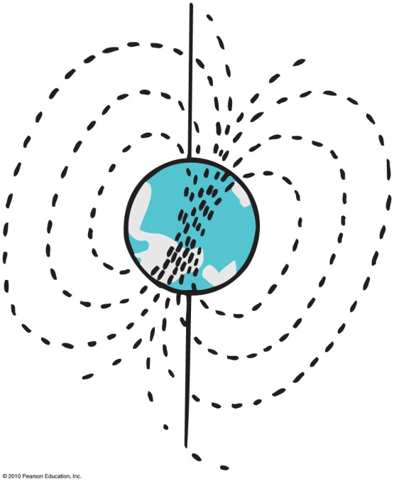
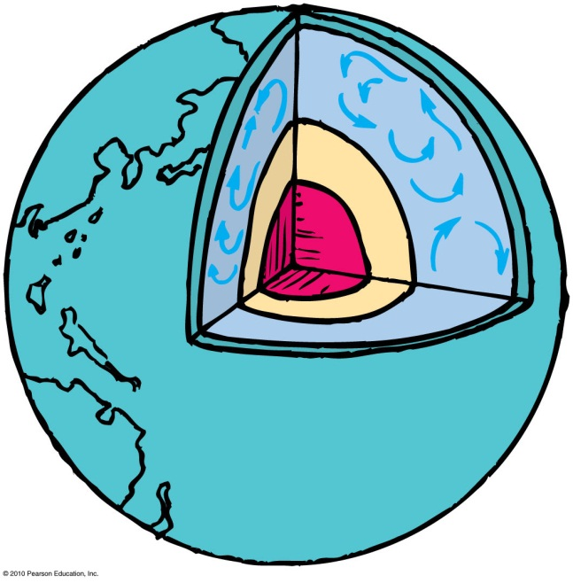
Earth’s Magnetic Field
Earth is itself a huge magnet.
The magnetic poles of Earth are widely separated from the geographic poles.
The magnetic field of Earth is due to electric currents in the molten interior.
Earth’s magnetic field reverses direction every several hundred thousand years

Slide 20
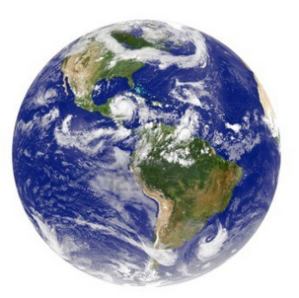
We know that the magnetic field of the earth is produced by electric currents in the molten core. The magnetic field of the earth can be modeled as if the earth contains a big bar-magnet. Knowing the direction compasses point, which way is this internal bar-magnet oriented?
Magnetic Poles
CHECK YOUR NEIGHBOR
A
N
B
S
S
N
Notes:
C. Both the same

Slide 21
S
N

Slide 22
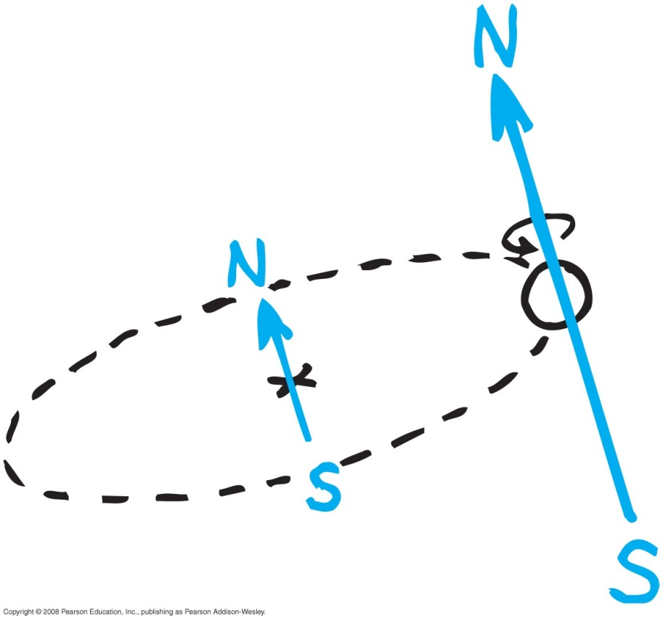
Magnetic Fields
Produced by two kinds of electron motion
Electron orbits
Electron spin
main contributor to magnetism
pair of electrons spinning in opposite direction cancels magnetic field of the other
unpaired electron spins give rise to net magnetic field of iron

Slide 23
A source of magnetism is
Magnetic Fields
CHECK YOUR NEIGHBOR
A. electrons orbiting around an atomic nucleus.
electrons spinning around internal axes.
both A and B.
None of the above
Notes:
C. Either or both of these.

Slide 24
Ferromagnetism (Iron)
Neighbouring Iron atoms like to have their electrons spinning in the same direction.

Slide 25
Ferromagnetism (Iron)
Sometimes a border develops between two regions within the iron where the neighbours all have different electron spin directions.
Magnetic Domain
Magnetic Domain

Slide 26
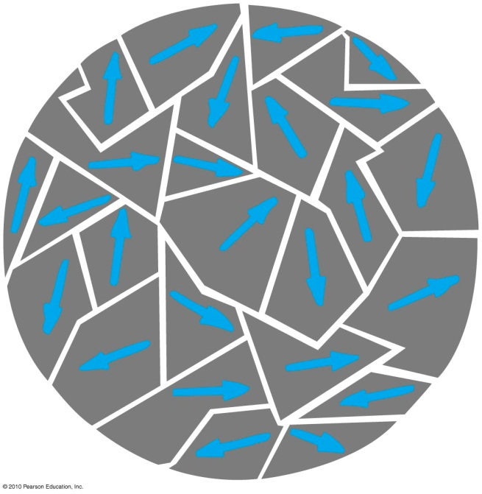
Magnetic Domains
Clusters of aligned magnetic atoms are called magnetic domains
Hitting a piece of iron with a hammer in a magnetic field can magnetize the iron by aligning the magnetic domains.

Slide 27
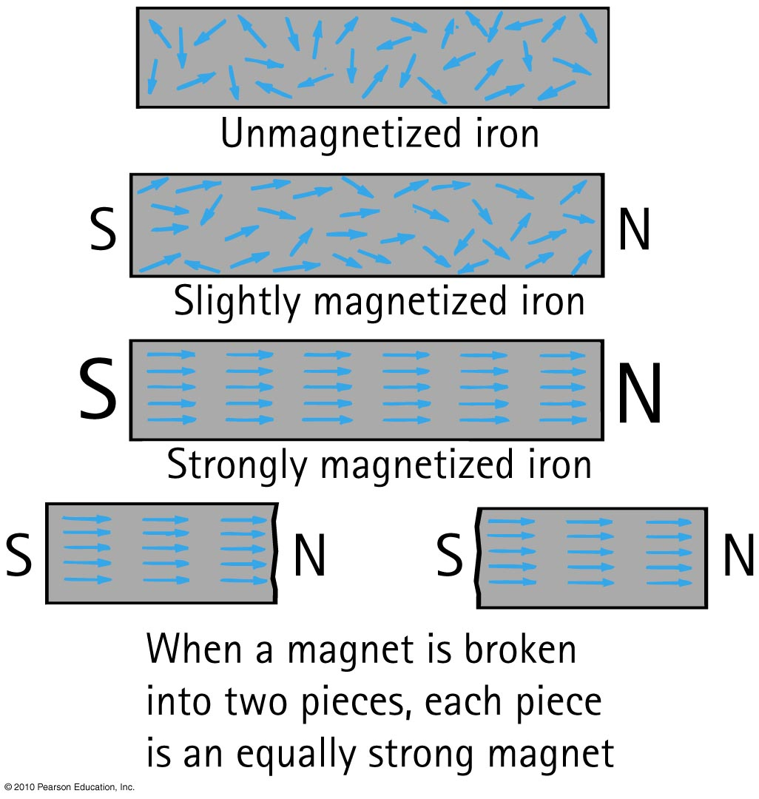
Permanent Magnets

Slide 28
Magnetic Domains
In a Permanent Magnet, the alignment of domains remains once external magnetic field is removed
In a Temporary Magnet, the alignment of domains returns to random arrangement once external magnetic field is removed

Slide 29
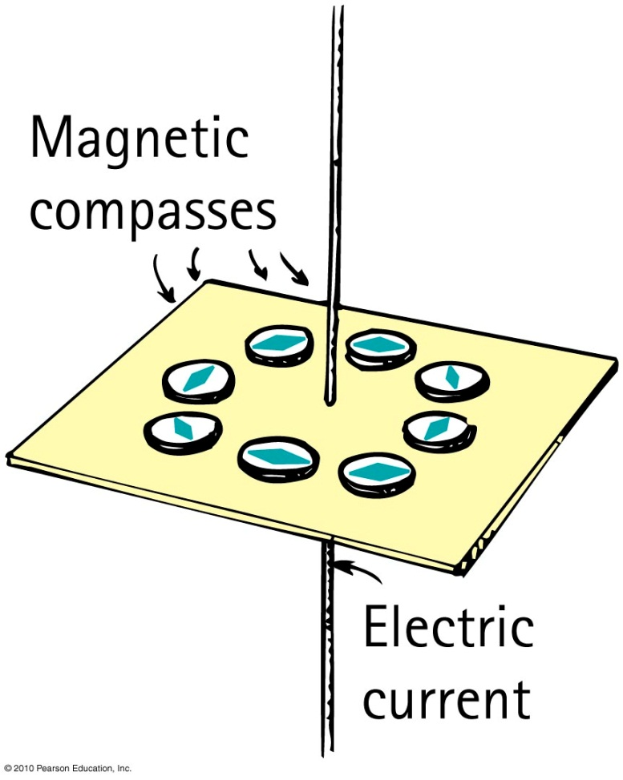
Connection between electricity and magnetism
Magnetic field forms a pattern of concentric circles around a current-carrying wire.
When current reverses direction,
the direction of the field lines
reverse.

Slide 30
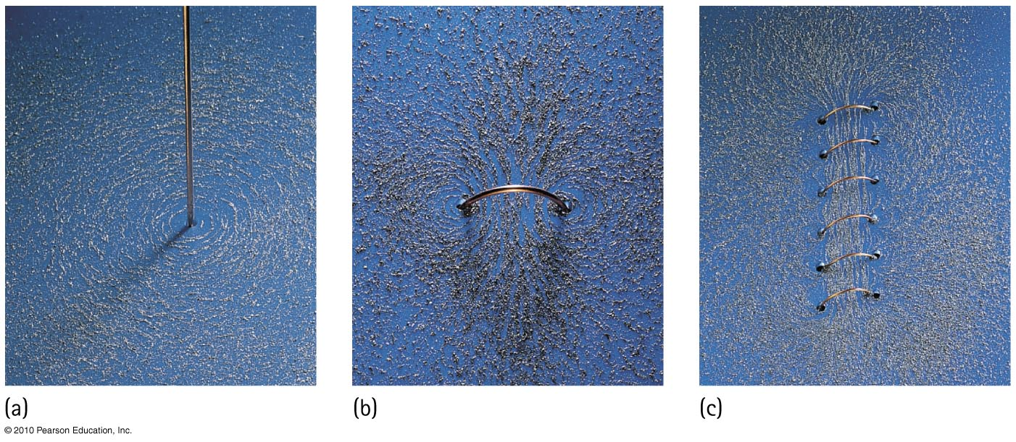
Magnetic field intensity increases as the number of loops increase in a current-carrying coil temporary magnet.

Slide 31
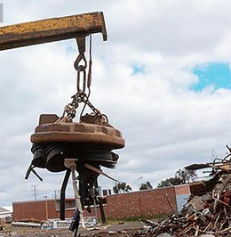
Electromagnets
A current-carrying coil of wire is an electromagnet.
The strength of an electromagnet is increased by
increasing the current through the coil
increasing the number of turns in the coil
having a piece of iron within the coil.
Magnetic domains in the iron core are induced into alignment, adding to the field.

Slide 32
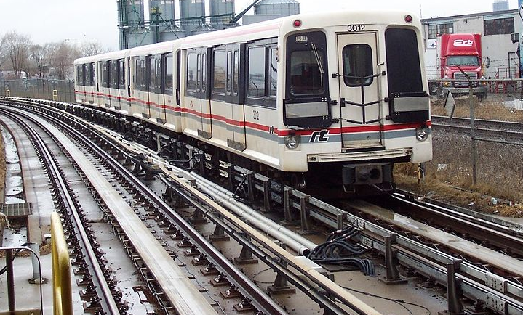
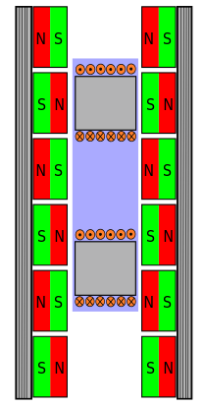
Electromagnets
The Scarborough LRT trains have freely rolling wheels, and use electromagnets of alternating polarity to pull themselves along.

Slide 33
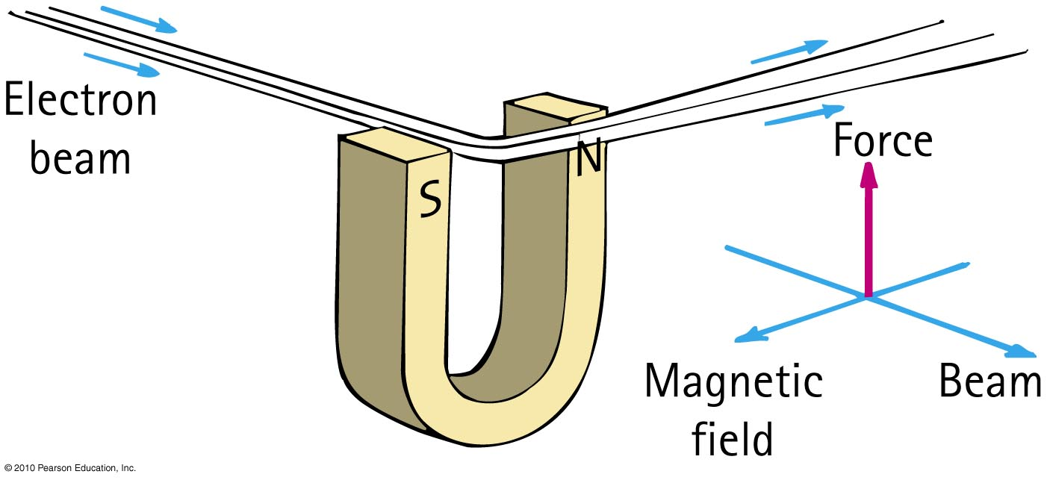
Magnetic Forces on Moving Charges
The magnetic force on a charged particle is perpendicular to the magnetic field and the particle’s velocity.

Slide 34
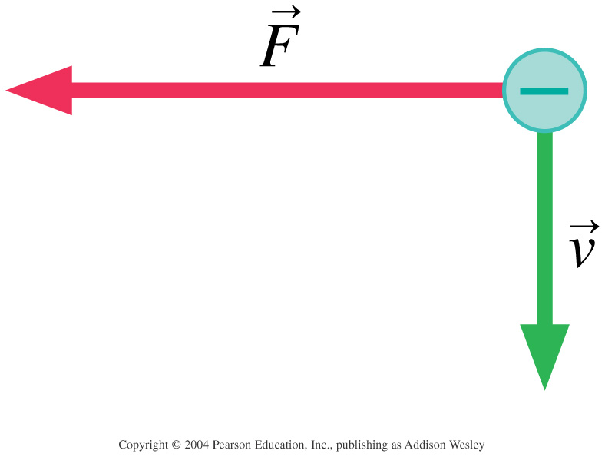
Magnetic Force on Moving Charges
CHECK YOUR NEIGHBOR
An electron moves down in a magnetic field.
It experiences a magnetic force to the left, as shown.
What is the direction of the magnetic field?
Left or right
Into the page or out of the page
Up or down
Notes:
STT32.5
Answer: B

Slide 35
The magnetic force on a moving charged particle can change the particle’s
Magnetic Force on Moving Charges
CHECK YOUR NEIGHBOR
A. speed.
direction.
Both A and B.
Neither A nor B.
Notes:
B. direction.

Slide 36
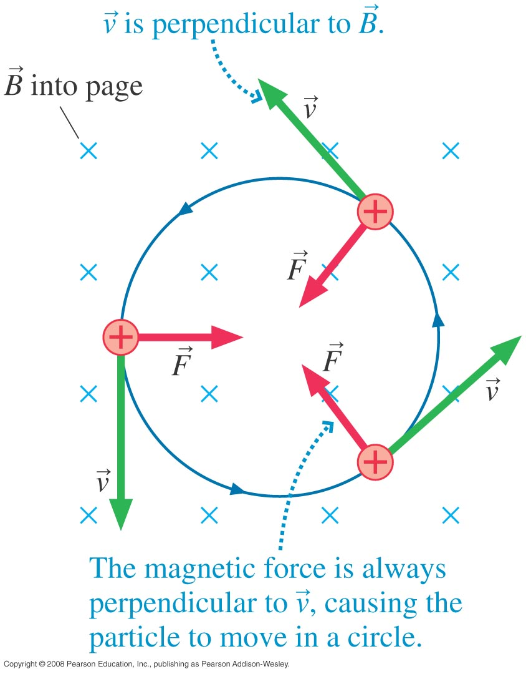
Magnetic Force is important for fast moving electrons or positive ions in a vacuum.
Since F tends to be perpendicular to v, it forms a good centripetal force.

Slide 37
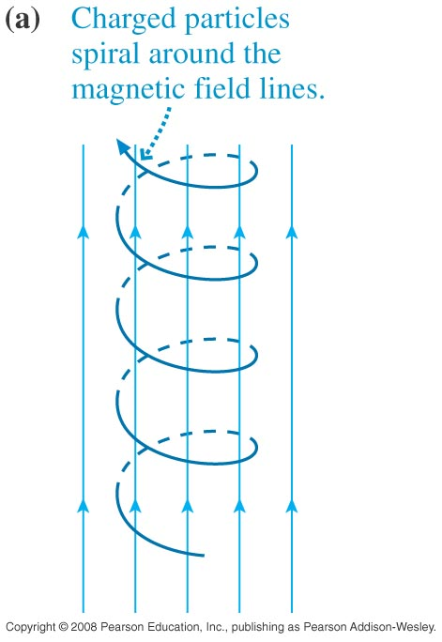
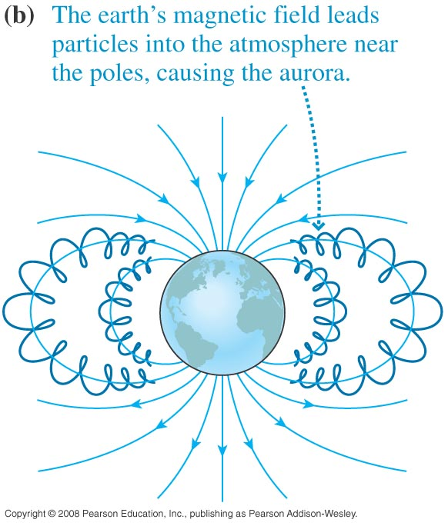
Cyclotron Motion: in 3D the motion of charged particles is not a circle but a spiral.
The Earth’s magnetic field protects us from high energy charged particles from the Sun (beta, alpha radiation).

Slide 38
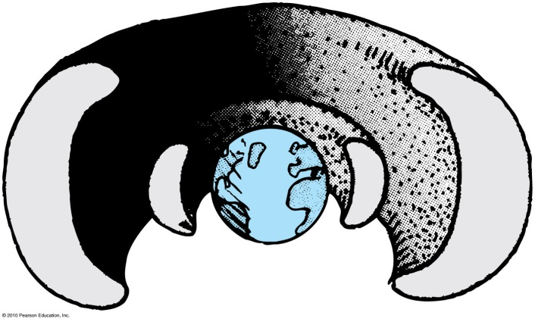
Earth’s Magnetic Field
Space is filled with fast-moving charged particles called cosmic radiation.
This kind of radiation is harmful to plants and animals.
Cosmic radiation is deflected away from Earth by Earth’s magnetic field.
Some of the charged particles are trapped in the outer reaches of Earth’s magnetic field and make up the Van Allen radiation belts

Slide 39
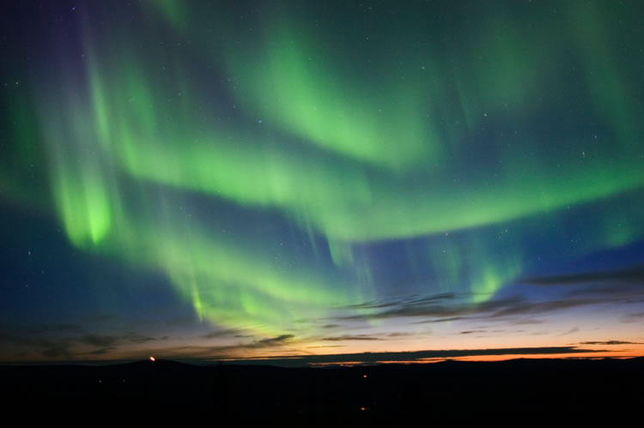
Aurora Borealis is natural light caused by charged particles accelerating in the Earth’s magnetic field.

Slide 40
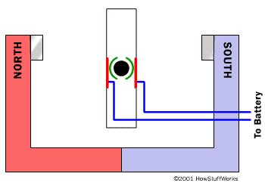
Before class on Monday
Please read Chapter 25, or at least watch the 10-minute pre-class video for class 19.
Something to think about:
Electric current can create a magnetic field.
Can a moving magnet create an electric field?
Image from http://www.energyquest.ca.gov/story/chapter04.html

