Slide 1
Note on Posted Slides
These are the slides that I intended to show in class on Mon. Mar. 25, 2013.
They contain important ideas and questions from your reading.
Due to time constraints, I was probably not able to show all the slides during class.
They are all posted here for completeness.

Slide 2
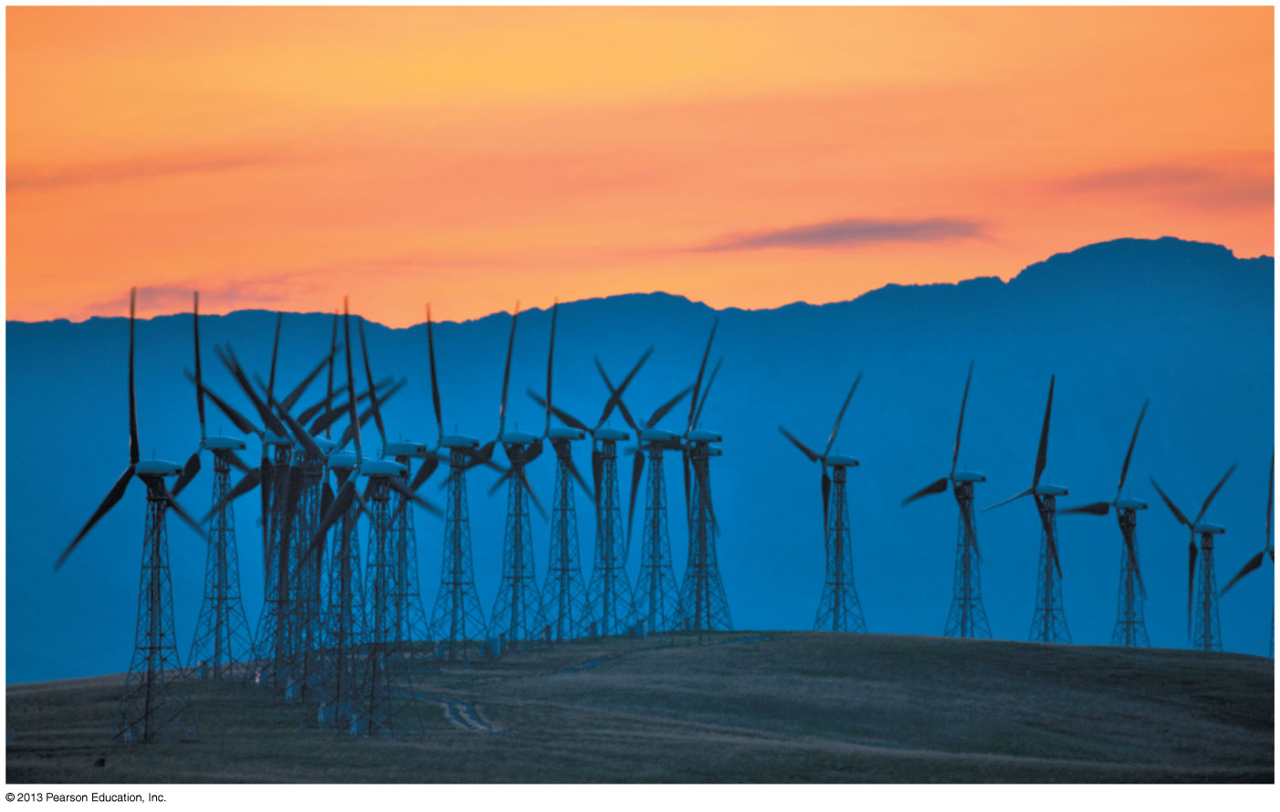
PHY205H1S Physics of Everyday Life Class 19: Electromagnetic Induction
Faraday’s Law
Generators and Alternating Current
Power Production
Self-Induction
Power Transmission
Field Induction

Slide 3
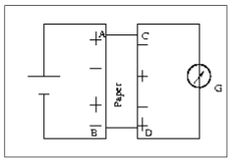
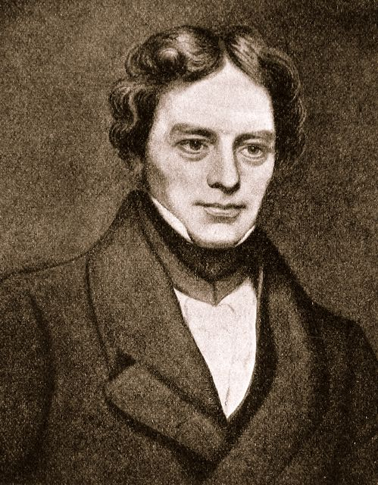
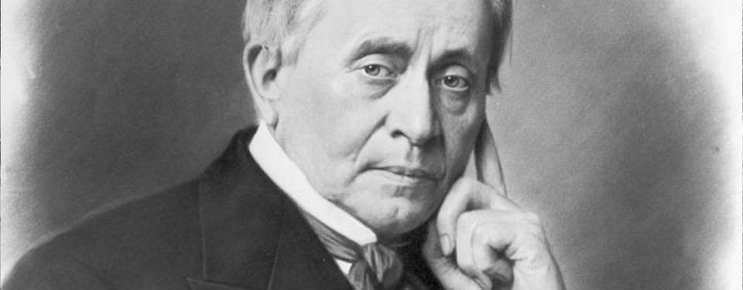
Faraday’s and Henry’s Discovery of 1831
Two physicists working on opposite sides of the Atlantic independently discovered and described electromagnetic induction.
Schematic of Faraday’s original experiment, which he first tried unsuccessfully in 1825.
Michael Faraday was the son of a blacksmith, born in 1791 in London, England.
Joseph Henry was born in 1797 in upstate New York to very poor parents.

Slide 4
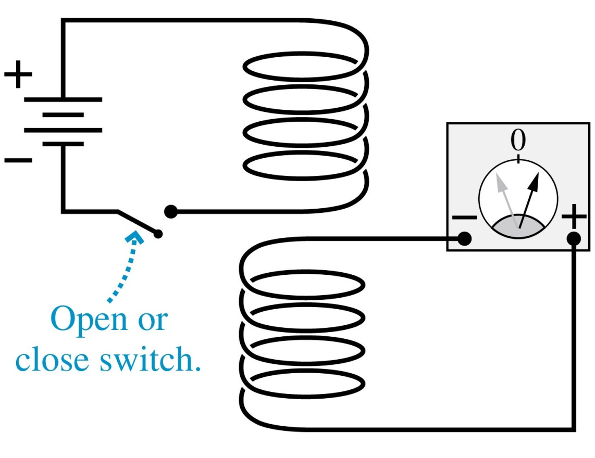
Faraday’s and Henry’s Discovery of 1831
When one coil is placed directly above another, there is no current in the lower circuit while the switch is in the closed position.
A momentary current appears whenever the switch is opened or closed.

Slide 5
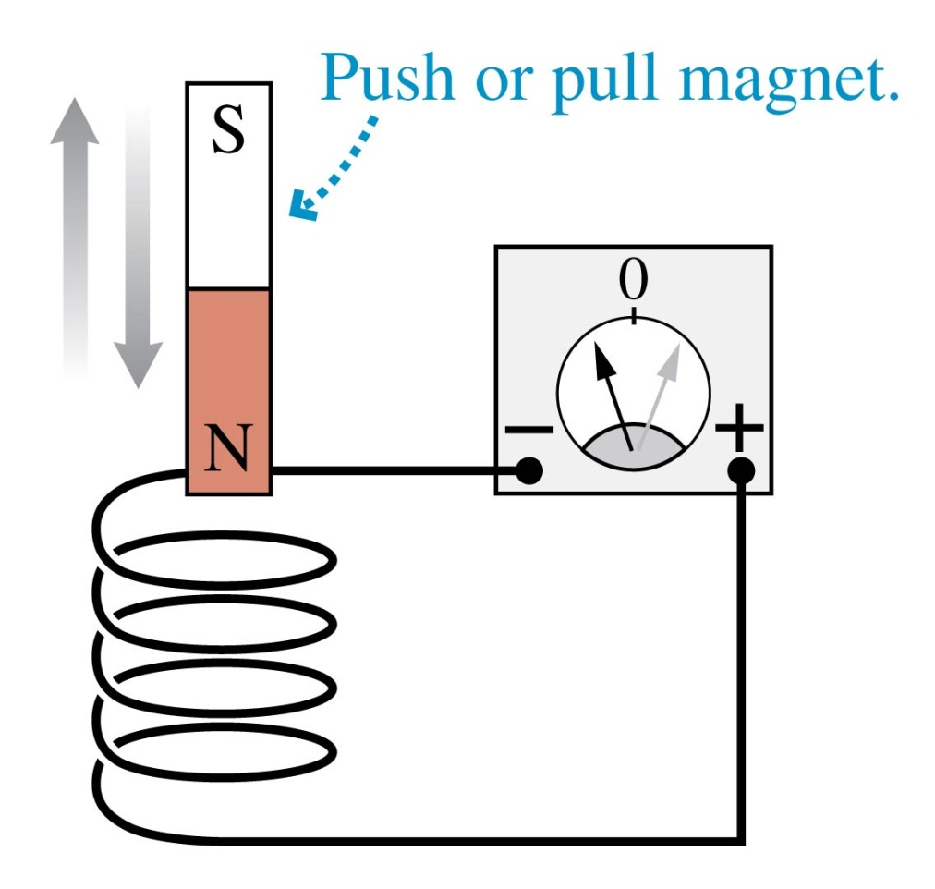
Faraday’s and Henry’s Discovery of 1831
When a bar magnet is pushed into a coil of wire, it causes a momentary deflection of the current-meter needle.
Holding the magnet inside the coil has no effect.
A quick withdrawal of the magnet deflects the needle in the other direction.

Slide 6
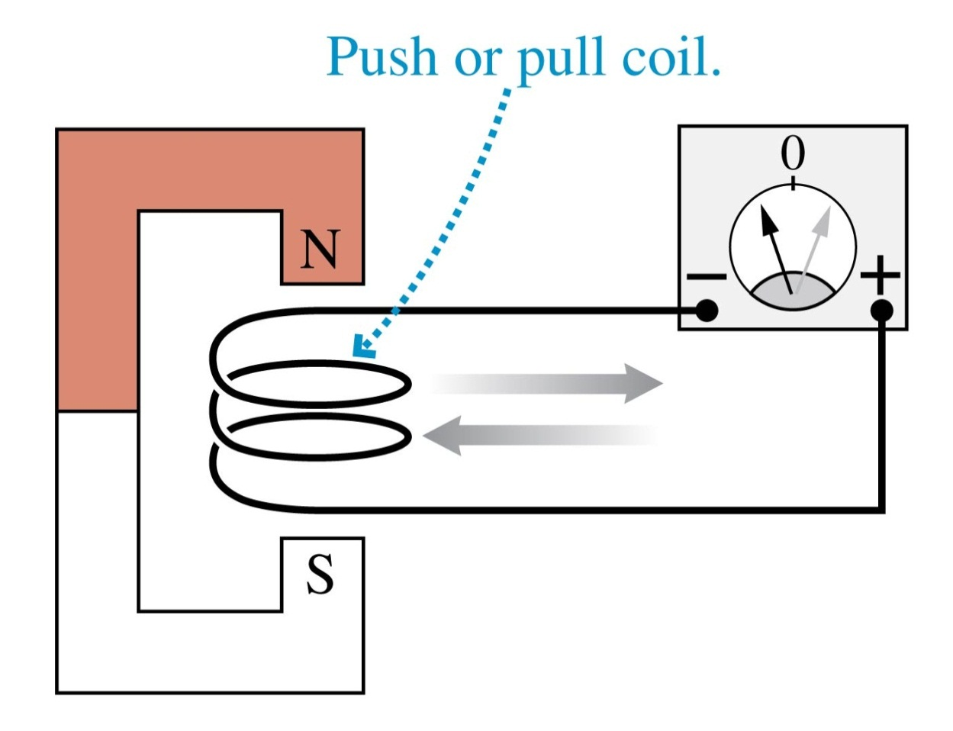
Faraday’s and Henry’s Discovery of 1831
A momentary current is produced by rapidly pulling a coil of wire out of a magnetic field.
Pushing the coil into the magnet causes the needle to deflect in the opposite direction.

Slide 7
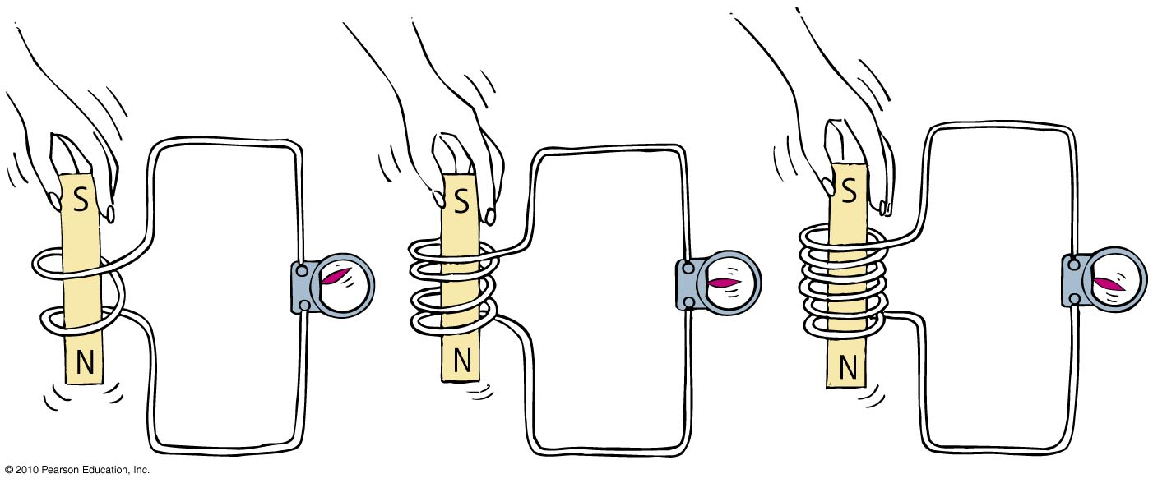
Changing the Number of “Loops”
When a magnet is plunged into a coil with twice as many loops as another, twice as much voltage is induced. If the magnet is plunged into a coil with 3 times as many loops, 3 times as much voltage is induced.

Slide 8
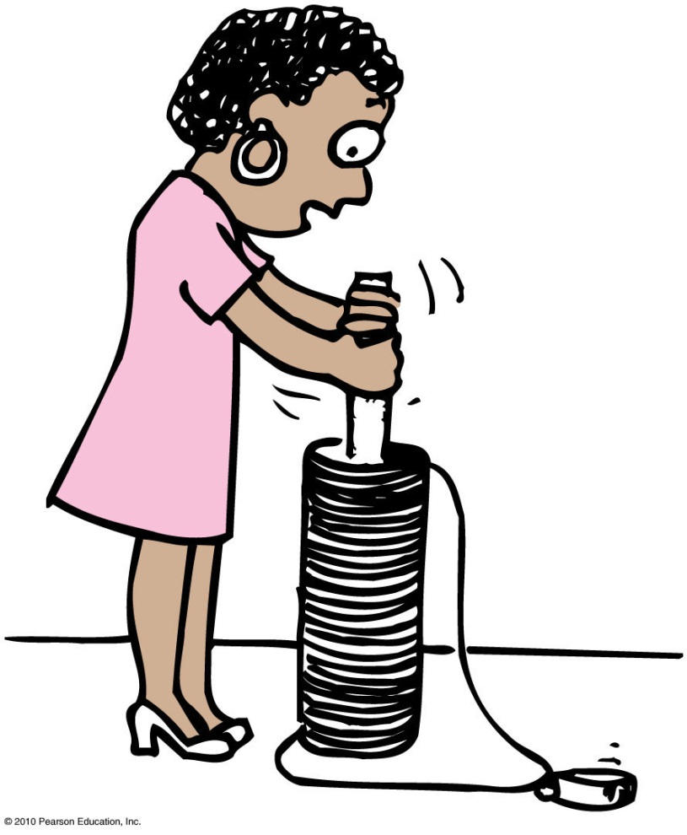
Electromagnetic Induction
It is more difficult to push the magnet into a coil with many loops.
This is because the induced voltage makes a current, which makes an electromagnet, which repels the magnet in our hand.
More loops mean more voltage, which means we do more work to induce it.

Slide 9
Faraday’s Law
The induced voltage in a coil is proportional to the number of loops, multiplied by the rate at which the magnetic field changes within those loops.
Amount of current produced by electromagnetic induction is dependent on:
resistance of the coil,
circuit that it connects,
induced voltage.

Slide 10
Which of the following explains the resistance you feel when pushing a piece of iron into a coil?
Faraday’s Law
CHECK YOUR NEIGHBOR
A. repulsion by the magnetic field you produce.
energy transfer between the iron and coil.
Newton’s third law.
resistance to domain alignment in the iron.
Notes:
A. repulsion by the magnetic field you produce.

Slide 11
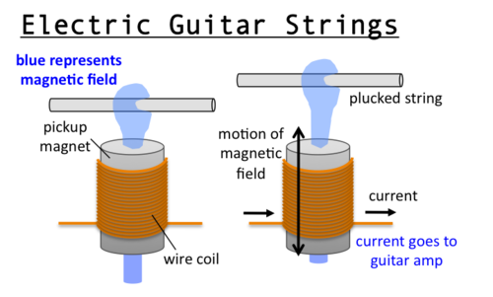
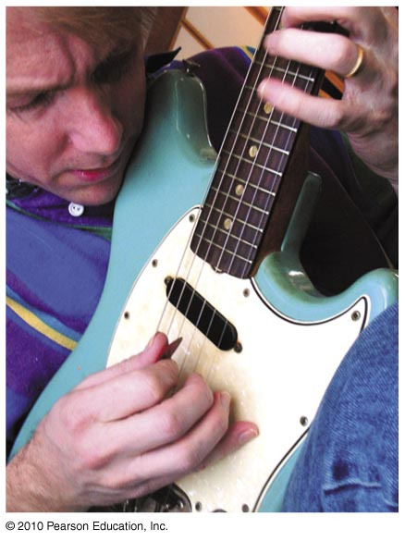
Electric Guitar Pick-ups
Voltage is induced in a coil of wire by changing the magnetic field passing through the coil.

Slide 12
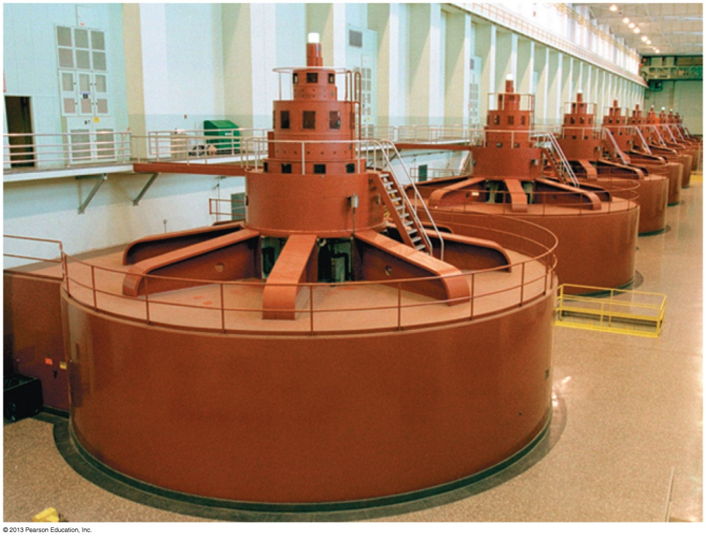
Electrical Generator
A generator is a device that transforms mechanical energy into electric energy.
A generator inside a hydroelectric dam uses electromagnetic induction to convert the mechanical energy of a spinning turbine into electric energy.

Slide 13
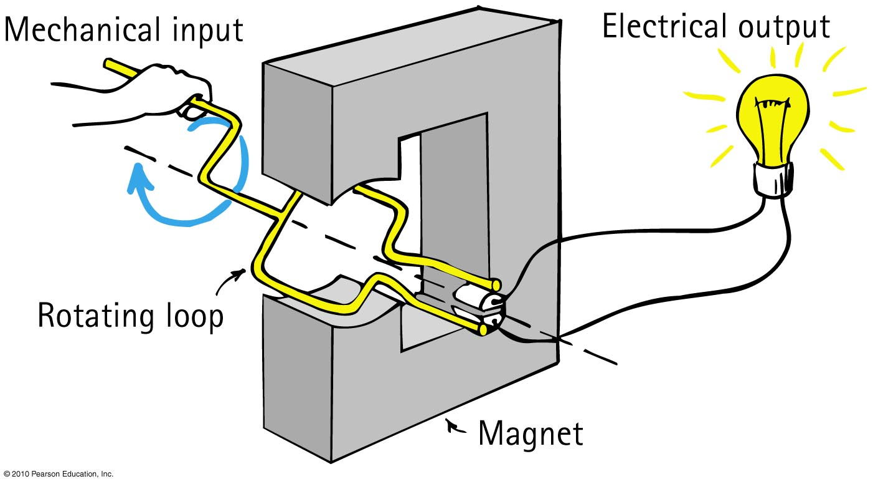
Electrical Generator
Opposite of a motor
Converts mechanical energy into electrical energy via coil motion
Produces alternating voltage and current

Slide 14
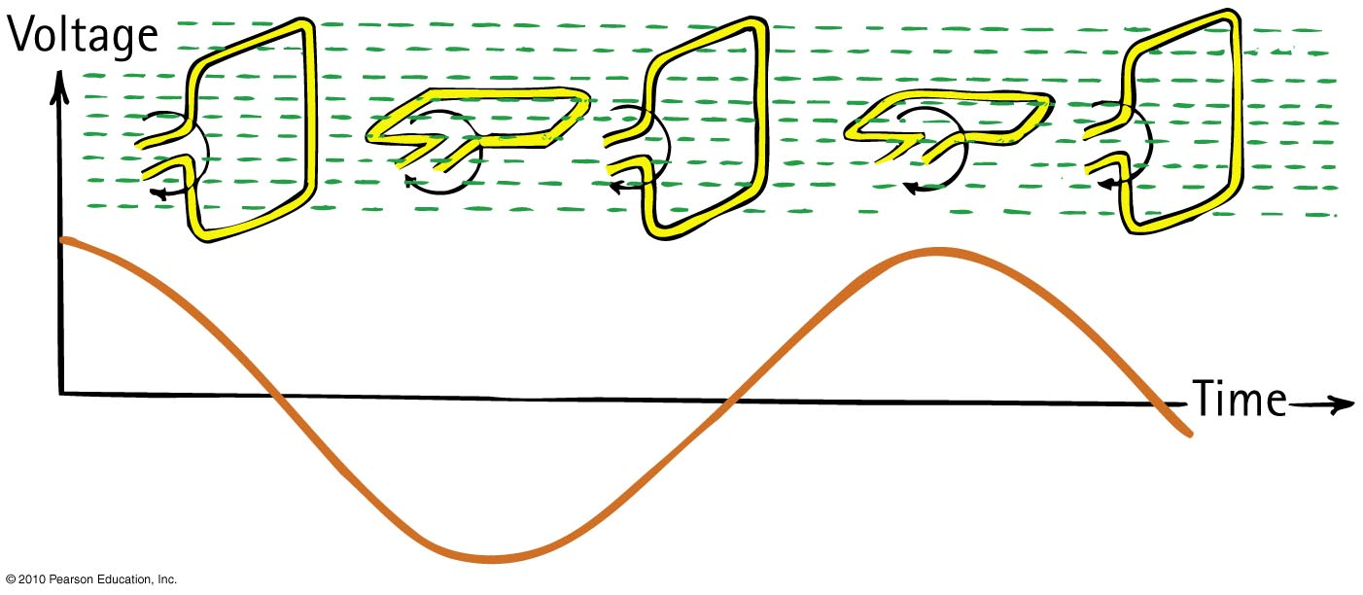
Electrical Generator
The frequency of alternating voltage induced in a loop is equal to the frequency of the changing magnetic field within the loop.

Slide 15
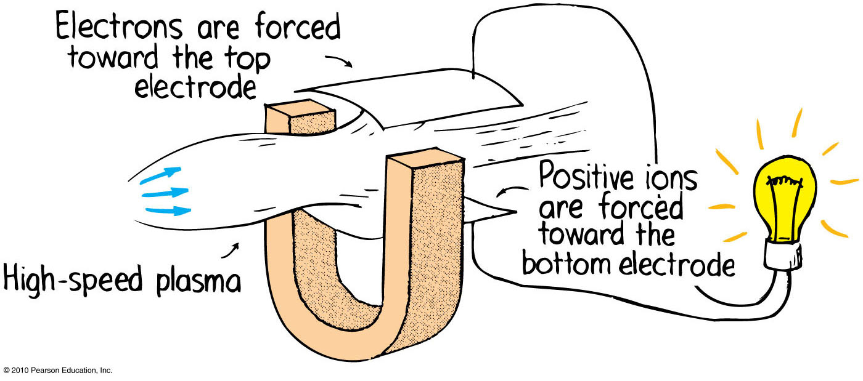
Power Production
MHD (MagnetoHydroDynamic) generator
Eliminates the turbine and spinning armature altogether.
A plasma of electrons and positive ions expands through a nozzle and moves at supersonic speed through a magnetic field.
The motion of charges through a magnetic field gives rise to a voltage and flow of current as per Faraday’s law.

Slide 16
If you push a magnet into a coil of wire, a voltage is produced. If you increase the speed with which you push the magnet into the coil, how does this change the voltage you produce?
Faraday’s Law
CHECK YOUR NEIGHBOR
Voltage is increased
Voltage is decreased
No change in voltage.
Notes:
A. more quickly.

Slide 17
If you push a magnet into a coil of wire, a voltage is produced. What else is created in the coil?
Faraday’s Law
CHECK YOUR NEIGHBOR
charge
current
energy
force
power
Notes:
A. more quickly.

Slide 18
If you push a magnet into a coil of wire, voltage and current is produced, so electric power is consumed in the coil. Where does this energy come from?
Faraday’s Law
CHECK YOUR NEIGHBOR
Atoms in the coil decay and release the energy, originally stored in their nuclei.
Electric potential energy, originally stored in the coil.
It is created by the electric forces involved.
The work you do pushing the magnet into the coil.
Notes:
A. more quickly.

Slide 19
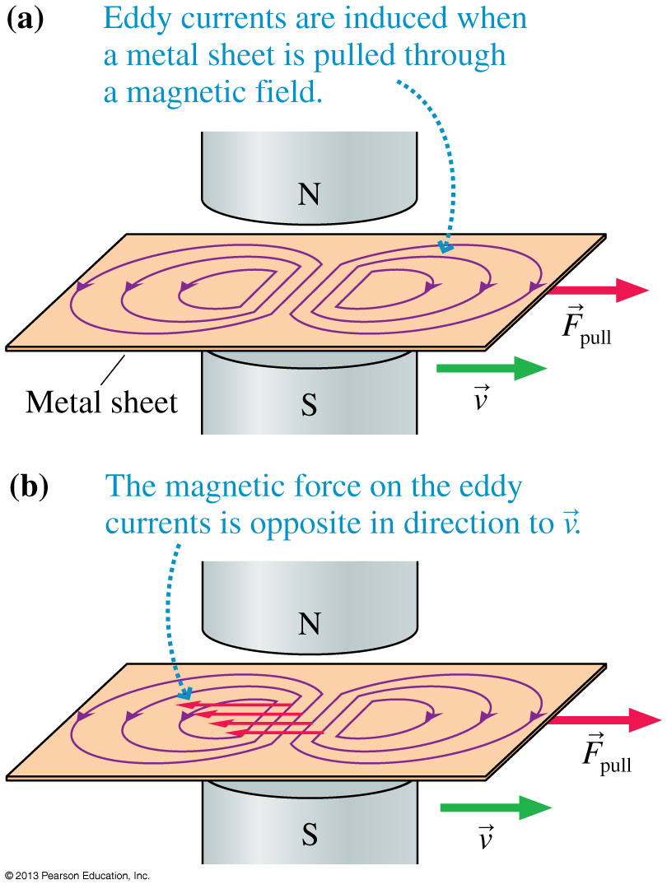
Magnetic Braking
Consider pulling a sheet of metal through a magnetic field.
Two “whirlpools” of current begin to circulate in the solid metal, called eddy currents.
The magnetic force on the eddy currents is a retarding force.
This is a form of magnetic braking.

Slide 20
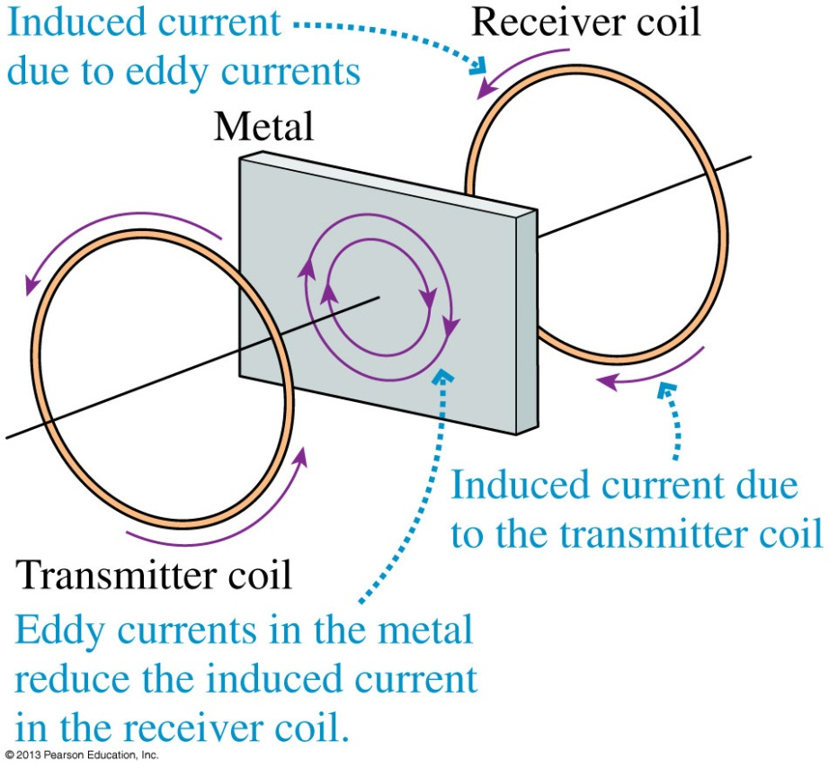
Metal Detectors
A metal detector consists of two coils: a transmitter coil and a receiver coil.
A high-frequency AC current in the transmitter coil causes a field which induces current in the receiver coil.
The net field at the receiver decreases when a piece of metal is inserted between the coils.
Electronic circuits detect the current decrease in the receiver coil and set off an alarm.

Slide 21
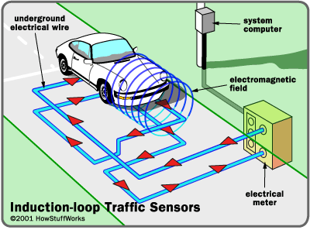
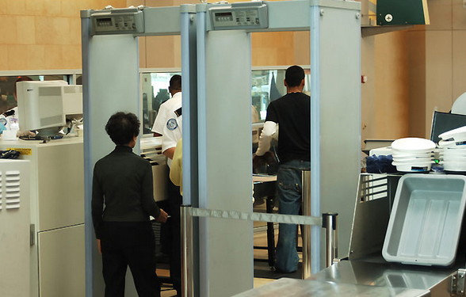
Metal Detectors
Activation of traffic lights by a car moving over underground coils of wire
Triggering security system at the airport by altering magnetic field in the coils as one walks through

Slide 22
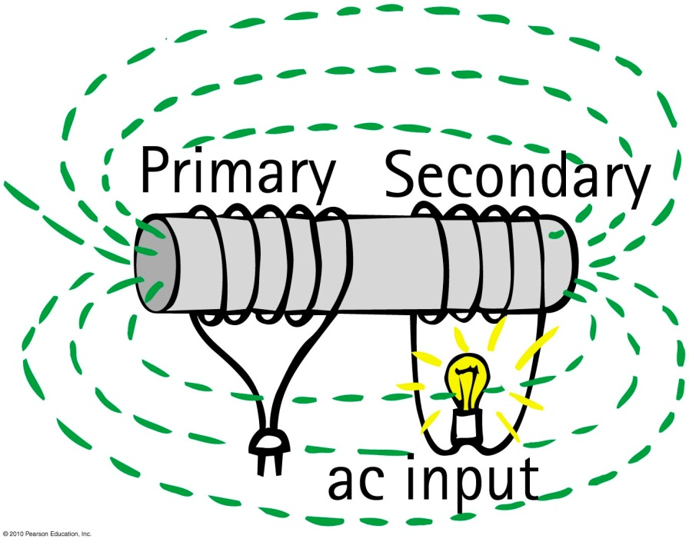
Transformers
output
Input coil of wire—the primary powered by ac voltage source
Output coil of wire—the secondary connected to an external circuit

Slide 23
Transformers
Step-up transformer
produces a greater voltage in the secondary than supplied by the primary
secondary has more turns in coil than the primary
Step-down transformer
produces a smaller voltage in the secondary than supplied by the primary
secondary has less turns in coil than the primary

Slide 24
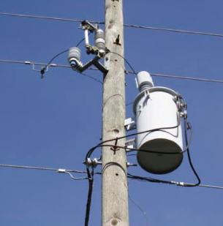
Transformers
Transformer relationship:
Primary voltage
secondary
voltage
=
Number of primary turns
number
of
secondary
turns
A common neighbourhood transformer typically steps 2400 volts down to 240 volts for houses and small businesses.

Slide 25
A step-down transformer outside your house takes 2400 Volt input AC from the sub-station, and outputs 240 Volts into your house (which is then further split to 120 V to your plugs). If the primary coil in this transformer contains 300 turns of wire, how many turns of wire should be in the secondary coil?
Power Production
CHECK YOUR NEIGHBOR
3
30
300
3000
30,000
Notes:
A. voltage.

Slide 26
Transformers
Transformer transfers energy from one coil to another.
Rate of energy transfer is power.
Power into primary ≥ power out of secondary
or, neglecting small heat losses:
(Voltage × current)_{primary} = (voltage × current)_{secondary}

Slide 27
A step-up transformer in an electrical circuit can step up
Power Production
CHECK YOUR NEIGHBOR
A. voltage.
energy.
Both A and B.
Neither A nor B.
Notes:
A. voltage.

Slide 28
Power Transmission
Almost all electric energy sold today is in the form of ac because of the ease with which it can be transformed from one voltage to another.
Large currents in wires produce heat and energy losses, so power is transmitted great distances at high voltages and low currents.
Power is generated at 25,000 V or less and is stepped up near the power station to as much as 750,000 V for long-distance transmission.
It is then stepped down in stages at substations and distribution points to voltages needed in industrial applications (often 440 V or more) and for the home (240 and 120 V).

Slide 29
Power Transmission; Calculation
Power is generated in Niagara Falls, and the current is sent down a 6-cm diameter copper wire that is 120 km long, which ends in Toronto.
Each wire has a resistance of 0.5 Ω.
In Toronto, you have house which wants to use 100 Watts of electricity.
What is the rate of heat loss in the long-distance wire if the power is delivered at 120 V?
What is the rate of heat loss in the long-distance wire if the power is delivered at 750,000 V?

Slide 30
Power Transmission; Calculation
What is the rate of heat loss in the long-distance wire if the power is delivered at 120 V?
0.5 Ω
+120 V
P = 100 W
$$I=\frac{P}{V}=0.83 A$$
0 V
0.5 Ω
Total current through wires needed to deliver 100 Watts to Toronto is 0.83 Amps.
Voltage drop along each wire is $V=IR=\left(0.83\right)\left(0.5\right)=0.4 V$
Heat loss rate in each wire is $P=IV=\left(0.83\right)\left(0.4\right)=0.3$ Watts
0.3% inefficiency for a single light-bulb in Toronto

Slide 31
Power Transmission; Calculation
What is the rate of heat loss in the long-distance wire if the power is delivered at 120 V 750,000 V?
0.5 Ω
+120 V 750,000 V
P = 100 W
$$I=\frac{P}{V}=0.83 A 0.0001 A$$
0 V
0.5 Ω
Total current through wires needed to deliver 100 Watts to Toronto is 0.83 0.0001 Amps.
Voltage drop along each wire is $V=IR=\left(0.83 0.0001\right)\left(0.5\right)=0.4 V$ 0.00005 V
Heat loss rate in each wire is $P=IV=\left(0.83 0.0001\right)\left(0.4 0.00005\right)=0.3$ 5×10⁻⁹ Watts
Efficiency increased by a factor of 40 million (~V²)

Slide 32
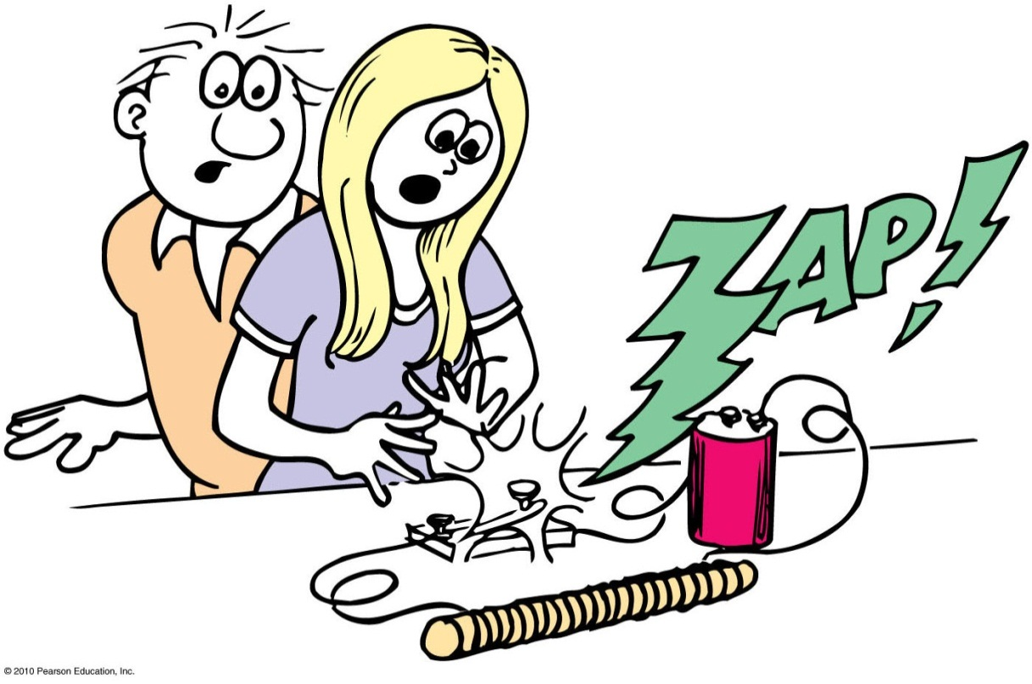
Self-Induction
Current-carrying loops in a coil interact not only with loops of other coils but also with loops of the same coil.
Each loop in a coil interacts with the magnetic field around the current in other loops of the same coil. This is self-induction.
When the switch is opened, the magnetic field of the coil collapses. This sudden change in the field can induce a huge voltage.

Slide 33
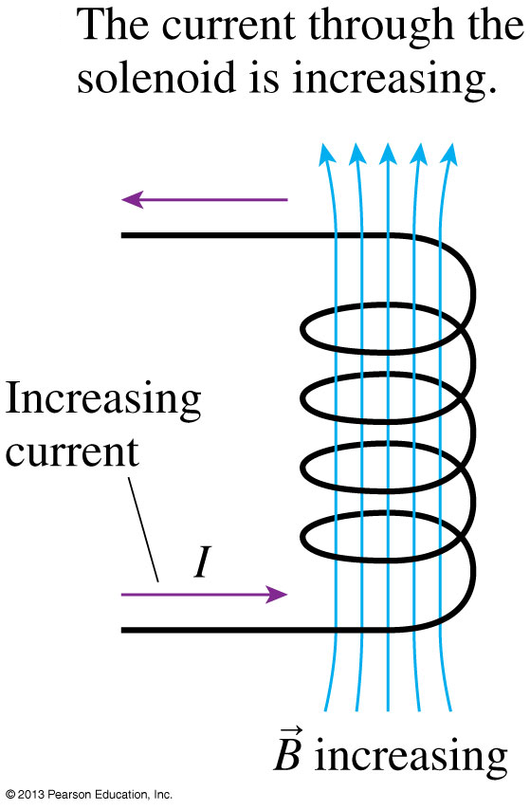
Self Induction
The current through the coil is increasing
Electric current in a coil creates a magnetic field.
As the current is increasing, the magnetic field increasing, so it must induce an electric field.

Slide 34
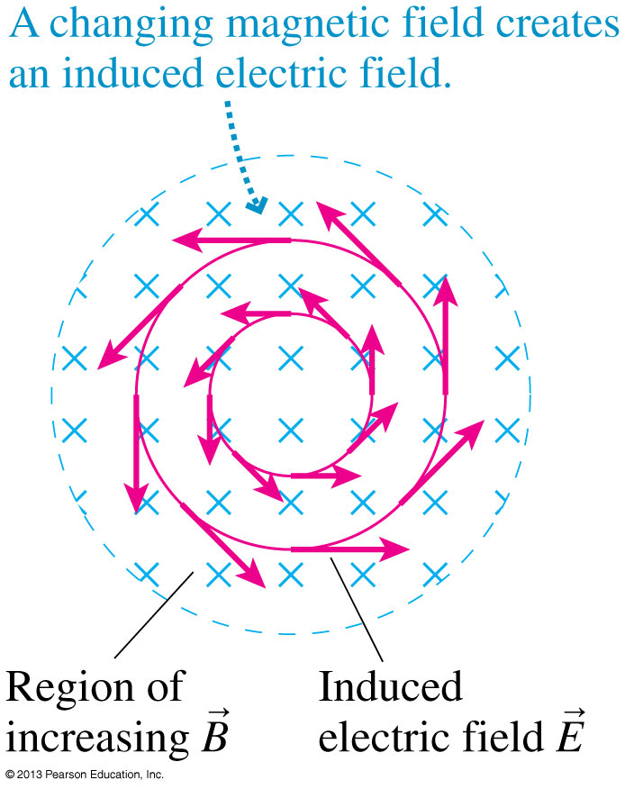
Looking down the coil..
As the magnetic field changes, it creates an electric field, which then can “self-induce” a current in the coil.
This is a direct consequence of Faraday’s Law.

Slide 35
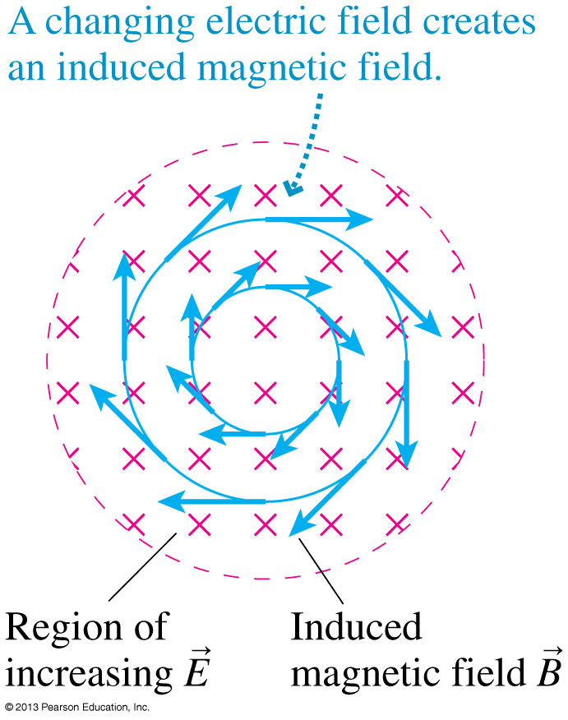
The Induced Magnetic Field
As we know, changing the magnetic field induces a circular electric field.
Symmetrically, changing the electric field induces a circular magnetic field!
The induced magnetic field was first suggested as a possibility by James Clerk Maxwell in 1855.

Slide 36
Field Induction
Electromagnetic induction is a “two-way street.”
Faraday’s law:
An electric field is induced in any region of space in which a magnetic field is changing with time
Maxwell’s counterpart to Faraday’s law:
A magnetic field is induced in any region of space in which an electric field is changing with time

Slide 37
The mutual induction of electric and magnetic fields can produce
Field Induction
CHECK YOUR NEIGHBOR
A. light.
energy.
sound.
None of the above.
Notes:
A. light.

Slide 38
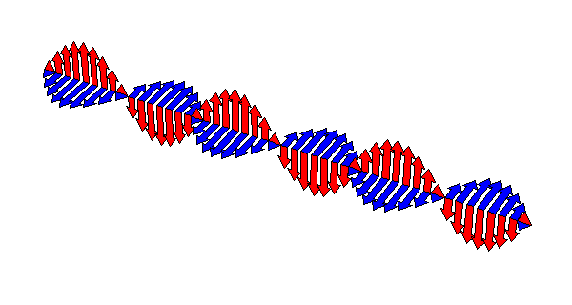
Maxwell’s Theory of Electromagnetic Waves
A changing electric field creates a magnetic field, which then changes in just the right way to recreate the electric field, which then changes in just the right way to again recreate the magnetic field, and so on.
This is an electromagnetic wave.

Slide 39
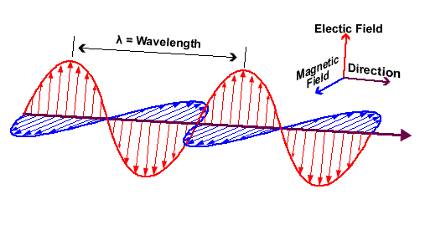
An electromagnetic wave (light) is traveling from left to right, as shown. At point P, what does the upward-pointing red arrow mean?
Field Induction
CHECK YOUR NEIGHBOR
The electric wave passes above the point P.
A maximum amount of light is at point P.
Photons are traveling upward at the point P.
A positive electric charge at P would be pushed upward by the electric force.
P
Notes:
A. light.

Slide 40
An electromagnetic wave (light) is traveling from left to right, as shown. At point P, what does the blue arrow mean, which is pointing out of the page?
Field Induction
CHECK YOUR NEIGHBOR
A compass at P would point out of the page.
The magnetic wave passes in front of point P.
A minimum amount of light is at point P.
Photons are traveling out of the page at the point P.
P
Notes:
A. light.

Slide 41
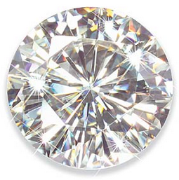
Before class on Wednesday
Please read Chapter 26, or at least watch the 10-minute pre-class video for class 20.
Something to think about:
Photons must travel at exactly the speed of light, 300,000 km/s. So how is it possible that light travels slower than this inside water or glass?

