Slide 1
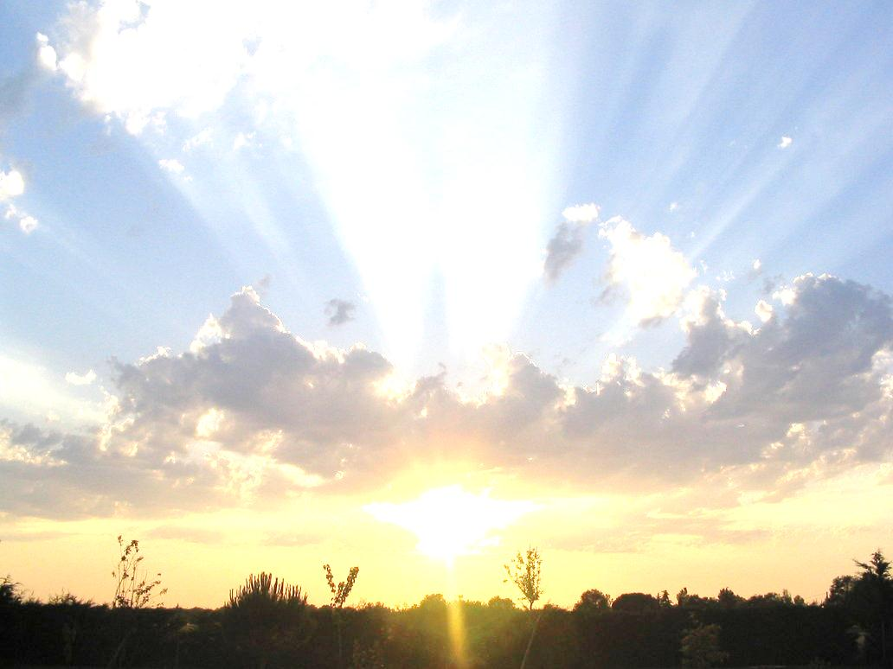
Conceptual Physics 11th Edition
Chapter 26:
PROPERTIES OF LIGHT
Electromagnetic Waves
The Electromagnetic Spectrum
Transparent Materials
Opaque Materials
Seeing Light—The Eye

Slide 2
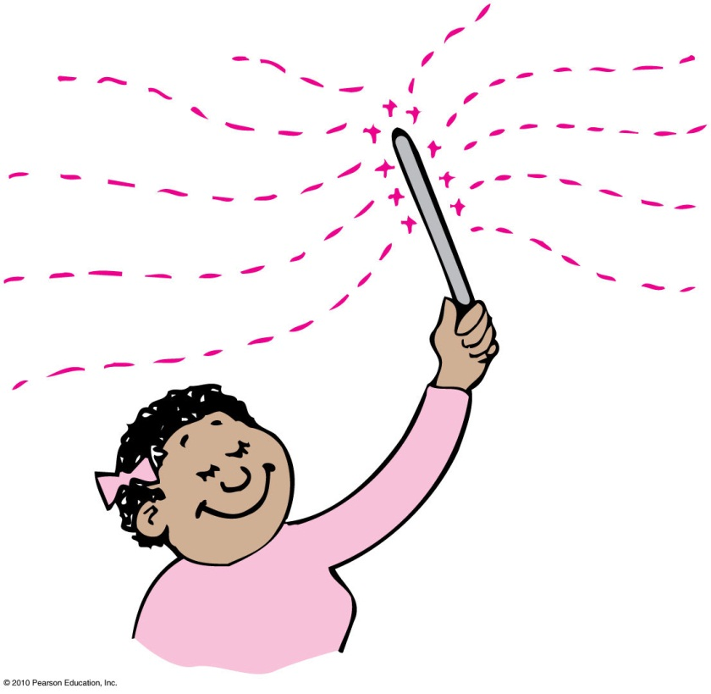
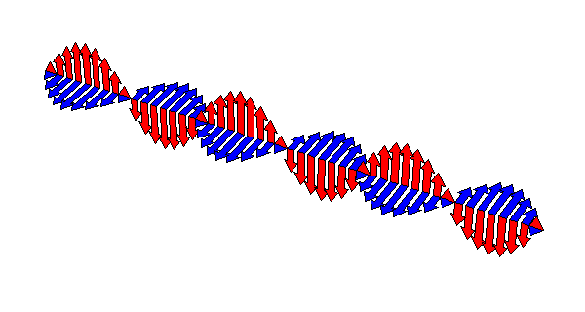
Electromagnetic Waves
Any time you shake an electrically charged object back and forth, you produce an electromagnetic wave.

Slide 3
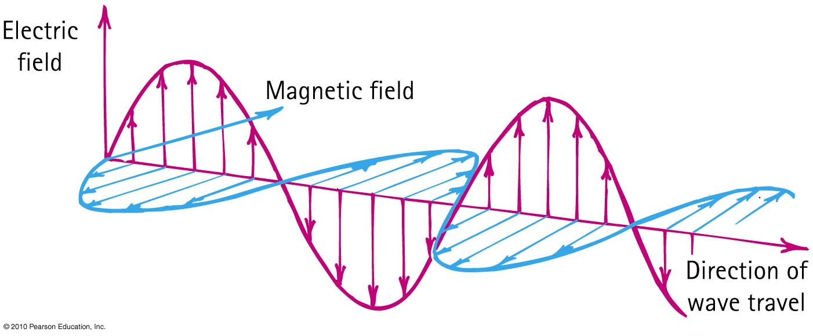
Electromagnetic Waves
The electric and magnetic fields of an electromagnetic wave are perpendicular to each other and to the direction of motion of the wave.

Slide 4
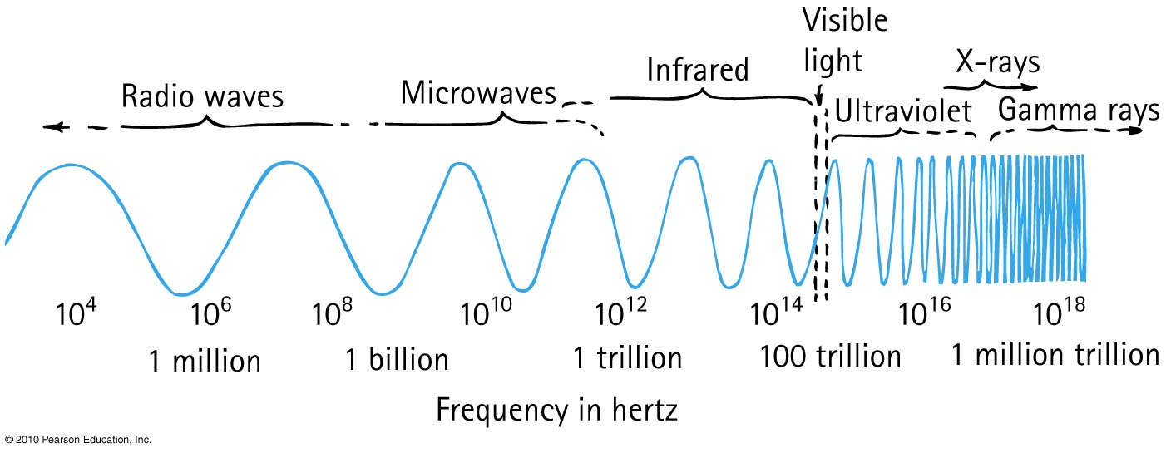
Electromagnetic Spectrum
In a vacuum, all electromagnetic waves move at the same speed
We classify electromagnetic waves according to their frequency (or wavelength)
Light is one kind of electromagnetic wave

Slide 5
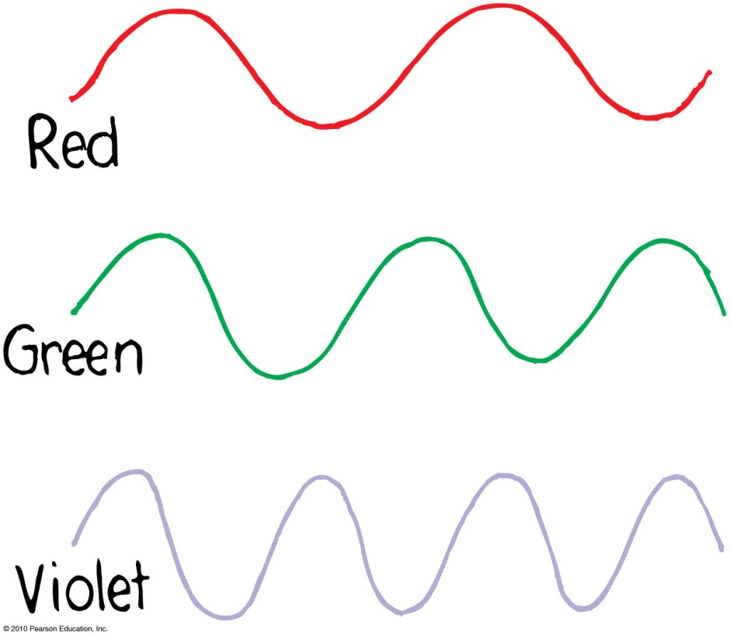
Electromagnetic Spectrum
The lowest frequency (and longest wavelength) light our eyes can see appears red
As the frequency increases, the light goes through the colors: orange, yellow, green, blue, violet
Violet light has nearly twice the frequency of red light, and half the wavelength

Slide 6
Transparent Materials
Glass blocks both infrared and ultraviolet, but it is transparent to visible light.

Slide 7
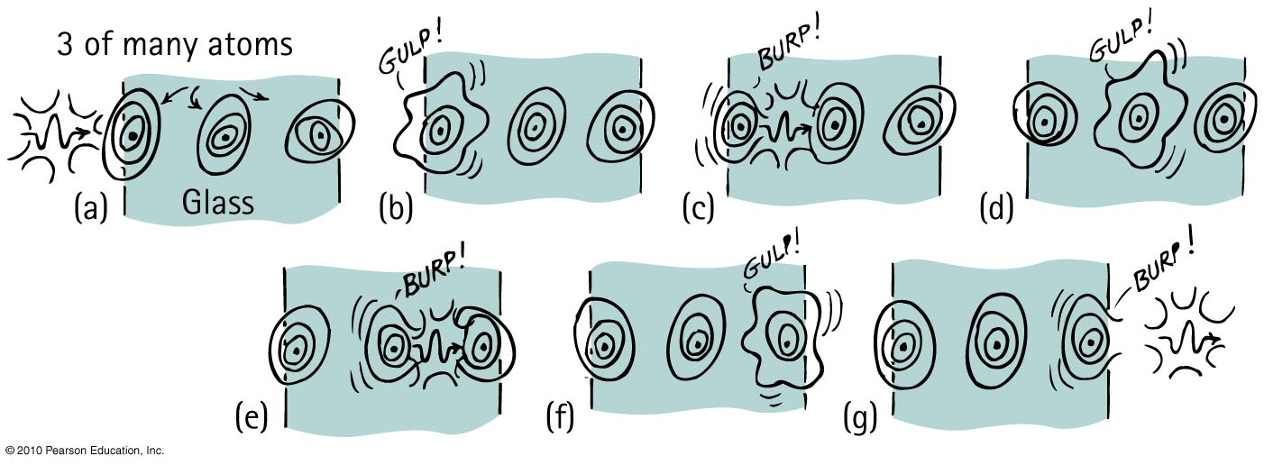
Transparent Materials
Averaged over many molecules, light travels more slowly through a transparent material than through a vacuum.

Slide 8
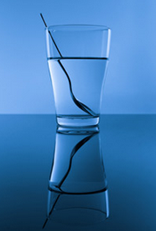
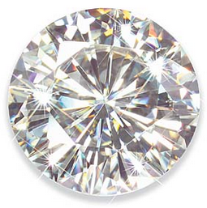
Transparent Materials
Average speed of light through different materials
Vacuum: c = 300,000,000 m/s
Atmosphere: slightly less than c (but rounded off to c)
Water: 0.75 c
Glass: 0.67 c, depending on material
Diamond: 0.41 c

Slide 9
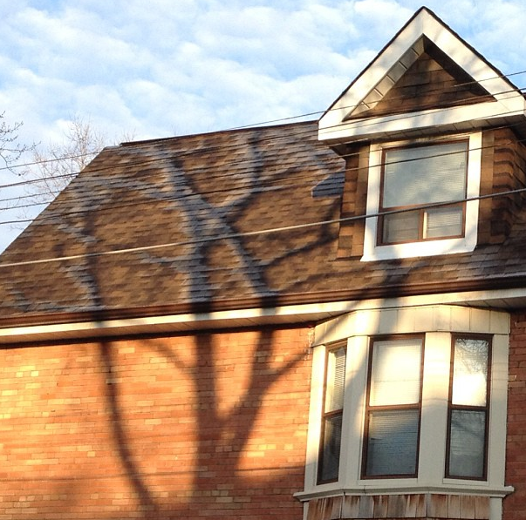
Opaque Materials
Most things around us are opaque—they absorb light without re-emitting it.
Vibrations given by light to their atoms and molecules are turned into random kinetic energy—into internal energy.
These materials become slightly warmer.

Slide 10
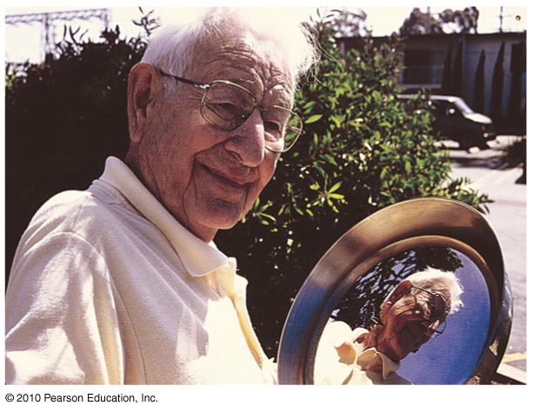
Opaque Materials
Metals
Light shining on metal forces free electrons in the metal into vibrations that emit their own light as reflection.

Slide 11
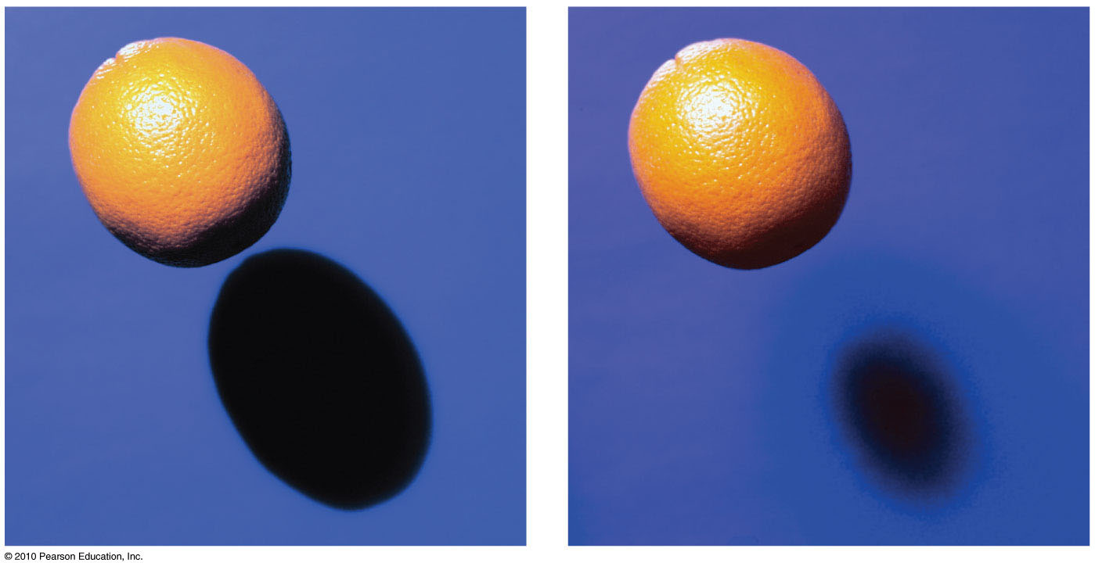
Rays and Shadows
A very distant or small light source will produce a sharp shadow.
A larger or more nearby light source produces a blurry shadow.

Slide 12
Shadows
The dark part inside a shadow where the light is totally blocked is called an umbra.
The penumbra is a lighter part around the edges of a shadow, where light from a broad source is only partially blocked.

Slide 13
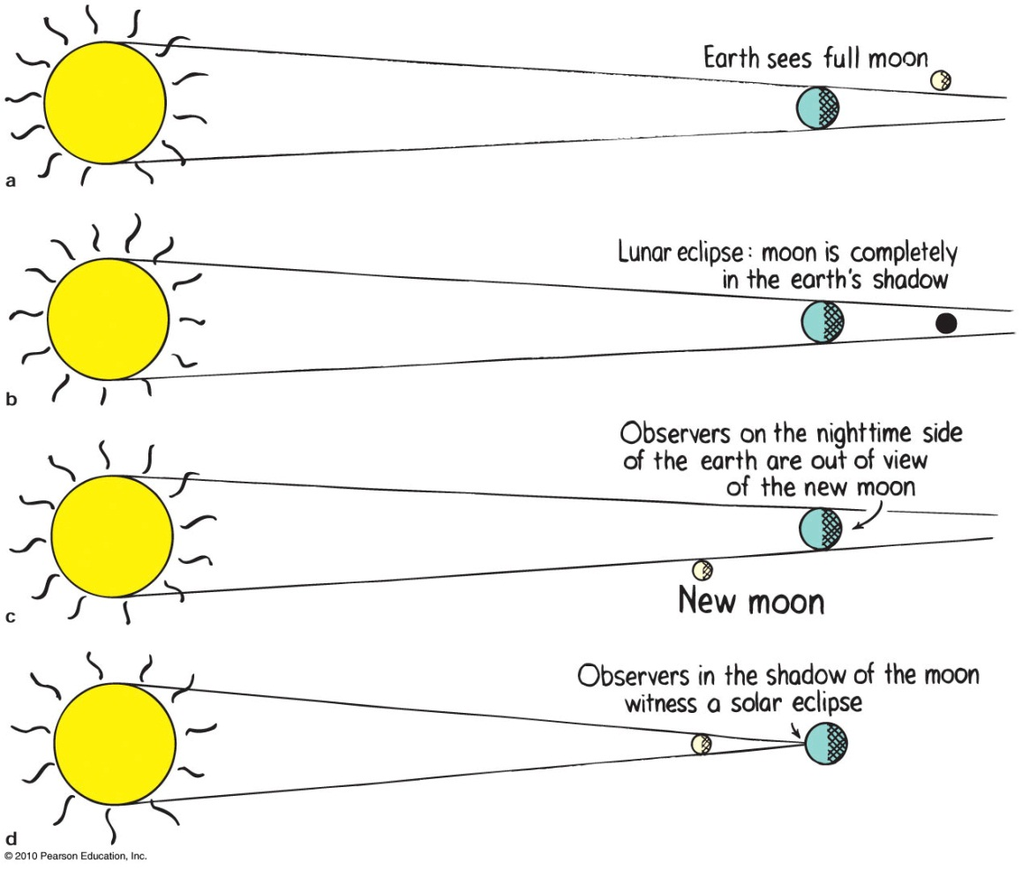

Slide 14
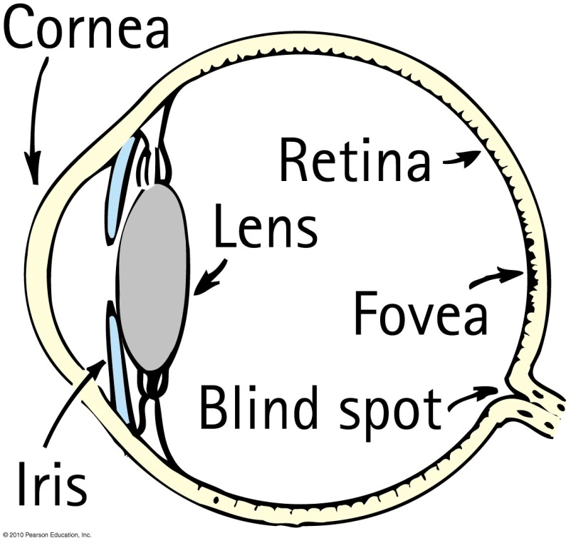
Seeing Light – The Eye

Slide 15
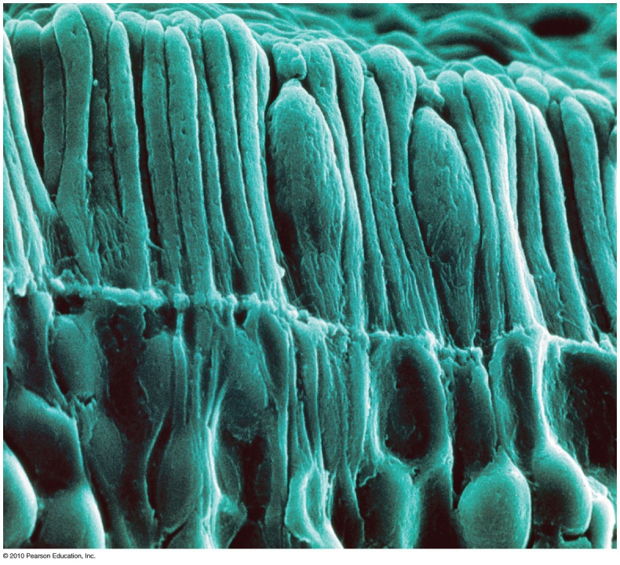
Seeing Light – The Eye
The retina is composed of tiny antennae that resonate to the incoming light.
Rods handle vision in low light.
They predominate toward the periphery of the retina.
Cones handle color vision and detail.
They are denser toward the fovea.
There are three types of cones, stimulated by low, intermediate and high frequencies of light.

