Slide 1
Note on Posted Slides
These are the slides that I intended to show in class on Wed. Mar. 27, 2013.
They contain important ideas and questions from your reading.
Due to time constraints, I was probably not able to show all the slides during class.
They are all posted here for completeness.

Slide 2
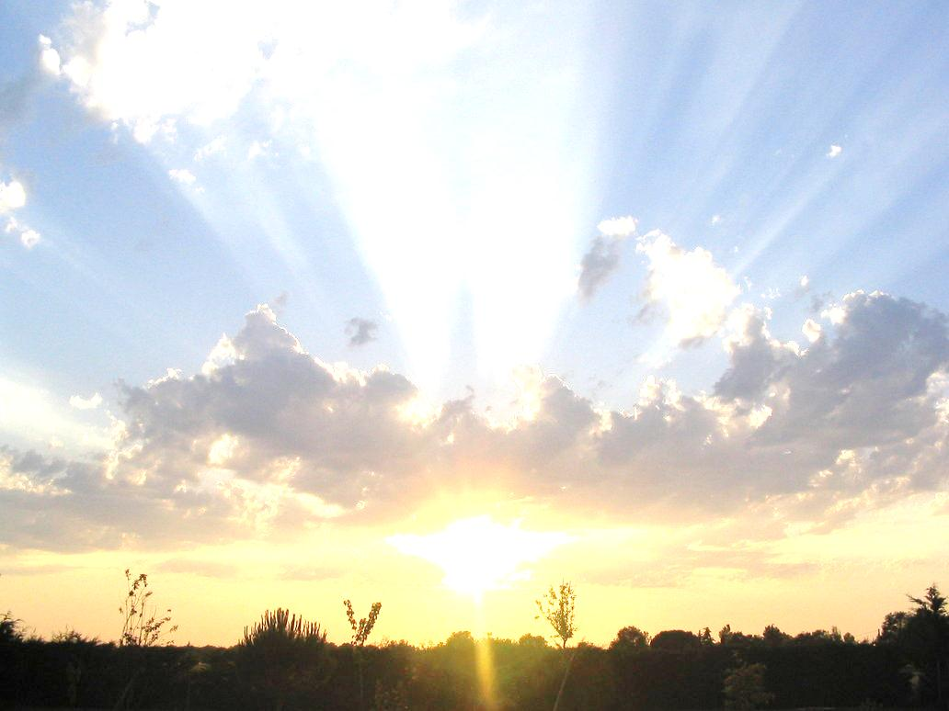
PHY205H1S Physics of Everyday Life Class 20: The Properties of Light
The History of Light
Electromagnetic Waves
The Electromagnetic Spectrum
Transparent Materials
Opaque Materials
Seeing Light—The Eye

Slide 3
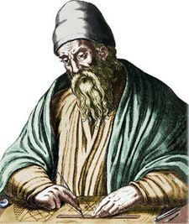
History of Light
300 B.C. – Euclid of Alexandria noted that light travels in straight lines, and wrote down the Law of Reflection for plane mirrors.
Unfortunately, Euclid believed that vision was due to our eyes emitting rays of light.

Slide 4
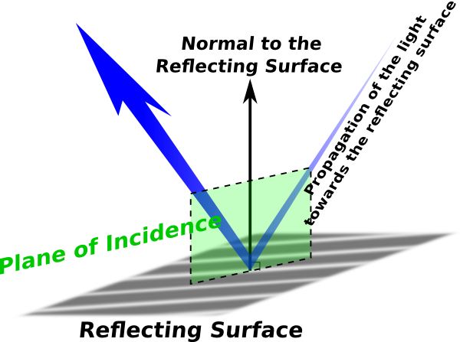
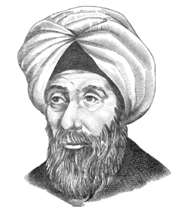
History of Light
1000 A.D. – Alhazen of Basra considered the law of reflection in 3-D, noting that the angles of incidence and reflection are in the same plane normal to the interface.
Alhazen proved experimentally that vision is due to light proceeding from objects into our eyes.
[image from http://www.clker.com/clipart-plane-of-incidence.html ]

Slide 5
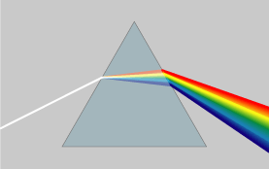
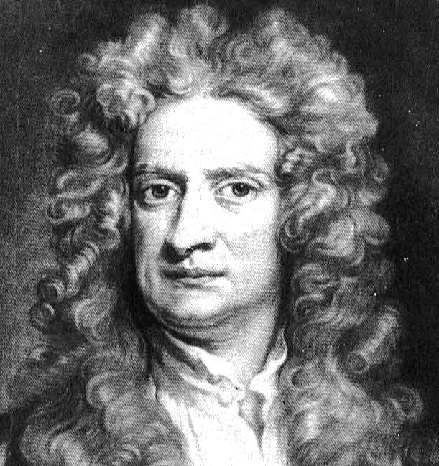
History of Light
1665 – Isaac Newton used a glass prism to disperse light and create a rainbow. He concluded that white light was composed of a mixture of a whole range of colours.
Unfortunately, Newton advocated the idea that light was a stream of particles, not a wave phenomenon.

Slide 6
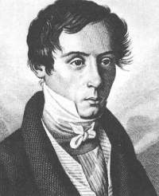
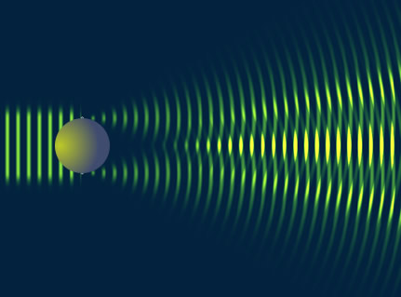
History of Light
1814 – Jean Fresnel promoted a wave theory of light, to explain fuzzy shadows, and interference.
Fresnel modelled light as a transverse wave (in something called the “aether”) and successfully predicted amplitudes of reflected and transmitted light from glass interfaces.
These successes convinced the scientific community that light was definitely a wave phenomenon.

Slide 7
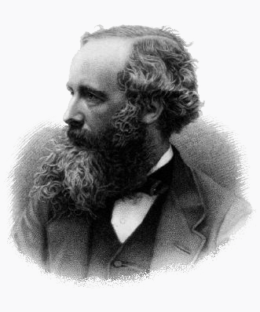
History of Light
1864 – James Clerk Maxwell published his equations describing the dynamic relations of the electric and magnetic fields.
Maxwell showed that disturbances in the electric and magnetic fields could propagate as a transverse wave, and he solved for the theoretical speed of this wave.
This speed was very close to the current experimental value, justifying his theory that light was an electromagnetic wave.

Slide 8
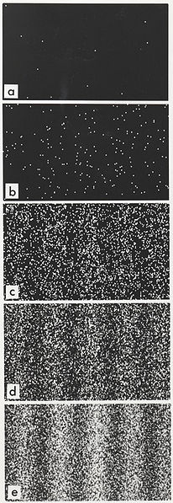
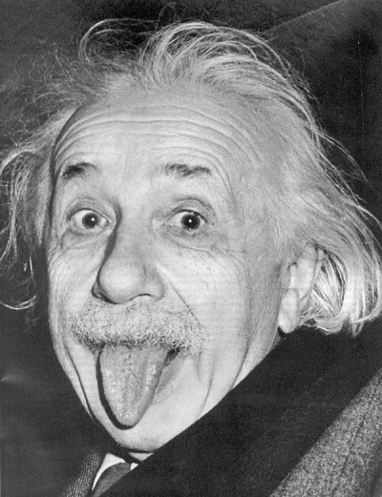
History of Light
1905 – Albert Einstein explained the photoelectric effect by proposing that light could only be delivered in globs or “particles” of energy (photons).
This lead to the theory of Quantum Mechanics, which states that every particle moves according to a wave equation which gives the probability density of its future location.
Thus, light is correctly understood as a stream of particles! But tiny particles move like waves.

Slide 9
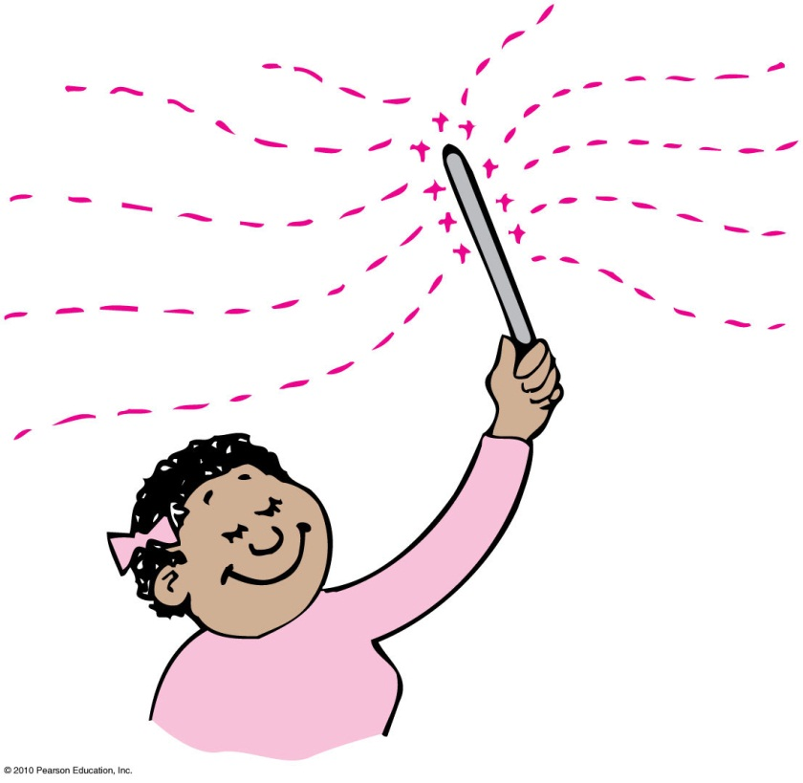
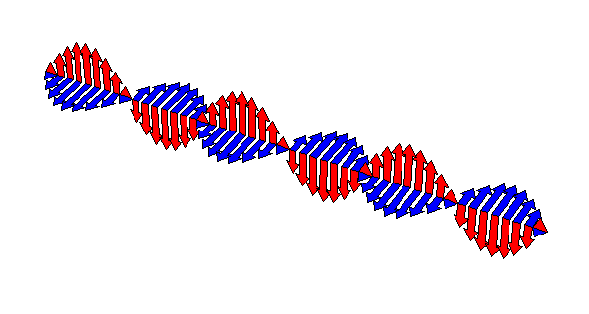
Electromagnetic Waves
Any time you shake an electrically charged object back and forth, you produce an electromagnetic wave.

Slide 10
Electromagnetic Waves
CHECK YOUR NEIGHBOUR
Consider the following three directions associated with a particular electromagnetic wave:
$\vec{E}$is the direction of electric field oscillations
$\vec{M}$is the direction of magnetic field oscillations
$\vec{v}$is the direction of wave motion
All 3 of $\vec{E}$, $\vec{M}$and $\vec{v}$ are parallel
All 3 of $\vec{E}$, $\vec{M}$and $\vec{v}$ are perpendicular
$\vec{B}$ and $\vec{v}$are parallel to each other, but both are perpendicular to $\vec{E}$
$\vec{E}$ and $\vec{M}$are parallel to each other, but both are perpendicular to $\vec{v}$
$\vec{E}$ and $\vec{v}$are parallel to each other, but both are perpendicular to $\vec{M}$

Slide 11
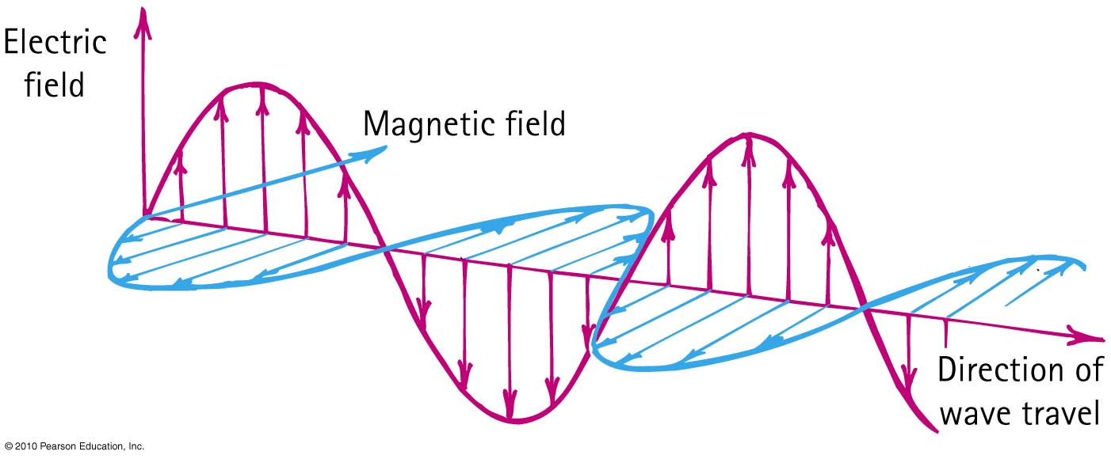
Electromagnetic Waves
The electric and magnetic fields of an electromagnetic wave are perpendicular to each other and to the direction of motion of the wave.

Slide 12
If an electron vibrates up and down 1000 times each second, it generates an electromagnetic wave with a
Electromagnetic Waves
CHECK YOUR NEIGHBOUR
A. period of 1000 s.
speed of 1000 m/s.
wavelength of 1000 m.
None of the above.
Notes:
D. none of the above.

Slide 13
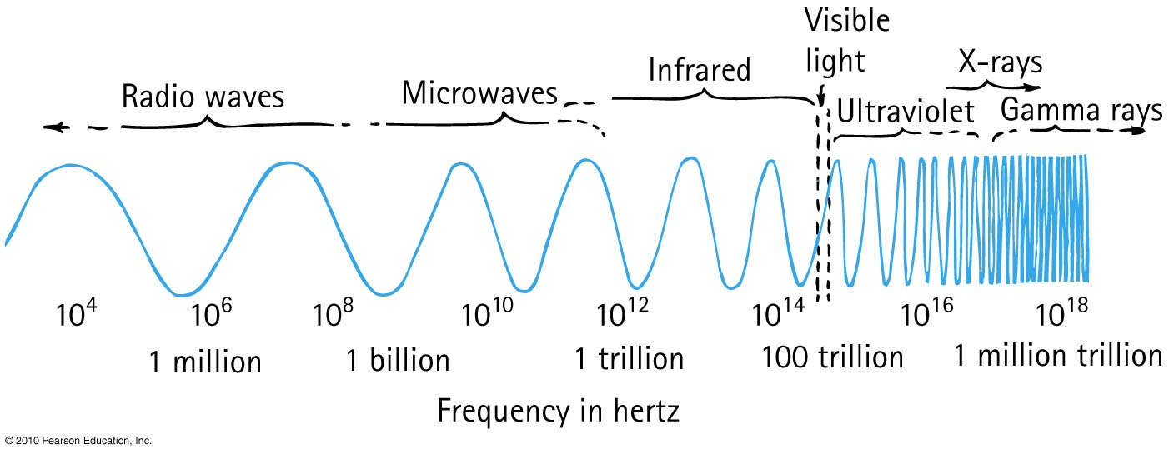
Electromagnetic Spectrum
In a vacuum, all electromagnetic waves move at the same speed
We classify electromagnetic waves according to their frequency (or wavelength)
Light is one kind of electromagnetic wave

Slide 14
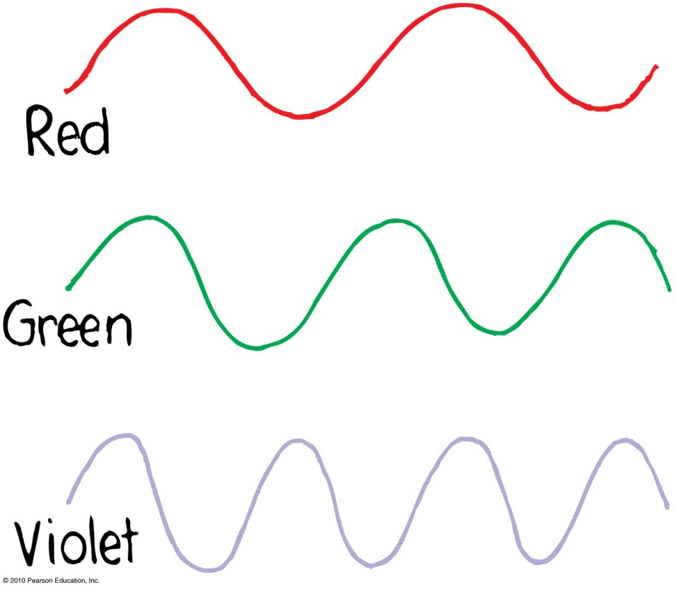
Electromagnetic Spectrum
The lowest frequency (and longest wavelength) light our eyes can see appears red
As the frequency increases, the light goes through the colors: orange, yellow, green, blue, violet
Violet light has nearly twice the frequency of red light, and half the wavelength

Slide 15
If a certain material is “transparent” (ie, not opaque), what does this mean?
Electromagnetic Waves
CHECK YOUR NEIGHBOUR
Electromagnetic waves of all frequencies can pass straight through it
Electromagnetic waves of all frequencies are reflected from its surface
Electromagnetic waves of all frequencies are absorbed throughout its volume
Electromagnetic waves of a certain frequency can pass straight through it
Notes:
D. none of the above.

Slide 16
Transparent Materials
Glass blocks both infrared and ultraviolet, but it is transparent to visible light.

Slide 17
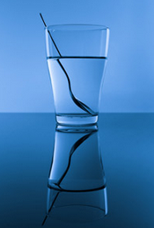
Refraction of Light
CHECK YOUR NEIGHBOUR
When light passes from water into air or vice-versa, it can bend its direction (making the spoon look broken below).
What causes this bending of the light rays?
Absorption due to resonance
Change in wave speed
Reflection
Scattering from small particles
Selective transmission

Slide 18
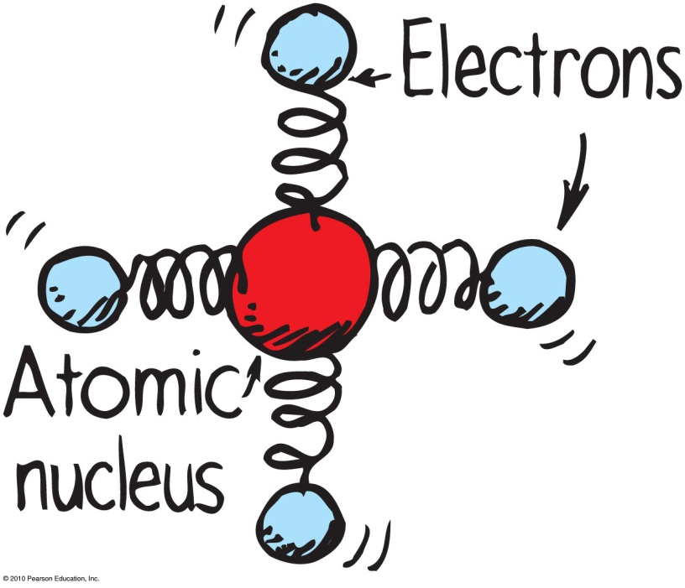
Light is transmitted similarly to sound.
Both are vibrations due to a vibrating source.

Slide 19
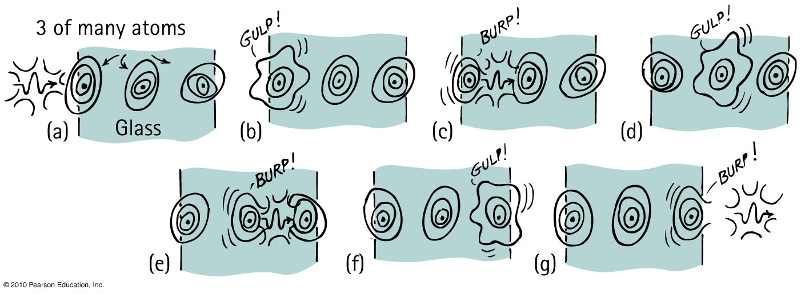
Photons can only travel at exactly the speed of light.
Each photon is absorbed an re-emitted each time it encounters an atom in a transparent material.
Averaged over many molecules, light travels more slowly through a transparent material than through a vacuum.

Slide 20
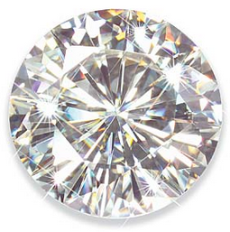
Transparent Materials
Average speed of light through different materials
Vacuum: c = 300,000,000 m/s
Atmosphere: slightly less than c (but rounded off to c)
Water: 0.75 c
Glass: 0.67 c, depending on material
Diamond: 0.41 c

Slide 21
Compared with the frequency of illuminating light on a piece of clear glass, the frequency of light that is transmitted into the glass
Transparent Materials
CHECK YOUR NEIGHBOUR
A. is less.
is the same.
is higher.
Notes:
B. the same.

Slide 22
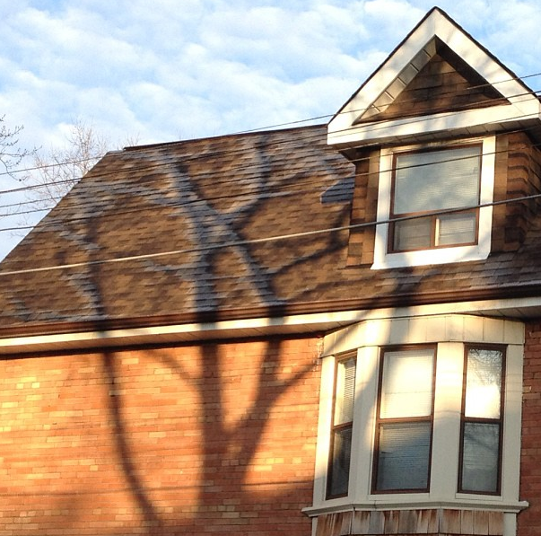
Opaque Materials
Most things around us are opaque—they absorb light without re-emitting it.
Vibrations given by light to their atoms and molecules are turned into random kinetic energy—into internal energy.
These materials become slightly warmer.

Slide 23
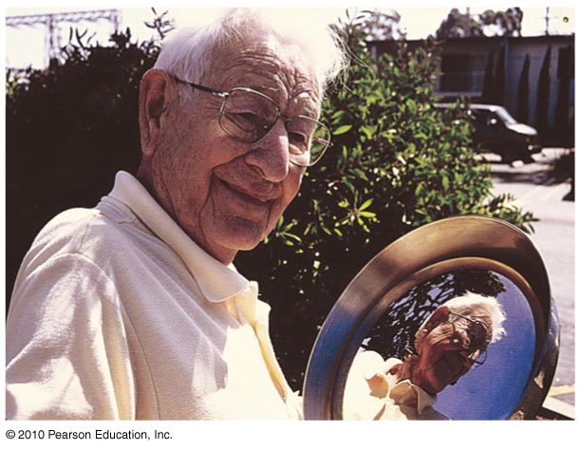
Opaque Materials
Metals
Light shining on metal forces free electrons in the metal into vibrations that emit their own light as reflection.

Slide 24
Which reflects more light, a white piece of paper or a black piece of paper?
Reflection
CHECK YOUR NEIGHBOUR
Black
White
About the same
Notes:
B. the same.

Slide 25
Which reflects more light, a white piece of paper or a mirror?
Reflection
CHECK YOUR NEIGHBOUR
White Paper
Mirror
About the same
Notes:
B. the same.

Slide 26
Mirror versus White Paper
Mirrors
The surface is flat at distance scales near or above the wavelength of light
It looks “shiny”, and you can see images in it.

Slide 27
Mirror versus White Paper
White Paper
The surface is rough at distance scales near or above the wavelength of light
Almost all surfaces reflect in this way!

Slide 28
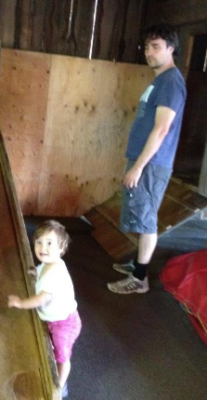
Harlow is looking at his daughter, Zainab. In terms of what physically allows him to see her, which arrow is best?
Reflection
CHECK YOUR NEIGHBOUR
A
B
Notes:
B. the same.

Slide 29
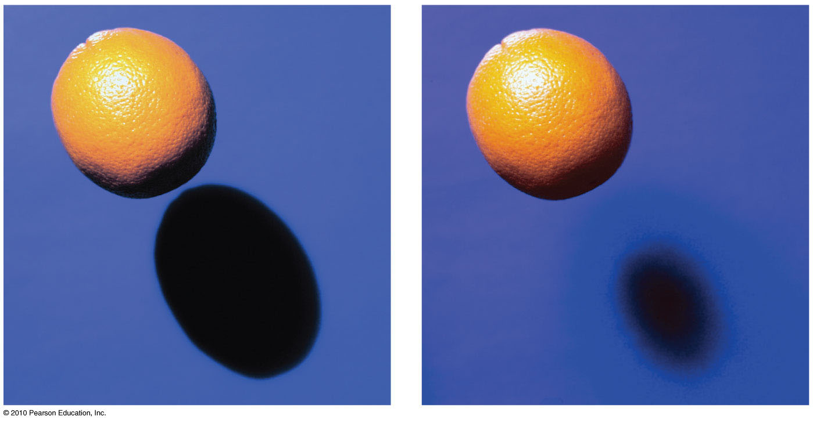
Rays and Shadows
A very distant or small light source will produce a sharp shadow.
A larger or more nearby light source produces a blurry shadow.

Slide 30
Shadows
The dark part inside a shadow where the light is totally blocked is called an umbra.
The penumbra is a lighter part around the edges of a shadow, where light from a broad source is only partially blocked.

Slide 31
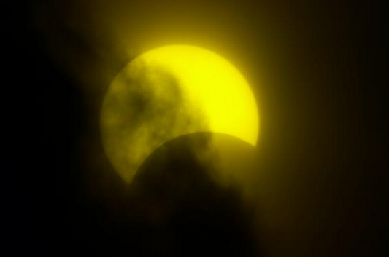
The photo shows a heavily filtered image of the sun during a partial solar eclipse. What is physically happening to cause this eclipse?
Reflection
CHECK YOUR NEIGHBOUR
Only the penumbra of the Earth’s shadow is falling on the moon.
Part of the umbra of the Earth’s shadow is falling on the moon.
The photographer is standing in the penumbra of the shadow of the moon which is falling on the Earth.
The photographer is standing in the umbra of the shadow of the moon which is falling on the Earth.
Notes:
B. the same.

Slide 32
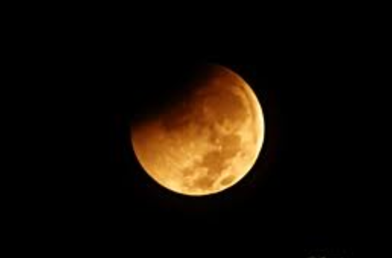
The photo shows an image of the moon during a partial lunar eclipse. What is physically happening to cause this eclipse?
Reflection
CHECK YOUR NEIGHBOUR
Only the penumbra of the Earth’s shadow is falling on the moon.
Part of the umbra of the Earth’s shadow is falling on the moon.
The photographer is standing in the penumbra of the shadow of the moon which is falling on the Earth.
The photographer is standing in the umbra of the shadow of the moon which is falling on the Earth.
Notes:
B. the same.

Slide 33
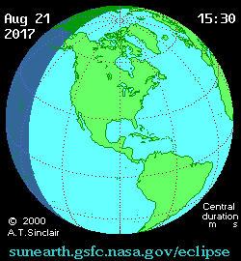
Total Solar Eclipse of August 21, 2017. Do NOT miss it!
…where will I be in 4 years from this summer?
Driving to Nashville, Tennesee!

Slide 34
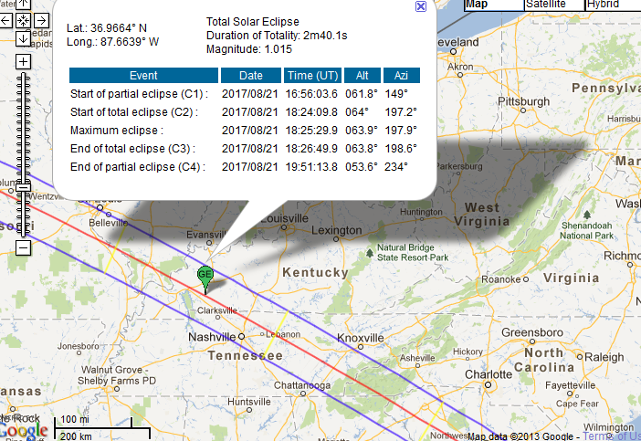
Total Solar Eclipse of August 21, 2017. Do NOT miss it!

Slide 35
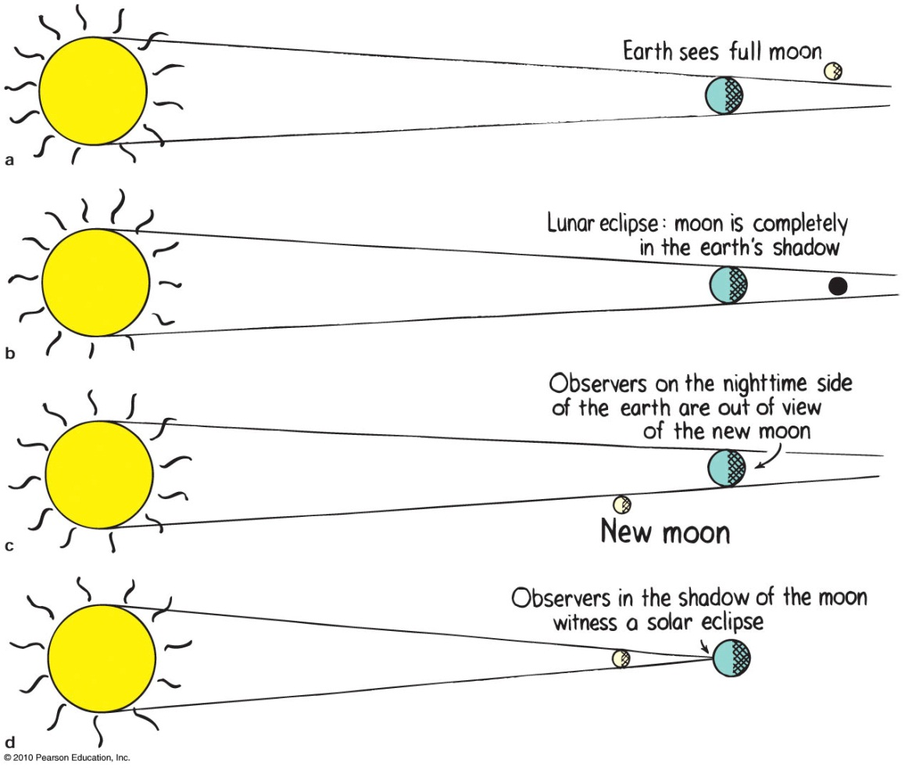

Slide 36
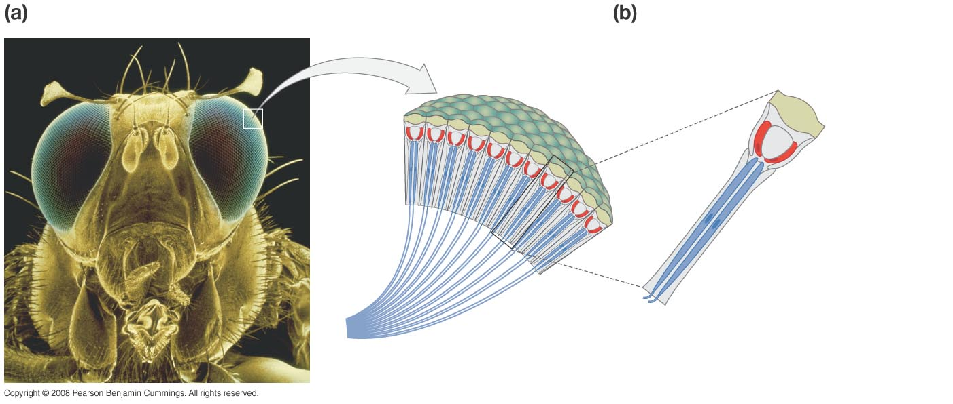
Insect eyes are compound!
Each ommatidium sends separate information to their brain.
Ommatidia are the functional units of insect eyes.
Ommatidia contain receptor cells that send axons to the insect’s brain.
Ommatidia
Lens
Receptor cells
Axons
Slide courtesy of Ross Koning, Biology Department, Eastern Connecticut State University
http://plantphys.info/sciencematters/vision.ppt
Notes:
36

Slide 37
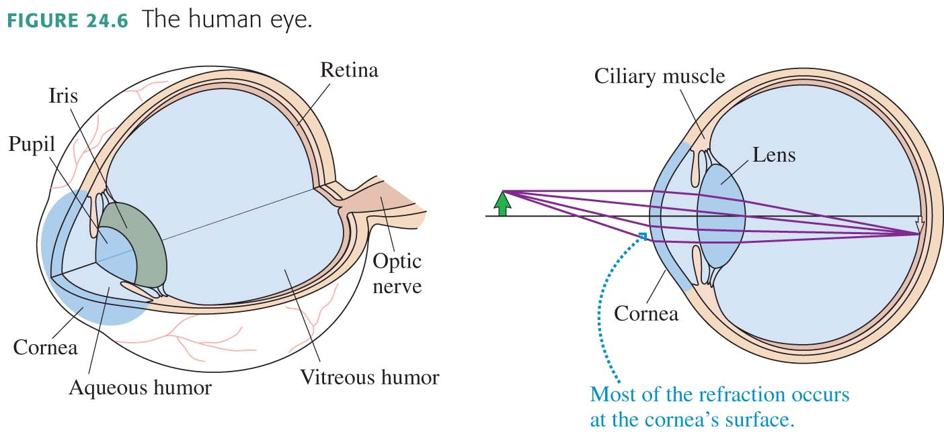

Slide 38
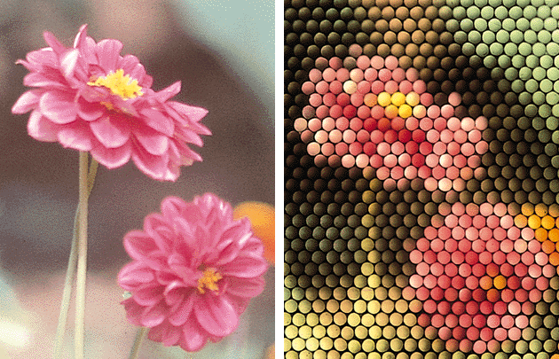
Human vs Insect Vision
Copyright Norton Presentation Manager
Slide courtesy of Ross Koning, Biology Department, Eastern Connecticut State University
http://plantphys.info/sciencematters/vision.ppt

Slide 39
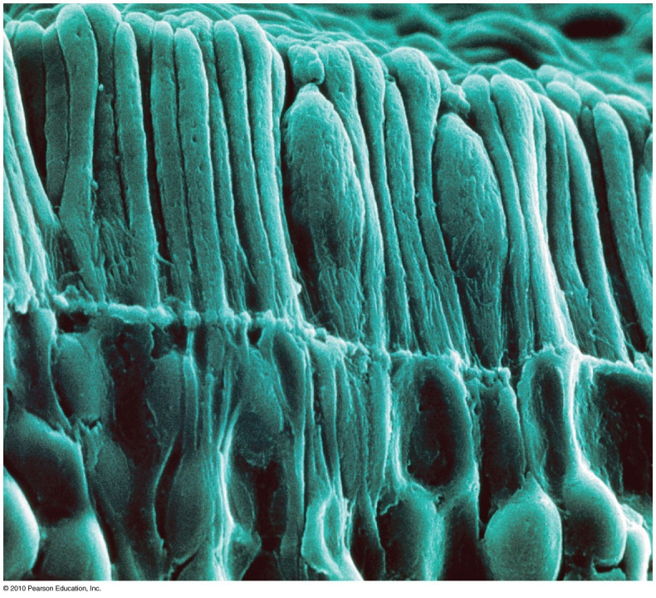
Seeing Light – The Eye
The retina is composed of tiny antennae that resonate to the incoming light.
Rods handle vision in low light.
They predominate toward the periphery of the retina.
Cones handle color vision and detail.
They are denser toward the fovea.
There are three types of cones, stimulated by low, intermediate and high frequencies of light.

Slide 40
Retina
The retina is filled with rods and cones
The spot where the optic nerve exits contains no receptors and is insensitive to light: blind spot (we don’t notice it because our brain fills in the gap with what it expects)
At the centre of the retina is the macula, which contains twice as many cones as rods
At the centre of the macula is the fovea centralis. It contains no rods, and the cones are very densely packed.
We constantly move our eyeballs to cause the light coming from the object of primary interest to fall on the fovea centralis.

Slide 41
Use right eye only (close left eye)…focus only on the target for this test!
Lock head in position…hold one finger up at arm’s length to cover view of target
Move arm slowly to the right, away from the target
Find your blind spot for that eye
Slide courtesy of Ross Koning, Biology Department, Eastern Connecticut State University
http://plantphys.info/sciencematters/vision.ppt

Slide 42
Use right eye only (close left eye)…our target is a row of numbers
1 2 3 4 5 6 7 8 9
Focus on each number in turn, until the break in the blue lines is in your blind spot. What is different when the blind spot holds a blank area?
Slide courtesy of Ross Koning, Biology Department, Eastern Connecticut State University
http://plantphys.info/sciencematters/vision.ppt

Slide 43
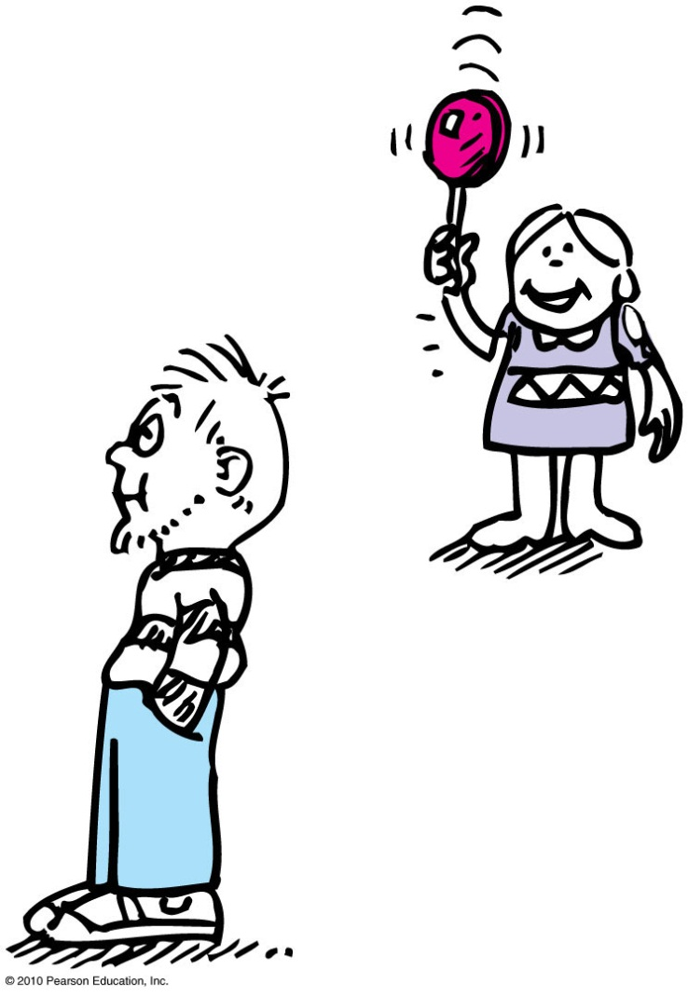
Seeing Light – The Eye
Although our vision is poor from the corner of our eye, we are sensitive to anything moving there.

Slide 44
Which half of this box is a lighter shade of gray?
Optical Illusions
CHECK YOUR NEIGHBOUR
The left half
The right half
Both halves are exactly the same shade of gray
I cannot tell!

Slide 45
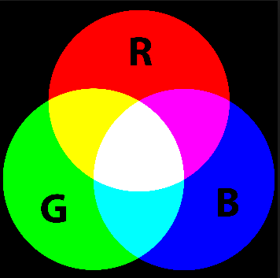
Before class on Monday
Please read Chapter 27, or at least watch the 10-minute pre-class video for class 20.
Something to think about:
Why are there exactly 3 “primary colours”? What physical property of the universe causes this?

