Slide 1
Conceptual Physics 11th Edition
Chapter 27:
COLOR
Color in Our World
Selective Reflection
Selective Transmission
Mixing Colored Light
Mixing Colored Pigments
Why the Sky Is Blue
Why Sunsets Are Red
Why Clouds Are White
Why Water Is Greenish Blue

Slide 2
Color
Color we see depends on frequency of light.
$$0.4 μm$$
$$0.7 μm$$
$$f$$
High Frequency,
Short wavelength
Low Frequency,
Long wavelength
$$λ$$

Slide 3
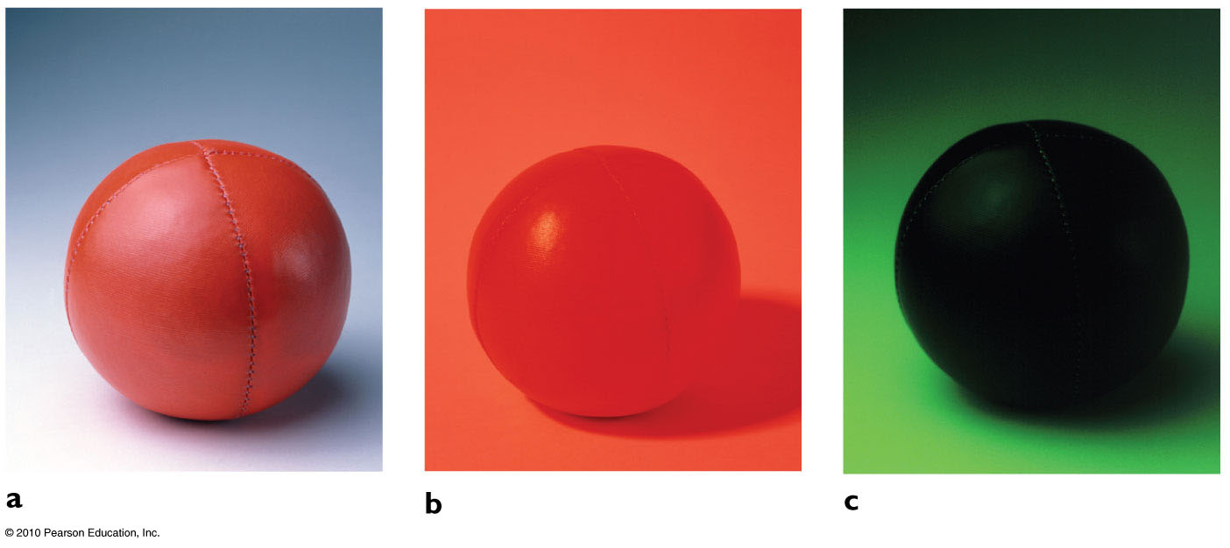
Selective Reflection
A red ball seen under white light.
Only red is reflected, other colors are absorbed.
A red ball seen under red light.
A red ball seen under green light.
There is no source of red light to reflect.

Slide 4
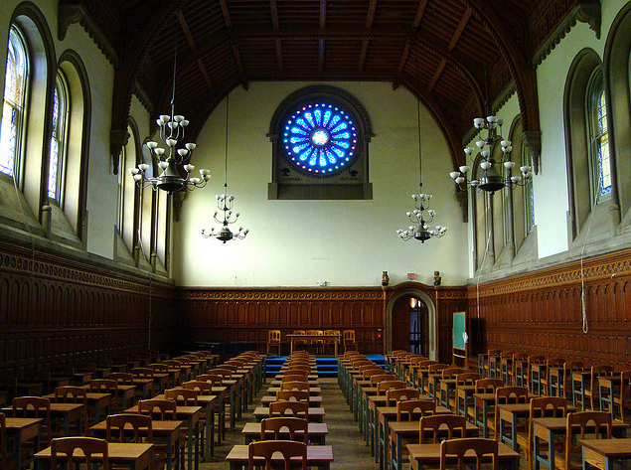
Selective Transmission
[image from http://www.flickr.com/photos/ricardipus/3571089449/in/set-72157607219489528 ]

Slide 5
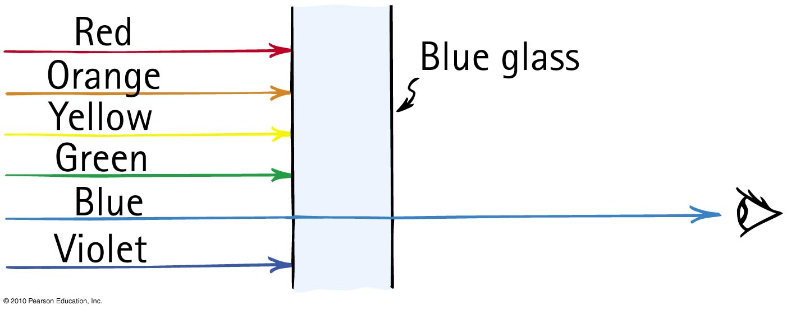
Selective Transmission
Color of transparent object depends on color of light it transmits.

Slide 6
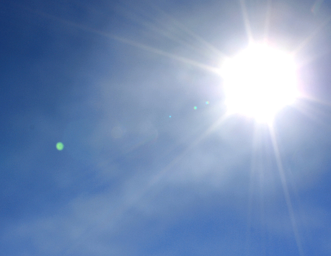
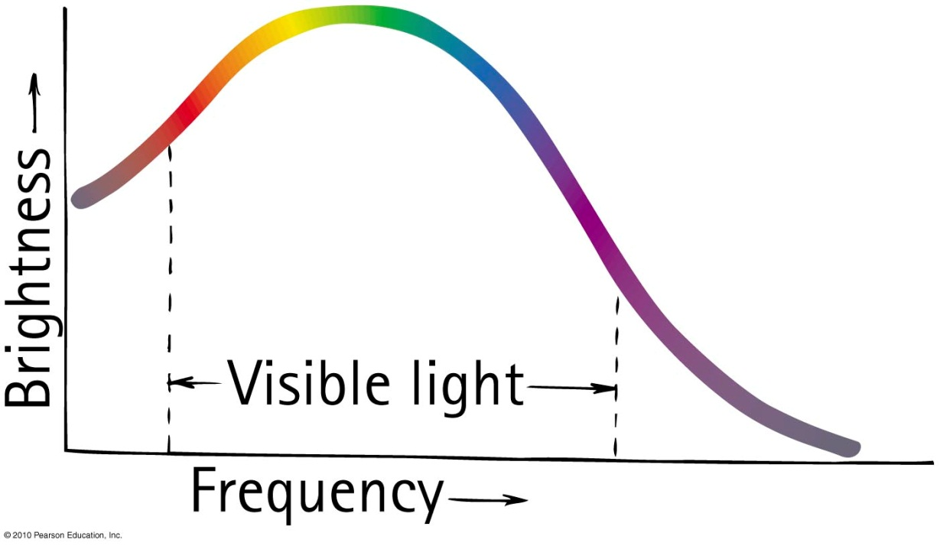
Mixing Colored Light
The spectrum of sunlight is a graph of brightness versus frequency.
Somehow, this mix looks “white” to us.

Slide 7
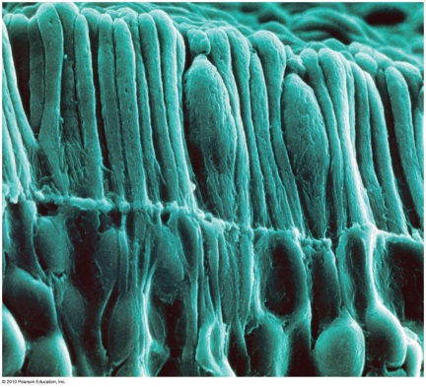
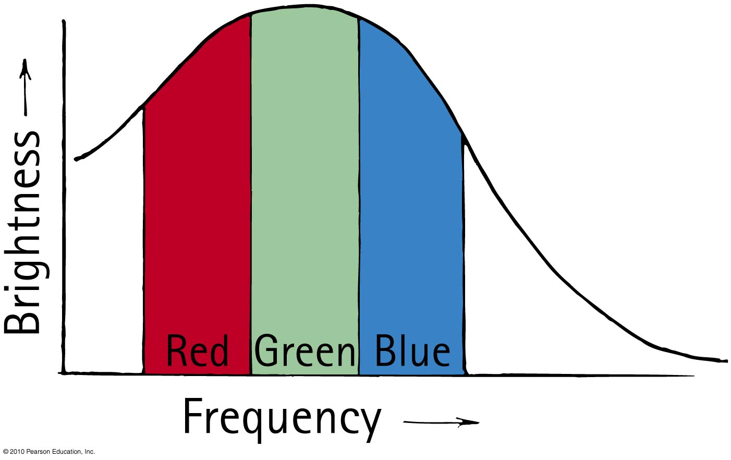
Radiation curve divides into three regions that match the color receptors in our eyes.

Slide 8
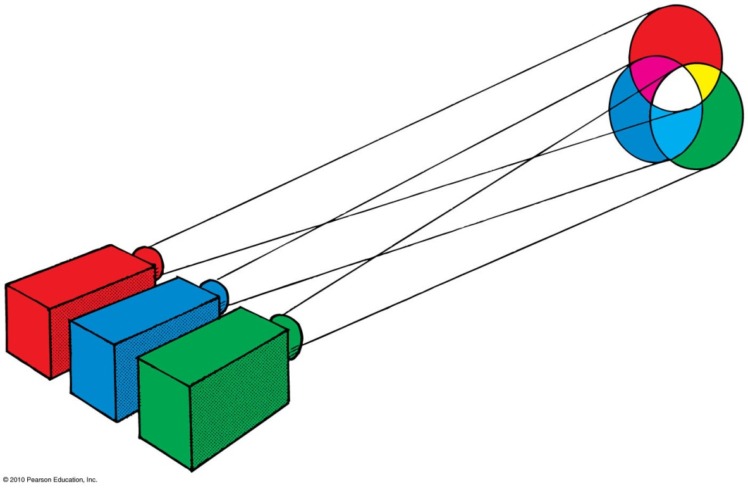
Additive primary colors:
Red, green, and blue

Slide 9
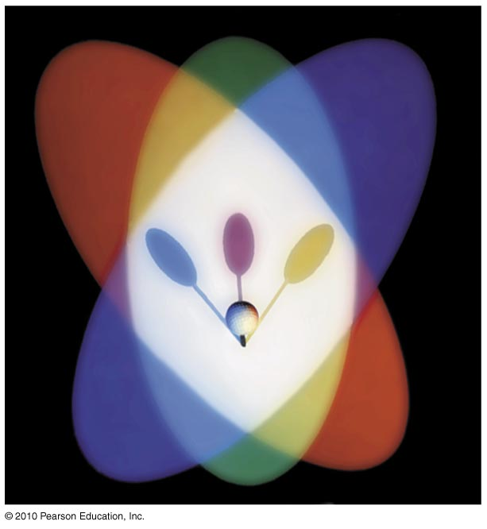
The shadows of the golf ball are the “subtractive primary colors”.
Cyan (opposite of red):
Magenta (opposite of green)
Yellow (opposite of blue)

Slide 10
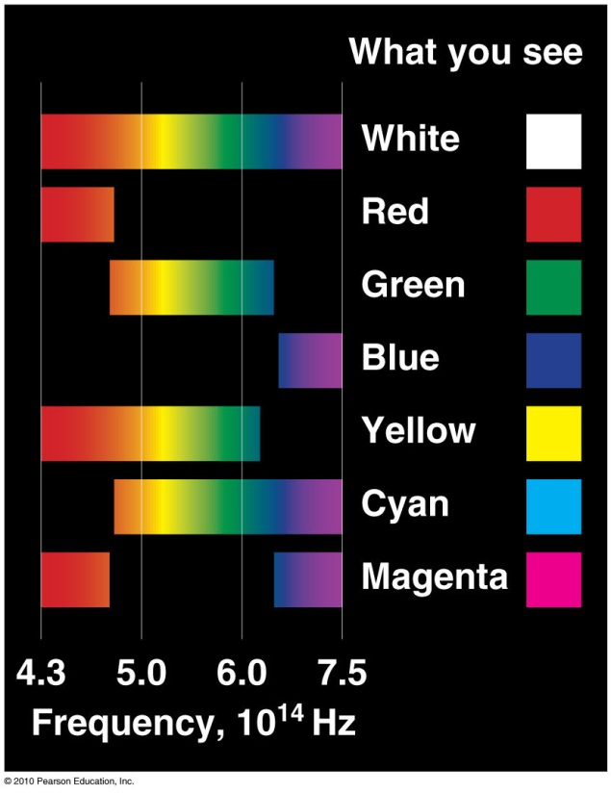

Slide 11
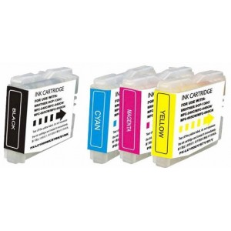
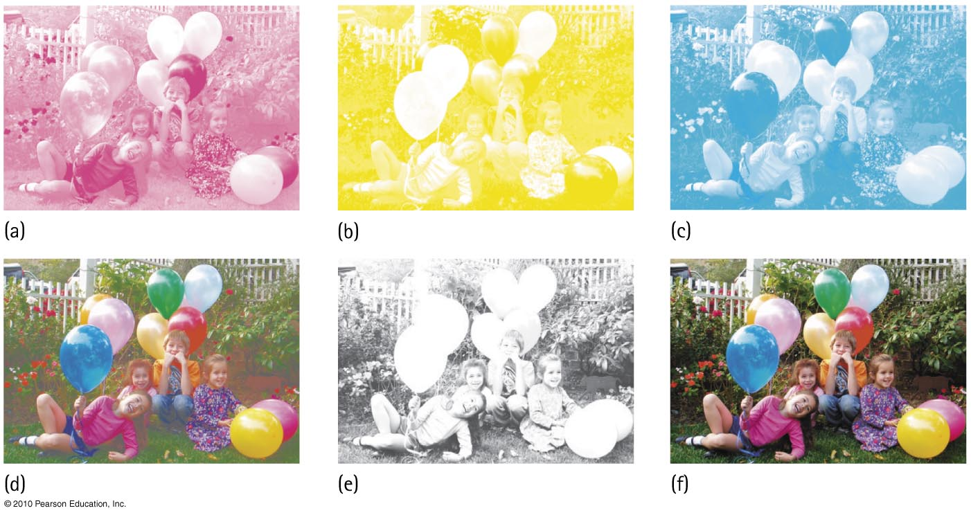
Only four colors of ink are used to print color photographs: magenta, yellow, cyan and black.

Slide 12
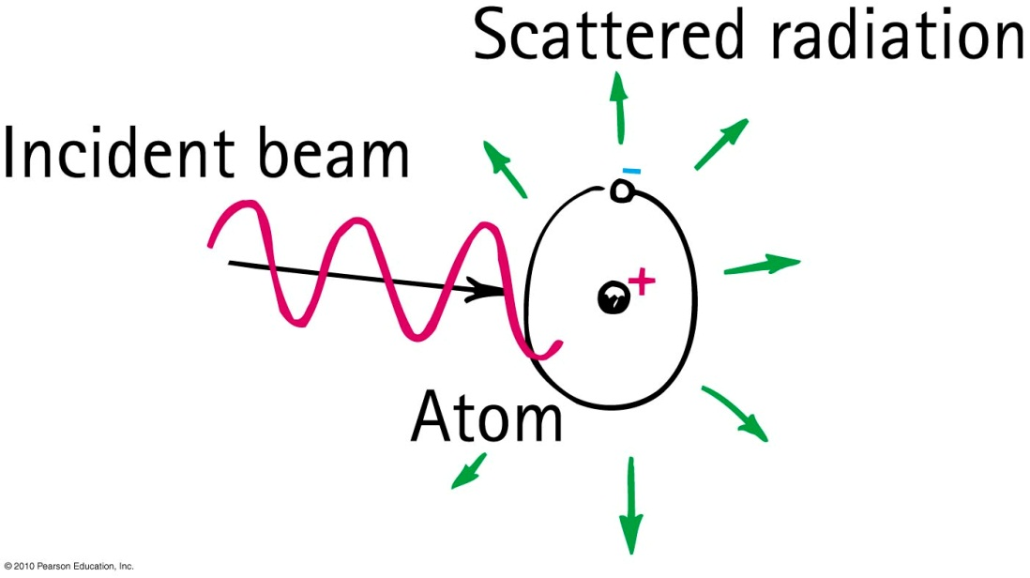
Why the Sky Is Blue
Results of selective scattering by particles smaller than the wavelength of incident light; such as nitrogen and oxygen molecules.
This kind of scattering is more at higher frequencies, and less at lower frequencies.

Slide 13
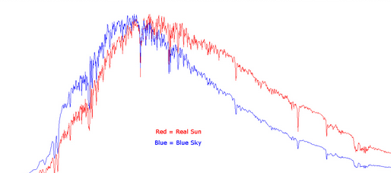
Why the Sky Is Blue
$$frequency$$

Slide 14
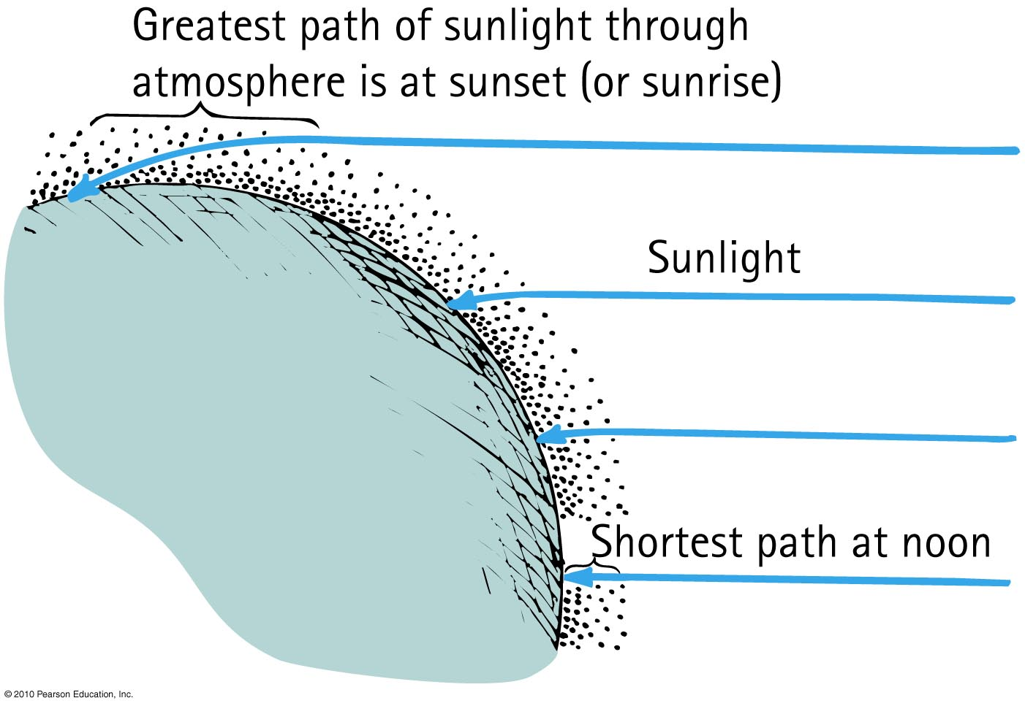
Why Sunsets Are Red
Light that is least scattered is light of low frequencies, which best travel straight through air.

Slide 15
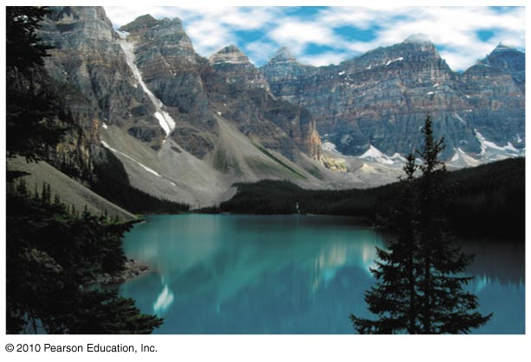
Why Water Is Greenish Blue
The intriguingly vivid blue of lakes in the Canadian Rockies is due to scattering.
The lakes are fed by runoff from melting glaciers that contain fine particles of silt, called rock flour, which remain suspended in the water.
Light scatters from these tiny particles and gives the water its eerily vivid color.

